Slide 1
Integration of Consistent Clinic Days into Team-Based Care at an FQHC: A Hybrid Model
London Muse, MD
Lidymar Ruiz, MBA
Sleepy Hollow Open Door FMC
Phelps Family Medicine Residency Program

Slide 2
Disclosures
N/A

Slide 3
Poll the audience
Text 22333
Type LONDONMUSE205
-or-
Respond at PollEv.com/londonmuse205

Slide 4
Notes:
What is your role?
https://www.polleverywhere.com/multiple_choice_polls/x3lIjFWC3gN6ttp

Slide 5
Notes:
If at residency site, what is your scheduling method?
https://www.polleverywhere.com/multiple_choice_polls/djKQvFQZi6QHRlT

Slide 6
Background
6-6-6 residency established in 2012, which expanded to 8-6-6 in June 2016
Training at
Northwell Phelps (community hospital)
Sleepy Hollow Open Door Family Medical Center [Federally Qualified Health Center (FQHC)]
3 Teams
Red, Lilac, Gold
Consist of attendings/residents, Patient Care Technicians (PCT/MA), 3 nurses

Slide 9
Rotating clinic schedule (pre-intervention)
Each resident was scheduled in clinic based on their rotation
(e.g. resident on Medical Subspecialties is in clinic on Thurs AM and Sat AM)
This method was used for PGY1-3
PGY1: 1 session per week
PGY2: 2 session per week
PGY3: 3 session per week
FMC rotation: 5-6 sessions per week
Each rotation is 2-4 weeks long
24 hour call schedule made based on clinic schedule
Scheduling designed by residency program
Site manager opened each resident’s template individually
Clinic staff only saw open templates in EMR

Slide 10
Prior experience
My experience as resident in new program
Difficulty predicting schedule
Working multiple Saturdays as PGY3
Difficulty making necessary changes
Lacking in patient continuity
Meeting minimum required patient care productivity targets for graduation

Slide 11
Prior experience (cont.)
My experience as site manager with previous medical director
Opening/Closing templates
Patient concerns
High turnover of staff
Team continuity representation
Daily staff scheduling difficulty

Slide 13
Half day clinic method
Literature³ notes
Fragmentation in both hospital and clinic setting for residency training
Message sent that clinic is secondary to inpatient care
Too many variances from month to month
Continuity with site rather than defined patient panel (individual/teams)
Residency education for ambulatory care suffers
Difficult for support staff to continuously accommodate new residents with limited familiarity
3. Greater New York Hospital Association. Redesigning the Teaching Clinic: A Toolkit for Improving Care Coordination and Resident Learning. October 2012.

Slide 14
Audience discussion
Any experiences from your site that you would like to share regarding half day clinic method scheduling?

Slide 15
Need for change
Joining forces as new leadership team
New medical director with residency experience in previous scheduling
Site manager with ~1 year using this method
“Clinic first” model was recommended from FMC organization
However, the most significant barrier remained, as the Residency depended on regular schedules for volunteer attendings and covering inpatient team
Hybrid model idea was formed

Slide 16
Recommendations² for scheduling in high functioning primary care clinics
Schedules are made far in advance so that clinics can plan their work.
Inpatient services do not control resident schedules; schedules are worked out collaboratively between clinic and hospital, with the clinic’s needs taken seriously.
Resident presence in the clinic is predictable so that teams can function smoothly.
The tension experienced by residents between inpatient and outpatient duties is reduced or eliminated.
2. Bodenheimer T, Gupta R, Dube K, Kong M, Olayiwola JN, Barnes K, Syer S, Willard-Grace R, Shipman S. High-Functioning Primary Care Residency Clinics: Building Blocks for Providing Excellent Care and Training. Association of American Medical Colleges, Washington D.C. 2016.

Slide 17
Hybrid model with Consistent Clinic Days for PGY-3 residents
Recognized that PGY-1&2 residents were more commonly in hospital-based rotations (inpatient medicine, ICU, neo, OB), while PGY-3 residents were more commonly on outpatient/more flexible rotations
PGY-3 residents had largest amount of FMC time and thus more continuity opportunity
PGY-3 residents also staffed Saturday clinic

Slide 18
Hybrid model with Consistent Clinic Days
Initial design thoughts
Gain buy-in from both parties
Ensure staffing/precepting needs were able to be met
Ensure enough variety in preceptor-resident teaching
Optimal pairing of residents/staff (team/personality-based)
Regularly provide access for all 3 teams
Allow team cross-coverage amongst residents

Slide 19
Hybrid model with Consistent Clinic Days for PGY-3 residents
6 PGY-3 residents, 2 on each team, split to have CCD on either Mon or Wed PM/EVE sessions
Every 4 week block, alternate between Tues AM and Sat AM clinic
Only exception is 2 weeks of inpatient medicine – only come to CCD session
Add this extra session during 2 weeks FMC outpatient medicine rotation

Slide 20
Example

Slide 21
Hybrid model with Consistent Clinic Days (cont.)
Clinic pros
Plans for physician from each team on heavy/longest patient care days
Stays the same all year
Allows pairing of staff with PGY-3 – similar to attendings – improved staff retention
Residents become more familiar with preceptor style

Slide 22
Staff satisfaction/retention
In Dec 2015, staff satisfaction survey results: “needing improvement”
Results were delayed (July 2016)
Heavy turnover continued
Brainstormed with clinic leadership
Needs reviewed with new onboarding medical director and changes implemented
Reviewed with clinic team – scheduling played major factor in dissatisfaction at work

Slide 23
Staff site survey 2015 vs 2017 (Agreed or Strongly Agreed)

Slide 24
Hybrid model with Consistent Clinic Days (cont.)
Clinic pros
Saturday schedule with more reliable patient access
Ease of follow up appointment scheduling for staff and patients – improved continuity
Staff engagement re: productivity, QI, and procedure goals

Slide 25
Hybrid model with Consistent Clinic Days (cont.)
Residency pros
Varied preceptor experience by alternating Tues/Sat
Limited time missed on rotations (PM/EVE)
Predictable schedule/pre-visit planning
Allows for medical students to rotate with their PGY-3 resident supervisors
Call schedule more predictable

Slide 26
Hybrid model with Consistent Clinic Days (cont.)
Residency pros
Saturday schedule more predictable - allows for swaps/vacation planning
Improved use of team for QI projects
Improved doctor-team relationship = better care of patient
Improved foundation for feedback/evaluations
All residents exceed patient care goal for year and for graduation

Slide 27
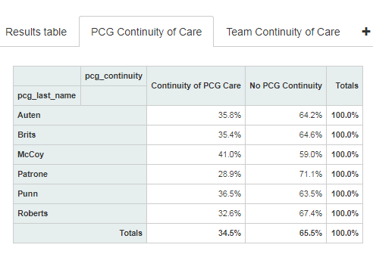
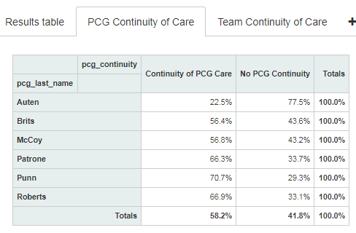
PGY3 Continuity
7/1/17-9/20/17
Post-intervention
7/1/16-6/30/17
Pre-intervention

Slide 28
Team Continuity
 | 7/2016-6/2017 | 7/2016-9/2016 | 7/2017-9/2017
Gold | 71.3% | 69.5% | 77.6%
Lilac | 68% | 67.3% | 80.6%
Red | 78.8% | 77.2% | 84.5%

Slide 29
PGY3 Productivity
9/11/17
Post-intervention
9/11/16
Pre-intervention

Slide 30
PGY3 Productivity End of year
 | Average # of pts seen for PGY3 year | Average # of pts seen during residency
7/2016-6/2017 (pre-intervention) | 1008 | 1741
7/2017-6/2018 (post-intervention) | 1088 (480 total patients over 6 residents) | 1765

Slide 31
Potential drawbacks to CCD
Inpatient medicine team supervision needs
Reduced flexibility for patients who can not come on their CCD sessions
Potential limitation of preceptor variety to learn from their experiences/styles
Each class has different abilities to adapt to higher productivity and evening clinic

Slide 32
Potential drawbacks to CCD
Unequal preceptor work/needs and access
CCD sessions with higher volume but more experienced residents; higher patient access
Other sessions with lower volume but may require extra preceptors to support more than one PGY-1 resident; lower patient access
Difficult transition from June to July for staff and patients – contrast more noticeable
Call inequities between Mon/Wed CCD

Slide 33
Audience discussion
Questions before transitioning to how we used this new model for our team-based care?

Slide 34
Team based care advantages¹
More access to care, shorter wait times
Increase in quality patient-centered care (patient education, behavioral health, patient advocacy)
Increased job satisfaction
Work environment improved
1. Schottenfeld L, Petersen D, Peikes D, Ricciardi R, Burak H, McNellis R, Genevro J. Creating Patient-Centered Team-Based Primary Care. AHRQ Pub. No. 16-0002-EF. Rockville, MD: Agency for Healthcare Research and Quality. March 2016

Slide 35
Team-based care in new site
Screens with rotating team facesheets in waiting room
Physician facesheets at front desk to help patients identify PCP
Team color-coordinated business cards
Team hallways for patient rooms

Slide 36
Team based care
Resident video #1
https://youtu.be/MeUVFfv5aiU
Notes:
https://www.youtube.com/playlist?list=PLEm5XCucTtZOFjt7FZP6moxb4mvVRMmCq

Slide 37
Team-based care in new site
Team pods
Integrating patient advocates to teams, mental health BHIS to pods
Procedures star chart
Opportunities for resident scribes

Slide 38
Team based care
Resident video # 2
https://youtu.be/A0u4B1lvi1E
Notes:
https://www.youtube.com/playlist?list=PLEm5XCucTtZOFjt7FZP6moxb4mvVRMmCq

Slide 39
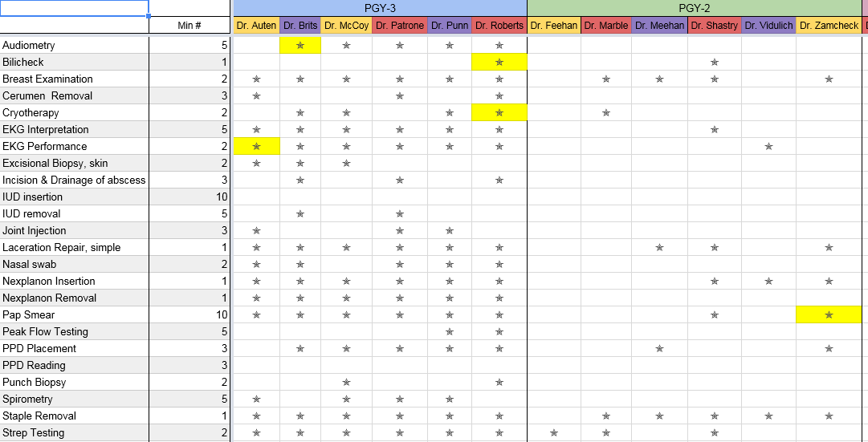
Example of Procedures Chart

Slide 40
Team based care
Nurse video
https://youtu.be/N7nthfnIpFY

Slide 41
Team communication¹
Regular team meetings
Daily clinic huddles, session mini-huddles
Business meeting QI projects by team
Helps build relationships between team members and promote a collective team identity without hierarchy
1. Schottenfeld L, Petersen D, Peikes D, Ricciardi R, Burak H, McNellis R, Genevro J. Creating Patient-Centered Team-Based Primary Care. AHRQ Pub. No. 16-0002-EF. Rockville, MD: Agency for Healthcare Research and Quality. March 2016

Slide 42
Video example of pt care
Resident video#3
https://youtu.be/Ro7Jk1xj1PE

Slide 43
Team-based daily schedule
Weekly schedules often repeat or are similar
Prevents double work on deciding rooms and copying schedule in multiple locations
Can provide rapid real-time communication of changes to all teams
Staff can prepare in advance (PTO, supervisor review)

Slide 44
Team-based daily schedule

Slide 45
Team communication¹
Effective intra-team communication also ensures that the patient does not have to convey information about past care or repeat critical pieces of information to various team members.
Co-locating to talk informally and frequently in private space
Use warm-hand offs
1. Schottenfeld L, Petersen D, Peikes D, Ricciardi R, Burak H, McNellis R, Genevro J. Creating Patient-Centered Team-Based Primary Care. AHRQ Pub. No. 16-0002-EF. Rockville, MD: Agency for Healthcare Research and Quality. March 2016

Slide 46
Team communication
Staff video
https://youtu.be/iZgu_ZtEKao

Slide 47
Next steps
Increased number of PGY-3 residents
Consider adding third CCD session on Tues PM/Eve – more staffing/precepting possibly needed
Consider split alternating days between Tues AM and Fri AM to provide better clinic coverage

Slide 48
Next steps (cont.)
Start new resident/staff pairing bonding earlier (“warm handoff”)
Provide slower ramp up in July
Consider adding 1 CCD session for PGY2
Consider swapping CCD sessions halfway through year – may impact the positive effects, however
Increase trials of scribe/resident pairings for practice management experience and decreased unlocked notes

Slide 49
References
Schottenfeld L, Petersen D, Peikes D, Ricciardi R, Burak H, McNellis R, Genevro J. Creating Patient-Centered Team-Based Primary Care. AHRQ Pub. No. 16-0002-EF. Rockville, MD: Agency for Healthcare Research and Quality. March 2016
Bodenheimer T, Gupta R, Dube K, Kong M, Olayiwola JN, Barnes K, Syer S, Willard-Grace R, Shipman S. High-Functioning Primary Care Residency Clinics: Building Blocks for Providing Excellent Care and Training. Association of American Medical Colleges, Washington D.C. 2016.
Greater New York Hospital Association. Redesigning the Teaching Clinic: A Toolkit for Improving Care Coordination and Resident Learning. October 2012.

Slide 50
Please evaluate this presentation using the conference mobile app! Simply click on the "clipboard" icon on the presentation page.

