Slide 1
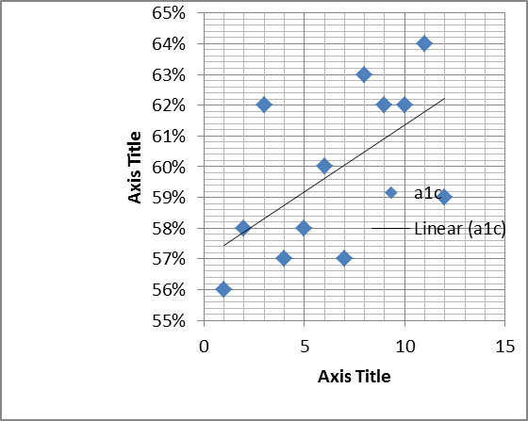
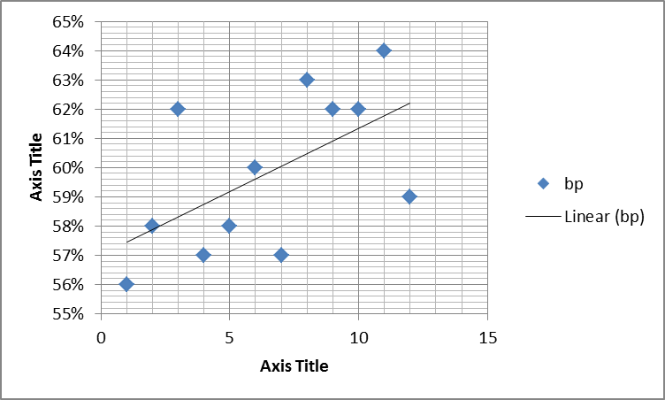
Low Staffing Levels: A Detriment to Quality Improvement Projects
Michael Malone M.D.,
Penn State Hershey Department of Family and Community Medicine
INTRODUCTION
Nursing levels are an important determinant of patient outcomes, but may not be considered in the development of quality improvement (QI) projects.
During a recent QI project implemented using a PDSA cycle, we had an incidental but substantial drop in nurse staffing levels. During this time, we found that we actually had worse outcomes. Initially, we considered the fact that the QI project was poorly designed. However, once staffing levels returned to normal, not only did the quality data improve back to baseline, but exceeded goal levels for the QI project
METHODS
. We graphed out quality data Vs the nurse staffing levels for the last fiscal year and found linear relationship.
RESULTS:
DISCUSSION
Results are consistent with previous literature that shows correlations with patient outcomes and nurse staffing. Our recent experience also suggests that when nursing levels drop below a certain threshold, QI projects may be futile; even well-designed projects that are effective with appropriate staffing.
CONCLUSION
QI projects are not completely dependent upon design. It also requires appropriate staffing to complete the projects. The session helps encourage one to evaluate staffing levels in relation to QI project success and to consider increasing staffing levels as part of QI design. This session showcases the fact that not everything can be accomplished through improvement in process alone.
REFERENCES
Leary A. et al. Nurse staffing levels and outcomes. Int J Health Care Qual Assur. 2017.
Blegan M, et al. Nurse Staffing and Patient Outcomes. Nursing Research 1998

