Slide 1
https://www.youtube.com/watch?v=tWSpqgdVmAA
Notes:
Show this as folks are entering the room for your presentation – this is about personal change and the value of grit, determination and sticktuitiveness

Slide 2
Behavioral Science Faculty as Change Leaders: Assess Skills & Strengthen Toolkits
Deborah Taylor, PhD
Central Maine Medical Center FMR
September 15, 2017

Slide 4
https://www.youtube.com/watch?v=uqW2zkcuzzA
Notes:
Show this to get your audience connected to the joys and challenges of leading change

Slide 5
Learning Objectives Upon completion, participants will be able to:
State core knowledge/skills/attitudes for BSEs in their capacity as change leaders;
Appraise leading change skills in categories of mastery;
Choose 1-2 leading change skill areas that need improvement and develop a PIP

Slide 6
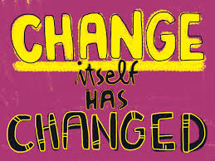
Notes:
1st video – change video with drawing of pictures - just love these!
2nd video – Pirates of the Caribbean – Johnny Depp importance of the leader’s approach and the confidence that s/he instills
3rd video – monkeys – it’s all above perspective

Slide 7
Leading Change “Recipe Ingredients”
VISION | SKILLS
INCENTIVES | RESOURCES
ACTION PLAN | WHAT HAPPENS IF YOU OMIT AN INGREDIENT?
Notes:
OFTEN CHANGES ARE MADE WITHOUT ALL THE INGREDIENTS – EACH OF THESE INGREDIENTS RESULTS IN A DIFFERENT RESPONSE WHEN IT IS NOT GIVEN ITS DUE ATTENTION IN A CHANGE PROCESS
EQUATE IT TO A RECIPE
WHAT IF YOU MADE CHIX PARM AND LEFT OUT THE CHICKEN OR THE SAUCE OR THE PASTA OR THE CHEESE?

Slide 8
MISSING
MISSING
MISSING
MISSING
MISSING

Slide 9
MISSING
MISSING
MISSING
MISSING
MISSING

Slide 10
MISSING
MISSING
MISSING
MISSING
MISSING

Slide 11
Notes:
Jumping the gun – starting before you are ready without a thought through action plan and anticipating risks and mine fields

Slide 12
MISSING
MISSING
MISSING
MISSING
MISSING

Slide 13
MISSING
MISSING
MISSING
MISSING
MISSING

Slide 14
MISSING
MISSING
MISSING
MISSING
MISSING

Slide 15
https://www.youtube.com/watch?v=wqDqEURhpHA
Notes:
Clip from The Office
VALUE OF GIVING FEEDBACK, NAMING A REALITY THAT SOME SEEM TO BE UNAWARE OF (CONNECTING THE DOTS), OFFER AN ALTERNATIVE, ETC.

Slide 16
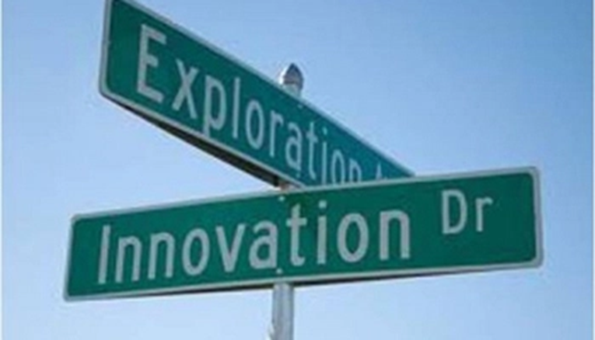
Anyone besides me every worked for someone who was an innovation……

Slide 17
30 Pieces to Leading Effective Change
Understand the need for change
Convince your team of the need for change
Communicate the need for change across the entire organization
Constantly communication what is happening, when and why
Listen to everyone & respond to feedback

Slide 18
30 Pieces to Leading Effective Change
Adapt your language and approach to suit your various audiences
Have a well thought through/thorough plan
Remain visible and accessible.
Look at the change from all perspectives
Achieve/celebrate quick wins to motivate the team.

Slide 19
30 Pieces to Leading Effective Change
Allow for sufficient time for info to be digested
Increase motivation by collecting/sharing proof of the benefits
Support & guide
Be prepared to adapt & change the plan
Have a clear vision

Slide 20
30 Pieces to Leading Effective Change
Invest time in understanding fears and work to resolve them
Visibly invest your own time/effort in the change
Develop a team of change agents that will help you promote change
Be passionate & engaging
Celebrate every success along the way

Slide 21
30 Pieces to Leading Effective Change
Reflect on the process and look for areas for improvement
Use all possible channels of communication
Pace yourself
Ensure communication is given by a skilled presenter…even if that is not you
Ensure that your data is robust & accurate

Slide 22
30 Pieces to Leading Effective Change
Learn the key change models that will help your team
Obtain regular (weekly) updates & monitor the change
Pilot your plan and offer risk free ways for people to try out the change
Never assume that those who resist are troublemakers…they likely have valid points
Assess all the possible risks before beginning

Slide 23
FOR MORE VISUAL LEARNERS

Slide 24
The Models

Slide 25
Notes:
Simple but clear – highlights the importance of personal responsibility, teamwork and EQ

Slide 26
Kotter’s 8 Steps for Leading Change (1-4)
1. Establishing a Sense of Urgency
2. Creating the Guiding Coalition
3. Developing a Change Vision
4. Communicating the Vision for Buy-in
Notes:
1: Establishing a Sense of Urgency
Help others see the need for change and they will be convinced of the importance of acting immediately.
Open an honest and convincing dialogue about what's happening in your healthcare organization. If many people start talking about the change you propose, the urgency can build and feed on itself.
What you can do:
Identify potential threats , and develop scenarios showing what could happen in the future.
Examine opportunities that should be, or could be, exploited.
Start honest discussions, and give dynamic and convincing reasons to get people talking and thinking.
Request support from customers (patients or learners in our case) as well as invested stakeholders
2: Creating the Guiding Coalition
Assemble a group with enough power to lead the change effort, and encourage the group to work as a team. What you can do:
Identify the true leaders in your organization, as well as your key stakeholders .
Ask for an emotional commitment from these key people.
Work on team building within your change coalition.
Check your team for weak areas, and ensure that you have a good mix of people from different areas of your residency, department, organization, etc.
3: Developing a Change Vision
Create a vision to help direct the change effort, and develop strategies for achieving that vision.
What you can do:
Determine the values that are central to the change.
Develop a short summary (one or two sentences) that captures what you "see" as the future of your residency, department or healthcare organization.
Create a strategy to execute that vision.
Ensure that your change coalition can describe the vision in five minutes or less.
Practice your "vision speech" often.
4: Communicating the Vision for Buy-in
Make sure as many as possible understand and accept the vision and the strategy.
What you can do:
Talk often about your change vision.
Address peoples' concerns and anxieties, openly and honestly.
Apply your vision to all aspects of operations – from training to performance reviews. Tie everything back to the vision.
Lead by example .

Slide 27
Kotter’s 8 Steps for Leading Change (5-8)
5. Empowering Broad-based Action
6. Generating Short-term Wins
7. Never Letting Up
8. Incorporating Changes into the Culture
Notes:
5: Empowering Broad-based Action
Remove obstacles to change, change systems or structures that seriously undermine the vision, and encourage risk-taking and nontraditional ideas, activities, and actions.
What you can do:
Identify, or hire, change leaders whose main roles are to deliver the change.
Look at your organizational structure, job descriptions, and performance and compensation systems to ensure they're in line with your vision.
Recognize and reward people for making change happen.
Identify people who are resisting the change, and help them see what's needed.
Take action to quickly remove barriers (human or otherwise).
6: Generating Short-term Wins
Plan for achievements that can easily be made visible, follow-through with those achievements and recognize and reward employees who were involved.
What you can do:
Look for sure-fire projects that you can implement without help from any strong critics of the change.
Don't choose early targets that are expensive. You want to be able to justify the investment in each project.
Thoroughly analyze the potential pros and cons of your targets. If you don't succeed with an early goal, it can hurt your entire change initiative.
Reward the people who help you meet the targets.
7: Never Letting Up
Use increased credibility to change systems, structures, and policies that don’t fit the vision, also hire, promote, and develop employees who can implement the vision, and finally reinvigorate the process with new projects, themes, and change agents.
What you can do:
After every win, analyze what went right, and what needs improving.
Set goals to continue building on the momentum you've achieved.
Learn about kaizen , the idea of continuous improvement.
Keep ideas fresh by bringing in new change agents and leaders for your change coalition.
8: Incorporating Changes into the Culture
Articulate the connections between the new behaviors and organizational success, and develop the means to ensure leadership development and success of that change and future efforts to change.
What you can do:
Talk about progress every chance you get. Tell success stories about the change process, and repeat other stories that you hear.
Include the change ideals and values when hiring and training new staff.
Publicly recognize key members of your original change coalition, and make sure the rest of the staff – new and old – remembers their contributions.
Create plans to replace key leaders of change as they move on. This will help ensure that their legacy is not lost or forgotten.

Slide 28
10 Guiding Principles for Leading Change Management
Notes:
According to a 2013 Strategy&/Katzenbach Center survey of global senior executives on culture and change management, the success rate of major change initiatives is only 54%. This is far too low. The costs are high when change efforts go wrong—not only financially but in confusion, lost opportunity, wasted resources, and diminished morale. When employees who have endured real upheaval, and put in significant extra hours for an initiative that was announced with great fanfare, see it fizzle out, cynicism sets in.

Slide 29
10 Guiding Principles for Leading Change Management
Lead with the culture.
Notes:
LEAD WITH THE CULTURE In the Katzenbach Center survey, 84% of executives surveyed said their organization’s culture was critical to the success of change management.
Review 4 major types of cultures to help people connect to what type of culture characteristics fit with their current culture as well as what would be their preferred culture.

Slide 30
4 Primary Organizational Cultures
#1 CLAN CULTURE
Friendly environment
People have a lot in common - similar to a large family
Leaders are seen as mentors (parent figures)
Held together by loyalty and tradition
Great involvement
Emphasizes long-term human resource development
Success is defined by addressing the needs of the customers and caring for the members
The organization promotes teamwork, participation, and consensus
Per the Organizational Culture Assessment Inventory - OCAI
Notes:
Clan Culture
This working environment is a friendly one. People have a lot in common, and it’s similar to a large family. The leaders or the executives are seen as mentors or maybe even as father figures. The organization is held together by loyalty and tradition. There is great involvement. The organization emphasizes long-term Human Resource development and bonds colleagues by morals. Success is defined within the framework of addressing the needs of the clients and caring for the people. The organization promotes teamwork, participation, and consensus.
Leader Type: facilitator, mentor, team builder Value Drivers: Commitment, communication, development Theory of Effectiveness: Human Resource development and participation are effective Quality Improvement Strategy: Empowerment, team building, employee involvement, Human Resource development, open communication

Slide 31
4 Primary Organizational Cultures
#2 ADHOCRACY CULTURE
Dynamic and creative working environment
Employees take risks.
Leaders are seen as innovators and risk takers.
Experiments and innovation are the glue within the organization.
Prominence is emphasized.
The long-term goal is to grow and create new resources.
The availability of new ideas, projects, outcomes is seen as success.
The organization promotes individual initiative and freedom.
Per the Organizational Culture Assessment Inventory - OCAI
Notes:
Adhocracy Culture
This is a dynamic and creative working environment. Employees take risks. Leaders are seen as innovators and risk takers. Experiments and innovation are the bonding materials within the organization. Prominence is emphasized. The long-term goal is to grow and create new resources. The availability of new products or services is seen as success. The organization promotes individual initiative and freedom.
Leader Type: Innovator, entrepreneur, visionary Value Drivers: Innovative outputs, transformation, agility Theory of Effectiveness: Innovativeness, vision and new resources are effective Quality Improvement Strategy: Surprise and delight, creating new standards, anticipating needs, continuous improvement, finding creative solutions

Slide 32
4 Primary Organizational Cultures
#3 MARKET CULTURE
Emphasizes finishing work and getting things done.
People are competitive and focused on goals.
Leaders are hard drivers, producers, and rivals at the same time. They are tough and have high expectations.
The emphasis on winning keeps the organization together.
Reputation and success are the most important.
Long-term focus is on reaching goals and being the best.
The organizational style is based on competition.
Per the Organizational Culture Assessment Inventory - OCAI
Notes:
Market Culture
This is a results-based organization that emphasizes finishing work and getting things done. People are competitive and focused on goals. Leaders are hard drivers, producers, and rivals at the same time. They are tough and have high expectations. The emphasis on winning keeps the organization together. Reputation and success are the most important. Long-term focus is on rival activities and reaching goals. Market penetration and stock are the definitions of success. Competitive prices and market leadership are important. The organizational style is based on competition.
Leader Type: Hard driver, competitor, producer Value Drivers: Market share, goal achievement, profitability Theory of Effectiveness: Aggressively competing and customer focus are effective Quality Improvement Strategy: Measuring client preferences, improving productivity, creating external partnerships, enhancing competiveness, involving customers and suppliers

Slide 33
4 Primary Organizational Cultures
#4 HIERARCHY CULTURE
Formalized and structured work environment.
Procedures decide what people do.
Leaders are proud of their efficiency-based coordination and organization.
Keeping the organization functioning smoothly is most crucial.
Formal rules and policy keep the organization together.
The long-term goals are stability and results, paired with efficient and smooth execution of tasks.
Trustful delivery, smooth planning, and low costs define success.
The personnel management has to guarantee work and predictability.
Per the Organizational Culture Assessment Inventory - OCAI
Notes:
Hierarchy Culture
This is a formalized and structured work environment. Procedures decide what people do. Leaders are proud of their efficiency-based coordination and organization. Keeping the organization functioning smoothly is most crucial. Formal rules and policy keep the organization together. The long-term goals are stability and results, paired with efficient and smooth execution of tasks. Trustful delivery, smooth planning, and low costs define success. The personnel management has to guarantee work and predictability.
Leader Type: Coordinator, monitor, organizer Value Drivers: Efficiency, timeliness, consistency, and uniformity Theory of Effectiveness: Control and efficiency with capable processes are effective Quality Improvement Strategy: Error detection, measurement, process control, systematic problem solving, quality tools

Slide 34
REFLECTIVE QUESTIONS
How would you describe your culture?
Which aspects of your culture support change and resilience and which do not?
How can you support aspects and replace detrimental aspects with new beliefs, behaviors and assumptions?

Slide 35
MORE REFLECTIVE QUESTIONS
When there is a gap between culture and the objectives of change, culture ALWAYS wins. Has this happened to you?
How do or could you contribute or influence your work culture? (Culture = behaviors (observable) and beliefs/ assumptions (hidden) – AKA the way we do things around here: a shared viewpoint developed over time)

Slide 36
For Your Consideration
Do your residents, faculty and staff understand how change works? Is there anything you could offer to demystify the process?
Do you have a change planning process that you use in your residency or dept – is it transparent?

Slide 37
10 Guiding Principles for Leading Change Management
Lead with the culture.
Start at the top.
Involve every layer.
Notes:
LEAD WITH THE CULTURE In the Katzenbach Center survey, 84% of executives surveyed said their organization’s culture was critical to the success of change management, and 64% saw it as more critical than strategy or the company’s operating model. Yet change leaders often fail to address culture—in terms of either overcoming cultural resistance or making the most of cultural support.
Instead of trying to change the existing culture itself, skilled change managers draw emotional energy from it. They tap into the way people already think, behave, work, and feel to provide a boost to the change initiative. To use this emotional energy, leaders must look for the elements of the culture that are aligned to the change, bring them to the foreground, and attract the attention of the people who will be affected by the change.
START AT THE TOP
Although it’s important to engage employees at every level early on, all successful change management initiatives start at the top, with a committed and well-aligned group of executives strongly supported by the CEO. This alignment can’t be taken for granted. Rather, work must be done in advance to ensure that everyone agrees about the case for the change and the particulars for implementing it. This means top executives must engage in discussion, listen closely to one another, and weigh conflicting points of view in order to agree on a coherent vision for the goals of any major change initiative. Leadership, as the drivers of change, must act as a collaborative and committed team throughout the process.
INVOLVE EVERY LAYER
Strategic planners often fail to take into account the extent to which midlevel and frontline people can make or break a change initiative. The path of rolling out change is immeasurably smoother if these people are tapped early for input on issues that will affect their jobs. Frontline people tend to be rich repositories of knowledge about where potential glitches may occur, what technical and logistical issues need to be addressed, and how customers may react to changes. In addition, their full-hearted engagement can smooth the way for complex change initiatives, whereas their resistance will make implementation an ongoing challenge.

Slide 38
10 Guiding Principles for Leading Change Management
Make the rational & emotional case together.
Act your way into new thinking.
Engage, engage, engage.
Notes:
MAKE THE RATIONAL & EMOTIONAL CASE TOGETHER
Leaders will often make the case for major change on the sole basis of strategic business objectives such as “we will enter new markets” or “we will grow 20% a year for the next three years.” Such objectives are fine as far as they go, but they rarely reach people emotionally in a way that ensures genuine commitment to the cause.
Human beings respond to calls to action that engage their hearts as well as their minds, making them feel as if they’re part of something consequential. By drawing directly on the company’s cultural history and traditions, leaders can activate a strong personal connection between the company and its employees.
ACT YOUR WAY INTO NEW THINKING.
Many change initiatives seem to assume that people will begin to shift their behaviors once formal elements like directives and incentives have been put in place. Yet far more critical to the success of any change initiative is ensuring that people’s daily behaviors reflect the imperative of change. Start by defining a critical few behaviors that will be essential to the success of the initiative. Then conduct everyday business with those behaviors front and center. Senior leaders must visibly model these new behaviors themselves, right from the start, because employees will believe real change is occurring only when they see it happening at the top of the company.
ENGAGE, ENGAGE, ENGAGE.
Leaders often make the mistake of imagining that if they convey a strong message of change at the start of an initiative, people will understand what to do. Nothing could be further from the truth. Powerful and sustained change requires constant communication, not only throughout the rollout but after the major elements of the plan are in place. The more kinds of communication employed, the more effective they are. Symbolic actions reinforce the impact of words.

Slide 39
10 Guiding Principles for Leading Change Management
Lead outside the lines.
Leverage formal solutions.
Leverage informal solutions.
Assess and adapt.*
Notes:
LEAD OUTSIDE THE LINES.
Change has the best chance of cascading through an organization when everyone with authority and influence is involved. In addition to those who hold formal positions of power—the company’s recognized leaders—this group includes people whose power is more informal and is related to their expertise, to the breadth of their network, or to personal qualities that engender trust.
We call these informal leaders “special forces.” They might include a well-respected field supervisor, an innovative project manager, or a receptionist who’s been at the firm for 25 years. Companies that succeed at implementing major change identify these people early and find ways to involve them as participants and guides. Informal leaders must be identified before they can be engaged. The best way to do this in a large organization is to run a network analysis. By mapping out connections and seeing who people talk to, you can complement the formal org chart with one that enables you to lead outside the lines.
LEVERAGE FORMAL SOLUTIONS.
Persuading people to change their behavior won’t suffice for transformation unless formal elements—such as structure, reward systems, ways of operating, training, and development—are redesigned to support them. Many companies fall short in this critical area.
After a strong start, a mentoring program for associates at a law firm faltered because no formal mechanisms were in place to support or reward this participation. Calculations for bonuses left development work out of the equation, and although senior partners paid lip service to the “wonderful work” the development committee was doing, they seemed to regard its members as internal volunteers. Once they recognized this problem, the firm’s leaders enacted substantial policy changes, starting with a mechanism the compensation committee could use to take into account the contributions made by those who trained others.
LEVERAGE INFORMAL SOLUTIONS.
Even when the formal elements needed for change are present, the established culture can undermine them if people revert to long-held but unconscious ways of behaving. This is why formal and informal solutions must work together. A top-tier technology company was trying to inculcate a more customer-centric mind-set after a decade focused on relentlessly cutting costs. A set of new procedures was put in place, but one of the most powerful solutions was purely cultural and informal—changing the informal motto that governed frontline decision making. By asking people at every level to be responsible for quality—and by celebrating and rewarding improvements—change leaders were able to create an ethic of ownership in the product.
ASSESS AND ADAPT.
The Strategy&/Katzenbach Center survey revealed that many organizations involved in transformation efforts fail to measure their success before moving on. Leaders are so eager to claim victory that they don’t take the time to find out what’s working and what’s not, and to adjust their next steps accordingly. This failure to follow through results in inconsistency and deprives the organization of needed information about how to support the process of change throughout its life cycle

Slide 40
https://www.youtube.com/watch?v=CS5ANkbdO_o
Notes:
Have the audience speak to what the man does in response to their resistance. Just a fun clip to play with.

Slide 42
What is a key characteristic to thriving in high change environments?

Slide 43
RESILIENCE

Slide 44
RESILIENCE
- The ability to absorb high levels of change without displaying dysfunctional behavior.
The ability to bounce back, and in fact bounce forward with speed, grace and determination.
To change before the case for change becomes desperately obvious
Notes:
3 DEFINITIONS OF RESILIENCE AS IT RELATES TO CHANGE

Slide 45
ATTRIBUTES OF A RESILIENT ORGANIZATION
Views change as an ongoing process
Tolerates ambiguity.
Encourages productive resistance.
Practice ‘Sober Selling”
Manages its change capacity.
Makes resilience a priority.
Notes:
Views change as an ongoing process
- see change as the natural order of things, expect change to be a constant, regard change as a process not an event
Tolerates ambiguity
Need to feel okay with feeling of discomfort being uncertain due to the ambiguity inherent in change, need to be okay with not being in control
Encourages productive resistance it is a natural resistance to the status quo, constructive resistance can improve the change, if you try to sidestep or repress resistance, it goes underground, better to give it a legitimate way to surface and be resolved
Practice Sober Selling
Tendency is to oversell the positive aspects of change and undersell the negative, creates a gap between expectations and what actually happens, the gap creates surprise, a sense of things being out of control and discomfort, sell the benefits but do not ignore the cost
Manages its change capacity
Think of it as a budget for change, be aware of all of the changes going on and the impact on your staff, don’t introduce major change when your change budget is maxed.
Makes resilience a priority
View it at a strategic necessity, right up there with efficiency and effectiveness, devote time and resources to building this capacity

Slide 46
LEADING FOR RESILIENCY
Increase your own resilience.
Work on your own EQ
Shift from reactive (change victim) to proactive (change leader) stance
Cultivate organizational resiliency as a strategic priority in your residency or department
Notes:
CLIP FROM PIRATES OF THE CARIBBEAN – JOHNNY DEPP AS THE CAPTAIN
TAKE THE INVENTORY

Slide 47
https://www.youtube.com/watch?v=_CV-D6d_c7A
Notes:
Pirates of the Caribbean – IMPORTANCE OF LEADERSHIP and having a “header” – building confidence in your team and how this clip shows the power of the leader for the morale, direction and outcomes of the group

Slide 48
RESILIENCY ASSESSMENT
What resilience “assets” do your FMR or Dept have?
What resilience “deficits” concern you and why?
R = Magnitude x Frequency of Change Time + Expense + Emotional Energy
Goal is to keep R high, the denominator even as the numerator
Notes:
THINK OF A TIME WHEN YOUR RESIDENCY TEAM DEMONSTRATED RESILIENCE THAT SERVED TO HELP ACHIEVE A GOOD OUTCOME/END?
THINK ABOUT A TIME WHEN YOUR RESIDENCY TEAM DEMONSTRATED BURNOUT AROUND A PROJECT – WHAT CONTRIBUTED TO THE BURNOUT? WHAT DEFICITS WERE EVIDENT OR WHAT KNOWLEDGE/SKILLS/ATTITUDES WERE ABSENT THAT NEEDED TO BE PRESENT OR PRESENT BUT NOT HELPFUL.
REFERENCES FOR THE PAST SLIDES
MANAGING AT THE SPEED OF CHANGE Daryl Conner
THE QUEST FOR RESILIENCE Gary Hamel
LEADING CHANGE Kotter
LEADING IN A CULTURE OF CHANGE Michael Fullan

Slide 49
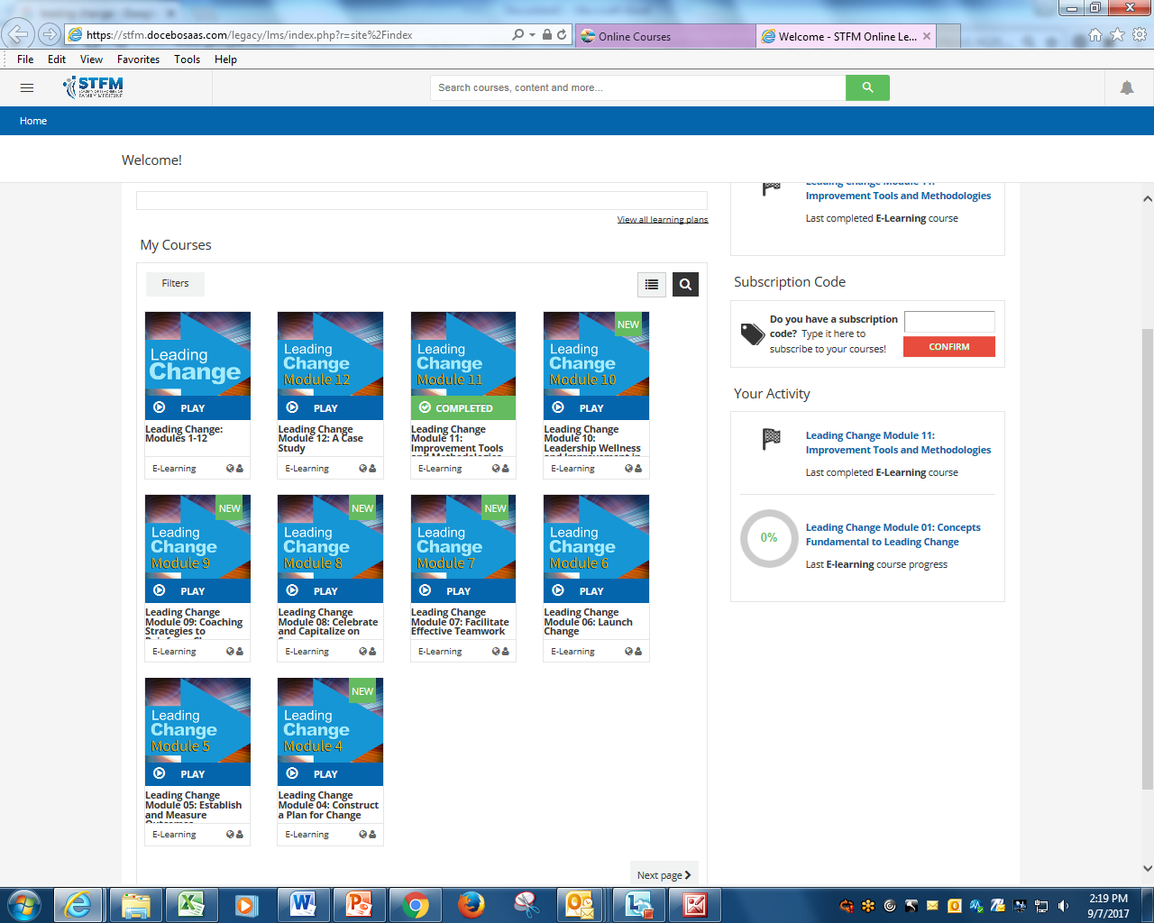
C
U
R
R
E
N
T
F
O
R
M
A
T
BREAKING NEWS…
Notes:
Version 1.0 had 12 courses and took about 3 hours to complete. It had relatively few activities.
Version 2.0 has the same information broken up into much smaller segments and reorganized for a more fluid learning experience. A new Leading Change Workbook will be available that contains handouts and almost 25 activities that can be done individually or in a group.
Some sample activities:
• Perform a SWOT Analysis
• Build a Case for Change
• Perform a Stakeholder Analysis
• Align your change project with the Mission and Vision of your institution
The course can be taken with a specific change project in mind or it can used a tool to learn more about change happens in an institution.
Leading Change 2.0 is free to anybody with an account on STFM.org. Membership in STFM is not required.
DUE TO BE DONE BY END OF 2017 AND ANNOUNCED TO MEMBERS BY EMAIL. BE ON THE LOOK OUT.

