Slide 1
Intro to OMM for MDs Workshop STFM Annual Conference May 3, 2023
Medical College of Wisconsin
Froedtert Menomonee Falls Hospital Family Medicine Residency Program
Menomonee Falls, WI
Kwanza Devlin, MD, FAAFP – Program Director
John Kim, DO – PGY2

Slide 2
Disclosures
None

Slide 3
Objectives
By the end of this session, learners will be able to:
Describe the 4 tenets of osteopathy
Explain, in general terms, some osteopathic treatments
Assess for some dysfunctions

Slide 4
Background

Slide 5
Four Tenets of Osteopathic Medicine
The mind, body, & spirit are a unit.
The body is capable of self-regulation, self-healing, and health maintenance.
Structure and function are reciprocally interrelated.
Rational treatment is based upon understanding & implementing the other 3 tenets

Slide 6
ASSESSMENT

Slide 7
Definition: Somatic Dysfunction
Impaired or altered function of related components of the somatic (body framework) system: skeletal, arthrodial, and myofascial structures and their related vascular, lymphatic, and neural elements.
Historically: Lesion, Still Lesion,
Osteopathic Lesion

Slide 8
Diagnostic Criteria for Somatic Dysfxn
T.A.R.T.
Tissue texture abnormalities
Asymmetry of structure
Restriction of motion
Tenderness

Slide 9
Tissue Texture Abnormalities

Slide 10
Tissue Texture Abnormalities
ACUTE
CHRONIC
Skin: hot, erythemic, moist
Tissue: swollen, increased turgor
Muscle: hypertonic, tender, spasm
Pain: severe, sharp
Skin: cold, pale, dry, increased drag
Tissue: fibrotic, atrophic, ropey
Muscle: hypotonic, flaccid
Pain: achy, dull

Slide 11
LET’S PRACTICE
Palpate each layer on your partners forearm
Can you tell if they are left or right handed?

Slide 12
Asymmetry of Structure

Slide 13
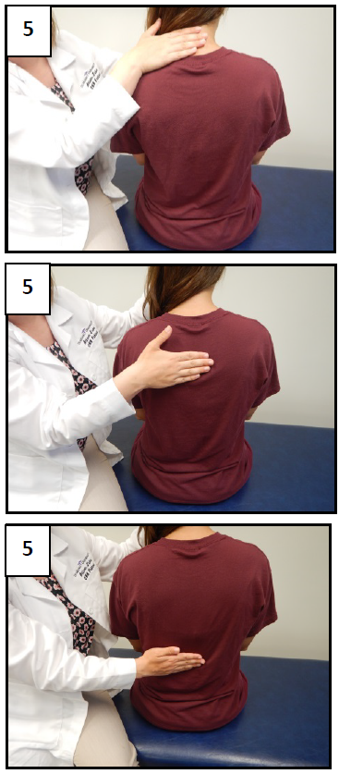
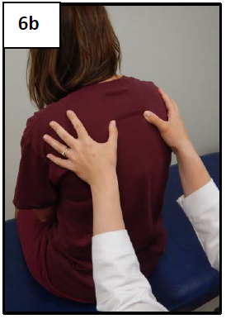
Side-to-Side Differences

Slide 14
LET’S PRACTICE
2 minute anatomic screening
Note any asymmetries

Slide 15
Restriction of Motion

Slide 16
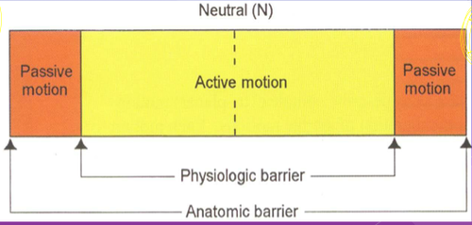
Normal Motion

Slide 17
Restrictive Barrier (Somatic Dysfunction)

Slide 18
LET’S PRACTICE
Assess range of motion of the neck and back
Note sided differences and abnormalities

Slide 19
Tenderness

Slide 20
Tender Points vs. Trigger Points
Tender points – small discrete hypersensitive areas within myofascial structures that result in localized pain
Trigger points – small discrete hypersensitive areas within myofascial structures where palpation results in referred pain, away from the site

Slide 21
Tender Points
Tender pts can be found in:
Ligaments
Tendons
Muscles
Fascia
(fascia contains contractile elements)

Slide 23
LET’S PRACTICE
Assess for thoracic spine tender points
Note locations

Slide 24
PLAN

Slide 25
Treatment
What is the dysfunction?
How do we help the body get back to the way it is supposed to be?

Slide 26
4 Techniques
Soft Tissue
Myofascial Release
Muscle Energy
Counterstrain

Slide 27
SOFT TISSUE
Best for tissue texture abnormalities

Slide 28
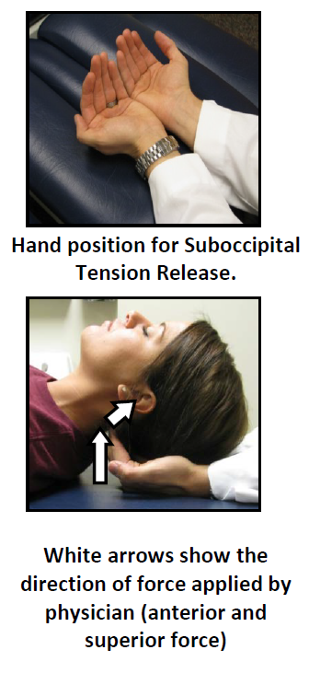
Suboccipital Tension Release
Patient lies supine. Physician is seated at the head of the table.
The physician places their finger pads together under the suboccipital area (occipito-atlantal junction).
With their finger pads, the physician directs pressure anteriorly and superiorly with a force comparable to the weight of the head.
Treatment is continued until the tissues release as evident by the head falling into the physician’s palms. Repeat as needed.
This may be applied up to the nuchal ridge where muscles are commonly tight due to stress.

Slide 29
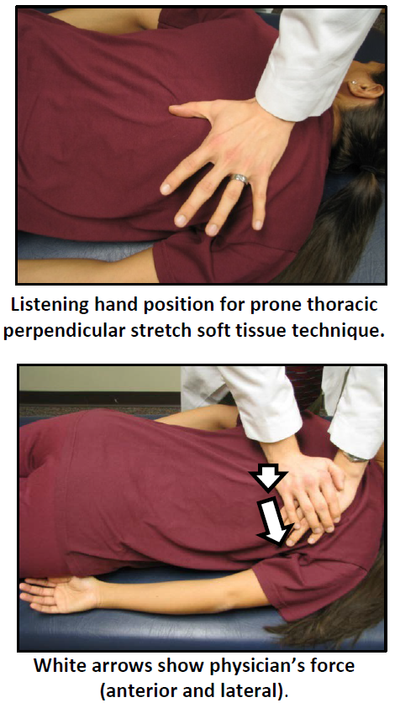
Prone Thoracic Perpendicular Stretch
Patient is prone; the physician stands at the side of the table opposite to the side being treated.
b. The physician places one hand (the “listening” hand) on the patient’s spine with the thumb and thenar eminence in the trough area between the spinous and transverse processes, over the erector spinae mass.
c. The physician’s other palm is placed on the thumb/thenar region and applies force through the “listening hand” in an anterior and lateral motion (into and toward the side of the table) to stretch and compress the tissues.
i. Hold pressure for 3 seconds and then release.
ii. DO NOT slide across the tissues; remain over the erector spinae mass.

Slide 30
MYOFASCIAL RELEASE
Best for restricted motion

Slide 31
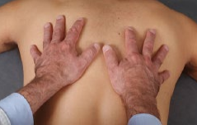
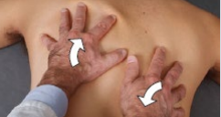
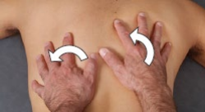
Prone Thoracic Myofascial Release
Patient is prone, physician is next to patient.
The physician places both hands palms down with the fingers slightly spread apart immediately paraspinal on each side.
A gentle downward force is applied into the patient’s thoracic tissues with only enough force to control the skin and underlying fascia while monitoring for ease bind motion.
Gentle/moderate force is applied either indirectly or directly meet the ease-bind barrier until a release is palpated.

Slide 32
MUSCLE ENERGY
Best for restricted motion/asymmetry

Slide 33
Upper Thoracic – Direct seated
DX: T1-T3 NS_{L}R_{R}
Pt sits. Dr. behind pt on the side of dsyfxn
Pt grasps back of head with opposite hand
Dr. grasps pts upper arm & contacts TP with thumb
Dr. engages all barriers (rotate/sidebend)
Pt. turns as Dr. resists for 3-5 seconds
Both relax tension for 2s (but not
back to neutral). Dr. to new barrier
7. Repeat process x3

Slide 34
COUNTERSTRAIN
Best for tender points

Slide 35
Counterstrain Treatment
Find the tender point
Establish a pain scale (e.g. $1 worth of pain)
Position in standard treatment position – usually wrap the body around the point/approximate origin and insertion sites
Recheck TP (how much is left now?)
Goal is 0 – minimum 30% of original (30¢)
Fine tune position for maximum effect
Hold treatment position for 90s (pt relaxed)
SLOWLY return to neutral
Reck point (Goal is zero)

Slide 37
SUMMARY
The body works best when it’s in working order
OMT – find the dysfunction, fix the dysfunction, leave it alone
Tissue abnormalities → treat with soft tissue
Asymmetry → treat with myofascial release
Restricted motion → treat with muscle energy
Tender points → treat with counterstrain

