Slide 1
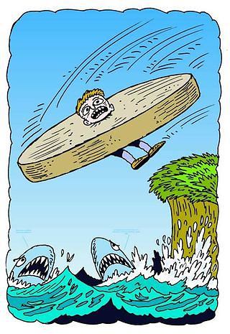
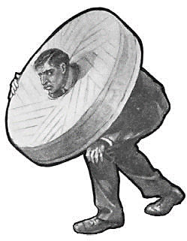
Behavioral Health Meets the Milestones: Millstones or Stepping Stones?
Peter D. Rainey MS, MedFT
Irina Kolobova, PhD
Julie Radico, PsyD, ABPP

Slide 2
Disclosures
You are awesome!
We are awesome!
We have nothing else left to disclose. However, we wish we did have something to disclose.

Slide 3
Please evaluate this presentation using the conference mobile app! Simply click on the "clipboard" icon on the presentation page.

Slide 4
Objectives
Describe domains of behavioral health curriculum.
Review a method to map behavioral health curriculum onto the Milestones.
Begin to identify which aspects of your current behavioral health curriculum may help address Family Medicine Milestones.
Notes:
Highlight a model for mapping behavioral science curriculum onto the Milestones framework,
On completion of this session, participants will be able to describe 5 domains of behavioral science curriculum.
5 Domains in of Behavioral Science
On completion of this session, participants will be able to describe a model to map their current behavioral health curriculum onto the Family Medicine Milestones.
Model to Map their Current BH Curriculum
On completion of this session, participants will be able to define which aspects of their current behavioral health curriculum may help address Family Medicine Milestones.
Define Aspects
apply to personal program
Share recommendations on how to best utilize the skills of behavioral science faculty in the competency evaluation process
Our examples vs examples from the Literature or both

Slide 5
Background
ACGME’s push towards competency based curriculum (Edwards & Frey, 2007)
Programs have variability in their curriculum (e.g., Freedy et al., 2013; Zubatsky et al., 2017)
Limited association between behavioral science curriculum and ABFM-ITE psychogenetic subsection scores (Griggs, 2009)
Core domains of behavioral science curriculum: core behavioral health topics and skills; communication skills; provider self-awareness and reflective practice; biopsychosocial/contextual care (Baird et al., 2017)
More than 30 behavioral and social science assessment tools mapped to LCME and ACGME competencies (Carney et al., 2015)

Slide 6
Program Requirements (ACGME):
The curriculum must be structured so behavioral health is integrated into the residents’ total educational experience, to include the physical aspects of patient care.
Residents must demonstrate knowledge of established and evolving biomedical, clinical, epidemiological and social behavioral sciences, as well as the application of this knowledge to patient care.
Diagnose, manage, and coordinate care for common mental illness and behavioral issues in patients of all ages;

Slide 7
So Why Does This Matter?
“It is important to recognize that the Milestones do not represent the totality of any discipline, but rather form a robust foundational core.”
“Remember, the Milestones are intended to be used as a formative framework to guide curricula, assessment, and CCC deliberations in programs.”
ACGME Guidebook

Slide 8
(Baird et al., 2017 –
reprinted with permission)

Slide 9
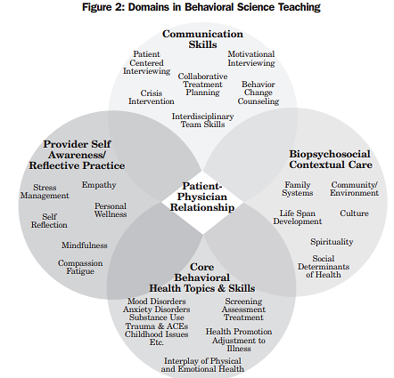
Current Proposed Model
+
Leadership
(Baird et al., 2017 – reprinted with permission)

Slide 10
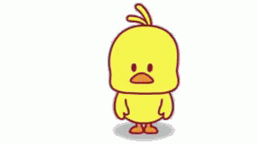
Methods to our Madness
Step 1 – Pre Baird et al (2017)
Inventory behavioral science curriculum
Categorize curriculum
Match to milestones
Step 2 – Post Baird et al (2017)
Map domains/tags from article to milestones
Then reviewed each item as a group
Then reviewed again individually
Then came to a final consensus

Slide 11
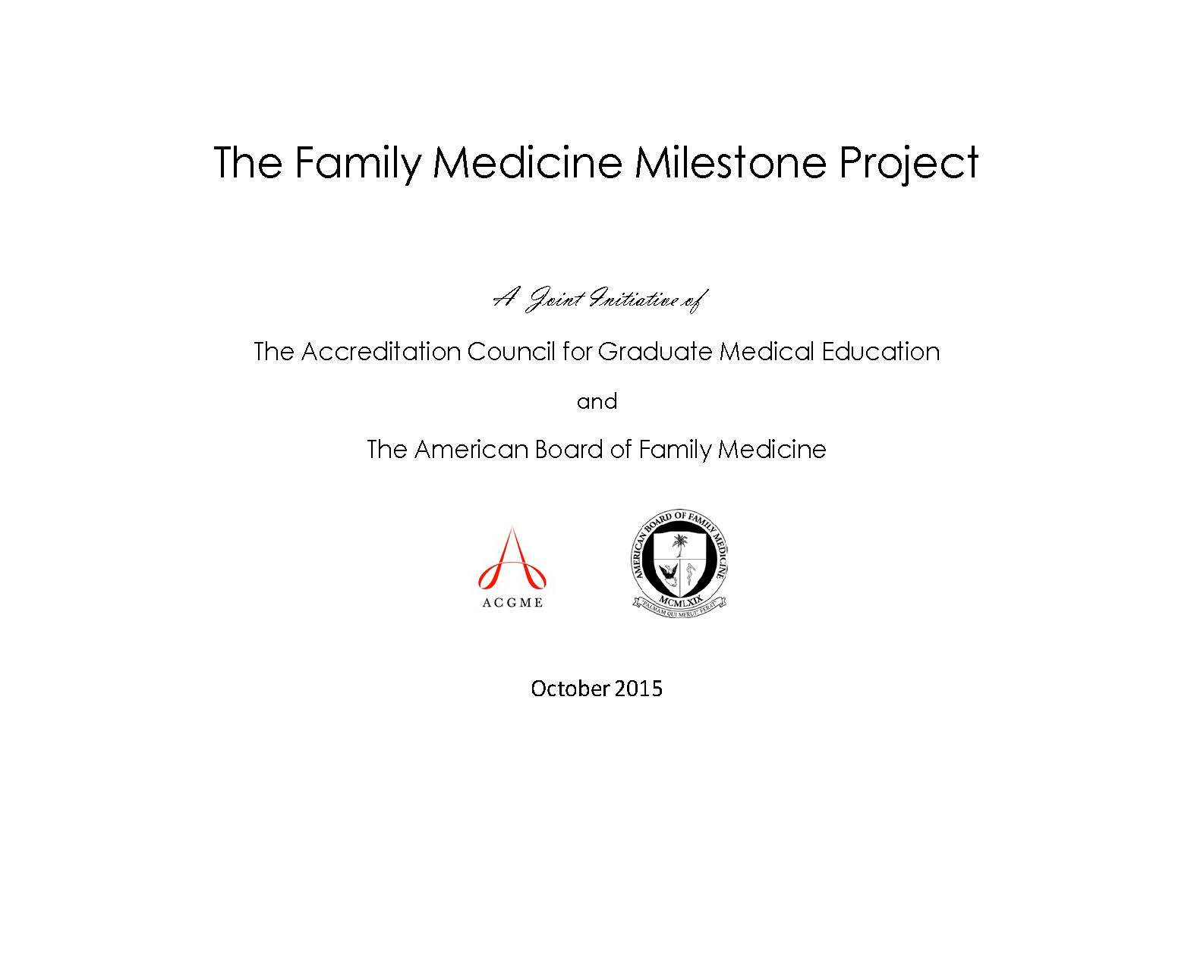

Slide 12
He Who Shuns the Millstone Shuns the Meal.
Desiderius Erasmus
Notes:
CCCs may be an excellent mechanism to identify those promotion criteria or, at the very least, to align Milestones performance with them. It is important to recognize that the Milestones do not represent the totality of any discipline, but rather form a robust foundational core. Consider how the Milestones fit into the program’s criteria for promotion and/or renewal of a resident’s/fellow’s appointment, a Core requirement. Remember, the Milestones are intended to be used as a formative framework to guide curricula, assessment, and CCC deliberations in programs. The Milestones will also ultimately guide and inform CCC deliberations that lead to a summative judgment for a resident’s/fellow’s promotion and graduation.

Slide 13
Total # of Milestones w/o Duplicates
Notes:
Duplicates= Within domain duplicates however there are duplicates across domains

Slide 15
% of Milestones The Model Covers
Notes:
Intended to highlight that we have major role to play in milestone evaluations and the efficacy of our teaching or curriculum could be evaluated by residents progress with the milestones.
We should learn the milestones so that we are able to provide justification for our feedback or direction to residents in areas they need to improve.
Milestones provide a common language for behavioral scientists to communicate with
Also pasted in comment: Talk about the gap with this example:
PROF-3/2.1
Displays a consistent attitude and behavior that conveys acceptance of diverse individuals and groups including but not limited to diversity in gender, age, culture, race, religion, disabilities, sexual orientation, and gender identity - Culture, Community/Environment, Spirituality, Social Determinants of Health (Use as example of Milestones shortcoming (failed to account SES and location)

Slide 16
Notes:
Curricula creation= Most Frequent

Slide 17
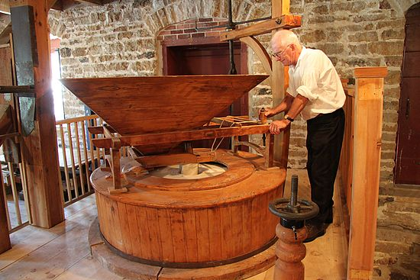
So Where Might You Start?
Milestone | Communication Skills | Provider Self Awareness/ Reflective Practice | BPS Contextual Care | Core BH Topics & Skills | Leadership
COM 2/2.2 | 1 |  | 1 | 1
COM 2/2.3 | 1 |  | 1 | 1
COM 2/3.1 | 1 |  | 1 | 1
PC 1/3.4 | 1 |  | 1 | 1
PC 2/4.2 | 1 |  | 1 | 1
PC 3/2.1 |  | 1 | 1 | 1
Notes:
Guiding the BH into the Millstone

Slide 18
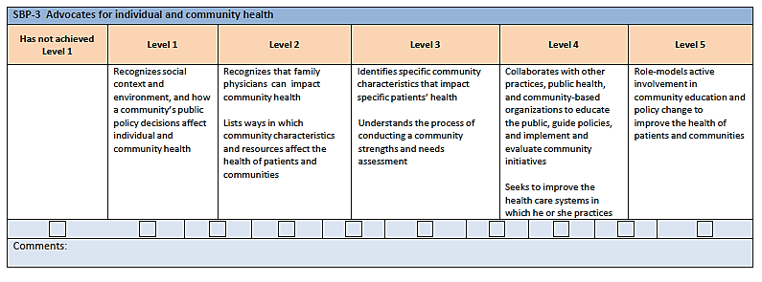
Notes:
Slide for group work if we choose to do group work

Slide 19
References
Baird, M. A., Hepworth, J., Myerholtz, L., Reitz, R., & Danner, C. (2017). Fifty years of contributions of behavioral science in family medicine. Family Medicine, 49(4), 296-303.
Carney, P. A., Palmer, R. T., Miller, M. F., Thayer, E. K., Estroff, S. E., Litzelman, D. K., ... & Satterfield, J. M. (2016). Tools to assess behavioral and social science competencies in medical education: A systematic review. Academic medicine: Journal of the Association of American Medical Colleges, 91(5), 730-742.
Edwards, F. D., & Frey, K. A. (2007). The future of residency education: implementing a competency-based educational model. Family Medicine, 39(2), 116-125.
Freedy, J. R., Carek, P. J., Dickerson, L. M., & Mallin, R. M. (2013). On track for success: an innovative behavioral science curriculum model. The International Journal of Psychiatry in Medicine, 45(4), 299-310.
Griggs, J.O.(2009). Measuring Behavioral Science Curricula in Family Medicine Residency. Family Medicine, 41(5), 311.
Zubatsky, M., Brieler, J., & Jacobs, C. (2017). Training experiences of family medicine resident on behavioral health rotations. Family Medicine, 49(8), 635-639.

