Slide 1
Achieving Relevant Outcomes
Mary Rose Puthiyamadam, MD
London Muse, MD

Slide 2
Disclosures
None

Slide 3
Poll
Polleverywhere
Text 22333
Type LONDONMUSE205
-or-
Respond at PollEv.com/londonmuse205

Slide 4
Objectives
Understand the role and use of patient registries.
Be able to understand the benefits and pitfalls of the online Relevant tool.
Brainstorm a creative use of Relevant (or similar patient registry) for quality improvement and/or physician productivity at your institution.

Slide 5
Who thought of Provider Report Cards?
1910 Dr. Emory Codman
“ Every hospital should follow every patient it treats long enough to determine whether or not treatment is successful and to inquire if not why not with a view to prevent a similar failure in future.”

Slide 6
Provider Report Cards
It was never intended to define providers
It was never intended to direct payment
It was never intended to deter satisfaction

Slide 7
History of Provider Report Cards
1980s
Private report cards used in hospital in Maryland and Cleveland on certain measures by administrators
Report cards then became publicly available

Slide 8
“Not everything that can be counted counts and not everything that counts can be counted.” --Albert Einstein

Slide 9
New style report Card
Third Quarter 2014 | Goal | Open Door | Mt. Kisco | Ossining | Portchester | Sleepy Hollow | Brewster
# of Diabetic Patients |  | 1695 | 292 | 432 | 689 | 190 | 83
% with A1c <7 | 58% | 51% | 53% | 48% | 52% | 55% | 45%
% with A1c 7 to 9 |  | 30% | 29% | 33% | 30% | 27% | 31%
% with A1c>9 | <15 | 18% | 16% | 18% | 18% | 17% | 22%
% with LDL in past 1 year | 85% | 81% | 88% | 82% | 75% | 98% | 75%
% with LDL <100 | 58% | 53% | 62% | 51% | 47% | 67% | 53%
% with Microalbumin in past 1 year | 37% | 79% | 78% | 78% | 82% | 91% | 92%
% with BP<140/90 |  | 78% | 85% | 78% | 74% | 76% | 84%
# of Women 24 to 65 y/o |  | 7206 | 1308 | 1832 | 3095 | 564 | 398
% with Pap in last 3 years | 93% | 75% | 72% | 78% | 76% | 82% | 64%
# of Women 42 to 75 y/o |  | 4248 | 759 | 160 | 1771 | 393 | 168
% with Mammogram in last 2 years | 81% | 66% | 63% | 70% | 66% | 66% | 49%
# of Adults >50 y/o |  | 4409 | 813 | 1131 | 1783 | 58 | 181
% with Colon Cancer Screen | 70% | 35% | 29% | 35% | 33% | 49% | 43%

Slide 10
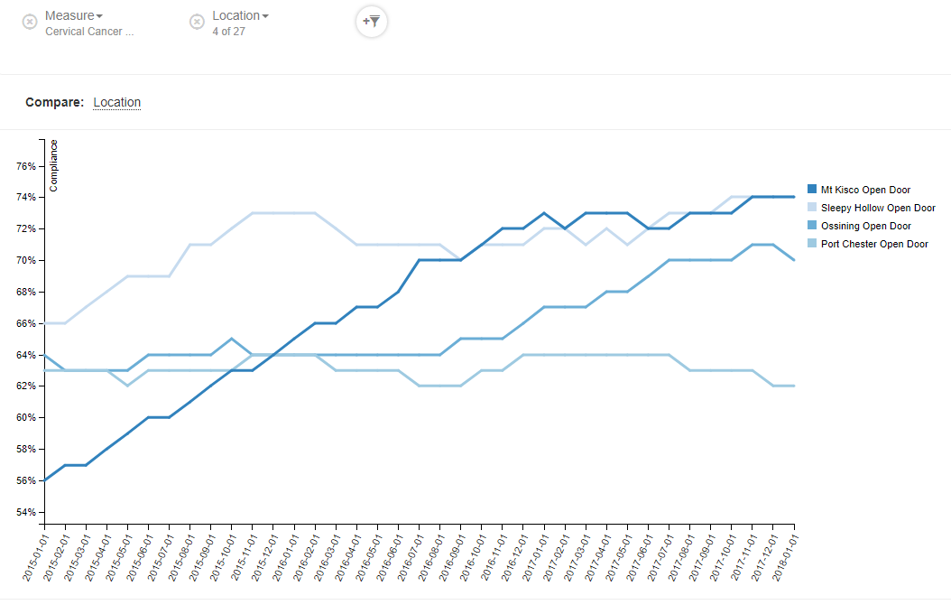
Cervical Cancer Screening
by site

Slide 11
Relevant Online Tool
Relevant

Slide 12
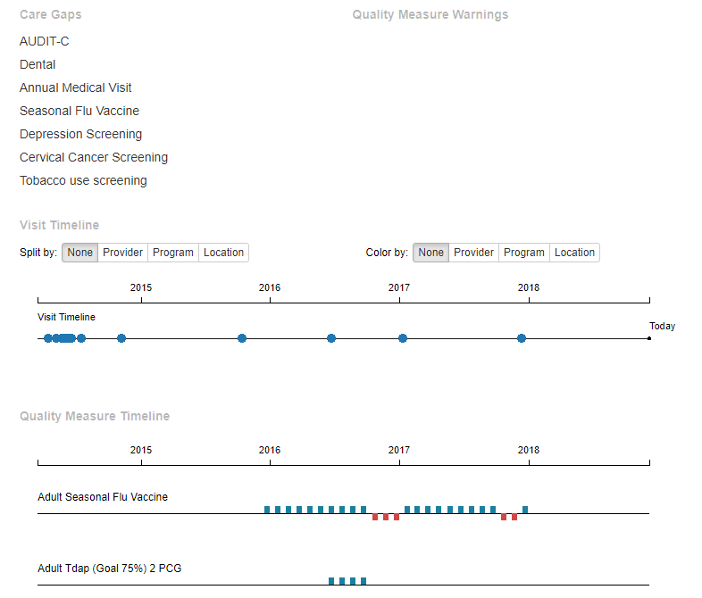
Visit Planning

Slide 13
Relevant Use in QI
Cancer screening
Monthly Events
E.g. Mother’s Day Mammogram
Immunizations

Slide 14
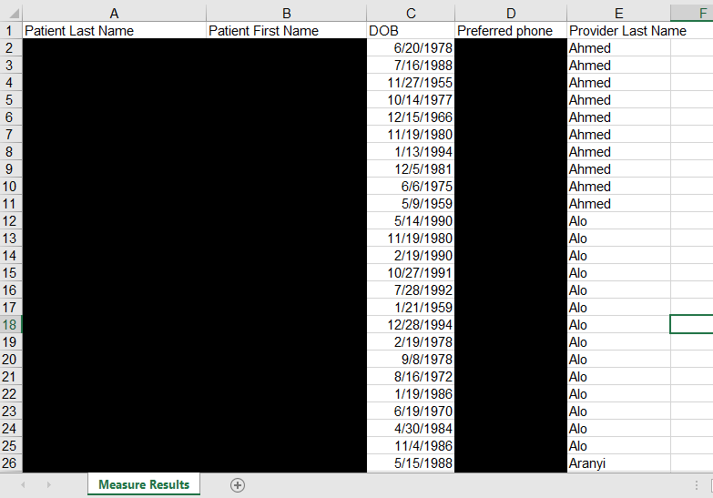
Holiday Cancer Screening Reflections

Slide 15
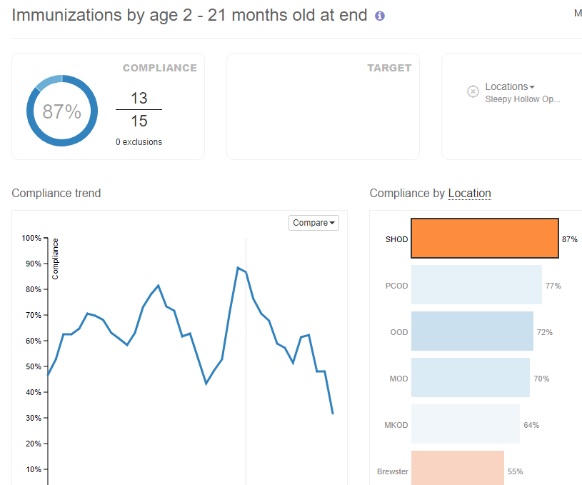
Immunizations

Slide 16
Relevant Use In PCMH
Site goals for Quality Improvement
Staff engagement

Slide 17
SHOD Quality Improvement Projects
 | Goal | 2/2018 | 9/2018
Tobacco screening/ intervention | 85% | 72% | 82%
SO/GI questions | 75% | 55.8% | 60%
Alcohol (and substance use) screening | 80% | 41% | 65%

Slide 18
Quality Improvement Projects
Each measure led by a PCT champion, discussed at huddles, presented at meetings
eCW/Relevant review at each monthly business meeting
Team meeting example
what’s working: huddle reminders, when PCT lets provider know that he/she asked the QI questions for the patient
what’s not: unsure how to easily tell if it has been done in the past year - we reviewed how to complete in eCW/Relevant
Later added in team competition to keep momentum and solidify in culture

Slide 19
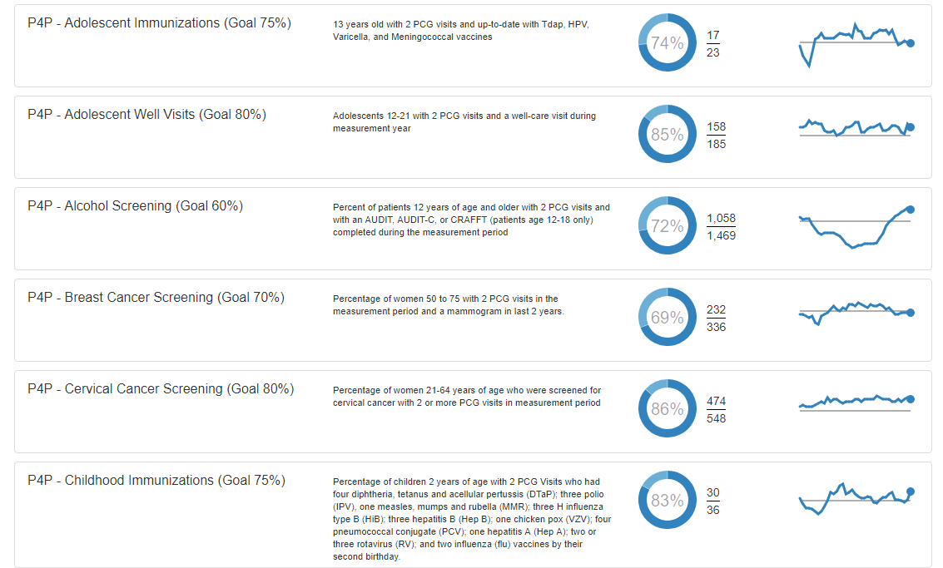
Relevant Use in P4P

Slide 20
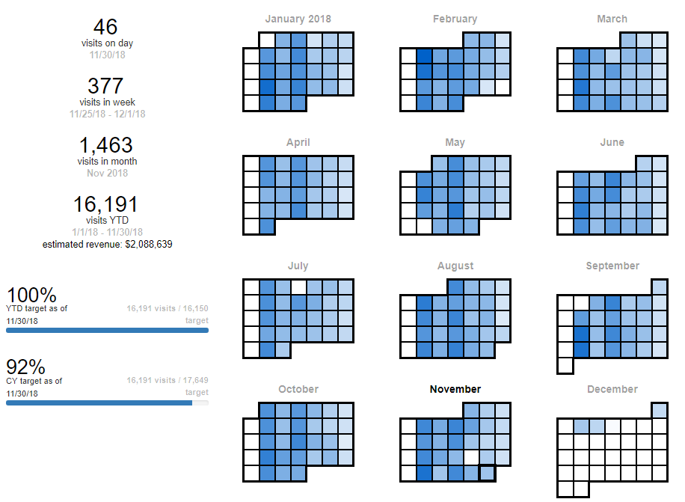
Productivity

Slide 21
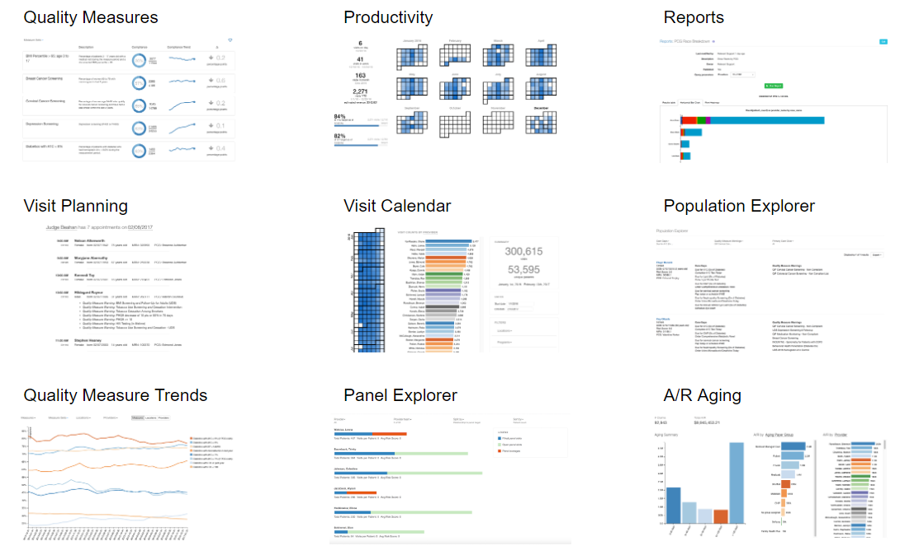
Management

Slide 22
Resident reflection
PGY-3 self directs a part of their practice they can reflect on through a “Relevant Project” PDSA
E.g. breast cancer screening – two resident perspectives

Slide 23
FMC Rotation Relevant Project Example
Breast cancer screening
Goal: to increase number of women 50-74 who have had mammogram in the past 2 years
Question: Does using a risk calculator increase incentive for women to obtain mammogram in a short time frame?
Project:
started at 15 of 30 patients, goal to increase from 50 to 70%
began with PCTs calling for appointment, creating DI orders
then added in option of picking up or mailing script for those with difficulty making appointments due to cost/time/transportation
Tried different types of risk assessment tools
Results
Recommended NIH Breast Cancer Risk Assessment Tool (BCRAT)
Improved to 72%

Slide 24
Challenges and pitfalls of online registry
Who is on patient panel?
Relies on correct information
Having registry does not necessarily mean outcome different
Urgency of patient registry use – forced to step back and look at population not individual

Slide 25
Audience Discussion
Any thoughts about ways you could use a similar online patient data collection tool in your institution?

Slide 26
References
Workman TA. Engaging Patients in Information Sharing and Data Collection: The Role of Patient-Powered Registries and Research Networks [Internet]. Rockville (MD): Agency for Healthcare Research and Quality (US); 2013 Sep. Defining Patient Registries and Research Networks.
Berwick DM, James B, Coye MJ. Connections between quality measurement and improvement. Med Care. 2003;3(41):I30–8.
Miller TP, Brennan TA, Milstein A. How can we make more progress in measuring physicians’ performance to improve the value of care? Health Aff. 28(5):1429–1437 Scholle SH, Roski J, Dunn DL, Adams JL, Dugan DP, Pawlson LG, Kerr EA. Availability of data measuring physician quality performance. Am J Manage Care. 2009;15(1):67–72.
Hofer TP, Hayard RA, Greenfield S, Wagner EH, Kaplan SH, Manning WG. The unreliability of individual physician ‘report cards’ for assessing the costs and quality of care of a chronic disease. J Am Med Assoc. 1999;281(22):2098–105

Slide 27
Please evaluate this presentation using the conference mobile app! Simply click on the "clipboard" icon on the presentation page.

