Slide 1
A Tale of Two Approaches
Caring for Patients with Complex Care Needs
Nancy Newman, MD
Kristin Cook, BSN, RN, PHN
Lourdes Martinez, CHW
Theresa Eckstein, MSW, LISW

Slide 2
Disclosures
None

Slide 3
Introductions

Slide 5
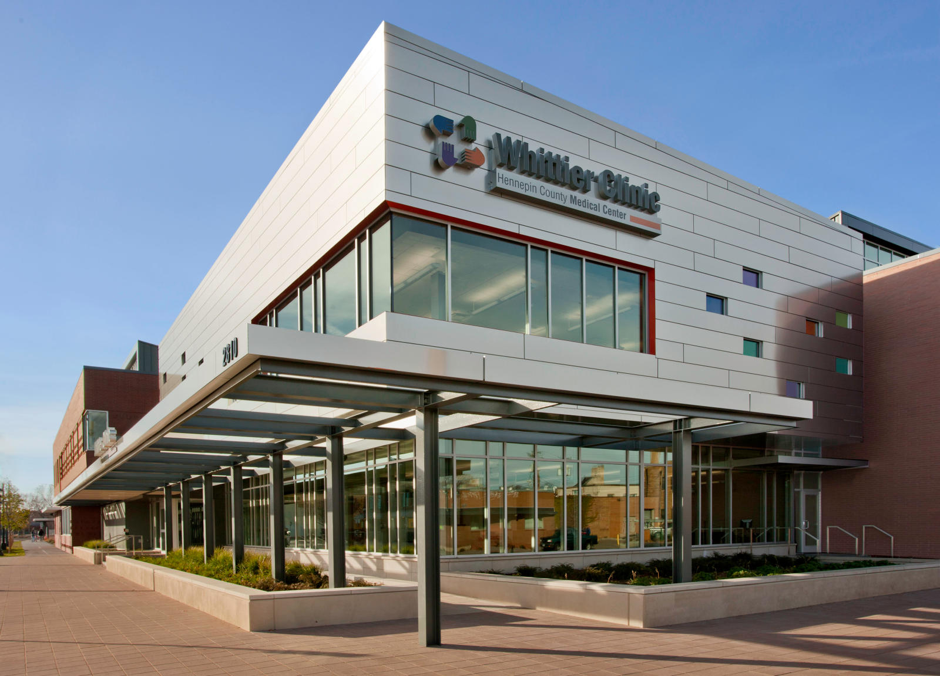
Our context
The Whittier Clinic
Large urban clinic, diverse patients, serving the underserved.
Part of safety net health system connected to the large county hospital
Primary care clinic for 11-10-12 Hennepin FM residency
Patients: 16% uninsured, 61% Medicaid/ Medicare, 19% private insurance

Slide 6
Identified Need
Patients with complex needs.
Providers overwhelmed
inadequate time for team collaboration at point of care
Residents lack opportunity for guided experience to learn skills
Limited faculty availability in regular clinic setting to teach about team-based care of patients with complexity.

Slide 7
The Idea
Create a special clinical setting within our clinic
Longer appointments
Dedicated team discussion time (huddle) to develop coordinated assessments and plans.
Special scheduling (ignore clinic late policy)
Immediate access to ancillary services
The Enhanced Care Clinic

Slide 8
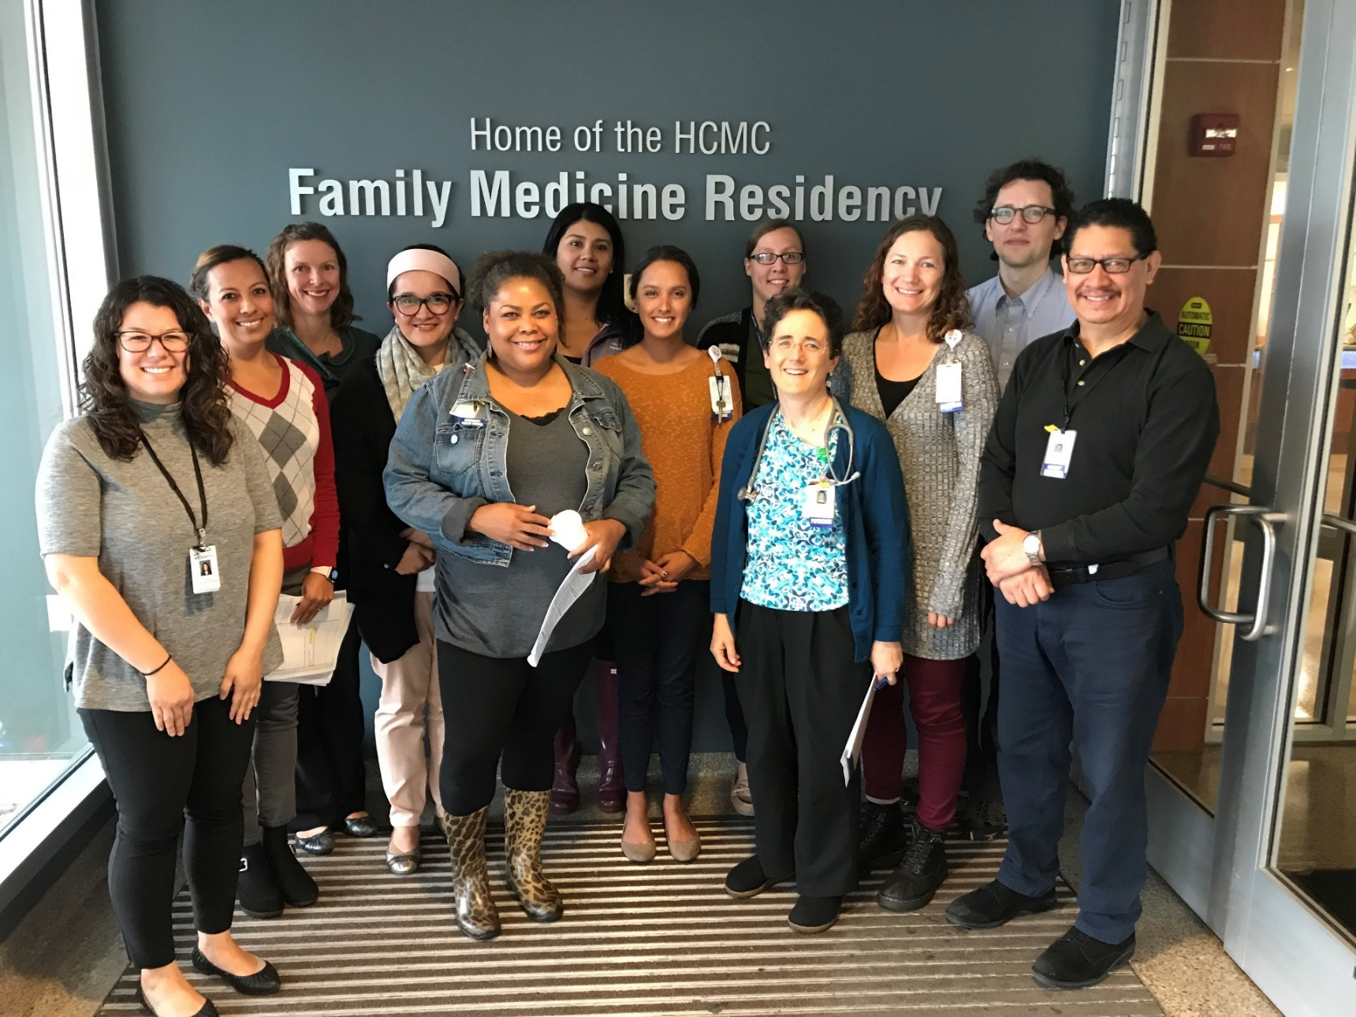
Our ECC Team

Slide 9
Our Vision
Clinical
Improved care of patients affected by complex comorbidities or social determinants of health
Patient satisfaction and improved “self-efficacy”
Education
Experiential component for residents about patients with complex needs in the setting of a team
Financial
Reduced utilization of ED and hospitalizations
Provider Satisfaction
More coordination of resources in management of patients with complex needs

Slide 10
Overview of our Presentation today
Approach #1 (opened July 2016)
Adjusting to Approach #2 (July 2017)
Advantages and Disadvantages of each
Our next steps
Lessons learned
Questions and discussion

Slide 11
Objectives and Goals
Describe our initiative to enhance experiential teaching about team based care of patients with complex needs
Summarize advantages and disadvantages of two different models of interdisciplinary care of patients with complex needs
Apply lessons learned to your own residency programs’ teaching about caring for patients with complex needs

Slide 12
Approach #1 The Enhanced Care Clinic
Summer 2016-June 2017
4 Hour clinic available to patients once per week
1st hour: team discussion, to prepare
Next 3 hours: patient care time
“One-Stop Shop”: multiple team members available as needed

Slide 13
Approach #1
Encouraged referrals from
PCPs
Nurses
Health Care Home panels
Inpatient teams discharging complex patients
Offered help navigating complex systems
Enrollment into ECC team care until stabilized, and then return to regular care
Longer appointment times and multidisciplinary care team available during appointment

Slide 14
Approach #1
Up to 8 patient visits per clinic session
Scheduled with MD and NP
Rotation of one third year resident monthly
during their “Practice Readiness” rotation
MD faculty member worked one-on-one with the resident
Partially offset decreased faculty productivity by billing at a higher level
Measure hospital readmissions & ED visits
Assess patients’ “self-efficacy” with Arizona Self-Efficacy Matrix

Slide 15
Approach #1
What happened (2016-17)
Recruited, scheduled and saw some patients
Eleven third year residents participated
Started to build a team culture
Some evidence that enrollment in ECC led to
More involvement with primary care provider, SW, RN
Fewer unplanned ED visits and hospitalizations

Slide 16
Approach #1
Unfortunately…
Limited number of referrals
Mostly from ECC team members
PCPs and patients reluctant to involve new MD
Huge administrative task to contact patients to schedule ECC appointments
High patient no show rate
2-3 patients/ week x 12 months
especially for unengaged patients

Slide 17
Approach #1
Unfortunately…
Patients with fewer complex needs were more likely to come to scheduled appointments
Clinic flow challenging when most patients did show up
Inadequate data to assess change in patient self-efficacy
Challenge of demonstrating financial benefits to the system

Slide 18
Approach #1
Realization…
“This is not sustainable.”

Slide 19
Facing Reality…
The patients were not coming
If you build it, they will not necessarily come.
Challenge of accomplishing simultaneously in real time
Patient care
Resident education
Team collaboration

Slide 20
Facing Reality…

Slide 21
Approach #2 Enhanced Care Coordination
Team huddle for 2 hours once/ week
Discussion of any clinic patient with complex needs
Assigned residents present their own patients
Clinical care plan documented in EHR for PCP and other team members for future patient care visits and care coordination

Slide 22
Approach #2
Patient care during regular clinic hours in the usual way
No need for special scheduling
Maintained PCP involvement
Ancillary team members attend regular clinic appointments as able
Enables discussion of patients not yet attending clinic appointments
Faculty and NP see regular patients in regular clinic after team huddle

Slide 23
Patient Example
Referred from inpatient RN clinical coordinator
Non-Alcoholic Fatty Liver Disease
Specialist recommending Liver Transplant
Abdominal Hernia causing significant impact on quality of life
Uninsured, no income
Lacked status within the United States
Coordination of multiple appointments
PCP
Gastroenterology
Liver transplant service at University of Minnesota
Surgery Clinic
Financial aid
EMA & EMA Care Plan
Legal Aid
Humanitarian Visa

Slide 24
Comparing Approaches Advantages
Approach #1
Synchronicity of team collaboration with patient visit
Longer patient appointments
No clinic late policy
Residents get focused teaching at point of care
Immediate implementation of plan of care
Approach #2
Attention to chronic disease panels and patients that are not yet engaged
More longitudinal for residents (all 3 classes can be involved)
Patients can choose any appt time
Team no longer needs to manage complex clinic flow

Slide 25
Comparing Approaches Disadvantages
Approach #1
•Patients can only access the clinic one half day/week
•Long appointments can be overwhelming for patients
•PCP rarely involved
•Residents less invested since usually not the PCP
•Demanding administrative task of scheduling patients with complex needs
•High no show rate
•Only 3rd year residents participate
Approach #2
•Delay in discussing and implementing plan with patient
•Implementation of plan more dependent on effective communication with PCP
•Standard clinic visit duration is often inadequate
•Less likely to have synchronicity with team members
•Less faculty time for point of care teaching

Slide 26
Resident Feedback
Third year residents (n=8)
“Approach #2”
Via written questionnaire

Slide 27
Resident Feedback
Positive Feedback
85-100% of residents “agreed” or “strongly” agreed that the ECC:
Helped me better understand complexities affecting patients
Helped me to identify barriers that impact patients
Helped me to identify resources to help care for patients
Increased my ability to work as a part of a multidisciplinary team
Provided me with a valuable conversation about my primary patients.
Provided me with realistic recommendations for care of my complex patients

Slide 28
Resident Feedback
What was most valuable?
Learning about additional “resources”
“Designated time” to discuss complex patients
“Having the input that each team member has to offer”

Slide 29
Resident Feedback
What would improve the experience?
Expand participation to include first and second year residents
Orientation materials describing what different team members do
Opportunities to talk with ancillary team over time

Slide 30
Resident Feedback
Would they want “one-stop shop”?
Over half of residents felt it would be useful or very useful “to see the patients immediately after the ECC meeting discussion”

Slide 31
Our Next Steps
Get more regular involvement of pharmacist, psychologist
Involve 1st and 2nd year residents (in process)
Educate the clinic about ECC (beyond just the residents)
Streamline communication about who is attending ECC each week
Continue to look for ways to measure outcomes (clinical, financial and patient satisfaction)

Slide 32
Lessons Learned System Challenges
Clinic
Space limitations /room crunch
Employee turnover
Hospital System
Silos (Different depts have different priorities)
Financial pressures for productivity
Measurement of outcomes not always prioritized
Residency Education
Competing priorities in the curriculum
Team Function
Communication
Role clarity

Slide 33
Lessons Learned Patient challenges
Care of patients with complex needs is complex
Expect higher no show rates
Be wary of scheduling restrictions (i.e. only one day/week)
To prioritize those with most complex needs, do not make attendance at appointments a pre-requisite for team attention

Slide 34
Lessons Learned
Provider-Patient Relationships
Respect the Patient- Primary Care Provider (PCP) relationship
Patients with complex needs that do not have a PCP relationship may be especially challenging to engage.

Slide 35
Lessons Learned Team
Building a New Team:
Create a culture of collaboration and reliable communication
Be sure to invite all relevant team members

Slide 36
Lessons Learned Overall Design
Approach #1 aimed to accomplish
extended patient clinic visit
resident education
team collaboration
It was not sustainable for our system
We had to give up a “really cool part”
There have been unexpected benefits to changing
All at the same
time and place

Slide 37
Lessons Learned Unexpected Benefits
Less stressful to administer
Residents more easily engaged longitudinally
Better positioned to integrate into the whole clinic

Slide 38
Lessons Learned
What is sustainable will depend on your system
Start wherever you can and adapt as needed

Slide 39
Questions?

