Slide 1
Effective Teaching Postures And Didactic Methods: Using The Self Of The Teacher As A Tool
Brenda Wilson, MS LT
UNTHSC TCOM
Faculty Development Center
Notes:
2-3 minute Introduction
Intro speaker– Welcome – I’m Brenda Wilson from Texas COM Faculty Development. I have been working in the area of faculty development for more than a couple of decades. I have found today’s topic to be a consistent need for faculty. In addition (or in support of those things) you will leave with knowledge about how posture and movement effect both speaker and audience, how you can improve your vocal clarity/projection and reduce fatigue while teaching.
In order to accomplish these things in the short amount of time we have, I need your permission to stretch you a bit, not too far.
Do I have your permission?

Slide 2
Disclosures
I have no potential
or known conflicts of interest
to disclose.
Notes:
Black out screen after disclosure.
Story – Who has been in a high stakes situation and worried about getting “the question” that you are just not sure how to answer? Not that you don’t have an answer but your just not sure the answer that is true to who you are is the one the other person wants to hear.
This happened to my younger sister, an early childhood teacher, interviewing for what seemed to be her dream job. The principal asked “What is the most important resource in your classroom?” Immediately, she had an answer “the children” but she thought “now that doesn’t seem very ‘academic’. She decided to get her true answer. “This may not seem very academic, but to me it is the children.” That answer sealed the job offer she was later told. I agree with my sister, you as my learners are the most important resource in this room. Even more so the kindergarteners, you each bring a wealth of knowledge and experience to this learning experience just like your learners. I would argue that the second greatest resource is to offer your whole true self your learners.

Slide 3
True or False
Your posture shortly before you enter a room to present does matter.
"Faking" an attribute will help you develop that attribute within your self.
A person's voice is either resonant or it isn't; there is little a person can do to change it.
Notes:
I used Polleverywhere to pose the listed questions to the group.

Slide 4
On completion of this session, the participants should be able to...
Discuss the physiological and emotional influence posture and have on speaker and audience
movement
Notes:
Let’s audit our own body language right now. Open or closed. We will come back to this.
We are going to focus first on you as the speaker, then we will look at a role model to get the audience experience.

Slide 5
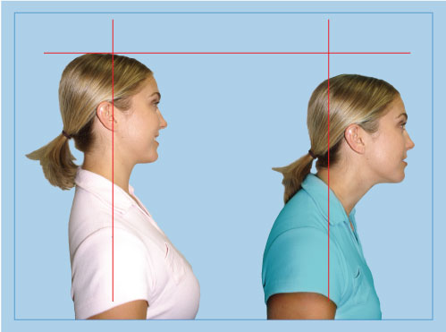
Posture
Notes:
Take about 10 minutes here.
Drs. Cuddy (Harvard Business School) and Dana Carney (then at Columbia now at Berkley) Andy Yap have done several studies about the influence of posture on physiological changes and emotional changes.
Let’s try it. If you judged your body language as closed. Take a POWER stance. If you judged your body language as open, adopt a withdrawn stance.
After two minutes of assuming a “power poses” there were hormonal changes and imagery changes in the brain – higher testosterone, lower cortisol and higher willingness to take risks.
After two minutes of a withdrawn posture – lower testosterone, higher cortisol and lower willingness to take risks.
One study independently blinded interviewers who interviewed subjects . The subjects were randomized to either Power or withdrawn immediately prior to brief interaction. Overwhelming positive for those with POWER over withdrawn.

Slide 6
Posture
Testosterone
20% Increase
25% Decrease
Cortisol
Risk
Taking
Willing
26% Increase

Slide 7
Posture
10% Decrease
Testosterone
Cortisol
15% Increase
26% Decrease
Risk Taking
Willing
Notes:
Drs. Cuddy (Harvard Business School) and Dana Carney (Columbia) have done several studies about the influence of posture on physiological changes and emotional changes.
Let’s try it. If you judged your body language as closed. Take a POWER stance. If you judged your body language as open, adopt a withdrawn stance.
After two minutes of assuming a “power poses” there were hormonal changes and imagery changes in the brain – higher testosterone, lower cortisol and higher willingness to take risks.
After two minutes of a withdrawn posture – lower testosterone, higher cortisol and lower willingness to take risks.
One study independent blinded interviewers interviewed subjects randomized to either Power or withdrawn immediately prior to brief interaction. Overwhelming positive for those with POWER over withdrawn.

Slide 8
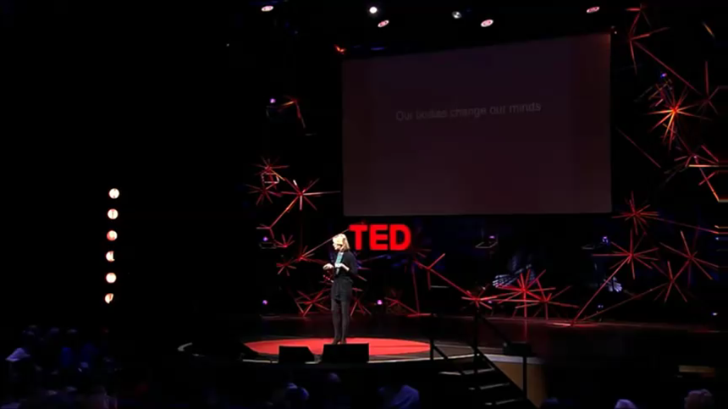
Click on picture for link to video
Notes:
Video is 4 minutes

Slide 9
Movement
ARTICLE ON MOVEMENT: http://www.edweek.org/tm/articles/2013/03/19/fp_griss.html
Notes:
When something moves, we pay closer attention to it. John Medina Brain Rule #We spend a great deal of time and effort on WHAT we are going to SAY when 90% of communication is NON VERBAL.
Direction of movement is significant.
Movement towards you suggests a threat.
Movement away may or may not be desirable. Lateral movement is easy to estimate for speed and begs the question 'To what destination?'
Turns: Changes in direction grabs attention, especially when the turn increases threat, such as when it it is towards you.
James Breeze research on online eye focus. F lines rather than Zs

Slide 10
Movement
Want to optimize attention
USE PURPOSEFUL MOVEMENT!
ARTICLE ON MOVEMENT: http://www.edweek.org/tm/articles/2013/03/19/fp_griss.html
Notes:
When something moves, we pay closer attention to it. John Medina Brain Rule #We spend a great deal of time and effort on WHAT we are going to SAY when 90% of communication is NON VERBAL.
Direction of movement is significant.
Movement towards you suggests a threat.
Movement away may or may not be desirable. Lateral movement is easy to estimate for speed and begs the question 'To what destination?'
Turns: Changes in direction grabs attention, especially when the turn increases threat, such as when it it is towards you.
James Breeze research on online eye focus. F lines rather than Zs

Slide 11
Focus on Posture
and
Movement
Click picture for link to video
Notes:
15 sec cli
What do feel as the audience? What behaviors from Camara Jones helped evoke that feeling?

Slide 12
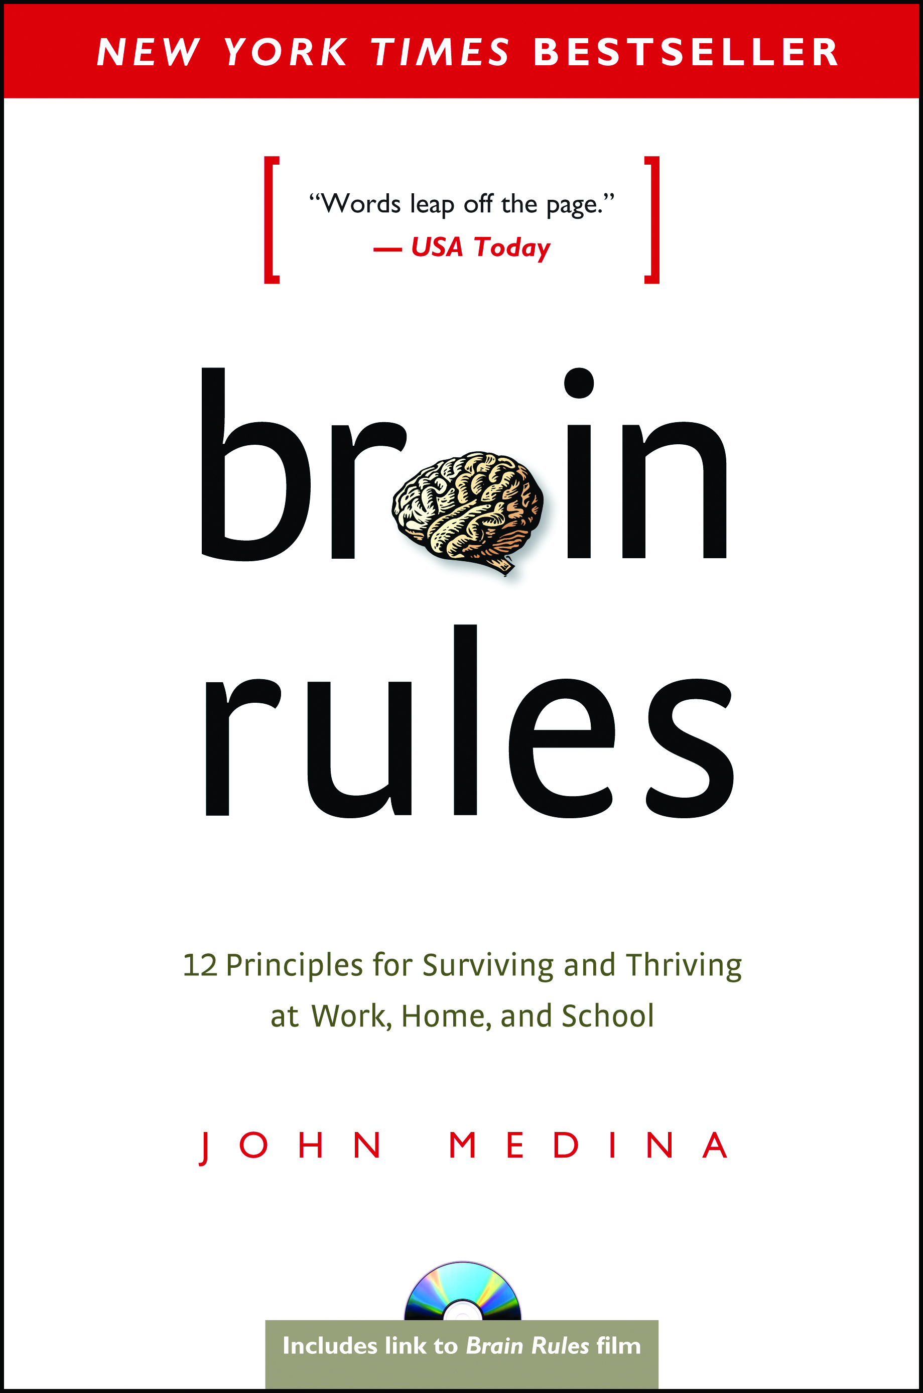
Want to Learn More
TED Talks
Your body language shapes who you are | Amy Cuddy

Slide 13
Celebrate what we learned
Posture
Example of open posture
What hormonal effect did Cuddy and Carney find?
Example of closed posture
What hormonal effect did Cuddy and Carney find?

Slide 14
Celebrate what we learned
Movement
Example of purposeful movement
Effect on attention
Example of random movement
Effect on attention

Slide 15
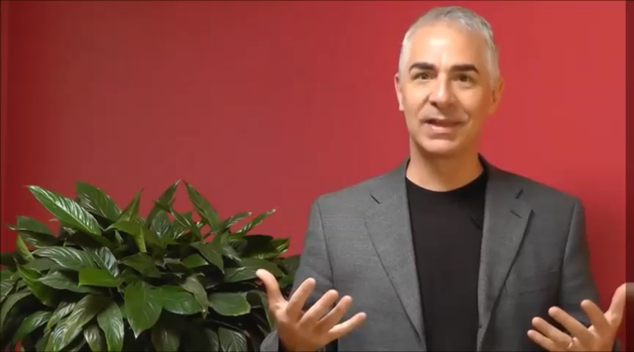
Resonance
Click on picture for link to video

Slide 16
Voice Resonance
Lessens Strain
Clear to Others
Reduces Fatigue
Projects Farther

Slide 17
On completion of this session, the participants should be able to...
Apply techniques to support the person to enhance his/her physicality, vocal clarity/projection and to reduce fatigue while teaching.

Slide 18
Let’s Practice
Notes:
Resonance – To find the pitch range where your voice is most resonant take the pringle can and with the palm of your hand fully engaged on the can hum into the can. Where you feel the most vibration is your optimal pitch for resonance. Practice speaking at that tone, then moving up in pitch a bit and down in pitch a bit. This is where you will get the least fatigue, clarity and projection. You can also place the palm of your hand on your upper chest area and the other hand palm near your diaphragm, practice speaking where you are feeling vibration in both hands.
Try blowing balloon up without your diaphragm moving. This is like trying to teach with only a small part of yourself, it just isn't too effective. Now try blowing up the balloon drawing deeply from your breath support and feeling in your diaphragm. Talk about effectiveness and bring your whole breath (being). Now tighten the opening of the balloon and let the air out. This is your voice when your vocal cords are tight – not very pleasant huh? Demonstrate the flight that happens when you relax your voice and bring your whole self to your teaching -- let then balloon take off with the release of the air.

Slide 19
Connecting to your teaching
Pair up
Share a high stress teaching situation you are facing or have faced
Discuss how some of these principles could be put to use.

Slide 20
Stickiness -- If we. . .
See it!
Hear it!
Tell it!
Memory
80 to 90%
Notes:
80-90% of what we do and see
10 – 20% of what we hear
The MORE connections -- the stickier
Now make plans to tell what you have learned today – your colleague, your friend, your partner

Slide 21
Take It Home
Notes:
Share your commitment via a calendar invite or email to yourself or a colleague.
Tweet what you have learned, email it to your friend/colleague.

Slide 22
What Questions Remain?

Slide 23
References
Carney DR, Cuddy AJ, Yap AJ. 2010 Oct 1; Power posing brief nonverbal displays affect neuroendocrine levels and risk tolerance. Psychological Science. 21(10):1363-8.
Cuddy A. 2012. Your body language shapes who you are. TedGlobal. Available at: https://www.ted.com/talks/amy_cuddy_your_body_language_shapes_who_you_are?language=en
Gray, D., Brown, S. and Macanufo, J., 2010. Gamestorming: A playbook for innovators, rulebreakers, and changemakers. O'Reilly Media, Inc..
Medina J. Brain Rules: 12 Principles for Surviving and Thriving at Work, Home, and School. Pear Press. 2014.
Miller, J. 2013. Crucial Speaking Skills: Resonance. Available at: https://www.youtube.com/watch?v=DEsiNQtbRMU

Slide 24
Please evaluate this presentation using the conference mobile app! Simply click on the "clipboard" icon on the presentation page.

