Slide 1
Cura Te Ipsum “Heal Thyself” Strategies to Avert Burnout, Build Resilience and Model Wellness
Catherine Florio Pipas, MD, MPH
Geisel School of Medicine at Dartmouth
STFM
Conference on Medical Student Education
February 3, 2018
“Knowing yourself is the beginning of all wisdom.” ~Aristotle

Slide 2
Disclosures
NONE

Slide 3
Pipas Pathway
Dartmouth, NH
Middlebury ,VT
Cambridge ,MA
Lewisburg ,PA
STFM/AAMC
CA
TDI-MPH
KY
OR
FL
LA
JMC, Philadelphia
Tooksok, Alaska
KS
TX
Camden, NJ
NM
WA
TN
Palo Alto, CA
UNC, NC
MUSC Charleston, SC
SWGFPR, Georgia
Xian, China
Beijing, China
Shanghai, China
WHO- Thailand
Honduras
South Africa
Notes:
MY Journey towards wellness and my quest to promote health and self care in others
which has literally taken me “Around the world!”
MY PIPAS FM journey at one of the strongest places, only now do know that
1986-1990- Jefferson Medical College- Mike Rosenthal
1990-1993-MUSC –MARC FM Residency-Alec Chessman, Steve Ornstein, Clive Brock, Peter Carek
1993-1994- UNC Chappell Hill Faculty Development Fellow- Allen Dietrich
1993 TDI MPH 2011 Dartmouth Asst Residency Director- Dan Eubank
1994-2007 Predoc Director TORI
(1999- SWGFPR)STEPHI Lanny Copeland, Joe Hobbs , Libby Poteet, Kent sheets
2000- Asst Dean DMS , OCER dir, (2005 Chair STFM Predoc) Patty Carney, Don Kollisch, Betsy Garrett
200? - Vice Chair CFM (200? PDDI STFM) Paul Paulman, UVM-David Little, Katie Margo
I had spent the last decade as a leader in predoctroal educ, directing the clerkship, mentoring students , watching some of the best and brightest interested in FM and PC enter other fields to achieve “job satisfaction and lifestyle needs met” watching our numbers at DMS go from 40-50% Pc (for a decade)to 20% PC including loosing a pisacano scholarship winner to Surgery (went rural in Utah to “do it all” ) Irony is we sponsored his preceptorship to a surgeon that functioned as a PC doc in his rural community
2000 to Vice Chair, I was offered by my Chair the opportunity to lead the clinical area , mentoring the faculty and change the way we deliver care to improve job satisfaction. it seemed the natural place I felt like I needed to enter the clinical world to make a difference and add support for our faculty, to be satisfied role models-
2007 Section chief, 2008 RPCC director
2012 GOLD,

Slide 4
Objectives:
Discuss the importance of Self-Care and the Impact of Burnout on individual performance, team effectiveness and community wellbeing.
Describe factors that threaten personal health and organizational wellness.
Explore evidence-based strategies for leading change personally and at the system level.
Notes:
STFM PLenary

Slide 5
My Health
is Critical to
My Effectiveness as a …
Notes:
OUR VISION is to create a community of HEALTHY LEADERS who are prepared to LEAD in HEALTH and create a culture of positive change
The American College of Physician Executives highlights a strong correlation between physician personal leadership and top-performing health systems. .
We DEFINE LEADERS NOT as those with TITLES< BUT as those effective in articulating a shared vision, inspiring collaborative partners, transforming challenges into opportunities and delivering meaningful and measurable outcomes,
Residency Directors in a TUCK needs assessment , want residents with leadership experience and
Students when clear that this is not about getting a title , want leadership skills that make them more effective physicians
We are all part of that vision that includes the health of each and every one of us and our commitments must be the developments of each and every one of us as an individual and to each of us as leaders.
We must go beyond educational disciplines to determine the competencies needed to overcome these 3 challenges
Solutions from Medical Education and Beyond: Educators are looking beyond the traditional models of medical education to business, psychology, sociology, and other disciplines for innovative solutions to these individual, team and systems challenges. Supporting personal and professional development through formal curriculum with guided self -assessment, self -reflection, self -discovery and self -monitoring can increase motivation, performance, satisfaction, personal effectiveness and improvement. (Benbassat and Baumal 2005) . The presence of learning communities and supportive mentors that foster team-based learning can enhance communication, strengthen relationships, and increase trust, performance and outcomes. (Sambunjak, Straus et al. 2010). Investment in quality improvement and systems thinking education can demonstrate significant improvements in efficiency, quality and cost containment; these concepts have begun to move into undergraduate and graduate medical education.

Slide 6
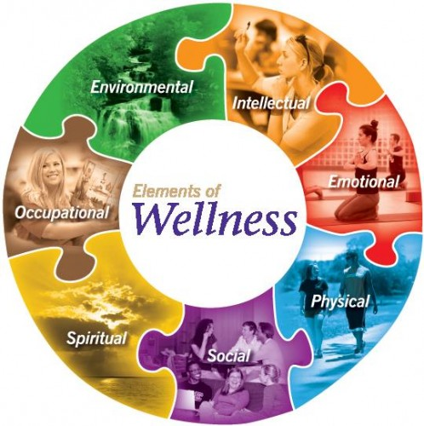
Vanderbilt University
Notes:
Whe We talk about wellness, we mean the whole person wellness. which are all INTERCONNECTED
PHYSICAL WELLNESS depends on so many factors , if you recall from the 1st class
Physical Wellness: a perception and expectation of physical health., Exercising regularly, Eating and sleeping properly, Getting regular physical check-ups, Avoiding the use of tobacco or illicit drugs
SPIRITUAL WELLNESS Spiritual Wellness: a positive perception of meaning and purpose in life. ,Being open to different cultures and religions, Giving your time to volunteer or participate in community service activities, Spending time defining personal values and ethics and making decisions that complement them, Spending time alone in personal reflection, Participating in spiritual activities, Participating in activities that protect the environment,
SOCIAL WELLNESS Caring connection about others ,Social Wellness: a perception of having support available from family, friends, or co-workers in times of need and a perception of being a valued support provider.
Being comfortable with and liking yourself as a person Interacting easily with people of different ages, backgrounds, races, lifestyles, Contributing time and energy to the community,Communicating your feelings
Developing friendships, Recognizing a need for “fun” time in your life, Budgeting and balancing your time to include both responsibilities and relaxation
EMOTIONAL WELLNESS Emotional Wellness: possession of a secure self-identity and a positive sense of self-regard; also the ability to cope with and/or improve unpleasant mood states.
Keeping a positive attitude, Being sensitive to your feelings and the feelings of others
Learning to cope with stress
Being realistic about your expectations and time
Taking responsibility for your own behavior
Dealing with your personal and financial issues realistically
Viewing challenges as opportunities rather than obstacles
Functioning independently but knowing when you need to ask for help
INTELLECTUAL WELLNESS
Intellectual Wellness: the perception of being internally energized by an optimal amount of intellectually stimulating activity.
Learning because you want to – not because you are told to. Doing the work assigned.
Learning through varied experiences – reading, writing, sharing and exploration
Observing what is around you
Listening
Finding applications for material learned in the classroom
Staying current with world affairs/news
Questioning
Exposing yourself to new experiences (e.g. arts, theater)
ENVIRONMENTAL WELLNESS
Environmental Wellness: the positive perception of the environment that one works and lives in.
Being aware of the natural environment you live in
Recognizing opportunities that lead you to new skills and acting on those opportunities
Working to ensure the stability and longevity of our natural resources
OCCUPATIONAL WELLNESS
Occupational Wellness: your outlook on your work and career
Finding satisfaction and worth in your work
Ensuring your work environment and relationships are comfortable
Finding ways to improve at work through skill development and active learning
Ability to make choices that foster positive attitudes toward work and your co-workers will enhance your personal and professional satisfaction and promote lifelong learning
Requires knowing enough about yourself to choose a rewarding and fulfilling occupation consistent with your personal interests, values and beliefs

Slide 7
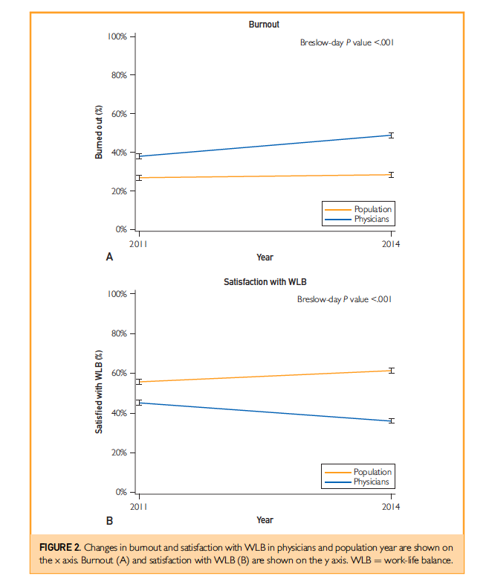
THE EPIDEMIC OF
BURNOUT
Shanafelt et al. Mayo Clin Proc.90(12):1600-1613 Dec 2015
> 50%
Students
Residents
Nurses
Clinicians
Researchers
Notes:
Abstract
Objective: To evaluate the prevalence of burnout and satisfaction with work-life balance in physicians and
US workers in 2014 relative to 2011.
Patients and Methods: From August 28, 2014, to October 6, 2014, we surveyed both US physicians and
a probability-based sample of the general US population using the methods and measures used in our
2011 study. Burnout was measured using validated metrics, and satisfaction with work-life balance was
assessed using standard tools.
Results: Of the 35,922 physicians who received an invitation to participate, 6880 (19.2%) completed
surveys. When assessed using the Maslach Burnout Inventory, 54.4% (n.3680) of the physicians reported
at least 1 symptom of burnout in 2014 compared with 45.5% (n.3310) in 2011 (P<.001). Satisfaction
with work-life balance also declined in physicians between 2011 and 2014 (48.5% vs 40.9%; P<.001).
Substantial differences in rates of burnout and satisfaction with work-life balance were observed by
specialty. In contrast to the trends in physicians, minimal changes in burnout or satisfaction with work-life
balance were observed between 2011 and 2014 in probability-based samples of working US adults,
resulting in an increasing disparity in burnout and satisfaction with work-life balance in physicians relative
to the general US working population. After pooled multivariate analysis adjusting for age, sex, relationship
status, and hours worked per week, physicians remained at an increased risk of burnout (odds
ratio, 1.97; 95% CI, 1.80-2.16; P<.001) and were less likely to be satisfied with work-life balance (odds
ratio, 0.68; 95% CI, 0.62-0.75; P<.001).
Conclusion: Burnout and satisfaction with work-life balance in US physicians worsened from 2011 to
2014. More than half of US physicians are now experiencing professional burnout.
ª 2015 Mayo Foundation for Medical Education and Research n Mayo Clin Proc. 2015;90(12):1600-1613

Slide 8
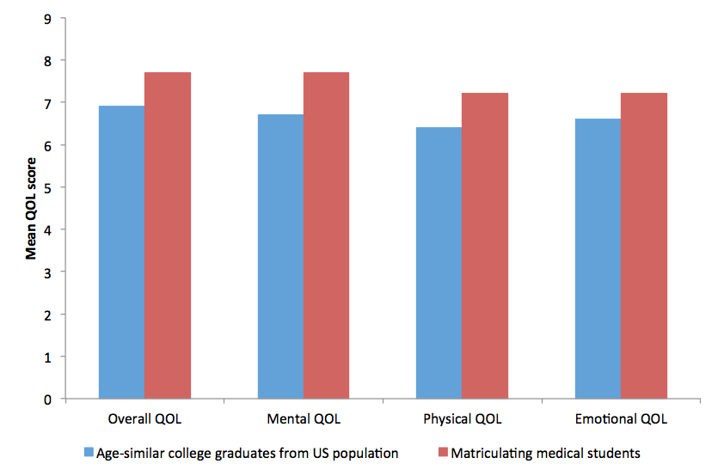
Matriculating medical students report better quality of life than age-similar college graduates
Brazeau et al. 2014
Notes:
Matriculating medical students report overall better quality of life as well as higher mental, physical and emotional health and and lower distress than age-similar college graduates
2014 Brazeau et al, Acad Med 2014, 89;1520-5
Acad Med. 2014 Nov;89(11):1520-5. doi: 10.1097/ACM.0000000000000482.
Distress among matriculating medical students relative to the general population.
Brazeau CM¹, Shanafelt T, Durning SJ, Massie FS, Eacker A, Moutier C, Satele DV, Sloan JA, Dyrbye LN.
Author information
Abstract
PURPOSE:
Many medical students experience distress during medical school. If matriculating medical students (MMSs) begin training with similar or better mental health than age-similar controls, this would support existing concerns about the negative impact of training on student well-being. The authors compared mental health indicators of MMSs versus those of a probability-based sample of the general U.S. population.
METHOD:
In 2012 all MMSs at six U.S. medical schools were invited to participate in a survey during orientation. The research team surveyed a probability-based sample of U.S. individuals using the same questions in 2011. Individuals from the population sample who completed a four-year college degree and matched within the appropriate age strata (< 30, 31-35, 36-40, > 40) were compared with MMSs. Surveys included demographics and validated instruments to measure burnout; depression symptoms; and mental, emotional, physical, and overall of quality of life (QOL).
RESULTS:
Demographic characteristics of the 582/938 (62%) responding MMSs were similar to U.S. MMSs. Relative to 546 age-similar college graduates, MMSs had lower rates of burnout (27.3% versus 37.3%, P < .001) and depression symptoms (26.2% versus 42.4%, P < .0001) and higher scores across the four QOL domains assessed relative to controls (all P < .0001). These findings persisted on multivariate analysis after adjusting for age, sex, relationship status, and race/ethnicity.
CONCLUSIONS:
These findings, along with high rates of distress reported in medical students and residents, support concerns that the training process and environment contribute to the deterioration of mental health in developing physicians.
Comment in
Two sets of articles to help us develop new educational approaches and nurture important connections. [Acad Med. 2014]

Slide 9
Matriculating medical students report lower
distress than age-similar college graduates
Brazeau et al. 2014 Acad Med 89:1520-6
Notes:
Matriculating medical students have lower distress than age-similar college graduates
2014 Brazeau et al, Acad Med 2014, 89;1520-5
STAURT SLAVE-1-12 -17 IAMSE

Slide 10
Education is Protective Against Burnout
2011 AMA Burnout Survey
Education (ref. high school graduates)
Bachelors degree OR=0.8
Masters Degree OR=0.7
Doctorate ( non- MD/DO) professional degree OR =0.6
MD/DO OR = 1.36
(Adjusting for age, gender, relationship status, and hours worked)
Notes:
Except in medicine?
The greater the education the lower the burnout with the exception of medicine
Odds ratio – showing 20, 30 and even 40% reduction with higher education , except in physisicans almost a 40% increase in burnout

Slide 11
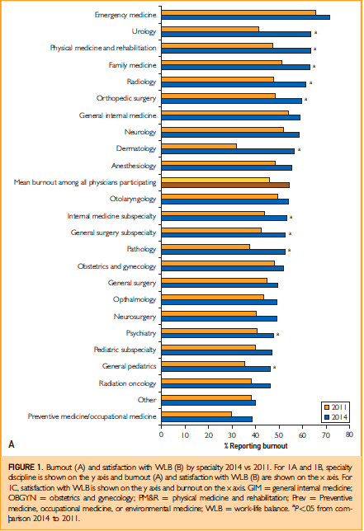
BURNOUT BY SPECIALTY 2011- 2014
Shanafelt et al. Mayo Clin Proc.90(12):1600-1613 Dec 2015

Slide 12
Physician Well-Being Index (Dyrbye 2013,2014)
7-item online instrument
evaluating multiple dimensions of distress,
strong validity and national benchmarks,
large sample of medical students, residents and practicing physicians
Physicians DO NOT reliably self-assess their own distress
Feedback from self–reported responses can prompt intention to respond to distress

Slide 13
Burnout – What does it look like?
“ Progressive loss of idealism, energy, and purpose experienced by people
in the helping professions as a result of the conditions of their work”
Compassion
Empathy
Motivation
Engagement
Accomplishment
Well Being
Compassion Fatigue
Exhaustion
Depersonalization
Disengagement
Poor Performance
Burnout
> 50%
Students
Residents
Nurses
Clinicians
Researchers
(Tait 2015) (Kearney 2009)
Notes:
Up to 60% of practicing physicians,and residents report symptoms of burnout and Nearly half of 3rd year medical students report burnout. associated with Reviewed in Krasner 2009
decreased empathy, poorer quality of care, patient dissatisfaction, increased medical errors, lawsuits, stress-related health problems,
marital and family discord, substance use, automobile accidents
Compassion: Feelings of caring for someone who is suffering and the motivation to relieve that suffering.
Compassion fatigue: State of tension and pre-occupation with the individual or cumulative trauma of one’s clients
Burnout: Form of mental distress manifested in normal individuals often recognizable in negative attitudes and sub-standard work performance
Can move from compassion, empathy and well-being into compassion fatigue, and then progress to burnout
Compassion fatigue:
- Hyper-arousal
- Avoidance of stressful situations
- Re-experiencing difficult events through persistent or intrusive thoughts or even dreams
Burnout:
- Emotional exhaustion
- Depersonalization
- Low personal accomplishment
*** reversible condition ***
No studies specifically address what it takes to sustain compassion.

Slide 14
BURNOUT Screening:
Maslach 22 item Burnout Inventory Survey
Emotional Exhaustion
Depersonalization
Personal Accomplishment ( protective)
“Do you feel burned out from your work?”
Maslach 1999
Notes:
Screening: 22 item survey Maslach Burnout Inventory or “Do you feel burned out from your work?
Strategies for personal self-care include prioritizing close relationships such as those with family;⁴⁵ maintaining a healthy lifestyle by ensuring adequate sleep, regular exercise, and time for vacations;⁴⁶ fostering recreational activities and hobbies;⁴⁷ practicing mindfulness and meditation;⁴⁸ and pursuing spiritual development.⁴⁹ A widely available instrument called the Wellness Wheel refers to 6 types of wellness – physical, intellectual, emotional, spiritual, social and occupational – and allows individuals to reflect on current life balance and self-care.⁵⁰ Individuals using such a tool can improve job satisfaction and overall well-being, reducing the likelihood of stress and burnout.
Full time had high emotional exhaustion and part time had moderate emotional exhaustion
63% experiencing high emotional exhaustion
38% experiencing moderate depersonalization
63% experiencing high personal accomplishment (protective)
N= 8 (80% response rate)

Slide 15
IMPACT OF BURNOUT
Individual: job dissatisfaction, anxiety, sleep disturbance, MSK pain , memory impairment, unprofessional behavior, depression and suicide
Organization: performance, absenteeism, presenteeism, turnover, increased costs ($1.6M -3.4B)
Society: (case of health professionals) suboptimal care, medical error, dissatisfaction, distrust, poor outcomes
PUBLIC HEALTH CRISIS
Sandra Sanchez-Reilly 2013, Dewa 2014, Shanafelt 2010, 2016, Ratanawongsa 2008, Forbes 2016, CEO’s ROI Health Affairs
Notes:
Effects personal and prefessional life
Extensive research has shown high rates of burnout among physicians,nurses, residents and medical students including those who work in academic health centers.
Oncol Nurs Forum. 2013 Jul;40(4):E303-11. doi: 10.1188/13.ONF.E303-E311. A comparison of burnout among oncology nurses working in adult and pediatric inpatient and outpatient settings.
Peterson et al. Journal of Advanced Nursing Volume 62, Issue 1, pages 84–95, April 2008
BURNOUT AND RESILIENCE AT 2 ends of the SPECTRUM Burnout – at least they stay warm
What is the potential risk to Leaders of change if focused only on external care needs?
Definied as :
Screening: 22 item survey Maslach Burnout Inventory or “Do you feel burned out from your work?
Strategies for personal self-care include prioritizing close relationships such as those with family;⁴⁵ maintaining a healthy lifestyle by ensuring adequate sleep, regular exercise, and time for vacations;⁴⁶ fostering recreational activities and hobbies;⁴⁷ practicing mindfulness and meditation;⁴⁸ and pursuing spiritual development.⁴⁹ A widely available instrument called the Wellness Wheel refers to 6 types of wellness – physical, intellectual, emotional, spiritual, social and occupational – and allows individuals to reflect on current life balance and self-care.⁵⁰ Individuals using such a tool can improve job satisfaction and overall well-being, reducing the likelihood of stress and burnout.

Slide 16
WHY?
WHY?
WHY?
WHY?
WHY?
Notes:
5 WHY ROOT CAUSE Analysis
Sorry if I have more questions than answers .I will review the data behind these and then look at possible causes
Root cause analysis
HOW CAN WE CHANGE this ? First we must understand it
What strategies are accessible to individuals, including those responsible for the health for others and those who lead systems and society?

Slide 17
What Factors Threaten Wellness ? (Individual)
Cultural Beliefs
Thoughts
Behaviors
LACK OF
WELLNESS
Physical
Emotional
Intellectual
Spiritual
Environmental
Social
Financial
Personality
Knowledge
Emotions
Notes:
WHY? WHY? WHY? WHY? WHY? (Root Cause Analysis) a tool in the Science of Improvement
Exercise break into 16 students groups of 2-3 and address one each then move clockwise o address others
(Fishbone TOOL must be done with a TEAM OF people to see all the lens,, everyone sees a piece of the elephant
Getting to root cause by asking WHY WHY WHY?
Next step is to look at process flow
ROOT Cause effect tool
amenable to change) not genes, DOH
Cause effect diagram to understand factors, we use the Improvement model everyday and can apply it here also
Physical hand washing, hygiene, nutrition, eat sleep and exercise

Slide 18
What Factors Threaten Wellness? (System)
People
Programs
Processes
LACK OF WELLNESS
Physical
Emotional
Intellectual
Spiritual
Environmental
Social
Financial
Environment
Policies
Methods
Notes:
Cause effect diagram to understand factors, we use the Improvement model everyday and can apply it here also

Slide 19
From Triple to QUADRUPLE AIM:
Better Care
Better Health
Lower Costs
Cura Te Ipsum- “heal thyself”
Proverb from Luke 4:23
From Triple to Quadruple Aim: Care of the Patient Requires Care of the Provider
Thomas Bodenheimer, MD1⇑ and Christine Sinsky, MD2,3
Ann Fam Med November/December 2014 vol. 12 no. 6 573-576
Notes:
medice, cura te ipsum (“physician, heal thyself”)
Proverb from Luke 4:23
Better care of Providers and Teams
MANY SYSTEM BASED SOLUTIONS exists, but this workshop is going to focus on individual level Strategies based on the charge from BODENHEIMER which ,seems so obvious to us in the filed of providing health
The industry can't achieve the Triple Aim's core ideals--providing better care, improving population health
and lowering costs--without first improving the work life of healthcare providers, write study authors
Thomas Bodenheimer, M.D., and Christine Sinsky, M.D.
The Triple Aim—enhancing patient experience, improving population health, and reducing costs—is widely accepted as a compass to optimize health system performance. Yet physicians and other members of the health care workforce report widespread burnout and dissatisfaction. Burnout is associated with lower patient satisfaction, reduced health outcomes, and it may increase costs. Burnout thus imperils the Triple Aim. This article recommends that the Triple Aim be expanded to a Quadruple Aim, adding the goal of improving the work life of health care providers, including clinicians and staff.

Slide 20
REFLECTION: What STRATEGIES do You/Others use to Sustain Wellness ?
?
?
Health & Wellness
?
Notes:
medice, cura te ipsum (“physician, heal thyself”)
Proverb from Luke 4:23
CHANGE HC LEADERS TO LEADERS
30 min What is the elephant in the room flip chart exercise ….
What are the greatest challenges you face?
What are the contributing factors and why are they there?
Lack of vision, hope DIsengagement
What STRATEGIES do effective Academic Scientists use to address Burnout and its Contributing Factors ?
TO take challenges and turn them into opportunites?

Slide 21
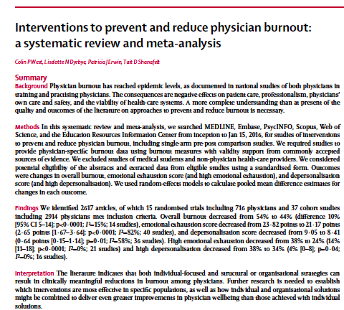
LANCET 2016
Individual & Organizational Strategies
Notes:
SPEAK from article
Reflective writing-https://reflectivemeded.org/
Lancet article on interventions systematic review Collin West 2016

Slide 22
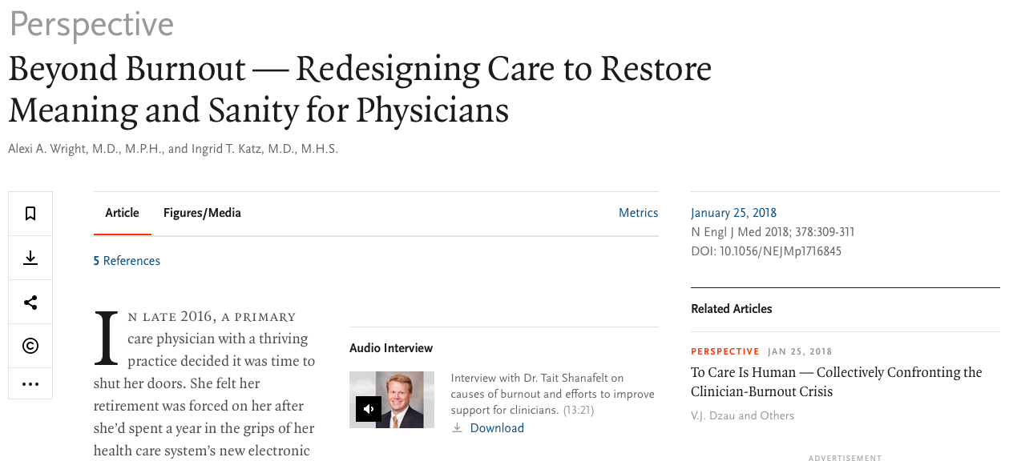
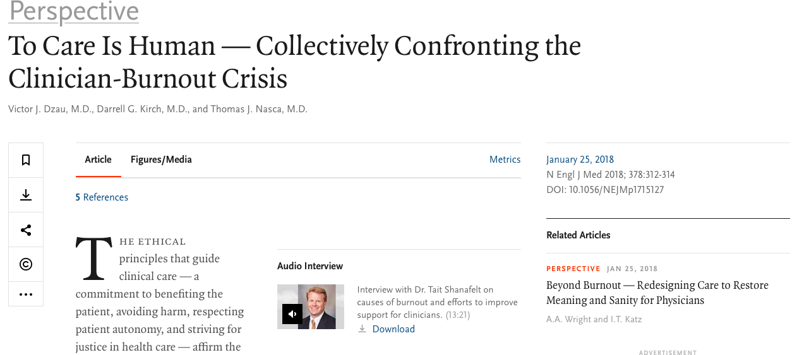
January 25, 2018

Slide 23
A Doctor's Dozen:
12 Strategies for Personal Health and a Culture of Wellness
For Health Professionals – and Everyone Else!
Catherine Florio Pipas, MD, MPH
Notes:
OUR VISION is to create a community of HEALTHY LEADERS who are prepared to LEAD in HEALTH and create a culture of positive change
The American College of Physician Executives highlights a strong correlation between physician personal leadership and top-performing health systems. .
We DEFINE LEADERS NOT as those with TITLES< BUT as those effective in articulating a shared vision, inspiring collaborative partners, transforming challenges into opportunities and delivering meaningful and measurable outcomes,
Residency Directors in a TUCK needs assessment , want residents with leadership experience and
Students when clear that this is not about getting a title , want leadership skills that make them more effective physicians
We are all part of that vision that includes the health of each and every one of us and our commitments must be the developments of each and every one of us as an individual and to each of us as leaders.
We must go beyond educational disciplines to determine the competencies needed to overcome these 3 challenges
Solutions from Medical Education and Beyond: Educators are looking beyond the traditional models of medical education to business, psychology, sociology, and other disciplines for innovative solutions to these individual, team and systems challenges. Supporting personal and professional development through formal curriculum with guided self -assessment, self -reflection, self -discovery and self -monitoring can increase motivation, performance, satisfaction, personal effectiveness and improvement. (Benbassat and Baumal 2005) . The presence of learning communities and supportive mentors that foster team-based learning can enhance communication, strengthen relationships, and increase trust, performance and outcomes. (Sambunjak, Straus et al. 2010). Investment in quality improvement and systems thinking education can demonstrate significant improvements in efficiency, quality and cost containment; these concepts have begun to move into undergraduate and graduate medical education.

Slide 24
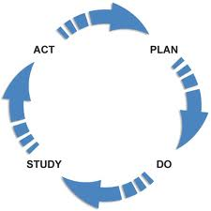
Improvement Framework for Personal and Systems Wellness
Continuous
Improvement
Notes:
“The whole idea of leadership is that you continuously improve yourself first” Simon Cooper, President, Ritz Carlton, The NEW GOLD STANDARDThe model for improvement serves as a framework from which health care leaders can apply strategies to lead systems change and to promote personal health and wellness.
Based on a CQ Improvement Strategies and can Prevention & Treat Burnout:
Self Awareness > Self Care> Self Improvement > Resilience
Demonstrate:
Awareness thru observation, mindfulness and self assessment;
Authenticity by aligning vision with health choices, and
Action by constructing a personal health improvement plan(PHIP)(Class 6)
Nothing I permananent Life is always changing Leading personal change is a perquisite for leading system change
Leadership requires facing and overcoming complex challenges and changes , and doing so continuously is a continuous improvement process. To be WELL , the leader themselves must also change as we are part of nature and never stay the same.
Like other continuous improvement processes , self improvement parallels the change process and begins with an assessment, it requires one to identify areas for improvement , prioritize and align improvements within a broad mission , construct an actionable plan , invest time and resources to implement and study the outcome and ultimately to achieve success. Success in this case being defined as an improved state of being.
Model based on The three steps for leading self change include:
Self Awareness, which is knowing thyself, a first step of understanding oneself, owns strengths, and ones areas for improvement , analogous to needs assessment
Authenticity which is being true to thyself a step that is analogous to writing ones own mission and values statement. This step sets the stage for optimally aligning ones personal choices to ones commitments .
Action , which is a commitment to improving thyself. This step drives change and outcomes thru constructing a concrete plan which when implemented creates change..
The process of personal improvement thus begins with self awareness and ends with self improvement . This process is analogous to a PDSA cycle, where one assesses a challenge, in this case it is personal, in order to make a plan and carry it out to create a change.

Slide 25
Evidence-based Improvement Process
Identify Gap or Challenge
Rapid PDSA
Measurable Performance
Improvement
Generalizable Scientific evidence
+
Particular
Context
Strategy
Global AIM
SMART GOAL
Process Analysis
Measurement
Intervention
Monitor / Revise
Health and Wellness
Literature
Guidelines
Best Practice
“YOU”
Personal STORY
Self assessment
“SWOT”
Culture
Environment
Batalden & Davidoff, BMJ Q&S, 2007
Notes:
Lots of models,
PDSA= IHI,. LEAN, cut waste, SIX SIGMA, decrease redundancy/ defects from manufacturing world, hybrids of these
Knowledge system 1: Traditional scientific evidence
Knowledge system 2: knowledge of the particular
Knowledge system 3: Measurement knowledge. Creating measures we haven’t had before. Looking at balanced measures over time. Interpreting measures over time.
Knowledge system 4: Connecting and planning knowledge. Knowing what types of models of linkage will work best under the circumstances.
Knowledge system 5: Executing change. What goes into successful execution. How top organizational leadership views execution of change in such a way that it happens, that stays and that it spreads as appropriate.
Taken as a whole, executing improvement into systems requires the combination of knowledge about the evidence with knowledge about the context and culture of care. Each one of these is insufficient on its own to lead to improved outcomes for patients.

Slide 26
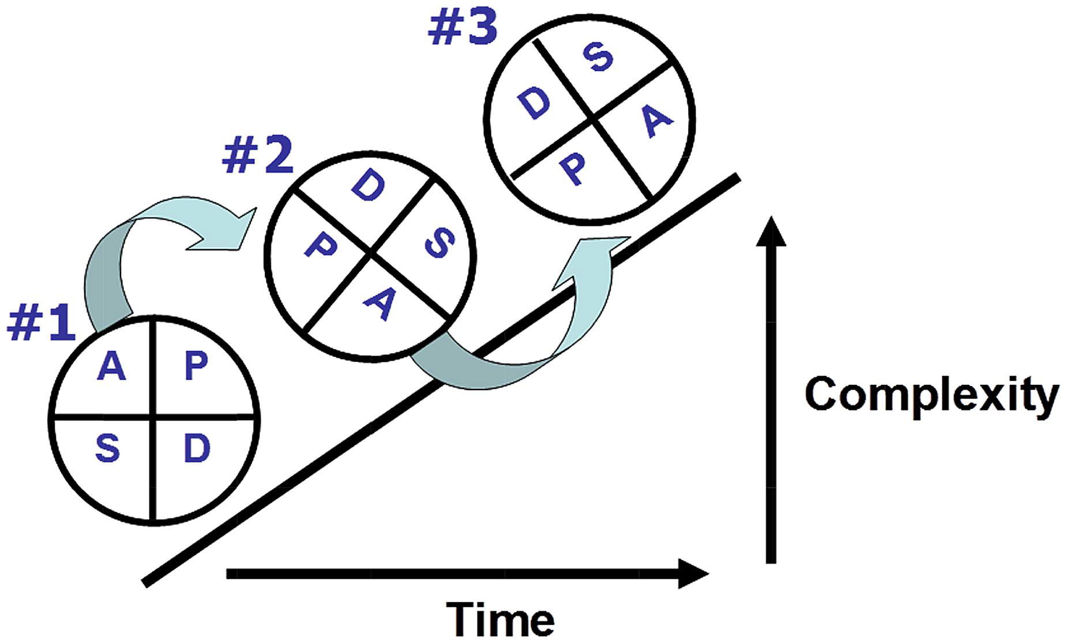
THEORETIC IMPROVEMENT MODEL
Ogrinc G, et al. BMJ Qual Saf 2013;0:1–3. doi:10.1136/bmjqs-2013-002703
Notes:
The first step in the science of improvement is awareness
Ogrinc G, et al. BMJ Qual Saf 2013;0:1–3. doi:10.1136/bmjqs-2013-002703
BMJ Qual Saf published online December 23, 2013
Greg Ogrinc and Kaveh G Shojania
Building knowledge, asking questions

Slide 27
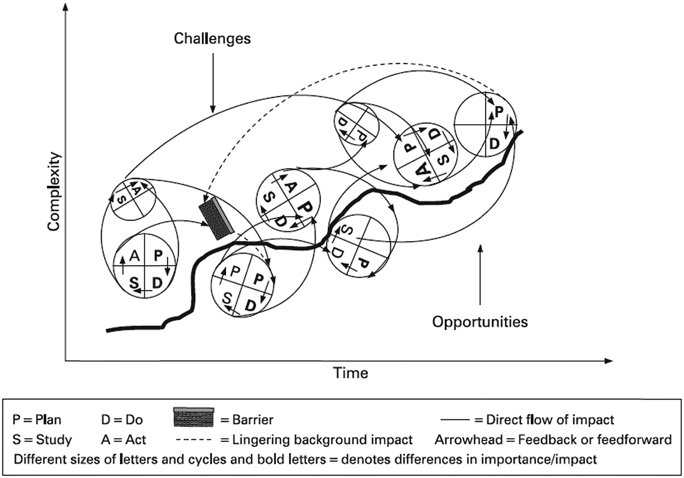
ACTUAL IMPROVEMENT MODEL
Ogrinc G, et al. BMJ Qual Saf 2013
Notes:
Ogrinc G, et al. BMJ Qual Saf 2013;0:1–3. doi:10.1136/bmjqs-2013-002703
BMJ Qual Saf published online December 23, 2013
Greg Ogrinc and Kaveh G Shojania
Building knowledge, asking questions

Slide 28
Select Strategies for Achieving Health & Wellness
Self Awareness “Know yourself “
Mindfulness
Self Assessment
Self Care “Be authentic to yourself”
3. Personal Mission & Vision
4. Personal Resilience
Self Improvement “Improve yourself”
5. SMART GOALS
6. Personal Health Improvement Tool (PHIT)
Notes:
“The whole idea of leadership is that you continuously improve yourself first” Simon Cooper, President, Ritz Carlton, The NEW GOLD STANDARD
Based on a CQ Improvement Strategies and can Prevention & Treat Burnout:
Self Awareness > Self Care> Self Improvement > Resilience
Demonstrate:
Awareness thru observation, mindfulness and self assessment;
Authenticity by aligning vision with health choices, and
Action by constructing a personal health improvement plan(PHIP)(Class 6)
Nothing I permananent Life is always changing Leading personal change is a perquisite for leading system change
Leadership requires facing and overcoming complex challenges and changes , and doing so continuously is a continuous improvement process. To be WELL , the leader themselves must also change as we are part of nature and never stay the same.
Like other continuous improvement processes , self improvement parallels the change process and begins with an assessment, it requires one to identify areas for improvement , prioritize and align improvements within a broad mission , construct an actionable plan , invest time and resources to implement and study the outcome and ultimately to achieve success. Success in this case being defined as an improved state of being.
Model based on The three steps for leading self change include:
Self Awareness, which is knowing thyself, a first step of understanding oneself, owns strengths, and ones areas for improvement , analogous to needs assessment
Authenticity which is being true to thyself a step that is analogous to writing ones own mission and values statement. This step sets the stage for optimally aligning ones personal choices to ones commitments .
Action , which is a commitment to improving thyself. This step drives change and outcomes thru constructing a concrete plan which when implemented creates change..
The process of personal improvement thus begins with self awareness and ends with self improvement . This process is analogous to a PDSA cycle, where one assesses a challenge, in this case it is personal, in order to make a plan and carry it out to create a change.

Slide 29
The RAISIN EXERCISE (Chocolate) “Everything has its beauty but not everyone sees it”. Confucius
Based on Kabat-Zinn. From Segal, Z. V., Williams, J. M. G., & Teasdale, J. D.
(2002). Mindfulness-Based Cognitive Therapy for Depression. NY: Guilford.
Notes:
HOW many of you have ever done mindfulness training? I will give you a brief TASTE . Literally
like wine tasting, savor the flavor, in a dark room, First thing I ‘ve tasted all month “ Resident AAMC/ NE FMEC 2013
Transcript: The Raisin Exercise
I’m going to go around the class and give you each a few objects. (raisin or m&m) Now what I would
like you to do is focus on one of the objects and just imagine that you have never seen
anything like it before. Imagine you have just dropped in from Mars this moment and
you have never seen anything like it before in your life.
Note. There is at least a 10-second pause between phrases, and the instructions are
delivered in a matter-of-fact way, at a slow but deliberate pace, asking the class to do
the following:
Taking one of these objects and holding it in the palm of your hand, or between your
finger and thumb. (Pause)
Paying attention to seeing it. (Pause)
Looking at it carefully, as if you had never seen such a thing before. (Pause)
Turning it over between your fingers, (Pause)
Exploring its texture between your fingers. (Pause)
Examining the highlights where the light shines … the darker hollows and folds.
(Pause)
Letting your eyes explore every part of it, as if you had never seen such a thing
before. (Pause)
And if, while you are doing this any thoughts come to mind about “what a strange
thing we are doing” or “what is the point of this” or “I don’t like these,” then just
noting them as thoughts and bringing your awareness back to the object. (Pause)
And now smelling the object, taking it and holding it beneath your nose, and with
each inbreath, carefully noticing the smell of it. (Pause)
And now taking another look at it (Pause)
And now slowly taking the object to your mouth, maybe noticing how your hand and
arm know exactly where to put it, perhaps noticing your mouth watering as it comes
up. (Pause)
And then gently placing the object in the mouth, noticing how it is “received” without
biting it, just exploring the sensations of having it in your mouth. (Pause)
And when you are ready, very consciously taking a bite into it and noticing the tastes
that it releases. (Pause)
Slowly chewing it … noticing the saliva in the mouth, … the change in consistency of
the object. (Pause)
Then, when you feel ready to swallow, seeing if you can first detect the intention to
swallow as it comes up, so that even this is experienced consciously before you
actually swallow it. (Pause)
Finally, seeing if you can follow the sensations of swallowing it, sensing it moving
down to your stomach, and also realizing that your body is now exactly one raisin
heavier.
Based on Kabat-Zinn. From Segal, Z. V., Williams, J. M. G., & Teasdale, J. D.
(2002). Mindfulness-Based Cognitive Therapy for Depression. NY: Guilford.
What was your experieince? A Resident shared this was the 1st thing she tasted in a month.. IF a raisin can be so powererful , imagine the power from that amount of attention to a friend, ourselves, appreciate the wonder that we are.

Slide 30
SELF SWOT
MY Strengths | MY Weaknesses
MY Opportunities | MY Threats
Adapted from SWOT analysis template – a free resource from www.businessballs.com. Template © Alan Chapman 2005.
Notes:
INCLUDE ASSESSMENT OF BURNOUT
How many of u have done a SWOT? Exec from HK, Tuck alumni 6/14 amazed the effectiveness of doing to self in my session
Consider a recent leadership challenge
A Self SWOT is about understanding your strengths, your weaknesses, your opportunities and the threats that exists for you in a given leadership situation. The goal is to determine how you can be more effective as a leader of change.
A SWOT analysis can be done looking at yourself globally or in a focused professional manner looking within the context of a particular leadership challenge.
Complete a SWOT on Yourself by Identifying Your :
Strengths: What knowledge, skills ,styles, attitudes, capabilities, USP's (unique selling points), values or philosophy do you hold around this situation?
Weaknesses- identify any gaps in knowledge, skills, capabilities, reputation, biases, vulnerabilities? Reliability ? Accountability, Morale, or in your performance or commitment.
Opportunities – identify any new niches, trends, partnerships, collaborative projects, initiatives or skills that enhance your strenghts > weaknesses
Threats, What potentially limits your effectiveness? And emphasizes your weaknesses over strenghts? Ex. If tired? For the purpose of the SELF SWOT think of intrinsic limits rather than extrinsic threats that may be political, policy, environmental, or organizational . Intrinsic threats /limitations may be , part of your belief system, biases, prejudices, recurrent thoughts or actions that based on past experiences limit your ways of effectively interacting and performing. What internal Obstacles do you face? Try not to focus on excuses or blame.
Consider validating your self SWOT by asking a trusted colleague(S), friend(s) or family member (S) to also complete a SWOT of you.

Slide 31
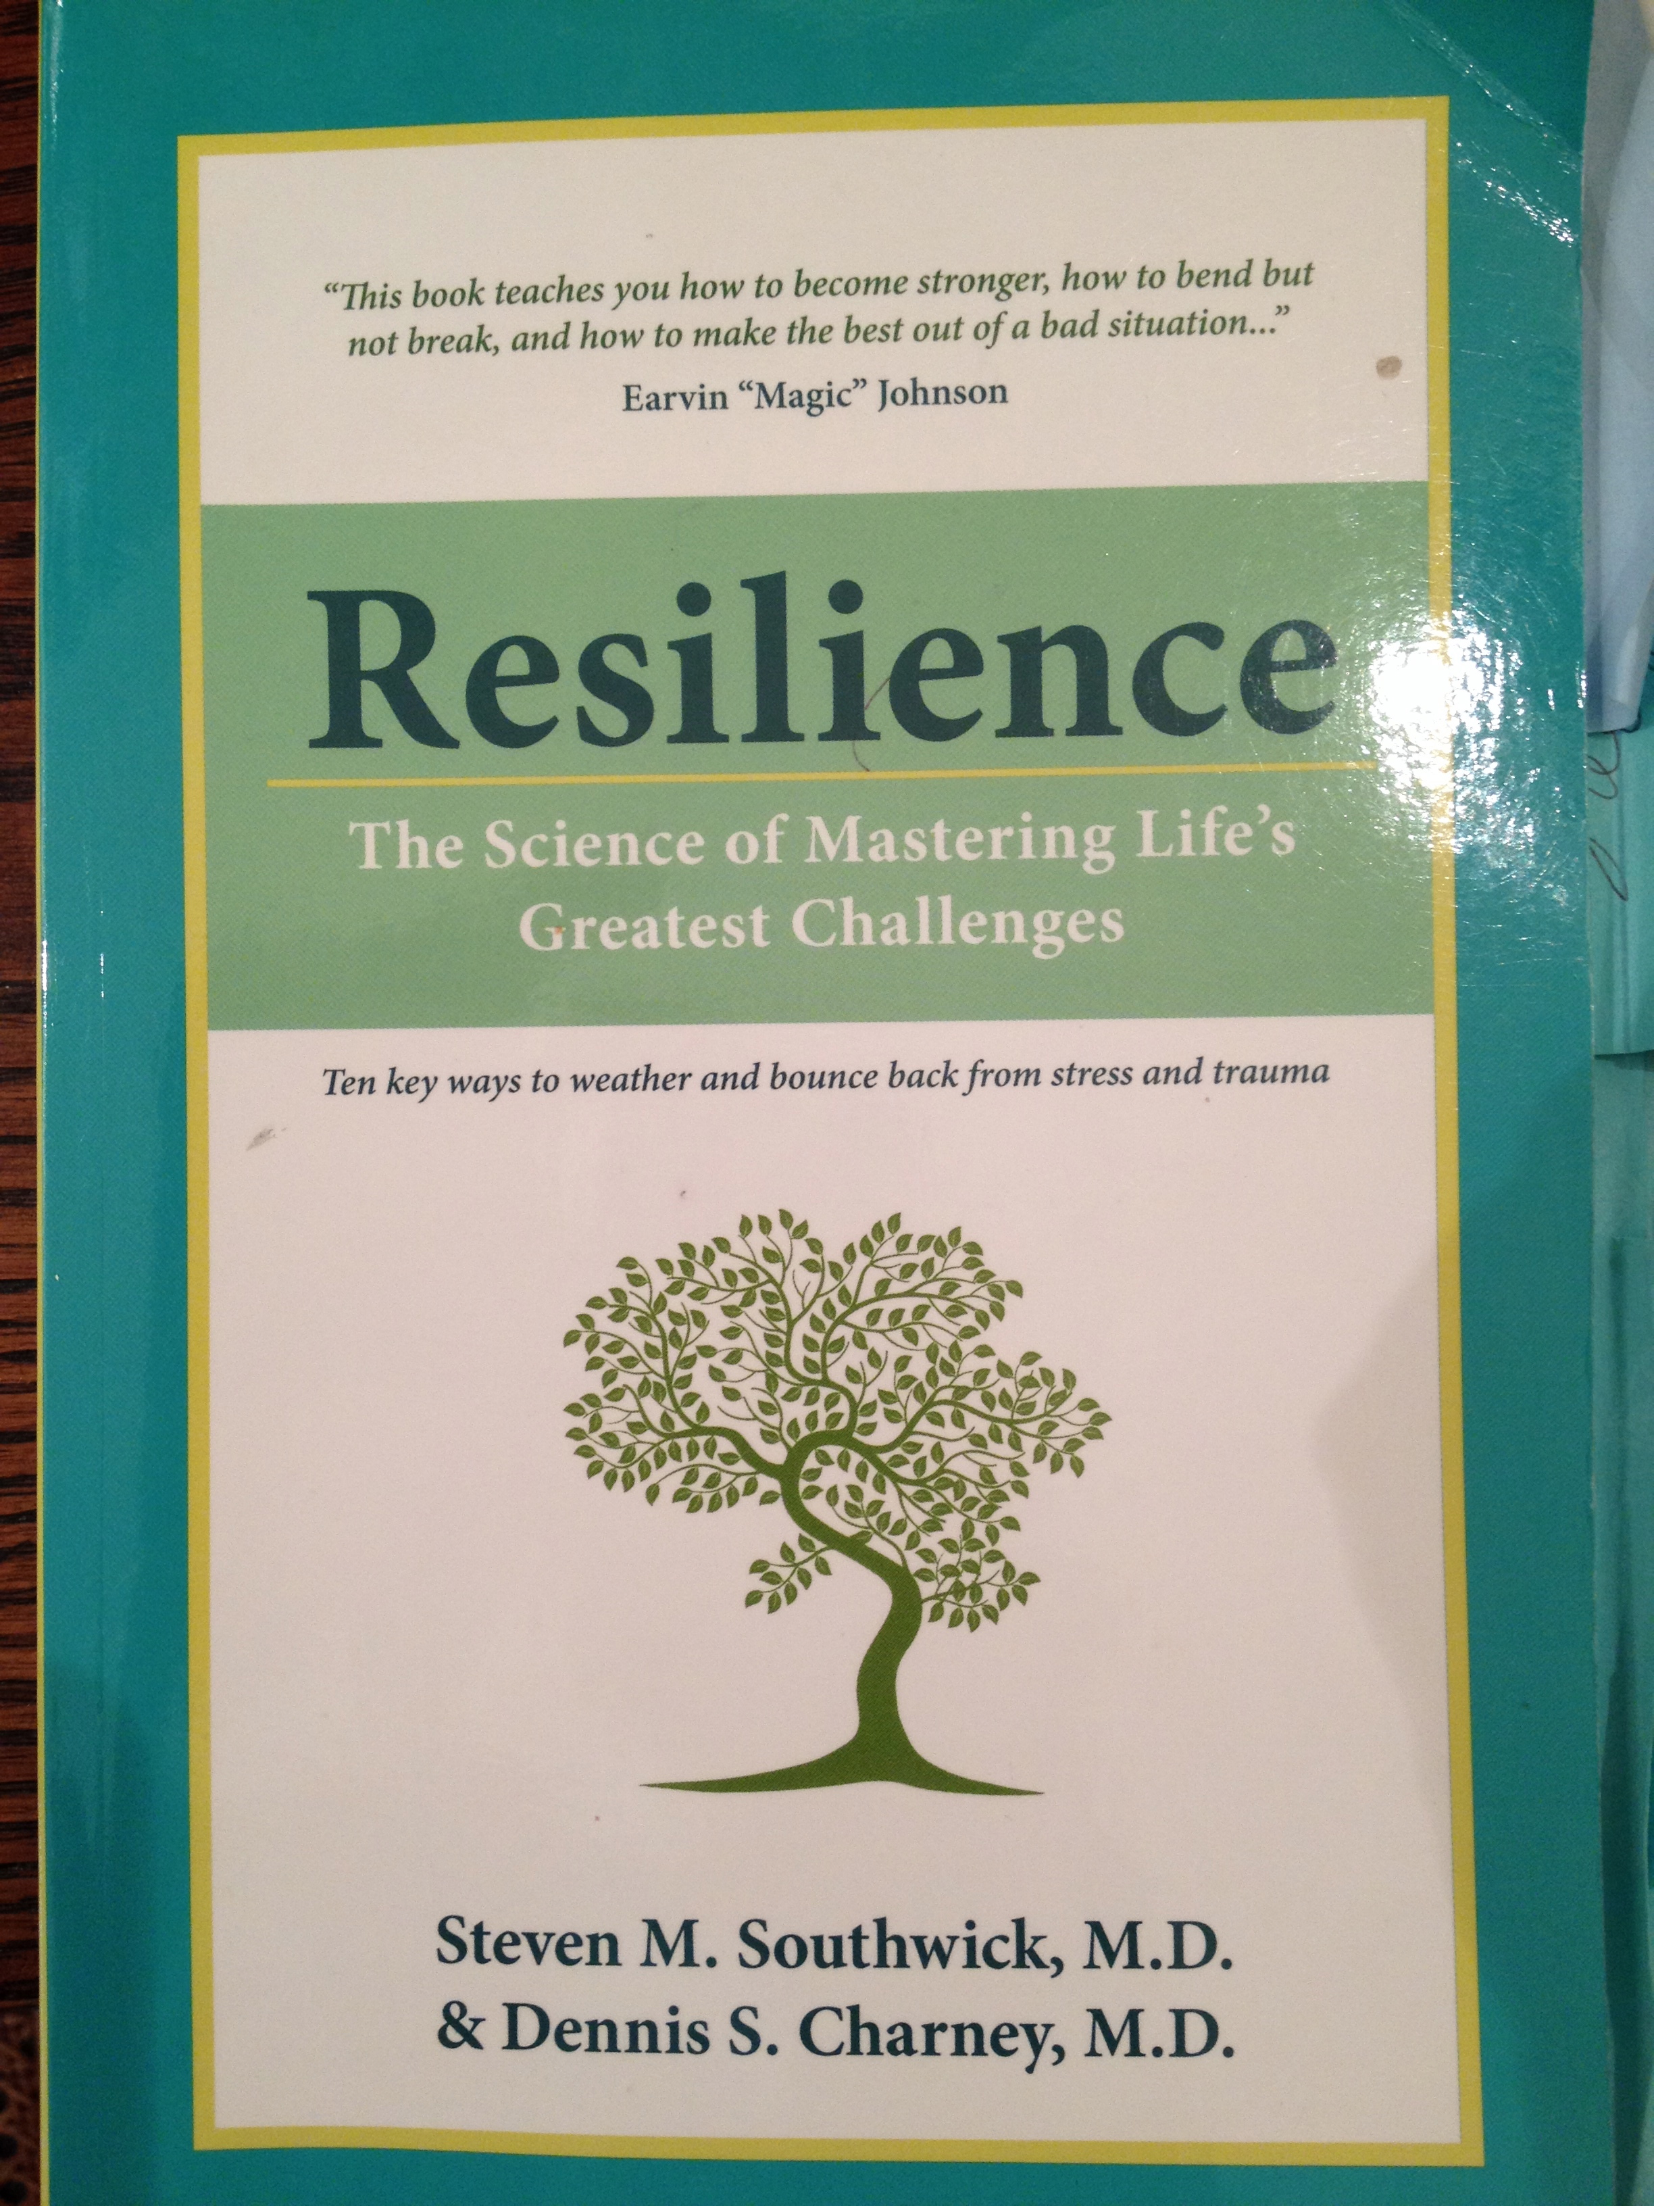
Resilience “the ability to bend but not break, to bounce back and sometimes even to grow when faced with adversity. Coutu, D. L.
Optimism
Facing Fear
Moral Compass
Religion /
Spirituality
5. Social Support
6. Role Models
7. Physical exercise
8. Mental exercise
Flexibility
& Acceptance
Meaning
& Purpose
Notes:
Nietsche – those that have a why , can handle almost any how
RAND studies may be 10-13 factors?, Resilience (can be GROWN)
One of the most thorough research summaries on Resilience is the 2012 book “Resilience” by Dr.s Steven Southwick and Dennis Charney . They interviewed POW’s , Special Forces Instructors and numerous civilians from multiple walks of life with a broad range of stresses . They integrated psychological and neuroscience literature and identified the following 10 factors which were possessed and practiced by those who succeeded despite significant stresses and against odds.
Resilience Exercise
Add these 10 to the appropriate boxes in your Self SOWT is it a S_W_O_T?for example if you are negative thinking , that may be a threat to your success, an opportunity may be appreciate inquiry
Rank your confidence from 1-5 in possessing , demonstrating or accessing these strategic factors that enhance resilience.
1. not at all, 2, somewhat, 3 moderately 4= very 5= extremely .
NO particular order
The first is an ability to see the positive in a situation, (Recall “LOT” is a test that has been used to assess optimism, respondents rate statements on a 5 point likert scale to assess their own capacity to seeing the positive side of a challenge.)
Second is a commitment to understanding, addressing and even benefitting from fear,
Third is the ability to display self discipline and a commitment to moral responsibility and to doing what is right under any circumstances
Fourth is a belief in a higher spiritual power and a reliance on prayer, meditation and mindfulness to overcome what may seem overwhelming
Fifth is the ability to capitalize on a network of family and friends for support
Sixth is possession of at least one continuous mentor from whom you gain personal strength, guidance and insight
Seventh is a regular habit of exercise and a belief that staying fit improves physical and mental well being and self esteem
Eighth is practice of activating cognitive function by problem solving, and commitment to life long learning to stimulate the mind
Ninth is accessing a milieu of different styles and strategies appropriate to a challenge and a willingness to learn from mistakes and accept what is not perfect
Tenth is the commitment to a mission that is greater than yourself and willingness to defend and not compromise on that which you stand for.
Keep notes of your rankings as this will be valuable in identifying areas for improvement later in your PIP.

Slide 32
ACTION: Analyze SWOT and CHOOSE
SMART Objective:
Specific –Actionable
Measurable – Process/Outcome Achievable – Confidence 1-10
Relevant – Importance 1-10 Timely – Set dates
MY Strengths | MY Weaknesses
MY Opportunities | MY Threats
Adapted from SWOT analysis template – a free resource from www.businessballs.com. Template © Alan Chapman 2005.
Notes:
Identify an area for improvement
A Self SWOT is about understanding your strengths, your weaknesses, your opportunities and the threats that exists for you in a given leadership situation. The goal is to determine how you can be more effective as a leader of change.
A SWOT analysis can be done looking at yourself globally or in a focused professional manner looking within the context of a particular leadership challenge.
Complete a SWOT on Yourself by Identifying Your :
Strengths: What knowledge, skills ,styles, attitudes, capabilities, USP's (unique selling points), values or philosophy do you hold around this situation?
Weaknesses- identify any gaps in knowledge, skills, capabilities, reputation, biases, vulnerabilities? Reliability ? Accountability, Morale, or in your performance or commitment.
Opportunities – identify any new niches, trends, partnerships, collaborative projects, initiatives or skills that you might take advantage of to be more effective I
Threats, What potentially limits your effectiveness? For the purpose of the SELF SWOT think of intrinsic limits rather than extrinsic threats that may be political, policy, environmental, or organizational . Intrinsic threats /limitations may be , part of your belief system, biases, prejudices, recurrent thoughts or actions that based on past experiences limit your ways of effectively interacting and performing. What internal Obstacles do you face? Try not to focus on excuses or blame.
Consider validating your self SWOT by asking a trusted colleague(S), friend(s) or family member (S) to also complete a SWOT of you.

Slide 33
Traditional view of Choice Adapted from D. Sull, C. Spinosa, Promised-based Management, HBR2007
High
Level of Importance
Important
Non-Urgent
Important
Urgent
Unimportant
Non-Urgent
Unimportant
Urgent
Low
Low
Level of Urgency
High
Notes:
“The primary determinant of successful execution is the promises each of us makes to ourselves and to each other…” D. Sull, C. Spinosa, Promised-based Management, HBR2007.COVEY QUADRANTS
ADD ITEM OF CHOICE TO YOUR SWOT- opportunities/threats –RISKS BENEFITS
Reflect on a leadership challenge or choice you currently face or have have faced. Think of an example when you were offered to take on an additional role or task? Consider the following: Cost/ Benefit
Important/ non urgent = long term relationships?
Urgent?
Costs and benefits?
Honorable?
Consider what choices you have ? Are you the only or the best person to do this job? Can you nominate another colleague?
Is/ was the opportunity important to achieving your priorities? That means is it in alignment with your authentic values and is it in the top 5 list? It may be important , but not to your current priority, therefore it is best to be done by someone else or at another time. But not now by you!
Is it urgent?
What are/ were the costs and benefits of your choice to you and to others? What must you or others give up to benefit from this decision.
Can you Honor your Word if you commit to this request?
Consider a time where you accepted an opportunity, that was not in alignment with your priorities?
Did you give your word without considering your priorities?
Did you give your word without considering the costs and benefits to you and to others?
Did you keep your word? Did you honor your word ?
Describe your feelings, thoughts and correlating actions and effectiveness when you were “in” versus “out” of integrity.
How did it feel to have the choice not to do something?
How did others respond to your declining an offer in order to fully devote yourself to your current responsibilities?

Slide 34
Wellness View of Choice Adapted from D. Sull, C. Spinosa, Promised-based Management, HBR2007
High
Level of Wellness
Wellness
Not Authentically Aligned
Wellness
Authentically Aligned
Not Well
Not Authentically Aligned
Not well
Authentically Aligned
Low
Low
Degree of Authentic Alignment to Values, Vision and Mission
High
Notes:
“The primary determinant of successful execution is the promises each of us makes to ourselves and to each other…” Adapted from D. Sull, C. Spinosa, Promised-based Management, HBR2007. ADD ITEM OF CHOICE TO YOUR SWOT- opportunities/threats –RISKS BENEFITS
Reflect on a leadership challenge or choice you currently face or have have faced. Think of an example when you were offered to take on an additional role or task? Consider the following: Cost/ Benefit
Important/ Aligned?
Urgent?
Costs and benefits?
Honorable?
Consider what choices you have ? Are you the only or the best person to do this job? Can you nominate another colleague?
Is/ was the opportunity important to achieving your priorities? That means is it in alignment with your authentic values and is it in the top 5 list? It may be important , but not to your current priority, therefore it is best to be done by someone else or at another time. But not now by you!
Is it urgent?
What are/ were the costs and benefits of your choice to you and to others? What must you or others give up to benefit from this decision.
Can you Honor your Word if you commit to this request?
Consider a time where you accepted an opportunity, that was not in alignment with your priorities?
Did you give your word without considering your priorities?
Did you give your word without considering the costs and benefits to you and to others?
Did you keep your word? Did you honor your word ?
Describe your feelings, thoughts and correlating actions and effectiveness when you were “in” versus “out” of integrity.
How did it feel to have the choice not to do something?
How did others respond to your declining an offer in order to fully devote yourself to your current responsibilities?

Slide 35
Personal Health Improvement Tool
GOAL: Increase Energy through Physical Exercise
SMART OBJECTIVE:
Specific – Run 5 times/week for 25 minutes
Measurable – Process: completed(yes/ no) , Outcome: personal rating of energy (1 to 5 scale)
Achievable – confident 9/10
Relevant – important 10/10 to my goal
Timely – beginning today and 5x/w for 1 month
Notes:
You will work on this more at the end of todays session
Pull out your PLP and review SMART objectives

Slide 36
GOAL: Reduce stress through
mindful meditation at lunch
SMART OBJECTIVE:
Specific – 10 min meditation QAM
Measurable – Process complete,
personal rating of stress (on 1 to 5 scale)
Achievable – confident 8/10
Relevant – important 10/10 to goal
Timely – begin today for 21 days
Notes:
You will work on this more at the end of todays session
Pull out your PLP and review SMART objectives
Let me introduce my Ladership Wellness journal, for AI
Leadership comes in many forms, but many we do not appreciate, become aware of or reflect upon , all of which can change our way of viewing , thinking , acting and thus feeling in the world.
Physical, emotional ,mental
by asking and emphasizing to ourselves what we or our teams and organization did well, we focus on the positives in our lives and we allow the positive to flourish and expand
Consider the coices that I am being asked to make – are they aligned with my priorities and vision

Slide 37
GOAL: Improve Resilience through Social Connections
SMART OBJECTIVE:
Specific –Contact 1 family/team member daily
Measurable – Process complete, self assess
“connectedness” 1-10 daily
Achievable – confident 9/10
Relevant – important 9/10 to my goal
Timely – begin today & daily for 60 days
Notes:
You will work on this more at the end of todays session
Pull out your PLP and review SMART objectives
Let me introduce my Ladership Wellness journal, for AI
Leadership comes in many forms, but many we do not appreciate, become aware of or reflect upon , all of which can change our way of viewing , thinking , acting and thus feeling in the world.
Physical, emotional ,mental
by asking and emphasizing to ourselves what we or our teams and organization did well, we focus on the positives in our lives and we allow the positive to flourish and expand
Consider the coices that I am being asked to make – are they aligned with my priorities and vision

Slide 38
GOAL: Enhance Positivity with Appreciative Inquiry (AI)
SMART OBJECTIVE:
Specific – Daily AI journal, list one item I did well, or identify the good that can came from an adverse experience
Measurable – Process completed, Outcome
personal rating of positivity (1 to 5 scale)
Achievable – confident 9/10
Relevant – important 10/10 to my goal
Timely – begin today & daily for 21 days
Notes:
http://well.blogs.nytimes.com/2015/01/19/writing-your-way-to-happiness/?_r=0
You will work on this more at the end of todays session
Pull out your PLP and review SMART objectives
Let me introduce my Ladership Wellness journal, for AI
Leadership comes in many forms, but many we do not appreciate, become aware of or reflect upon , all of which can change our way of viewing , thinking , acting and thus feeling in the world.
Physical, emotional ,mental
by asking and emphasizing to ourselves what we or our teams and organization did well, we focus on the positives in our lives and we allow the positive to flourish and expand
Consider the coices that I am being asked to make – are they aligned with my priorities and vision

Slide 39
Personal Health Improvement Tool (PHIT)
www.myphit.org (mobile responsive)
Plan your PHIT (Theme, SMART goal & Metrics)
Create a TEAM (CoW18, SPW17, CMEI, STFM, UK)
Track your PHIT (30 days +)
Receive encouragement (daily reminders )
View PHIT progress ( Your and Team results)
Provide Feedback (CHAT)
Notes:
Welcome to www.myphit.org
Kathryn Patton, 2016, Krisin Kuntzen, Jason Beaton 2017
the website/mobile responsive
Register – per todays workshop ( email /username)
PLAN your PHIP ( Theme/ SMART)
IMPLEMENT and TRACK PHIP Results (21+ days) can fill in anytime, best to do daily
Receive Email Reminders and Comparison Results
FEEEDBACK to us

Slide 40
Top 10 PHIT THEMES
Begin Meditation/Mindfulness
Enhance Physical Exercise
Advance Healthy Eating
Improve Sleep Hygiene
Foster Reflection/ Journaling
Un Plug from Technology
Improve Time Mgmt.
Increase Social Supports
Promote Positivity/Appreciative Inquiry
Pursue a passion- new/old hobby (read, write, sing)
Notes:
Johny Carson TOP 10 strategies for promoting personal wellness and minimizing Burnout in PHIP
What is the SMART Objective or general theme of your Personal Health Improvement Plans?

Slide 41
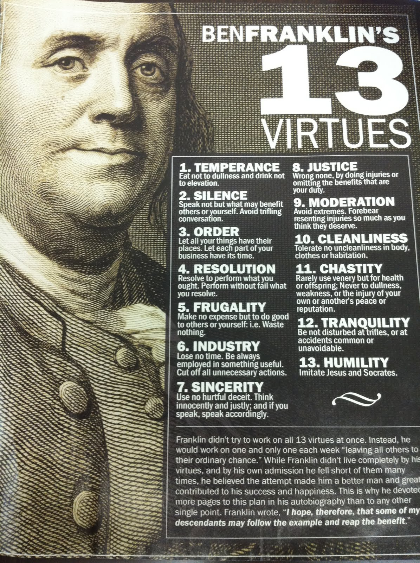
Notes:
Let me leave you with a PHIT by a gentleman we all know and love who died at the ripe age of 84 in 1790 , when the ave life expectancy for white males at that time was 30-40
Ben franklin equated virtues with happiness , and the quest to be the best person he could be.
He identified 13 virtues and strived to achieve those
He attached SMART BEHAVIORUS to each of the virtues , so that they may be measured and then he monitored them daily one at a time for a week, giving himself black marks when he failed to achieve the virtue in that days time.
Heaimed for a clean slate and found , after many repeats of these week after week, he proclaimed himself much more HAPPY , but never perfect!

Slide 42
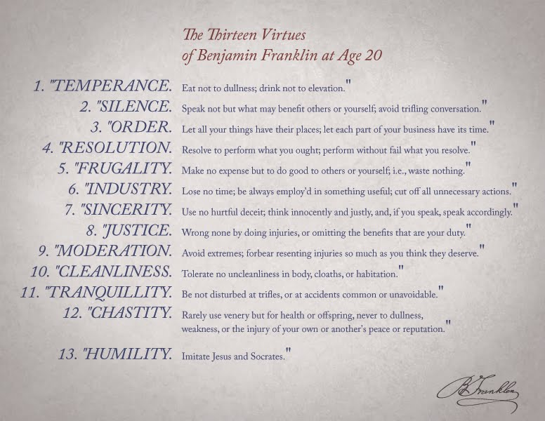

Slide 43
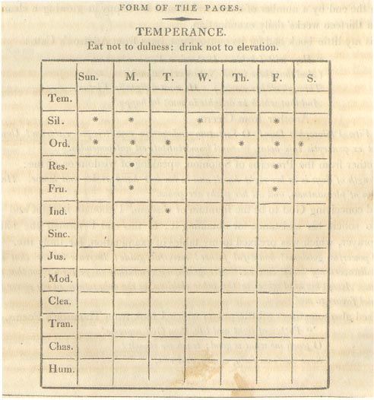

Slide 44
Self
Awareness
Self
Care
Personal
& Team
Wellness
Self Improvement
“Healthy Communities
begin with Healthy Individuals”
Self Awareness- Self Care- Self Improvement
Notes:
“Those who have must give” Eleanor Roosevelt
Leaders who are balanced, well and whole , those who have Integrity embraces challenges as opportunities and effectively lead change in themselves and others.
They do this thru awareness, authenticity and action.
Self Awareness, is a first step in understanding one’s leadership capabilities. As a leader it is our responsibility to assess ourselves and our surroundings, that is to know our strengths, weaknesses, opportunities and potential threats or areas for improvement. This includes observing one’s own stress levels and early identification of signs and symptoms that may indicate stress. A leader is Resilient and can access multiple factors to embraces and adapt in the face of complex challenges.
Authenticity allows a leader alignment of commitments and choices with their mission and thus optimizes one’s likelihood to keep their word and establish trust.
Action that is built upon AWARENESS AND AUTHENTICITY provides a leader a genuine plan upon which to perform, change and deliver outcomes and continuously improve, in a fashion that leaves them WHOLE and in integrity.

Slide 45
Faculty Development Delivered: Customized Faculty Development at Your Institution/Program
Please contact Ray Rosetta rrosetta@stfm.org at the STFM office for more details and to schedule your tailored workshop!

Slide 46
THANK YOU
Please evaluate this presentation using the conference mobile app! Simply click on the "clipboard" icon on the presentation page.

Slide 47
Shanafelt TD, Hasan O, Dyrbye LN, et al. Changes in Burnout and Satisfaction With Work-Life Balance in Physicians and the General US Working Population Between 2011 and 2014. Mayo Clinic proceedings. 2015;90(12):1600-1613.
Dewa CS, Loong D, Bonato S, Thanh NX, Jacobs P. How does burnout affect physician productivity? A systematic literature review. BMC Health Serv Res. 2014;14:325.
Shanafelt TD, Dyrbye LN, West CP, Sinsky CA. Potential Impact of Burnout on the US Physician Workforce. Mayo Clinic proceedings. 2016;91(11):1667-1668.
Ratanawongsa N, Roter D, Beach MC, et al. Physician burnout and patient-physician communication during primary care encounters. Journal of general internal medicine. 2008;23(10):1581-1588.
Shanafelt TD, Balch CM, Bechamps G, et al. Burnout and medical errors among American surgeons. Ann Surg. 2010;251(6):995-1000.
Holleman WL, Cofta-Woerpel LM, Gritz ER. Stress and morale of academic biomedical scientists. Academic medicine : journal of the Association of American Medical Colleges. 2015;90(5):562-564.
Brazeau CM, Shanafelt T, Durning SJ, et al. Distress among matriculating medical students relative to the general population. Academic medicine : journal of the Association of American Medical Colleges. 2014;89(11):1520-1525.
Dyrbye LN, West CP, Satele D, et al. Burnout among U.S. medical students, residents, and early career physicians relative to the general U.S. population. Academic medicine : journal of the Association of American Medical Colleges. 2014;89(3):443-451.
Leiter MP, Maslach C. Six areas of worklife: a model of the organizational context of burnout. Journal of health and human services administration. 1999;21(4):472-489.
Shanafelt TD, Noseworthy JH. Executive Leadership and Physician Well-being: Nine Organizational Strategies to Promote Engagement and Reduce Burnout. Mayo Clinic proceedings. 2017;92(1):129-146.
Panagioti M, Panagopoulou E, Bower P, et al. Controlled Interventions to Reduce Burnout in Physicians: A Systematic Review and Meta-analysis. JAMA internal medicine. 2017;177(2):195-205.
Bodenheimer T, Sinsky C. From triple to quadruple aim: care of the patient requires care of the provider. Annals of family medicine. 2014;12(6):573-576.
Sanchez-Reilly S, Morrison LJ, Carey E, et al. Caring for oneself to care for others: physicians and their self-care. The journal of supportive oncology. 2013;11(2):75-81.
Notes:
Gabbard JAMA

Slide 48
Kearney MK, Self-care of physicians caring for patients at the end of life: “Being connected … a key to my survival” JAMA. 2009;301(11):1155–1164. E1
Maslach, C., Leiter, M P. Six Areas of Worklife: A Model of the Organizational context of Burnout, Journal of Health and Human Services Administration, Vol. 21, No. 4 (SPRING, 1999),pp. 472-489
Jager AJ¹Association Between Physician Burnout and Identification With Medicine as a Calling., Mayo Clin Proc. 2017 (16)30770-4.,
Colin P West, Liselotte N Dyrbye, Patricia J Erwin, Tait D Shanafelt Interventions to prevent and reduce physician burnout: a systematic review and meta-analysis 2016 The Lancet
Panagioti, M., et al. (2017). "Controlled Interventions to Reduce Burnout in Physicians: A Systematic Review and Meta-analysis." JAMA Intern Med 177(2): 195-205
McEwen, B. S. (2007). "Physiology and neurobiology of stress and adaptation: central role of the brain." Physiol Rev 87(3): 873-904.
Matthieu Ricard, Mind of the Meditator, Scientific American (November 2014), 311, 38-45
Beach, MD, MPH , A Multicenter Study of Physician Mindfulness and Health Care Quality, Ann Fam Med 2013;421-428.
Fortney, MD, Abbreviated Mindfulness Intervention for Job Satisfaction, Quality of Life, and Compassion in Primary Care Clinicians: A Pilot Study, Ann Fam Med 2013;412-420. doi:10.1370/afm.1511
McEwen, B. S. OBSERVE FOR HALLMARKS OF STRESS. (2007). "Physiology and neurobiology of stress and adaptation: central role of the brain.” Physiol Rev 87(3): 873-904
Coutu, D. L. (2002). "How resilience works." Harv Bus Rev 80(5): 46-50, 52, 55 passim. http://www.ncbi.nlm.nih.gov/pubmed/12024758
Southwick, S. M. and Charney, D.S. (2012). “Resilience, The Science of Mastering Life’s Greatest Challenge Cambridge University Press 2012
Souba, W. W. (2001). "Leadership and strategic alignment--getting people on board and engaged." J Surg Res 96(2): 144-151.
SWOT analysis template free resource www.businessballs.com.Template © Alan Chapman 2005.
Krasner, Epstein, JAMA 302:1284-1293, 2009,
Dobkin 2013,
Notes:
http://greatergood.berkeley.edu/news_events/event/the_science_of_burnout_what_is_it_why_it_happens_and_how_to_avoid_it#.WKMhgBTCfj4
(Note there's a live webcast option) per Mary
Doctors on Life Support, Time Mag Sept 2015 http://time.com/4012840/doctors-on-life-support/
Compilation of articles on leadership. The first article in the collection is Kotter’s What Leaders Really Do. https://www.regonline.com/custImages/250000/250761/5%20Articles%20and%20YB%20Profile%20for%20Reading-SLDP.pdf
Ten Percent Happier by Dan Harris
http://www.medscape.com/features/slideshow/lifestyle/2016/public/overview?src=ban_dne_1601_mscpmrk_lifestylereport2016&uac=234711MX&ImpID=977475

Slide 49
QI RESOURCES
AAMC Educating for Quality https://www.aamc.org/initiatives/cei/educatingforquality/
Institute for Healthcare Improvement (IHI) Open School includes essential training and tools in an online, educational community to help you and your team deliver excellent, safe care. (Register as an academician to avoid costs)http://www.ihi.org/education/IHIOpenSchool/Pages/default.aspx
HRSA Quality Improvement Toolkit https://www.hrsa.gov/quality/toolsresources.html
Mayo Clinic Quality Academy http://qiresources.mayo.edu/

