Slide 1
STFM Faculty for Tomorrow Resident as Educators Curriculum: Social and Emotional Learning (SEL)
Sonya Shipley, MD
Meaghan Ruddy, MA, PhD

Slide 2
Learning Objectives
Describe the 5 domains of SEL
Apply these domains to the everyday work of being a resident-teacher
Assess the value of integrating SEL into teaching in residency

Slide 3
Part 1: What is SEL and why should I care?
Social
and
Emotional
Learning
Term around since 1994
Social and emotional knowledge, skills, attitudes and behaviors (KSAB)s CAN. BE. TAUGHT.
Changes the hidden curriculum
(Weissberg et al, 2015)
Notes:
The term social and emotional learning was coined in 1994 by a group child advocates, educators, and researchers brought together to explore the social determinants of learning. The Collaborative for Academic, Social, and Emotional Learning (CASEL) was born from this meeting at the Fetzer Institute, the brainchild of what is now known as the Fetzer Group.
The driving concept of SEL is that social and emotional knowledge, skills, attitudes and behaviors (KSABs) can be taught/ learned via explicit instruction. Engagement in SEL creates nurturing learning environments, altering the implicit curriculum toward positive social and emotional program climates and learning conditions.
Weissberg R. P., Durlak J. A., Domitrovich C E., Gullotta T. P. Social and emotional learning: Past, present, and future. Handbook of Social and Emotional Learning: Research and Practice, 2015

Slide 4
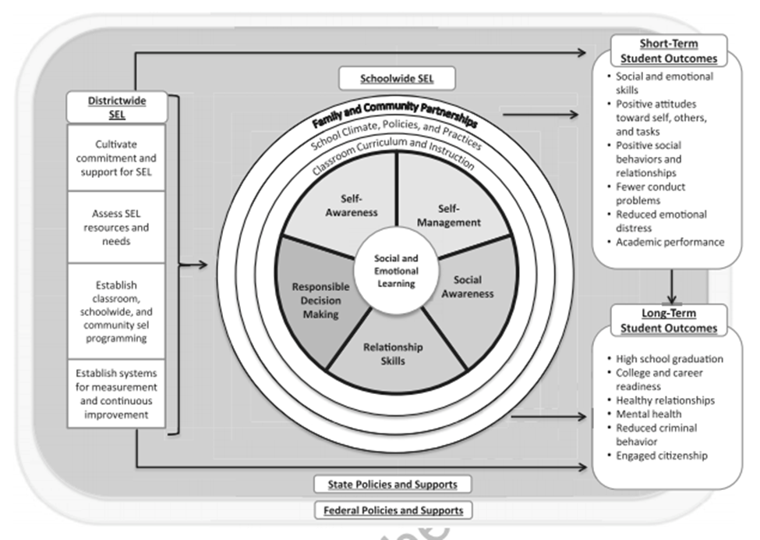
5 Competencies of SEL
Notes:
The Five Competencies of SEL are pictured here contextualized within the educational system. While the work of CASEL focused on K-12 education, the depiction may well be of medical education.
The 5 Domains:
Self-Awareness. Accurately assessing one’s feelings, interests, values, and strengths; maintaining a well-grounded sense of self-confidence.
Self-Management. Regulating one’s emotions to handle stress, controlling impulses, and persevering in addressing challenges; expressing emotions appropriately; and setting and monitoring progress toward personal and academic goals.
Social Awareness. Being able to take the perspective of and empathize with others; recognizing and appreciating individual and group similarities and differences; and recognizing and making the best use of family, school, and community resources. Relationship Skills. Establishing and maintaining healthy and rewarding relationships based on cooperation; resisting inappropriate social pressure; preventing, managing, and resolving interpersonal conflict, and seeking help when needed.
Responsible Decision Making. Making decisions based on consideration of ethical standards, safety concerns, appropriate social norms, respect for others, and likely consequences of various actions; applying decision-making skills to academic and social situations; and contributing to the well-being of one’s school and community.
What would we change on here to make it explicitly relevant to med ed?

Slide 5
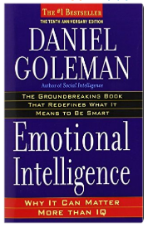
Emotional Intelligence (EI)
Basis for SEL
Daniel Goleman
Recognizing, understanding and using emotions
Began in 1930 with exploration into social intelligence
Made popular in 1995 with Goleman’s book
(Weissberg et al, 2015)
Notes:
SEL is related but not entirely the same as emotional intelligence (EI). EI is an understanding of how emotions function in ourselves and in others, and how to regulate emotions in order to enhance living. Work on emotional intelligence began in the 1930s with an exploration into the ability of people to know how to best navigate within groups. The term itself was coined in 1990 by psychologists Salovey and Mayer. Daniel Goleman’s book of that name brought the concept into prominence and though not everyone agrees with his conception, there is ample evidence that EI exists in some form, those who have it excel, and those who don’t have it can be taught how to get it.
Weissberg R. P., Durlak J. A., Domitrovich C E., Gullotta T. P. Social and emotional learning: Past, present, and future. Handbook of Social and Emotional Learning: Research and Practice, 2015

Slide 6
EI Domains
Self-awareness
Social awareness
Self-management
Relationship management
(Goleman, 1994)
Notes:
Goleman’s version of EI, the one most widely used and accepted, consist of four domains and 19 competencies. It is strikingly similar to the domains of SEL with SEL including a 5th area in responsible decision-making.
Self-awareness requires that we know our own emotions. When we’re feeling something can we accurately acknowledge what is going on. What are some identifiers of anger vs frustration?
Self-management is the ability to manage our emotions and motive ourselves to engage more effectively. If I have identified that I am angry, how do I manage that in the moment and then afterward in a way that does not result in repression AND how do I motivate myself to do better?
Social awareness refers to being able to recognize the emotional state of others in our social engagements. It is the social cognate of self-awareness such that those questions asked of the self are now asked of our awareness of others. How is a patient, a colleague, a direct report, a friend feeling and how would we know?
Goleman takes this social awareness one step further and, as with self-management, asks us to consider how we can use our increasingly accurate awareness of the emotional states of others to better and more effectively engage with others. This is skillful means, knowing your audience, paying attention to the other in the environment AND acting on that awareness.
SEL is contextualized for education and therefore includes the social component of acting, decision-making and it’s impacts. We would need program evaluation to assess SEL en toto but we can get to the concept by focusing for the moment on the EI of everyone in the room.
Goleman, D. (1994) Emotional Intelligence. Bantam: New York, NY

Slide 7
Emotional Intelligence (EI)
How much do you know about your emotions and how they interact with those of others in your environment?
Time to test it out!
EI Self-Assessment
Notes:
Emotional Intelligence (EI) self-assessment online app https://s3.amazonaws.com/eiassets/ei_responsive.htm

Slide 8
Let’s Discuss
Personal Level
We don’t have to share our EI scores, but generally how does your EI impact your experiences as a resident?
What are some of the most important and/ or challenging tasks you face as a resident? How might SEL be helpful?
How might a focus on SEL change your residency experience?
Systems Level
How would teaching with SEL change the experiences of the learner and the teacher?
How would SEL in residency impact the culture of the clinical learning environments in your program?
What changes could be made today to meaningfully integrate SEL into your program?

Slide 9
Discuss It!
Pair up and provide examples of challenging or rewarding teaching and learning experiences
For each example, address how each of the SEL competencies was or was not present.
If a competency is identified as not being present, discuss how the presence of that competency would have altered the experience.
SEL Competencies
Self-awareness
Self-management
Social Awareness
Relationship Skills
Responsible decision-making

Slide 10
Critical Assessment
Seeming like a good idea is not equivalent to a workable solution.
Critical assessment evaluates the whole, the good-the bad-the ugly-the neutral, to come to a decision about the value of the thing being assessed.
Address the potential benefits and barriers to integrating SEL into your own teaching and learning as well as into our program as a whole.
Use SMART or CLEAR goal setting
(Economy, 2015)
Notes:
Economy P. Forget SMART goals - try CLEAR goals instead. http://www.inc.com/peter-economy/forget-smart-goals-try-clear-goals-instead.html

Slide 11
SMART and CLEAR
Specific (Goals must be clear and unambiguous)
Measurable (Results must be able to be measured in some way, for example, the number of products sold each week, or the percent completion)
Attainable (Goals must be realistic and attainable by the average employee)
Relevant (Goals must relate to your organization's vision and mission)
Time-bound (Goals must have definite starting and ending points, and a fixed duration)
Collaborative (Goals should encourage employees to work together collaboratively and in teams)
Limited (Goals should be limited in both scope and duration)
Emotional (Goals should make an emotional connection to employees, tapping into their energy and passion)
Appreciable (Large goals should be broken down into smaller goals so they can be accomplished more quickly and easily for long-term gain)
Refinable (Set goals with a headstrong and steadfast objective, but as new situations or information arise, give yourself permission to refine and modify your goals)
(Economy, 2015)
Notes:
Economy P. Forget SMART goals - try CLEAR goals instead. http://www.inc.com/peter-economy/forget-smart-goals-try-clear-goals-instead.html

Slide 12
Summary
Social and emotional learning, or SEL, asserts that skills in emotional recognition and management referent to self and others can be taught and learned.
SEL Competencies
Self-awareness
Self-management
Social Awareness
Relationship Skills
Responsible decision-making

Slide 13
References
Weissberg R. P., Durlak J. A., Domitrovich C E., Gullotta T. P. Social and emotional learning: Past, present, and future. Handbook of Social and Emotional Learning: Research and Practice, 2015.
Webb A R, Young R A, Baumer J G. Emotional intelligence and the ACGME competencies. JGME 2010 doi: 10.4300/JGME-D-10-00080.1
ACGME CLER Guidelines
Reflections The SoL Journal Vol 14 (1)
Belfield et al. The economic value of social and emotional learning. 2015
Social-Emotional Learning Assessment Measures for Middle School Youth http://www.search-institute.org/sites/default/files/a/DAP-Raikes-Foundation-Review.pdf
Goleman D. How to be emotionally intelligent. The New York Times, April 7, 2015. http://www.nytimes.com/2015/04/12/education/edlife/how-to-be-emotionally-intelligent.html?action=click&pgtype=Homepage&region=CColumn&module=MostEmailed&version=Full&src=me&WT.nav=MostEmailed&_r=1
Economy P. Forget SMART goals - try CLEAR goals instead. http://www.inc.com/peter-economy/forget-smart-goals-try-clear-goals-instead.html

