Slide 1
Professional Development Workshop: Applying the Race and Culture Guide to Reduce Bias in Medical Teaching Cases
Workshop Presenters:
Original Workshop Authors:
Ryan Vagedes, DO
Sharon Casapulla, EdD, MPH
Berkeley Franz, PhD
Katy Kropf, DO
Anna Kerr, PhD
Frances Wymbs, PhD
Alicia Rodgers, DO, MS
Sami Nandyal, DO
Chynna Smith, DO
David Strawhun, DO, MEd

Slide 2
Workshop Outline
Goal: Apply the Race and Culture Guide to teaching cases
Introduction & Background
Defining Key Terms
Student Perspectives
Race & Culture Guide
Small Group Break Out Session
Practice with sample cases
Edit real teaching cases
Large Group Discussion
Notes:
In this workshop, we will walk-through the The Race and Culture Guide (Krishnan et. al, 2019) published in Academic Medicine in 2019 and also cover some other topics that will help prepare to editing teaching cases. First, we will cover some background information that led up to why this workshop is needed. We will take some time to develop a common language by defining some key terms. Additionally, we will invite student perspectives to help contextualize why this is so important. Next, we will break into small groups to work through cases and applying the Race and Culture Guide. Each small group was encouraged to bring an existing case to work on during the breakout sessions. There are also sample cases we have constructed to help work through the guide. Facilitators will be available to answer questions in the breakout sessions, but we are all learning alongside you! Finally, we will reconvene for a large group discussion to wrap up the workshop.

Slide 3
Background
Teaching cases are critical to learning throughout medical training
Cases prime students to pay attention to certain factors
Essentialism - connecting clinical presentations to patient demographics
Teaching cases may unintentionally:
Introduce/Reinforce implicit biases
Perpetuate health inequities
Need for structural competency in creating all teaching cases
Create space to work through cases building upon shared meaning
Notes:
In general, we know that teaching cases are critical to learning throughout all stages of medical training and can be especially formative early on in training (i.e., medical school). Because of the breadth and depth of medicine, throughout training there is an unfortunate necessity to focus on the “most important” topics which can often lead to material being condensed.
One of the most common instructional strategies in medical and other allied health professions education is case-based learning where students are taught through clinical cases. The use of clinical cases in medical education is ubiquitous and offers the ability for learners to synthesize and integrate basic and clinical sciences. Clinical cases also offer the opportunity to discuss social and structural determinants of health but can inadvertently reinforce essentialist ideas. By presenting clinical presentations without providing space to discuss nuances of social determinants of health, students can potentially remember shortcuts—connecting pathologies with patient demographics. While unintentional, these shortcuts can introduce or even reinforce existing implicit biases and could potentially work to perpetuate health inequities.
The work from Krishnan et al. was published in 2019 in Academic Medicine. Based on this foundation research showing how bias unintentionally makes its way into teaching cases, students, faculty, and administrators at Ohio University Heritage College of Osteopathic Medicine looked inward and created a space to learn and discuss these powerful factors that influence student learning, and more importantly, created an action-focused workshop for students, faculty, and staff to edit real teaching cases in the curriculum.

Slide 4
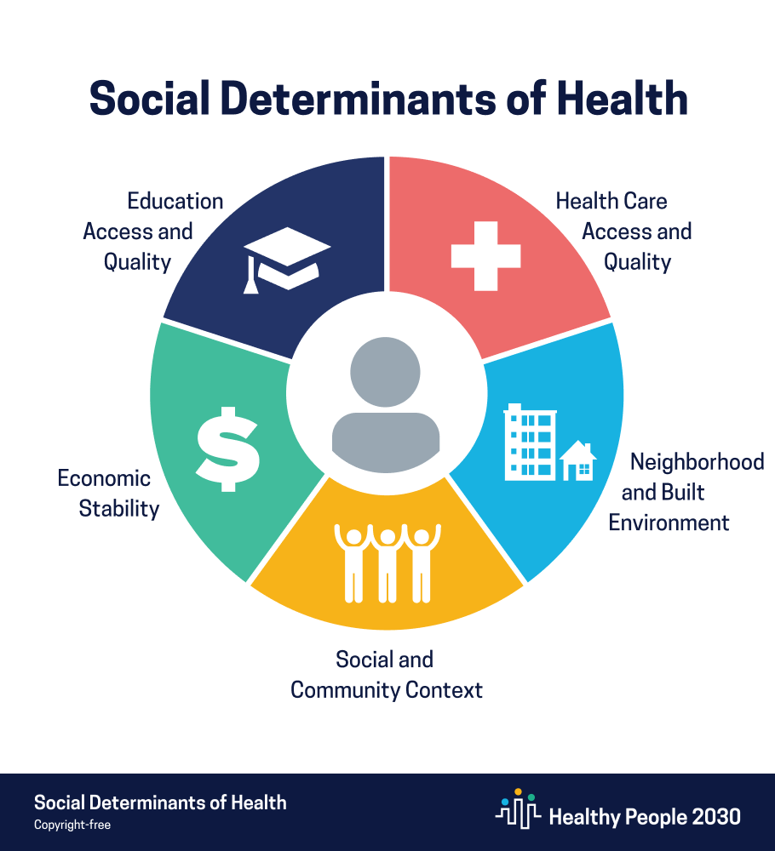
Defining Key Terms
Social and Structural Determinants of Health (SSDOH)
Race
Ethnicity
Culture
Essentialism
Implicit bias
Notes:
Image Source: Image by Healthy People 2030, U.S. Department of Health and Human Services, Office of Disease Prevention and Health Promotion. Retrieved 12/23/2021, from https://health.gov/healthypeople/objectives-and-data/social-determinants-health.
Before going much further, it is important to develop a common shared language. This slide contains key terms that are used in the workshop.
Social and Structural Determinants of Health (SSDOH): institutions, systems, policies, and other factors that directly and/or indirectly affect the health of groups and individuals. These factors often create and perpetuate a social hierarchy.
Structural example: institutional racism influenced housing policies (e.g., redlining) which has disproportionately affected minority communities (e.g., living closer to sites of pollution increasing exposure to hazardous chemicals).
Social example: Trans individuals are more likely to experience discrimination and violence based on gender identity which results in less access and use of primary care services.
Race: social construct of grouping individuals based on perceived physical differences that has been used to justify discrimination. Race is not based on any real biological differences—i.e., racial groups are not discernible based on genetic information (there is more genetic variability within racial group than between racial groups).
Ethnicity: social construct of grouping individuals based on common ancestry/geographic origins
Culture: shared values, beliefs, customs, and other patterns of human behavior and connection associated with a group or community
Essentialism: the idea that different racial, ethnic, religious, or cultural groups are monolithic and/or can be defined solely on certain characteristics
Implicit Bias: stereotypes that individuals hold about certain groups or communities that are often not explicit, or in conscious awareness

Slide 5
Tenets of Structural Competency
Recognize structures that shape clinical interactions
Develop extra-clinical language of structure
Rearticulate “cultural” formulations in structural terms
Observe and imagine structural interventions
Developing structural humility
“The trained ability to discern how a host of issues defined clinically as symptoms, attitudes, or diseases… represent the downstream implications of a number of upstream decisions about such matters as health care and food delivery systems…or even about the very definitions of illness and health.”
Metzl JM & Hansen H (2014)
Notes:
These tenets of structural competency encourage a framework of understanding health and illness, including patients' symptoms, beliefs, and behaviors as being shaped by the surrounding social and structural context. For example, this could include contextualizing a patient's hypertension as reflecting limited access to healthy foods, limited exposure to health education, or heightened exposure to chronic stress from racism. Instead of focusing on individual patient attributes such as their demographics or culture, this could include acknowledging how structures limit economic, social, and physical well-being for certain groups of people in the United States. Following this shift, interventions too should focus less on individual patient behavior and addressing the structures that promote inequality and health disparities. Finally, structural humility refers to adopting an openness to learning about how structures shape health and asking patients for more context about their health experiences rather than relying on cultural stereotypes.

Slide 6
Student Perspectives
Notes:
Invite any students present to share perspectives on the importance of this topic.
For example:
Clerkship directors play integral role in formative learning for clinical students and can serve as role models for clinical reasoning
Connection to question banks/board questions and critical thinking – which can reenforce stereotypes
Presenting cases teaches students how to present a case (i.e., what to include)
Connection to clinical practice and evidence-based medicine – guidelines, clinical decision-making tools

Slide 7
Race & Culture Guide (Krishnan et al., 2019)
List of items for the case reviewer
Designed to stimulate case reflection on subconscious messaging
Examples of problematic language
Specific recommendations provided
Rationale and evidence for revisions
Highlights 6 mistakes common in teaching cases
Notes:
Reference to full article: Krishnan A, Rabinowitz M, Ziminsky A, Scott SM, Chretien KC. Addressing race, culture, and structural inequality in medical education: a guide for revising teaching cases. Acad Med. 2019;94:550-5)
In response to students’ concerns about bias in patient cases, Aquifer—a commonly used online case-based medical education platform—recruited a team of faculty and students to critically analyze their teaching cases in order to identify content that perpetuates stereotypes related to race and culture. The team identified six specific areas for improvement and developed a practical, structured, and evidence-based guide for revision of existing teaching cases. The 20-item case review tool can be used by curriculum developers and medical educators can use to review their teaching cases for bias and stereotyping. The tool provides detailed examples of language and recommendations for revisions.

Slide 8
Mistake 1
Mistake 2
Etiologies of disease center around individual behaviors and characteristics without any context of upstream factors. Language used to describe patients’ characteristics and behavior prevents understanding of root causes of health disparities and perpetuates racial and cultural biases.
Mistake 3
Patient descriptions frequently include reductionist and essentialist portrayals of non-Western cultures and people of color.
Mistake 4
Cases ignore or portray a sense of futility in addressing social and structural causes of disease and illness.
Mistake 5
Cases lack critical reflection on health disparities and implicit bias in medicine.
Mistake 6
Cases do not consistently portray minority identities among patients, medical students, and physicians, and therefore do not reflect the current U.S. population in each of these categories.
Cases do not distinguish between race as a genetic risk factor and the social or structural causes of racial health disparities.
Notes:
This slide shows the list of six most commonly made mistakes identified by Krishnan et al. (2019) when examining Aquifer teaching cases.
Cases do not distinguish between race as a genetic risk factor and the social or structural causes of racial health disparities.
Etiologies of disease center around individual behaviors and characteristics without any context of upstream factors. Language used to describe patients’ characteristics and behavior prevents understanding of root causes of health disparities and perpetuates racial and cultural biases.
Patient descriptions frequently include reductionist and essentialist portrayals of non-Western cultures and people of color.
Cases ignore or portray a sense of futility in addressing social and structural causes of disease and illness.
Cases lack critical reflection on health disparities and implicit bias in medicine.
Cases do not consistently portray minority identities among patients, medical students, and physicians, and therefore do not reflect the current U.S. population in each of these categories.

Slide 9
Breakout Room
Notes:
Now, we will break up into small groups. While in small groups, facilitators will distribute cases and help walk through the Race and Culture Guide tool. While the entire guide may be lengthy, your facilitators will help to streamline discussion. Use the sample cases to help practice applying principles from the guide before moving on to editing any real cases provided by your group. Facilitators will be available to answer questions in the breakout sessions, but remember we are all learning alongside you!

Slide 10
Large Group Discussion
Notes:
As we return from small groups, we understand that we could probably double or even triple the amount of time given and there would still be great dialogue breaking apart the cases and well as suggestions on edits.
Allow for organic conversation and group-level reflection on the small group breakout session. If needed, below are some options for discussion questions. When there is five minutes left, give the large group a time warning. Before ending, thank all facilitators and participants for coming. Remind participants that this is not the end of this discussion, and that future dialogue and change is necessary.
Discussion Questions:
What were some of the key points brought up in [case]?
What were some of the top edits suggested for [case]?
The sample case with the MCQ included both the case vignette and the answer rationale. For any faculty member who writes assessment items, what was it like to pick apart this case example?
For any student present, what was this experience like to pick apart teaching cases?
Not all clinical cases use images, but some do and some also use other media like video clips. What was it like to discuss the use of images in the clinical cases?
Discussion regarding the problematic use of race and other cultural identifiers in clinical cases may lead someone to think about removing all identifiers altogether in medical education curricula. Throughout your group discussion, did this topic come up? Did any group talk about when it may be appropriate and when it may not be appropriate?
Thinking beyond this workshop, what is one thing you are going to do differently?

Slide 11
Workshop References
Bourgois P, Holmes SM, Sue K, Quesada J. Structural Vulnerability: Operationalizing the Concept to Address Health Disparities in Clinical Care. Acad Med. 2017;92(3):299-307. doi:10.1097/ACM.0000000000001294
Egede LE. Race, Ethnicity, Culture, and Disparities in Health care. J Gen Intern Med. 2006;21(6):667-669. doi:10.1111/j.1525-1497.2006.0512.x
Harvard Project Implicit. What are implicit and explicit stereotypes? Accessed December 23, 2021. https://implicit.harvard.edu/implicit/faqs.html#faq1
Krishnan A, Rabinowitz M, Ziminsky A, Scott SM, Chretien KC. Addressing race, culture, and structural inequality in medical education: a guide for revising teaching cases. Acad Med. 2019;94:550-5.
Metzl JM, Hansen H. Structural competency: Theorizing a new medical engagement with stigma and inequality. Soc Sci Med. 2014;103:126–133.
Oppenheimer GM. Paradigm lost: race, ethnicity, and the search for a new population taxonomy. Am J Public Health. 2001;91(7):1049-1055. doi:10.2105/ajph.91.7.1049
Solar O, Irwin A. A Conceptual Framework for Action on the Social Determinants of Health. World Health Organization; 2010:79. Accessed December 27, 2021. https://www.who.int/sdhconference/resources/ConceptualframeworkforactiononSDH_eng.pdf
U.S. Department of Health and Human Services. Social Determinants of Health. Healthy People 2030. Accessed December 23, 2021. https://health.gov/healthypeople/objectives-and-data/social-determinants-health

Slide 12
Additional Slides
Case 1
Case 2

Slide 13
Case 1: Case Vignette-Style Question of Patient with Diabetic Nephropathy
A 57-year-old Black male presents to the office for an annual checkup. He was diagnosed with hyperlipidemia and hypertension for which he takes rosuvastatin and hydrochlorothiazide. He has been non-compliant on his medications. He has no complaints other than noticing his urine seems “foamy.” Examination shows trace edema in the lower extremities. Urinalysis shows microalbuminuria and glucosuria. His Hb_{A1C} is 9.0% and a random blood glucose is 246 mg/dL. Vitals are reported in the table.
Temperature | 99.0°F (37.2°C)
Heart Rate | 70 bpm
Respiratory Rate | 12 breaths/min
Blood Pressure | 146/84 mmHg
The patient was lost to follow up and admitted to the hospital three years later with fatigue, cramping, abdominal pain, and swelling in his legs. Renal biopsy shows eosinophilic nodular glomerulosclerosis.
What is the most likely diagnosis?
Post-streptococcal glomerulonephritis
Diabetic nephropathy
Amyloid nephropathy
Focal segmental glomerulosclerosis
Granulomatosis with polyangiitis
Rationale: Black patients are diagnosed with diabetes at greater rates than white patients. With a Hb_{A1C} is 9.0% and a random blood glucose is 246 mg/dL, the patient met diagnostic criteria for diabetes. This patient was non-compliant on medications and did not return for a follow-up visit so his condition worsened until the patient presented with diabetic ketoacidosis and renal failure. Eosinophilic nodular glomerulosclerosis (Kimmelstiel-Wilson nodules) is a pathologic finding of diabetic nephropathy.
Notes:
Sample Case Author: R. Vagedes (2021)

Slide 14
Case 1: Case Vignette-Style Question of Patient with Diabetic Nephropathy
A 57-year-old Black male presents to the office for an annual checkup. He was diagnosed with hyperlipidemia and hypertension for which he takes rosuvastatin and hydrochlorothiazide. He has been non-compliant on his medications. He has no complaints other than noticing his urine seems “foamy.” Examination shows trace edema in the lower extremities. Urinalysis shows microalbuminuria and glucosuria. His Hb_{A1C} is 9.0% and a random blood glucose is 246 mg/dL. Vitals are reported in the table.
Temperature | 99.0°F (37.2°C)
Heart Rate | 70 bpm
Respiratory Rate | 12 breaths/min
Blood Pressure | 146/84 mmHg
The patient was lost to follow up and admitted to the hospital three years later with fatigue, cramping, abdominal pain, and swelling in his legs. Renal biopsy shows eosinophilic nodular glomerulosclerosis.
What is the most likely diagnosis?
Post-streptococcal glomerulonephritis
Diabetic nephropathy
Amyloid nephropathy
Focal segmental glomerulosclerosis
Granulomatosis with polyangiitis
Rationale: Black patients are diagnosed with diabetes at greater rates than white patients. With a Hb_{A1C} is 9.0% and a random blood glucose is 246 mg/dL, the patient met diagnostic criteria for diabetes. This patient was non-compliant on medications and did not return for a follow-up visit so his condition worsened until the patient presented with diabetic ketoacidosis and renal failure. Eosinophilic nodular glomerulosclerosis (Kimmelstiel-Wilson nodules) is a pathologic finding of diabetic nephropathy.
Notes:
Facilitator Note: This case depicts a Black man as being non-compliant and assumes that his behaviors are why his condition worsened. The rationale states a health disparity but does not explain why through social and structural determinants of health.)
Sample Case Author: R. Vagedes (2021)

Slide 15
Case 2: Case (Excerpt) of Patient with PJP (AIDS-Defining Illness)
CC: cough, fever
HPI: Roberto Gonzalez is a 27-year-old Latino male presenting to the office with a 2-month history of a non-productive cough that makes him feel short of breath sometimes. Cough medication does not help, and activity makes his cough worse. He states has also had a fever for the past 2 weeks which he reports ibuprofen has been helping to control his temperature. He has also noticed he lost 7 lbs unintentionally in the past month. He is concerned about his health and says balancing upcoming exams and with his health has been giving him a lot of anxiety.
PMHx: major depressive disorder, general anxiety disorder
Meds: citalopram 40 mg qd, ibuprofen 250 mg bid prn
Allergies: NKDA
Immunizations: flu (2020), TDaP (2015)
Surgical Hx: appendectomy (2005)
Family Hx: Mother (55, alive) – hyperlipidemia; Father (57, alive) – HTN, pre-diabetes; unknown grandparent hx; no siblings
Social Hx: college student studying communications, lives with one roommate, drinks 3 cups coffee/day, drinks 8-12 beers each weekend, admits to using Adderall he buys from roommates for partying 1-2 times/month, denies tobacco use
Sexual Hx: sexually active exclusively with men, state he thinks he has had at least 10 sexual partners in the past year but he is not sure, states he has never had a previous STI, states he occasional uses condoms but often forgets
Notes:
Image Source: Image by Daniel Foster, retrieved from: https://www.flickr.com/photos/danielfoster/31339065143 on 12/23/2021. Creative Commons license associated (CC BY-NC-SA 2.0).
Sample Case Author: R. Vagedes (2021)

Slide 16
Case 2: Case (Excerpt) of Patient with PJP (AIDS-Defining Illness)
CC: cough, fever
HPI: Roberto Gonzalez is a 27-year-old Latino male presenting to the office with a 2-month history of a non-productive cough that makes him feel short of breath sometimes. Cough medication does not help, and activity makes his cough worse. He states has also had a fever for the past 2 weeks which he reports ibuprofen has been helping to control his temperature. He has also noticed he lost 7 lbs unintentionally in the past month. He is concerned about his health and says balancing upcoming exams and with his health has been giving him a lot of anxiety.
PMHx: major depressive disorder, general anxiety disorder
Meds: citalopram 40 mg qd, ibuprofen 250 mg bid prn
Allergies: NKDA
Immunizations: flu (2020), TDaP (2015)
Surgical Hx: appendectomy (2005)
Family Hx: Mother (55, alive) – hyperlipidemia; Father (57, alive) – HTN, pre-diabetes; unknown grandparent hx; no siblings
Social Hx: college student studying communications, lives with one roommate, drinks 3 cups coffee/day, drinks 8-12 beers each weekend, admits to using Adderall he buys from roommates for partying 1-2 times/month, denies tobacco use
Sexual Hx: sexually active exclusively with men, state he thinks he has had at least 10 sexual partners in the past year but he is not sure, states he has never had a previous STI, states he occasional uses condoms but often forgets
Notes:
Image Source: Image by Daniel Foster, retrieved from: https://www.flickr.com/photos/danielfoster/31339065143 on 12/23/2021. Creative Commons license associated (CC BY-NC-SA 2.0).
Facilitator Note: This case depicts a gay Latino man ultimately diagnosed with AIDS. Many of the descriptions in the case stereotype gay men of color as engaging in high-risk sexual activity with numerous partners and having alcohol and drug abuse.
Sample Case Author: R. Vagedes (2021)

