Slide 1
How do we better understand and serve Black patients hurt by discriminatory law enforcement practices?
The 44th Forum for Behavioral Science in Family Medicine
Danielle Henderson, Ph.D. (she/her/ella)
Molin Shi, Ph.D. (she/her/她)
Jenifer L. Vohs, Ph.D. (she/her)

Slide 2
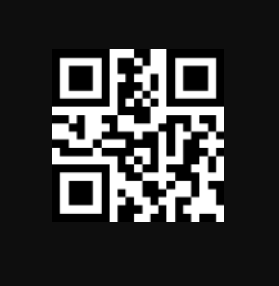
The 44th Forum for Behavioral Science in Family Medicine
Please check-in to this session
You can use the QR code to the right which should also be available in written form at the entrance to the room.
You can also use this code in your app.
Self Check-In Code: W5GQC
Notes:
Jen

Slide 3
The 44th Forum for Behavioral Science in Family Medicine
Disclosures
The speakers have no conflicts of interest to declare.
Topics discussed may bring up difficult emotions and reactions, please take care of yourself throughout the course of this Lecture Discussion.

Slide 4
The 44th Forum for Behavioral Science in Family Medicine
Goals and Objectives
At the end of this presentation, participants will be able to:
Describe the impact of discrimination experience by law enforcement on physical and mental health and well-being in an adult Black primary care sample.
Describe the roles of religiosity, resiliency, and perceived social support as potential protective factors for discrimination experience, health, and well-being in a Black adult primary care sample.
Explain relationships among childhood trauma and measures of health, quality of life, and discriminatory experiences in a Black adult primary care sample.

Slide 5
The 44th Forum for Behavioral Science in Family Medicine
Agenda
Brief introduction of speakers
Presentation on research
Small group discussion
Large group discussion
Q&A opportunity
Notes:
Intro = 5 min
Research = 15 min
Small group = 20 min
Large group = 10 min
Q&A = 10 min

Slide 6
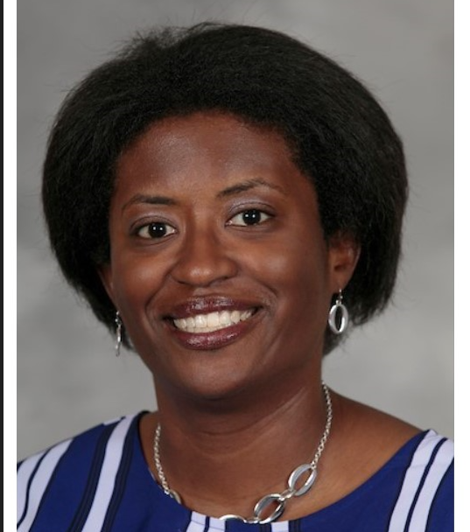
Introductions
1
1
The 44th Forum for Behavioral Science in Family Medicine
2
Indiana University School of Medicine, Department of Psychiatry
UT Southwestern Medical Center, Simmons Comprehensive Cancer Center
Notes:
Include each of our pictures here and we can quickly do the intro

Slide 7
Background
The 44th Forum for Behavioral Science in Family Medicine
Black people are 1.3 times more likely to be unarmed compared to white people yet are 3 times more likely to be killed by police.
Compared to other groups in the U.S., Black men more likely to be profiled, targeted, accused, investigated, wrongfully committed, harshly sentenced, and incarcerated for crimes.
Impact of discrimination by law enforcement on overall health and wellbeing is insufficiently studied, despite these disparate experiences.

Slide 8
Study Aims
The 44th Forum for Behavioral Science in Family Medicine
Association of discriminatory experience by law enforcement with:
Individual characteristics
Mental health
Physical health
Quality of life (QOL)
Roles of religiosity, resiliency, perceived social support
Relations between childhood trauma and health, QOL, discriminatory experiences
Notes:
Individual characteristics = age, gender, income
Mental health number of mental health diagnoses, symptoms endorsed on measures of depression, anxiety, and trauma
Physical Health number of medical conditions
Quality of Life
Aim 2. Roles in discriminatory experiences, health, and QOL.

Slide 9
Method
The 44th Forum for Behavioral Science in Family Medicine
Recruitment urban family medicine clinic, in large midwestern health system
Adult (18+) Black men and women
Informed consent
Compensation $50 visa gift card
Completed questionnaires on iPad with RA available for questions
Notes:
*partnering with colleagues from other disciplines b/c we had a lot of support from the family medicine colleagues for recruitment.
Special thanks to research assistant Ashley Bazier, who was a doctoral student and now Dr. Ashley Bazier. She made this study possible.
Ashley cold called patients and attended clinic to talk to interested individuals.
Participants completed measures independently on an iPad. To mitigate impact of limited understanding due to literacy or research language, Ashley helped read study items when a participant requested. Because of her clinical training, Ashley kept a neutral tone and able to make people feel comfortable with the questions we were asking.

Slide 10
Method
The 44th Forum for Behavioral Science in Family Medicine
Discrimination | Police and Law Enforcement Scale (PLE)
Mental Health | Beck Anxiety Inventory (BAI) Beck Depression Inventory (BDI) PTSD Checklist for DSM-5 (PCL-5) Self-report of mental health concerns & conditions
Physical Health | Self-report of physical health concerns & conditions
Quality of Life | World Health Organization Quality of Life (WHOQL-BREF)
Resiliency Factors | Spiritual Involvement and Beliefs Scale (SIBS) Brief Resilient Coping Scale (BRCS) Social Provisions Scale (SPS)
Childhood Adversity | Adverse Childhood Experiences (ACEs)
Notes:
We were mindful of the questions we were asking and had a safety plan if Ashley felt unsafe/emergency services needed. We put a safety protocol in place that covered what the RA should do if a patient endorsed suicidal intent/plan; suicidal ideation (with no intent/plan). How to handle attempts to flee. Guidelines to complete a suicide screen. Also encouraged Ashley to call and/or secure message us at any time if she did not feel comfortable and/or was unsure what to do.

Slide 11
Selected Results
The 44th Forum for Behavioral Science in Family Medicine
50 Black adults (M_{age} = 52.04 years, SD = 13.2)
female (60%)
unemployed (66%)
unmarried (70%)
with hypertension (64%)
with lifetime mental health dx (58%)
46% had discriminatory experiences with law enforcement in past 5 years.

Slide 12
Aim 1
The 44th Forum for Behavioral Science in Family Medicine
Discriminatory experience by law enforcement reported significantly more by:
Younger Black adults with higher-income, fewer medical conditions, and more trauma symptoms than those without PLEs
Roles of religiosity, resiliency, perceived social support
Relations between childhood trauma and health, QOL, discriminatory experiences

Slide 13
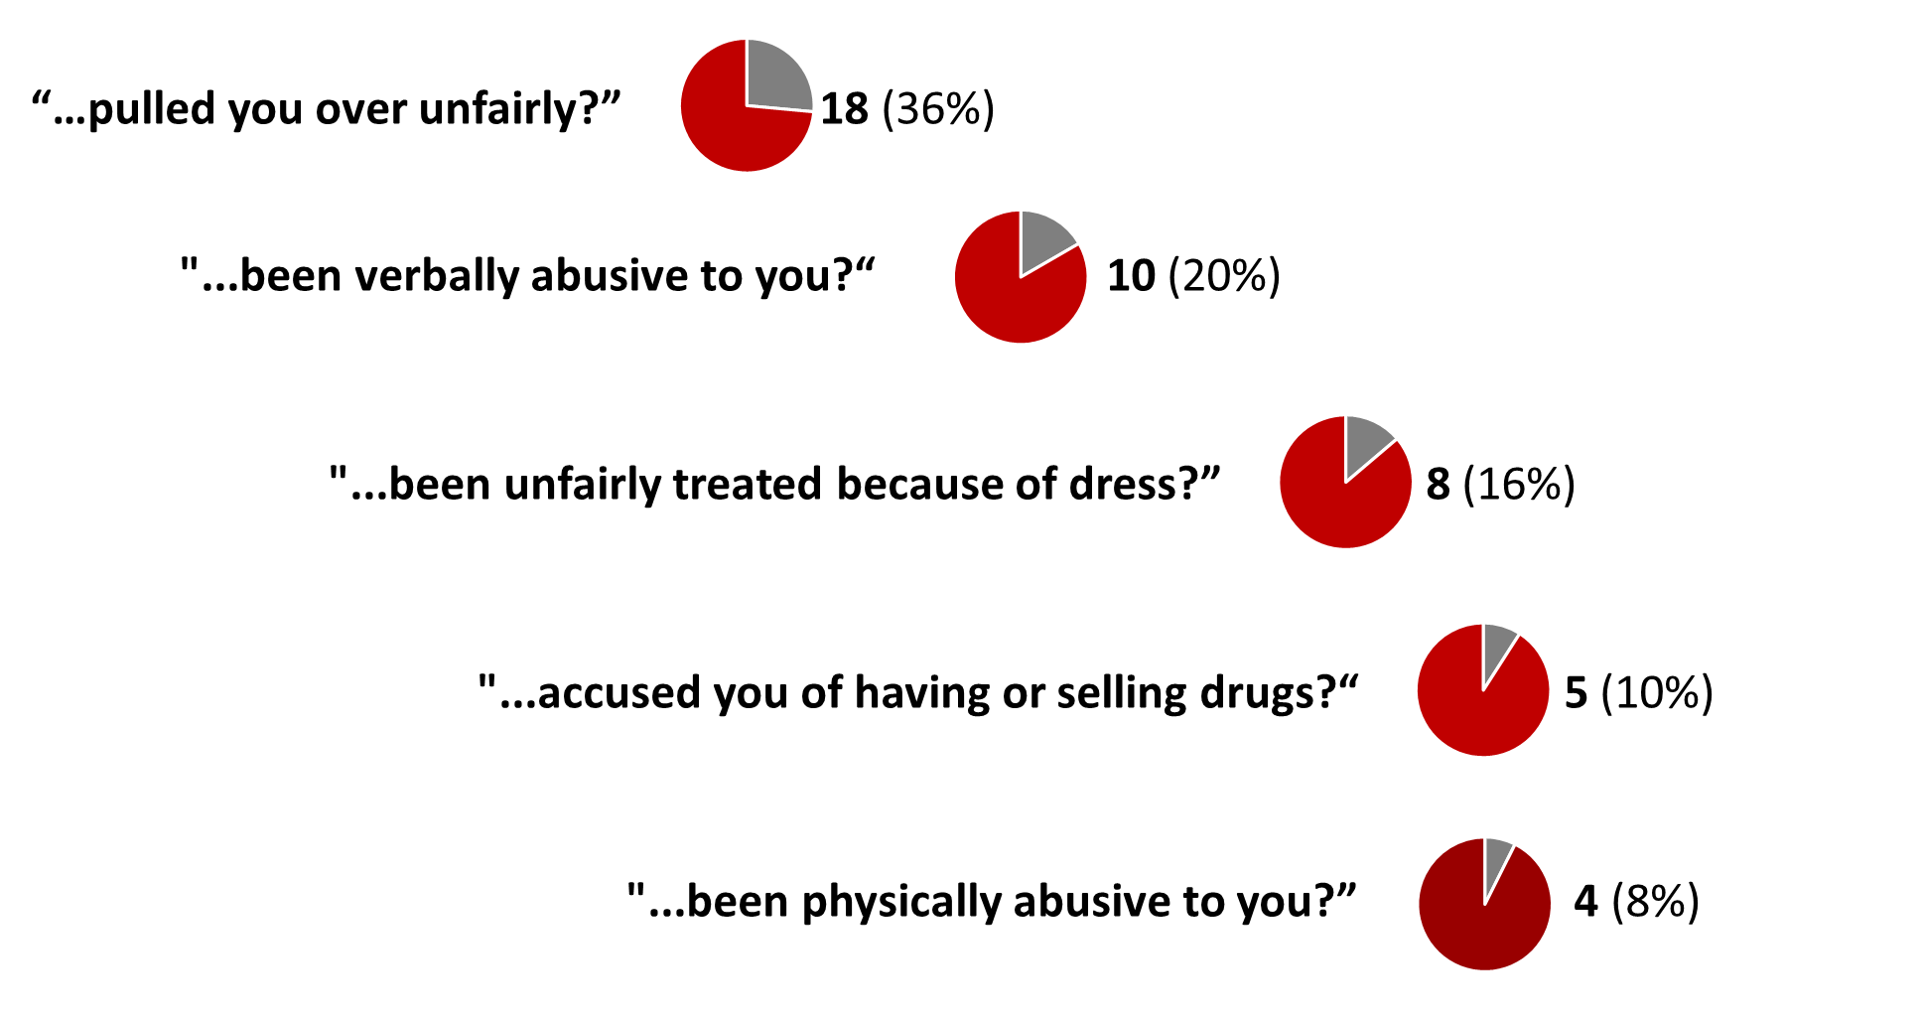
Endorsed Law Enforcement Discriminatory Experience
The 44th Forum for Behavioral Science in Family Medicine

Slide 14
The 44th Forum for Behavioral Science in Family Medicine
31-33: clinically meaningful score
30.09
19.59
NO YES
Discriminatory Experiences
PTSD Checklist for DSM-5 (PCL-5)

Slide 15
The 44th Forum for Behavioral Science in Family Medicine
20.0
17-20: borderline clinical depression
14.0
11-16: mild mood disturbance
NO YES
Discriminatory Experiences

Slide 16
Aim 2
The 44th Forum for Behavioral Science in Family Medicine
Discriminatory experience by law enforcement reported significantly more by
Younger Black adults with higher-income, fewer medical conditions, and more trauma symptoms than those without PLEs
Spirituality is protective:
physical health
depression
anxiety
trauma
domains of QOL
Relations between childhood trauma and health, QOL, discriminatory experiences
Notes:
No significant relations between resiliency, perceived social support, with discriminatory experience, health, QOL.

Slide 17
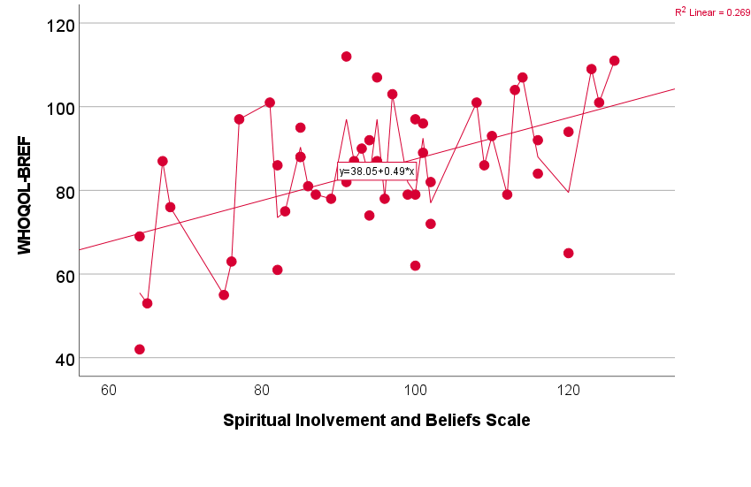
Religiosity and Quality of Life
The 44th Forum for Behavioral Science in Family Medicine

Slide 18
Aim 3
The 44th Forum for Behavioral Science in Family Medicine
Discriminatory experience by law enforcement reported significantly more by
Younger Black adults with higher-income, fewer medical conditions, and more trauma symptoms than those without PLEs
Spirituality is protective: physical health, depression, anxiety, trauma, domains of QOL.
Significant childhood adverse events:
74% reported caregiver separation
higher ACEs associated with more trauma sx but not other health, QOL, discriminatory experiences

Slide 19
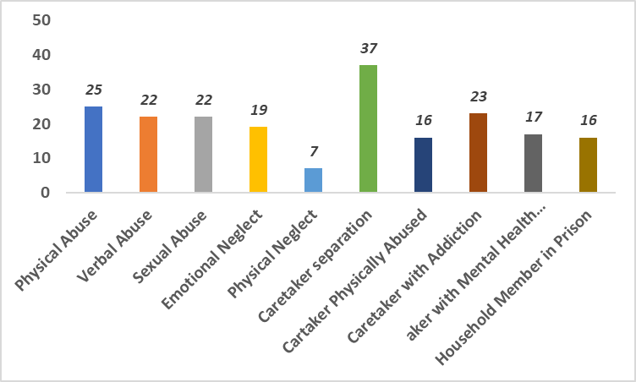
Adverse Childhood Experience Scale
The 44th Forum for Behavioral Science in Family Medicine
Notes:
Showing number of individuals endorsing adverse childhood experiences, by item.
The second highest reported was physical abuse, 25 (50%)

Slide 20
Summary and Key Takeaways
The 44th Forum for Behavioral Science in Family Medicine
Discriminatory experiences with law enforcement
Highlighted intersectionality of age and income
Associated with more PTSD and depressive symptoms, fewer ongoing physical conditions
Did not differentiate reported # mental health diagnoses or QoL
↑ Religiosity ↓ medical and mental health symptoms
Spirituality is protective
Childhood traumas did not predict number of reported negative experiences with law enforcement
This sample endorsed a high number of childhood traumas

Slide 21
Limitations
The 44th Forum for Behavioral Science in Family Medicine
Quantitative/aggregate -> qualitative/narrative data, larger sample sizes
Timeframe of questionnaires -> both proximal and distal data needed
Limitations with diagnoses and access to care
Expanding on SES proxy data -> neighborhood-level data
Cultural factors in seeking and reporting mental health concerns
Process group
Replicate this study among adolescents
Notes:
Much information is masked when we use aggregate data. One participant had 20 incidents of discriminatory experiences with law enforcement. And from the narrative data shown earlier, the information could be much more nuanced when we use mixed methods with both quantitative and qualitative data. The low power when we started to look at group difference also meant we couldn't test interaction effects of age and gender given that we were the first use of the PLE with women.
"past 5 years" of discriminatory experiences with law enforcement – some reported more experiences when they were younger, which possibly would have a more robust relation with ACEs.
The lack of diagnoses and high presence of symptoms like PTSD symptoms may reflect access to care.
Many research efforts toward neighborhood characteristics and community-level data. Also taking a closer look at substance use data, number of people in home, etc.
While we set up the study in ways that hopefully reduced barriers to access this research and to discuss these issues, there are still many cultural factors at play in Black folks being willing to seek and report mental health concerns.
Several participants expressed they wanted more opportunity to talk about these experiences, especially in a group setting. So we would be interested in running some form of focus group through grants like PCORI that looks at patient experience with historically excluded groups, replication, qualitative data, timeframe of questionnaires, ask about access to care challenges.
Replicating with Black adolescents given our older sample.

Slide 22
Impact and Reflections
The 44th Forum for Behavioral Science in Family Medicine
Importance of including law enforcement exposure, spirituality, and using trauma lens in clinical interview and case conceptualization
It is okay to be uncomfortable. Ask the questions!
Break down barriers to access research as participants:
Including historically excluded and understudied in clinical research (and trials)
RA w/ flexible schedule
Recruited at their medical appt (i.e., point-of-care)
Compensation
Value of psychologists
Notes:
After completing the PLE, participants were asked: "Is there anything else you would like to share about your experiences?"
At the very end of the study, participants were asked: "Is there anything else you would like to add about your experiences that we have not already asked about?"
"Felt really good to talk about this today.“
Participants expressed it was important and healing to be asked and heard
Have a unique position in a medical system based on our training to use culturally-informed view of patients we come across. It’s never just about their medical or psychiatric conditions. We get to bring these strengths to working with pts in front of us, and with the various types of colleagues we interface through education. And of course, through training of the next generation of psychologists, which leads us to Dr. Morton’s talk.

Slide 23
Small Group Discussion
The 44th Forum for Behavioral Science in Family Medicine
What are your reactions to these findings?
Do you ask your patients/clients about their spiritual/religious practices? Why?/Why not?
What do you know about the law enforcement in your area?
Do you ask your patients/clients about their experiences with discrimination from law enforcement? Why?/Why not?
Do you ask about other forms of discrimination? Why?/Why not?
Notes:
After the small group discussions, we will have a large group discussion. Please be prepared to have one of your group members share what was discussed in your small group with the larger group.

Slide 24
Large Group Discussion
The 44th Forum for Behavioral Science in Family Medicine
Call outs from each small group
What is one change you can make to your work with patients?
What is one action step you are personally willing to take to improve your understanding of some of the information discussed in today’s presentation?

Slide 25
THANK YOU! Q&A
The 44th Forum for Behavioral Science in Family Medicine
Danielle Henderson (danihend@iupui.edu)
Molin Shi (molin.shi@utsouthwestern.edu)
Jen Vohs (jvohs@iupui.edu)

Slide 26
Selected References
The 44th Forum for Behavioral Science in Family Medicine
Carson, E.A. (2014). Prisoners in 2013. U.S. Department of Justice. https://bjs.ojp.gov/content/pub/pdf/p13.pdf
Edwards, F., Lee, H., & Esposito, M. (2019). Risk of being killed by police use of force in the United States by age, race–ethnicity, and sex. Proceedings of the National Academy of Sciences, 116(34), 16793–16798. https://doi.org/10.1073/pnas.1821204116
Geller, A., Fagan, J., Tyler, T., & Link, B. G. (2014). Aggressive Policing and the Mental Health of Young Urban Men. American Journal of Public Health, 104(12), 2321–2327. https://doi.org/10.2105/ajph.2014.302046
Sewell, A. A. (2017). The Illness Associations of Police Violence: Differential Relationships by Ethnoracial Composition. Sociological Forum, 32, 975–997. https://doi.org/10.1111/socf.12361

Slide 27
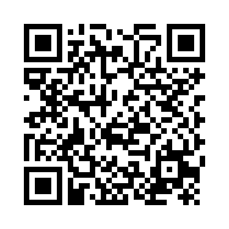
The 44th Forum for Behavioral Science in Family Medicine
Session Evaluation
Please complete an evaluation of this session. There is a direct link in your conference app. You can also use this QR code.

