Slide 1
Medical Ethics and Health Disparities
Kwanza Devlin, MD
FMFH FMRP
March 2022

Slide 2
Objectives
By the end of this session, participants will:
Have greater awareness of medical ethics failures and their impact on health disparities
Have participated in narrative medicine exercise

Slide 3
Notes:
Poll Title: Do not modify the notes in this section to avoid tampering with the Poll Everywhere activity. More info at polleverywhere.com/support How are doctors perceived? https://www.polleverywhere.com/free_text_polls/e7KsKABS5j79Ph36C2C6W

Slide 4
Medicine is Story-sharing
Hear – interpret – try to intervene
Beyond the words
How does this relate to their beliefs of health and self?
How do our biases impact what we hear?
Same for patient as we try to intervene in their story
How do our beliefs and values impact what we say/how we say it?
How do our patients’ biases impact what they hear?

Slide 5
Introduction to Narrative Medicine
Use narration to understand and connect
Attention
Representation
Affiliation

Slide 6
Fernald School
1848: Experimental School for Teaching &Training Idiotic Children
1940s/1950s – US Atomic Energy Commission, Harvard, MIT, Quaker Oats
Invites for “smarter kids” to “science club”
Given radioactive calcium and iron in cereal and milk to measure absorption
1993 – school librarian found evidence and reported
1994 – Task Force on Human Subject Research in Mass

Slide 7
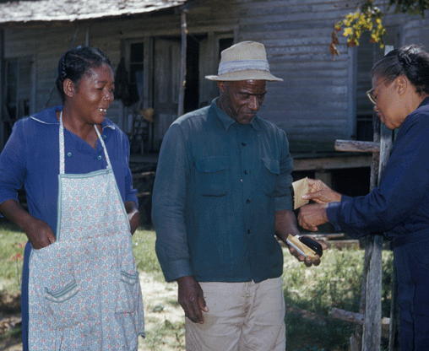
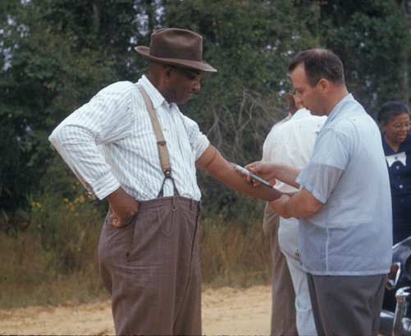
Tuskegee Syphilis
1932-1973 – US Public Health Services, local providers
Invites for tests and treatments
Watch disease progression without treatment
Selection: Southern Black men due to “excessive sexual desire” and low chance of treatment before dying from disease
1940s – PCN available, not given
1972 – Article published. 1973 – experiments halted

Slide 8
Guatemala STI
Started in Terre Haute penitentiary with Dr. Maloney (Marquette grad)
1946-1948 (-1955) – US Public Health Service (Dr. Cutler), Guatemalan gov’t, PASB
No invite. Ages 1-72. Soldiers, prisoners, sex workers, psych pts, orphanages, leprosy institutions
Test prophylaxis
5500 people/1500+ infected – Syphilis, gonorrhea, chancroid – “normal exposure”, injection, pus in urethra, rectum or eyes, penile abrasion inoculation, ingestions, cisternal punctures

Slide 9
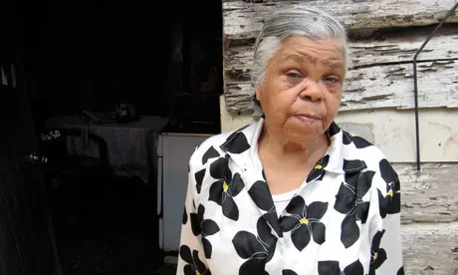
Marta Orellana
2011

Slide 10
Attention
What stood out to you in Marta’s story/her words?

Slide 11
representation
How would you describe Marta’s emotions/thoughts?
Child Marta OR Adult Marta

Slide 12
Affiliation
Describe a time, that you were aware of, when a patient felt powerless

Slide 13
Notes:
Poll Title: Do not modify the notes in this section to avoid tampering with the Poll Everywhere activity. More info at polleverywhere.com/support What words might the people in these studies (or their families) use to describe physicians? https://www.polleverywhere.com/free_text_polls/uPy3mHz5xbnqNFTuwW4KT

Slide 14
In 1990, a survey found that 10% of African Americans believed that the U.S. government created AIDS as a plot to exterminate blacks, and another 20% could not rule out the possibility that this might be true.

Slide 16
Notes:
Poll Title: Do not modify the notes in this section to avoid tampering with the Poll Everywhere activity. More info at polleverywhere.com/support Causes of Health Disparities https://www.polleverywhere.com/free_text_polls/JozQCm0ypyqFZeV2ri0E3

Slide 18
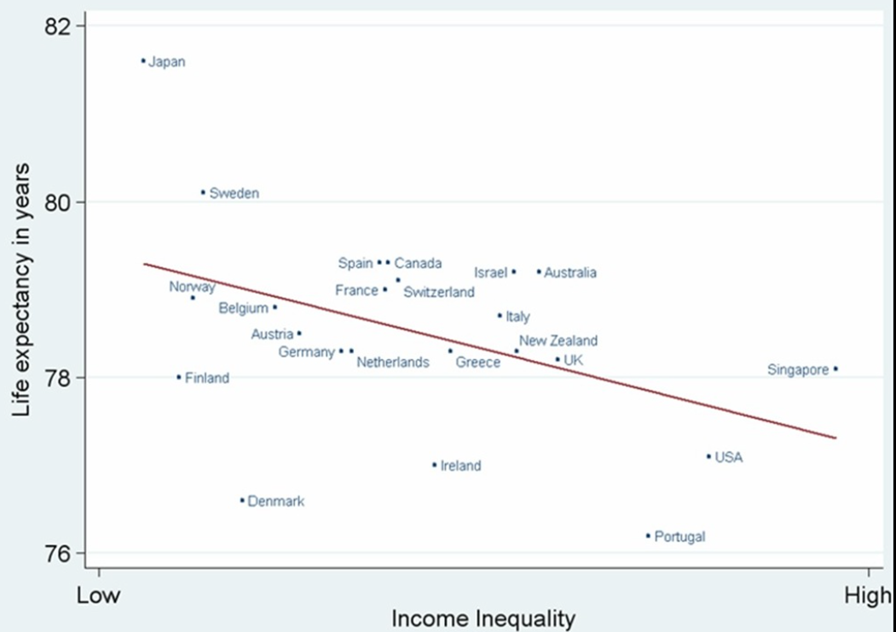
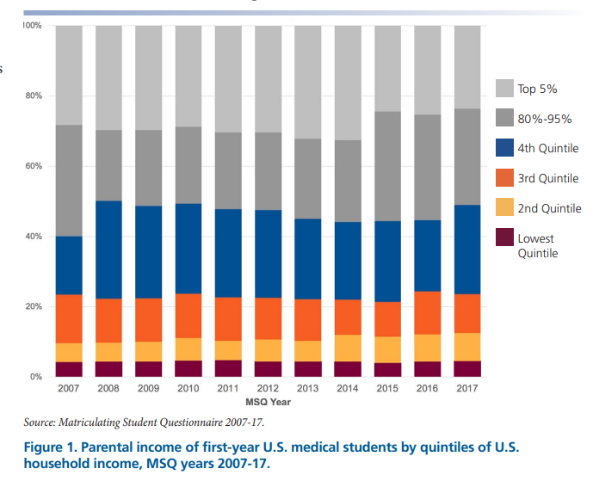
Nearly 80% of medical students come from families in the top 25% income

Slide 19
General rules
LISTEN
You may not always know the whole story
Ask for clarification
Never assume

Slide 20
References
https://ahrp.org/1944-1956-radioactive-nutrition-experiments-conducted-by-harvard-and-mit-on-disabled-children/
https://www.cdc.gov/tuskegee/timeline.htm
https://www.infoplease.com/history/black-history/the-tuskegee-syphilis-experiment
https://www.washingtonpost.com/news/retropolis/wp/2017/05/16/youve-got-bad-blood-the-horror-of-the-tuskegee-syphilis-experiment/
https://law.stanford.edu/wp-content/uploads/2011/09/EthicallyImpossible_PCSBI_110913.pdf
https://www.aamc.org/media/9596/download
https://www.theguardian.com/world/2011/jun/08/guatemala-victims-us-syphilis-study
Narrative Medicine: Attention, Representation, Affiliation. October 2005. Narrative 13(3):261-270. DOI:10.1353/nar.2005.0017
Human Medical Trials (At Issue in History). Kelly Barth. Greenhaven. 2002.

