Slide 1
Introduction to Motivational Interviewing
Tovë M. Goldson, MD, PhD
Notes:
https://www.slideshare.net/healthygen/motivational-interviewing-63122137

Slide 2
Objectives
Define Motivational Interviewing (MI)
Defining the Stages of Change
Brief review of BATHE
Understand and use interview techniques
OARS
EOE
Understand and use Scaling to elicit Change Talk from the patient
The Stages of Change in action

Slide 3
Motivational Interviewing
Before
After

Slide 4
Motivational Interviewing
Motivational Interviewing is a method that works on facilitating and engaging intrinsic motivation within the patient in order to change behavior.
MI is a goal-oriented, patient-centered counseling style for eliciting behavior change by helping patients to explore and resolve ambivalence.
The examination and resolution of ambivalence is a central purpose, and the physician is intentionally directive in pursuing this goal.
Miller and Rollnick (1991)
Notes:
Validated tool *** find references.

Slide 5
What exactly is ambivalence?
is a state of having simultaneous conflicting reactions, beliefs, or feelings towards some object

Slide 6
Who can give an example of ambivalence from a patient?
Anyone?
Anyone?

Slide 7
Ambivalence can be …
understanding the consequence of poorly controlled DM while eating doughnuts and forgetting to take metformin regularly
wanting to lose weight but not starting the diet and exercise program

Slide 8
Using MI, the goal is to help the patient explore and resolve ambivalence by changing their behavior.
Motivation to change is elicited from the patient, and is not imposed from outside forces.
It is the patient's task, not the physician's, to articulate and resolve the patient's ambivalence.
Direct persuasion is not an effective method for resolving ambivalence.
The counseling style is generally quiet and elicits information from the patient. (Leave space!)
The physician is directive, in that they help the patient to examine and resolve ambivalence.
Notes:
emphasize this

Slide 9
Stages of change (Am Fam Physician. 2000 Mar 1;61(5):1409-1416.)
Precontemplation
Contemplation
Preparation
Action
Maintenance
Relapse

Slide 10
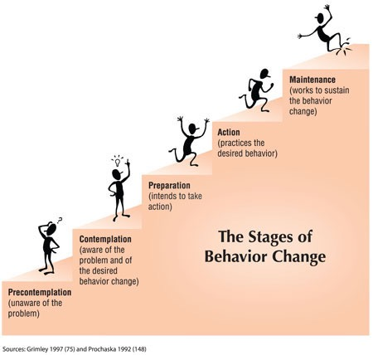

Slide 11
BATHE (Am Fam Physician. 1998 May 1;57(9):2131-2134.)
- The Reconnaissance -
B: Background
A: Affect
T: Trouble
H: Handling
E: Empathy
Notes:
The BATHE technique is a brief psychotherapeutic method that addresses the patient's background issues, affect and most troubling problem. The emphasis of the interview then shifts to how the patient is handling the problem and a demonstration of empathy by the physician.
This is the reconnaissance.

Slide 12
The Interview part 1: Know your OARS
O: open ended question
How are you taking your medication? vs. Are you taking your medication as directed?
A: affirmations – reinforce the patient’s efforts & strengths, can be simple or complex
You are taking this seriously
You have faced some difficult challenges, but haven’t given up
R: Reflections
Repeat or rephrase the patient’s statements to show you hear and understand
S: Summary
Make sure that you got the whole story

Slide 13
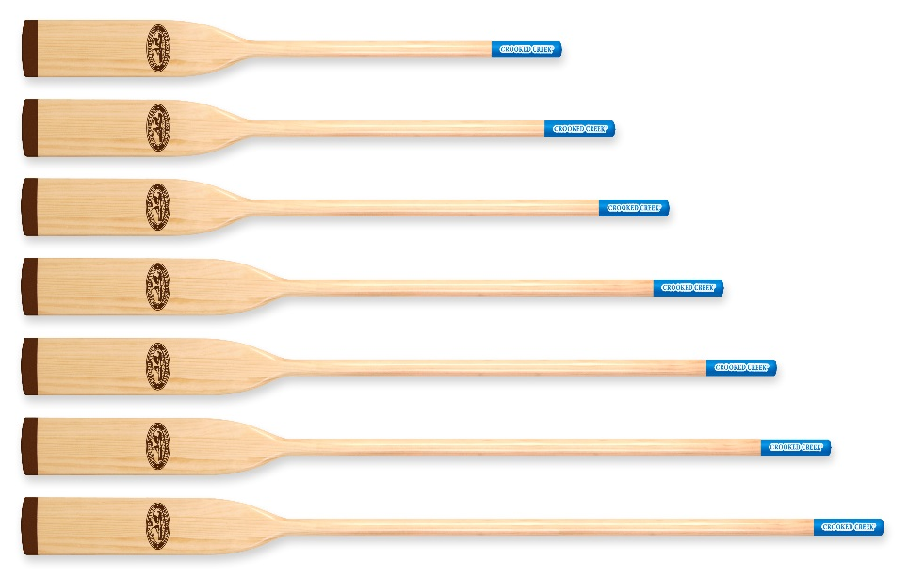
Let’s practice!
Open-ended questions
Affirmations
Reflections
Summary

Slide 14
The Interview part 2: Know your EOE: Explore – Offer – Explore (a.k.a. Ask-Tell-Ask)
Explore – what does the patient know, what would they like to know
What do you know about type 2 diabetes?
When it comes to feeding your baby, what would be most helpful for you to learn more about?
What have you heard about this medication?
Offer (Ask Permission) – and share in a nonjudgmental manner
Do you mind if I share my concerns? or Can I share some information with you?
Research suggests… Studies have shown… Others have benefitted from…
Emphasize that they have control, it’s their choice
Explore – get thoughts, feelings, reactions
How do you feel about this information?
What concerns you the most?

Slide 15
Let’s practice!
Explore
Offer
Explore

Slide 16
The Interview part 3: Scaling Importance & Confidence
Importance
0 1 2 3 4 5 6 7 8 9 10
------------------------------------------------------------------------------------------
Confidence
0 1 2 3 4 5 6 7 8 9 10
------------------------------------------------------------------------------------------

Slide 17
Scaling Importance & Confidence to elicit Change Talk
On a scale of 0 to 10, how important would you say is it for you to … take your medication on time?
Why a 6 and not a 3?
Reinforce any change talk!
On a scale of 0 to 10, how confident are you in your ability to … take your medication on time?
Why a 5?

Slide 18
Change Talk
Who can give example of change talk?
I want to …
There are good reasons for …
I really ought to …
I’m going to …
I intend to …

Slide 19
Let’s practice!
On a scale of 0 to 10, how important would you say is it for you to --?
On a scale of 0 to 10, how confident are you in your ability to -- ?

Slide 20
Stages of change (Am Fam Physician. 2000 Mar 1;61(5):1409-1416.)
Precontemplation - create awareness
Contemplation - persuade, motivate
Preparation - educate
Action - facilitate action
Maintenance - reinforce changes
Relapse - encourage

Slide 21
Realistic Approaches to Counseling in the Office Setting (Am Fam Physician. 2009 Feb 15;79(4):277-284.)
During precontemplation and contemplation, patients are more likely to respond to a cognitive approach, such as discussing the benefits of habit change, possibly supported by written information.
In the precontemplation stage, the patient perceives that the disadvantages of changing outweigh the benefits, whereas this pattern is reversed in the action stage.
Therefore, during precontemplation and contemplation, physicians should highlight the advantages of change.

Slide 22
Realistic Approaches to Counseling in the Office Setting (Am Fam Physician. 2009 Feb 15;79(4):277-284.)
In the preparation stage, the patient chooses a starting date and strategy for change.
The action stage should target the behavioral skills and day-to-day challenges the patient encounters during his or her efforts to change.
During action and maintenance, brief lapses or more enduring relapses are common. Physicians should praise and support the patient’s efforts to change and use statistical evidence to stress that episodes of relapse are normal.

Slide 23
Questions?

Slide 24
References
Miller, W.R., and Rollnick, S. Motivational Interviewing: Preparing People To Change Addictive Behavior. New York: Guilford Press, 1991.
Am Fam Physician. 1998 May 1;57(9):2131-2134
Am Fam Physician. 2000 Mar 1;61(5):1409-1416
Am Fam Physician. 2009 Feb 15;79(4):277-284

