Slide 1
WELCOME TO THE WORLD CAFÉ!
USE OF SITUATION-BASED GROUP DISCUSSIONS TO IMPROVE RESIDENCY INTERVIEWS
Amoreena Ranck Howell, MD, MSPH
Darlene Lawrence, MD
Keith Egan, DO
University of Maryland
Family Medicine Residency
National Family Medicine Residency at Unity Health Care
Notes:
1

Slide 2
DISCLOSURES
None

Slide 3
LEARNING OBJECTIVES
Describe the relevant fundamental design principles of the World Café method of group discussion as an assessment tool
Describe the potential advantages of using situation-based collaborative dialog as part of the resident interview process.
Host a situation-based group discussion session using the World Café method and be able to develop an assessment tool reflective of the attributes that your own program finds valuable.
Notes:
Describe the relevant fundamental design principles of the World Café method of group discussion as a valuable assessment tool to use during the residency interview season.
Describe the potential advantages of using situation-based collaborative dialog as part of the resident interview process, such as being able to assess non-standardized attributes of the candidates and introducing a fresh approach to the often repetitive interview day process.
Host a situation-based group discussion session using the World Café method and be able to develop an assessment tool reflective of the attributes that your own residency program finds valuable.
3

Slide 4
RESIDENCY INTERVIEWS
What characteristics do programs want in candidates?
How can we determine which candidates have those characteristics?
How can a program distinguish itself from others?

Slide 5
RESIDENCY INTERVIEWS
Traditional Model
Dinner with current residents
Individual Interviews with faculty ± current residents
Lunch with current residents ± faculty
Tour
Other options
Blinded interviews, standardized questions
Group/panel interview
“Speed dating” (Multiple mini interviews)
Behavior-based interview w/ scoring rubric
Clinical scenario(s)
Notes:
Traditional interview methods can miss key traits that are thought to be associated with greater resident success, such as critical thinking and ability to function in a dynamic group environment. To address these issues, our program decided to adapt the World Café group discussion method as an interview tool, using ability to participate in collaborative dialog to give insights that are difficult to capture otherwise. The World Café method is typically used for group problem-solving by intermixing of smaller subgroups working on the same question(s). We adapted this method to use as part of our interview process by presenting two current event scenarios with related questions which we hoped would elicit responses highlighting desirable traits: some medical knowledge, critical thinking about systems and prioritization of resources, familiarity with social determinants of health, skill with patient-centered communication, and social media concepts. Faculty and current residents participate with each group in order to facilitate as well as to observe the candidates’ behaviors, which are then evaluated using a standardized rubric. This method has received positive feedback from candidates, residents, and faculty at our program.
5

Slide 6
RESIDENCY INTERVIEWS
Problem-solving skills
Systems thinking
Interpersonal interactions
Collaborative Dialogue?
Notes:
Traditional interview methods can miss key traits that are thought to be associated with greater resident success, especially in a primary care residency, such as critical thinking and group interactions. A candidate’s ability to participate in collaborative dialog can give additional insight that is difficult to capture otherwise.
6

Slide 7
WORLD CAFÉ
“In 1995, a small group of business and academic leaders were meeting at the home of Juanita Brown and David Isaacs in Mill Valley, California. […]
With their plan for a morning large-circle dialogue disrupted by rain, the two dozen participants spontaneously formed into small, intimate table conversations about the questions that had drawn them together, recording their insights on makeshift paper “tablecloths.”
They periodically interrupted these conversations to switch tables so the insights and ideas that had real power might circulate, deepen, and connect.
Harvesting the table conversations enabled them to notice the emerging patterns in their thinking, which then enriched subsequent rounds of conversation.”
Notes:
7

Slide 8
WORLD CAFÉ: PROCESS
Setting – create the environment
Welcome and Introduction by host
Small group rounds – ideally at least 3
Questions – can be repeated or built upon
Harvest – share insights with rest of group
Notes:
8

Slide 9
WORLD CAFÉ: PROCESS
Seat 4 – 5 people at small Café-style tables or in conversation clusters.
Set up progressive rounds of conversation, 15 – 20 min each
Encourage participants to write, doodle and draw key ideas on their tablecloths (graphic recording)
Upon completing the initial round of conversation, may ask one person to remain at the table as a “table host” for the next round, while the others serve as travelers or “ambassadors of meaning.” The travelers carry key ideas, themes and questions into their new conversations, while the table host welcomes the new set of travelers.
Notes:
9

Slide 10
WORLD CAFÉ: PROCESS – LET’S TRY IT!
Divide into groups of 4 – 5 people.
We will have two rounds of conversation, ~15 min each.
Please write, doodle and draw key ideas (graphic recording).

Slide 11
OUR SCENARIO
There has been the first confirmed local mosquito transmission of Zika virus in the Washington, DC area. You are part of the CDC team planning the initial Emergency Response to this new outbreak….
It is 12 months later and now a vaccine for the virus has been developed and released. Design a patient information website for the vaccine. Then write a tweet (140 characters) advertising the vaccine/website. Who will RT4U?
Notes:
11

Slide 12
OUR IDEA
Use World Café method to evaluate desired traits:
Collaborative behavior & Social interactions
Critical thinking & systems-based problem solving
Effective patient education and Social Media interaction
Score candidates using a behavioral rubric
Increase desirability of our program by adding a more fun portion to the interview day
Increase our own group functioning and conversational leadership by exposing faculty and residents to method
Notes:
Typical one-on-one interviews, while more informative than personal statements and transcripts, give very little information about traits that are thought to be critical in resident functioning, including social interactions and critical thinking skills. Additionally, it can often be difficult to assess how a candidate truly functions in a dynamic group environment. In general, no strong association has been found with particular application characteristics and performance during residency, though some evidence exists that behavioral measures are more predictive of resident success.
We adapted the World Café method to use as part of our interview day by creating two discussion questions that build on each other which we felt were relevant to desirable traits in potential residents. First, we created a semi-clinical scenario which involved critical thinking about systems and prioritization of resources. Second, we had participants collaborate on a patient education document and social media interaction. A few faculty and current residents participate with each group in order to facilitate as well as to observe the candidates’ behaviors. Candidates are then ranked using a behavioral rubric based on key traits which results in a numeric score.
12

Slide 13
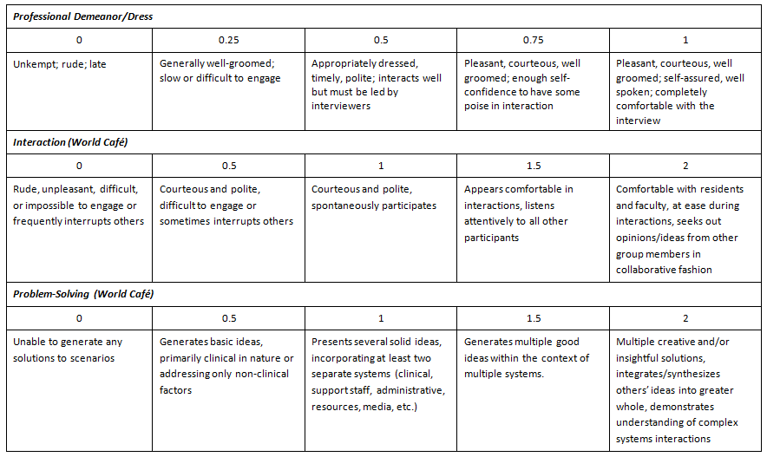
EVALUATION OF CANDIDATES

Slide 14
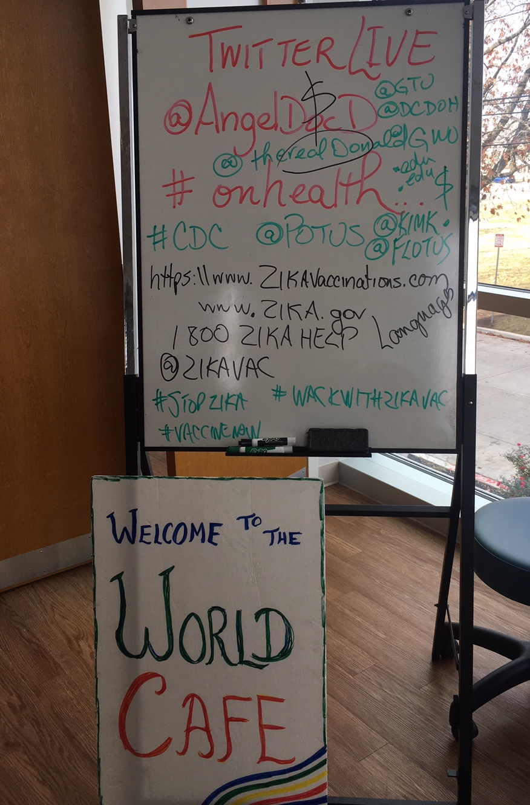
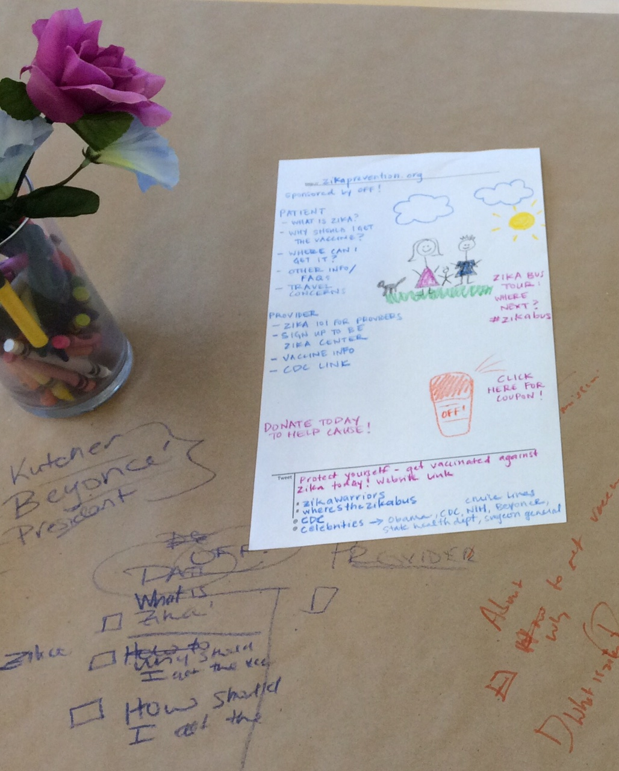

Slide 15
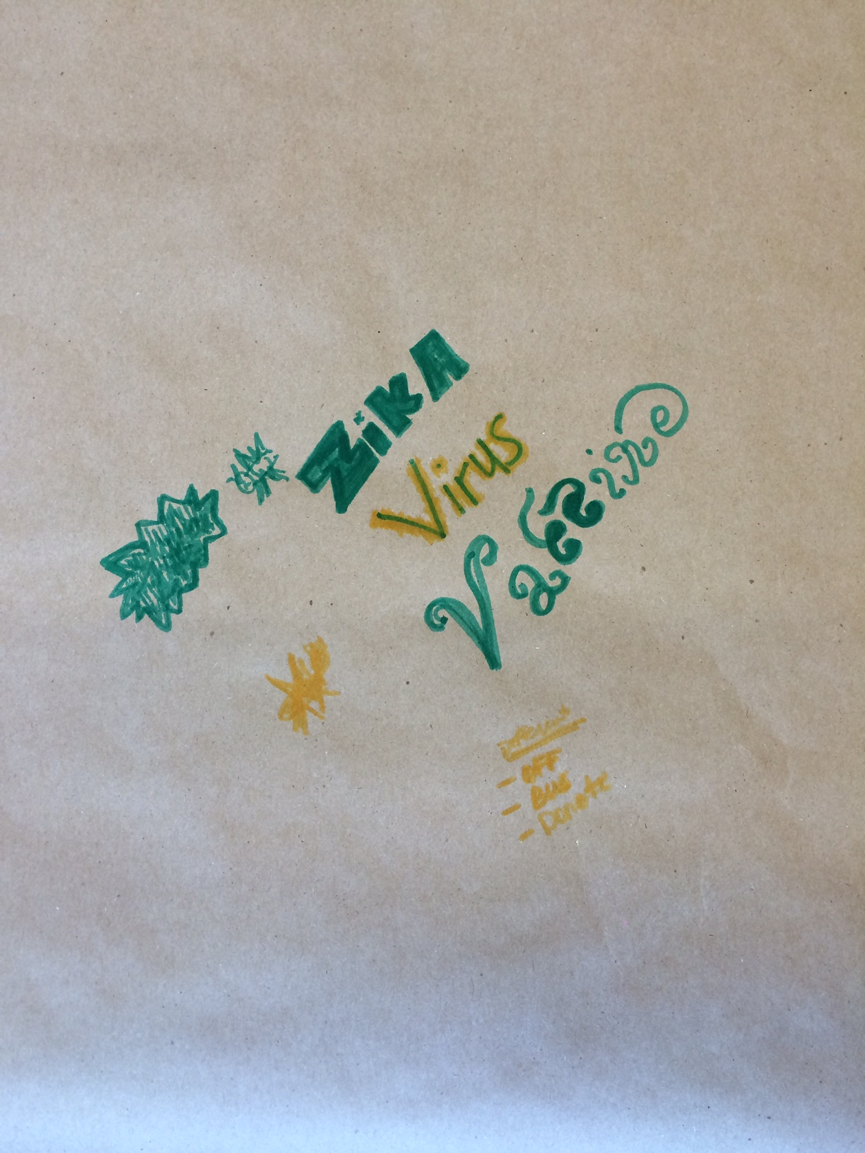
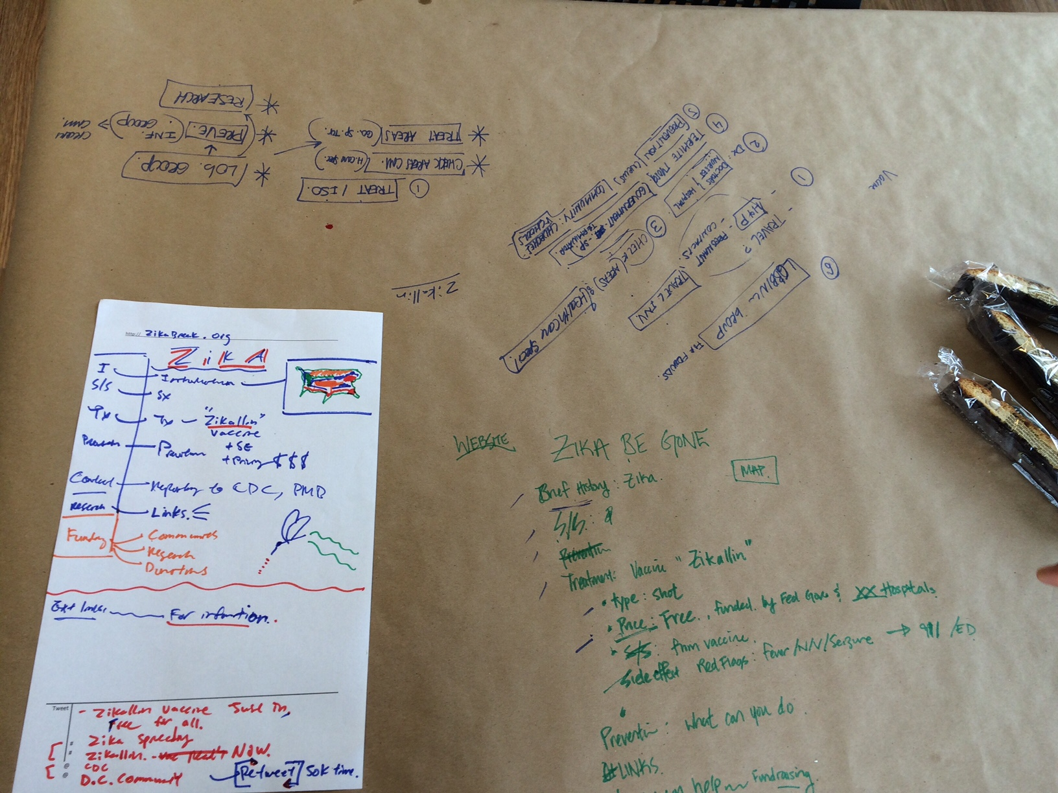
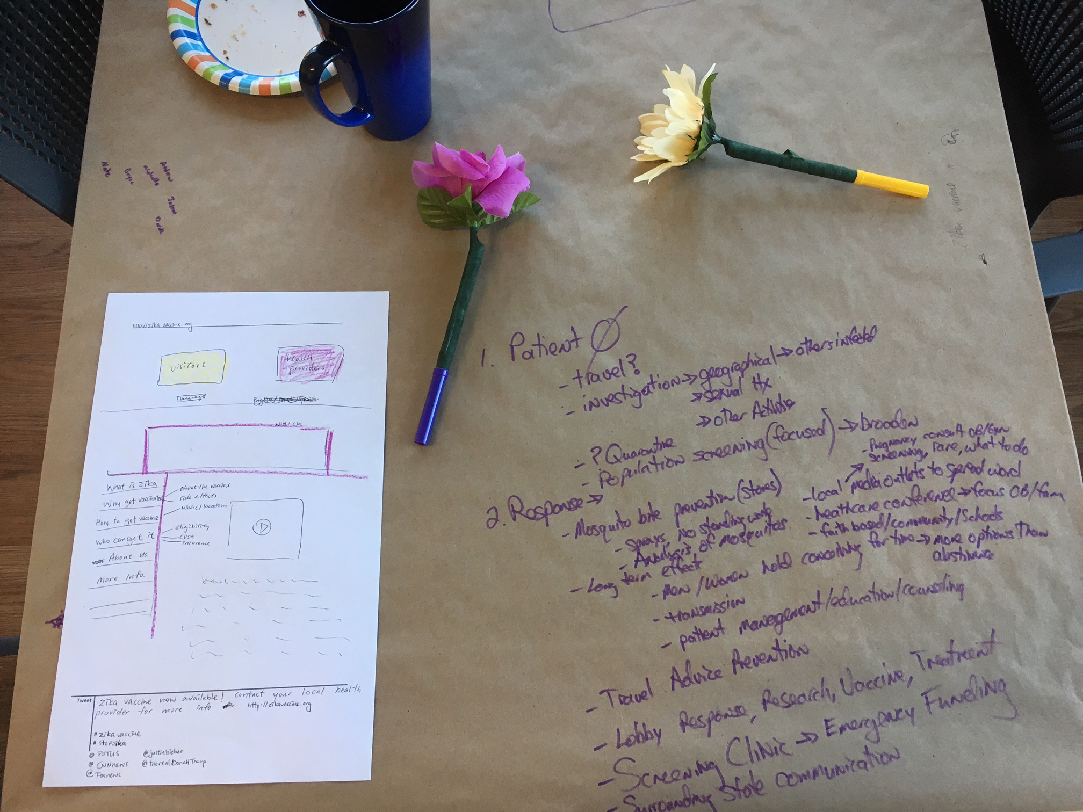
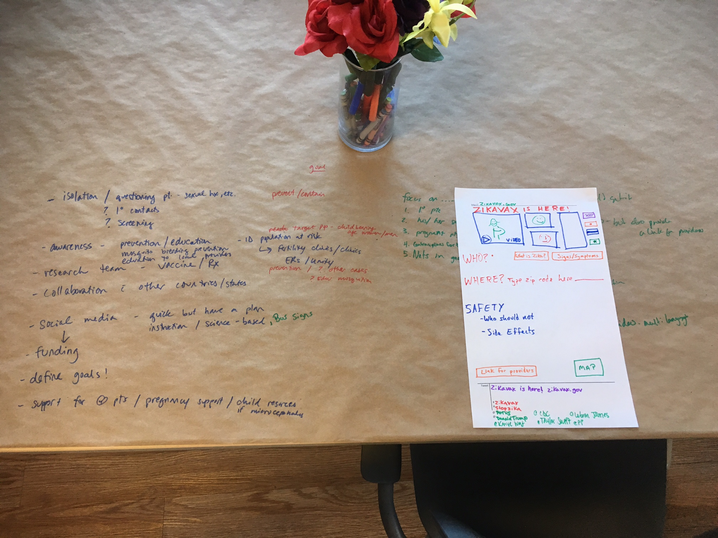
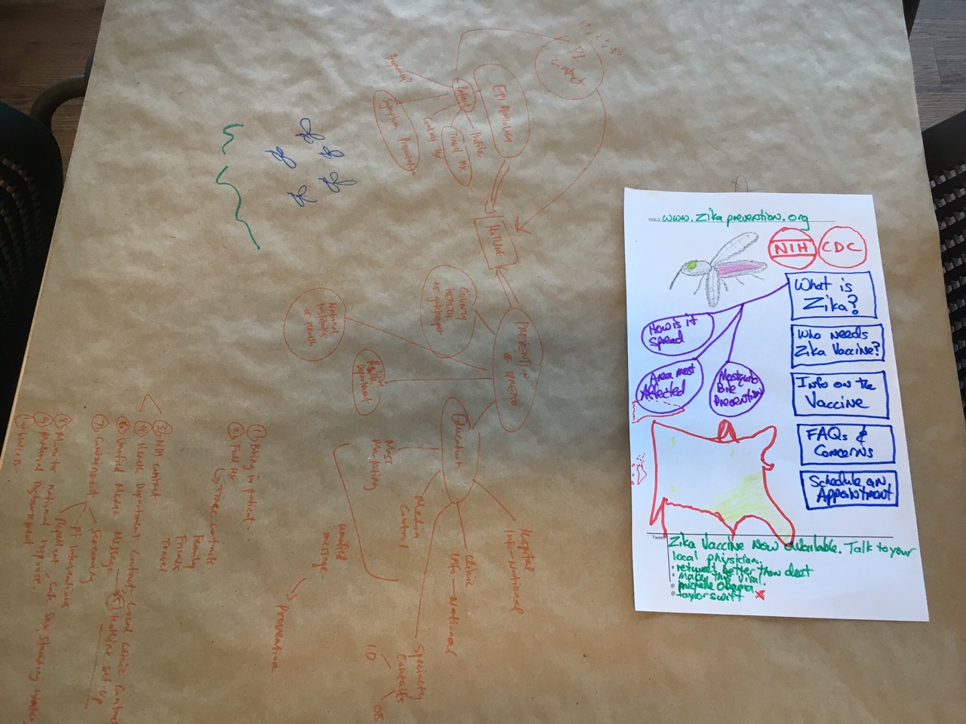

Slide 16
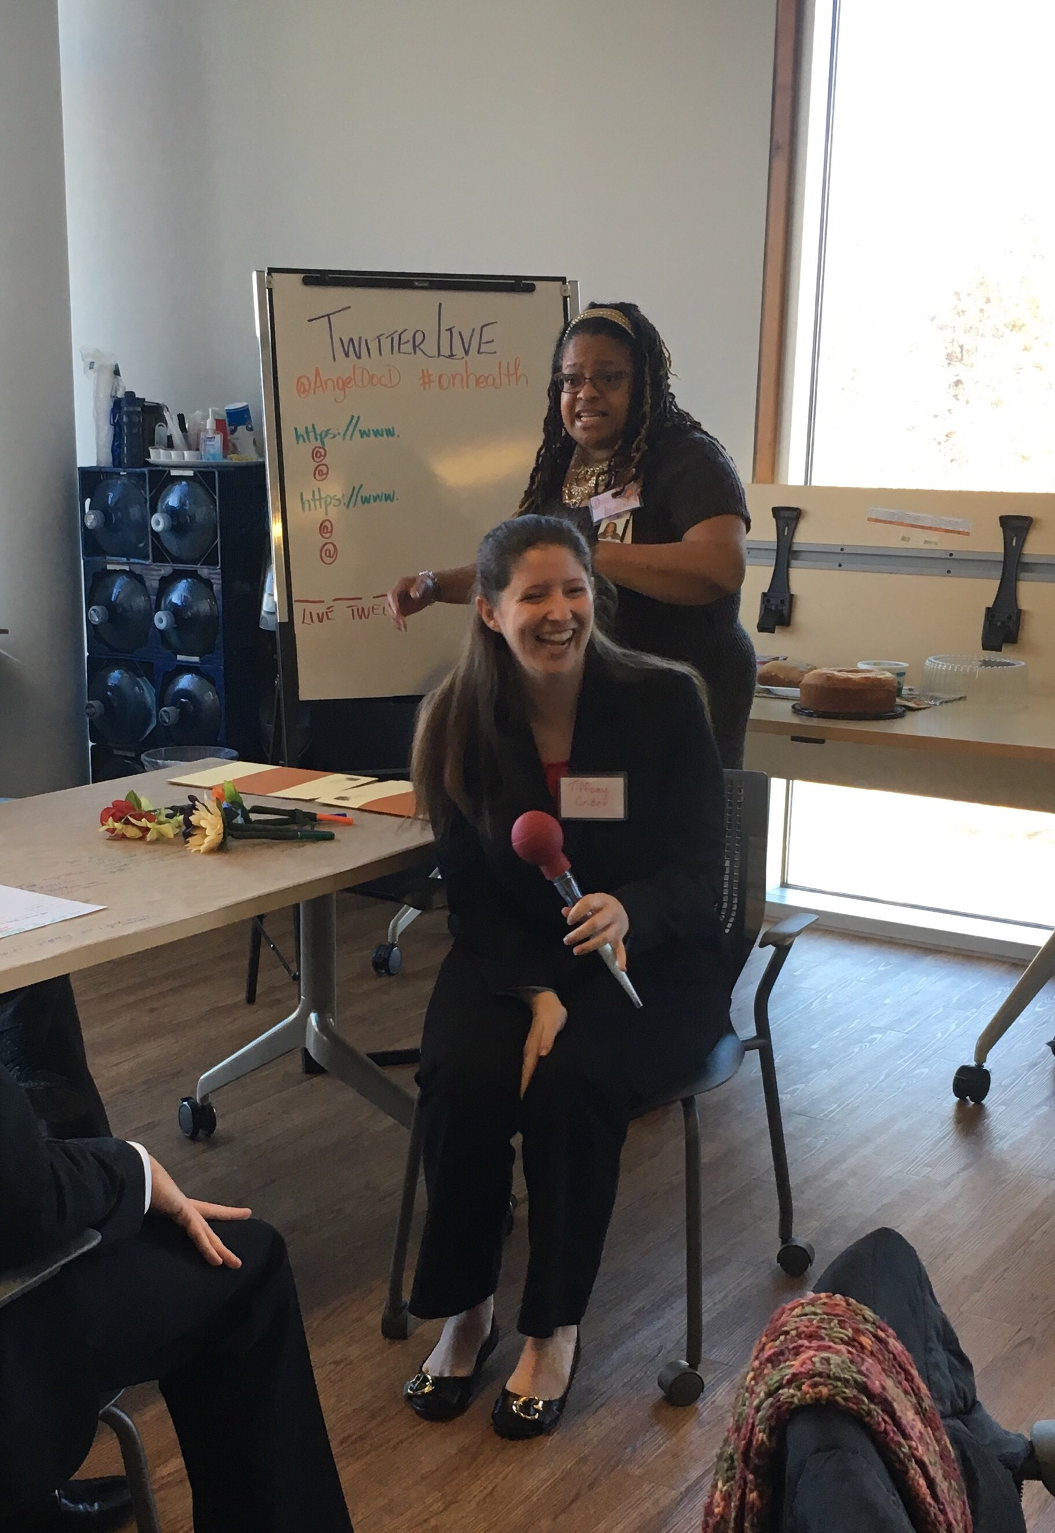
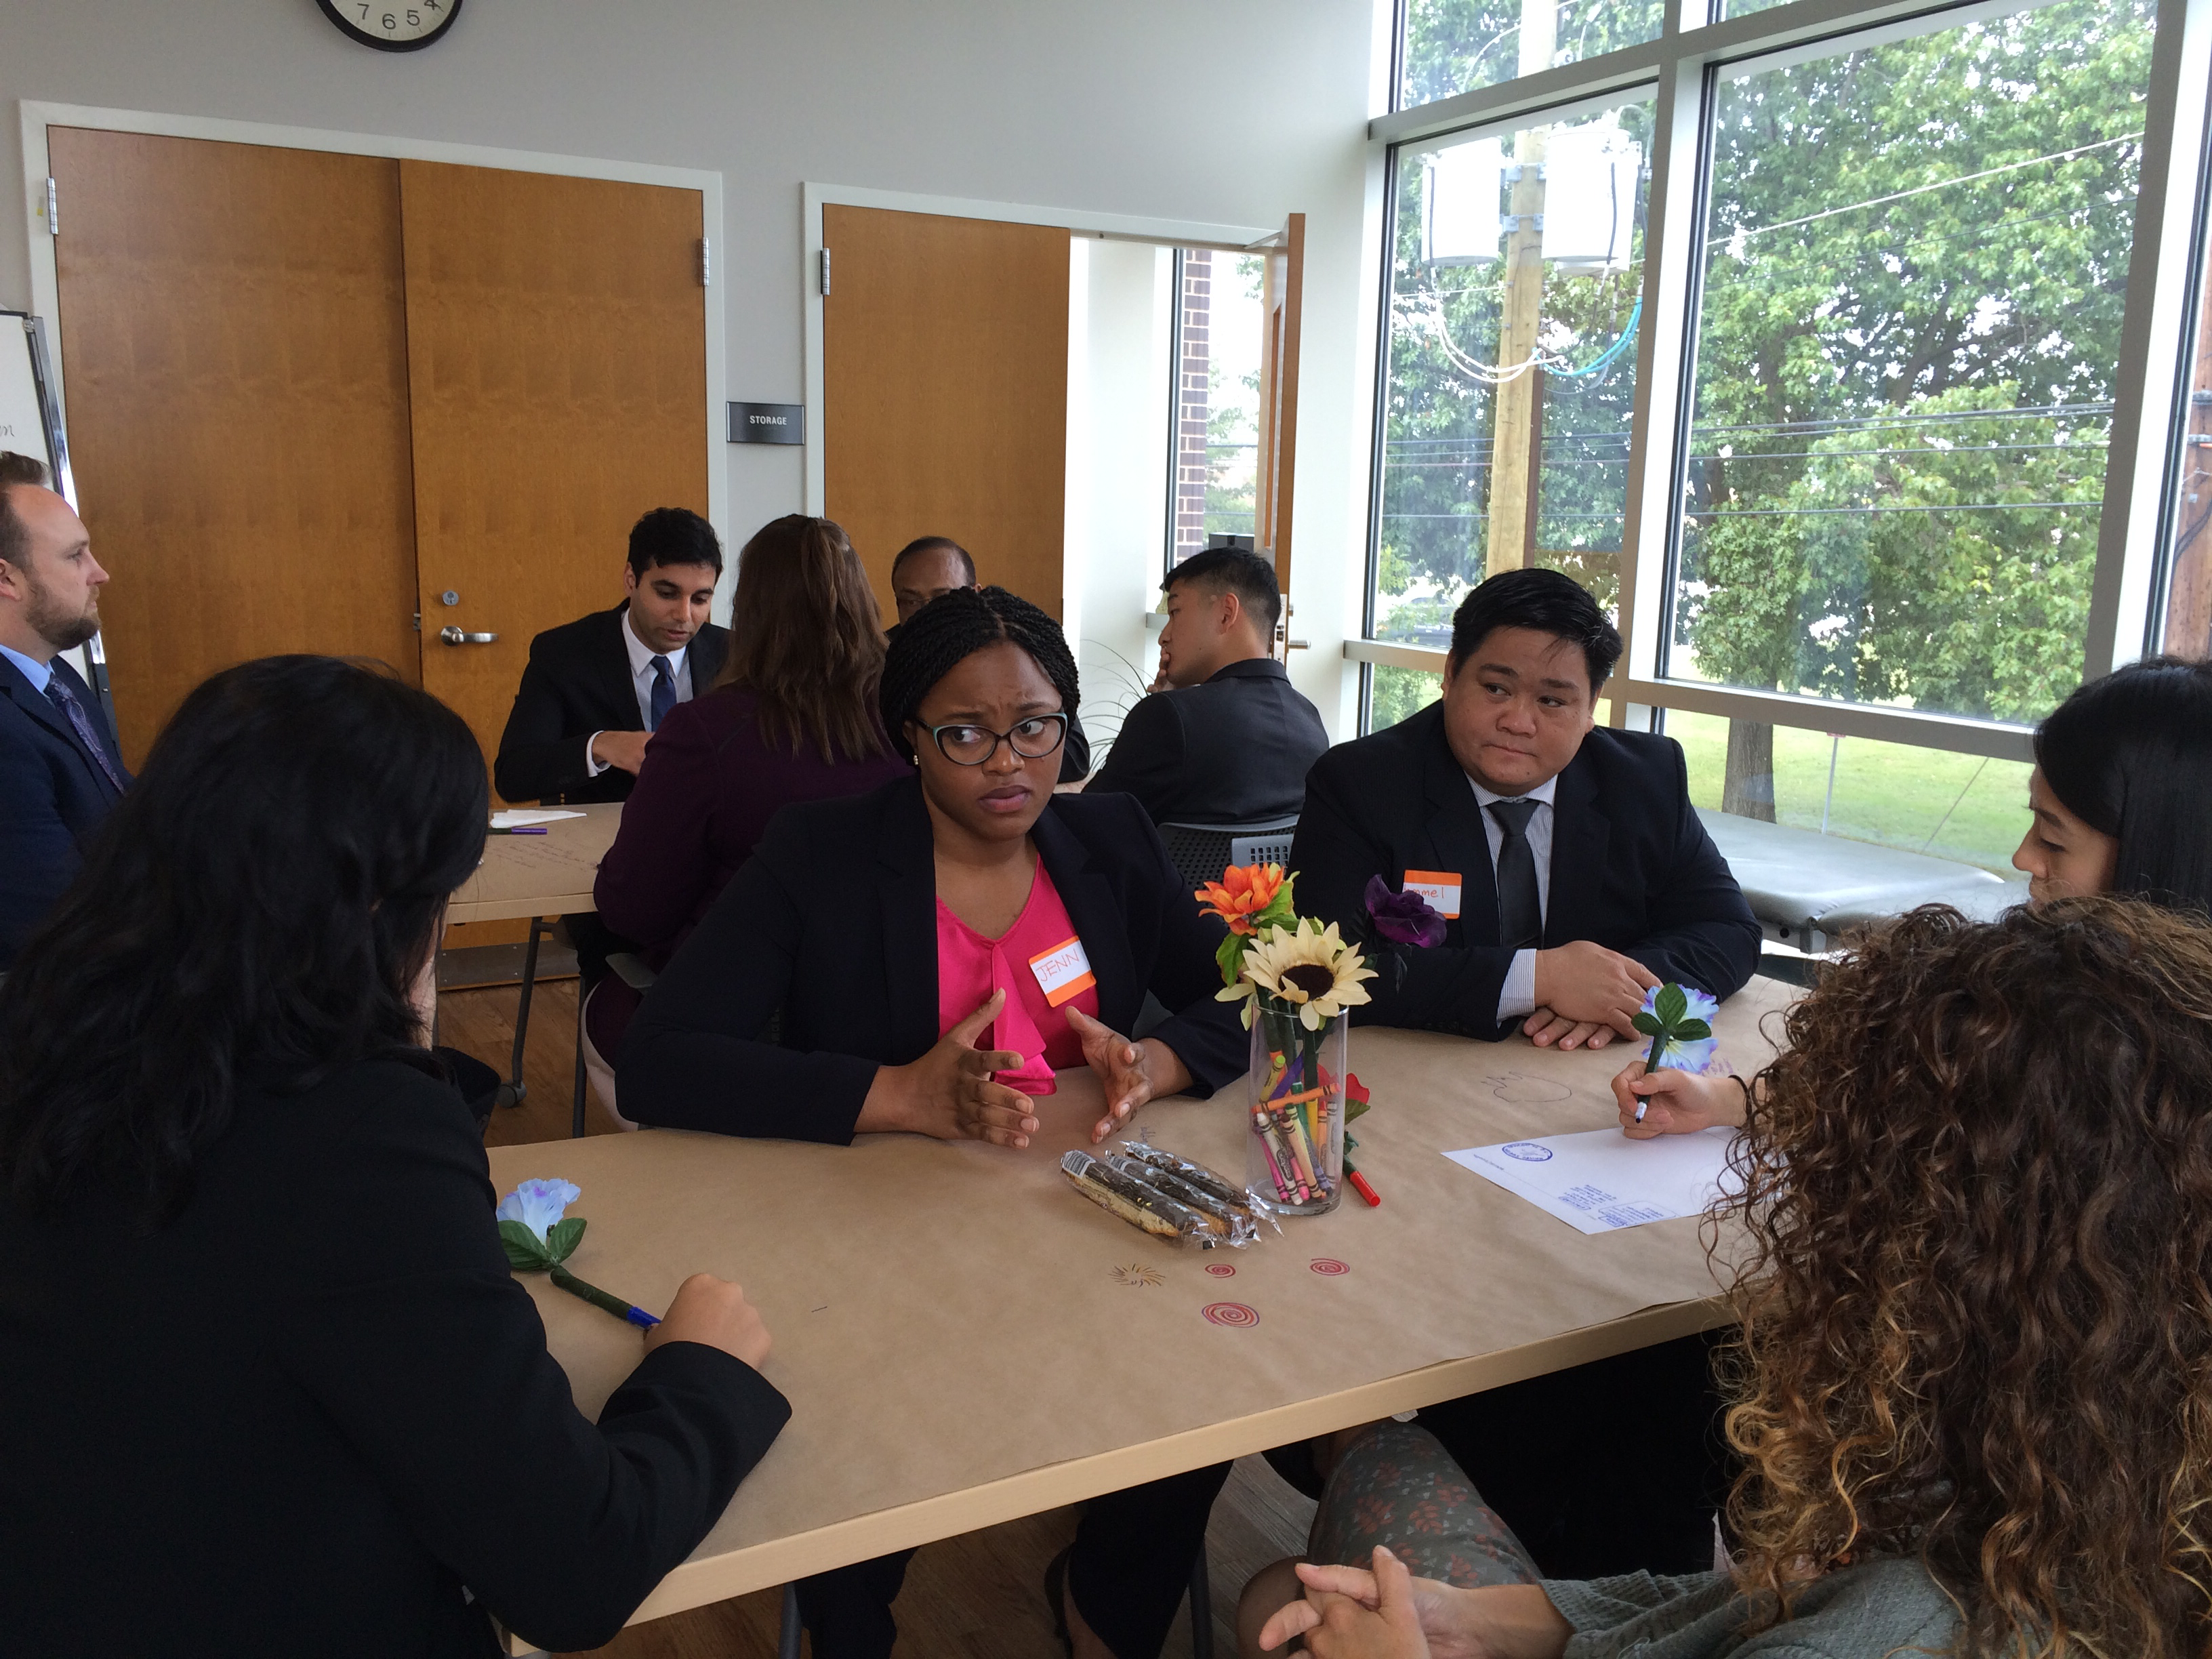

Slide 17
HOW DID IT GO?
Did we evaluate the traits we thought we would?
Was it fun for us?
Was it fun for the candidates?
Notes:
17

Slide 18
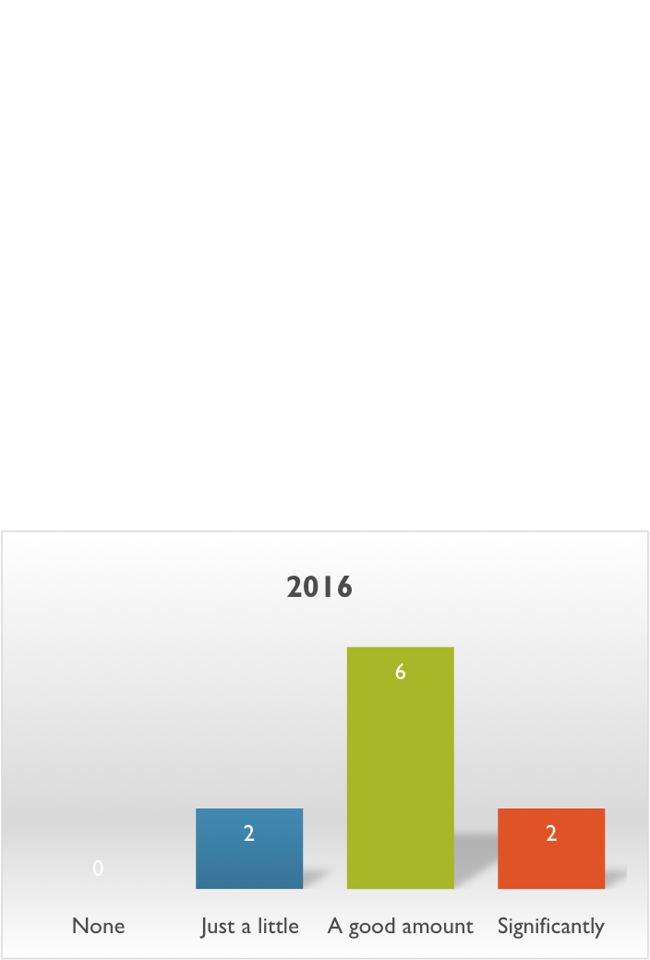
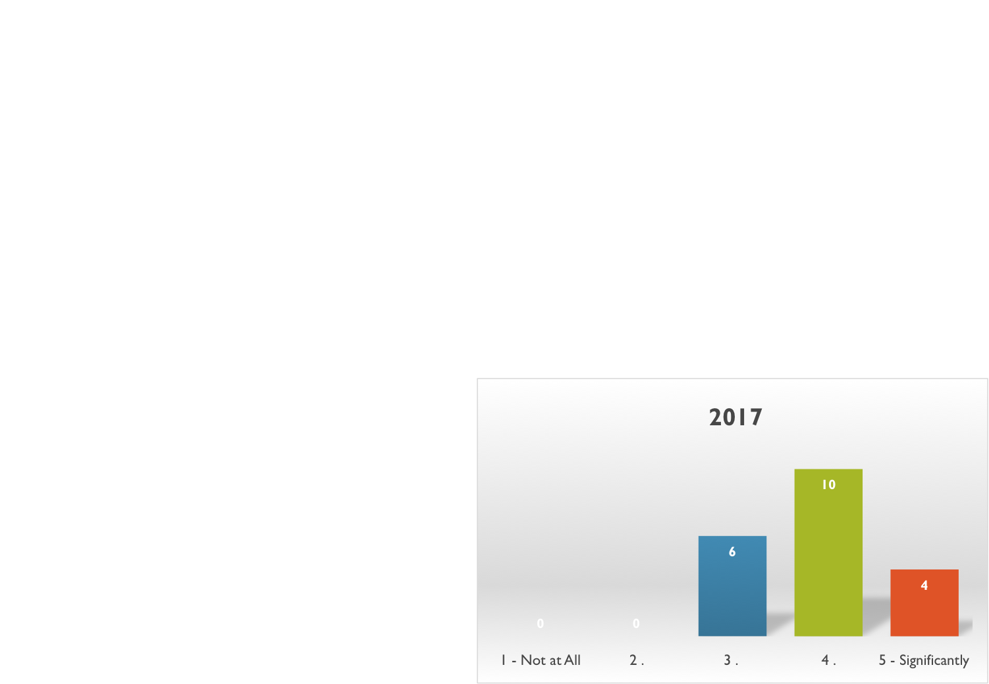
HOW DID IT GO?
How much did you feel the World Cafe provided information about the applicants' interpersonal interactions you would not have been able to get from the rest of the interview process?
Notes:
18

Slide 19
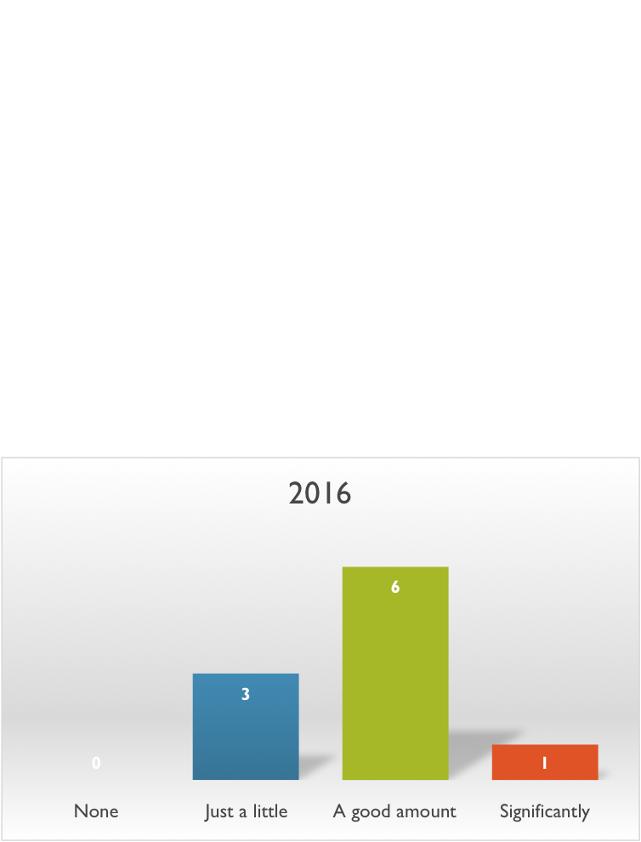
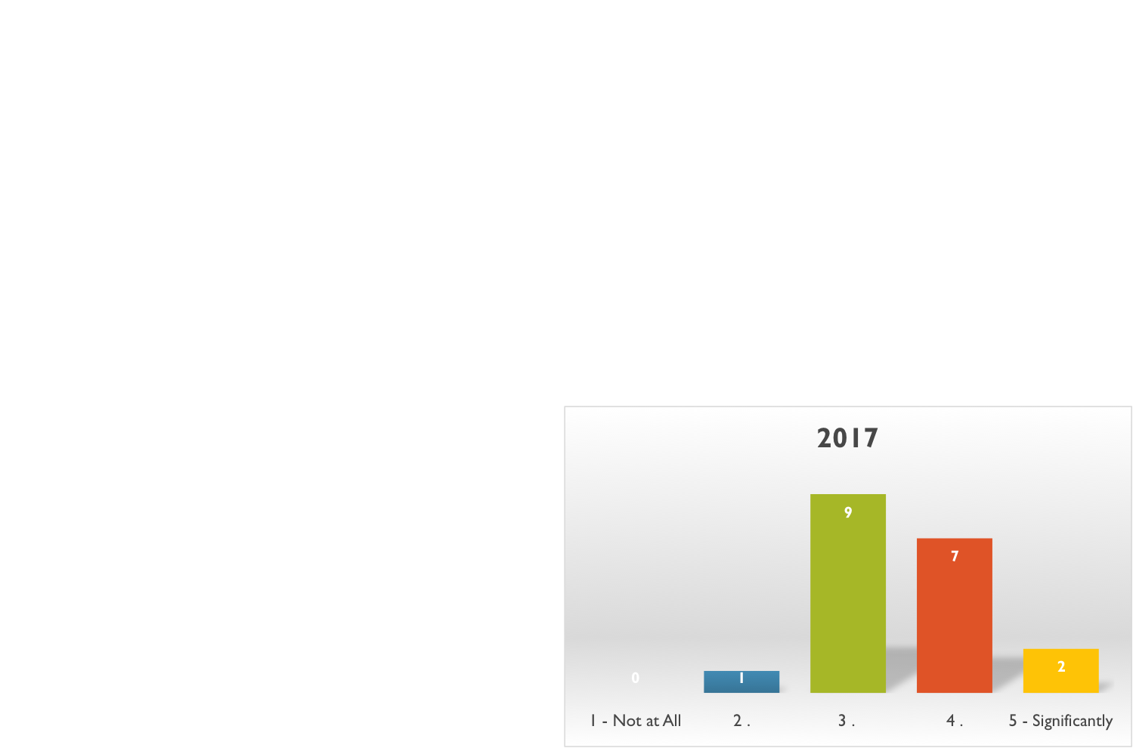
HOW DID IT GO?
How useful did you find the World Cafe format for assessing applicants' Problem Solving abilities?
Notes:
19

Slide 20
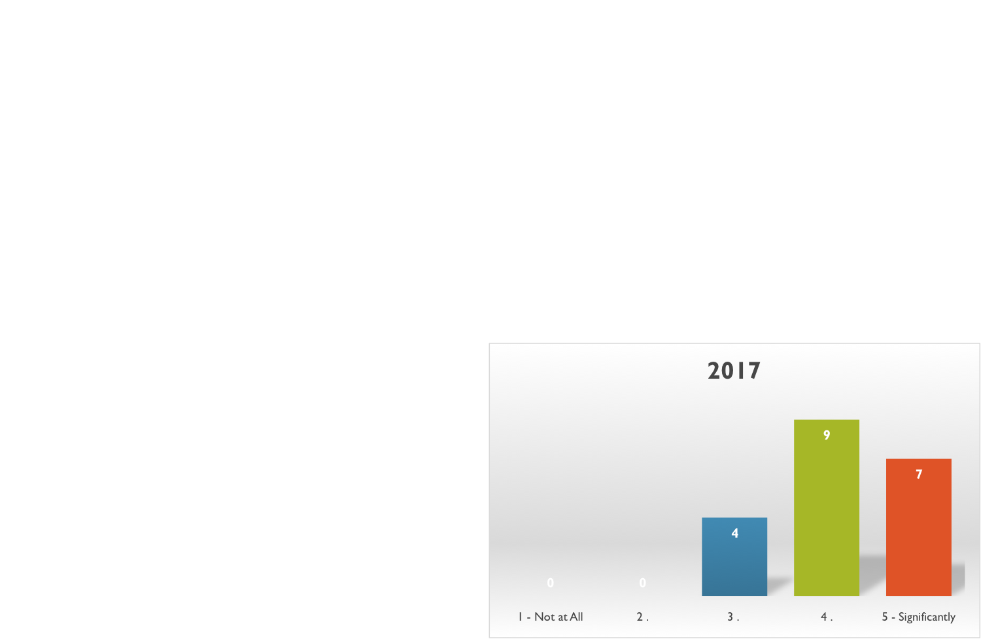
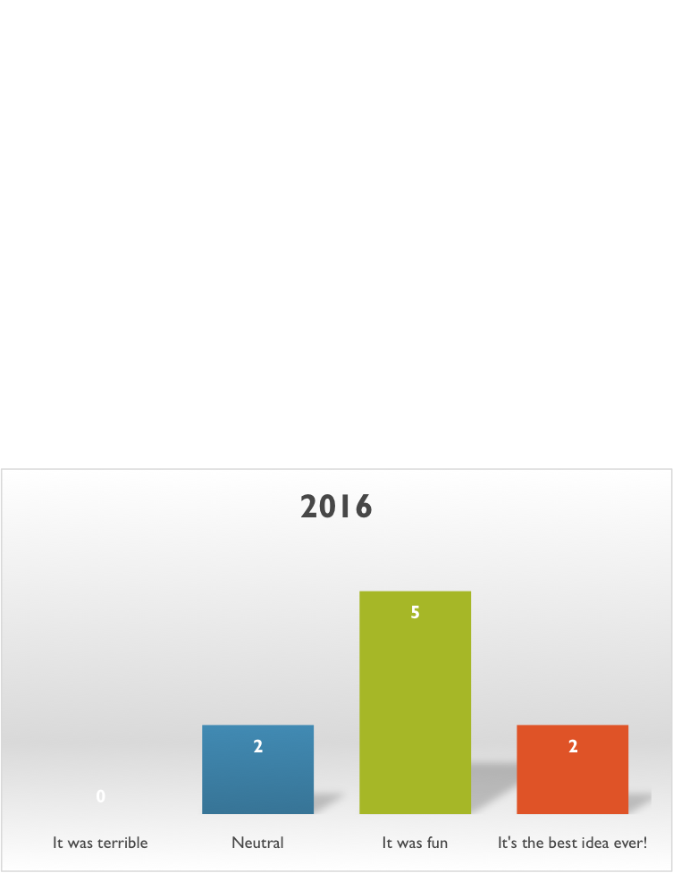
HOW DID IT GO?
How enjoyable did you find the World Café activity?

Slide 21
HOW DID IT GO?
Comments
Not sure if World Cafe provides an accurate picture of applicants interpersonal skills since they are all trying to be on their best behavior with both program faculty as well as with other applicants.
I think that this activity gives a good experience for the candidates and makes our program more attractive, something just as valuable as whatever assessment we may get of the candidates.
It is a great way to see the applicants in a group setting
I think we should only present the scenario. Sometimes the person who introduced the world cafe would give too much away about the purpose of it and what we were looking for.
While I thought it was GREAT, I could see how a shyer (is that a word?) candidate might have a hard time getting into the spirit of it. That being said, those who did well in the cafe tended to be comprehensively more impressive.
Take out the interviewer participation/prompting and interact completely as observers. Separate the two groups completely during the exercise and have one observed for each group. Inform interviewees ahead of time that there will be a group portion during their interview
It is a very important piece of the interview; but we're still left to make quick conclusions on a short interaction
More Cafe foods...

Slide 22
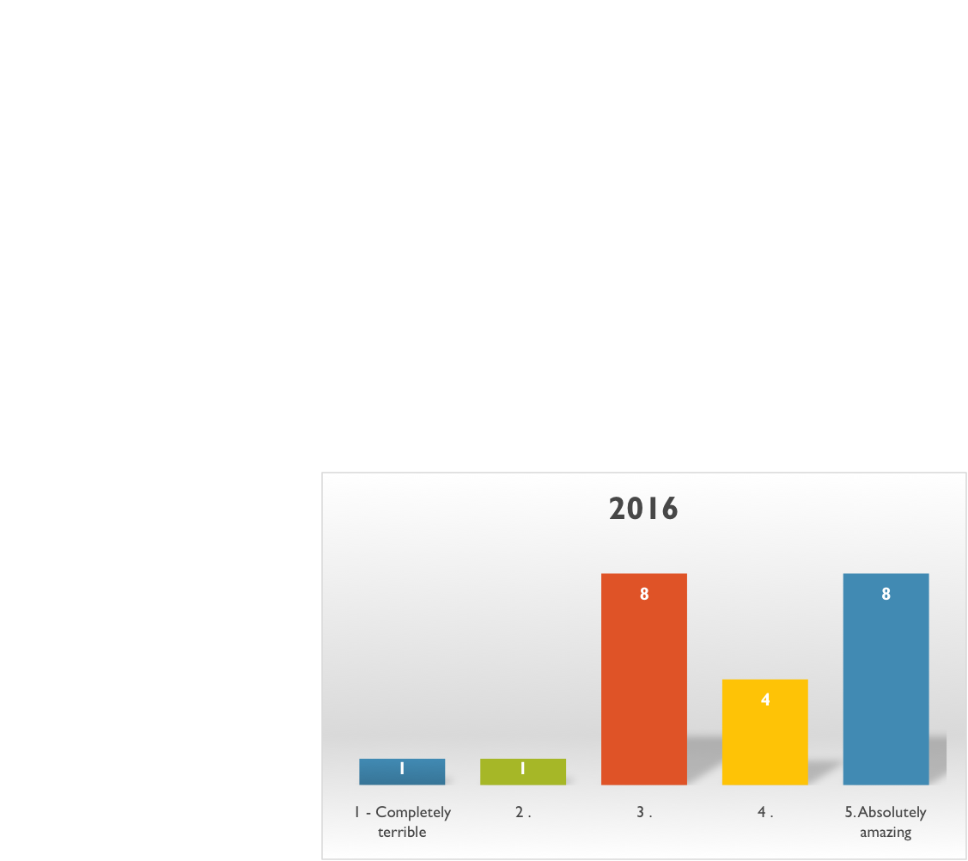
HOW DID IT GO? CANDIDATES RESPONSES
How would you rate the World Café portion of the interview day?

Slide 23
HOW DID IT GO? CANDIDATES RESPONSES
Comments
I thought it was a great unique aspect of the interview
It was a welcome change from other interviews
The experience was fun and enjoyable!
The residents were fantastic and the malleability of the program is very attractive.
It was fun and entertaining, allowed me to relax a little and see the residents working in a group setting. I did not have an experience like this at any other interview
I enjoyed brainstorming and how the faculty attempted to make it fun and lighthearted. Did not feel like it accurately represented teamwork skills as there were only 2 students and the goals/how interviewees were being evaluated was not clear.
I loved coloring on the tables. I liked having an activity different than just interviews to interact with faculty. I was a little confused about what exactly we were trying to do during that activity but I was also one of the first interview groups.

Slide 24
HOW DID IT GO? SECONDARY GOALS
Made our program more attractive by having a World Café session as part of our interview day
Faculty development: improved group dynamics and collaborative leadership
Greater depth of faculty familiarity with candidates
Notes:
Interviewing candidates for residency involves assessing potential residents’ skills and fit with a program based on standardized data and limited interactions. Generally, no strong association has been found between specific application characteristics and performance during residency, though some data exist that behavioral measures are more predictive of resident success. While hard to predict which residents may need remediation, it is generally seen as easier to address knowledge deficiencies compared with behavioral problems. We found the real-life scenarios presented in the World Café serve to elicit crucial skills not typically assessed such as leadership, collaboration, abstract thinking, and consideration of social justice. Additionally, the situation-based interactive sessions provide insight into participants’ emotional intelligence, i.e. self-awareness/regulation, motivation, empathy, and social skills. We have found that having faculty participate in the World Café has been a form of faculty development, improving our group dynamics and collaborative leadership. Having the World Café as part of an interview day lends greater depth of familiarity with candidates, while hopefully leaving a lasting impression on them.
24

Slide 25
WORLD CAFÉ: DESIGN PRINCIPLES
Set the Context
Create Hospitable Space
Explore Questions that Matter
Encourage Everyone’s Contribution
Connect Diverse Perspectives
Listen Together for Patterns and Insights
Share Collective Discoveries
Notes:
1) Set the Context Pay attention to the reason you are bringing people together, and what you want to achieve. Knowing the purpose and parameters of your meeting enables you to consider and choose the most important elements to realize your goals: e.g. who should be part of the conversation, what themes or questions will be most pertinent, what sorts of harvest will be more useful, etc..
2) Create Hospitable Space Café hosts around the world emphasize the power and importance of creating a hospitable space—one that feels safe and inviting. When people feel comfortable to be themselves, they do their most creative thinking, speaking, and listening. In particular, consider how your invitation and your physical set-up contribute to creating a welcoming atmosphere.
3) Explore Questions that Matter Knowledge emerges in response to compelling questions. Find questions that are relevant to the real-life concerns of the group. Powerful questions that “travel well” help attract collective energy, insight, and action as they move throughout a system. Depending on the timeframe available and your objectives, your Café may explore a single question or use a progressively deeper line of inquiry through several conversational rounds.
4) Encourage Everyone’s Contribution As leaders we are increasingly aware of the importance of participation, but most people don’t only want to participate, they want to actively contribute to making a difference. It is important to encourage everyone in your meeting to contribute their ideas and perspectives, while also allowing anyone who wants to participate by simply listening to do so.
5) Connect Diverse Perspectives The opportunity to move between tables, meet new people, actively contribute your thinking, and link the essence of your discoveries to ever-widening circles of thought is one of the distinguishing characteristics of the Café. As participants carry key ideas or themes to new tables, they exchange perspectives, greatly enriching the possibility for surprising new insights.
6) Listen together for Patterns and Insights Listening is a gift we give to one another. The quality of our listening is perhaps the most important factor determining the success of a Café. Through practicing shared listening and paying attention to themes, patterns and insights, we begin to sense a connection to the larger whole. Encourage people to listen for what is not being spoken along with what is being shared.
7) Share Collective Discoveries Conversations held at one table reflect a pattern of wholeness that connects with the conversations at the other tables. The last phase of the Café, often called the “harvest”, involves making this pattern of wholeness visible to everyone in a large group conversation. Invite a few minutes of silent reflection on the patterns, themes and deeper questions experienced in the small group conversations and call them out to share with the larger group. Make sure you have a way to capture the harvest – working with a graphic recorder is recommended.
25

Slide 26
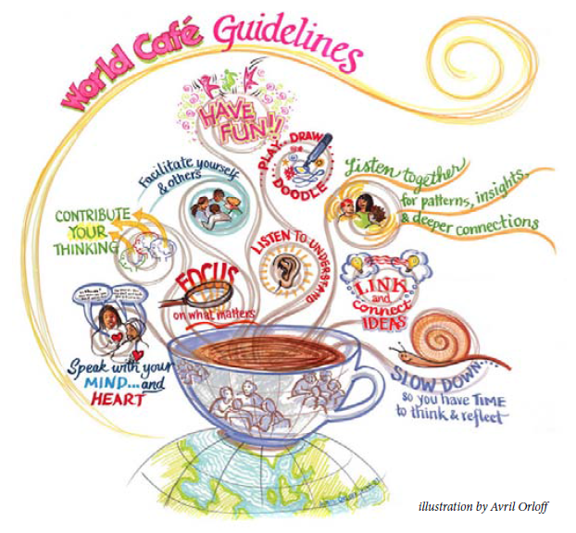
THANK YOU!
@AHowellMD
@AngeldocD
@DrBeaker
http://www.theworldcafe.com/wp-content/uploads/2015/07/Cafe-To-Go-Revised.pdf
Notes:
26

Slide 27
Please evaluate this presentation using the conference mobile app! Simply click on the "clipboard" icon on the presentation page.

