Slide 1
Finding the Right Fit: Family Medicine in a New Integrated Curriculum
Mark Beamsley, M.D.
David Deci, M.D

Slide 2
Disclosures
None

Slide 3
Objectives
Describe opportunities and challenges associated with traditional vs integrated curricula
Discuss strategies to help transition from an existing to a different clinical rotation model
Identify ways to effectively blend clinical training experiences while also highlighting the unique joys and considerations of a career in Family Medicine

Slide 4
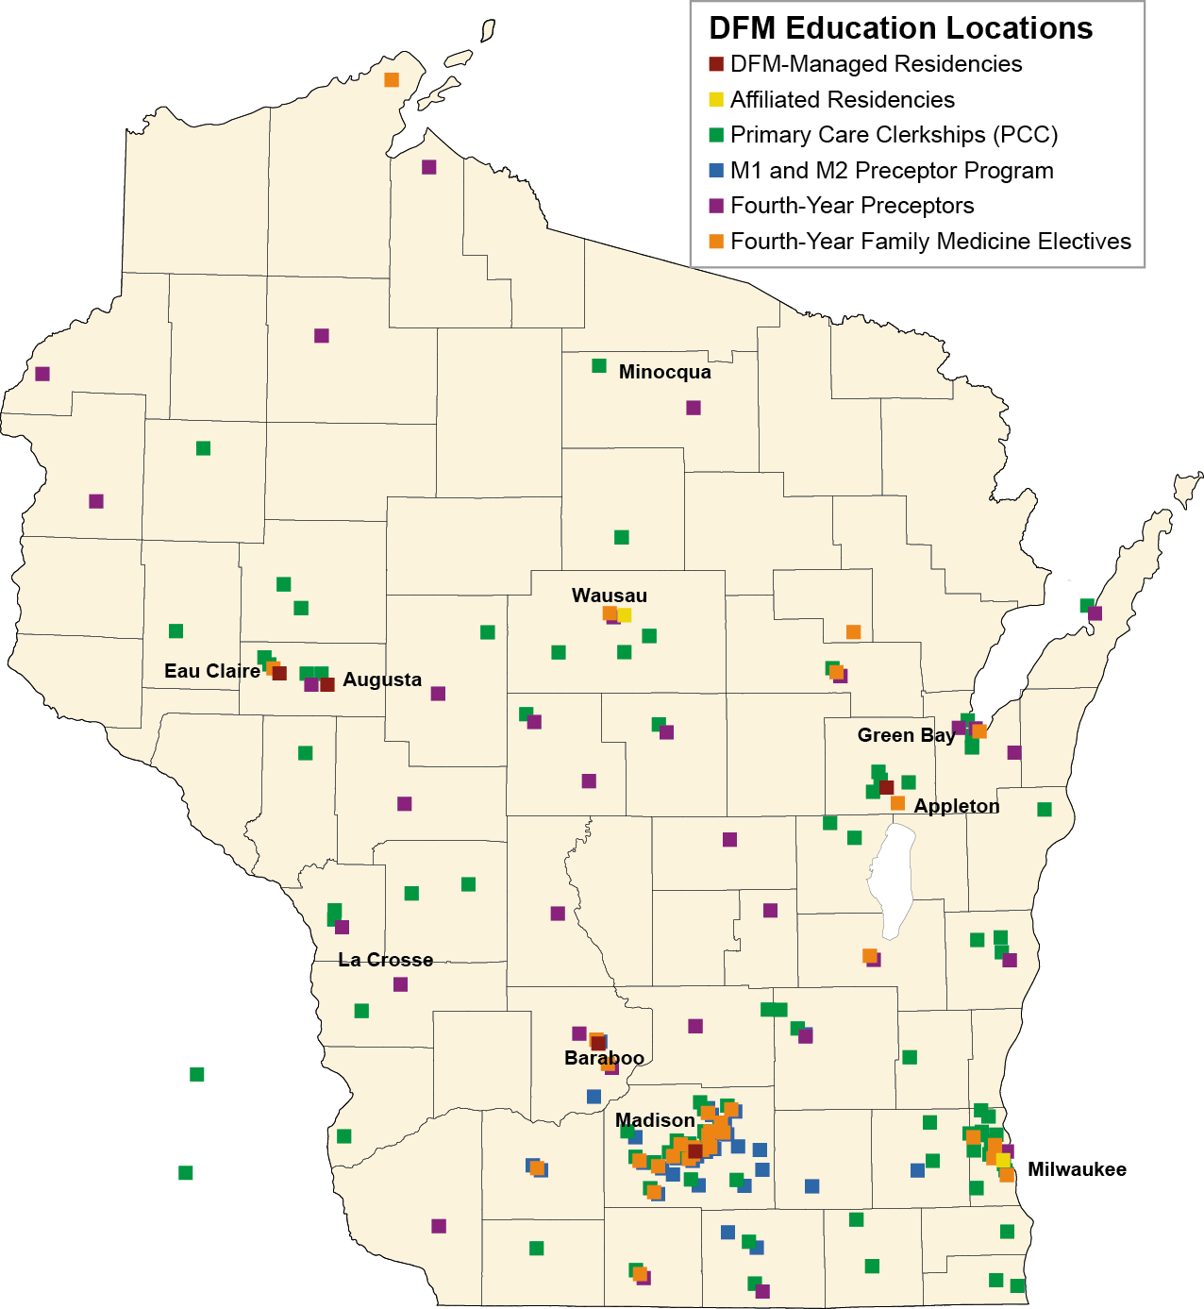
Background
185 students: State-wide campus
Existing curriculum: Traditional clerkship structure. Family Medicine is part of an 8 weeks required Primary Care Clerkship
August 2016: UW School of Medicine and Public Health (SMPH) begins transition to new integrated curriculum
http://www.countyhealthrankings.org/rankings/data/wi
Notes:
Current approach (empirically based)

Slide 5
Background
Key aspects of new curriculum:
Multidisciplinary design teams
Clinical training with integrated specialties
Earlier start to clinical rotations
Relate basic sciences to clinical rotations
More time for career exploration, NBME exams, residency prep
Notes:
Current approach (empirically based)

Slide 6
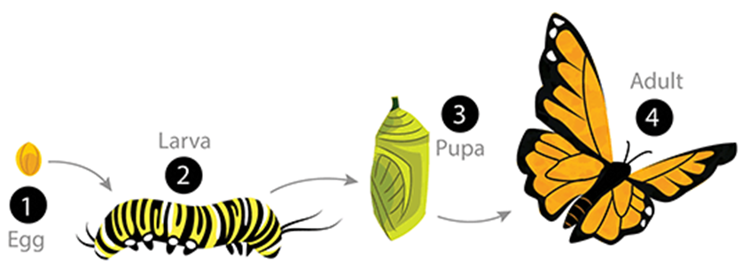
Potential Benefits
Improved learning
Systems-based approach emphasized
Uniform rotation lengths
More ability to track experiences, skills
Improved residency preparation
https://askabiologist.asu.edu/complete-metamorphosis
Notes:
Current approach (empirically based)

Slide 7
Primary Care Clerkship (8 weeks)
Chronic and Preventive Care (12 weeks)
Common ambulatory acute & chronic conditions
FM, GIM, Peds clinics
FM, GIM (Peds)clinics
Community Health
Small Group Learning
Neurology and Behavioral health
Specialty clinics

Slide 8
Challenges
Dilution effect from blending
Course “ownership” (admin and directing)
NBME shelf exams ~ specialty specific
Notes:
Current approach (empirically based)

Slide 9
Challenges
Overlap” in curricula
www.warnerbros.com/perfect-storm

Slide 10
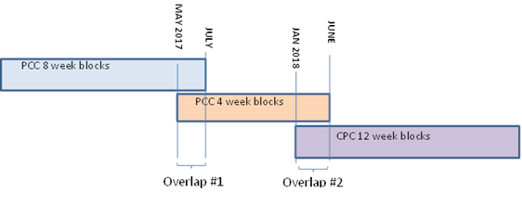
Curricula Transition
*2-3x increase in preceptor need during overlap during overlaps

Slide 11
Strategies for Transition
Reduce length of PCC clerkship to decrease overlap period*
Add online content
Engage FM faculty & leadership in transition
Discuss preceptor need & critical periods
Define MSE as a core departmental mission
Develop model with students assigned to clinic by FTE
Clinic and departmental outreach plan:
Information sessions re: SMPH changes
Faculty development assistance
Further define model for clinic template adjustment
Limit curricula overlap at individual campuses
Pilot components of new curriculum
Notes:
Current approach (empirically based)

Slide 12
Helping Students See the Trees and the Forest
Maintain preceptor/mentor model
Create “Selectives”
Create Model for Student-Patient panel
Use small groups to discuss various perspectives

Slide 13
Comments, questions
http://www.chgeharvard.org/resource/seeing-forest-trees-harvard-design-magazine

