Slide 1
The Robot Will See You Now: The Evolving Future of Family Medicine
Aaron Michelfelder, M.D.
Michelle Byrne, M4
Loyola University Chicago Stritch School of Medicine

Slide 2
Disclosures
Nothing to Disclose for Either Presenter

Slide 3
Objectives
Foster openness to new possibilities for the structure and function of the future family medicine team
Analyze the role of touch from both people and technology in caring for patients
Define several disruptive technologies impacting the transformation of family medicine

Slide 4
Road Map
Future Oriented
Influences/ Drivers of Change
Disruptive Innovations
3 T’s for Family Medicine’s Future
Technology
Teams
Touch
A Future Family Physician

Slide 5
Influences
IHI Triple Aim
Improve Population Health
Decrease Cost
Improve patient Experience
(Improve HC Team Experience)
Affordable Care Act
Shift from “Volume to Value”
Repeal and Replace

Slide 6
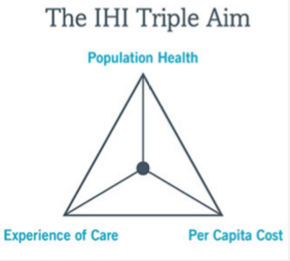
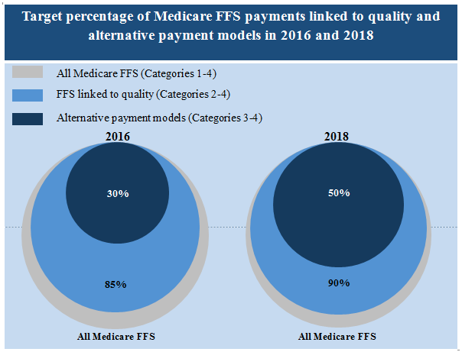
Influences
http://www.ihi.org/engage/initiatives/tripleaim/Pages/default.aspx
Image from www.itup.org

Slide 7
Influences
Patients
Care Anywhere
Care Anytime
Care That is Convenient
Care That is Affordable
Technology
???Health Care Provider Shortage???

Slide 8
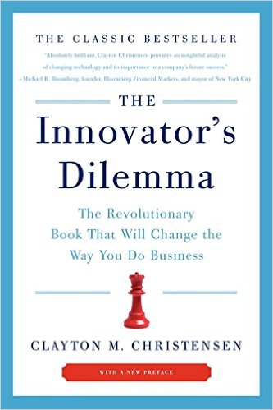
Disruptive Innovations

Slide 9
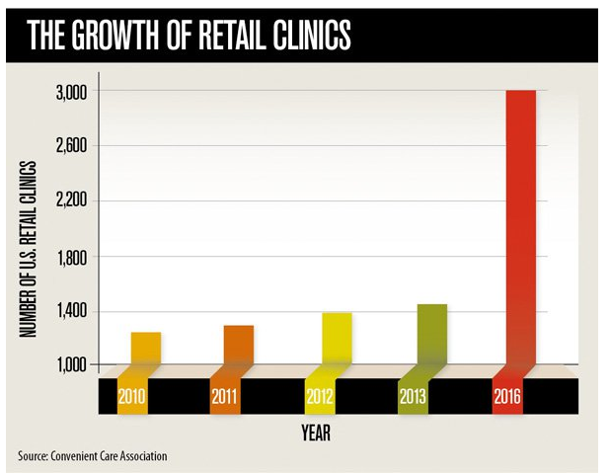
Disruptive Innovations
From Medical Economics
http://medicaleconomics.modernmedicine.com/medical-economics/content/tags/cvs-caremark/what-retail-clinic-growth-can-teach-physicians-about-pat?page=full

Slide 10
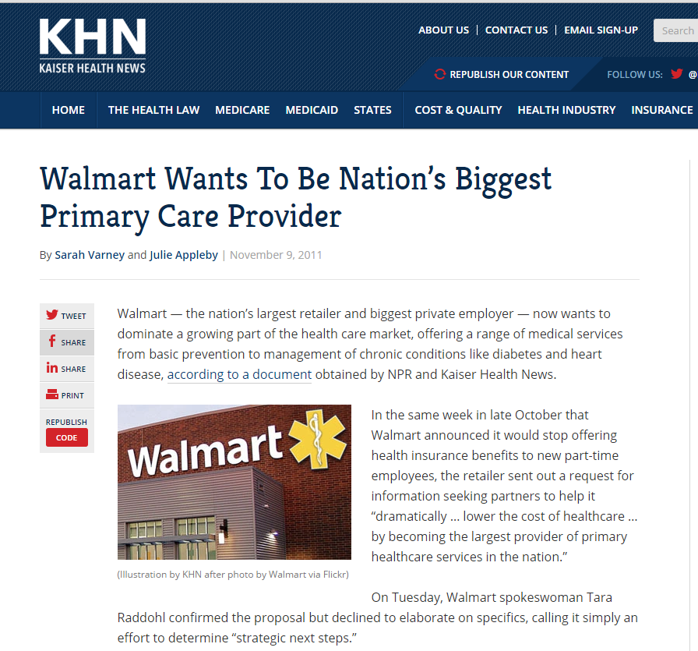

Slide 11
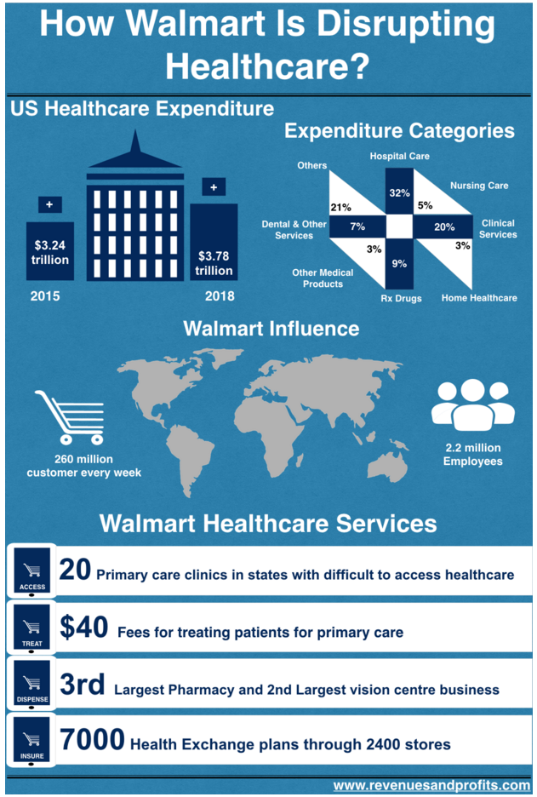
Image from http://revenuesandprofits.com/how-walmart-is-disrupting-healthcare-2/

Slide 12
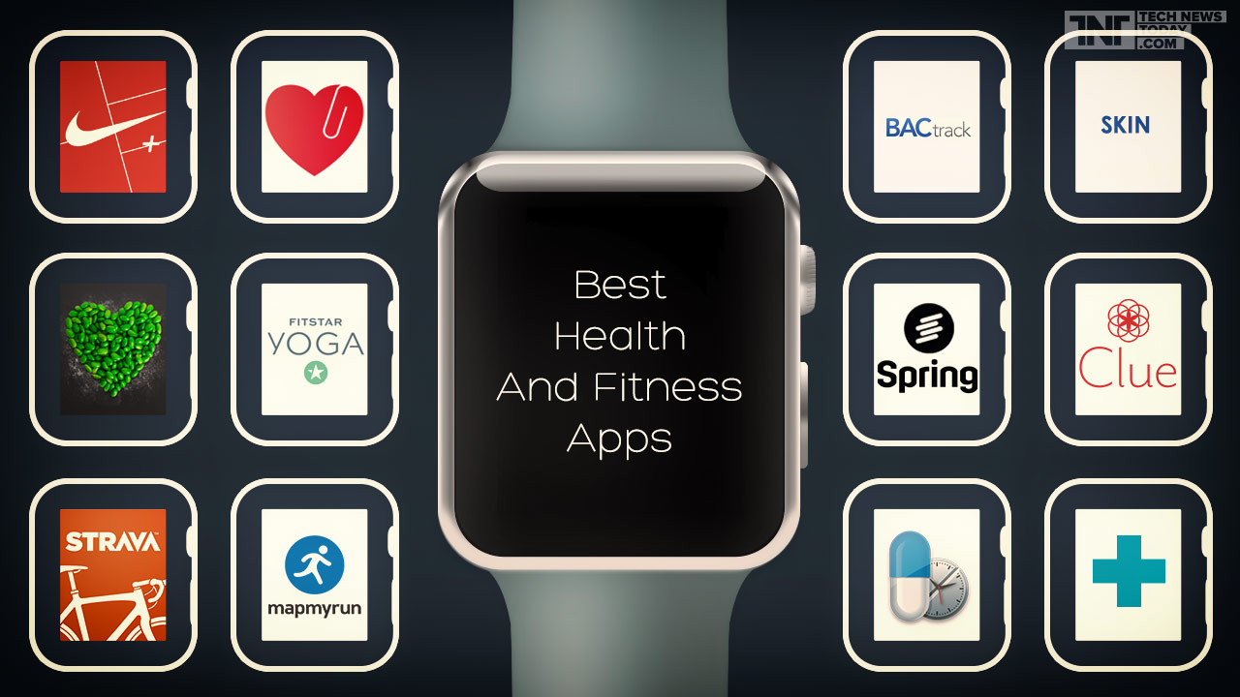
http://images.technewstoday.com.s3.amazonaws.com/tnt/here-are-some-of-the-best-apple-watch-health-and-fitness-apps.jpg

Slide 13
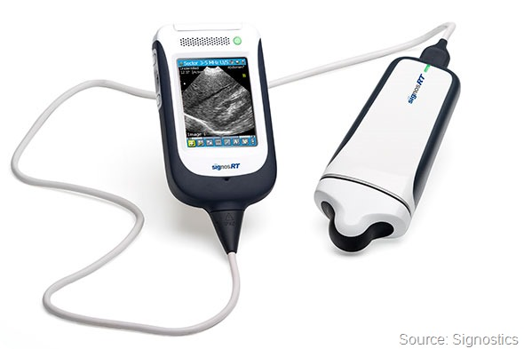
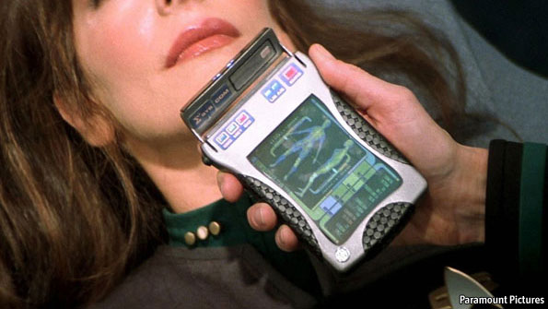
http://www.news-medical.net/image.axd?picture=Signostics%203_thumb.jpg

Slide 14
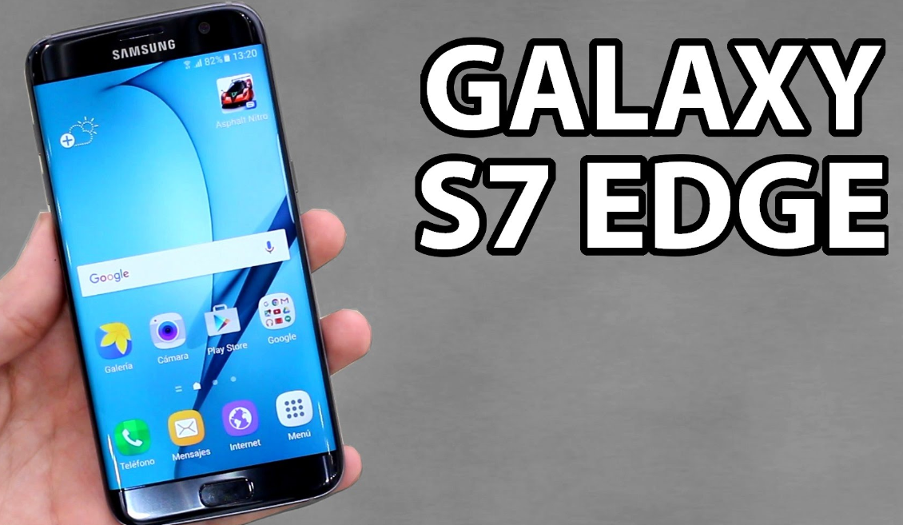
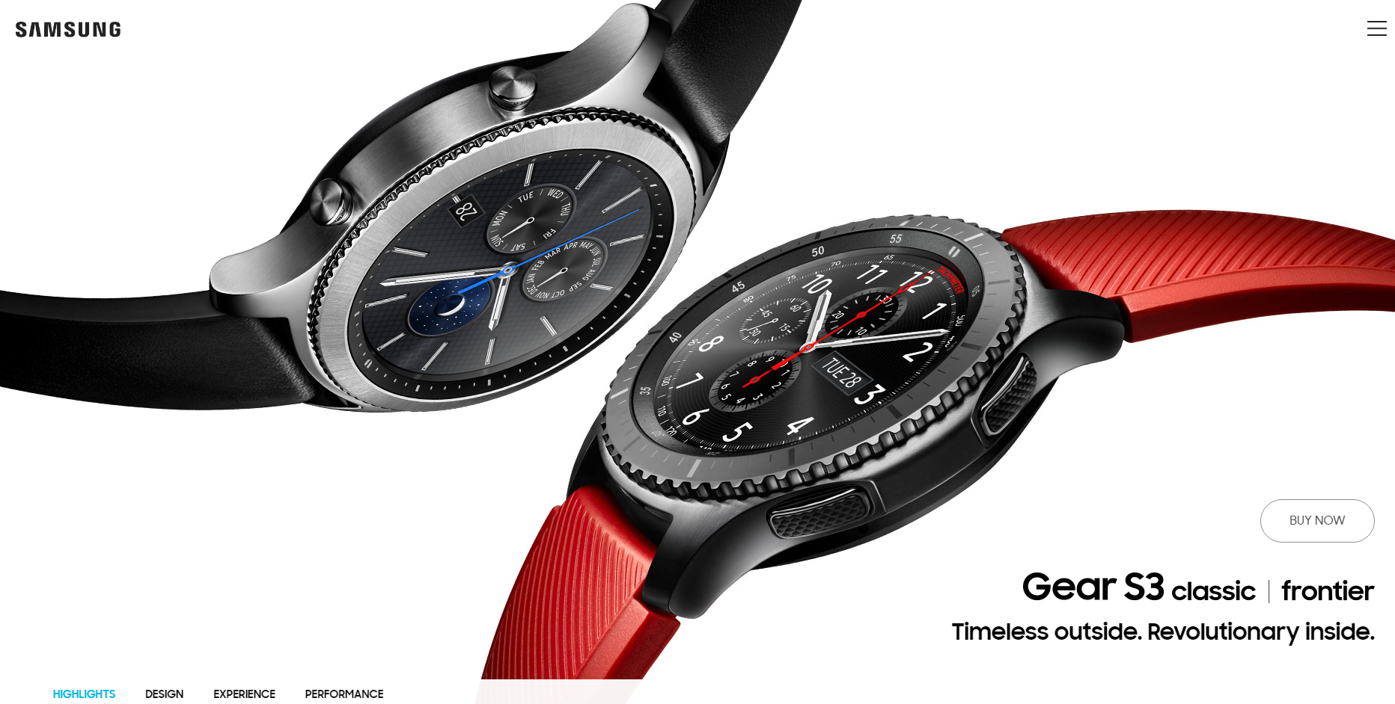

Slide 15
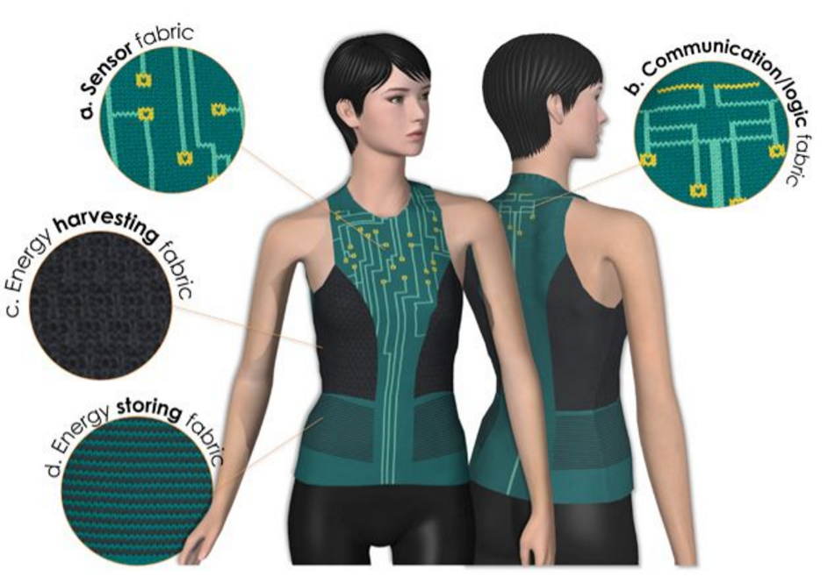
https://www.pinterest.com/pin/485825878530628250/
Notes:
https://www.pinterest.com/pin/485825878530628250/

Slide 16
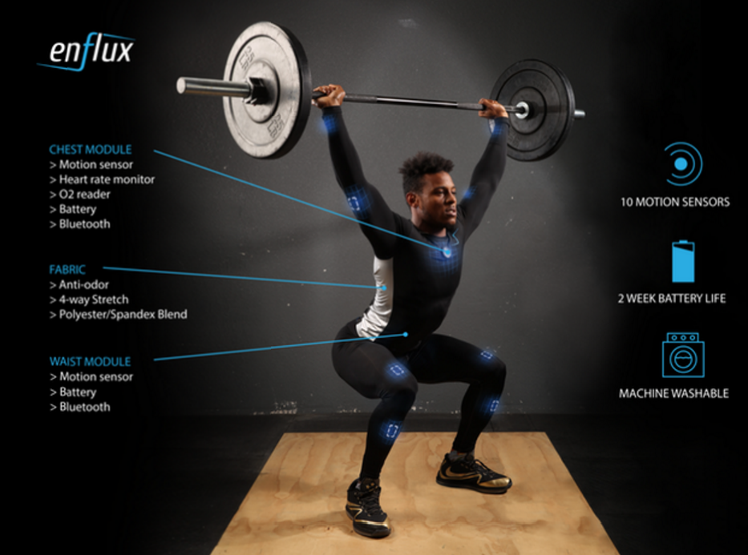
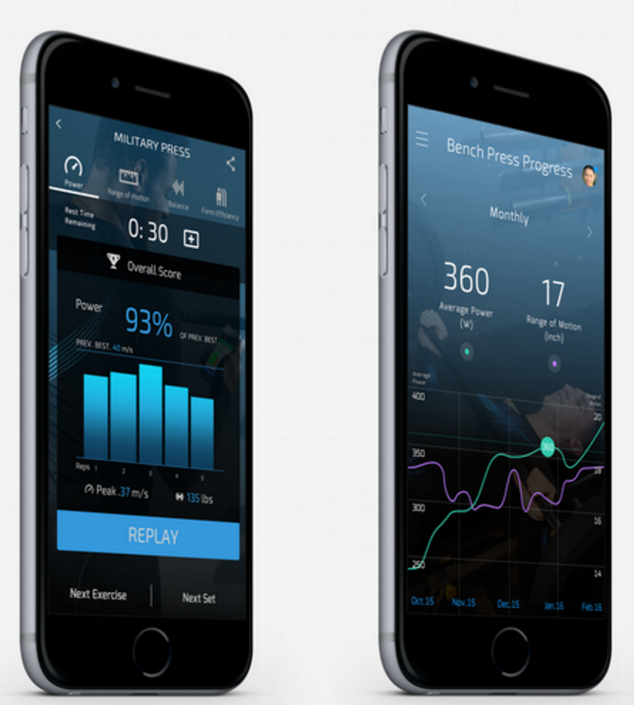
http://www.sportswearable.net/get-form-feedback-and-3d-workout-tracking-with-enflux-smart-clothing/

Slide 17
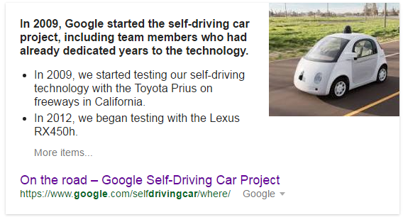
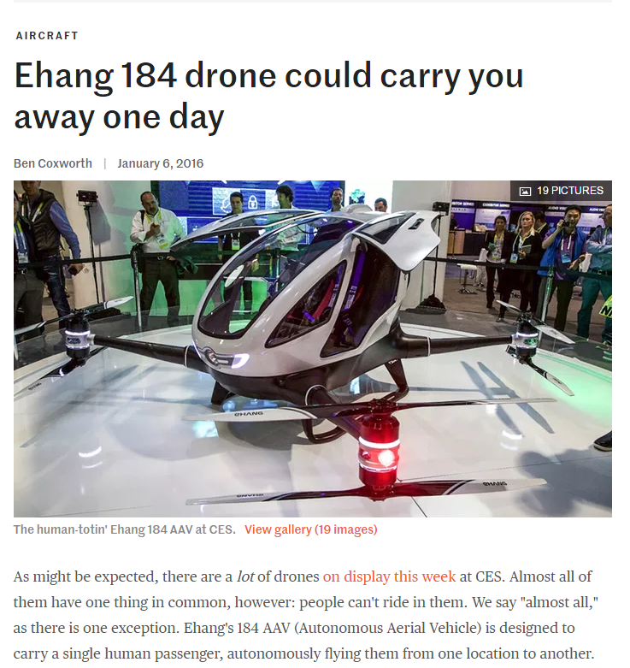
Autonomous Vehicles

Slide 18
http://www.boeing.com/history/products/757.page

Slide 19
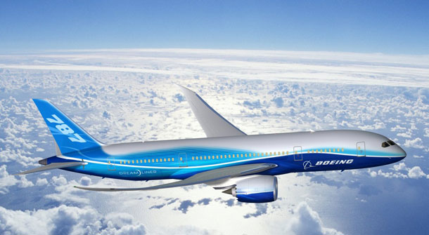
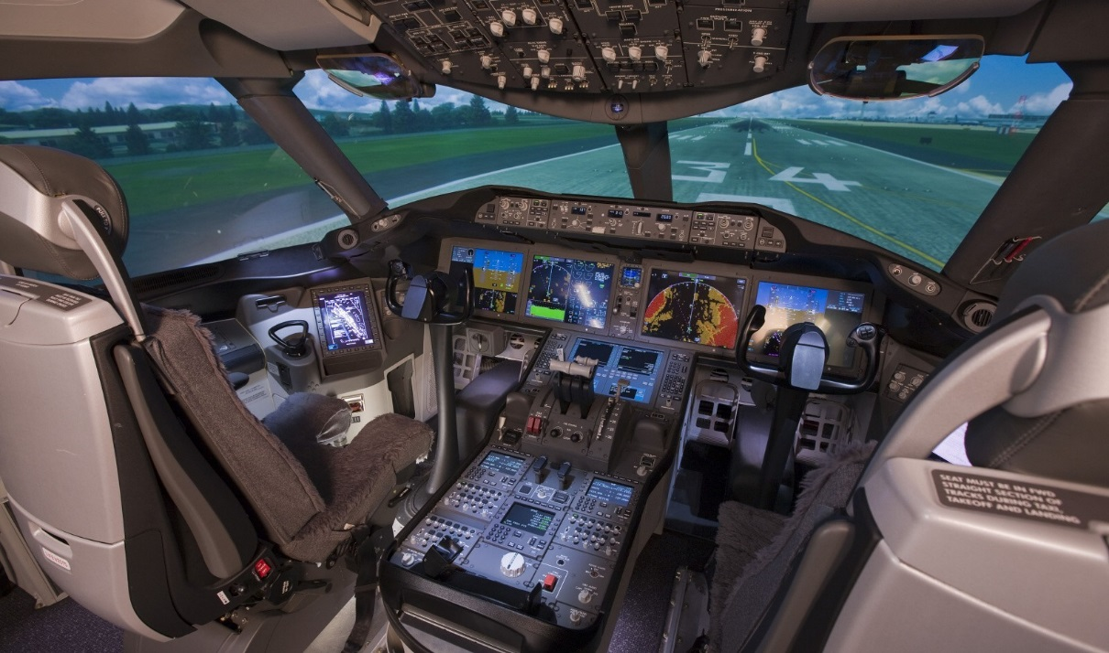

Slide 20
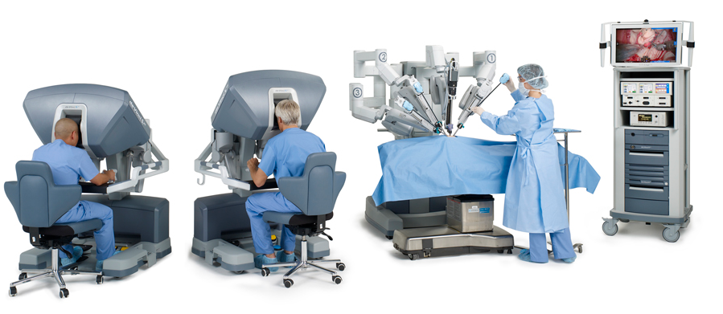
da Vinci Robot

Slide 21
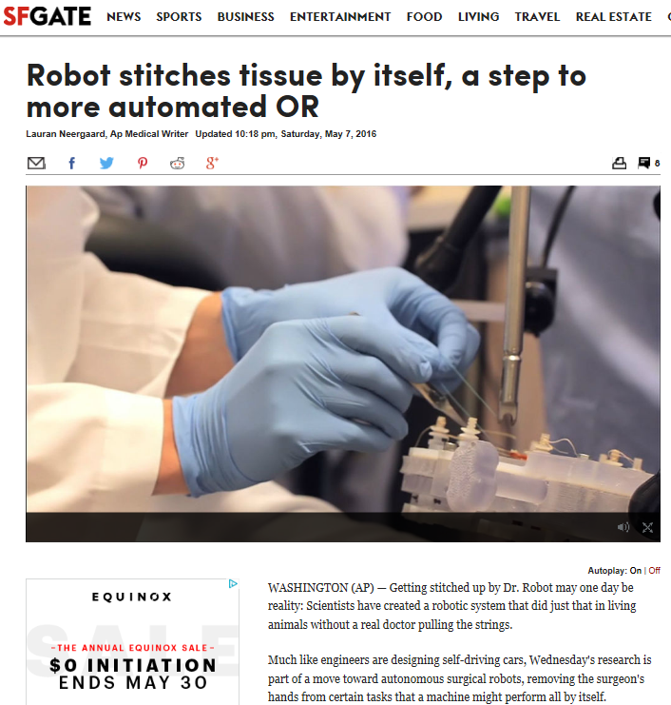

Slide 23
https://www.opternative.com/

Slide 25
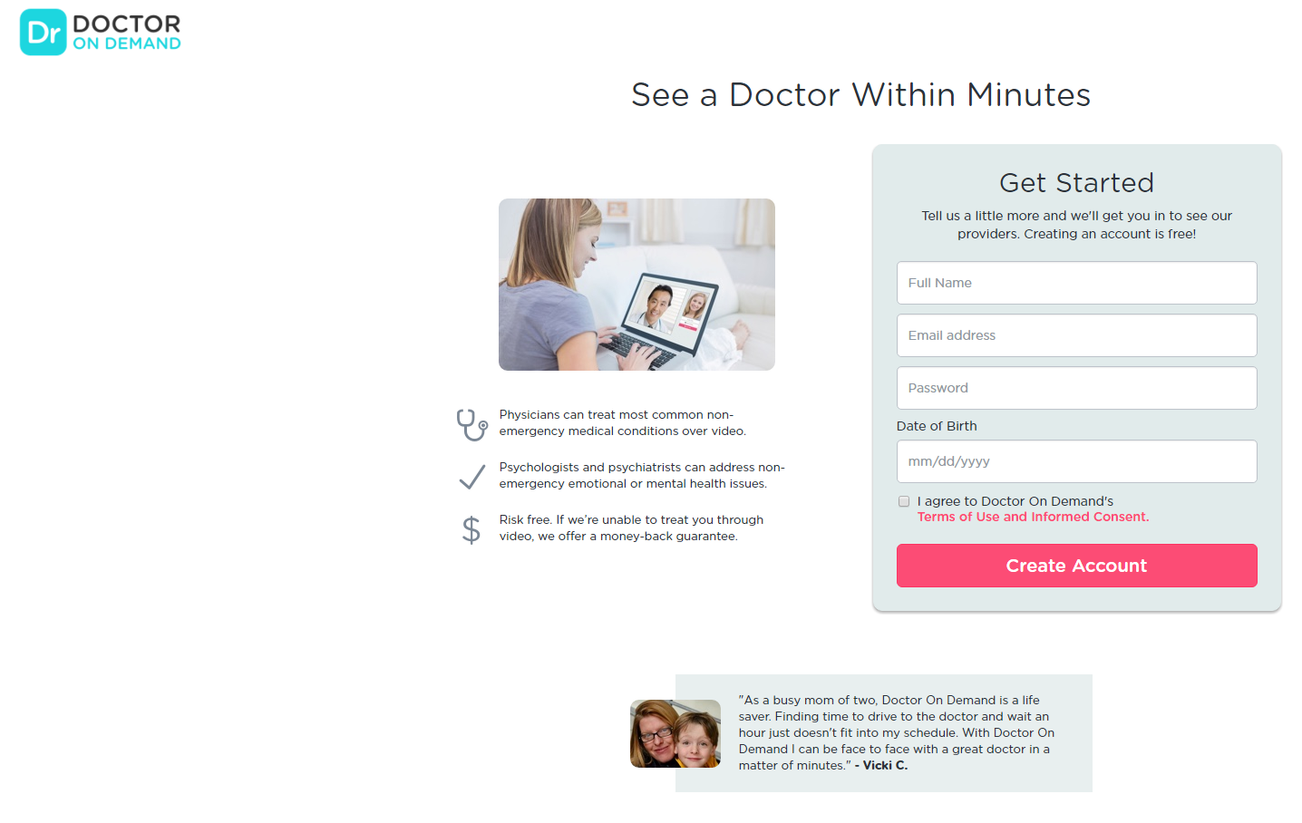

Slide 26
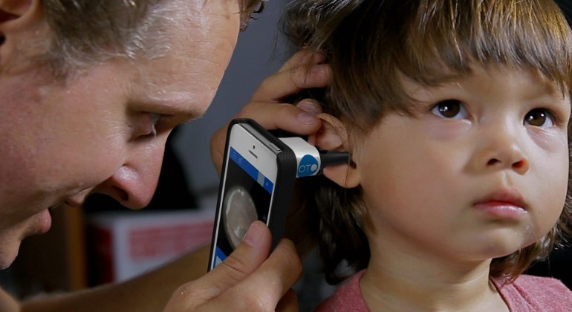
http://www.slashgear.com/oto-home-otoscope-iphone-case-makes-ear-exams-mobile-17359731/

Slide 27
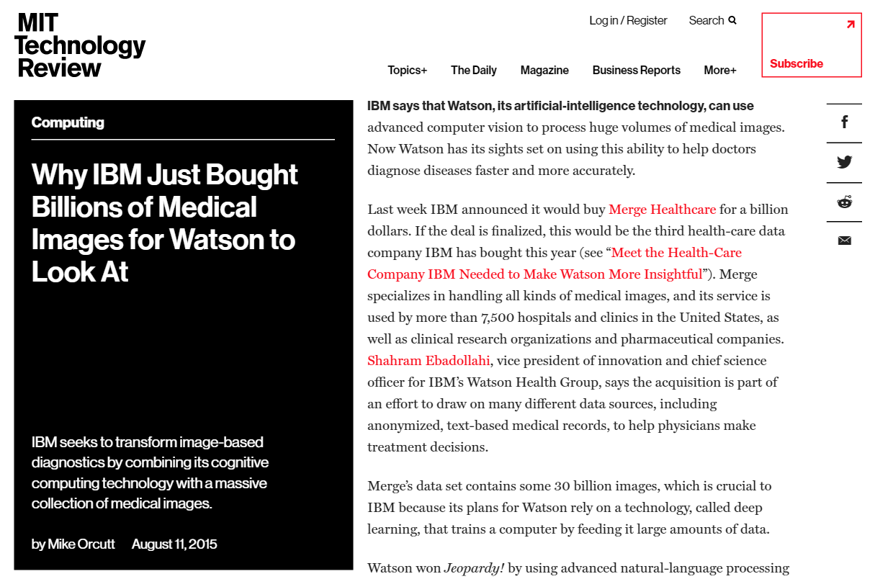
https://www.technologyreview.com/s/540141/why-ibm-just-bought-billions-of-medical-images-for-watson-to-look-at/

Slide 28
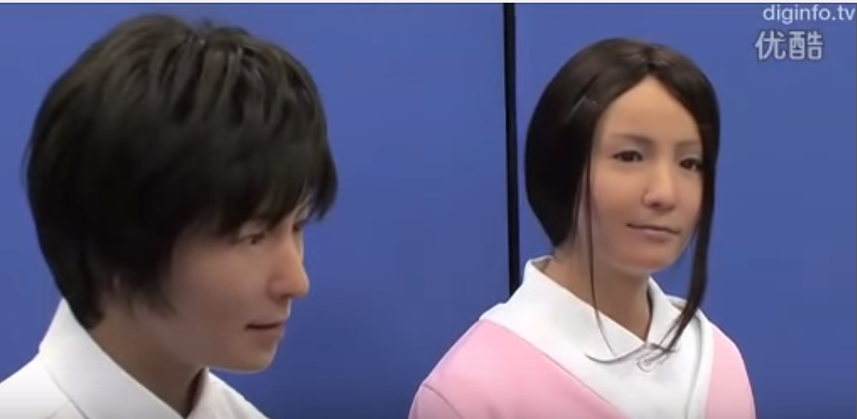
https://www.youtube.com/watch?v=MaTfzYDZG8c

Slide 29
The Future of Family Medicine
More Automation
More Data
More Technology
Fewer Physicians?
Fewer Face-to-Face Interactions
Larger, Smaller & More Integrated Health Care Teams
Different Skill Sets

Slide 30
The Future of Family Medicine: 3 T’s
Technology
Teams
Touch

Slide 31
Technology
Evidence-Based Technology Use
New Technology Evaluation
Engage Learners for Tech Creation
POC Ultrasound
Physical Exam Skills
Obesity
Over the phone
On a screen

Slide 32
Technology
Health Information Technology
Telehealth
Quality and Safety Sciences
Perceptual Skills

Slide 33
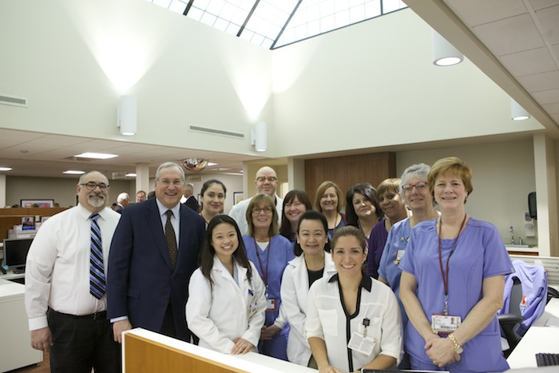
Teams
Current Primary Care Team
Care Coordinator
RN
Physician
FM, IM, Peds, Med/Peds
Psychiatry
APP
Behavioral Health
Social Worker
Dietician
MA/LPN/PCT
PT/OT
Front Desk Staff

Slide 34
Teams
http://www.aacn.nche.edu/education-resources/ipecreport.pdf

Slide 35
Teams
Future Health Care Team
Patients
Veterinarians
Public Health Sciences
Biomedical Sciences
Librarian
Computer Science
Human Interface Technology
Software Engineer

Slide 36
New Model of Primary Care
Community
Outpatient Primary Care Team
Patient +
RN Care Coordinator
ED/Urgent Care
Hospitalist

Slide 37
Touch
???

Slide 38
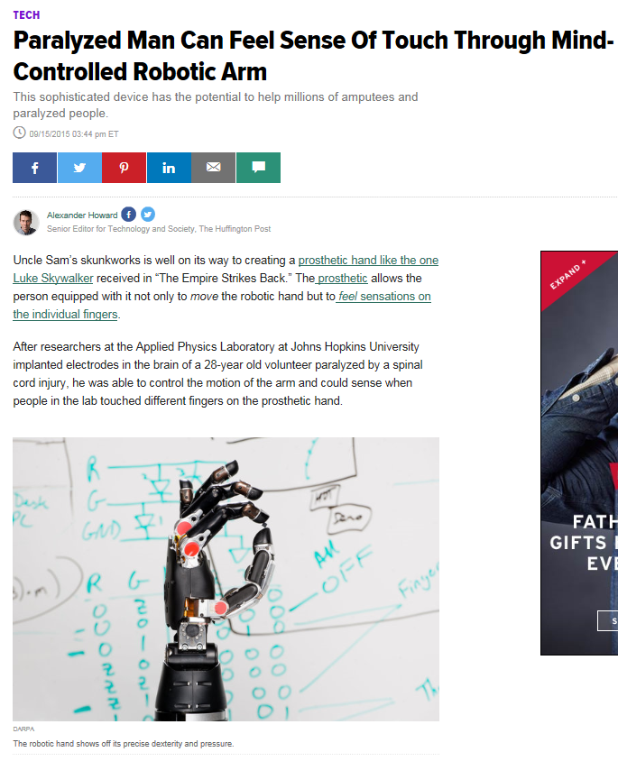

Slide 39
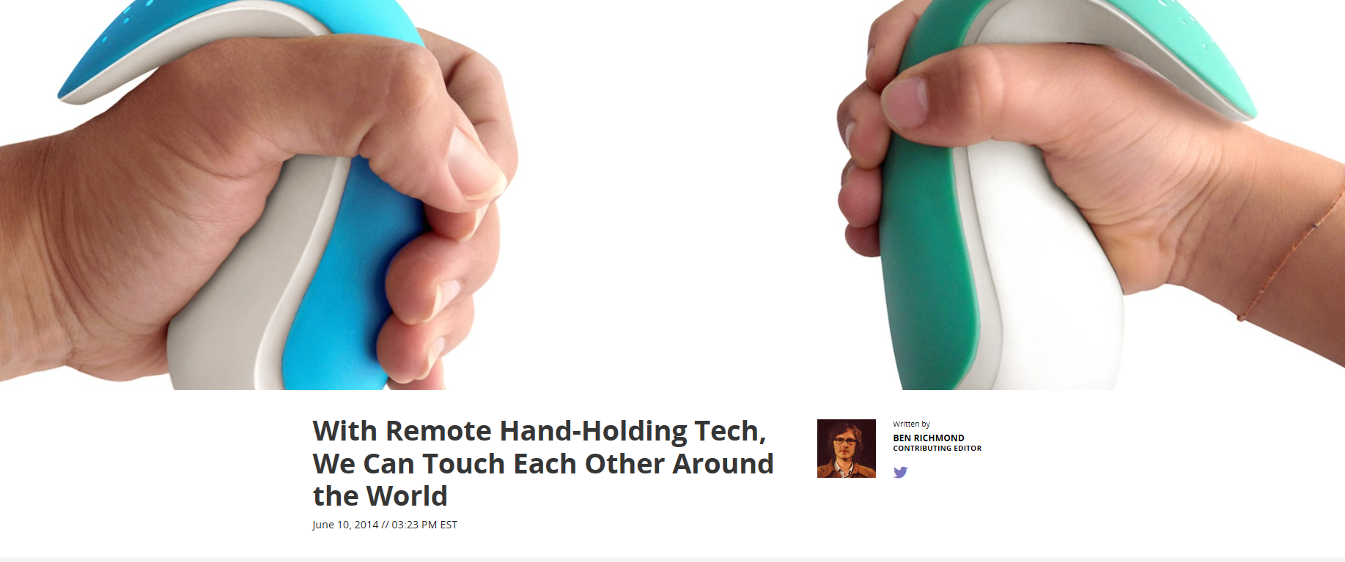

Slide 41
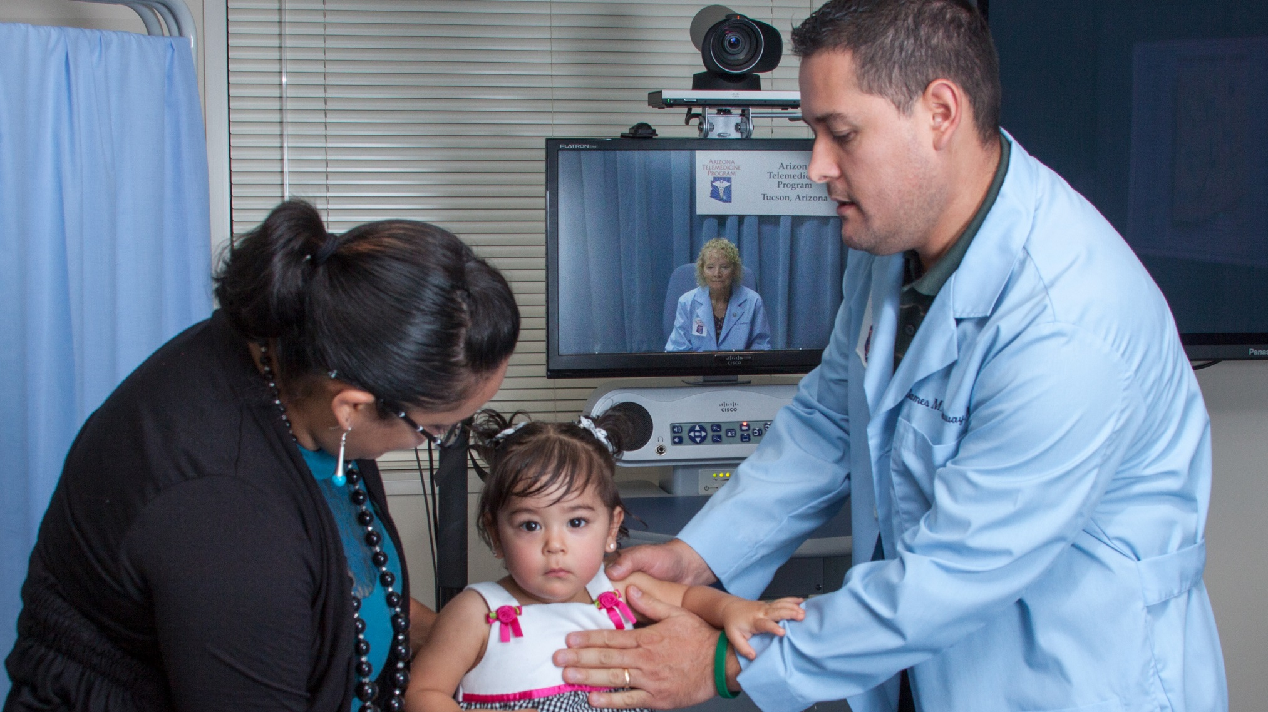
Arizona Telemedicine Program
https://www.azpm.org/p/top-news/2015/4/27/62348-new-technology-improves-medical-access-amid-doctor-shortage/

Slide 42
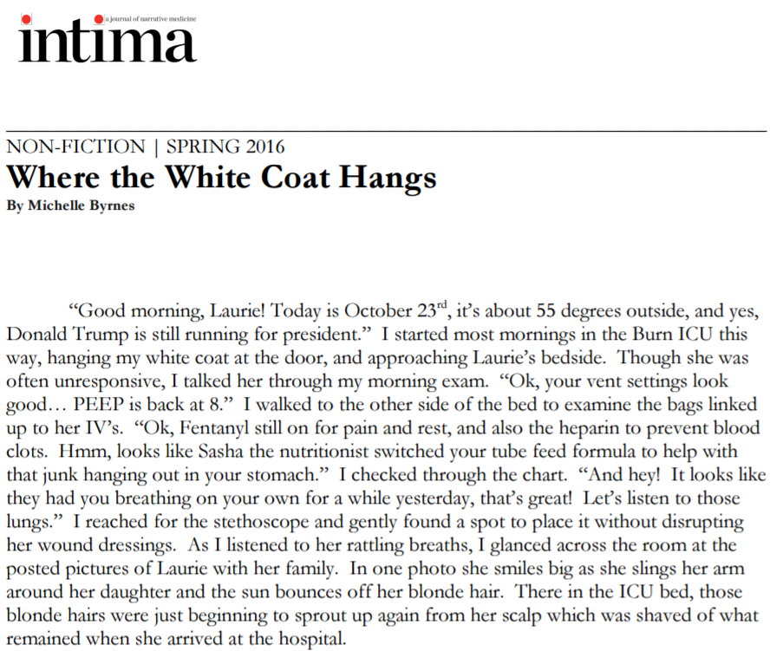
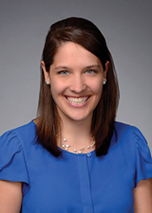
https://www.theintima.org/s/MichelleByrne-WheretheWhiteCoatHangs.pdf
Michelle, Byrne, M4
Future Family Physician

Slide 43
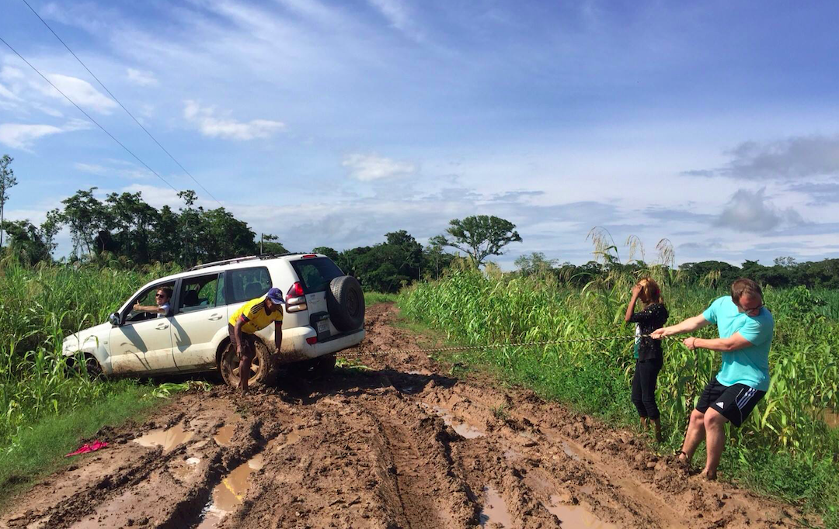
Notes:
- Summer between first and second year

Slide 44
Who Chooses Family Medicine?
The data: Students who are older, have a rural background or intent, lower income expectation, show a preference for FM at matriculation, attend public school, participate in special FM programs, go to schools with required clerkships, a social mission, and a strong FM department.

Slide 45
Importance of Mentors
YOU MATTER!
(a lot)

Slide 46
Overheard at STFM…
“We are our best marketing tool!”
“Your first job as a teacher is to be a role model”
“We need to be aware of the way we’re showing up”
“They are watching you like a hawk”
Notes:
Main exposure is to academic centers and ladder-climbing specialists- we need YOU to show us another way of doctoring
you can fight the hidden curriculum by taking are of yourself, by enjoying your job, by loving your families, by being active with your hobbies
remind us that doctoring can add joy to our lives and that we can be joyful while doing it

Slide 47
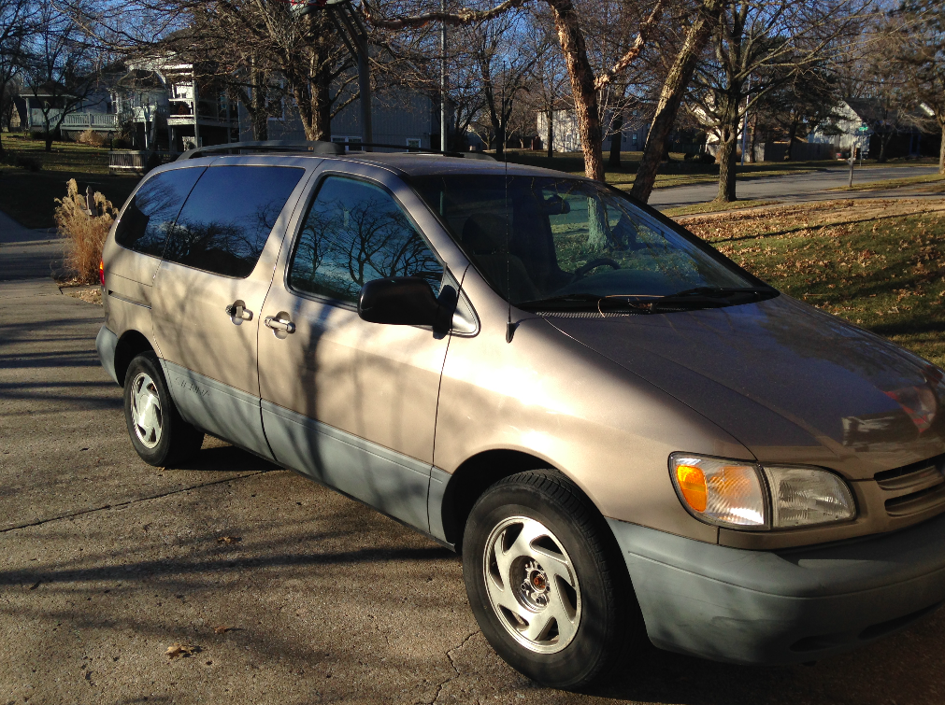
Why Students Choose FM
Paycheck

Slide 48
Notes:
She just makes it safe to be a learnerShe creates physical space for you and gives you a clear role so you don't feel out of placeShe respects everyoneShe makes it possible to picture what you should strive to be
- she has pictures up of max the camel
She asks the nurse what she thinks and she genuinely cares
share the cookies your patient brought you for your birthday
- they live out the values that we have in family medicine: considering social determinents, building relationships, team-based care,

Slide 49
Best Practices of a FM Teacher
They make space for us
They challenge us
They celebrate with us!
Notes:
Take a moment to recall a mentor that you’ve had in family medicine.
Turn to the person next to you and tell them one word that describes them
Lots of amazing traits: good with patients, dedication to underserved, etc
Accessibility, involvement in med school early on – jeremy story
Challenging - call us to our best selves
“we are drawn to doctors who have joy in what they do– figure out what you can celebrate about your job with your students”

Slide 50
A Student Spin On…
Technology
Teams
Touch
… and how you as a mentor can help!

Slide 51
Teams
Interprofessional Education Lessons
Who is the expert?
What am I uniquely
trained to do?
Notes:
- Lucky to be the “pioneer” med student in the ITIE program started by Dr. Michelfelder and his colleague Dr. Vlasses from the school of nursing
Through this program completed a project over the course of a year with students from a variety of other health profession programs including dietetics, health informatics, nursing, and public health
Together we designed the Wellness Connection Clinic, a model to be used by a transitional housing organization in Chicago
Incredible experience of working in a team, 2 major take aways:
What other health professionals are experts in, and what i’m an expert in:
- working at the opt of your licensure, allowing FM docs to do what they are best at
Responsibility of FM to be the leader in transitioning primary care to a more interprofessional state

Slide 52
Teams
Areas of Expertise
Disease processes
Models of care and payment
Population health
Supply needs
Logistics

Slide 53
Teams
“Aren’t you afraid that a nurse practitioner is going to take your job?”
NO!
Notes:
This is something I’ve often had classmates and others ask me whenever I suggested FM as a potential career path
And my simple to answer to you is, NO!
And after the first half of the lecture, I’m far more fearful of nurses than robots.
- Teachers of family medicine are in the prime position to work toward this team transformation
- Encourage you to involve your students in the interprofessional aspects of your job

Slide 54
Technology
A 2016 study of how residents spend time:
51% of their day on computers
9% of their day with patients
Remainder: Phone, walking, waiting, meeting
Notes:
- This study, shocking exactly zero people in this room, is something that I do worry about as a trend in medicine.
- Dr. Mich has already given all of us some healthy fear about the ways that technology will disrupt the current way we function

Slide 55
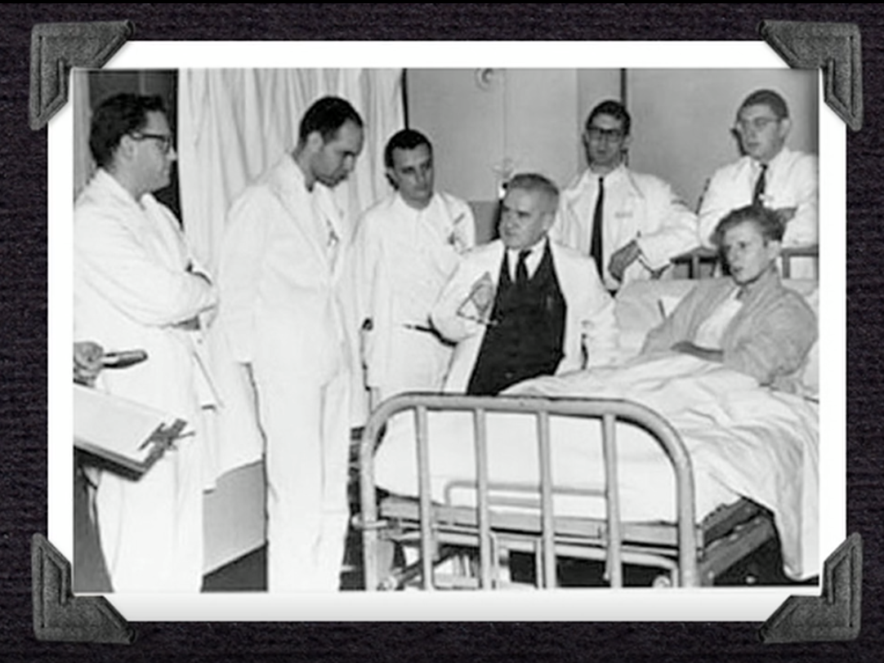
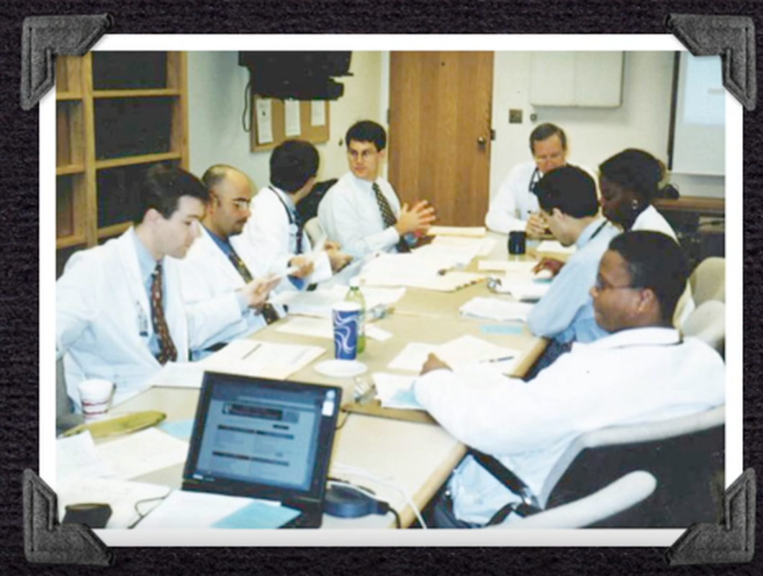
“Rounds”- then and now
Notes:
- From my perch on the stool, I watch the sea of blue gowns fall like a crashing wave. Heads bow, vials drop, and the oxygen mask is pulled from his face. I am stuck midair with elbows locked, prepared for the next round of compressions that will no longer come.
Because no CPR video or trainer can truly portray what it feels like to pump someone’s heart with your own hands.
Team members are preparing medications to inject, steadily squeezing his oxygen bag, and buzzing around the room completing a symphony of other tasks in rhythm.
We were in the business of life vs death, and our approach was mechanical, routine, algorithmic.

Slide 56
Touch: A History
“the art of laying hands”
Percussion: Dr. Auenbrugger, late 1700’s
Stethoscope: Dr. Laennec, early 1800’s
A Doctor's Touch: Abraham Verghese
Notes:
Percussion discovered with barrells of wine
Experience with dianne, holding her hand
Spent a month in the burn unit during my surgery rotation
Cared for a patient whom I’ll refer to as Laurie
“the art of laying hands”
Interrupting patients in 14 minutes
7:36 left, 4:27
OR 3:12 to include ritual explanation

Slide 57
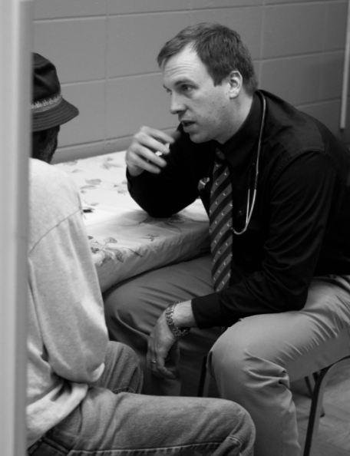
Touch
Notes:
- Something that really encouraged me about family medicine was the commitment that the doctors continued to have to spending time with patients and knowing them inside out
Ben powers MD
“the doctor” Sir Luke Fields in 1891 “a scene of social importance”

Slide 58
“You’ll never be an expert in
anything but your patient”
– Jessica McIntyre, MD
Notes:
This is all i ever wanted to be an expert in from the beginning

Slide 59
“Here’s my last point: don’t be afraid to be real caregivers.
Caregiving forces you to deal with the problem of compassion
in its original sense. Compassion means “suffering with.”
Don’t be afraid to suffer with your patients. […]
Don’t listen to those who tell you to maintain your distance.
Deal with everyone who walks in the door.
And keep your door open.” - Dr. Paul Farmer

Slide 60
References
Mamykina L, Vawdrey DK, Hripcasak G. How Do Residents Spend Their Shift Time? A Time and Motion Study With a Particular Focus on the Use of Computers. Academic Medicine. 2016 Jun;91(6):827-32.
Verghese, A. “A Doctor’s Touch”. https://www.ted.com/talks/abraham_verghese_a_doctor_s_touch
Campos-Outcalt D, Senf J, Pugno P, McGaha A. Family Medicine Specialty Selection: A Proposed Research Agenda. Family Medicine 2007;39(8):585-9.

Slide 61
Please evaluate this presentation using the conference mobile app! Simply click on the "clipboard" icon on the presentation page.

