Slide 1
Crafting Supports for the Disorganized Resident
The 44th Forum for Behavioral Science in Family Medicine

Slide 2
The 44th Forum for Behavioral Science in Family Medicine
Please check-in to this session
You can use the QR code to the right which should also be available in written form at the entrance to the room.
You can also use this code in your app.
Presenters, please insert the QR code picture to the right (in speaker portal – session files).
Also, type here the Self Check-In Code (5-letter-number combination; in speaker portal – session description).

Slide 3
The 44th Forum for Behavioral Science in Family Medicine
Disclosures
Speakers, please note any conflicts of interest or any content or processes that may be stressful

Slide 4
The 44th Forum for Behavioral Science in Family Medicine
Goals and Objectives
Identify the behaviors associated with disorganized residents
Describe how resident disorganization impacts milestone ratings
Utilize lean systems to help residents recognize components of their processes that create waste and distress
List at least three strategies for assisting the disorganized resident

Slide 5
Distractions in medicine

Slide 6
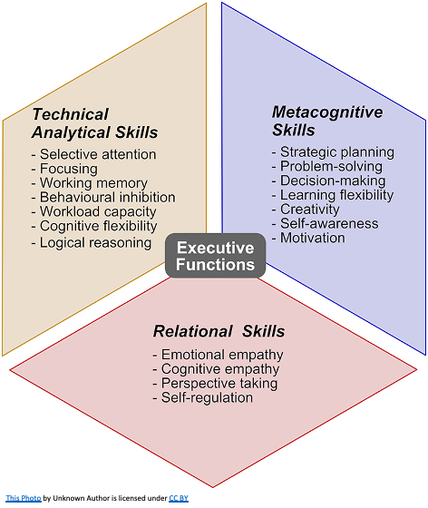
Executive Function...

Slide 7
Small Group activity
Divide into two sets 10 minutes
Draw and label a high performing resident vs unorganized resident.
Discussion on the topic 5 minutes
This Photo by Unknown author is licensed under CC BY-SA.
Notes:
Discussing differentials - emphasize the concern about implicit bias and avoiding the halo and horns phenomenon

Slide 8
Causes of disorganization
Possible pre-existing conditions (ADHD)
Sleep issues
Substance use 10-14% of physicians
Other mental health disorders
Poor time management skills
Systemic issues
Interruptions – Critical care Physicians were interrupted an average 11 times per hour
This Photo by Unknown author is licensed under CC BY-SA-NC.

Slide 9
Milestones Impacted by Disorganization
Systems Based Practice 2: System Navigation for Patient Centered care
Performs safe and effective transitions of care/handoffs
Practice-Based Learning and Improvement 2: Reflective Practice and Commitment to Personal Growth
Identifies factors that contribute to gaps between expectations and actual performance
Professionalism 2: Accountability/Conscientiousness
Takes responsibility for failure to complete tasks and responsibilities, identifies potential contributing factors, and describes strategies for ensuring timely tasks completion in the future
Responds promptly to requests or reminders to complete tasks and responsibilities
Professionalism 3: Self-Awareness and Help-Seeking Behaviors
Recognizes limits in the knowledge/skills of self

Slide 10
How can we identify learners that need help?
This Photo by Unknown author is licensed under CC BY.
Notes:
5 minutes – mini lecture about identification of signs that could identify learners in need of support.

Slide 11
Early disclosure/identification is key to success
Helps avoid crises
Plan for potential challenges
This Photo by Unknown author is licensed under CC BY-NC.

Slide 12
Develop a protocol for early identification
Mention disclosure of disabilities immediately after match and multiple times during onboarding/orientation
Train all faculty on what to do after a learner discloses
If disorganization is due to a disability alert Human Resources to obtain accommodations

Slide 13
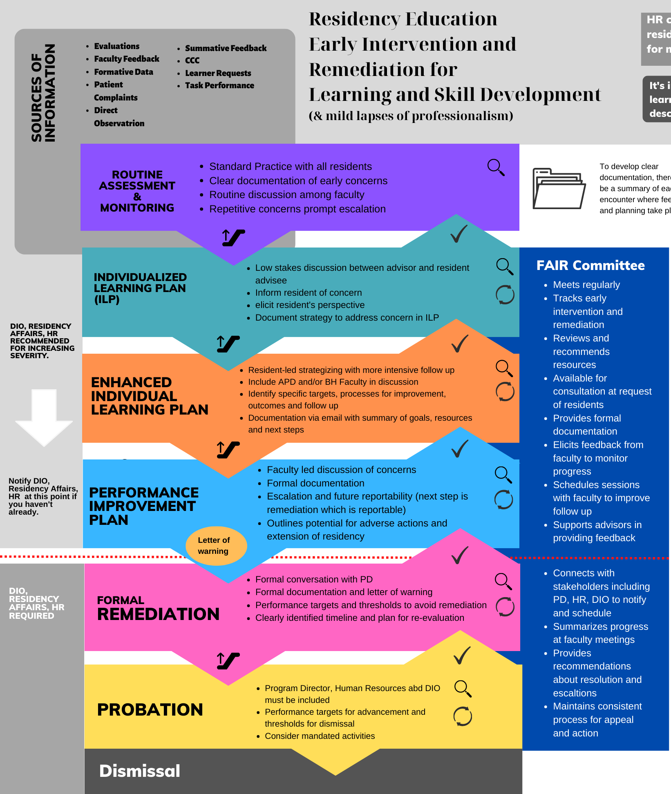
Create a safe space where learners can share that they are struggling
FAIR Committee
Normalizing struggles

Slide 14
Have program coordinator alert faculty about residents who are having difficulty with onboarding
Survey support staff about resident processes regularly
Utilize direct observation
Consider Time Studies

Slide 15
Lean Systems- Waste Walk
Originally developed for manufacturing
Looks at 8 areas of waste in a process
Defects
Overproduction
Waiting
Non-utilized talent
Transportation
Inventory
Motion
Extra Processing

Slide 16
Patient roomed
Resident Reviews Patient Chart – 10 min
Resident enters room
Resident exits room to ask nurse a question
Resident goes into room
Resident exits room aans askes for medical supplies
Resident goes back into room
Resident comes out of room to staff
Resident comes out of room to ask another question of nurse, checks computer
Resident goes into room with Attending
Resident goes back into room
Resident comes out of room to talk to nurse about plan
Resident goes back into room to ask about preferred pharmacy
Patient leaves

Slide 17
A Lean Systems Modification
Resident huddles with nurse and develops a plan
Nurse rooms patient, placing needed equipment in the room
Resident enters room
Resident comes out of room to staff
Resident goes into room with Attending
Resident reviews schedule for the day and patient charts
Patient Leaves

Slide 18
Process mapping activity
Go over sample process :
Precepting and presenting outpatient
Inpatient rounding
Inpatient signout
Outpatient workflow
Self-study (exam/board prep)
QI requirement
Use post its to map a typical process (include chart review, nurse interaction, etc.)
Each group presents their process with ways to improve organization and/or efficiency

Slide 19
Additional tools to help?

Slide 20
Additional tools
Implement check box to-do lists
Create note templates and quick texts
Implement huddles with teams
Create a data organization system for the day
Assign a mentor to help with tasks priorization
Identify ways to find uninterrupted time to complete tasks
Teach agenda setting
Decrease patient load to facilitate skill development
Review stress management strategies

Slide 21
Thoughts?

Slide 22
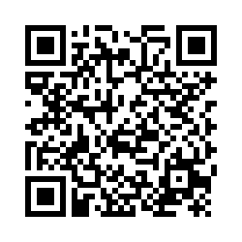
The 44th Forum for Behavioral Science in Family Medicine
Session Evaluation Link
Session Evaluation Link
Please complete an evaluation of this session. There is a direct link in your conference app. You can also use this QR code.

