Slide 1
SNaP QI
April 6

Slide 2
Reflection on Patient Calls
- How did the actual patient responses compare to your predictions? What surprised you?
- How was the exercise of inputting data into the Pareto spreadsheet?
- How did you feel about your ability to educate the patient, address their concerns, and/or help them navigate an issue?
- Any unintended consequences/harms? (ex, less time spent discussing other issues)

Slide 3
Pareto Analysis
Completion rate = 7/11 (64%)

Slide 4
Pareto Reflections
80:20 rule is an observation, not a law
Pareto may be easier to do in certain contexts, such as more discrete events in quality and safety areas
Frequency of medication error types
Frequency of diagnosis in hospital re-admission settings

Slide 5
Addressing COVID-19 in SNaP
QI PROJECT
-EBM
-Patient Navigation
QI Didactics
Source: IHI National Forum 2018

Slide 6
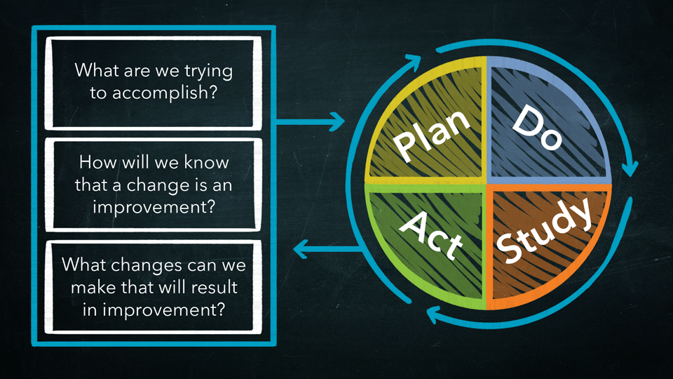
Source: EdX PH556x course - Practical Improvement Science in Health Care: A Roadmap for Getting Results

Slide 7
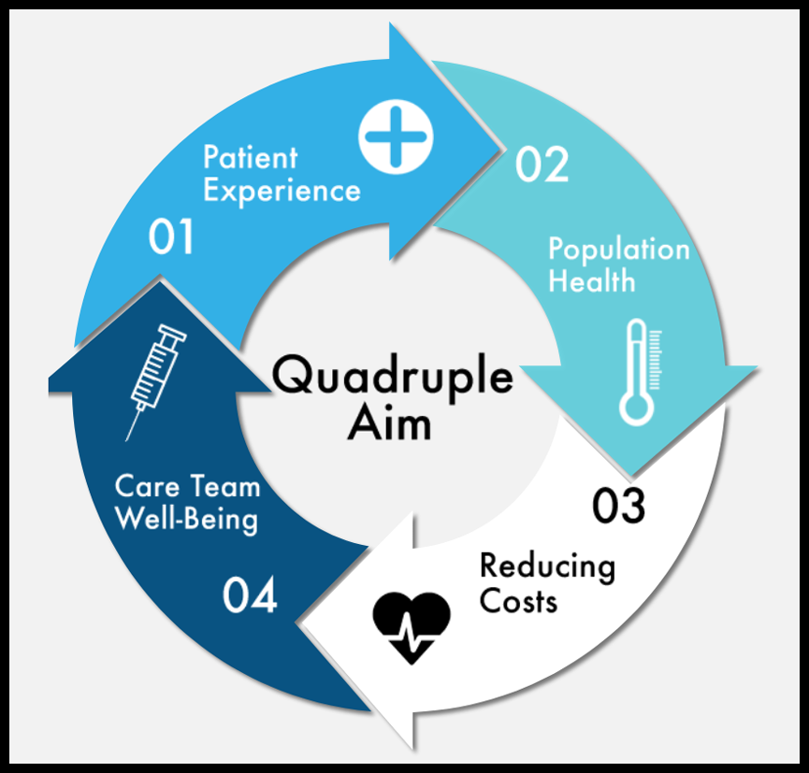
Patient Navigation in SNaP

Slide 8
Patient Navigation in SNaP during COVID-19
?
?

Slide 9
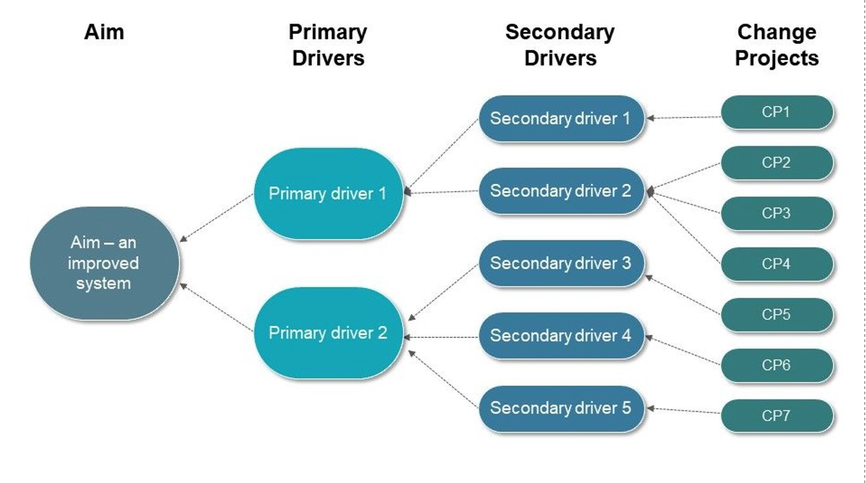
Driver Diagram: a visual display of what drives or contributes to an overall aim
Source: https://www.slideteam.net/driver-diagram-basic-plan-example-of-ppt.html

Slide 10
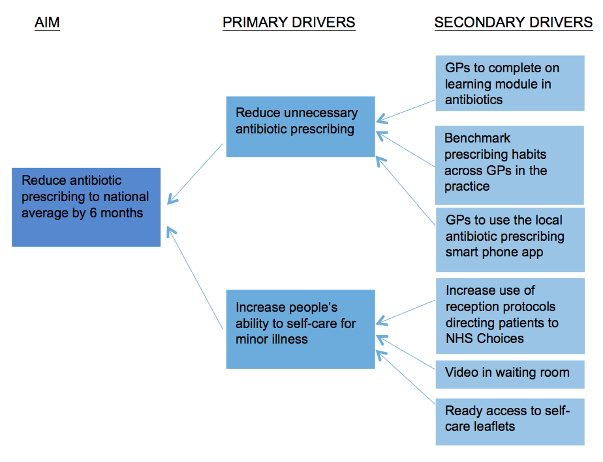
Source: https://gpexcellencegm.org.uk/resources/rcgp-quick-guide-driver-diagrams/

Slide 11
Driver Diagram: a visual display of what drives or contributes to an overall aim
Respond adequately to patient needs during the COVID-19 pandemic

Slide 12
Your Turn – what problem do you want to address?
System level: improve a process in patient navigation related to COVID-19 (information dissemination, connection to resources)
Individual level: help your own patient with their goals (health coaching)
Communication: method of obtaining patient data, framing of words (COVID), timing of interview, patient's ability to identify data
Helping patient identify problems and prioritizing data
Balancing relevant issues

Slide 13
4 guidelines for setting an aim
Set one now. There is no such thing as a perfect aim statement. You can fix it later.
Make sure your aim feels meaningful.
Set an aim that you can track progress on.
Be ambitious*

