Slide 1
Population Health and Latino Immigrant Patients: Opportunity or Problem?
Society of Teachers of
FAMILY MEDICINE

Slide 2
Re-Claimer: Learning Objectives
Gain overview of Latino Epidemiological Paradox (LEP)
Appreciate how Latino immigrants strengthen the Paradox (LEP)
Appreciate how standard Social Determinants of Health (SDOH) do not predict LEP
Understand how alternative SDOH for Latino patients may include Assimilation and Acculturation

Slide 4
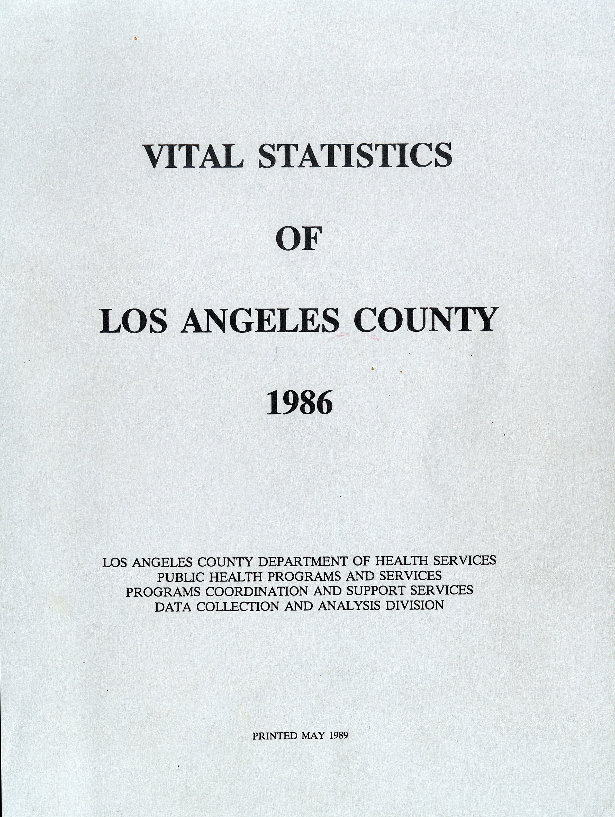
The Book That Changed My Life, 1989

Slide 5
Age-Adjusted Death Rate for Heart, Cancer, Stroke and CLRD, CA, 2013
Source: La Nueva California, 2017, p. 61

Slide 6
Life Expectancy, Non-Hispanic White and Latino, California, 2010-2012
Sources: La Nueva California, 2017, p. 65

Slide 7
Labor Force Participation, Male 16+ Years, California, 1940-2015
Source: La Nueva California, 2017, p. 56

Slide 8
Public Assistance as Percentage of Poverty Population, California, 1990-2014
Source: La Nueva California, 2017, p. 57
Notes:
Ok - checked against both spreadsheets

Slide 9
Immigrants Strengthen Latino Profile

Slide 10
Labor Force Participation, Latino Male 16+ US Born and Immigrant, California, 1990-2015
Source: La Nueva California, 2017, p. 75
Notes:
Ok - checked against both spreadsheets

Slide 11
Latino Adult Public Assistance to Poverty Ratio US Born and Immigrant, California, 1990-2014
Source: La Nueva California, 2017, p. 76
Notes:
Ok - checked against both spreadsheets

Slide 12
Heart, Cancer Prevalence, US Born and Immigrant Latino, USA, 2009-2013
Source: National Health Interview Survey, 2009-2013
Notes:
Ok - checked against both spreadsheets

Slide 13
Obesity and Smoking, US Born and Immigrant Latino, USA, 2009-2012
Source: National Heath and Nutrition Evaluation Survey, 2009-2012 2009-2013
Notes:
Ok - checked against both spreadsheets

Slide 14
Infant Mortality, US Born Latino and Immigrant Latino United States, 2013
Per 100,000
US
Source: La Nueva California, 2017, p. 77

Slide 15
University
Of
California
Press,
Feb. 7, 2017
G

Slide 16
California State constitution, 1849

Slide 17
University
Of
California
Press,
Feb. 7, 2017
G

Slide 18
Re-Claimer: Learning Objectives
Gain overview of Latino Epidemiological Paradox (LEP)
2. Appreciate how Latino immigrants strengthen the Paradox (LEP)
Appreciate how standard Social Determinants of Health (SDOH) do not predict LEP
Understand how alternative SDOH for Latino patients may include Assimilation and Acculturation

Slide 19
University
Of
California
Press,
Feb. 7, 2017
G
Next

