Slide 1
IGNITING A PRIMARY CARE MOVEMENT
ANDREW MORRIS-SINGER, MD
© Primary Care Progress, Inc., 2017

Slide 2
I DO NOT
have a financial interest or arrangement,
or affiliation with one or more organizations that could be perceived as a real or apparent conflict of interest in the context of the subject of this presentation.
DISCLOSURE STATEMENT OF FINANCIAL INTEREST
© Primary Care Progress, Inc., 2017

Slide 3
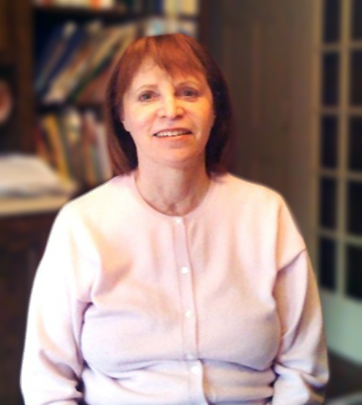
mom
© Primary Care Progress, Inc., 2017

Slide 4
© Primary Care Progress, Inc., 2017

Slide 5
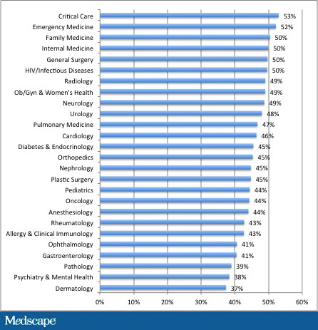
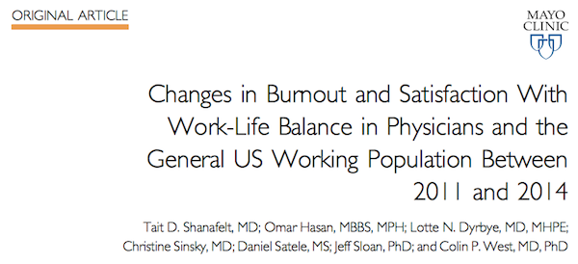
© Primary Care Progress, Inc., 2017

Slide 6
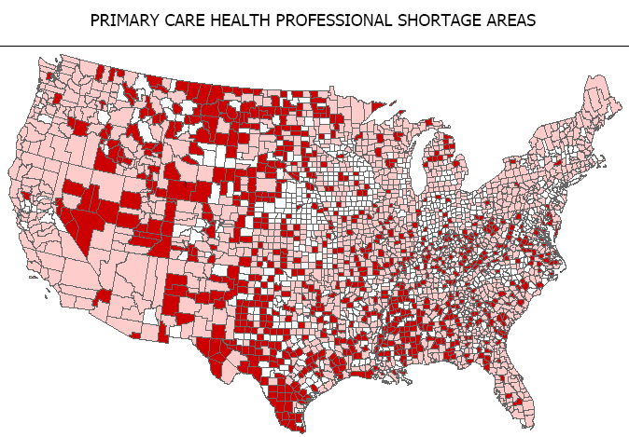
© Primary Care Progress, Inc., 2017

Slide 7
We tend to
overvalue the
things we can
measure and
undervalue the
things we cannot.
John Hayes
© Primary Care Progress, Inc., 2017

Slide 8
© Primary Care Progress, Inc., 2017

Slide 9
POWER
HOPE
LEADERSHIP
SHIFT
© Primary Care Progress, Inc., 2017

Slide 10
MOBILIZATION
© Primary Care Progress, Inc., 2017

Slide 11
© Primary Care Progress, Inc., 2017

Slide 12
Took the high road.
Built big, diverse teams.
Identified and mobilized all our resources.
© Primary Care Progress, Inc., 2017

Slide 13
Lone rangerism made our work difficult.
We had to do the head and the heart work.
We needed to foster people’s commitments
to one another and the team.
Data was an important piece of the puzzle, but….
© Primary Care Progress, Inc., 2017

Slide 14
time to hang ‘EM UP?
© Primary Care Progress, Inc., 2017

Slide 15
54%
88%
59%
of doctors
are moderately to
severely stressed
of doctors
wouldn’t recommend a career
in medicine to their
children
of doctors
are burned out
1
2
3
Mayo Clinic 2014
VITAL Worklife & Cejka Search Physician Stress and Burnout Survey 2015
Jackson Healthcare; 2013 Physician Outlook and Practice Trends
© Primary Care Progress, Inc., 2017

Slide 16
© Primary Care Progress, Inc., 2017

Slide 17
A pessimist sees
the difficulty in
every opportunity; an optimist sees
the opportunity in every difficulty.
Winston Churchill
© Primary Care Progress, Inc., 2017

Slide 18
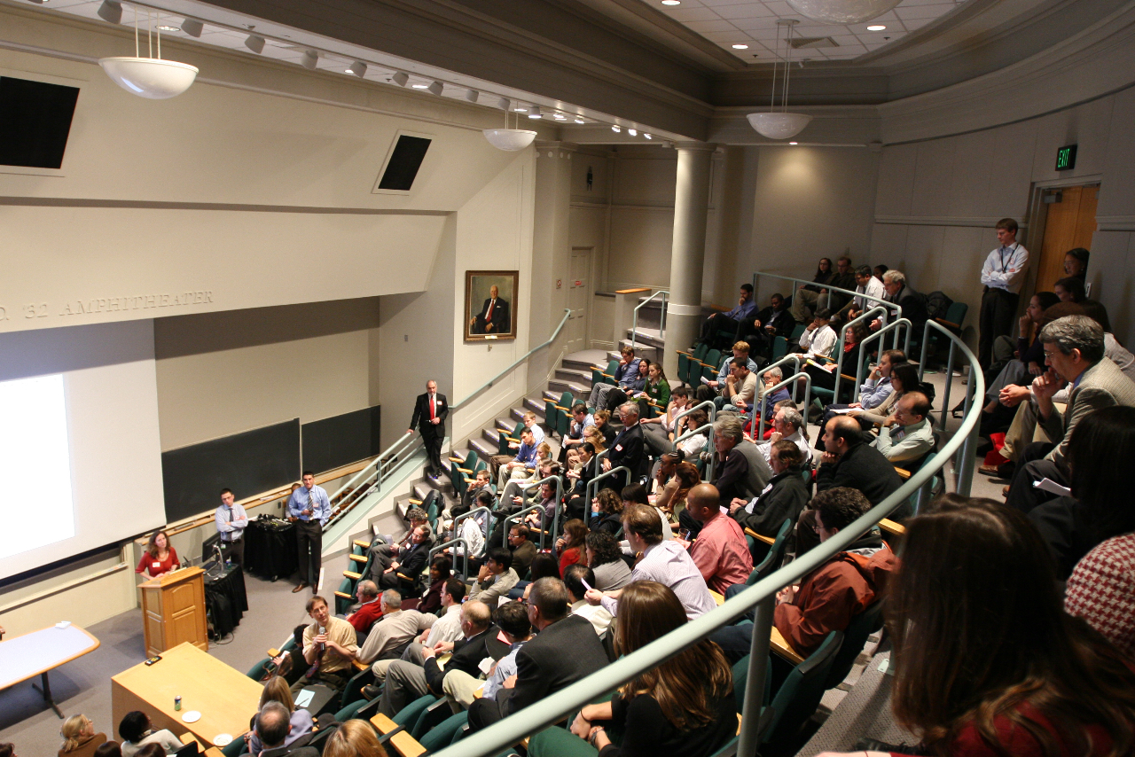
mobilizing a diverse
COMMUNITY
© Primary Care Progress, Inc., 2017

Slide 19
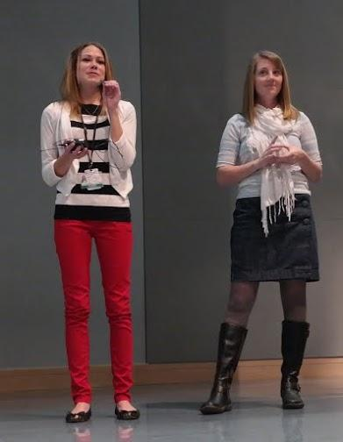
addressing the HEART
© Primary Care Progress, Inc., 2017

Slide 20
students as
LEADERS
© Primary Care Progress, Inc., 2017

Slide 21
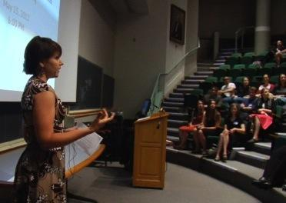
spreading
IDEAS
IDEALS
IDENTITIES
© Primary Care Progress, Inc., 2017

Slide 22
POWER
HOPE
LEADERSHIP
SHIFT
© Primary Care Progress, Inc., 2017

Slide 23
identifying our community
shared
PAIN
desire to
CONNECT
HOPE
© Primary Care Progress, Inc., 2017

Slide 24
© Primary Care Progress, Inc., 2017

Slide 25
© Primary Care Progress, Inc., 2017

Slide 26
POWER
HOPE
LEADERSHIP
SHIFT
© Primary Care Progress, Inc., 2017

Slide 27
© Primary Care Progress, Inc., 2017

Slide 28
ORGANIZATIONAL
CHANGE
MOVEMENT
BUILDING
Centralized control
Focus on planning and structure (head)
Enforcement
Change is done to you
Decentralized control (autocatalytic action)
Focus on inspiration and engagement (heart)
Leadership development
Change happens through you
© Primary Care Progress, Inc., 2017
© Primary Care Progress, Inc.

Slide 29
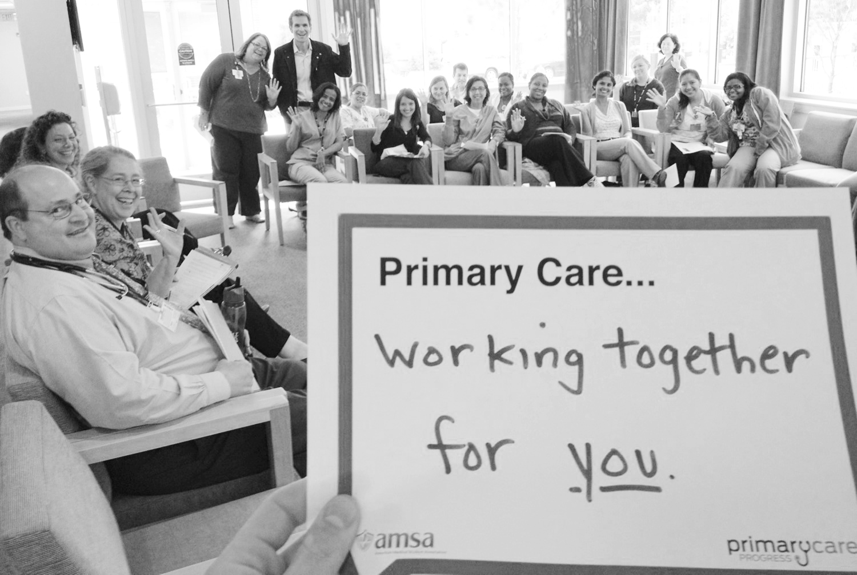
creating a
TEAM
(c) Primary Care Progress
© Primary Care Progress, Inc., 2017

Slide 30
power of
SOCIAL NETWORKS
There’s a tendency for humans to
influence and copy one another,
without even realizing it.
Dr. Nick Christiakis
© Primary Care Progress, Inc., 2017

Slide 31
creating a
TEAM
(c) Primary Care Progress
© Primary Care Progress, Inc., 2017

Slide 32
© Primary Care Progress, Inc., 2017

Slide 33
is this
CULTURAL DRIFT?
?
© Primary Care Progress, Inc., 2017

Slide 34
fostering
CULTURAL DRIFT DRIFT
1
2
3
4
5
Promote true
connections –
depth and
breadth.
Get the people talking,
not experts.
Tap the heart and the head.
Cater to
different learning styles.
Make
it fun!
© Primary Care Progress, Inc., 2017

Slide 35
POWER
HOPE
LEADERSHIP
SHIFT
© Primary Care Progress, Inc., 2017

Slide 36
A social movement is a collective,
acting with organization and continuity to
vs.
MAKE
CHANGE
STOP
CHANGE
© Primary Care Progress, Inc., 2017

Slide 37
STATUS
QUO
© Primary Care Progress, Inc., 2017

Slide 38
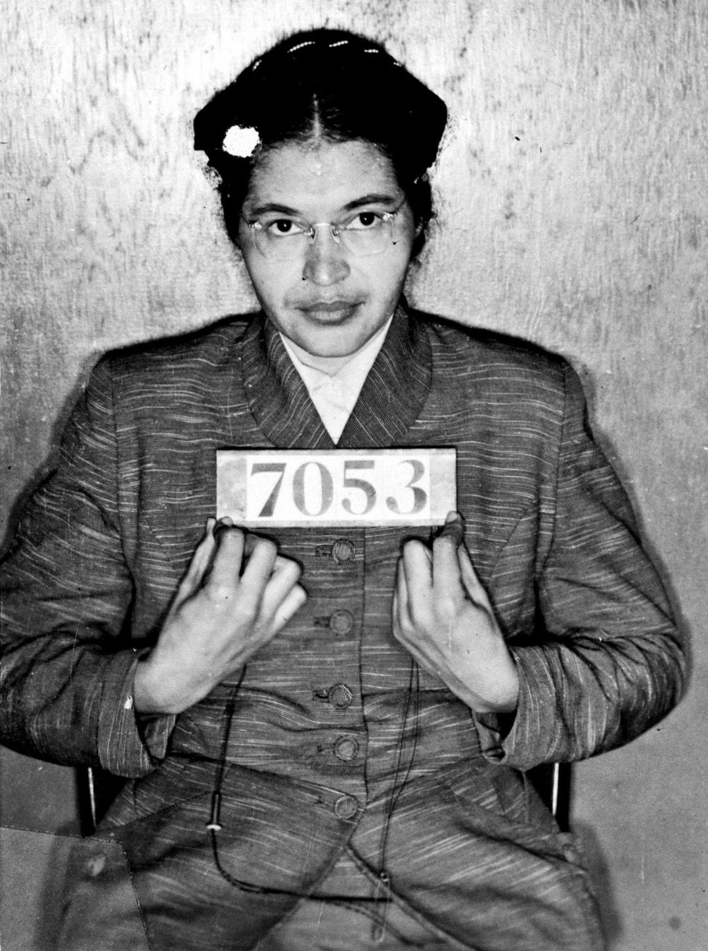

Slide 39
POWER
© Primary Care Progress, Inc., 2017

Slide 40
$
© Primary Care Progress, Inc., 2017

Slide 41
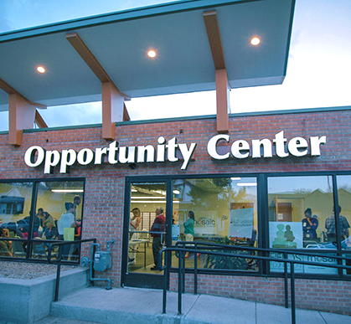
kari MADER
© Primary Care Progress, Inc., 2017

Slide 42
© Primary Care Progress, Inc., 2017

Slide 43
success is POSSIBLE
© Primary Care Progress, Inc., 2017

Slide 44
© Primary Care Progress, Inc., 2017

Slide 45
be inclusive and BUILD A TEAM
© Primary Care Progress, Inc., 2017

Slide 46
© Primary Care Progress, Inc., 2017

Slide 47
© Primary Care Progress, Inc., 2017

Slide 48
© Primary Care Progress, Inc., 2017

Slide 49
US vs.THEM
© Primary Care Progress, Inc., 2017

Slide 50
how do we
FRAME THE ISSUE
?
© Primary Care Progress, Inc., 2017

Slide 51
let’s combine the
HEAD AND THE HEART
© Primary Care Progress, Inc., 2017

Slide 52
© Primary Care Progress, Inc., 2017

Slide 53
build a MOVEMENT
stay CONNECTED
Andrew Morris-Singer, MD
andrew@primarycareprogress.org
@AMorrisSinger
@PCareProgress
Primary Care Progress
primarycareprogress.org
© Primary Care Progress, Inc., 2017

