Slide 1
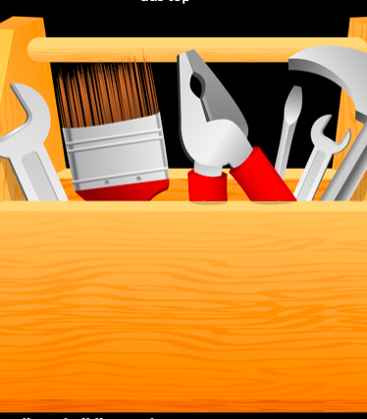
Teaching Resilience: Create a wellness toolbox that fosters resilience
Leah A. Stem, MD, Anne Williams, PharmD, Pooja Kirpekar, PharmD, Greg Jaffe, MD, Andrea Karsh LCSW, BCD.
UPMC St. Margaret Faculty Development

Slide 2
Identity Inventory
Who are you?
Write down identities to describe yourself
Introduce yourself to the person next to you using 3 of your identities
Notes:
Pooja

Slide 3
Objectives
Identify and use validated tools for assessing well-being
Define burnout, wellness, and resilience
Develop an action plan for activities that teach resilience
Notes:
Leah

Slide 4
Residency is a formative time
Clinical Skill Development
Medical Decision Making
Meaning in work
Self care
Notes:
Burnout is part of a national conversation with high rates (reported higher than 50% in med students, residents, and early career physicians) and far reaching consequences- profession dropout, medical error, depression/suicide, patient access,
During training, learners are likely to report high emotional exhaustion and diminished quality of life in all dimensions. Residents tend to report a “survival attitude” like life on hold until the completion of residency, this delayed gratification can continue throughout their entire career
Residency is a formative time with habits learned in clinical skills, medical decision making. I think it is also important for educators to address the other habits learned in residency such as self-care and meaning in work
Some key drivers in physician burnout are ineffective work environment, inadequate support, loss of autonomy/control, and loss of values and meaning in work
To decrease burnout, there certainly need to be structural interventions, but there are also benefits of indivual-focused interventions. The majority of this talk will dive into those and how we can teach resilience

Slide 5
Definitions
Notes:
Leah
ACGME asks educators to identify burnout and support wellbeing
﻿However, if we don’t
know what burnout and wellness are, then how do we know if the interventions work?

Slide 6
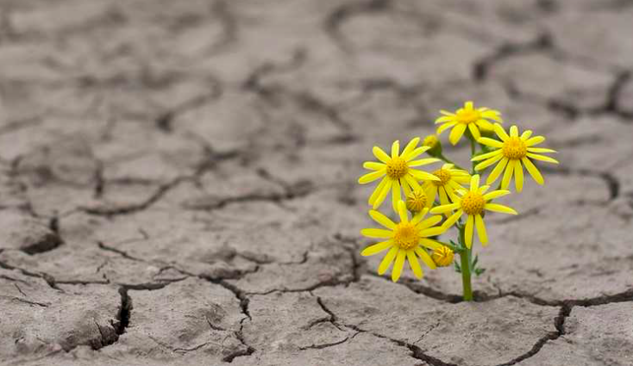
Can you define these terms? How would you measure them?
Burnout
Wellness
Resilience
Notes:
Leah
Interest started by thinking about these three terms- burnout, wellness and resilience

Slide 7
Burnout Physical or emotional exhaustion usually as a result of prolonged stress or frustration.
” … an erosion of the soul caused by a deterioration of one’s values, dignity, spirit and will.”
-Christina Maslach, PhD
Notes:
Leah
Burnout- term coined in 1970s describe emotional/physical exhaustion observed in healthcare professionals under chronic stress. Futher characterized by Maslach who developed a scale rating frequency of emotional exhaustion, depersonalization, and
The gold standard for diagnosing burnout is the Maslach Burnout Inventory, consisting of a 22-item questionnaire that measures three dimensions of burnout:

Slide 8
Wellness Dynamic process involving self-awareness and healthy choices resulting in a successful, balanced lifestyle
Notes:
Leah
Wellness- few residency programs have a formal definition dynamic and ongoing process involving self- awareness and healthy choices resulting in a successful, balanced lifestyle. May encompass physical, mental, emotional, spiritual domains

Slide 9
Resilience The ability of an individual to respond to stress in a healthy manner with positive coping mechanisms
High resilience is associated with low burnout
Resilience is both a trait and a learned skill
Notes:
Leah

Slide 10
Maslach Burnout Inventory
Notes:
Leah
Valid and Reliable
Measure developed and released in 1981. Different types exist, and the MBI for Human Services Survey (MBI-HSS) is commonly used in burnout research.
3 areas are covered: Emotional Exhaustion, Depersonalization, and low sense of personal accomplishment with responses in form of frequency rating
Data Analysis
Preferred to examine relationships with subscale scores as continuous variables – can use cut offs of low/average/high. A common approach is to consider individuals as having at least one symptom of burnout if they have high scores in either the EE (score of 27 or higher) or DP (score of 10 or higher) subscales. his approach identifies individuals whose degree of burnout places them at increased risk of potentially serious personal and professional consequences.
Full scale takes about 10-15min

Slide 11
Satisfaction with Life Scale Physician Well-Being Index Brief Resilience Scale
Notes:
SWLS short 5- item instrument designed to measure global cognitive judgements of satisfaction with one’s life
Life satisfaction component of well-being correlate with measures of mental health and predictive of future behaviors
7 point likert style response scale
20 is the neutral point
5-9 indicate extremely dissastisfied, 31-35 extremely satisfied
Physician Well-Being Index
Simple online 7-item instrument developed buy Mayo Clinic multiple dimensions of distress
Strong validity evidence and national benchmarks from samples of medical students , residnets, and physicians

Slide 12
Reflect
How to survey?
Frequency of survey?
Notes:
Leah
Now that you’ve had a chance to see 3 different reliable and valid tools in burnout, wellness, and resilience, take a chance to reflect on how you can use these.
How do you want to survey? Electronically through email, kept on a common site, paper/pencil given before a lecture or in the workroom?
What frequency do you think you should survey? There aren’t guidelines in literature on how often to survey but it does seem like burnout changes throughout the year so administering a survey at least twice a year
Lastly think about what surveys you would include – you may want to track both burnout and wellness

Slide 13
Activities
Notes:
Anne
We just identified ways to evaluate now we are going to focus on activities that promote wellness and resilience within your program. Our goal is for you to both assess wellness and implement activities in your program to promote wellbeing.

Slide 14
Share
What are you currently doing at your program for wellness and resilience?
Notes:
Anne

Slide 15
Resilience is a skill that can be taught
Four elements that build resilience in primary care:
Perspectives
Prioritization
Practice management
Supportive relations
High resilience is associated with low burnout
Notes:
Anne
There are activities that can build learned behaviors of resilience.
Some clinicians handle the chronic stress of our work well while others become dissatisfied, drained, and exhausted.
There are key areas contributing to resilience with support in the literature.

Slide 16
Perspective
Valuing the physician role
Maintaining interest
Developing self-awareness
Notes:
“I’m really privileged to be able to do this” This quote reflects the first domain that we’ll focus on which is perspective.
Changing your point of view and outlook to be able to enjoy work and life more
Themes here include valuing the physican role, maintaining interest, developing self- awareness,
These are crucial for maintaining an optimistic perspective that limits burnout and builds resilience

Slide 17
Perspective
Guided reflection on meaning in work
Gratitude list
Mindfulness based training
Notes:
I want to walk you through three activites you can do in a group. The first idea is guided relfection on meaning in work. Which includes a facililated session to acknowdlege the hardships we encounter during our job with an emphasis on finding the silver lining. A RCT compared two groups one who had an hour of protected free time weekly and the other who participated in a 1 hour guided group discussion. ﻿Rates of depersonalization, emotional exhaustion, and overall burnout decreased substantially in the reflective group. A lot of time when we speak of burnout we think that just providing time off will be enough, however this study shows that healthy engagement is crucial for resilience. It also demonstrates that you don’t need to disengage from work to feel well. While both time off and reflection are are necessary being able to show others how to find meaning in work is so powerful.
You’ve probably heard of meditation and it’s scientific benefits. Like most other skills this needs to be practiced and taught. compared to guided reflection this is more focused on internal individual thought patterns. Typically, this training is done through meditation. Like learning any new skill most people need to be guided and taught how to meditate with practice. Later in this presentation Andy Karsh will lead us through a mindfulness exercise.
Last but not least a gratitude list is a simple way, also based in research, to bring positive psychology to your learners.

Slide 18
Gratitude list
Write down 3 things
Be specific as possible
Practice at least 3 times a week
Notes:
People who regularly practice gratitude can be more resilient. Several studies have shown that people who regularly practice gratitude have better overall wellbeing, life satisfaction, resilience, relationships and levels of happiness.
simply keeping a gratitude journal—regularly writing brief reflections on moments for which we’re thankful—can significantly increase well-being and life satisfaction.

Slide 19
Prioritization
Setting limits
Self Care
Notes:
Part of it is knowing what’s important to us , putting these things first in our lives
One element of prioritization is setting limits means knowing when to say no
In our line of work there are many opportunities that come up and can add demands on our time. Identifying those opportunities that sustain and energize are really important when deciding to say yes. Settting limits is also about knowing when to say no.
This domain covers ideas like setting limits- being able to unapologetically say no and authentically saying yes
Doctors are notorious workaholics, often putting their jobs first at the expense of their own health. A central part of wellness is prioritizing self care. These are classic ideas of wellness like time off from work, nutrition, sleep , exercise, primary care visits

Slide 20
Prioritization
Healthy snacks
Resources for medical care and counseling
Identity Inventory
Non-negotiables
Notes:
What practical things can we do to teach prioritization to our residents?
Self-care is a classic area we think of when we talk about wellness- ways to support include addressing nutrition and preparing ideas for healthy snacks at work, perhaps stocking the workroom or common area if funding exists.
Further support for self-care includes creating and sharing resources for medical care like PCPs, dentistry and clear routes for counseling services
You remember the identiy inventory this is a great way of showing us what matters and who we are, prioritizing the different roles in our lives.
Who am I is one and also prioritizing what matters to me
Value Ranking can help battle the myth of delayed gratification and highlights what matters to you most to help you realize areas for change

Slide 21
Non-Negotiables

Slide 22
Practice Management
Sound business management
Good staff relations
Effective practice arrangements
Notes:
Resilient clinicians emphasize that medical practice is a business. understanding management is important and this theme comes out in research through sound business management, staff relations, and effective practice arrangements

Slide 23
Practice Management
Chart Efficiency
Morning Huddle
Appreciative Inquiry
Notes:
Most of us have probably been to EMR training sessions which are long, tiring, and rarely helpful for increasing efficiency. What’s more useful are small group practice sessions to improve efficiency and address learner specific needs. The way you could use this by setting aside time for small group teaching on charting
Incorporating a morning huddle in to the work flow brings unity and team work to staff. These can be small meetings before clinic starts to address group goals, changes in workflow. It incorporates all of the office staff
Another powerful method to bring change to groups is appreciative inquiry

Slide 24
Appreciative inquiry asks groups to start positive and leverage change through strengths
Discover- “What is working well?”
Dream- “What does it look like if it happened all the time?”
Design- ”How can it happen?”
Delivery- “What is the first step?”
Notes:
Appreciative Inquiry (AI) can be a dynamic approach to resolving community problems. The process was developed in the business world and has many applications for leading groups to positive change.
The process starts with identifying a topic
For an example, in my program I thought about the way physical surrounding impact mood. In most programs the pharmacy is in the basement with no windows. My group came together and discussed how we felt better when we worked in settings with natural light. If my group were doing an AI on our wellbeing the process would look like this:
Discovery phase- this is where the group brainstorms on the positive- so for us a focus on the fact that we felt better in environments with light next is the dream
The dream phase is thinking of all the ways we can have more of this. These can be expansive and the group is allowed to just brainstorm things like moving the pharmacy to a windowed room, sky lights, outdoor breaks, a garden by the pharmacy, outdoor working space, greenery in the office
The next phase design takes it back to reality by asking how can it happen? We realized from the residents that we could use natural spectrum daylight lamps or happiness lamps that emit 5,000 lux and mimic white light without harmful UV rays. The end of this phase also get the group to focus on resources needed
The last step a group works on is delivery starting with “what is the first step” for us that was asking for the funding to purchase the lamps for our program.
Now, think of a topic for AI that you can do with your residnets. For us, it was “wellbeing at work” you can also offer topics such as “clinic workflow” or “continuity scheduling”.
(give a few minutes and hear from people)

Slide 25
Supportive Relations
Positive personal relationships
Effective professional relationships
Good communication
Notes:
Peer support is essential with open communication around difficult cases and stress-related issues
Supportive home environment
Address pervasive occupational stress

Slide 26
Supportive Relations
Buddy Program
Electing a social chair
Awards
Balint
Notes:
Balint groups are named after psychoanalyst Michael Balint he and his wife started psychological training seminars for general practitioners in London. Balint aims to focus on the doctor patient relationship
Confidential mall group usually 9-10 people, discussion with a case. Someone volunteers to talk about a patient who has been on her mind , the presenter steps back and listens to the group response.
The group responds to what they heard in various forms- clarifying quations, emotional reactions, imaging what it’s like to be that patient or be that clinician
Balint groups are studied in the literature with outcomes of decreased burnout however these are usually in groups who chose to participate. in residency it’s found that personality or emotional variables may be responsible for some residents not connecting with this teaching approach

Slide 27
Gratitude List
Non-Negotiables
Appreciative Inquiry
Balint

Slide 28
Mindfulness Meditation

Slide 29
Objectives
Identify and use validated tools for assessing well-being
Define burnout, wellness, and resilience
Develop an action plan for activities that teach resilience

