Slide 1
2019 STFM Conference on
Practice & Quality Improvement

Slide 2
Setting
Southern Illinois University Family Medicine Residency Program
2 Family Medicine offices plus 1 mobile school-based health center
7 full time faculty, 5 full time PAs, 4 social workers, 19 residents, 1 sports medicine fellow plus several part time faculty and APPs
2 different EHRs (Epic and Touchworks)

Slide 3
Wellness Curriculum to Cultivate Culture Change: A Residency Program’s Challenging Journey to Wellness
Alicia Markley, MPAS, PA-C and
Jennifer Hammonds, LCSW

Slide 4
Disclosures
None

Slide 5
The Importance of Wellness
Published research has demonstrated that physicians and medical service providers are at high risk for burnout, compassion fatigue, depression and suicide.
Residents are at particularly high risk, given the demands of residency training and the lack of perceived control.

Slide 6
The Patient Care Team
“If the nurses ain’t happy, ain’t nobody happy!”
If we focus efforts to improve overall wellness solely on resident physicians, we inadvertently exclude those people to interact with patients a majority of the time.
Creating a culture of wellness must include all those within the clinic and should emphasize a team approach to obtain best outcome.

Slide 7
2018 Project Goals
Improve resident education by increasing awareness and understanding of burnout and the importance of overall provider wellness.
Extend this curriculum to include faculty physicians, advanced practice providers, nursing staff, non-clinical support staff.
Create a culture of wellness within each clinic.

Slide 8
Original Project Framework
Confidentially surveyed all provider, nursing, and support staff using a modified Mini-Z burnout survey to estimate the stress level and burnout risk of our patient care team.
Overall job satisfaction rated as good
Good teamwork ratings
More than 50% of respondents reported feeling a great deal of stress in their job
More than 50% of respondents reported that the work atmosphere was chaotic

Slide 9
Specific staff concerns
Overscheduling and understaffed
Personal conflicts between employees
Unequal distribution of work
Not enough time for professional training
Poor communication throughout all levels of the clinic

Slide 10
Wellness Program Launch September 2019
Developed a monthly Wellness Activity and learning objective based upon the survey results.
Start simple, building on what we were already doing well
Monthly ‘free’ casual day
Potluck lunches for interested staff
Get staff invested in our goals and objectives
Share highlights of faculty meetings with a monthly communication newsletter for all staff

Slide 11
Late 2018 – Early 2019
30 Days of Gratitude
Gratitude Tree
Daily reminders and words of support and appreciation
“Beat the Winter Blues” appreciation day in January/February
Step Challenge
Chair Yoga sessions
Service Dogs in training visit

Slide 12
Late 2018 – Early 2019
MVP project: Soccer ball that is passed to a new person each month who the previous month’s MVP chooses as the person who has been the “most valuable” to them over the previous month
Yearly community service projects
Boys and Girls Club fundraiser and Toy Drive
Stuff the Turkey to help support local food pantry
School supplies for needy kids
Jeans for Charity to help support the School Health Program
Annual Match Party and Holiday Luncheons

Slide 13
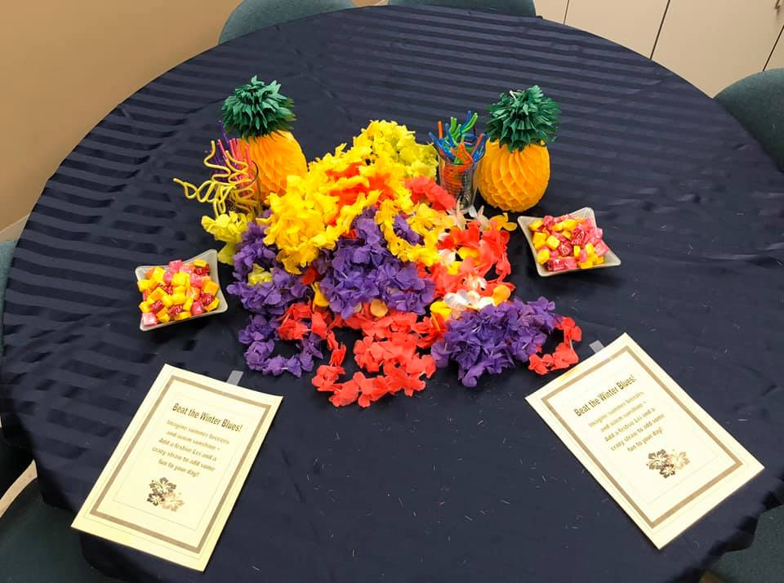
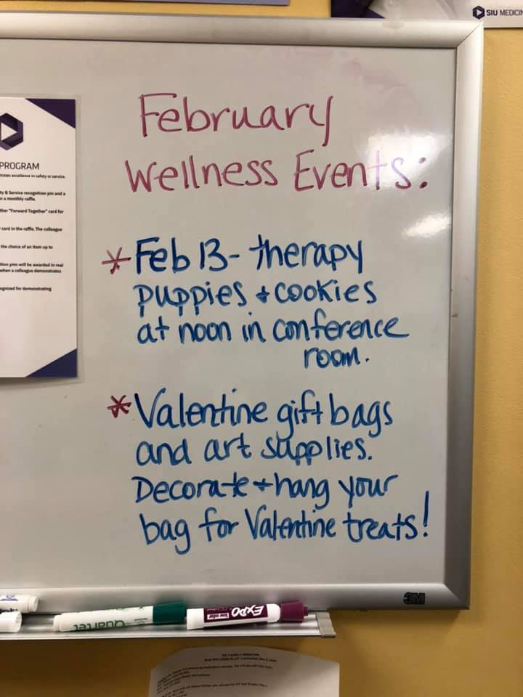
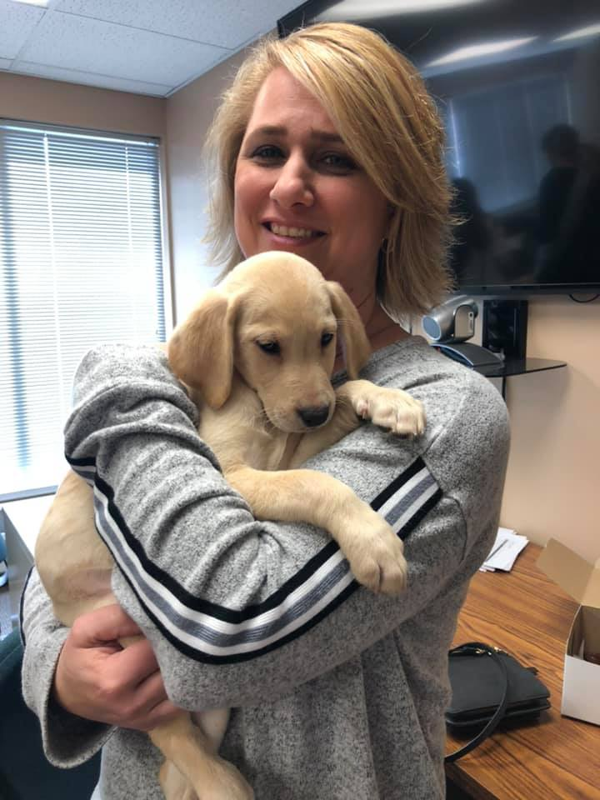
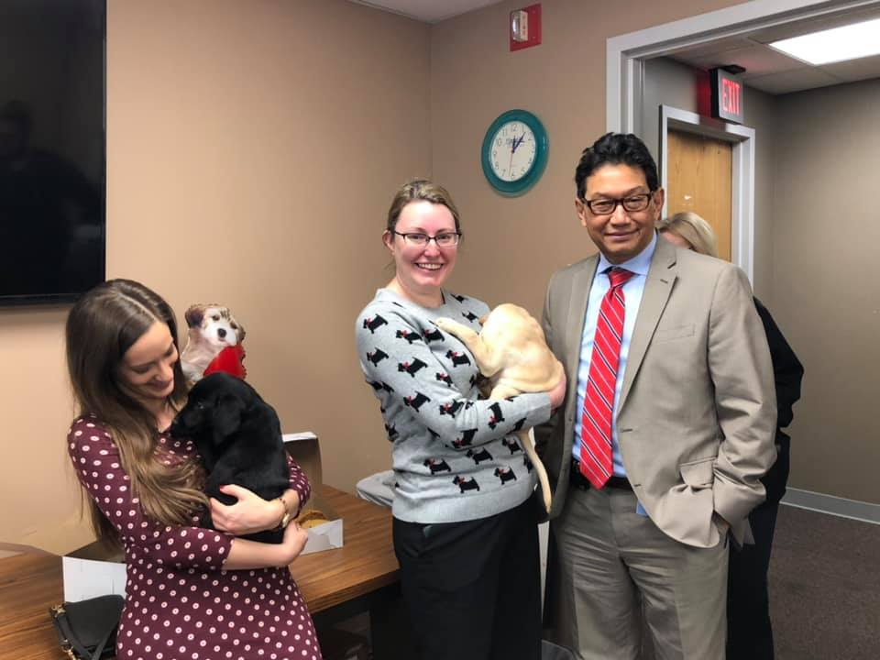
A sampling of wellness activities:

Slide 14
Staff Response
Initial response to increased wellness opportunities seemed very positive
Participation was good at both clinical sites
Everyone involved felt the program was starting to make some positive changes
Faculty, residents and staff were again queried using the same burnout survey that was used initially…

Slide 15
 | Average score 2018 | Average score 2019 | Scoring
1. Overall job satisfaction | 1.8 | 2 | 1-2 highly satisfied
2. Feel great deal of job stress | 2.3 (18/29 answered 1 or 2) | 2.66 (16/32 answered 1 or 2) | 1-2 high stress
3. Burnout | 2.3 | 2.22 | 3-5 burnout
4. Control over workload | 3.1 | 3.1 | 3-5 satisfactory control
5. Sufficient time to complete work | 3.1 | 3.1 | 3-5 satisfactory time
6. Atmosphere in work area | 3.3 (15/29 answered 4 or 5) | 3.25 (10/29 answered 4 or 5) | 4-5 chaos
7. Professional values aligned with leaders | 2.4 | 2.4 | 1-2 high values alignment
8. Care team works efficiently | 3.5 | 3.5 | 3-5 good teamwork
9. Time working at home | 3.5 | 3.8 | 1-2 too much work at home
10. Work day is frustrating | 3.1 | 3.4 | 3-5 not frustrated with work day

Slide 16
Staff comments
Revealed some animosity between co-workers that was affecting the work environment
Still the same issues with lack of communication
Overall, staff report to love what they do, but struggle with workflow, administration and leadership, feeling cramped and understaffed

Slide 17
Do the numbers tell the whole story?
Staff routinely report they enjoy participating in wellness opportunities
Activities seen as a pleasant distraction, though issues within the clinic unchanged
May staff members expressed gladness at attempt to make work like more pleasant and positive.

Slide 18
Goals achieved
Awareness of the importance of Wellness Culture
Revealed opportunities for growth and improvement
Expanding wellness opportunities to all care team members

Slide 19
Challenges, but not excuses
Several points of frustration throughout the year that took the wind out of our sails
New EHR
Move to a new building
Practice sites owned by different entities, so not really able to make activities available at both sites

Slide 20
Roadblocks and missteps
Time
Committee lead by providers who have multiple other commitments
Change is hard from the bottom up
Without buy-in from administration and leadership, meaningful long term culture change is difficult
Program had some support, but often ended up more as an after thought or filler program that could get bumped or rescheduled to make room for other activities

Slide 21
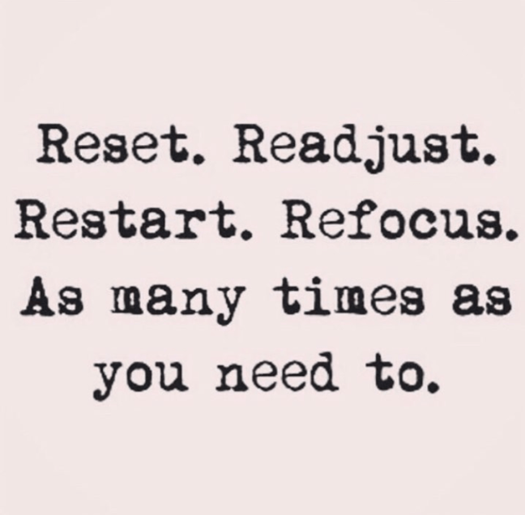

Slide 22
Refocus and move forward
Continue to offer more inclusive wellness opportunities
Recruit administration to help promote culture change by improving accessibility for staff at different sites
Enlist staff to participate in planning and future program expansion

Slide 23
Refocus and move forward
Encourage staff to take time to maintain not just work wellness, but also physical and mental health
Encouraging participation in recommended screenings and preventive care
Staff Balint groups
Opportunities for 5-minute mediation breaks
Quiet room/decompression space
Lunchtime walking groups/Yoga breaks

Slide 24
Long Term Goals
Continue to enhance communication between administration and staff.
Improve sense of engagement for all team members.
Maintain sense of appreciation and value.
Make annual All-Staff retreats a fundamental clinic practice.
Encourage Team Leaders to role model productive and positive attributes.
Protected time for required annual training.

Slide 25
The Future of Healthcare
Continue to offer more inclusive wellness opportunities
Recruit administration to help promote culture change by improving accessibility for staff at different sites
Enlist staff to participate in planning and future program expansion

Slide 26
Evaluate
Please evaluate this presentation using the conference mobile app! Simply click on the "clipboard" icon on the presentation page.

Slide 27
Thank you

