Slide 1
More Than Words: Systemic Influences on Doctor-Patient Communication
Hernan Barenboim, PhD
All Saints Family Medicine Residency
Medical College of Wisconsin
Milwaukee, WI
Aaron J. Grace, PsyD
Waukesha Family Medicine Residency at ProHealth Care
Medical College of Wisconsin
Waukesha, WI
Notes:
H&A

Slide 2
Disclosures
None
Notes:
A

Slide 3
Goals and Objectives
Participants will be able to describe systemic elements of effective communication based on Attachment Theory applied to the relationship between family medicine providers and patients.
Participants will be able to evaluate the communication process between residents and patients from an attachment perspective using the secure, avoidant/dismissive, anxious/preoccupied and disorganized/fearful categories.
Participants will describe how to deliver a communication module focused on a balance between content (what is said), process (how it is said) and relationship
Notes:
A

Slide 4
Poll

Slide 5
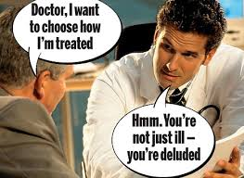
Notes:
H
Patients want to receive health information, but they also want to have meaningful relationships with providers
Patients wants to be part of the decision making and have a voice in the care
Problems to get effective communication and relationships in primary care time/medical records/PCP overwhelm with amounts of work
Good communication is imperative to achieve patient centered care

Slide 6
Communication and medical education
Successful provider- patient communication is associated with improved health outcomes
Curricular emphasis on formal communication type education
There is a decline in communication skills during and after medical education
Notes:
H
(Liu, Huan, Gao & Cheng, 2017)
(Rosenbaum, 2017)
(Wouda & Van de Wiel, 2013)

Slide 7
Why do residents think this is?
Too difficult to anticipate patient reactions (Wouda & Van de Wiel, 2013)
Not enough modeling by seasoned faculty (Rosenbaum, 2017)
Need more opportunities for self-assessment (Rosembaum, 2017)
Notes:
H

Slide 8
Content and process in the medical interview
What is said vs how it is said
Non-verbal behaviors
Open and closed questions
Residents tend to follow a traditional format of information gathering and documentation
Notes:
A
(Kurtz, Silverman, Benson & Draper, 2003)

Slide 9
Focusing on content
Biomedical tendency
Does not provide all the information
Answer to the “what” question
Neglects important aspects of the relationship
Notes:
A

Slide 10
Focusing on process
Bio-psycho-social tendency
Patients and doctors are happier following this philosophy
More valuable information is collected in appointments
Generally more efficient
Notes:
A

Slide 11
Poll

Slide 12
The science of attachment
A model to focus on the process aspect of the doctor-patient communication
Notes:
H

Slide 13
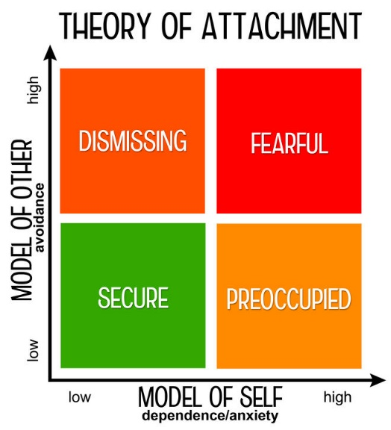
Notes:
H

Slide 14
Examined the effect of PCP attachment style on communication with patients
PCP anxiety and avoidance significantly predicted clinical competency and patients’ global impressions of the provider
High levels of anxiety and avoidance demonstrated less intensive and more evasive interaction style
Notes:
H

Slide 15
Examined the relationship between health care case managers and serious psychopathological disorders
Patients perceived preoccupied providers to intervene in greater depth
Patients perceived dismissive providers as not interested in the relationship
Patients perceived secure providers as having the right dose of interventions
Notes:
H

Slide 16
Systematic review of literature on attachments and Emotional Intelligence
Provider’s attachment style may impact the ability to respond to and explore patients’ cues for emotional distress
Avoidant style of attachment results in more emotional distance between providers and patients
Call to use the doctor as the unit of analysis to measure patient satisfaction and to reduce the risk of single-source biases in current research
Notes:
H

Slide 17
Video
Pay attention to:
Content and process
Two dimensions of attachment
Notes:
A

Slide 18
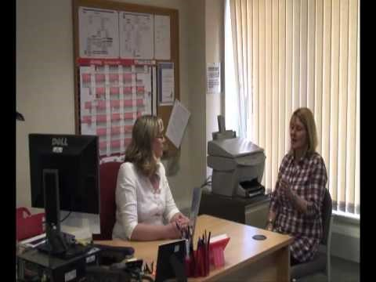
Notes:
0:20 – 3:20
https://youtu.be/95Pm-D2ToS8
https://youtu.be/95Pm-D2ToS8?t=18

Slide 19
What information was transmitted?
How was the relationship?
What thoughts you have about the view of self / other (attachment) in the in the provider? In the patient?
What could have made it better?
Notes:
A

Slide 20
Assessing your attachment style
A 1-item measure
Notes:
H

Slide 21
Following are four general relationship styles that people often report. Place a checkmark next to the letter corresponding to the style that best describes you or is closest to the way you are.
____ A. It is easy for me to become emotionally close to others. I am comfortable depending on them and having them depend on me. I don’t worry about being alone or having others not accept me.
____ B. I am uncomfortable getting close to others. I want emotionally close relationships, but I find it difficult to trust others completely, or to depend on them. I worry that I will be hurt if I allow myself to become too close to others.
____C. I want to be completely emotionally intimate with others, but I often find that others are reluctant to get as close as I would like. I am uncomfortable being without close relationships, but I sometimes worry that others don’t value me as much as I value them.
____ D. I am comfortable without close emotional relationships. It is very important to me to feel independent and self-sufficient, and I prefer not to depend on others or have others depend on me.
Notes:
H

Slide 22
Now please rate each of the relationship styles above to indicate how well or poorly each description corresponds to your general relationship style.
____ A. It is easy for me to become emotionally close to others. I am comfortable depending on them and having them depend on me. I don’t worry about being alone or having others not accept me.
____ B. I am uncomfortable getting close to others. I want emotionally close relationships, but I find it difficult to trust others completely, or to depend on them. I worry that I will be hurt if I allow myself to become too close to others.
____C. I want to be completely emotionally intimate with others, but I often find that others are reluctant to get as close as I would like. I am uncomfortable being without close relationships, but I sometimes worry that others don’t value me as much as I value them.
____ D. I am comfortable without close emotional relationships. It is very important to me to feel independent and self-sufficient, and I prefer not to depend on others or have others depend on me.
1234567
Disagree Strongly Neutral/ Mixed Agree Strongly
Notes:
H

Slide 23
Poll
Notes:
A

Slide 24
Teaching Medical Learners
Mostly on case-by-case basis
Point out patient interactions during video review and staffing
Explicitly draw attention to the process
Notes:
A

Slide 25
Pre-occupied
High anxiety of self, low avoidance
“I’m bad, you’re good”
Will tend to struggle with:
boundaries
Notes:
A

Slide 26
Pre-occupied
“Pulls” for: Reassurance
Reassurance often doesn’t help
Why?
Strategy:
Discuss their feelings / experience
Frustrate the desire for reassurance
Role model setting a boundary
Notes:
A

Slide 27
Dismissing
Low anxiety of self, High avoidance
“I’m good, you’re bad”
Will tend to struggle with:
anger toward patients, problems with communication
Notes:
A

Slide 28
Dismissing
“Pulls” for: Confrontation or withdrawal
Reframing is essential
Connection and commitment to the relationship -- intimacy
Resist punitive or authoritarianism – will make dismissing style even stronger
Notes:
A

Slide 29
Fearful
High anxiety of self, high avoidance
“I’m bad, you’re bad”
Will tend to struggle with:
Asking for help, building relationships, emotional lability
Notes:
H
Important internal anxiety resulting in avoidance
Conflict is inside and outside

Slide 30
Fearful
Most difficult of the styles
Self-perpetuating
Use combination of both previous strategies
Lean into intimacy
Help learner focus on interpretation of the relationship – learner should invest more in the relationship with patient
Notes:
H
Focus on the internal conflict first and then the consequence on the external reactions

Slide 31
Questions and Discussion
Notes:
H&A

Slide 32
References
Bartholomew, K. & Horowitz, L. M. (1991). Attachment styles among young adults: A test of a four category model. Journal of Personality and Social Psychology, 61, 226-244.
Dozier, M., Cue, K. L., & Barnett, L. (1994). Clinicians as caregivers: role of attachment organization in treatment. Journal of consulting and clinical psychology, 62(4), 793.
Fletcher, I., McCallum, R., & Peters, S. (2016). Attachment styles and clinical communication performance in trainee doctors. Patient education and counseling, 99(11), 1852-1857.
Kurtz, S., Silverman, J., Benson, J., & Draper, J. (2003). Marrying content and process in clinical method teaching: enhancing the Calgary–Cambridge guides. Academic Medicine, 78(8), 802-809.
Liu, Y., Huang, Y., Gao, H., & Cheng, X. (2017). Communication skills training: Adapting to the trends and moving forward. BioScience Trends, 11(2), 142-147.
Rosenbaum, M. E. (2017). Dis-integration of communication in healthcare education: Workplace learning challenges and opportunities. Patient Education and Counseling, 100(11), 2054-2061.
Wouda, J. C., & van de Wiel, H. B. (2013). Education in patient–physician communication: how to improve effectiveness?. Patient education and counseling, 90(1), 46-53.

