Slide 1
2023 FMEC Annual Meeting
October 13 - 15 | Providence, RI
Family Medicine: Anchoring Patients and Communities

Slide 2
2023 FMEC Annual Meeting
2022 FMEC Annual Meeting
October 13 - 15 | Providence, RI
Family Medicine: Anchoring Patients and Communities

Slide 3
Making It Count: Health Policy Analysis Skill Building Workshop for Family Physicians
Madeline Taskier, MD
Emmeline Ha, MD

Slide 4
Faculty Disclosure
It is the policy of the FMEC that all individuals in a position to control content disclose any relationships with commercial interests upon nomination/invitation of participation. Disclosure documents are reviewed for potential conflict of interest (COI), and if identified, conflicts are resolved prior to confirmation of participation. Only those participants who had no conflict of interest or who agreed to an identified resolution process prior to their participation were involved in this CME activity.
All faculty in a position to control content for this session have indicated they have no relevant financial relationships to disclose.
The content of this material/presentation in this CME activity will not include discussion of unapproved or investigational uses of products or devices.

Slide 5
Outline
Introductions
Key Health Policy Issues Affecting Family Physicians
Intro to Health Policy Analysis
Our Policy Problem: Workshop
Group Discussion
Q&A

Slide 6
Learning Objectives
Describe the most salient issues in family medicine and primary care health policy in 2023.
Identify core components of a health policy analysis framework.
Evaluate three policy proposal options from a primary care policy issue and justify recommendations for a policy.
Identify one to two actionable policy issues that affect your communities.

Slide 7
Contact Information
Madeline Taskier, MD
taskierm@thewrightcenter.org
@MTaskierMed
@EmmelineHa
Emmeline Ha, MD
Assistant Professor of Emergency Medicine, FM Division, George Washington University School of Medicine
Madeline Taskier, MD
Core Faculty, The Wright Center National Family Medicine Residency at Unity Health Care.
Clinical Assistant Professor, GW

Slide 8
CPV-GW Health Policy Research Fellowship
Emmeline Ha, Fellow 2021-2022
Madeline Taskier, Fellow 2022-2023
Research Areas:
Target Medical Schools
Landscape of Family Medicine
Op-Eds
Mask Access/Policies
Maternal Health Access in DC
Policy Placement:
AAPCHO
Language Access
Insurance Access
NCCL
DC Statehood!
Research Areas:
Integrated Behavioral Health Workforce
Long COVID and Natural Language Processing
Abortion Care Provision by Family Physicians after Dobbs
Health Policy Education in Residency
Writing: Trauma-Informed Care
Policy Placement:
HHS Office of the Assistant Secretary for Health Initiative to Strengthen Primary Health Care under Adm. Rachel Levine

Slide 9
Key Policy Issues Affecting Family Physicians
What do you think?
Source: Aafp.org

Slide 10
This is a loaded question!
Dependent on:
Geography, Regionality, and Population Size
Local and regional population
Local policies & politics
Healthcare Delivery Landscape
Current Policies
Many other factors!

Slide 11
What policy issues are affecting MOST family physicians?
Health Care Coverage and Access
Insurance, Medicaid Expansion, Safety Net Care
Health Care Delivery System
Infrastructure, Hospital Ownership, Public Health System Infrastructure
Primary Care Workforce
Recruitment, Retention, Tackling Burnout, Unionization reform, HPSA Areas
Growing and supporting a workforce to reflect our patient populations
Primary Care Payment Reform
Information Technology
EMR Interoperability, Cost of HIT, Patient Safety, Telehealth
Health Equity
Inclusive Care for racially, ethnically, language-diverse populations, gender-affirming/inclusive care
Climate change and health equity
Pharmaceutical Equity
Medicare Part D, Security of the 340B program
Reproductive Justice
Access to maternity care, safe abortion

Slide 12
Health Policy Analysis
What is Policy Analysis?
The systematic examination of a policy problem from the perspective of a particular stakeholder with the purpose of helping an individual/organization/group make a choice that is reflective of the values of the stakeholder and the practical and political realities.

Slide 13
Why Health Policy Analysis?
Should action be taken to address a given problem?
If so, what type of action should be taken?
This provides us with an organized framework for how to recommend a type of action.

Slide 14
Core Elements of a Policy Analysis
Problem Statement/Issue Statement
Background
Landscape
Options
Recommendations

Slide 15
Problem Statement
We have national primary care physician shortage in the United States. By 2035, HRSA projects shortage of almost 36,000 full-time equivalent primary care clinicians.
Family Physicians form a significant percentage of this current workforce.
How do we increase the recruitment and retention of family physicians in the next 10 years nationally?

Slide 16
Problem Statement
What is the policy problem?
Decreasing Number of Family Physicians Entering and Staying In the Primary Care Workforce
Who is the primary stakeholder or decision maker?
US Senate HELP (Health, Education, Labor, Pensions) Committee, US Congress
What are their values?
Generally care about delivering primary care to communities, fiscally conservative
What are the relevant practical and political realities?
Divided Congressional Landscape, No speaker of the house, expiration of continuing resolution that kept government open, Upcoming Election, Other healthcare priorities in the short term
Broad or narrow problem statement?
Broad

Slide 17
Background
Detailed description of the problem
Summarizes Evidence
Provides a Fact Base
Determines the Magnitude of the Problem
Why is this issue area important?

Slide 18
Background
Is the problem changing?
Historical Trends
Future Projections
Who is affected?
Populations
Geography
Affected Equally?

Slide 19
Landscape
Clarify Political Landscape
Economic Context
Identify Stakeholders

Slide 20
Options
Identify Evaluation Criteria
Identify options (potential solutions)
Evaluate
Justify Your
Final Recommendation

Slide 21
Potential Evaluation Criteria
Net Benefit
Cost and Financing
Equity
Administrative Ease
Legality
Political Feasibility
Social Acceptability

Slide 22
Recommendation
Choose only one option:
Which proposed policy solution is strongest when evaluated by the standardized criteria?
What is the best course of action?
Remember: “Analysis, not advocacy”

Slide 23
Example
 | POLICY #1 | POLICY #2 | POLICY #3
Efficacy (increase the number of FM in PC)
Implementation Cost
Political Feasibility

Slide 24
Your Policy Analysis: Increase the FM Workforce by 2033
POLICY #1 | POLICY #2 | POLICY #3
Increase the Capacity of the Teaching Health Center Program by: Increase Funding Term to 8 years Increase Per Resident Amount (PRA) to $210,000 annually Increase number of Teaching Health Center Planning Grants | Increase Primary Care Pathways: Develop National Law that requires any medical education institution receiving federal funding needs to have a primary care training track in their health professions education | Make Primary Care Salaries More Competitive in Underserved Settings: Revamping the National Health Service Corps Budget to Increase Salaries/Provide Loan Repayment

Slide 25
What do you recommend to the Senate HELP committee?

Slide 26
Which Evaluation Criteria Did You Use?
Cost
Simplicity of Policy
Ease of Implementation
Ability to Measure Outcomes
Social Acceptability
Political Feasibility
Overall Impact on the Workforce
Equitable Access

Slide 27
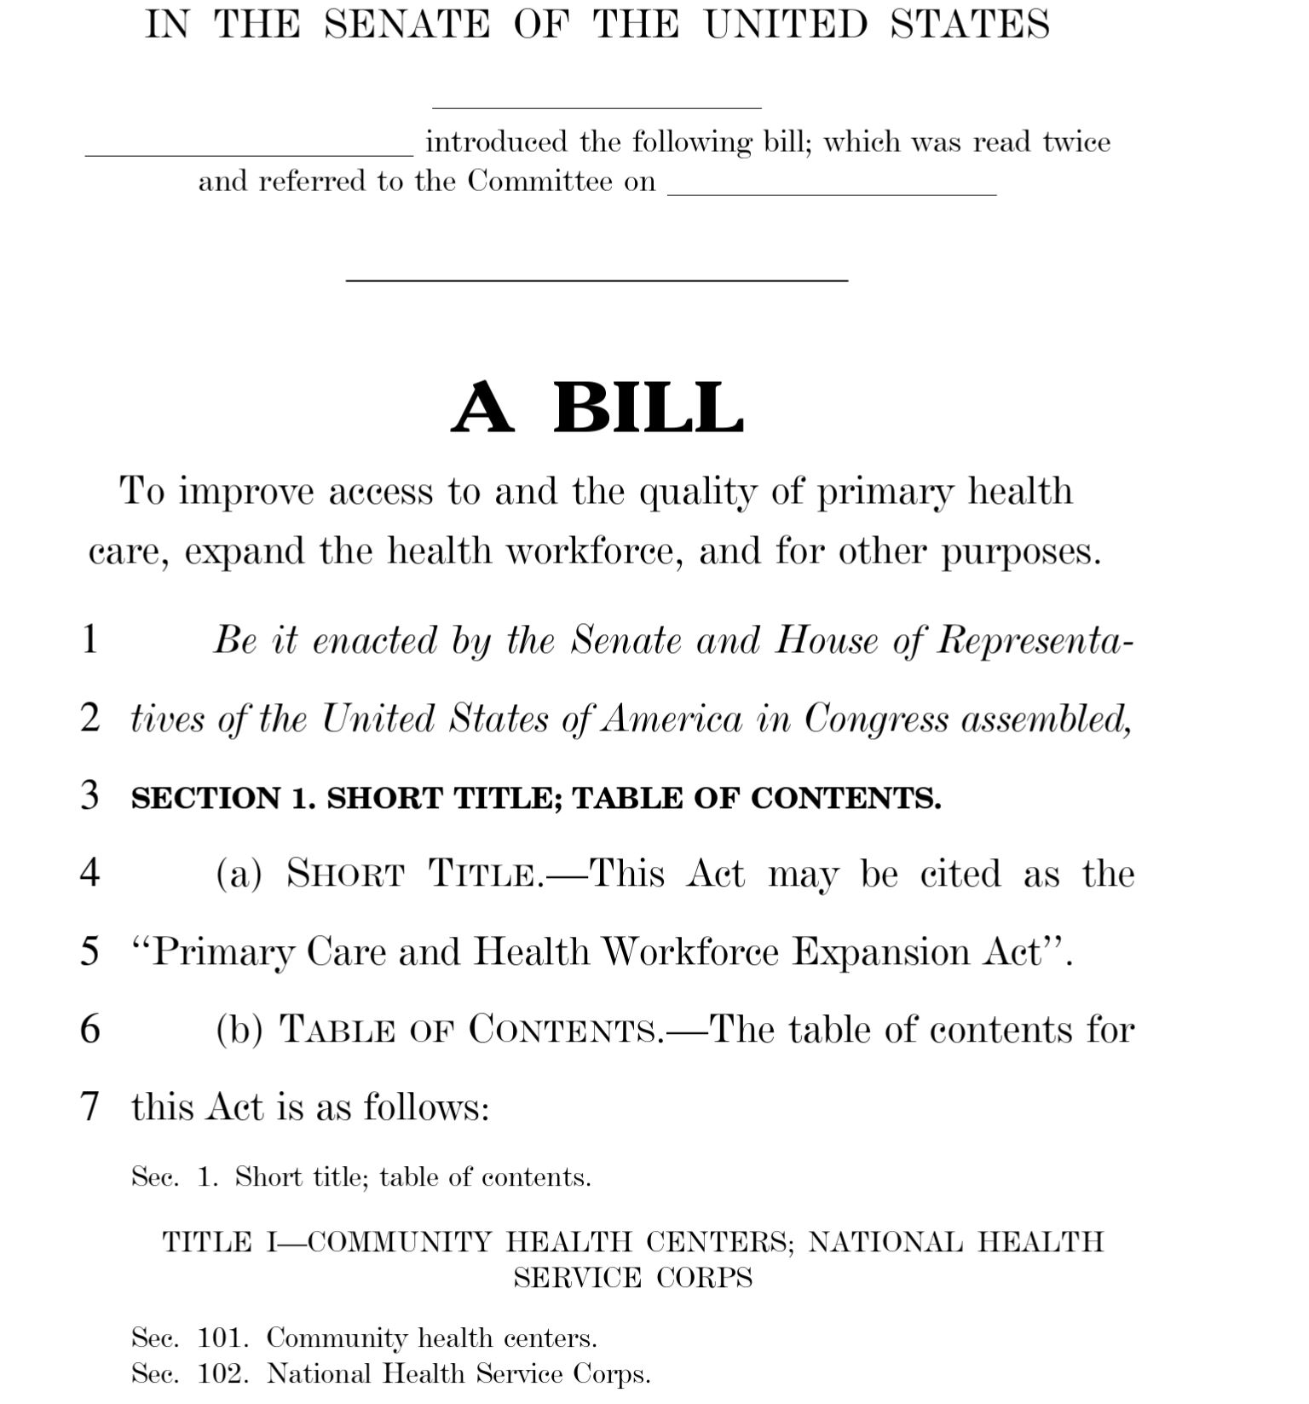
What challenges did you observe?
Tailoring to stakeholders
National Impact vs. more effect starting locally
Cost
No standardized definition for terms like “underserved”
Non-specific, broad policy language
Who holds the responsibility to implement
Source: help.senate.gov

Slide 28
How Can You Utilize This Framework for Policy Issues in Your Own Community?

Slide 29
Thank you! Questions?
Contact Information
Madeline Taskier, MD
taskierm@thewrightcenter.org
@MTaskierMed
@EmmelineHa
Don’t forget to evaluate this session!
How to Rate a session in the Conference App:
Go to the session you want to rate
Click on the purple button that says “Rate Session”
Click on the stars and rate it from 1-5 stars
Please enter comments and feedback for the presenter. This data is presented to them after the conference.

