Slide 1
Mind the Gap: Medical and Health Professions Students’ Understanding of Clinical Roles in an Interprofessional Student-Run Free Clinic
William Hay (University of Nebraska Medical Center)
Mary Ann Powell (University of Nebraska Omaha)
T Lynne Barone (University of Nebraska Omaha), Samantha K. Ammons (University of Nebraska Omaha), Craig G. Hughes (University of Nebraska Omaha), Bao Tram Ngoc Huynh (University of Nebraska Omaha), Angela M. Brown (University of Nebraska Omaha), Joseph McGuire (University of Nebraska Omaha), Breanna Thompson (University of Nebraska Omaha), Jay Irwin (University of Nebraska Omaha)

Slide 2
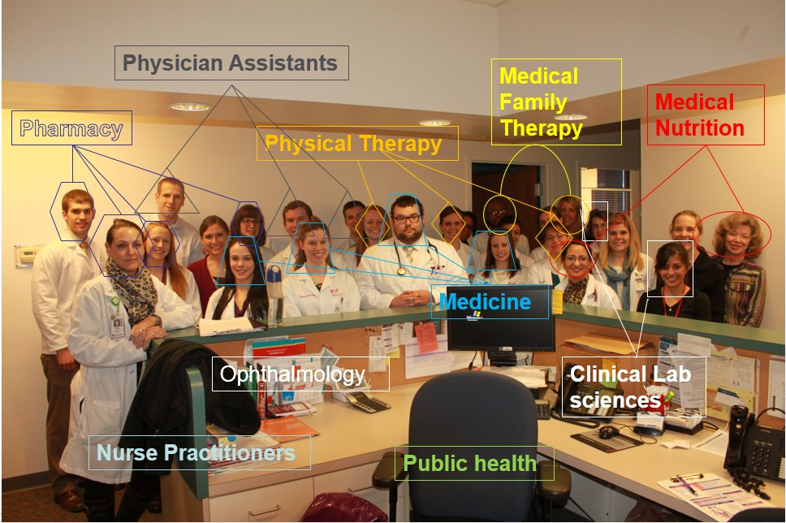
GOODLIFE Clinic
GOODLIFE is a an interprofessional diabetes specialty clinic that is part of the SHARING clinics
Notes:
GOODLIFE Greater Omaha Outreach for Diabetes Lifestyles Impacting Fitness and Education is part of the SHARING clinics.
It meets once a month in the evening for about 4 hours. Patients are referred into it from various UNMC clinics. It is housed in an existing UNMC primary care clinic (uses its facilities).
Disciplines (or professions): Medicine, Pharmacy, Physician Assistant, Nurse Practitioner, Physical Therapy, Medical Nutrition, Medical Lab Sciences and Behavioral Health
Over the course of two years we studied the GOODLIFE clinic, one of the UNMC SHARING Clinics in Omaha NE, which specializes in diabetic care. GOODLIFE is a student-run clinic using an interprofessional team approach as this is associated with improved patient outcomes for diabetic care (Shojania, et al., 2006, Tricco et al., 2012).
Changes Bill made at GOODLIFE to promote interprofessional teams
Pre-clinic huddle/identify self-role
Started co-interviewing – 2 or3 disciplines together
Have students form Interprofessional team follow their patient though the entire evening
All providers identified in the note
Shared responsibilities/coverage
Explore & expand roles for each discipline
7. Use EHR to see that patients seen by all disciplines over time
8. Each discipline write their own notes
Interprofessional precepting
Future - all disciplines have templates
Future – interprofessional debrief/grand rounds

Slide 3
Does working in a student-run free clinic improve interprofessional learning?

Slide 4
Methods & Analysis
Qualitative Methods
Participant observation of student clinical teams by seven ethnographers (N=71)
Informal interviews on interprofessional roles and education
Quantitative Methods
Time use data on patient-team interaction
Survey on interprofessional beliefs and knowledge before and after clinic: slightly modified SPICE-R (Student Perceptions of Interprofessional Clinical Education-Revised) (N=305)
Notes:
1. To capture behavior, we observed and interviewed 71 interprofessional teams documenting how (and whether) disciplines interacted preparing for and providing patient care, as well as their knowledge of other disciplines and attitudes towards interprofessional education.
Informal interviews Used a professional role checklist inventory to ask students about their knowledge of other disciplines, and their experience with interprofessional education
2. Time use data: We used HOURS, a time-use documentation software, to capture turn-taking behavior and the percentage of time disciplines talk during the patient interaction and exam.
3. We surveyed student attitudes and knowledge using a modified SPICE-R. Surveys were given to students to complete before clinic began and again when they had finished for the night. SPICE-R: Student Perceptions of Interprofessional Clinical Education--Revised

Slide 5
SPICE-R Survey Questions
Working with students from another health profession enhances my education
My role within an interprofessional healthcare team is clearly defined.
Health outcomes are improved when patients are treated by a team that consists of individuals from two or more health professions.
Patient satisfaction is improved when patients are treated by a team that consists of individuals from two or more health professions
Participating in educational experiences with students from another health profession enhances by future ability to work on an interprofessional team.
All health professional students should be educated to establish collaborative relationships with members of other health professions.
I understand the roles of other health professionals within an interprofessional team.
Clinical experiences are the ideal place within their respective curricula for health professional students to interact.
Health professionals should collaborate on interprofessional teams.
During their education, health professional students should be involved in teamwork with students from other health professions in order to understand their respective roles.
Notes:
(this is also in Handout-both questions and instructions)
Instructions at the top of survey “In this survey, you are being asked about your attitudes toward interprofessional health care teams and the team approach to patient care. By interprofessional health care team, we mean two or more health professionals (e.g. nurse, pharmacist, physician, physician assistant, medical lab sciences, etc.) who work together to plan, coordinate, and/or deliver patient care. Please be candid as you indicate the extent of your agreement with each of the following statements related to interprofessional teams and the team approach to care.”

Slide 6
SPICE-R Survey
Working with students from another health profession enhances my education
My role within an interprofessional healthcare team is clearly defined.
Health outcomes are improved when patients are treated by a team that consists of individuals from two or more health professions.
Patient satisfaction is improved when patients are treated by a team that consists of individuals from two or more health professions
Participating in educational experiences with students from another health profession enhances by future ability to work on an interprofessional team.
All health professional students should be educated to establish collaborative relationships with members of other health professions.
I understand the roles of other health professionals within an interprofessional team.
Clinical experiences are the ideal place within their respective curricula for health professional students to interact.
Health professionals should collaborate on interprofessional teams.
During their education, health professional students should be involved in teamwork with students from other health professions in order to understand their respective roles.
FACTOR 1: EDUCATIONAL REQUIREMENTS

Slide 7
SPICE-R Survey
Working with students from another health profession enhances my education
My role within an interprofessional healthcare team is clearly defined.
Health outcomes are improved when patients are treated by a team that consists of individuals from two or more health professions.
Patient satisfaction is improved when patients are treated by a team that consists of individuals from two or more health professions
Participating in educational experiences with students from another health profession enhances by future ability to work on an interprofessional team.
All health professional students should be educated to establish collaborative relationships with members of other health professions.
I understand the roles of other health professionals within an interprofessional team.
Clinical experiences are the ideal place within their respective curricula for health professional students to interact.
Health professionals should collaborate on interprofessional teams.
During their education, health professional students should be involved in teamwork with students from other health professions in order to understand their respective roles.
FACTOR 2: TEAM ROLES AND EXPECTATIONS

Slide 8
SPICE-R Survey
Working with students from another health profession enhances my education
My role within an interprofessional healthcare team is clearly defined.
Health outcomes are improved when patients are treated by a team that consists of individuals from two or more health professions.
Patient satisfaction is improved when patients are treated by a team that consists of individuals from two or more health professions
Participating in educational experiences with students from another health profession enhances by future ability to work on an interprofessional team.
All health professional students should be educated to establish collaborative relationships with members of other health professions.
I understand the roles of other health professionals within an interprofessional team.
Clinical experiences are the ideal place within their respective curricula for health professional students to interact.
Health professionals should collaborate on interprofessional teams.
During their education, health professional students should be involved in teamwork with students from other health professions in order to understand their respective roles.
FACTOR 3: INDIVIDUAL ROLE CLARITY

Slide 9
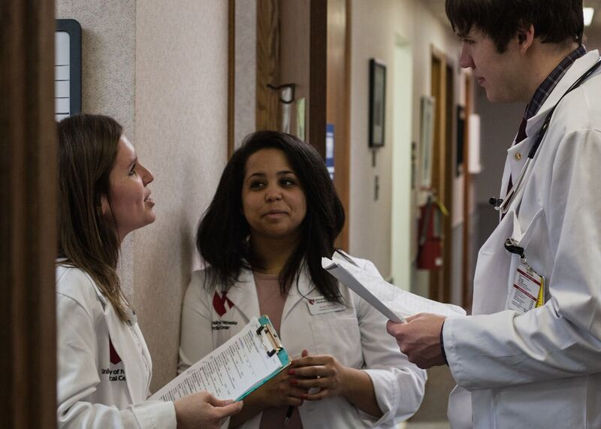
Volunteering at GOODLIFE improves student attitudes toward interprofessional education and clarifies professional roles
Notes:
Demographics
As you can see in your handout, roughly half of the sample was comprised of medical students and pharmacy students, with the other disciplines making up the rest.
27.5% Medical School (84 students)
1% Nursing (3 students)
29.2% Pharmacy (89 students)
11.5% Physical Therapy (35 students)
15.1% Physician Assistant (46 students)
6.6% Nutrition (20 students)
2.6% Family Medical Therapists (8 students)
6.6% Medical Lab Sciences (20 students)
Most students were women (70.8%, or 216 students). Average age was 25.5
Students tended to be early in their training across disciplines (so, Medical students were slightly more likely to be 1 or 2nd years rather than 3rd or 4th years)
But moving to our findings: First, GOODLIFE changes attitude towards IP and a clearer understanding of professional roles.

Slide 10
Survey says...
Table 1. Overall Change in Factors (N=306)
Factor | Pre-Test Mean | Post-Test Mean | Change T2-T1 | p
Educational Requirements | 4.615 | 4.76 | .146 | <.000
Team Roles & Expectations | 4.263 | 4.534 | .2793 | <.000
Individual Role Clarity | 4.147 | 4.366 | .219 | <.000
Students report improved knowledge of disciplines (their own and others)
By the end of the night, they are more supportive of interprofessional collaboration

Slide 11
Medical Students’ Year in School & Role Clarity
Table 2. Medical Student Change in Factors by level in program (N=84)
Factor | Pre-Test Mean | Post-Test Mean | Change T2-T1 | p
Educational Requirements Lower Division Upper Division | 4.684 4.471 | 4.765 4.700 | .082 .229 | .183
Team Roles & Expectations Lower Division Upper Division | 4.299 4.174 | 4.469 4.486 | .170 .314 | .261
Individual Role Clarity Lower Division Upper Division | 4.327 4.171 | 4.347 4.514 | .020 .343 | .020
Among medical students at GOODLIFE, shifts in role clarity are especially pronounced among those in their 1st or 2nd year of training
Notes:
Upper Division Medical Students improve their individual role clarity more than do Lower Division Medical Students across the evening.

Slide 12
Exposure to the GOODLIFE Model has a Compounding Effect
Table 3: Effect of Prior GOODLIFE Experience on Change in Factors (N=305)
Factor | Pre-Test Mean | Post-Test Mean | Change T2-T1
Educational Requirements No Prior GOODLIFE GOODLIFE Experience | 4.643 4.583 | 4.741 4.788 | .100 .208*
Team Roles & Expectations No Prior GOODLIFE GOODLIFE Experience | 4.239 4.297 | 4.492 4.595 | .253 .295
Individual Role Clarity No Prior GOODLIFE GOODLIFE Experience | 4.076 4.241* | 4.279 4.481* | .204 .241
Students who have attended GOODLIFE at some point in the past report:
Improved appreciation of how clinics contribute to interprofessional training
New attendees and repeat attendees both improve in role clarity, with clinic attendance having a cumulative effect
*one tailed significance p<.05
Notes:
MAP language about the data:
Previous experience at Goodlife clinics (self-reported, and could have been at any time, either before the study started, or after), improves appreciation of IP.
There is a significant difference in change for the educational requirement (factor 1), with those with prior GOODLIFE experience changing more over the course of the evening.
No significant changes in other factors for this group.
Goodlife experience increases individual role clarity in both the pre- and post SPICE-R, but the change between pre- and post- is not significant.

Slide 13
Explicit Faculty Instructions Improve Team Collaborations
Stay together as a team throughout the clinic.
Co-interview the patient as a team
Team makes a the plan together
Present to an interprofessional panel of faculty preceptors
Every profession should write their own note into the patient records.
Notes:
Faculty modeling—What the faculty preceptor said about the importance of IP teams and how they should work at GOODLIFE at the beginning of clinic mattered. If the preceptor did a good job hitting all five points (see below), the ethnographers would see more IP behavior—even on teams which didn’t have ideal patient interaction.
The minute students set foot in GOODLIFE, faculty adhere to a template and instruct students that they will be placed into IP teams, and given instructions on how the night will proceed
Example of Explicit Instructions that Guided Teams toward Sustained Collaboration
“In this clinic, find someone from another discipline and co-interview the patient. And, medical students, let them talk too! You present together to the interprofessional faculty and stay together to make a plan. Everyone write a note… Don’t underestimate how helpful another profession can be.” (Team 28 from 051017).
Example of More Vague Instructions that Resulted in Less Team Collaboration
“Look at the chart with them” and “co-interview the patient”… “Some may have to peel off, but generally stick together as a team.” (Team 12 from 110916)
Seventy-one (71%) percent of the most collaborative teams according to time use data (so MD students are less likely to dominate during the patient interview) began their night with Hay mentioning at least 5 out of 6 of the explicit instructions.

Slide 14
Students struggle with role clarity, but team composition can reduce role ambiguity
Notes:
To better understand what the pre and post survey results meant, we also collected qualitative data. This involved both observation by ethnographers embedded with the teams from formation to note writing, and informal interviews. Initial interviews revealed substantial variation in understanding professional roles other than their own. Students ranged from a popular understanding (i.e. pharmacists know about medications) to being able to articulate a more nuanced model of professional scope of practice.
Thus, we began asking students about specific tasks completed by team members at GOODLIFE to better map their understanding of professional roles. Data was collected through interviews with students after they had worked with their interprofessional teams to see patients, completed precepting and when they were working on their notes.
We asked members of teams (of all professions) their understanding of the clinical role of each profession, including their own, in performing tasks typical at GOODLIFE. What we found was that students (from all programs) benefited from not just having another profession on a team to discuss the patient, they benefited most when they could see other professions deliver care from the beginning to the end of the process.

Slide 15
Medical students improve interprofessional role knowledge by working with teammates
Table 4 : Medical Students Knowledge of the Physical Therapist Role on a Interprofessional Team
 | MD w/ PT on Team (N=10) |  | MD w/o on Team (N=14)
 | Yes | Unsure | Yes | Unsure
PT microfilament exam? | 100% | 0% | 57.1% | 7.1%
PT take patient history? | 70% | 0% | 50% | 7.1%
PT discuss medications? | 40% | 10% | 7.1% | 21.4%
Notes:
For example, medical students with a physical therapy student teammate demonstrate greater understanding/less ambiguity of PT roles (post clinic):
Microfilament exam, History, Medication
There was less shift on things that were more obviously within scope of practice or not : Exercise, blood sugar testing, educating patients about Injecting insulin.

Slide 16
The GOODLIFE Model Works
Students benefit from working alongside other disciplines to provide patient care
Students benefit from seeing preceptors from multiple disciplines working together
Notes:
GOODLIFE model works (IP teams, modeling through instructions & precepting)
Students benefit from seeing other disciplines/professions engaging with the patient, AND seeing preceptors from multiple disciplines/professions working together. (Seeing vs telling is important).

Slide 17
The GOODLIFE Model Works
Students have an improved understanding of their own roles and those of other disciplines
A multi-year mixed approach provides support for “seeing” the process of interprofessional learning
Notes:
Instructions at the beginning defining the process, IP team participation, IP precepting all reinforce collaborative structure and improve own role clarity for med students and other disciplines/professions
Conducting a longer term study with multiple forms of data in this form of educational environment has some advantages.
Longitudinal data allows us to move beyond the “noise” of individual factors (personality, test days), and pinpoint the factors that do matter (such as year in program, gender, and whether or not they have volunteered at the GOODLIFE clinic before).

Slide 18
References
Dominguez D.G., Fike, D.S., MacLaughlin, E.J., Zorek, J.A. A comparison of the validity of two instruments assessing health professional student perceptions of interprofessional education and practice. Journal of Interprofessional Care. 2015. 29(2):144-149.
Gilkey, M.B. & Earp, J.A. L. Effective interdisciplinary training: Lessons from the University of North Carolina’s student health action coalition. Academic Medicine. 2006. 81:749–758.
Haggarty, D. & Dalcin, D. Student-run clinics in Canada: An innovative method of delivering interprofessional education. Journal of Interprofessional Care. 2014; 28(6): 570–572.
IOM (Institute of Medicine). Measuring the impact of interprofessional education on collaborative practice and patient outcomes. 2015. Washington, D.C.: The National Academies Press.
Meah, Y., Smith, E., Thomas, D. Student-run health clinic: Novel arena to educate medical students on systems based practice. Mount Sinai Journal of Medicine. 2009. 76(4): 344- 356.
Sheu, L.C., Zheng, P., Coelho, A.D., Lin, L.D., O’Sullivan, P.S., O’Brien, B.C., Yu, A.Y., Lai, C.J. Learning through service: Student perceptions on volunteering at interprofessional hepatitis B student-run clinics. Journal of Cancer Education. 2010. 26:228-233.
Thistlewaite, J., Dallest, K. Interprofessional teamwork: Still haven’t decided what we are educating for? Medical Education. 2014. 48:552-560.
Tricco A, Ivers N, Shojania K, et al. Effectiveness of quality improvement strategies on the management of diabetes: A systematic review and meta-analysis. Lancet. June 16, 2012. 379(9833):2252-2261.
Vincent, C. Social scientists and patient safety: Critics or contributors? Social Science & Medicine. 2009. 69: 1777-1779.
Wang, T. & Bhakta, H. A new model for interprofessional collaboration at a student-run free clinic. Journal of Interprofessional Care. 2013. 27: 339–340.
Waring, J.J. Constructing and re-constructing narratives of patient safety. Social Science & Medicine. 2009. 69: 1722–1731.
Weinstein AR, Dolce MC, Koster M, et al. Integration of systematic clinical interprofessional training in a student-faculty collaborative primary care practice. Journal of Interprofessional Care. July 2017:1-4.
World Health Organization (2010). Framework for action on interprofessional education & collaborative practice. Health Professions Networks Nursing & Midwifery Human Resources for Health. http://www.who.int/hrh/nursing_midwifery/en/ Retrieved October 1, 2014.

