Slide 1
There's an App for That: Behavioral Health Apps to Improve Patient Care and Education
Stephen Warnick, Jr., MD
Chris White, MD, JD, MHA
Kevin Brazill, DO, MS

Slide 2
Disclosures
The presenters have no relevant conflict of interests to disclose regarding the content of this presentation.

Slide 3
Goals and Objectives
Understand the scope of apps available for smartphones in the realm of behavioral health, including the broad categories in which they can be used.
Create a framework from current best practices that can be used in the future to rigorously evaluate new behavioral health applications.
Utilize and download clinical apps on their smartphone for use in patient care and teaching in primary care clinics.

Slide 4
To whom are you listening…
Stephen Warnick, Jr., MD
Chris White, MD, JD, MHA
Kevin Brazill, DO, MS

Slide 5
Taking the pulse of the audience…..
A) Currently use mobile phone apps with behavioral health patients
B) Currently use apps personally but not sure which to use with patients
C) Still sporting a flip phone

Slide 6
A Framework for Evaluating Mental Health Apps
Adapted from the American Psychiatric Association’s App Evaluation framework.
Roughly 250,000 health-based apps available, an estimated 10,000 of them are mental-health focused.
When interacting with patients, how do we begin to make sound, evidence-based recommendations on the thousands of apps available?
Here’s a start...

Slide 7
App Evaluation Framework
Flexible, Framework-based Scoring Preferred
Hierarchy and questions to guide informed decision-making
Static scoring is not useful
Apps change
Poor reliability of raters
No one treatment gets Five Stars or an “A+”

Slide 8
App Evaluation Framework
Interoperability/Data Sharing
Ease of Use
Evidence
Risk/Privacy/Security
Ground Level
Torous, J. “Evaluating Psychiatric Smartphone Apps.” www.education.psychiatry.org. APA. Jan 2017

Slide 9
App Evaluation Framework
Ground Level
Information gathering before evaluation
Who is the underwriter/developer?
How much $ & who is advertising?
Is it a medical app?
When was its last update?

Slide 10
App Evaluation Framework
Risk, Privacy & Security
Profiling
Loss of confidentiality
Dissemination of erroneous information
Does HIPAA apply and if so, are guidelines being followed?

Slide 11
App Evaluation Framework
Risk, Privacy & Security
Is there a privacy policy?
Is data collected, encrypted, or shared with 3rd parties?
Where is data stored?
Can the user opt-out of data collection?
What happens to information if an app is deleted?

Slide 12
App Evaluation Framework
Evaluating the Evidence
Grandiose, amazing claims often made by developers
What is the evidence underscoring the app’s premise?
Does the content seem reasonable?
What do other users say in the iTunes of Google Play store?

Slide 13
App Evaluation Framework
Ease of Use
How complicated is the app to use?
Is the interface intuitive?
Does it work on iOS and Android?
Can users customize the apps?
Can users with disabilities use the app?

Slide 14
App Evaluation Framework
Data Sharing-Interoperability
Can the therapist/physician and patient share data?
Can app-based data interact with the pt’s EMR?
Does the app communicate w/ wearable tech (FitBit)?
Can data be downloaded, printed and shared?

Slide 15
App Evaluation Framework
With a framework in place, approaching the most popular, user-friendly, and accessible apps can enable the patient to communicate, process, and heal in new and innovative ways.

Slide 16
Virtual Hope Box
Booster Buddy
Calm
Pacifica

Slide 17
Virtual Hope Box
Cost : Free
Dx : Anxiety / Depression
Pros
Nice single source
Some customization
Easy to use
Has been studied
Cons
Not very graphic intense
Less updated

Slide 18
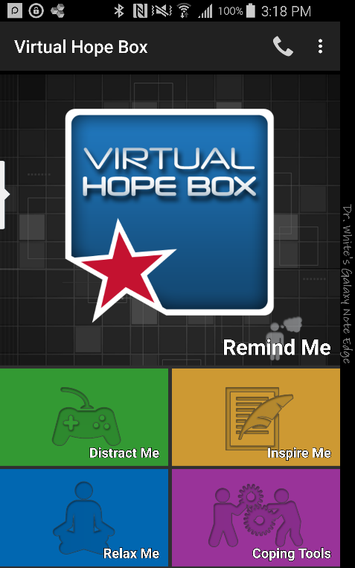
Virtual Hope Box
Upload personal photos
Relaxation
Breathing exercise
PMR
Guided imagery (3)
Distractions (puzzles)
Inspiration
Activity scheduling / Coping

Slide 19
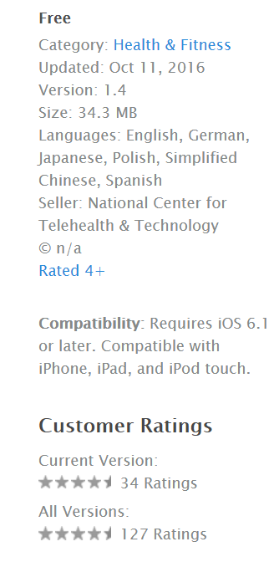
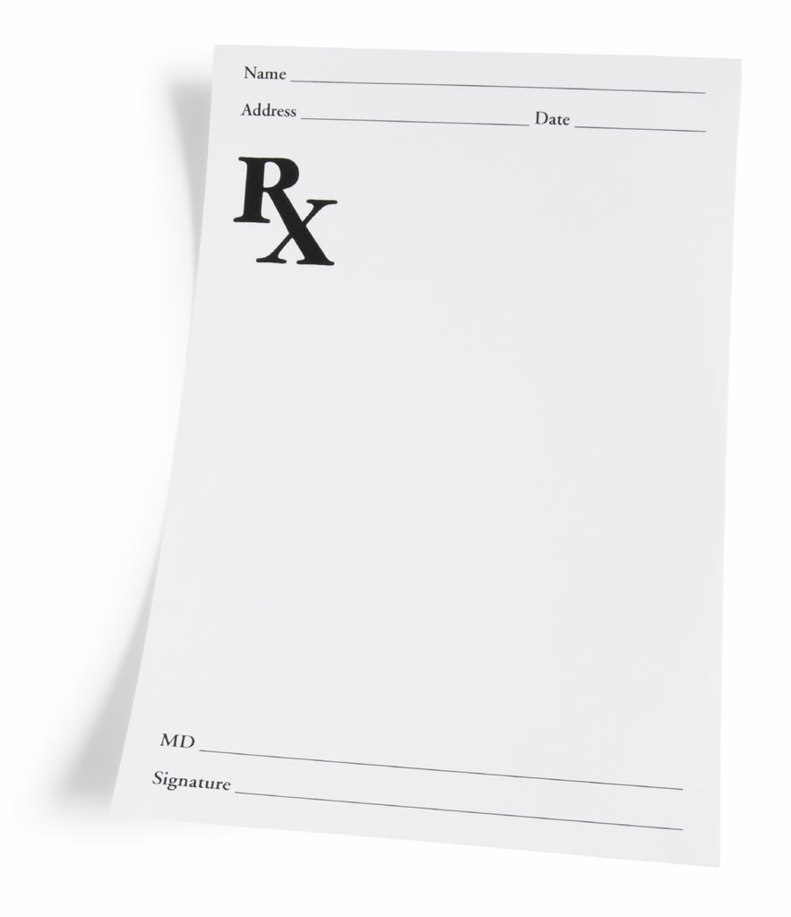
Virtual Hope Box
Customize your app with photos
Use Relax Me exercises 2x a day
Schedule 5 behavioral activation activities per week

Slide 20
Booster Buddy
Cost : Free
Dx : Depression
Pros
Good for younger (token economy)
Promotes relatedness (virtual level)
Cons
No breathing/relaxation scripts

Slide 21
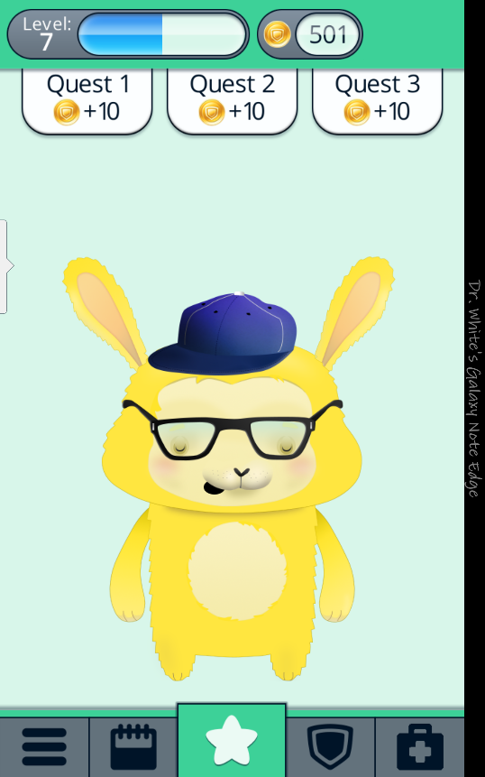
Booster Buddy
Safety planning
Medication minder
3 daily ‘quests’
Ability to dress buddy
Lots of coping skills

Slide 22
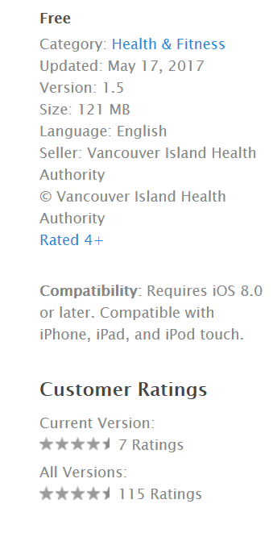
Booster Buddy
Customize your app (crisis line, meds, pick your buddy)
Track your mood, meds, and substance abuse for 1 week
2-3 levels per week, pick the next wardrobe item

Slide 23
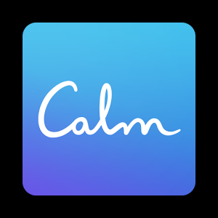
Calm
Cost: Free to $60 a year
Dx : Anxiety/Insomnia
Pros
Very beautiful interface
Cons
Primary relaxation focus
Minimal tracking

Slide 24
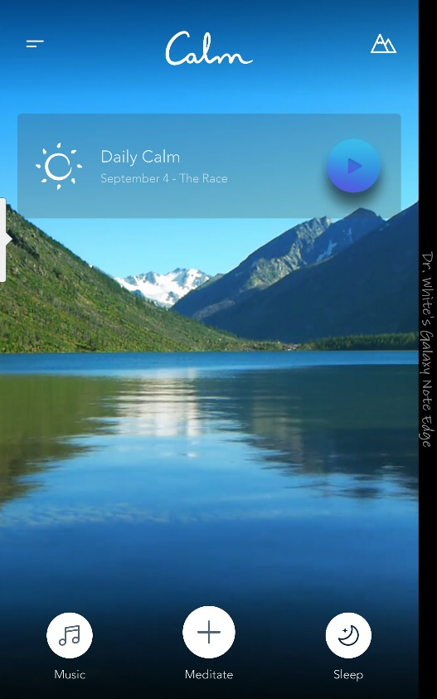
Calm
Breathing exercises
Meditation by topic / including daily
Series of ‘classes’
Sleep stories
Limited music

Slide 25
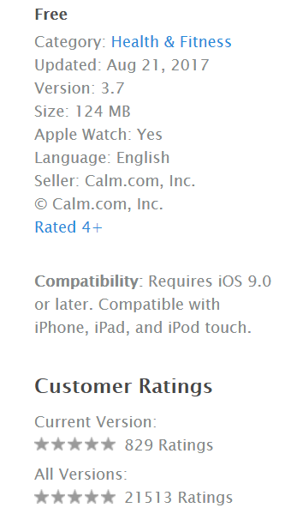
Calm
Breathing Exercise 2x a day for 1 week
Complete a ‘7 Days of ….”
Find a sleep story which works

Slide 26
Pacifica
Cost : free -> $36/yr
Dx : Depression/Anxiety
Pros
Very beautiful interface
Mood/sleep tracking

Slide 27
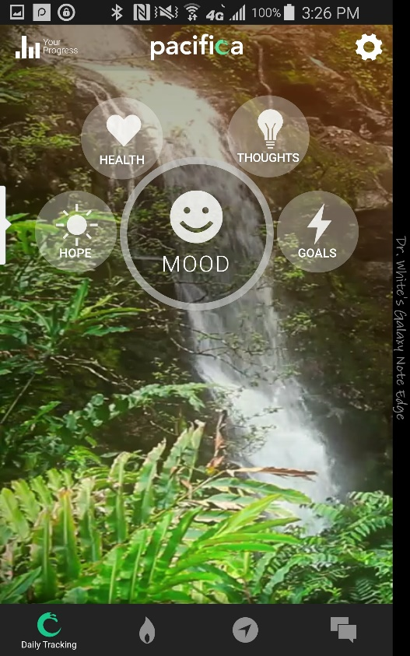
Pacifica
Patient self report tracking
Guided meditations
CBT/positive psychology infused

Slide 28
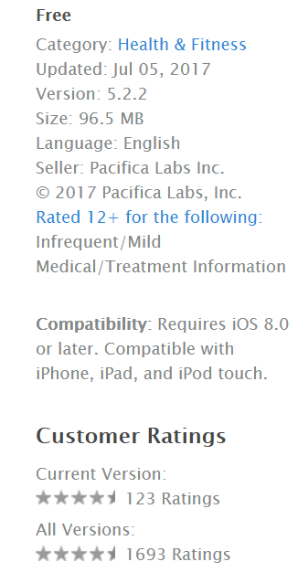
Pacifica
Enter monitoring data for 1 week
Practice with the Relax Now skills (pick 2 a day)
Complete a guided path

Slide 29
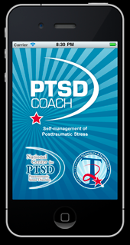
Applying the Framework - Ground
PTSD Coach
Free App (iOS/Android) and Website
Developed by VA National Center for PTSD and Department of Defense
Developed in 2011, updated regularly
(in 9/17, last updated was 8/1/17 in iOS)

Slide 30
Applying the Framework – Safety/Risk
From Website:
“Any data created by the user of this app are only as secure as the phone/device itself. Use the security features on your device if you are concerned about the privacy of your information. Users are free to share data, but as the self-monitoring data belong to each user, HIPAA concerns do not apply while the data are stored or shared. If the user were to transmit or share data with a health care provider, the provider must then comply with HIPAA rules”
App allows you to export and delete data
Can opt out of anonymous usage data
No data transferred or transmitted to VA; stays on the phone.
Phone calls to 911 and other Crisis lines in the App

Slide 31
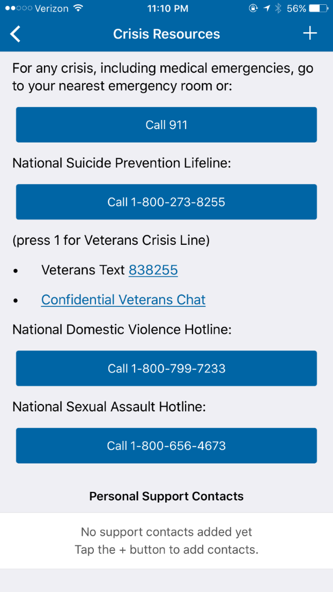
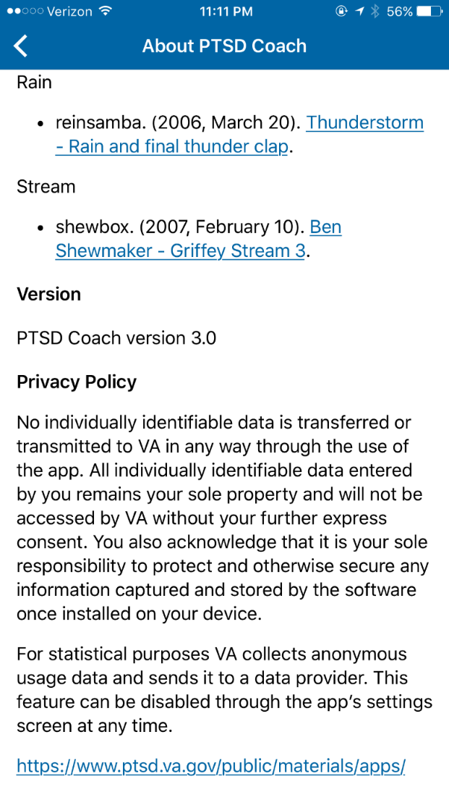
Applying the Framework – Safety/Risk

Slide 32
Applying the Framework – Efficacy/Evidence
Clinical trial listed on ClinicalTrials.gov but not published yet¹
No harm from the app
Evidence of decreased PCL-5 scores.
Published trial from 2015 also suggesting that early use helped decreased distress scores for patients up to 2 points (on scale of 1-10).²
1. https://clinicaltrials.gov/ct2/show/NCT02445196
2. Owen JE, Jaworski BK, Kuhn E, et al. mHealth in the Wild:Using Novel Data to Examine the Reach, Use, and Impact of PTSD Coach. JMIR Ment Health 2015 Mar 25;2(1):e7.

Slide 33
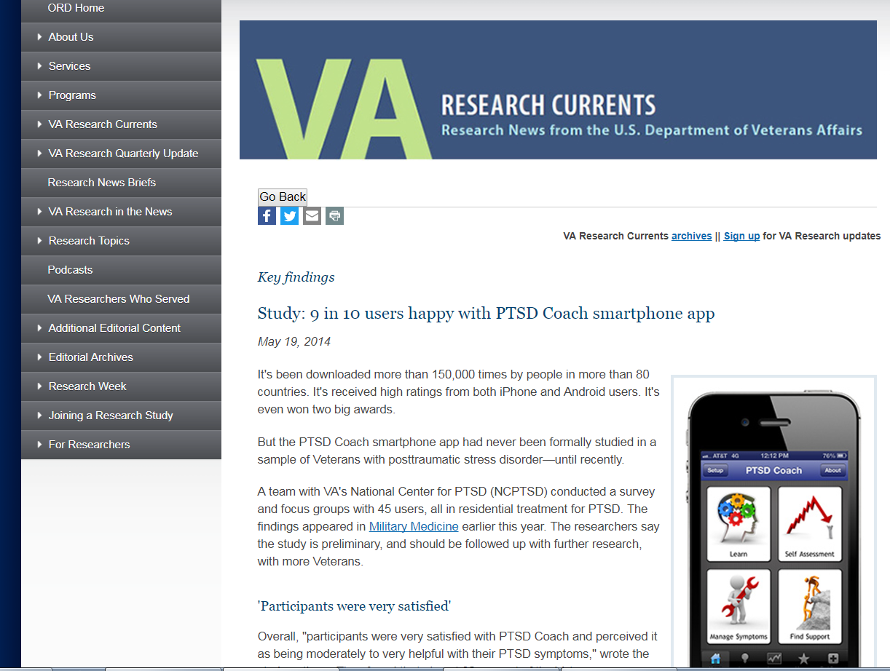
Applying the Framework – Usability/Ease

Slide 34
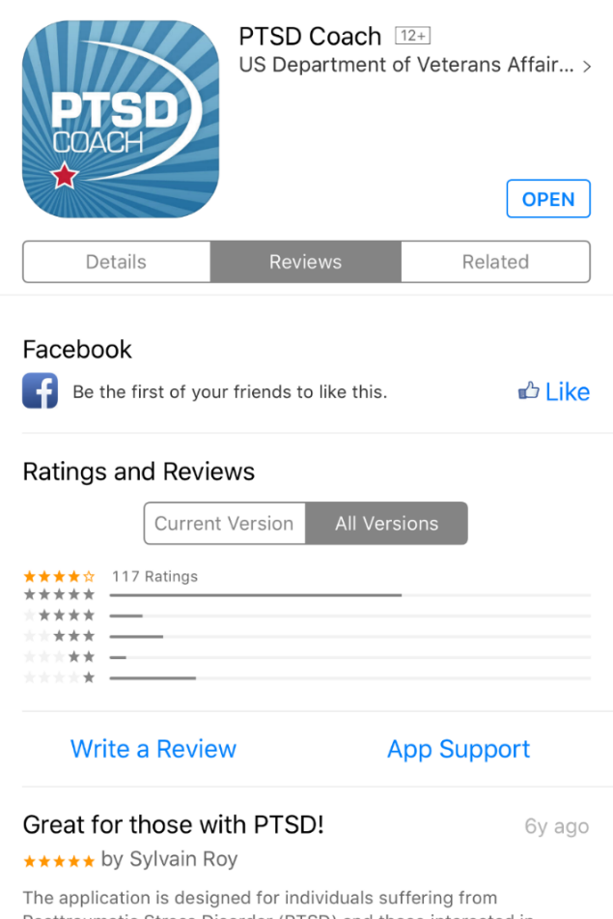
Applying the Framework – Usability/Ease
Can look at app ratings and feedback
iOS app store 4/5 star rating average, mostly 5 stars
114,109 downloaded app on iOS¹
15519 used next day
17459 used one week later
28755 used on month later
17435 used 3 months later
6276 used 1 year later
1. Owen JE, Jaworski BK, Kuhn E, et al. mHealth in the Wild:
Using Novel Data to Examine the Reach, Use, and Impact of
PTSD Coach. JMIR Ment Health 2015 Mar 25;2(1):e7.

Slide 35
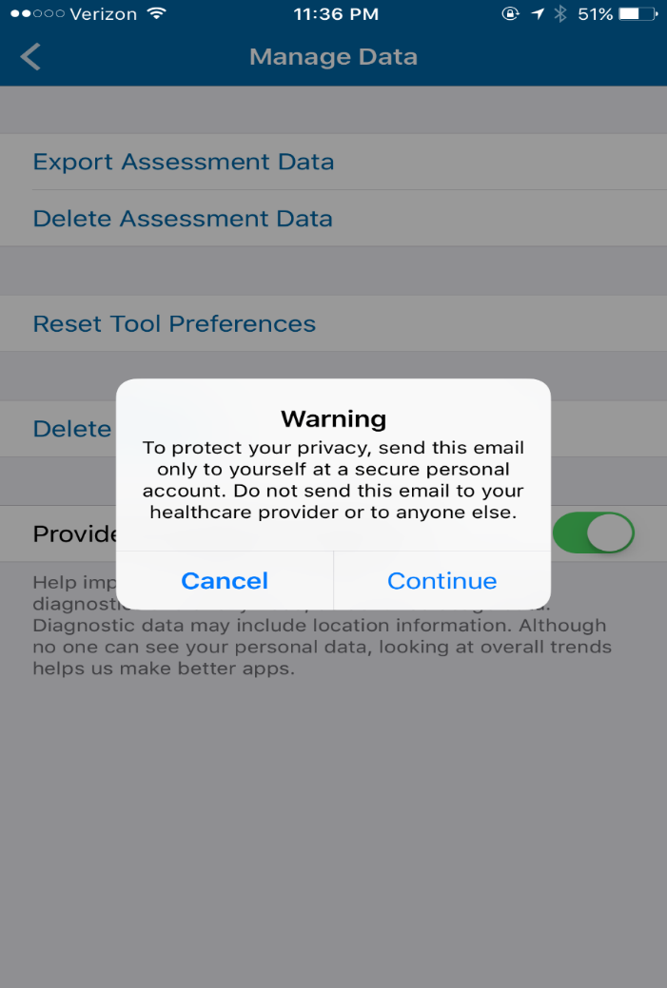
Applying the Framework - Interoperability
Allows for export of symptoms using a validated scale
Can e-mail from the app
Allows for saving of symptoms using a validated scale

Slide 36
What Apps Have You Used?
We will compile a list and publish to STFM Resource Library
We will not be evaluating each app today
What apps have you, your students/residents/colleagues, or your patients used?
Which have worked well?
Which would you NOT recommend? Why?

