Slide 1
Bridging the Gap: Integrating Mental Health Professionals in Residencies to Reduce Health Disparities
Emilee Delbridge, PhD, Max Zubatsky, PhD, &
Jocelyn Fowler, MA
Thursday, September 22, 2016

Slide 2
Disclosures
No Financial Disclosures to Report

Slide 3
Goals and Objectives
Participants will:
Identify models of integrating mental health learners into medical residency sites.
Describe potential challenges to developing integrated care training sites, as well as potential approaches to overcoming these challenges.
Identify opportunities for initial or expanded integration of behavioral health in primary care, as well as relevant research questions.

Slide 4
Who is here? What brings you here?

Slide 5
Session Overview
Introductions
Integrated Care Overview
Evidence & Research & Case Study
2 Collaborations
Survey results; QI data
Small Group
Large Group
Q &A
Notes:
This slide may be deleted.

Slide 6
Introductions

Slide 7
Integrated Care
Some evidence that Integrated Behavioral Health beneficial for patient outcomes.
How are we looking at different outcomes around operational and financial areas?
Access to care, fee for service, cost offset
Different Levels of Integration
PCBH
Collaborative Care Model
Notes:
Background, overview

Slide 8
Identify behavioral risks (e.g. substance abuse, PTSD, depression, child abuse)
Identify prevalence of chronic medical conditions (diabetes, rheumatoid arthritis, fibromyalgia, chronic pain)
Identify barriers to care
Asset mapping and community strengths
Identify community psychosocial stressors
Notes:
Logistics: Describe program & Integrated Care. Relationship of MFT program housed in SLU Medical School/FM dept.
Different clinics that have MFT students

Slide 9
American Family Physicians Promo
Notes:
As you are watching this video, please identify 2 or 3 things that you feel align with the greater conversation about wellness? And how wellness may look to different learners/professionals.
In addition to this, how does this message connect to your philosophy of family therapy?
If you and your colleagues were part of designing this video, what would you have added?
Small Group activity:
Write answers on large “post its” that will be placed throughout the room.

Slide 10
Medical Family Therapy and Family Medicine at Saint Louis University
Quality Improvement Data from Integrated Care
Most frequent diagnoses from medical referrals: Major Depression, Generalized Anxiety, Adjustment Disorder
Themes from Qualitative Focus Groups from Physicians/Residents:
Not fully confident what new training students can offer regarding services
Want new mental health professionals to take a more proactive approach in teaching and observation
The need to address “the most attainable issues in the least amount of sessions”
Notes:
Logistics: Describe program & Integrated Care. Relationship of MFT program housed in SLU Medical School/FM dept.
Different clinics that have MFT students

Slide 11
Case Study

Slide 12
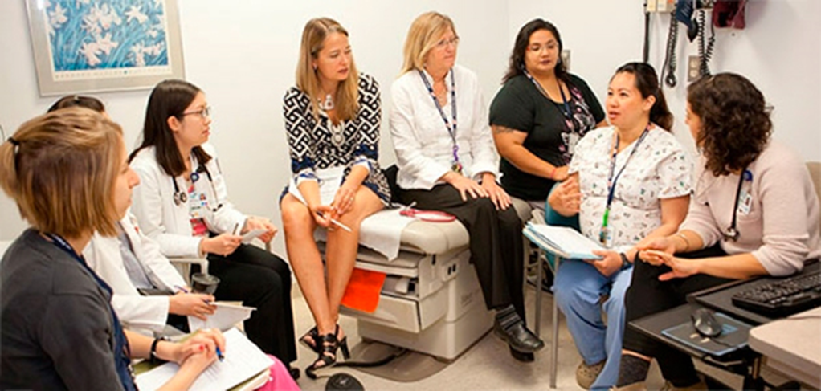
Challenges to Integrating Training Students
New Care Culture
Language of Medicine
Trust that the Medical Team has in Student Competencies
Shorter patient visits
Notes:
QI results. And any qualitative results.
Other results of research scholarship. Also any upcoming or future inquiries

Slide 13
Family Medicine Residency
Relationship/MOU with MFT Master’s Program
Counseling Intake Triage Clinic
Counseling needs of patients
Doctoral Internship
Notes:
Nuts & bolts

Slide 14
IU Integrated Care Results
78% had referred a pt
72% received follow up from provider and/or pt
30% stated pt made minimal-moderate improvements
35% stated pt made moderate-significant improvements
No worsening or new concerns
(n=18)
Notes:
Resident survey results re. Counseling/Integrated Care.
#s of pts provided with Care

Slide 15
Pros & Cons of Integrated Training
Balancing the needs of multiple learners
Focus on learners or patients?
Models for effectively focusing on both?
Meeting needs (& crises) of patients
Training healthcare professionals to work together
Notes:
I don’t know if this slide needs to be here. (Or maybe somewhere else?) These points—and there are probably many more—came to me as I was working on these slides.

Slide 16
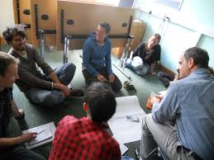
What brought you here…
What is going well with Integrated Care delivery and/or training?
How would you like to start or expand Integration?
What is a shared challenge of Integration or Clinical Training?
Notes:
Small groups of 4-5
10 minutes: ID problem/challenge. → 10m to brainstorm possible solutions/share examples of practices & training models.

Slide 17
Large Group
Notes:
15 minutes. What are the main take-away points or next steps you will leave with?
Then 10 minutes of Q & A

Slide 18
Thank you!
Emilee Delbridge, PhD, LMFT
edelbrid@iupui.edu
Max Zubatsky, PhD, LMFT
zubatskyjm@slu.edu
Jocelyn Fowler, MA
fowlerje@slu.edu

