Slide 1
S06: How to Write an Op-Ed
Bich-May Nguyen, MD, MPH, FAAFP @bicmay
Ranit Mishori, MD, MHS, FAAFP @ranitmd
Kenneth W. Lin, MD, MPH, FAAFP @kennylinafp
Sarah Kureshi, MD, MPH

Slide 2
Disclosures
None

Slide 3
Opinion-Editorials
Guest column, usually 500-700 words
The smaller the paper, the better change of getting published
You are well-positioned to be an “expert”
Has anyone published one?

Slide 4
Basic Structure
Anecdote
Problem
Solution
Call to action
Tie back to anecdote

Slide 5
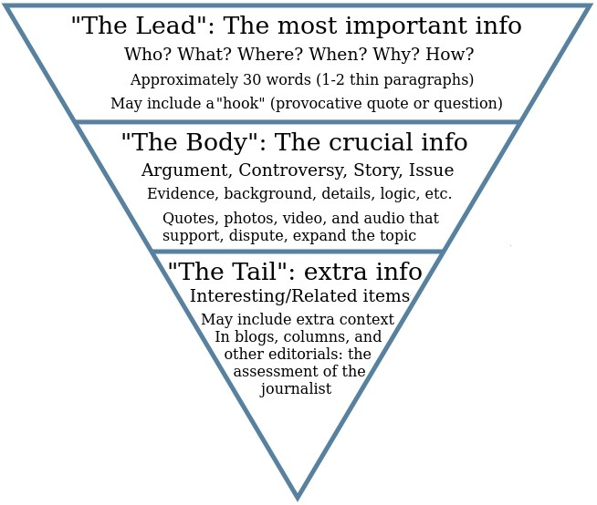

Slide 6
Exercise 1
What is your main message?
Name three arguments supporting your main message
What is the call to action?
Make outline and one group will report

Slide 7
Exercise 2
What are 1-2 opposing arguments?
What are your counterarguments?

Slide 8
Tell Us a Story
We remember stories, not stats
Stories grab attention

Slide 9
Exercise 3
Individually, reflect on a personal experience that shows why this topic is important

Slide 10
Keys to Getting Published
Be original
Have a unique point of view
Tug on emotion
Offer specific recommendations
Tout local angles

Slide 11
After Publication
Email your legislators’ offices
Share on social media multiple times
Send copies to your communications department
Send copies to STFM, AAFP

Slide 12
Finding the Right Venue
Geography: http://www.usnpl.com
Topic
Timeliness
Format
Published before?
DO NOT pitch story without first reading publication

Slide 13
How to Pitch to Editor
Address editor by name
State who referred you
Introduce yourself and why you’re writing
Summarize context, background, evidence
Explain why audience would be interested
Acknowledge process

Slide 14
Thank You! Questions?
Bich-May Nguyen, MD, MPH, FAAFP @bicmay
Ranit Mishori, MD, MHS, FAAFP @ranitmd
Kenneth W. Lin, MD, MPH, FAAFP @kennylinafp
Sarah Kureshi, MD, MPH

Slide 15
Please evaluate this presentation using the conference mobile app! Simply click on the "clipboard" icon on the presentation page.

