Slide 1
SNaP QI
April 13

Slide 2
Your feedback (thank you!)
+
Time spent brainstorming patient driver diagrams after learning about the tool
Flexibility with changing projects
Δ
Better ways to encourage participation during open discussion
Limit outside class work/modify assignment deadlines
Have students create the pareto chart themselves; more time spent on pareto analysis

Slide 3
Today's Agenda
20 min large group PDSA didactics and discussion
30 min: split into two QI project team Webex meetings
Have open on your screen: PPT slides, driver diagram, brainstorming excel spreadsheet (see email)

Slide 4
QI Project Teams
Social resource needs: Browning, Joey, Sophie, Carol
Healthcare coordination/health-seeking behaviors: Trisha, Landon, Linh, Alex

Slide 5
Project Roles During Small Groups
Driver Diagram Lead: as your team members are discussing ideas, translate those ideas into the driver diagram visual. This will help your team see the bigger picture.
PDSA Lead: facilitate discussion to complete excel spreadsheet in real-time
Three Questions Lead: summarize discussion learnings by answering the 3 Qs
Change Concept Lead: Teach this topic to your team and identify the change concept(s) relevant to your PDSA cycle
Indicate which role you want in the chat box
Notes:
Assign students

Slide 6
Planning PDSA #1
You have identified an issue of interest to address
You have some questions and/or ideas on how to address this issue
We are going to practice the structured method of PDSA cycles to rapidly test your ideas – trial and learning!

Slide 7
See QI Project Brainstorming Spreadsheet on Box

Slide 8
PDSA Cycle = vehicle for learning and action
Three common objectives for using the cycle
1. To build knowledge to help answer any one of the three questions
2. To test a change
3. To implement a change
**testing = to evaluate the change on a temporary basis, on a small scale
**implementing = making it part of the day-to-day operations for a process or system
**an important practical consequence of testing before implementing is that some tests are expected to fail

Slide 9
Source: Institute for Healthcare Improvement Open School

Slide 10
ANSWER: C

Slide 11
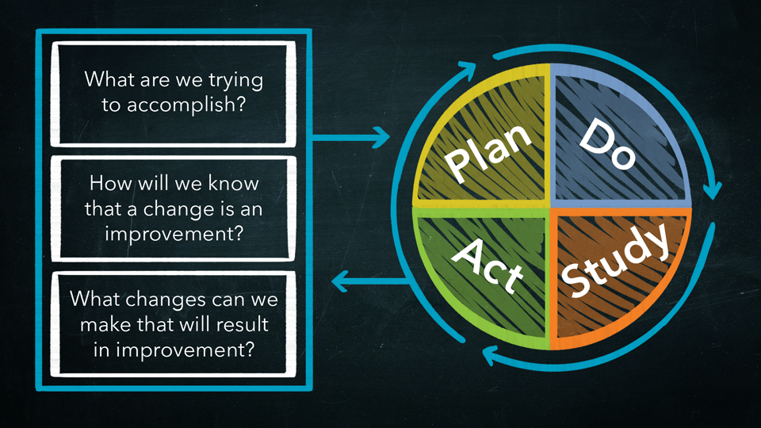
MODEL FOR IMPROVEMENT
AIM
MEASURES
CHANGE IDEAS
In practice, the questions can be answered in any order

Slide 12
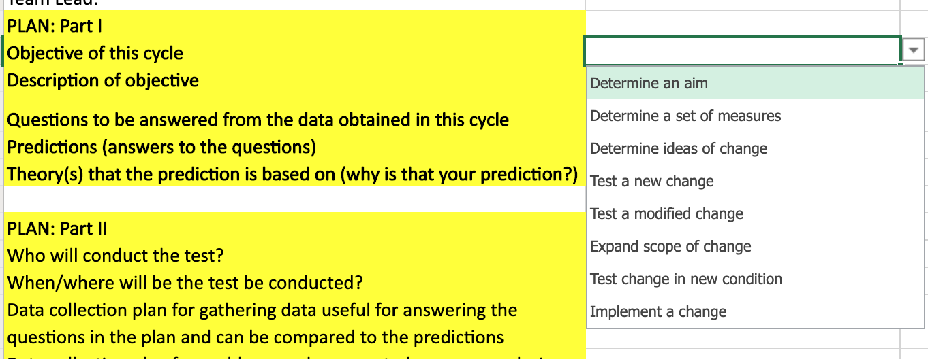

Slide 13
Using PDSAs to build knowledge to answer one of the three questions
Determine an aim: anesthesia team wanted to decreased overall medication errors, developed a data collection plan to classify med errors into categories, studied the PDSA by creating a pareto chart, and acted by determining an aim based on the 80:20 rule
Determine measures: test the clarity of survey questions to make sure you're measuring what you want to measure
Determine ideas of change: survey patients for what their thoughts on better waiting room environment

Slide 14
For your PDSA cycle, which objective are you interested in? (use chat box)
*Note: the cycle doesn't have to involve all your patients

Slide 15
Principles for Testing a Change
Test on a Small Scale & Build Knowledge Sequentially
Simulate a change (physical or computer)
Have others with some knowledge of the change review and comment on its feasibility
Test the new product or process on members of the team
Conduct the test with one patient
Conduct the test over a short period of time (one shift, one week, etc)
Why is it important to test on a small scale? (Answers in the chat box)

Slide 16
Principles for Testing a Change
Test on a Small Scale & Build Knowledge Sequentially
Simulate a change (physical or computer)
Have others with some knowledge of the change review and comment on its feasibility
Test the new product or process on members of the team
Conduct the test with one patient
Conduct the test over a short period of time (one shift, one week, etc)
Reduces people's fears of making a change
Reduces procrastination (people try to develop the perfect change because of the potential consequences of a failed test)
Minimizes risk from failed tests and maximize the learning

Slide 17
Principles for Testing a Change
Collect Data Over Time
There will be variation in the measures of the product/process due to causes and conditions unrelated to the change being tested.
The effect of the change is distinguished from these uncontrolled or extraneous conditions by viewing the patterns of data over time.
In general, choose small samples over a long period of time instead of a larger one collected over a short period of time.
Next week: run chart simulation

Slide 18
Source: Institute for Healthcare Improvement Open School

Slide 19
ANSWER: B

Slide 20
Based on what is learned from the cycle, a change might be...

Slide 21
Based on what is learned from the cycle, a change might be...
Implemented as is (adopt) -- rarely after one successful small-scale test
Dropped (abandon)
Modified (adapt)
Increased in scope (expand)
Tested under other conditions

Slide 22
Proper Collection of Data
Real world improvement: it may not be perfect and it won't feel as sophisticated as controlled research studies. Regardless, there are important guidelines to be mindful of.
Explicitly state the questions to be answered by the data
Link the questions to your predictions to enhance learning
Who, what, when, where
Two types of data collection: data to answer your questions & data to identify unexpected problems

Slide 23
What do you notice about the questions on the right column?
Why is it important to make predictions during the plan phase?

Slide 24
Tips:
Avoid yes/no answers
Consider "how much" and "why"?
Reasons for making predictions in the plan phase:
- make the why underlying the prediction clear
- understand differences in team members' assumptions before collecting data
- prevent hindsight bias
- enhanced learning in the study phase when results are compared to predictions
- helps you improve how to collect data and test changes

Slide 25
See QI Project Brainstorming Spreadsheet on Box
See "PDSA example" sheet

Slide 26
Project Roles During Small Groups
Driver Diagram Lead: as your team members are discussing ideas, translate those ideas into the driver diagram visual. This will help your team see the bigger picture.
PDSA Lead: complete the spreadsheet to prepare for your data collection this week
Three Questions Lead: summarize discussion learnings by answering these 3 Qs (see ppt slide #21)
Change Concept Lead: Teach the topic and identify the change concept(s) relevant to your PDSA cycle (read ppt slide #22-24)
Notes:
Assign students

Slide 27
End of Session Goals
PDSA #1 Plan completed
Driver Diagram draft completed, e-mail to Sherry
Answers to 3 questions completed
Change concepts explained & identified to group
Knowledge check survey and session feedback: https://forms.gle/RBDBhRYPMKDrhXnJ8
E-mail Sherry (liansh@ohsu.edu) at any time if you have questions
Reem, Resources Group – stay here
Sherry, Care Coordination Group – switch to other WebEx meeting

Slide 28
Change Concepts
There are many kinds of change that will lead to improvement. These changes can be organized into umbrella change concepts.
A change concept is a general notion that is useful in the development of more specific ideas for changes that lead to improvement. Change concepts stimulate critical and creative thinking, which lead to inventive and specific improvement ideas.
Many change concepts come from the manufacturing industry, but are also applicable to the health care system.
There are seventy-two change concepts, falling under nine overarching categories.
These categories are: eliminating waste, improving work flow, optimizing inventory, changing the work environment, enhancing the consumer relationship, managing time, managing variation, designing the system to avoid mistakes, and focusing on a product or service.
Source: http://www.hqontario.ca/Portals/0/Documents/qi/qi-change-concepts-and-ideas-primer-en.pdf

Slide 29
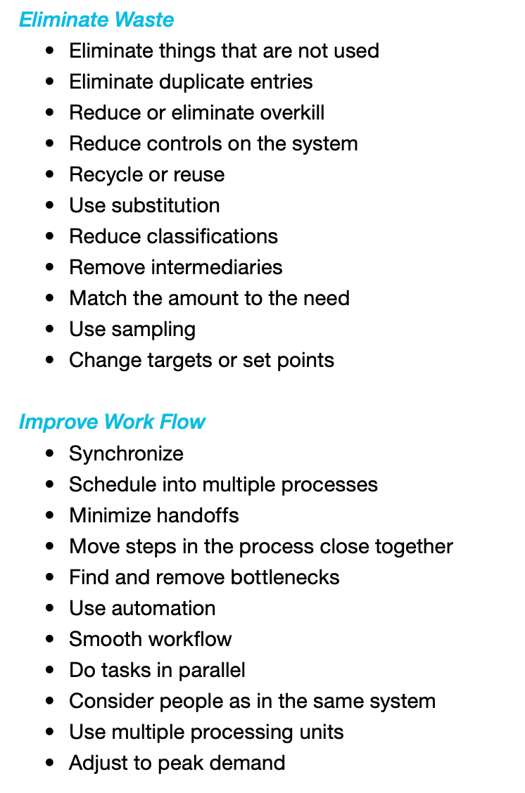
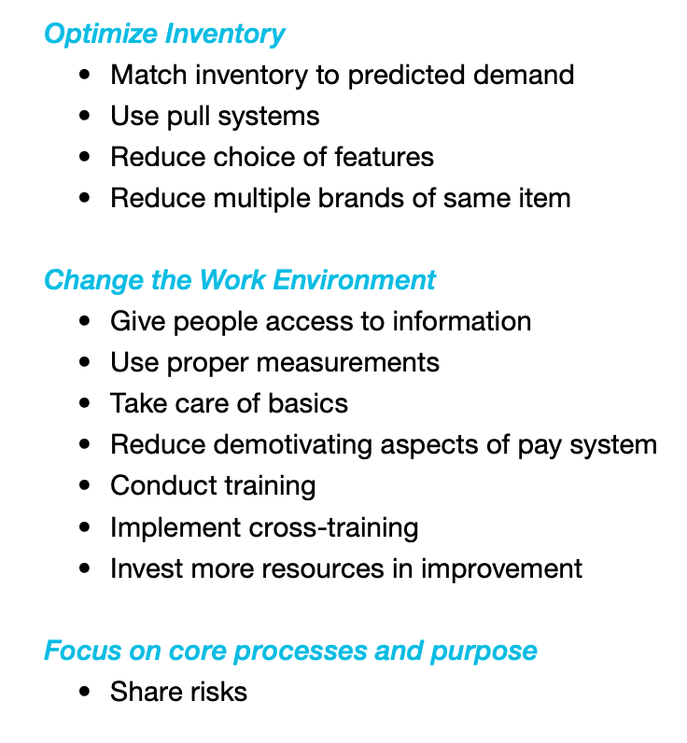
Source: http://www.hqontario.ca/Portals/0/Documents/qi/qi-change-concepts-and-ideas-primer-en.pdf

Slide 30
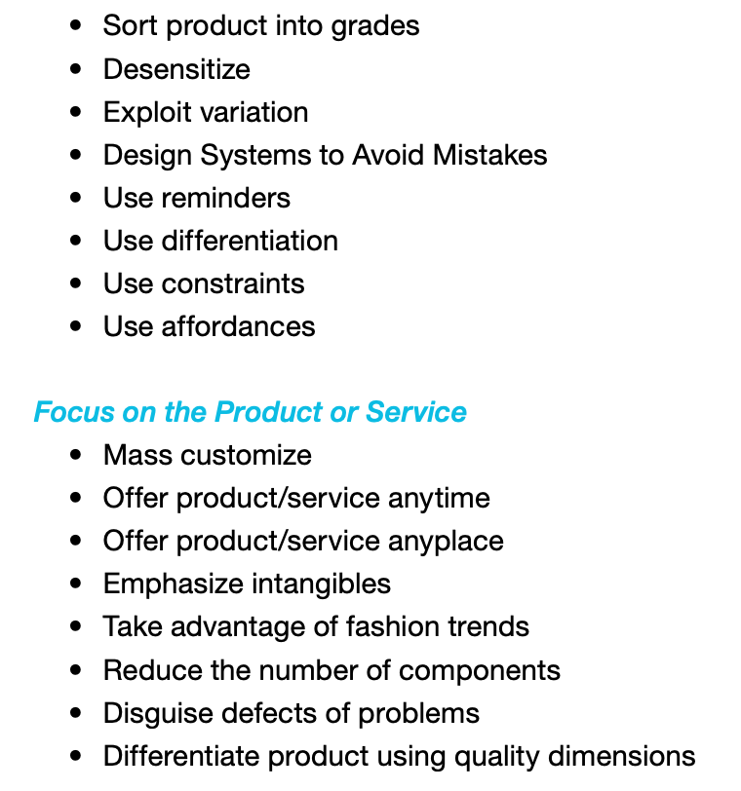
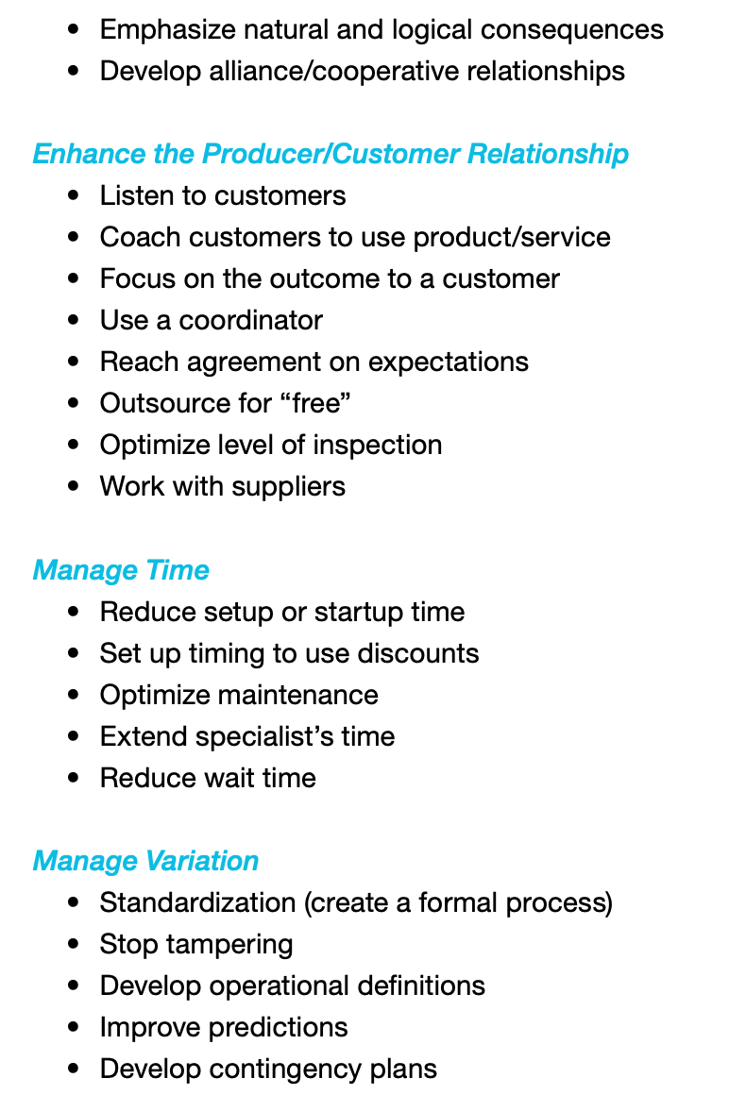

Slide 31
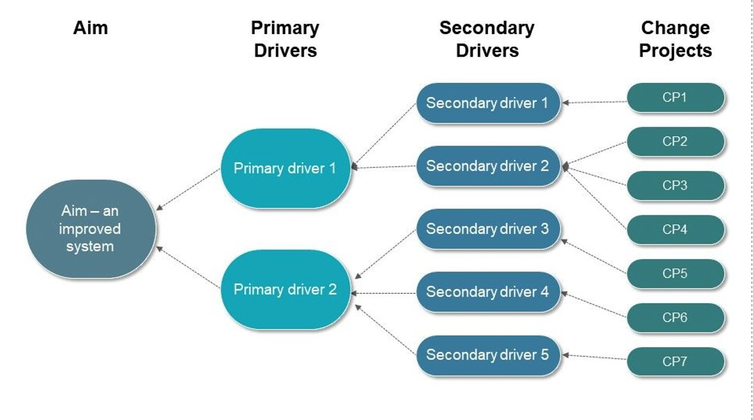
Driver Diagram: a visual display of what drives or contributes to an overall aim

Slide 32
