Slide 1
Isolated and Marginalized? Strategies to Build a Community of Connected Colleagues
Lindsay T. Fazio, PhD
Limor Gildenblatt, PhD, LCSW
Mary R. Talen, PhD
Adrienne A. Williams, PhD
Notes:
Intros here right?

Slide 2
Disclosures
We have nothing to report or disclose.
LF

Slide 3
Goals and Objectives
Upon completion, participants will be able to:
Identify strategies to develop and maintain a professional community.
Recognize the benefits of collaborative relationships with professional colleagues.
Understand networking and relationship building opportunities in their region.
LF

Slide 4
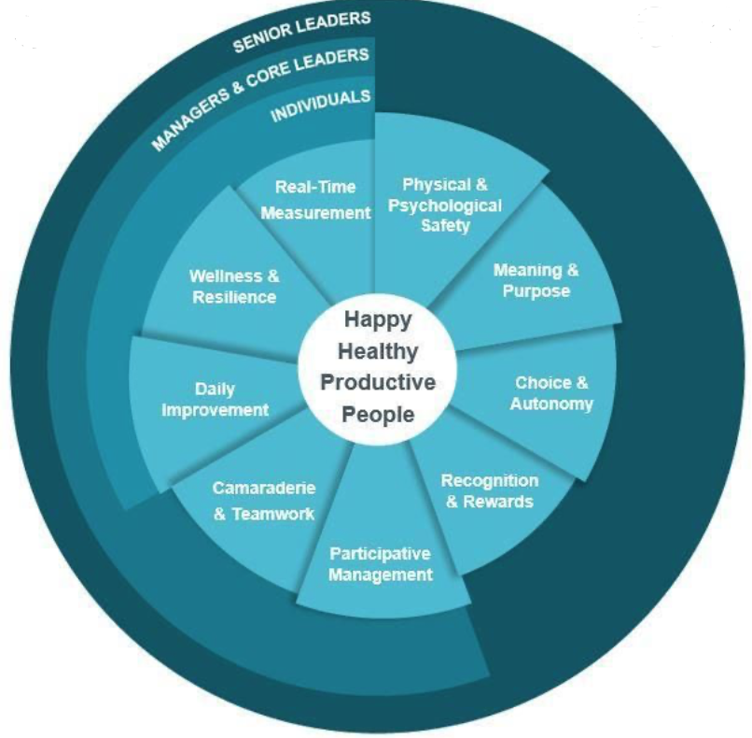
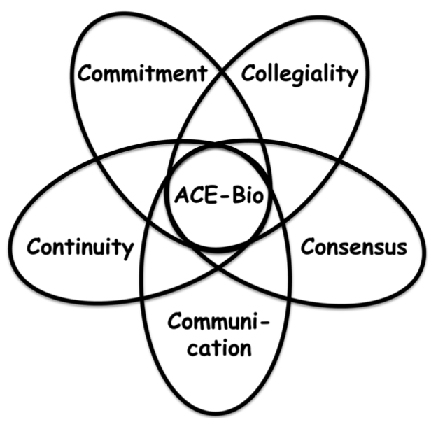
Connections and Community
Focus on Meaning and Joy in work
Five C’s of Community
LF
Notes:
2020 Has presented a slew of stressors and difficulties we could not have imagined when we decided to put this presentation together. Now more than ever, building and staying connected to one another is crucial to our wellbeing. In addition to the pandemic stressors, the battle to avoid and reduce burnout is ever present for family medicine educators.
Today we are
Many of you are likely familiar with the IHI Joy in Work model presented here on the screen. IHI has taught us that there are 9 critical components to creating Joy in Work which leads to healthy, happy, productive people. The Comradery and Teamwork domain speaks to the need for social cohesion, productivity in teams, shared understanding, and trusting relationships. While I’m hopeful that we have a sense of connectedness and meaningful interactions with people in our home programs– connecting with a professional group can meet this need as well. IHI goes on to say even with receiving recognition and rewards without comradery the recognition is just a party.
You will also see the image that represents the 5Cs of community which include collegiality, contentiousness, communication, continuity, and commitment. This is a framework originally developed to promote connectedness in interprofessional teams in biomedical research. However the guiding principles are also beneficial to building our community groups such as being committment to goals of the group, using inclusive language, mutual respect, and offering support and consultation. You will find the reference to read more about this model at the end of the presentation.

Slide 5
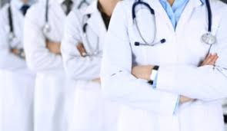
Behaviorists in a Sea of Physicians
Only BH provider
Economic differences
Hierarchies and Microaggressions
Different skill set and expertise
LF
Notes:
In preparing for our talk and what contributes to a feeling of isolation-- I found myself reflecting on how vary different the Behaviorists experience might be in the educational world than our physician colleagues. I have often thought of my role as the sole behavioral science faculty as living on an island in a sea of physicians around me. While this is both invigorating to be the sole mental health person it also presents some unique challenges (challenges might include covering your patients and inbox when you want to take day off, navigating your colleagues personal mental health information, and limited access to case consultation).
Other factors, while obvious are not discussed openly) which contribute to the isolation includes:
Economic differences in pay (this was found even amoungst the behavioral science faculty in a study published last year)
The medicine hierarchy that has existed for decades problematic because it can contribute to microaggressions that occur between our physician colleagues. Example refer to BH faculty by their first name and physician colleagues as Dr. SuchandSuch.
Additionally, mental health and physician colleagues come from different training models that speak different landuages.
In the end this is difference also contributes to the success of training amazing physicians.

Slide 6
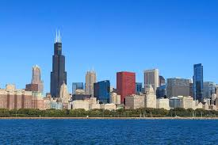
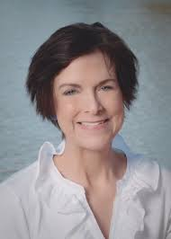
In the Beginning……
2008
MacNeal, UIC, St. Joseph's, West Suburban
Tri-Annual Meetings
20012-2017
Loss of Key members
Healthcare System changes
2018-
2019-Present
Dyad Connections
Shifting Positions
ONWARD....
MT
Notes:
When I first came to the MacNeal Family Medicine residency, I was alone, but Maria Devins at UIC adopted me. With her support, we corralled the Chicago troops—Kay Levin, Steve Romm, Tony Atkins, Rhonda Willmans, Steve Zuckerman and Jose Nino. We met to share stories, curriculum ideas, be sounding boards for each other. We rotated sites, ate food, and could chat endlessly….there was so much to say….and so little time. But over time, we struggled with coordinating schedules, carving out protected time, coping with shifting responsibilities. And, then we lost our mainstays—Maria Devins died of cancer, Kay Levin retired, Steve Romm retired, ….Jose and I were the remnants and we had our bi-month lunches at Milk and Honey and annual lunches at the Forum or STFM. And, others like Limor and lindsey were having contact
Themes and Cycles
12 years of waxing and waning
Consistent need for connection and shared resources.
Changing positions, members and systems of care

Slide 7
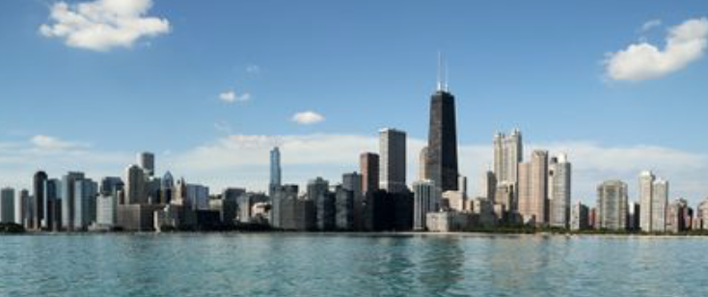
Developing our Community
Experience in Indiana and Kansas
Relocated to Chicago and looking for network of “my people”
LF
Notes:
In an age of growing burnout and professional dissatisfaction finding meaning and joy in the work we do is essential. Additionally building a sense of community has shown to be an effective evidence- based strategy to protect us against burnout.
I’ll share our story of how we came to be. I have moved several times during my career and thankfully have been able to remain in family medicine education. Early in my career while faculty at a community based program in Indiana a group of us thought we should get together and share lectures and have lunch together. At that time 7 Behaviorists decided to meet in person in Indianapolis. There are currently 14 program in Indiana, at that time there were fewer, and we had the majority of programs behaviorists. It was amazing to meet people in the same role as me. We shared lectures, had a tasty lunch, and problem solved program issues. Additionally, we because friends and support network for each other. It was an amazing experience. It was also great to then know people and be able to connect at STFM and other conferences. Then I moved again and found when I landed in Kansas City the behaviorists were not connected to one another in either state. Again I started the pursuit to bring an amazing group of colleagues together to build our community. Then we moved again and the pursuit started all over again.

Slide 8
Structure & Maintenance
Meet quarterly in person
Half day Fri mornings
In person, rotate residencies
2019: Aug, Dec, March canceled due to Covid
Host provided food
LG
Notes:
Following Lindsay’s intro to the idea of this group
Pre-covid
August 2020 – Limor’s residency, Resurrection Medical Center, Lunch provided
December 2020 – Half day Friday, Mary’s residency – Northwestern, Breakfast provided
March 2020 – Supposed to go to Lindsay’s residency at Northshore… but, Covid.

Slide 9
Structure & Maintenance
Email prior to the meetings for agenda
Topic Examples: Wellness curriculum, BH rotations, feeling isolated as Behavioralists
Connect in between via emails or calls
Upcoming presentations
Google share drive
LG

Slide 10
Structure & Maintenance
9 Members = 8 Behavioralists, 1 Physician
On emails/mtg invites
In person meetings – 5-6 people
Systems represented:
AMITA Health University of Illinois, Chicago
Advocate Northwestern
Northshore Private Practice
LG
Notes:
How many people
How many BH
How many diff systems – AMITA, Northwestern, U of I
Members:
Limor, Jose, Tony, Rhonda, Sarah Kay – AMITA – 5
Lindsay – Northshore - 1
Mary – Northwestern – 1
Adrienne – UIC
Joel – Swedish - 1
Zuckerman – Advocate – 1
*Note that some of us have moved around in residencies this past year, group was a big connection for that – from just being aware of positions opening up to connecting with one another about diff types of programs, small vs. large, all American vs. IMGs etc

Slide 11
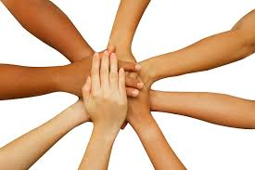
Group During Covid
April 2020 – Met every other Friday at 10 AM through summer on Zoom
Aug 2020 – Present – Meet monthly on Zoom
Future goal – Back to in person…
LG
Notes:
Topics –
Hand pic – come together as supports, whats challenging for each of us, for our residencies
Supp group – how were we doing these
Presentations – FACE COVID, Telehealth communication skills, etc.

Slide 12
Strategies to Develop Community
Join an existing community
Chicago Behavioral Science Consortium example
Fellowship alumni groups
Society for Health Psychology Local Networking Events
The Forum
AW

Slide 13
Examples of Conferences/Organizations
The Forum
STFM
APA
NASW
APAHC
SBM
SSWLHC
ACMA
AOSW
Network for Social Work Management
ABS
CFHA
AW
Notes:
The Forum – The Forum for Behavioral Science in Family Medicine
https://www.mcw.edu/departments/family-and-community-medicine/professional-development/continuing-medical-education/behavioral-science-forum
STFM – Society of Teachers of Family Medicine
https://www.stfm.org
APA – American Psychological Association
https://www.apa.org/
NASW – National Association of Social Workers
https://www.socialworkers.org
APAHC – Association of Psychologists in Academic Health Centers
https://ahcpsychologists.org
SBM – Society of Behavioral Medicine
https://www.sbm.org
SSWLHC – Society for Social Work Leadership in Health Care
http://sswlhc.org
ACMA – American Case Management Association
https://www.acmaweb.org
AOSW – Association of Oncology Social Work
https://aosw.org
NSWM – Network for Social Work Management
https://socialworkmanager.org
ASWB – Association of Social Work Boards
https://socialworkmanager.org
CFHA – Collaborative Family Healthcare Association
https://www.cfha.net

Slide 14
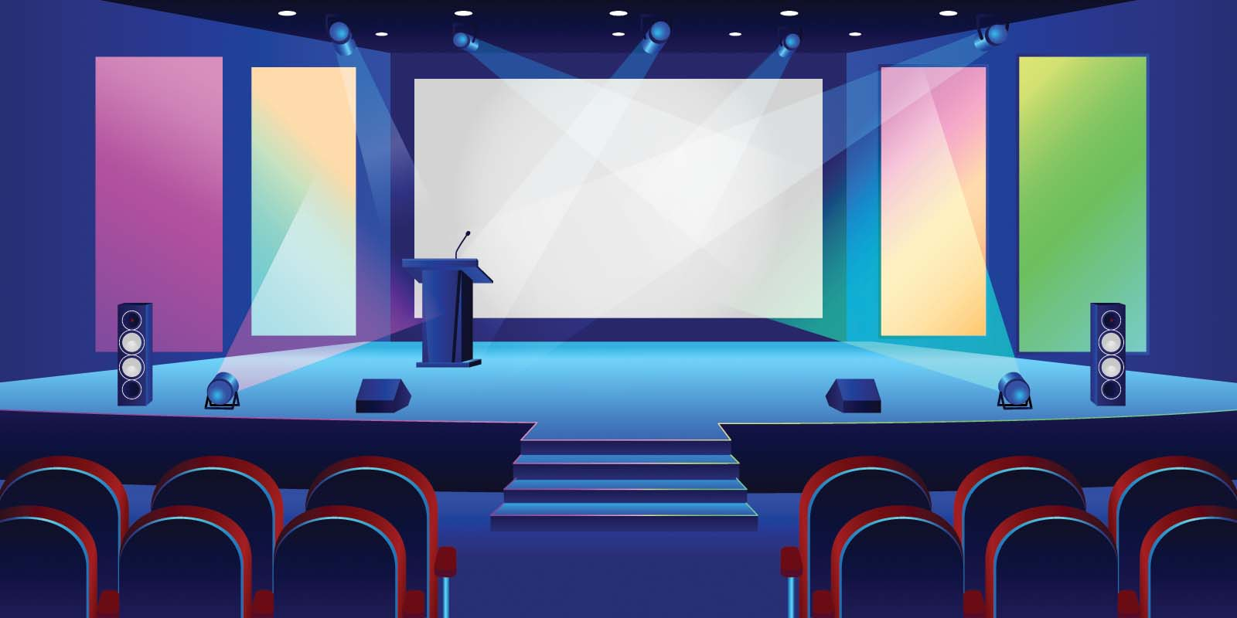
Three Strategies to Develop Community
1. Build community through conferences
Get at least one business card
Review the attendance list for people in your city
Follow up with phone/zoom meeting 2-4 weeks later
Do not just make an email connection
Schedule a follow up meeting
AW

Slide 15
Strategies to Develop Community
2. Build community through email solicitation
Look up other programs in your area
Find people on their website
Email the person and ask for a meeting
If no response, follow with a phone call
AW

Slide 16
Strategies to Develop Community
3. Build community through an event
Direct invitations
Social Media
List Serves (Professional Organization, Institution)
AW

Slide 17
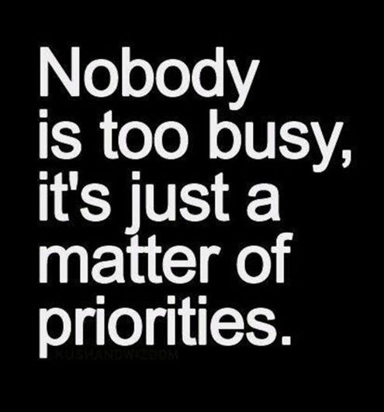
Strategies to Maintain Community
Identify shared needs
Identify obstacles and challenges
Identify ways to connect
Set goals for follow-up
No less than quarterly
AW

Slide 18
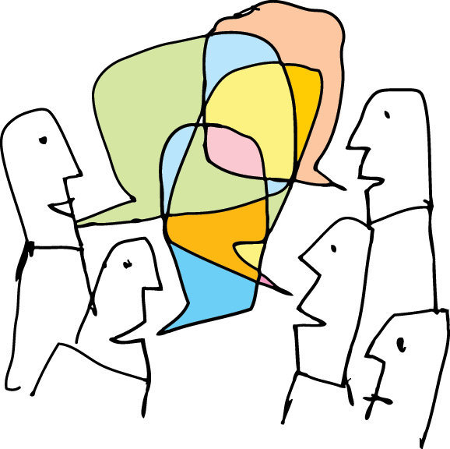
Let’s Discuss…
MT
Notes:
Break out Rooms by time zone.
Will split people up based on the time zone you live in. We will ask that you select your own time zone. If the room is full. No worries. We will another room for you.

Slide 19
Discussion Questions
What challenges have you faced when trying to make connections?
Have you had successful experience connecting with others? What’s worked?
Notes:
Give instructions

Slide 20
MT
Notes:
Ask people to chat in themes and findings from their groups.

Slide 21
MT
Notes:
Chat in intention Identify one strategy you can use to connect to someone in your region after this conference.

Slide 22
References
Orlando, C.E. (2000). The collegium: Community as gathering place. New Directions for Higher Education (109), 33-41
Palaez, N., Anderson, T., Gardner, S. M., Yin, Y., Abraham, J. K., Bartlett, E. L., et al. (2018). A community-building framework for collaborative research coordination across the education and biology research disciplines. CBE-Life Sciences Education (17), 1-10.
doi: 10.1187/cbe.17-04-0060.
Steinert, Y., Mann, K., Andeson, B., Barnett, B.M., Centeno, A., Naismith, L., et al. (2016). A systematic review of faculty development initiatives designed to enhance teaching effectiveness: A 10-year update. Med Teach, 38(8), 769-86.
doi: 10.1080/0142159X.2016.1181851.

