Slide 1
2019 STFM Conference on
Practice & Quality Improvement

Slide 2
How do Registries, Population Health, and Quality Metrics affect residency education and Patient Care?
David Voran, MD
Medical and Informatics Director – Family Medicine Center
Truman Medical Center – Lakewood
Kansas City
2019 STFM Conference on Practice & Quality Improvement

Slide 3
From raking leaves to managing a forrest
Or…
…the journey begins

Slide 4
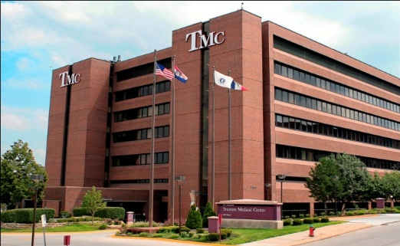
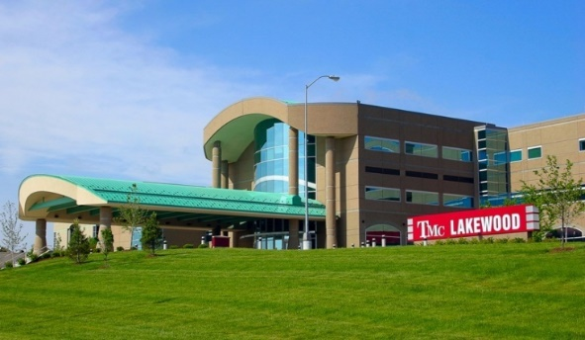
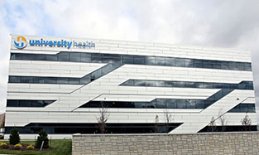
Level I Trauma Center
Health Sciences District
2
Inpatient facilities
600
60
7
4K
625
medical
staff
beds
clinics
Community
clinics
employees
Lakewood
1,348
3,428
86K+
1,395
nursing staff
births
ED visits
Trauma admissions
30K+
11,153
490K+
22,602
Behavioral Health
myTruHealth patient portal accounts
Surgical cases
Outpatient visits
Acute admissions
As the regional SafetyNet organization we average >$100M in uncompensated care annually over the last 10 years
University Health
4
2019 STFM Conference on Practice & Quality Improvement
Notes:
Mitzi
TMC is primary community teaching hospital for UMKC School of Medicine
450 medical students and 350+ resident physicians train at TMC each year
More than 1,000 UMKC School of Medicine graduates serve the residents of Jackson County and the Kansas City Metro

Slide 5
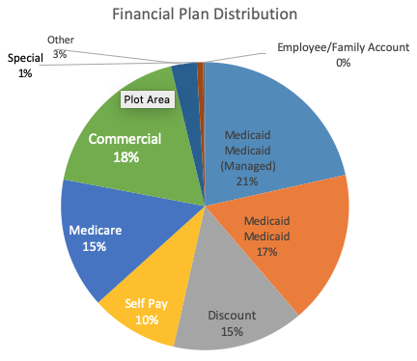
The reality: 63% of patients are Medicaid, discount or have no insurance

Slide 6
Agenda
Describe our dashboard
1
Review our methods
2
Discuss impact
3
Join the conversation on Twitter #CPQI19

Slide 7
FMC Dashboard
Numerical Table
Data Visualization
2019
Constantly Changing
Join the conversation on Twitter #CPQI19

Slide 8
“Internal” sources of the data
Millennium and Rev Cycle
Join the conversation on Twitter #CPQI19

Slide 9
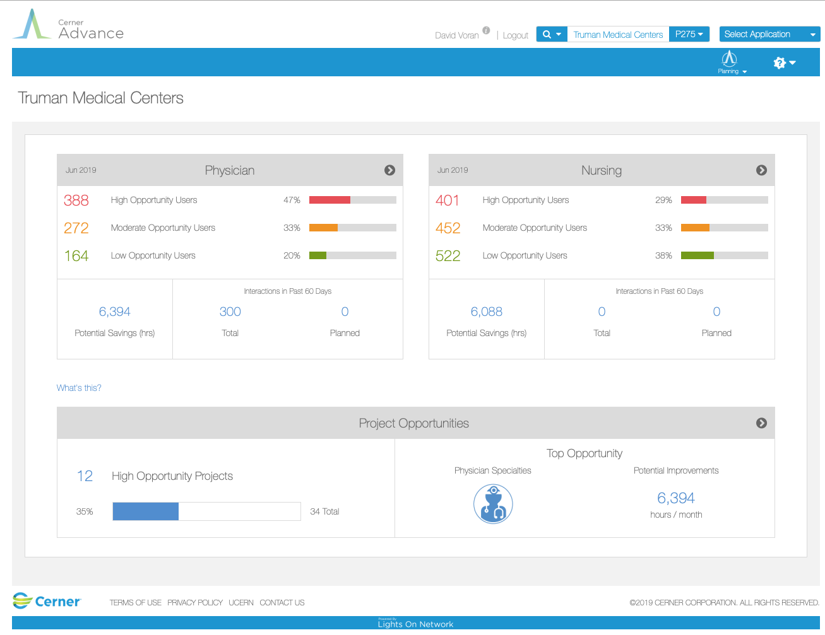
“External” Data sources
HealthIntent, Cerner Advance,
CMS, local patient satisfaction database
Join the conversation on Twitter #CPQI19

Slide 10
So Why?
Original Reasons
Understand practice profile
Track resident experience
Submit ACGME reports
Know our patients
Increase transparency
More Recent Objectives
Better educate residents for value-based care
Improve workflows
Close care gaps
Shifts focus from individual to group
Leaves > Trees
Increase interest and reduce animosity towards EHRs
Prepare residents for data driven world
Photos by Unknown Author is licensed under CC BY-NC-ND
Join the conversation on Twitter #CPQI19

Slide 11
The Dashboard
November 2019 Version
Join the conversation on Twitter #CPQI19

Slide 12
Numerical Section Details
Demographics
Resident Degree Class PCMH
Progress Current Block Continuity Visits
Continuity Status
Panel Size
% New
% Peds
% Seniors
Engagement No Show Rate
Continuity Rate
Portal Use
Pt Satisfaction …coming soon
Quality Overall Registry Score
Med Rec
EHR Use Pajama Time
Productivity Total Charges
wRVUs
Clinic Charges
wRVUs
Join the conversation on Twitter #CPQI19

Slide 13
Data Visualization
Practice Description
Resident Progress
Join the conversation on Twitter #CPQI19

Slide 14
Data Visualization
Registry and Quality Measures
EHR Utilization and Patterns
Join the conversation on Twitter #CPQI19

Slide 15
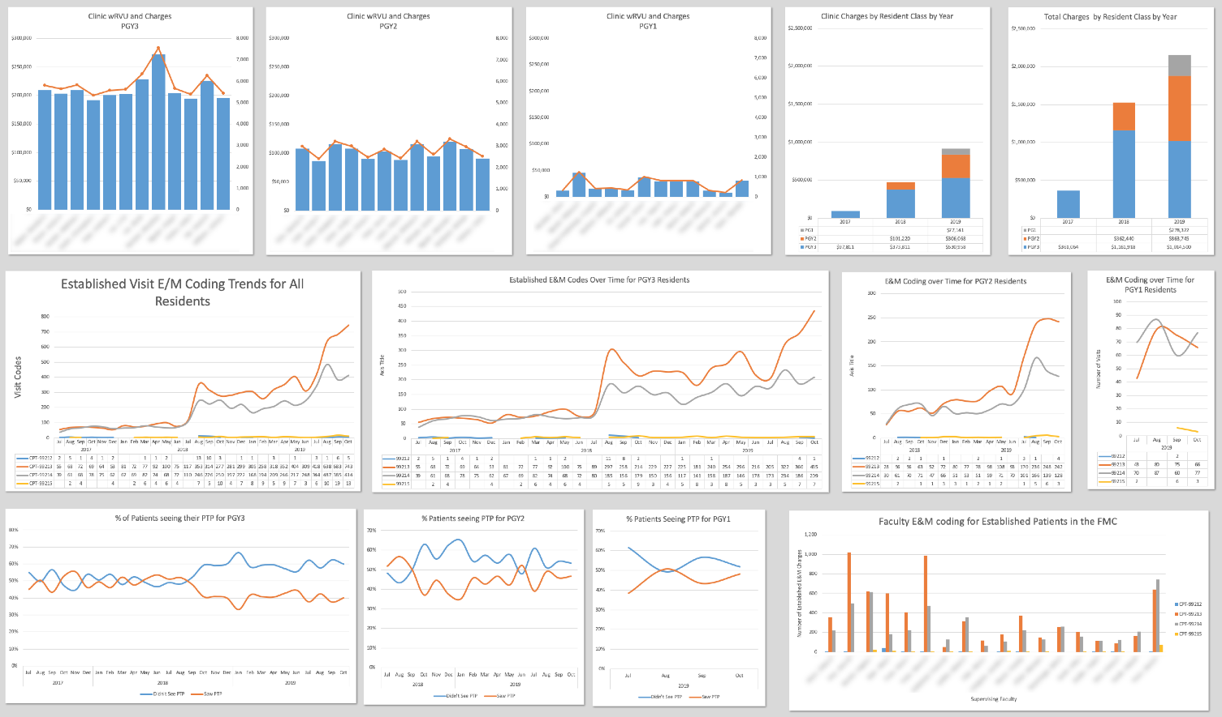
Data Visualization
Charges, wRVU’s, E&M Coding Patterns
Join the conversation on Twitter #CPQI19

Slide 16
Making It All Real
How to get residents interested, involved, egaged, and getting the “BIG” picture
Join the conversation on Twitter #CPQI19

Slide 17
Methodology
Open up Access to Reports, Registries and Management Dashboards
1
Integrate Population Health and Quality Measures into Rotations, Clinics and Clinic Visits
2
Help residents connect the dots and start to think proactively
3
Join the conversation on Twitter #CPQI19

Slide 18
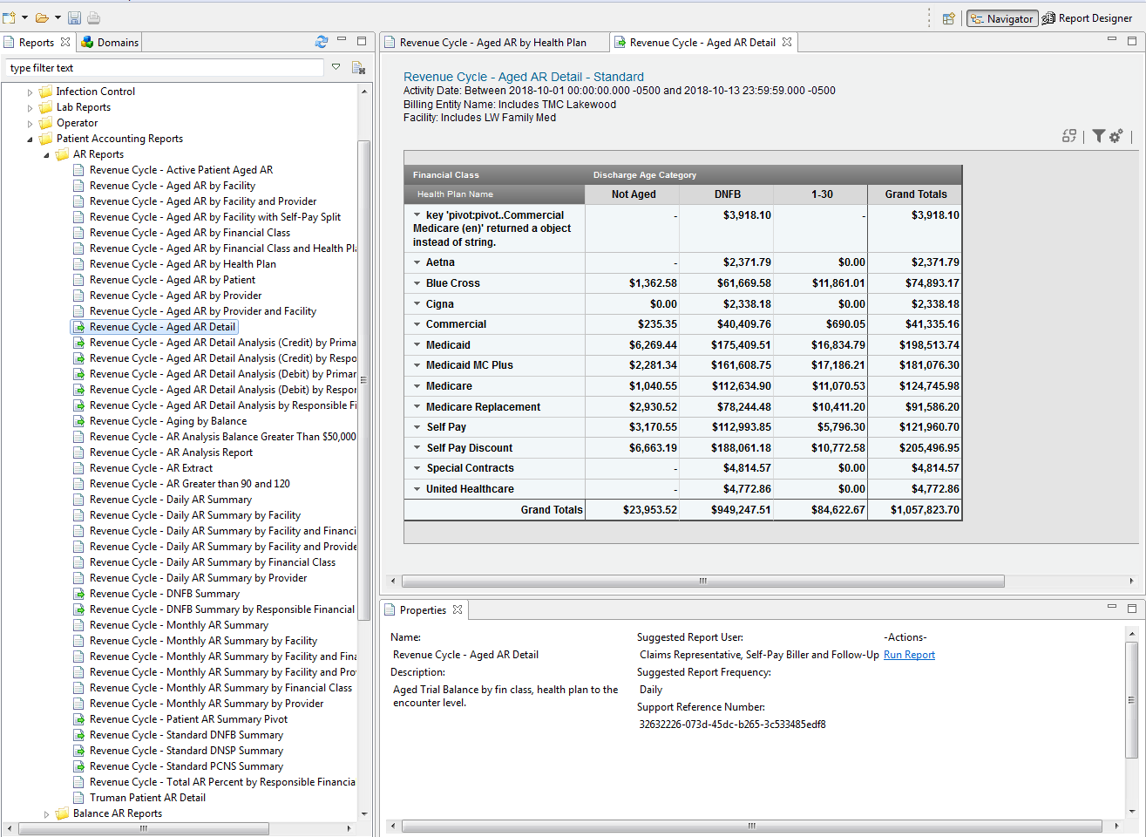
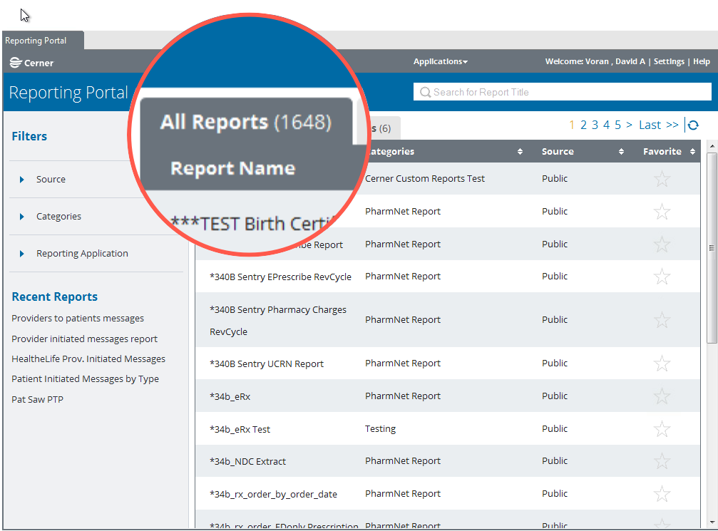
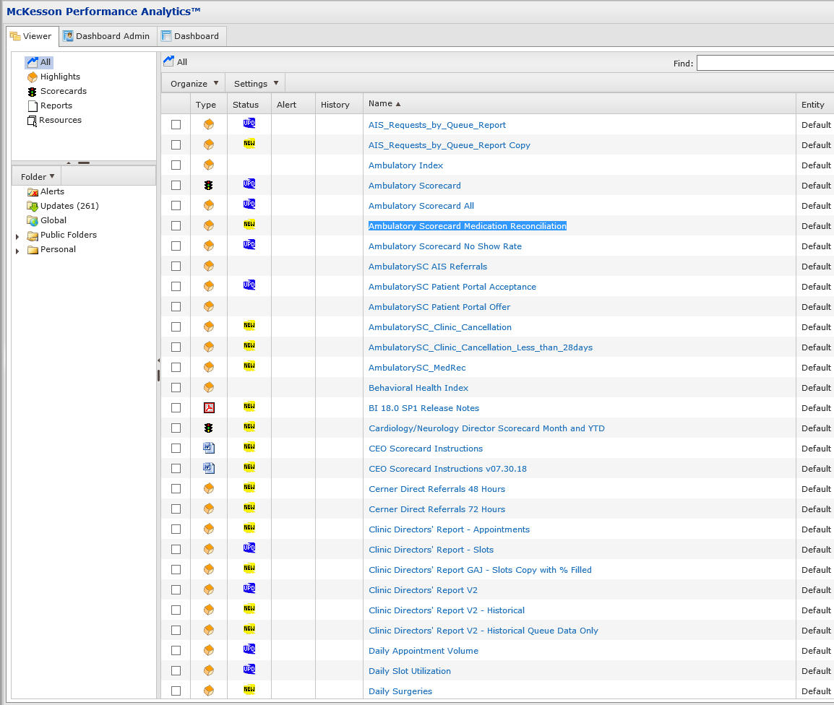
Step 1: Transparency
Join the conversation on Twitter #CPQI19
Notes:
It’s very important to provide access to the same tools administrators use to evaluate and manage departments.

Slide 19
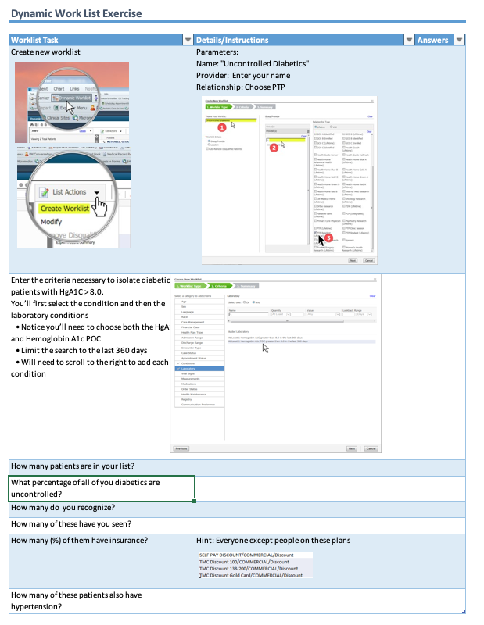
Step 2: Curriculum
Assignments on their own panel patients
Join the conversation on Twitter #CPQI19
Notes:
It’s very important to provide access to the same tools administrators use to evaluate and manage departments.

Slide 20
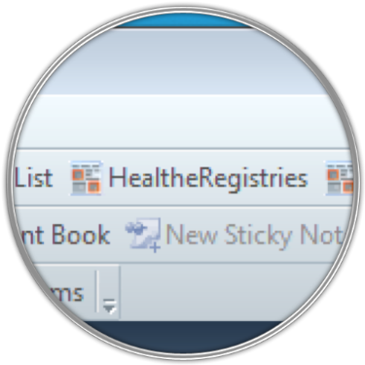
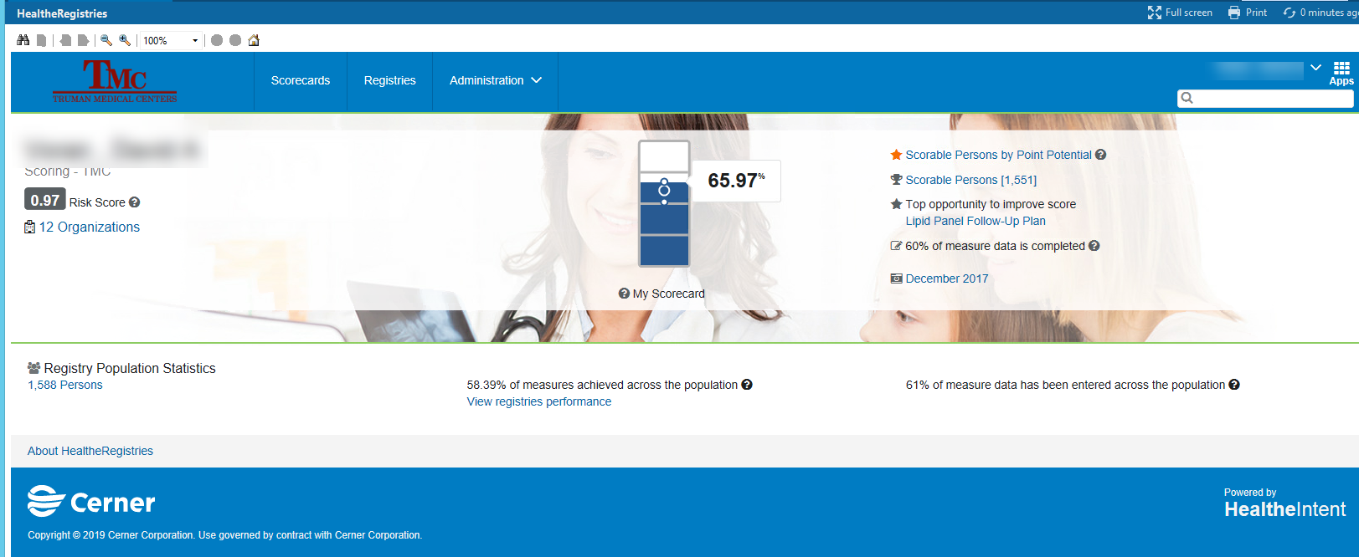
Step 3: Reinforcement
Data is a click or two away …
Huddles
Checkouts
Join the conversation on Twitter #CPQI19

Slide 21
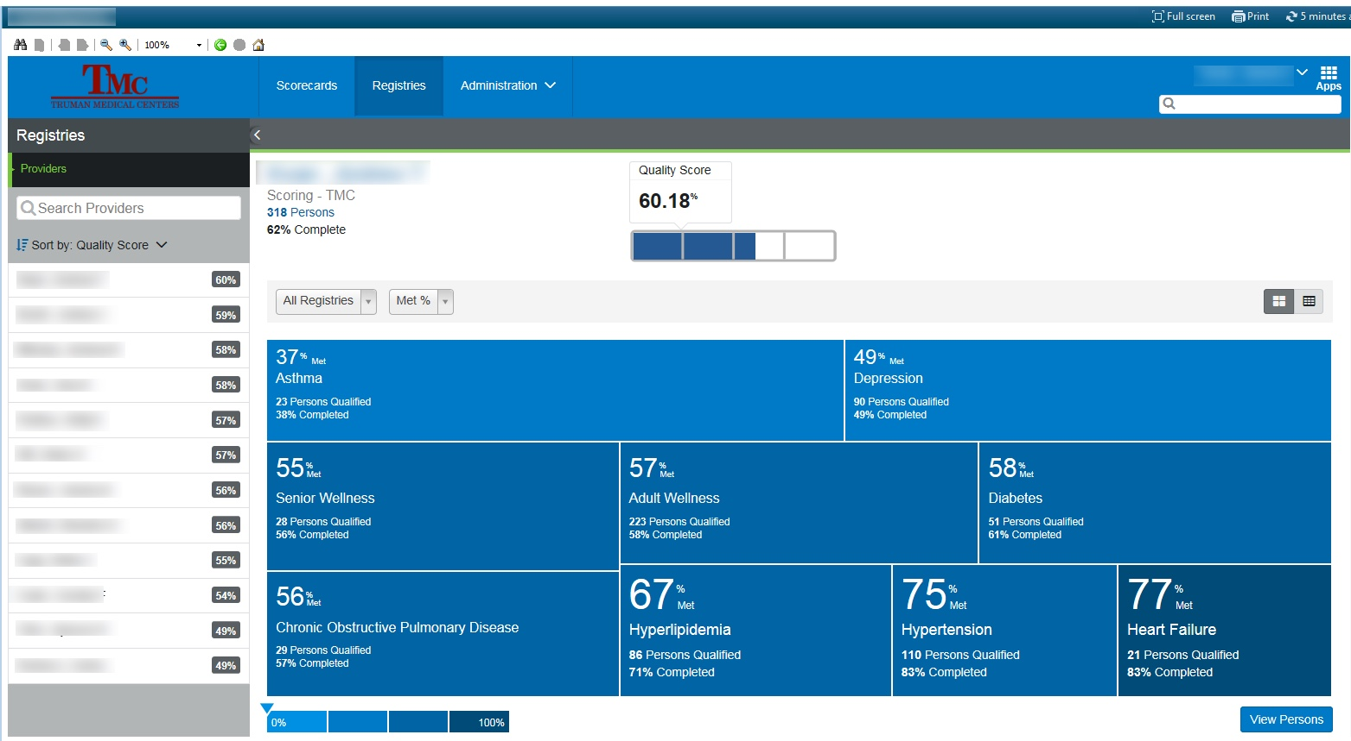
On which registries are my patients?
Essence of Population Health – Where’s the trees?
Join the conversation on Twitter #CPQI19

Slide 22
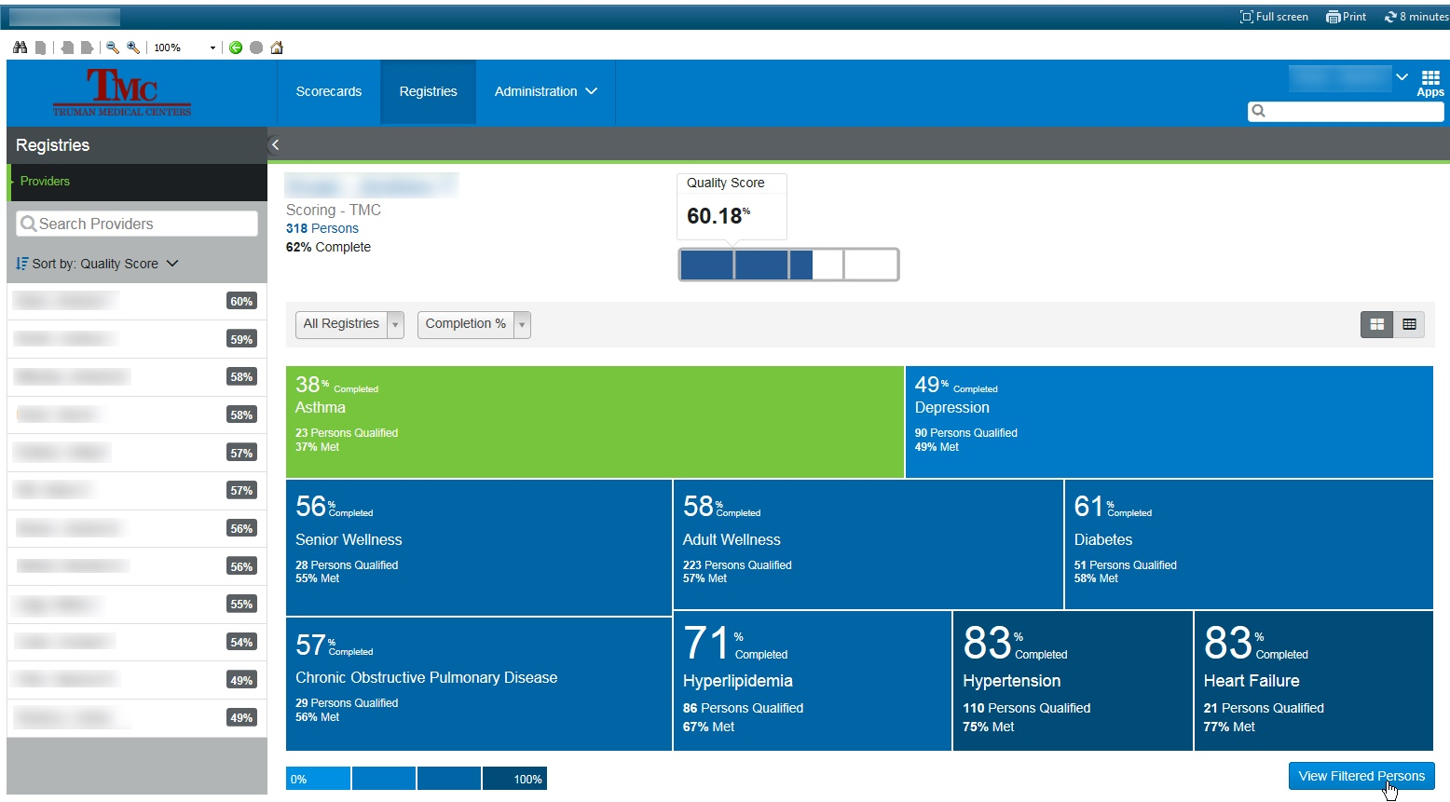
Which part of the forrest needs attention?
… and which trees need help?
Join the conversation on Twitter #CPQI19

Slide 23
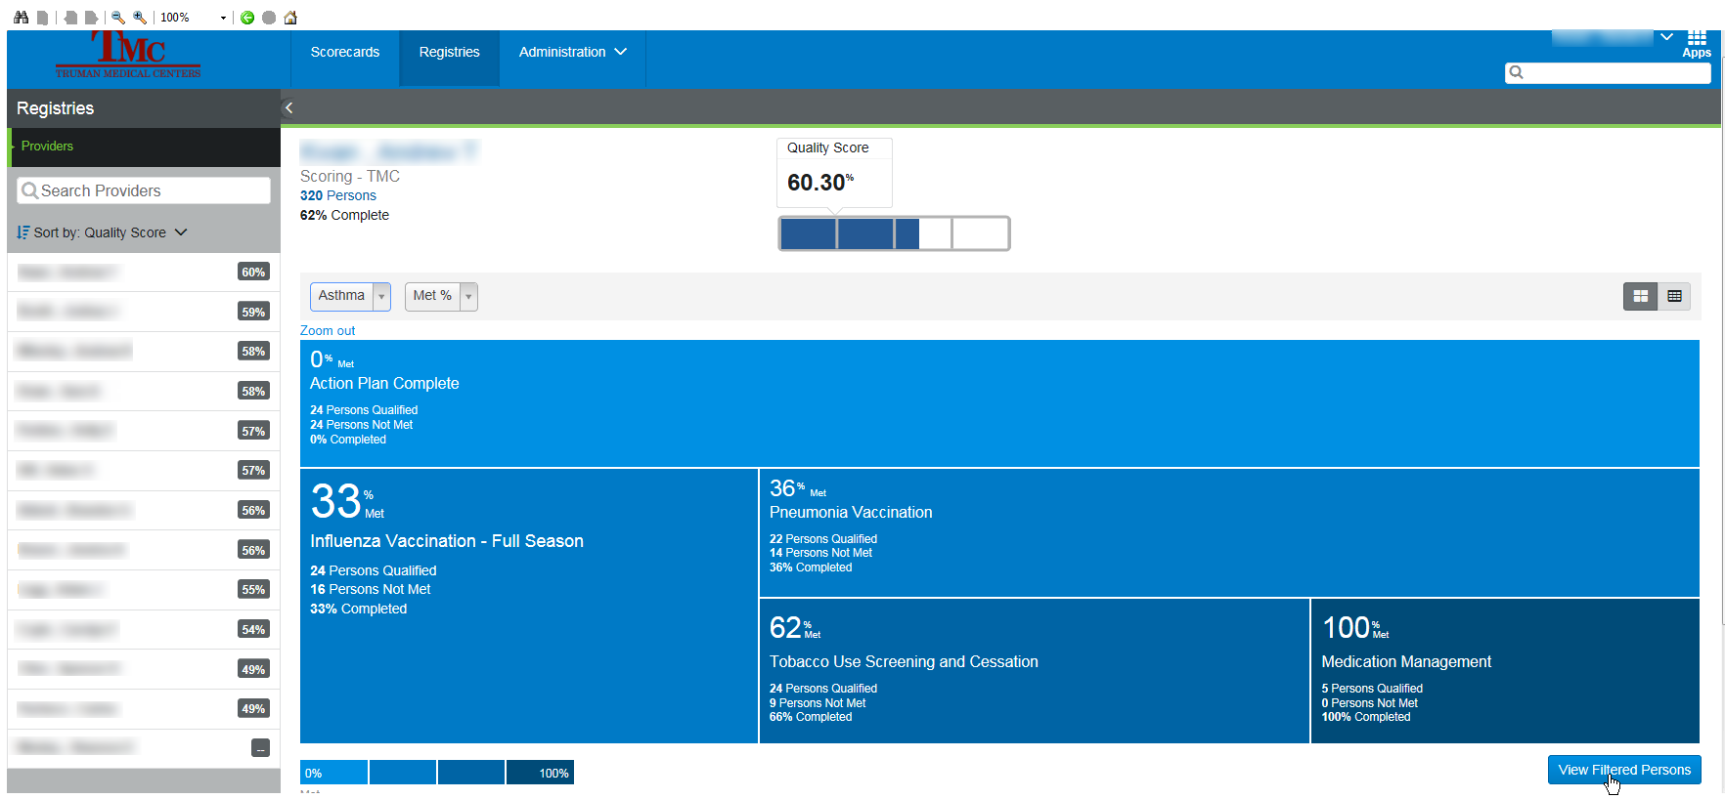
Which patients?
Which trees?
Join the conversation on Twitter #CPQI19

Slide 24
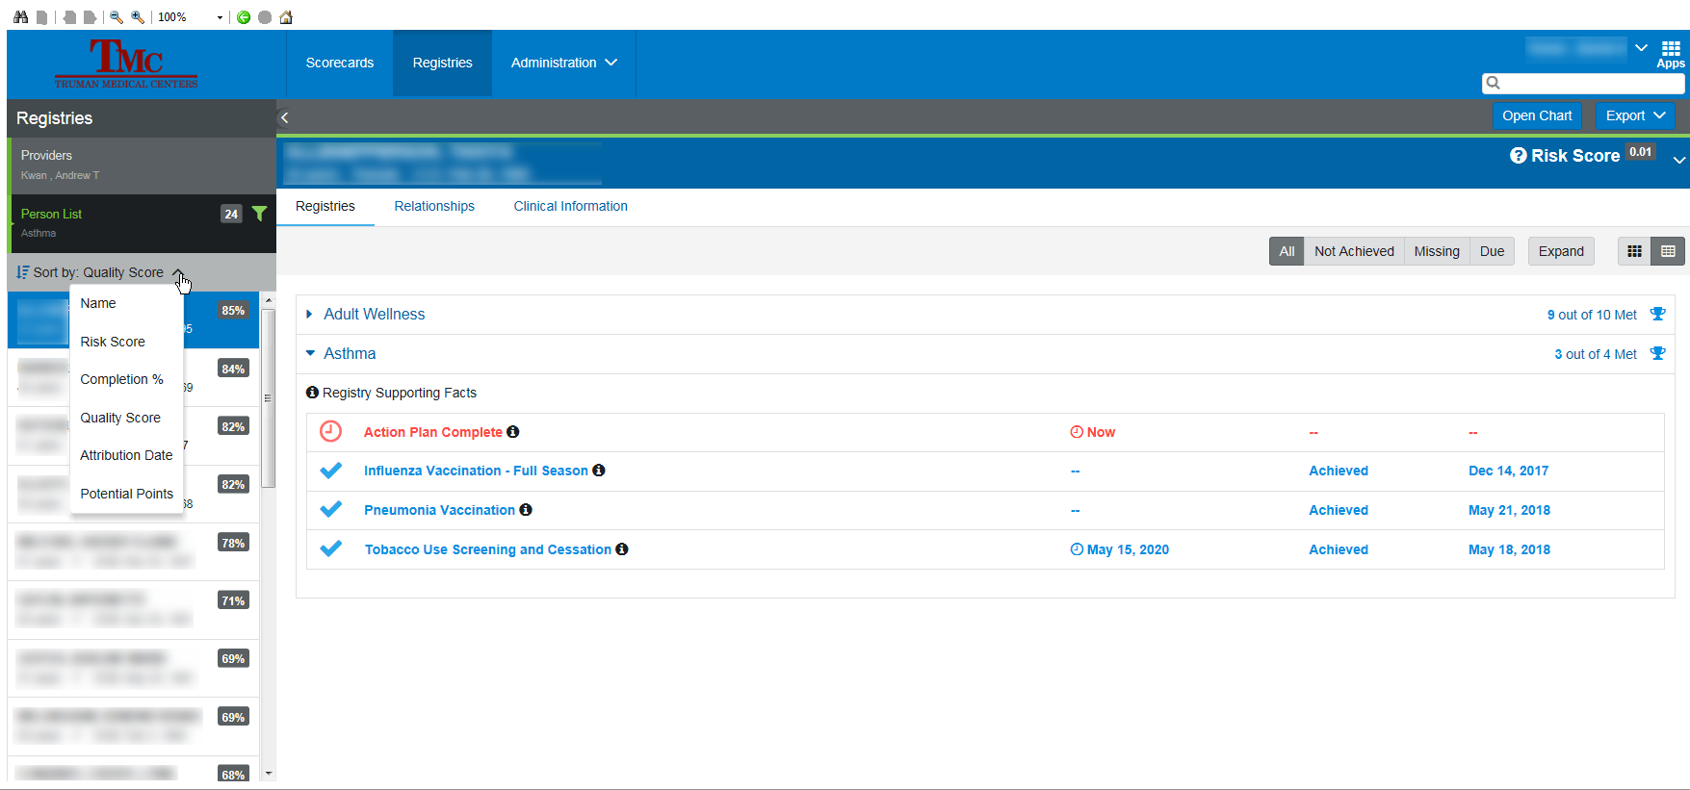
What’s wrong with the patient?
Finding out exactly what needs to be done – Care Gaps
Join the conversation on Twitter #CPQI19

Slide 25
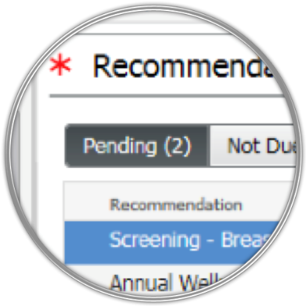
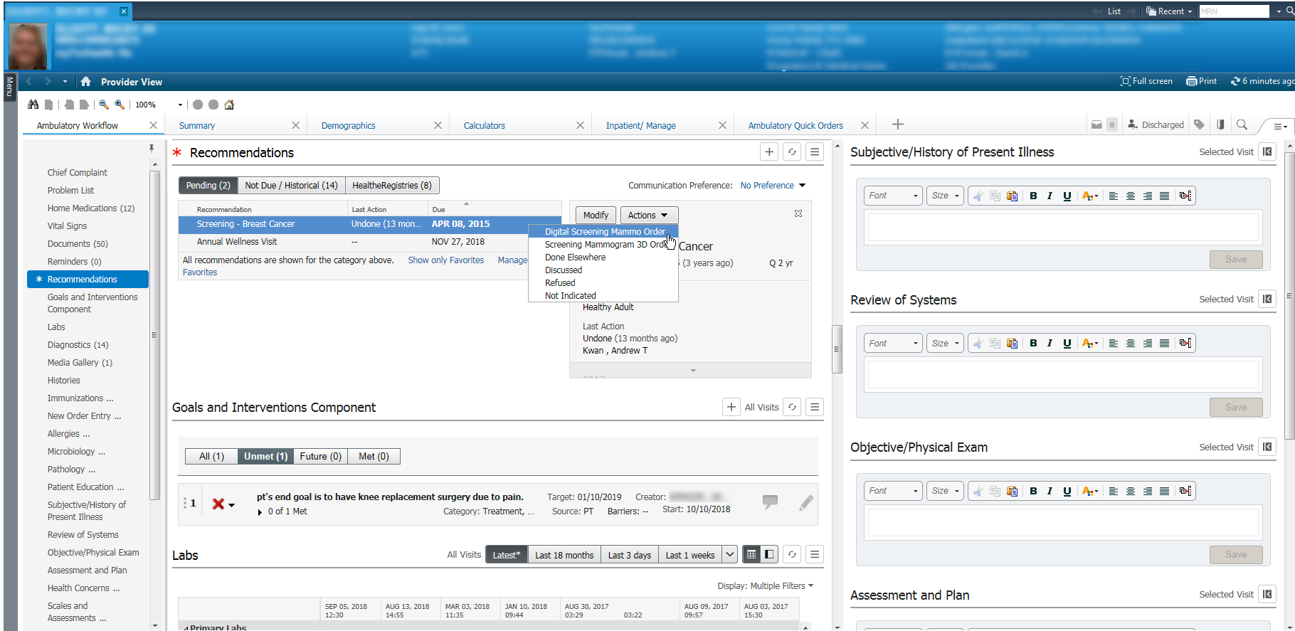
Sharing with the patient
Incorporating care gap closure during visit with patients
Join the conversation on Twitter #CPQI19

Slide 26
Block end “MOB” Meetings
Occur ever 4 weeks
At rotation change
“Now for the numbers ….”
Highlight different data set
Encourage group think
Reinforce panel and population management approaches
Making Ourselves Better
Join the conversation on Twitter #CPQI19

Slide 27
What’s happening?
Join the conversation on Twitter #CPQI19

Slide 28
Population Health Registry Scores
October plunge
16 to 86 measures
Incorporated into Practice Management
Registry Integration Program begins
Join the conversation on Twitter #CPQI19

Slide 29
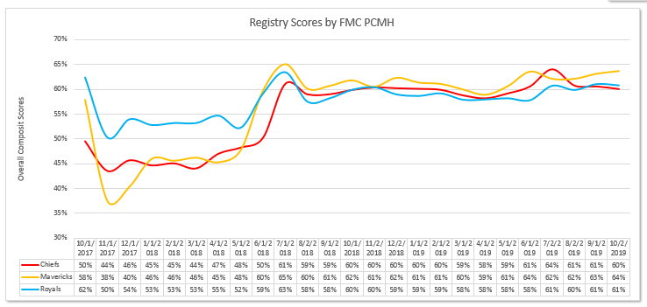
Why not more progress?
Join the conversation on Twitter #CPQI19

Slide 30
Let me count the ways
Attribution
High panel risk
Slot availability
Practice panel size too large
Acute visit training
Reactive medicine
Social determinant burden
Face-to-face reimbursement
Join the conversation on Twitter #CPQI19

Slide 31
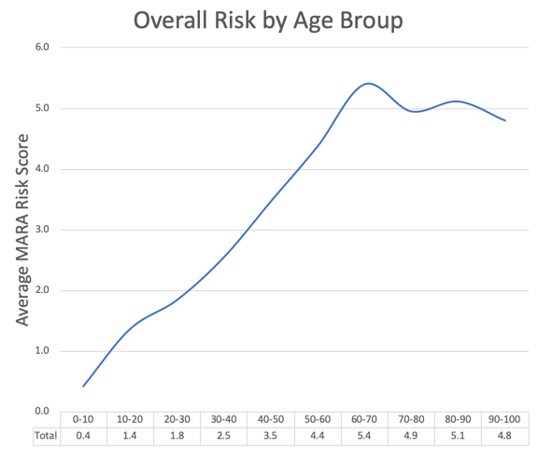
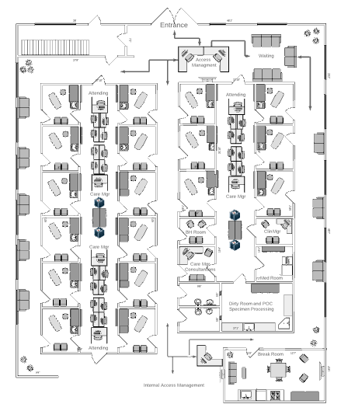
Other Confounders
Require major changes in workflow
Issues that interfere with improved metrics
Solidify measure mapping A few measures cannot be met in the system
Schedule templates Reduced time for adult preventive visits Acute/reactive visit culture
Residency rotations Continuity disruptions
Clinic architecture Exam rooms inhibit patient engagement
Social Issues Poverty Time – many working 2 low paying jobs Transportation Cost of medication Co-pays
Age and Risk Increasing age of our patients (Boomers) When do we stop measuring and age out?
Patient participation and engagement Lifestyles are impossible to change in a clinic setting
Join the conversation on Twitter #CPQI19
This Photo by Unknown Author is licensed under CC BY-SA

Slide 32
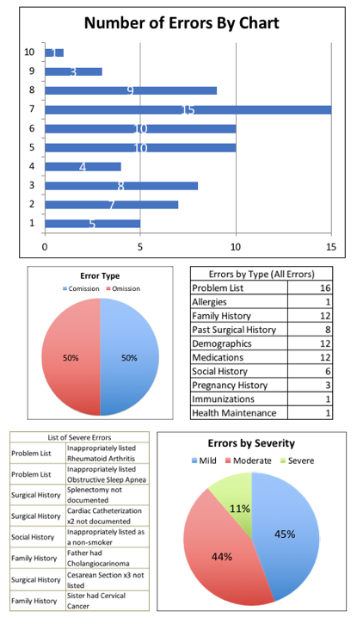
Reconciliaion Integrity Accuracy
Missing in Action
Join the conversation on Twitter #CPQI19

Slide 33
What we must do
Banish our [physician] fixation with notes
Start paying attention to parts of the chart required for automated measures …doesn’t matter now and will not in 2021
Connect resident activity with remuneration
Refocus medical education on lifestyle
Get rid of RVU based compensation
Go beyond encounter based system
Somehow change western culture
Learn how to teach doctors population management
Begin proactive rather than reactive scheduling
Break free from the “exam room” jail and get involved in our patient’s lives
Join the conversation on Twitter #CPQI19

Slide 34
In Review

Slide 35
Summary
Data Dashboard
Internal and External Data Sources
Get Answers
Ask Questions
Change Behavior
Make Connections
Expand Viewpoint
From Pt to Population
Manage a Forrest
Join the conversation on Twitter #CPQI19

Slide 36
The Slog
Importance of value-based reimbursement education
Better, more relevant and evidence-based measures
EMR configurations that elevate measures and care gaps even more than we do now
Push registry measures to patient
Results can be disappointing for many reasons outside our control
Systems designed for reactive acute conditions … not proactive management of diseases and lifestyles
We don’t have “medicines” for social determinants that affect patient’s ability to comply with measures
Need to build in reconciliation and validation of data in order to improve accuracy … can’t be done without the patient
Join the conversation on Twitter #CPQI19

Slide 37
Need to work the forest, not leaves
…the journey begins

