Slide 1
Resident-Led Milestones Creating Self-Directed Learners
Susan Cochella, MD, MPH; Katherine Fortenberry, PHD;
Sherilyn DeStefano, MD; Kara Frame, MD;
Kirsten Stoesser, MD; Sonja Van Hala, MD, MPH, FAAFP
University of Utah Family Medicine Residency Program

Slide 2
Objectives
Participants will be able to:
Describe a resident-led milestones process
Describe impact of resident leadership
Analyze own milestones processes
List steps to move toward resident-led process

Slide 3
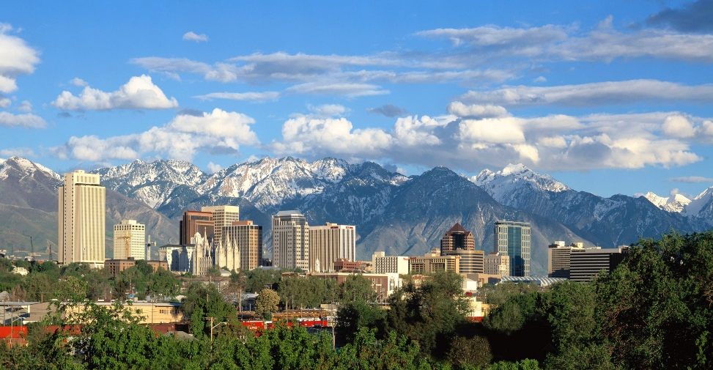
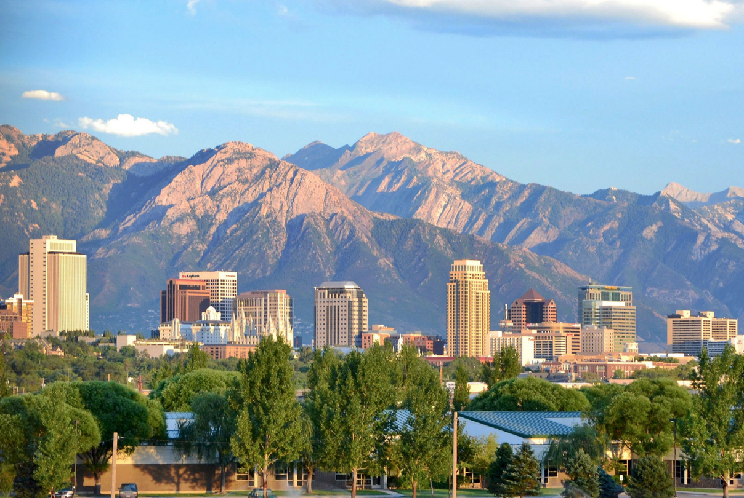
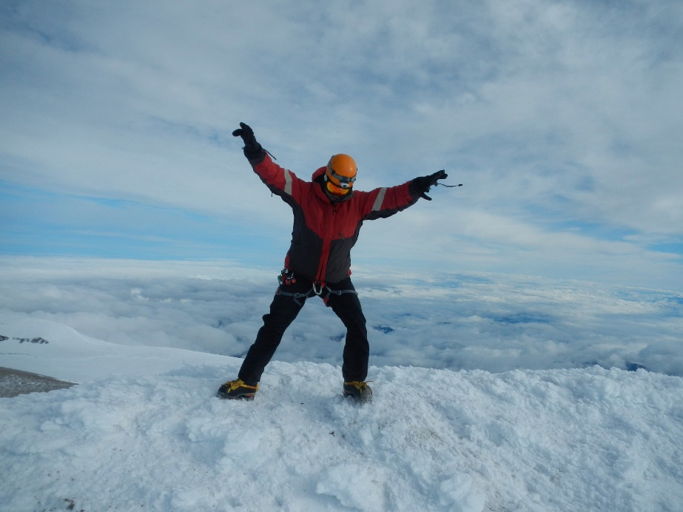
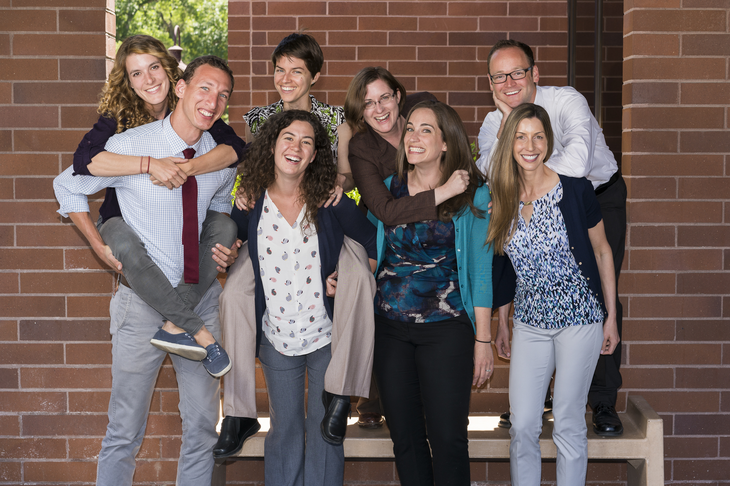
Who Are We?
Cityscape credit: garrett/flickr via creative commons
Notes:
Who we are as a residency
Our CCC
At the University of Utah Family Medicine Residency Program, the CCC is comprised of an interdisciplinary group of Family Medicine faculty:
Family Medicine Physicians
Geriatrician/Nutritionist
Psychologist

Slide 4
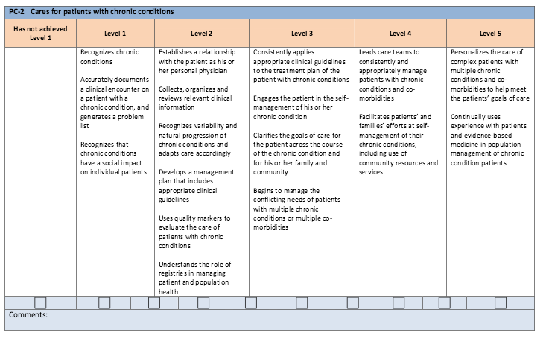
Milestones Challenges?
Notes:
Challenges with Milestones themselves
-Each individual category can be extremely comprehensive.
-Some points subjective, with wide room for interpretation.
Problems with the evaluation process
-Many questions require introspection/reflection on part of resident.
-Impossible as an individual Family Physician faculty to have first hand knowledge of each item assessed for every resident.
-Even with an interdisciplinary group of evaluators, comprehensive evaluation is difficult.
-Available evaluations do not always provide information pertaining to every Milestone every time.
Problems with milestones interfering with learning process
Having a faculty committee formally tell a resident where they score could potentially:
-be very stressful for a resident.
-inhibit motivation of the resident to review their evaluations and critically reflect on their own performance.
-impair a resident from developing the skills needed for lifelong self-directed learning and improvement.

Slide 5
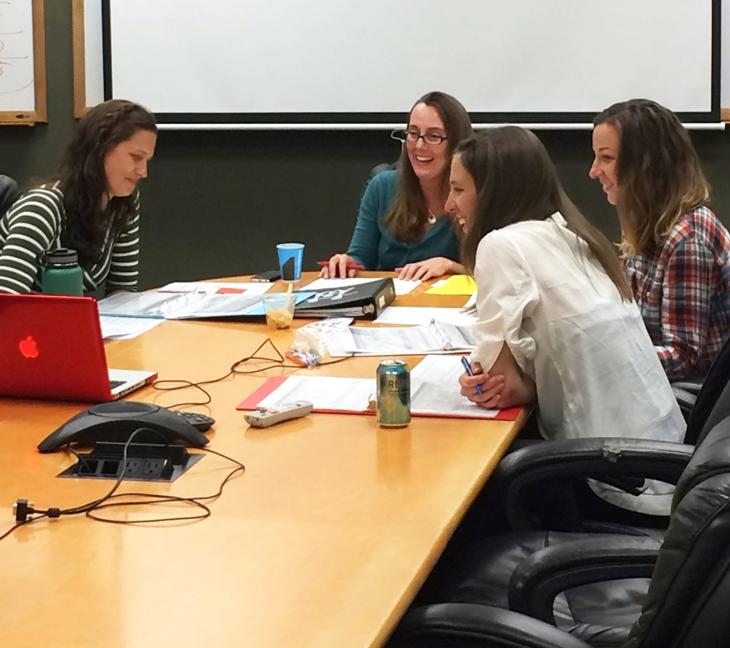
One potential solution to these challenges…
Resident-Led Milestones
What?
-Residents self-evaluate
-Residents lead their meetings
Why?
-Hone skills
Self-assessment
Self-directed learning
Leadership
-Improve accuracy
-Reduce stress
-Increase resident engagement
Notes:
Why?
One of our main goals of residency is to encourage resident’s self-directed improvement and learning. These are critical skills that bolster the sustained high quality of care we intend graduates of the program to deliver their whole lives.

Slide 6
Resident-led Milestones Process - Overview
1mo before:
Data emailed to resident, advisor, CCC
Milestones meeting! CCC completes milestones form
Resident and advisor complete ILP
Resident reviews data, self-assesses each milestone
Resident and Advisor fine-tune self-assessment
Observation-based feedback given & entered throughout residency

Slide 7
Data-Driven Process
1mo before:
Data emailed to resident, advisor, CCC
Milestones meeting! CCC completes milestones form
Resident and advisor complete ILP
Resident reviews data, self-assesses each milestone
Resident and Advisor fine-tune self-assessment
Observation-based feedback given & entered throughout residency

Slide 8
Data
Observational feedback
Every clinic session
MA feedback
Rotation evaluations
Patient satisfaction – Ratings and comments
Quality metrics
Procedure logs
Graduation requirements dashboard
Prior milestone ratings
Prior ILP

Slide 9
Resident Self-Assessment
1mo before:
Data emailed to resident, advisor, CCC
Milestones meeting! CC completes milestones form
Resident and advisor complete ILP
Resident reviews data, self-assesses each milestone
Resident and Advisor fine-tune self-assessment
Observation-based feedback given & entered throughout residency
Notes:
The resident, with the support of their advisor, LEADS the Milestones meeting.
The resident presents their self-assessed score to the Milestones CCC, and provides supporting examples.
The Milestones CCC, utilizing the information presented by the resident in combination with review of all the evaluations, and following group discussion, determines the final score for each level.

Slide 10
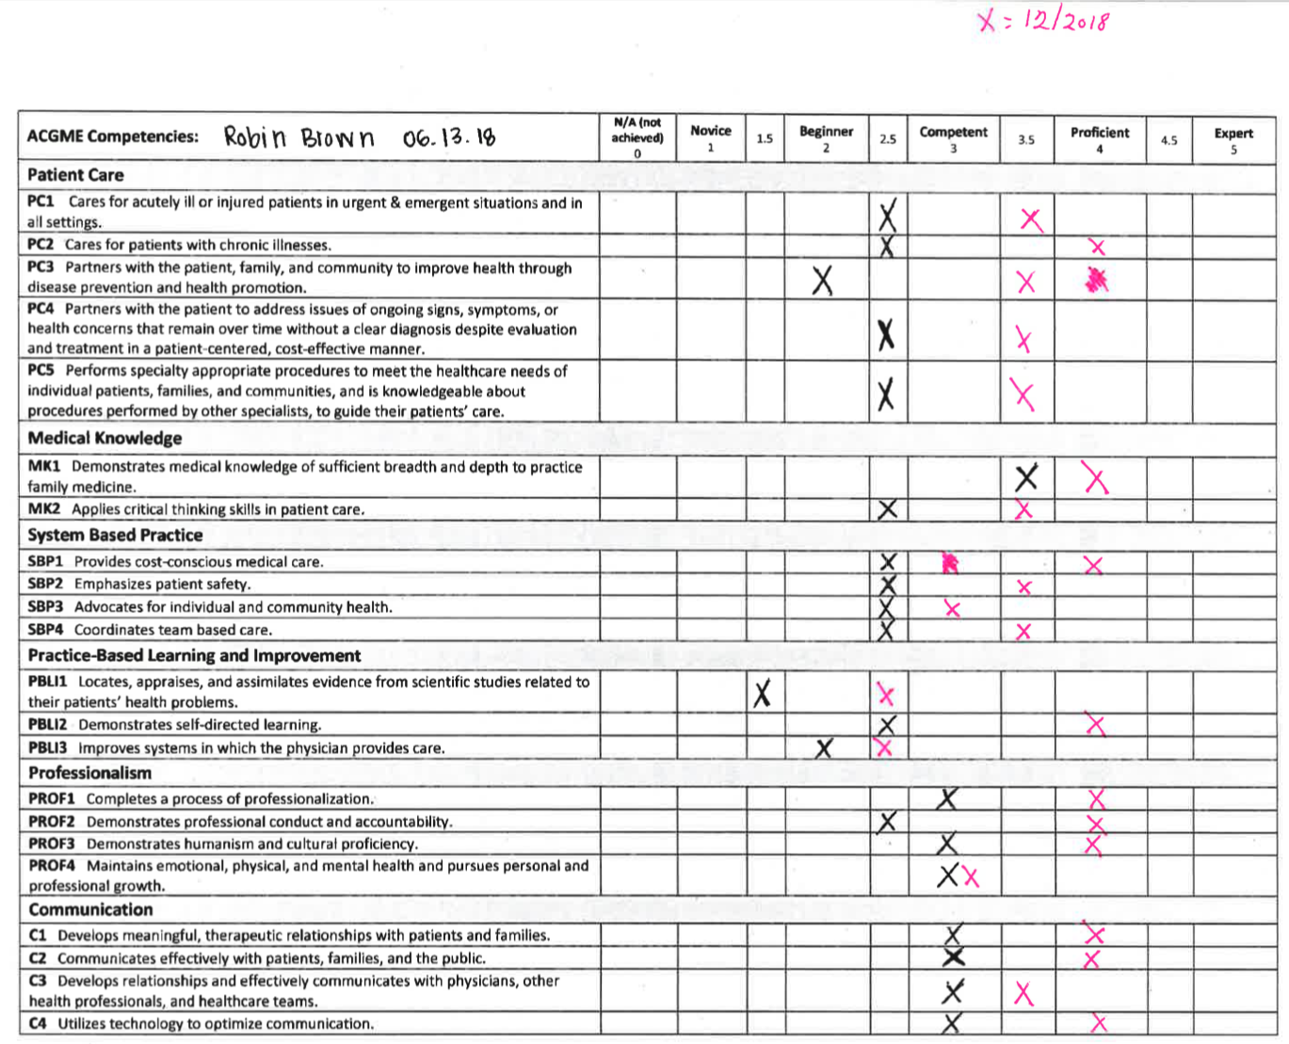
Notes:
Emphasize that we ask the resident to come up with specific examples to support their rating, prior to the meeting.
Really emphasize how much of this work is happening beforehand, by the resident (NOT THE CCC)
The milestones prep is built into the scheduled Advisor Meetings, which occur quarterly. The quarterly meeting occurs priors to the Milestones Meetings. This is deliberately done to reduce burden on the advisors by not scheduling an extra meeting.

Slide 11
The Milestones Meeting
1mo before:
Data emailed to resident, advisor, CCC
Milestones meeting! CC completes milestones form
Resident and advisor complete ILP
Resident reviews data, self-assesses each milestone
Resident and Advisor fine-tune self-assessment
Observation-based feedback given & entered throughout residency
Notes:
The resident, with the support of their advisor, LEADS the Milestones meeting.
The resident presents their self-assessed score to the Milestones CCC, and provides supporting examples.
The Milestones CCC, utilizing the information presented by the resident in combination with review of all the evaluations, and following group discussion, determines the final score for each level.

Slide 12
Who’s in the driver’s seat?

Slide 13
Fears and Barriers:
“Don’t residents score themselves too high, biasing the assessment?”
Notes:
From our experience, residents overwhelmingly tend to underestimate their own skills and abilities, much more frequently than they even recognize or overestimate their competency.

Slide 14
Fears and Barriers:
“Can residents interpret the milestone wording?”
Expect unexpected outcomes
Seamlessly Telephonic...
Process of Professionalization

Slide 15
Milestone Meeting Demonstration

Slide 16
Demo: Self-rating too high: PC1

Slide 17
Demo: Resident adds info: SBP 3

Slide 18
Demo: Self-rating too low: SBP 4

Slide 19
Meeting Follow-up
1mo before:
Data emailed to resident, advisor, CCC
Milestones meeting! CC completes milestones form
Resident and advisor complete ILP
Resident reviews data, self-assesses each milestone
Resident and Advisor fine-tune self-assessment
Observation-based feedback given & entered throughout residency
Notes:
The resident, with the support of their advisor, LEADS the Milestones meeting.
The resident presents their self-assessed score to the Milestones CCC, and provides supporting examples.
The Milestones CCC, utilizing the information presented by the resident in combination with review of all the evaluations, and following group discussion, determines the final score for each level.

Slide 20
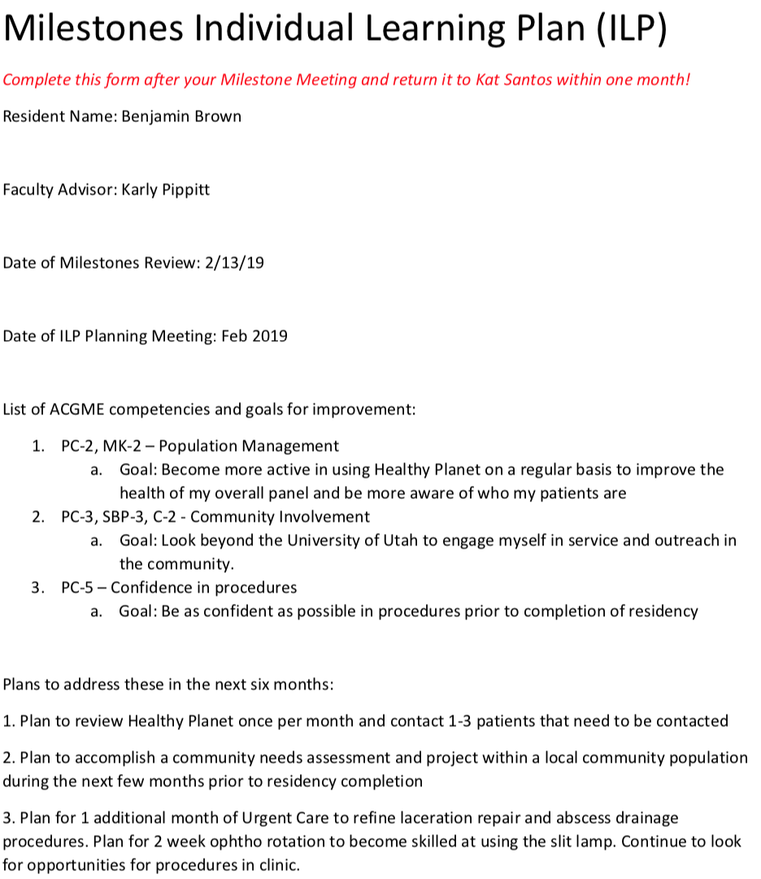

Slide 21
Resident-Led Milestones – Process Summary
The Resident:
Independently reviews evaluations and performance data
Self-assesses with advisor input
Leads Milestones Meeting
Submits ILP
The CCC:
Provide feedback about the resident’s self-evaluation
Mentor about Milestone interpretation and learning options
Finalize and submit Milestone rating

Slide 22
Outcomes
ABFM board exam pass rates - not worse
2010 - 2013: 71.4% - 87.5% passing
2014 – present: 100% passing
Progress along milestones
R1, R2, R3
Program improvement
Program limitations visible
Milestone conversations inspire improvement

Slide 23
Educational Impact: Average milestones standing, End of R1 year

Slide 24
Educational Impact: Average milestones standing, End of R2 year

Slide 25
Educational Impact: Average milestones standing, End of R3 year

Slide 26
What Do Residents Think?
Preliminary data from first resident focus group
Meetings
“friendly and conversational”
Challenges
“questions are really wordy”
How to improve the process
“where I stand clinically she (CCC faculty) doesn’t know – she hasn’t worked with me”
Resident learning
“If you’re not prepared, you won’t know what to say”
“…meetings bring up lots of things, deficiencies you can improve on”
“(ILP goals)… the more specific and measureable, the better”
“there are things I would never remember to do without the milestones”
Notes:
ng residents in charge of leading their own Milestones meetings will yield a process where:
Evaluation meetings are efficient
Assessments are highly accurate
Residents develop ownership for lifelong self-assessment and improvement
Residents are less stressed

Slide 27
What Do Faculty Think?
- Preliminary data from first faculty focus group
Consistent with resident focus group
“The meetings are a safe space to receive feedback, the residents should not feel like they need to defend their scores, it is more of discussion than a lecture”
Unique insight
“It is like driver’s ed, being in the car with a student driver”
“We can’t understand a resident better than the resident understands themselves”
Idea for improvement
Let residents create their own professional milestone

Slide 28
Activity
Collect question cards
Small Groups
Complete worksheet individually
Discuss responses in groups of 4
Large Group
Share key concerns
Address questions

Slide 29
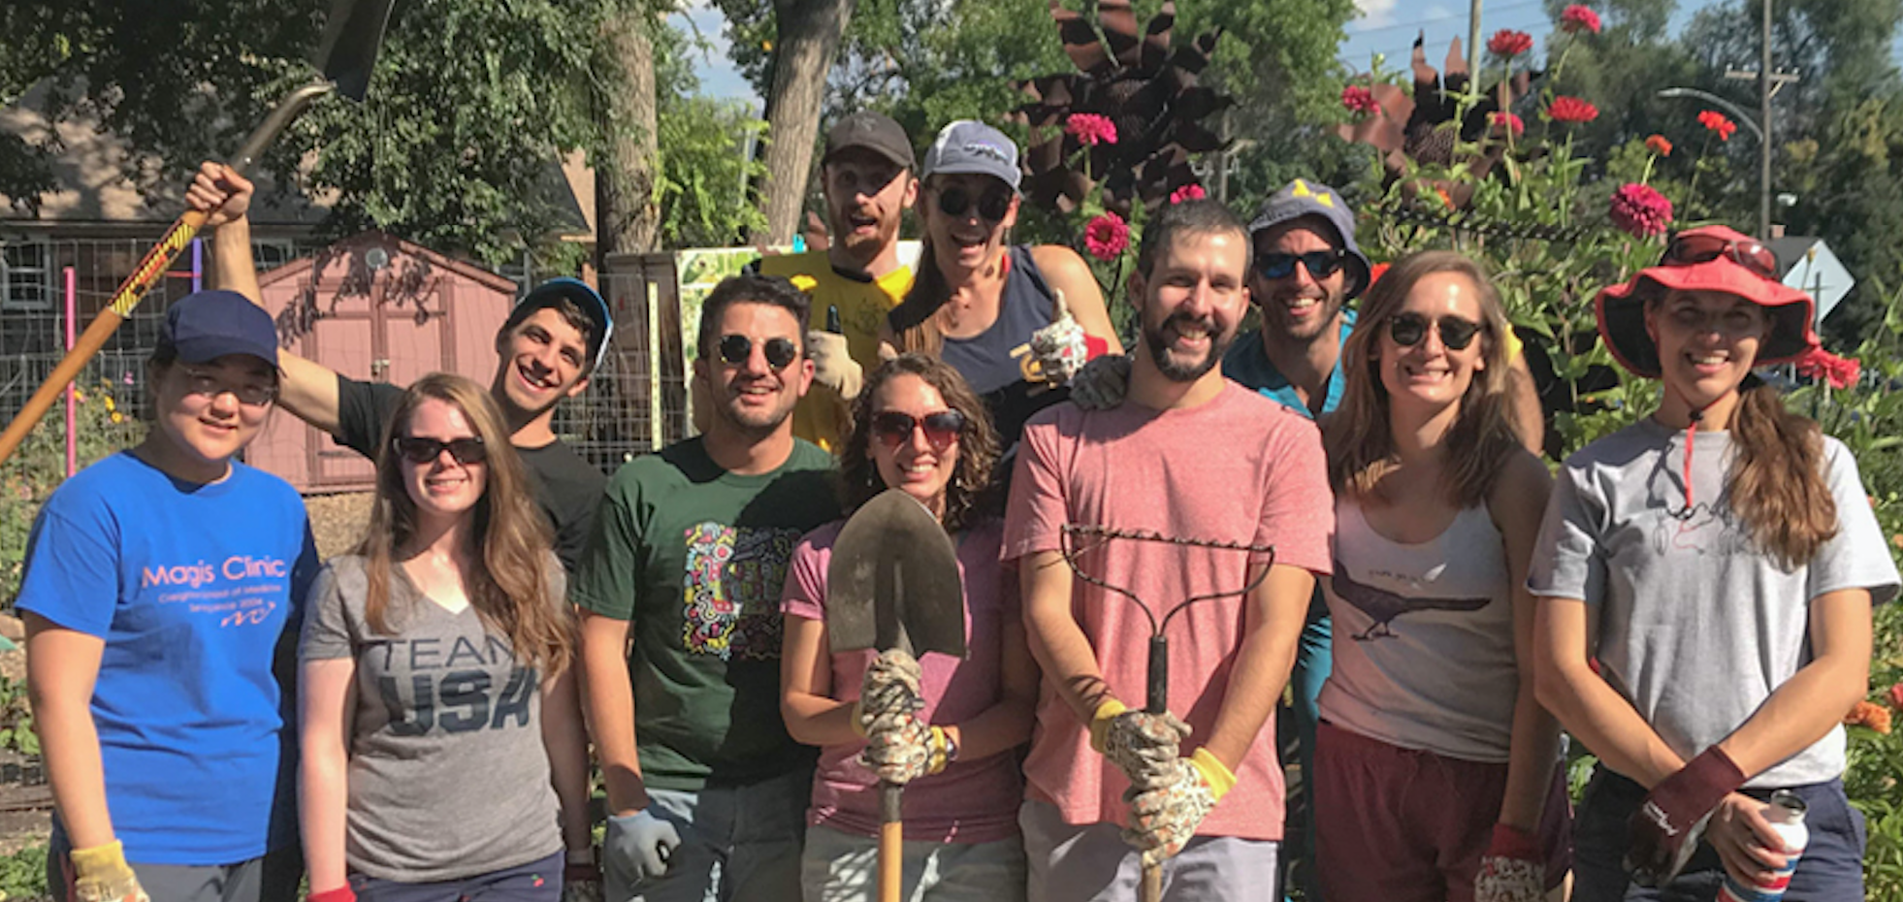
Thank You! Thanks to our department’s Health Studies Fund for sponsoring our research
Susan.Cochella@hsc.utah.edu www.Medicine.Utah.Edu/DFPM

Slide 30
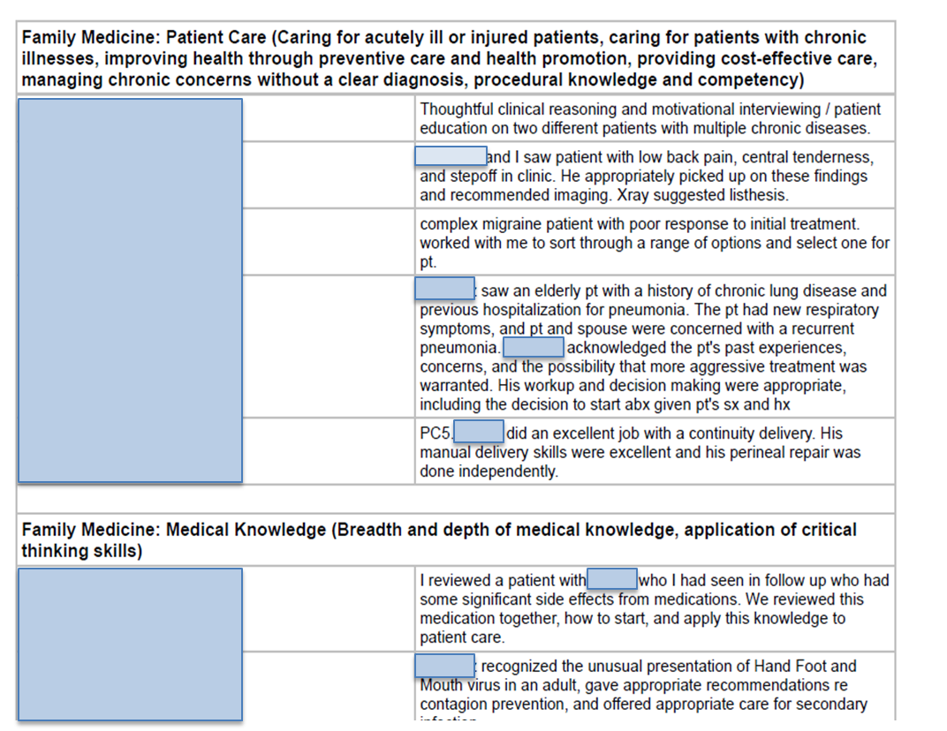
Data: Clinic ‘On-the-Fly’ Formative Evaluations
Notes:
Real time formative feedback in continuity clinic is provided by the supervising attending to the resident each clinic session, focusing on one Milestone. Feedback is given verbally, and then logged electronically. Attendings are required to do one evaluation on each resident for each clinic session, and should be something that is observable.

Slide 31
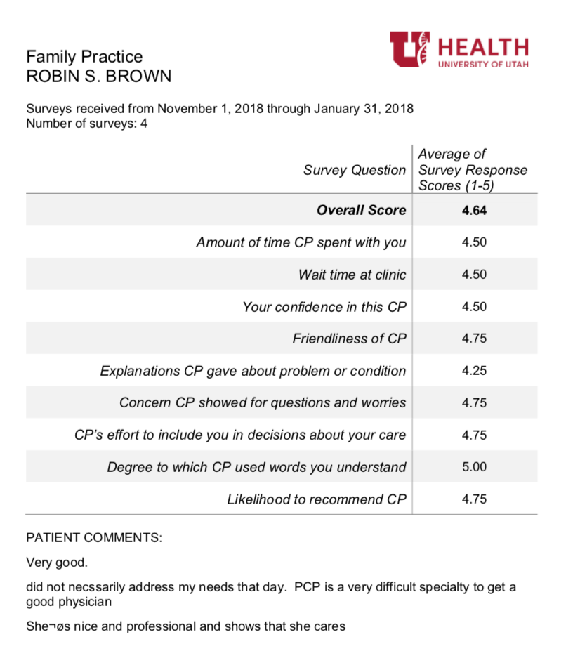
Data: Patient Satisfaction
Notes:
Other assessments are collected and collated by support staff (including rotation evaluations, patient satisfaction scores, MA feedback, wRVUs, chart closure rates, procedure logs, presentation performance, quality metrics).

Slide 32
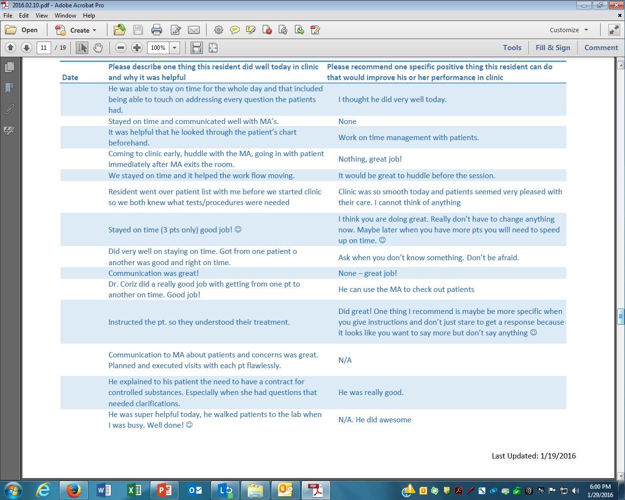
Data: MA Feedback

Slide 33
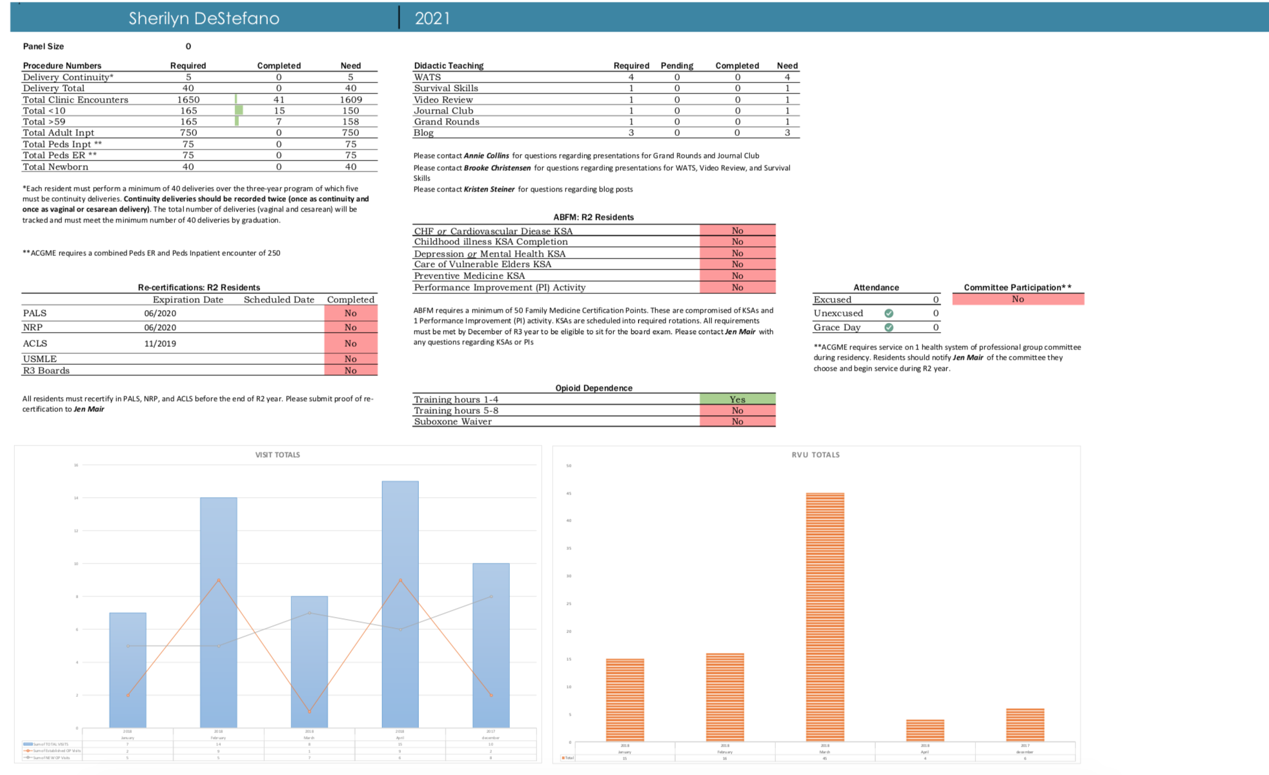
Data: Graduation Requirements

Slide 34
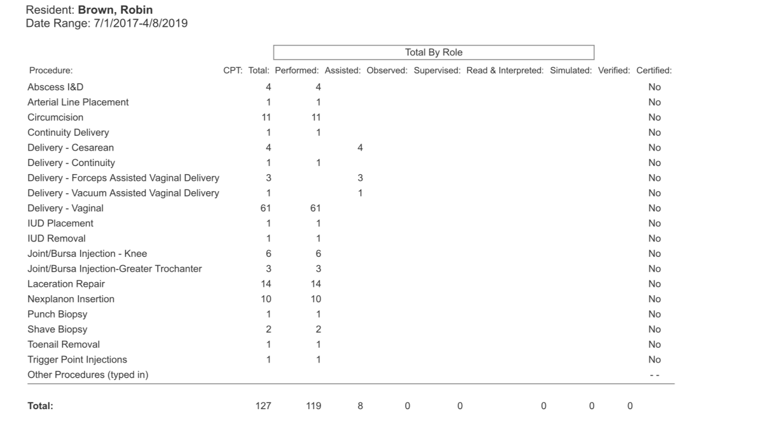
Data: Procedures Documentation

Slide 35
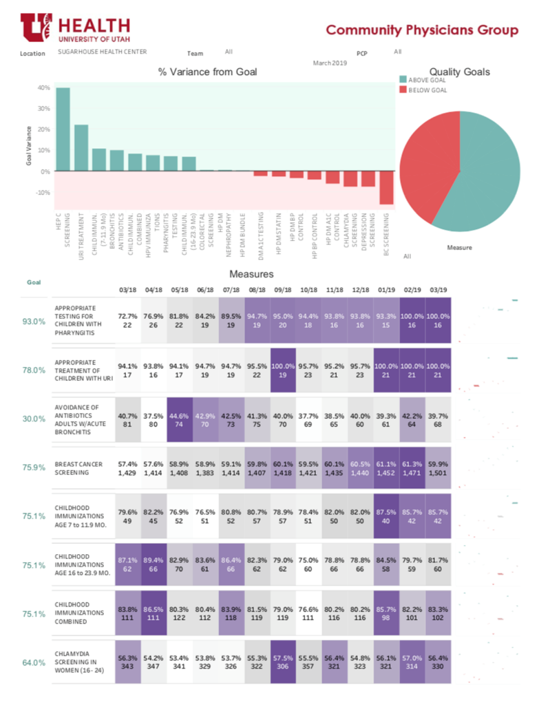
Data:
Quality Metrics

