Slide 1
Journal Club
UHS Wilson Family Medicine Residency

Slide 2
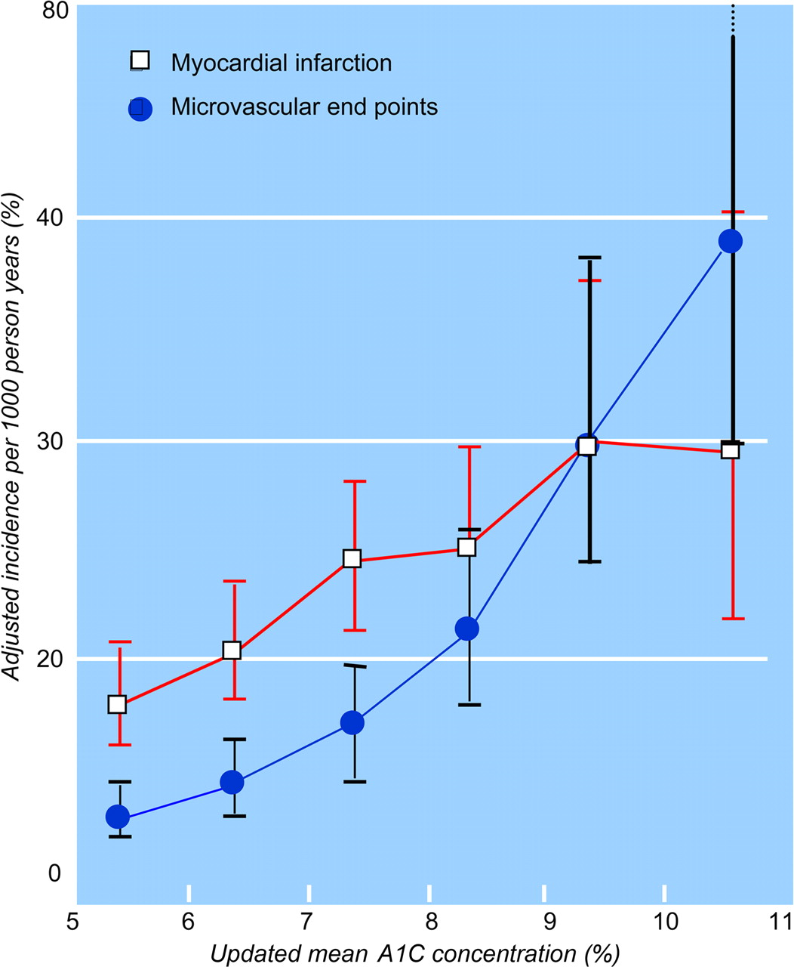
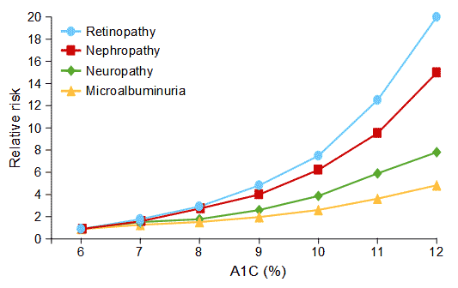
A1c and Outcomes
Higher A1c = bad
Lower A1c = good
lowering A1c from
higher to lower = ???

Slide 3
Higher to Lower
Hypertension
higher BP = bad
lower BP = good
lowering high BP to lower BP
outcomes improved ACEI, diuretic, CCB
outcomes NOT improved Atenolol
Cholesterol
higher Chol = bad
lower Chol = good
lowering high Chol to lower Chol
outcomes improved statins, binding resins, PCSK9’s
outcomes NOT improved HRT, Niacin

Slide 4
Journal Club
usually an article
today a question to answer
we manage type II diabetes super-frequently
just how good should you aim to make A1c?
you’ve probably heard different A1c goals
you’ve probably been told different A1c goals
today figure it out for yourself

Slide 5
Journal Club activity!
4 groups
4 RCT’s on the topic
evaluate 4 articles on how good to make A1c
15 minutes to review article
then each group 5 minute report to the group
decide what to conclude

Slide 6
Group report
What kind of study
(hint: it’s an RCT!)
Who were the patients (inclusion, exclusion criteria)
What outcomes measured
What were the interventions
What were the findings
in relative and absolute terms, if given
Concerns for bias, error, confounding, validity

Slide 7
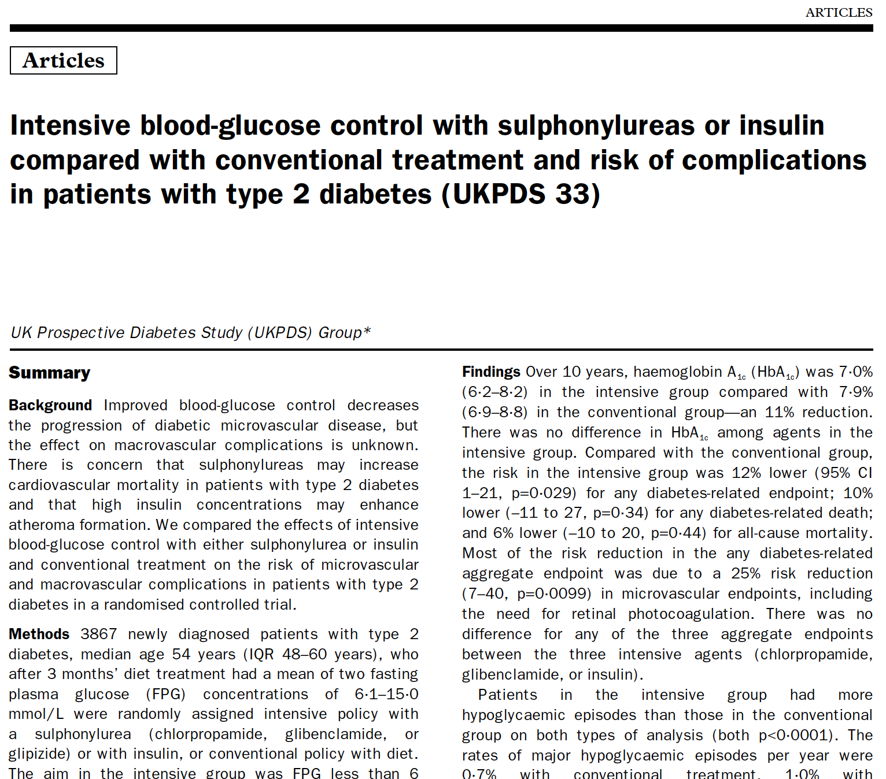
Group report
What kind of study
cohort, case-control, RCT, etc.
Who were the patients (inclusion, exclusion criteria)
What outcomes measured
What were the interventions
What were the findings in relative and absolute terms
Concerns for bias, error, confounding, validity

Slide 8
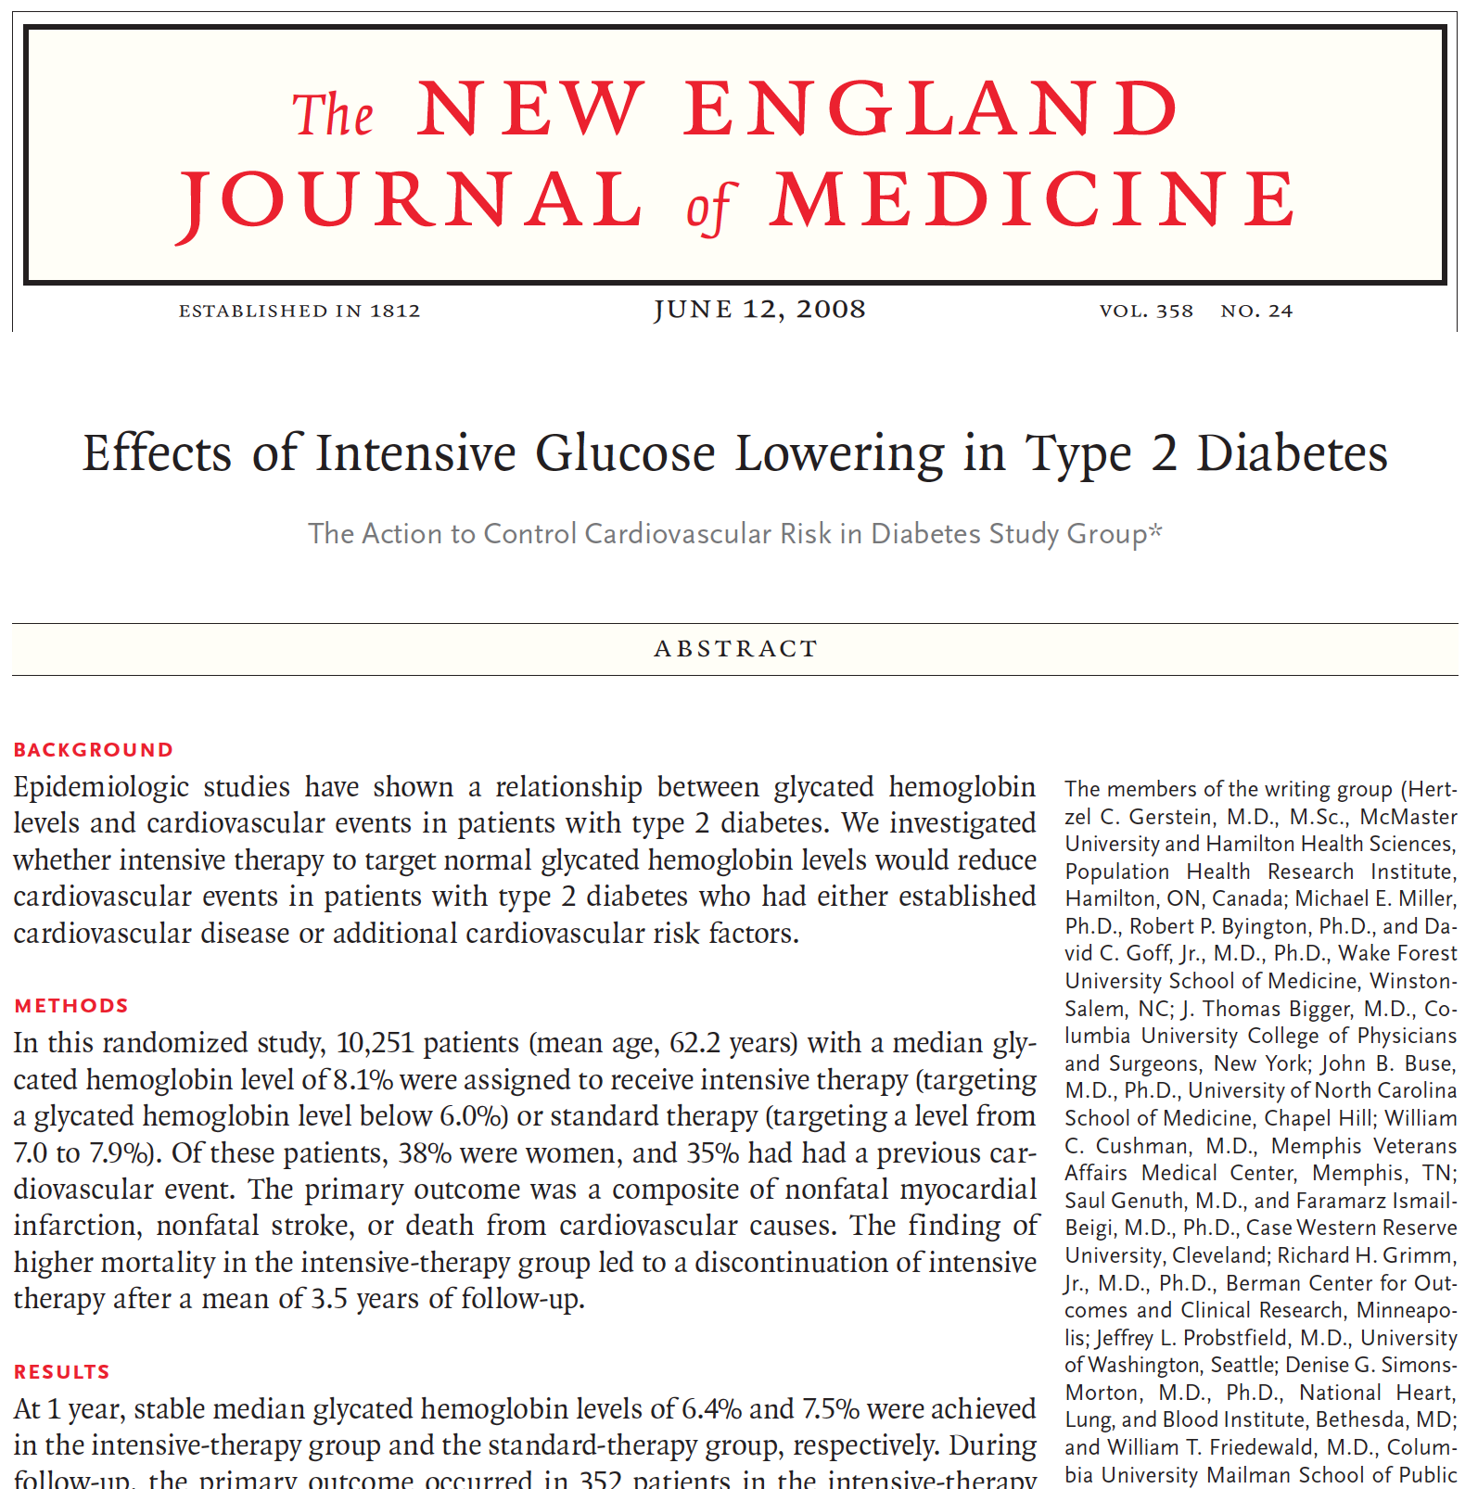
Group report
What kind of study
cohort, case-control, RCT, etc.
Who were the patients (inclusion, exclusion criteria)
What outcomes measured
What were the interventions
What were the findings in relative and absolute terms
Concerns for bias, error, confounding, validity

Slide 9
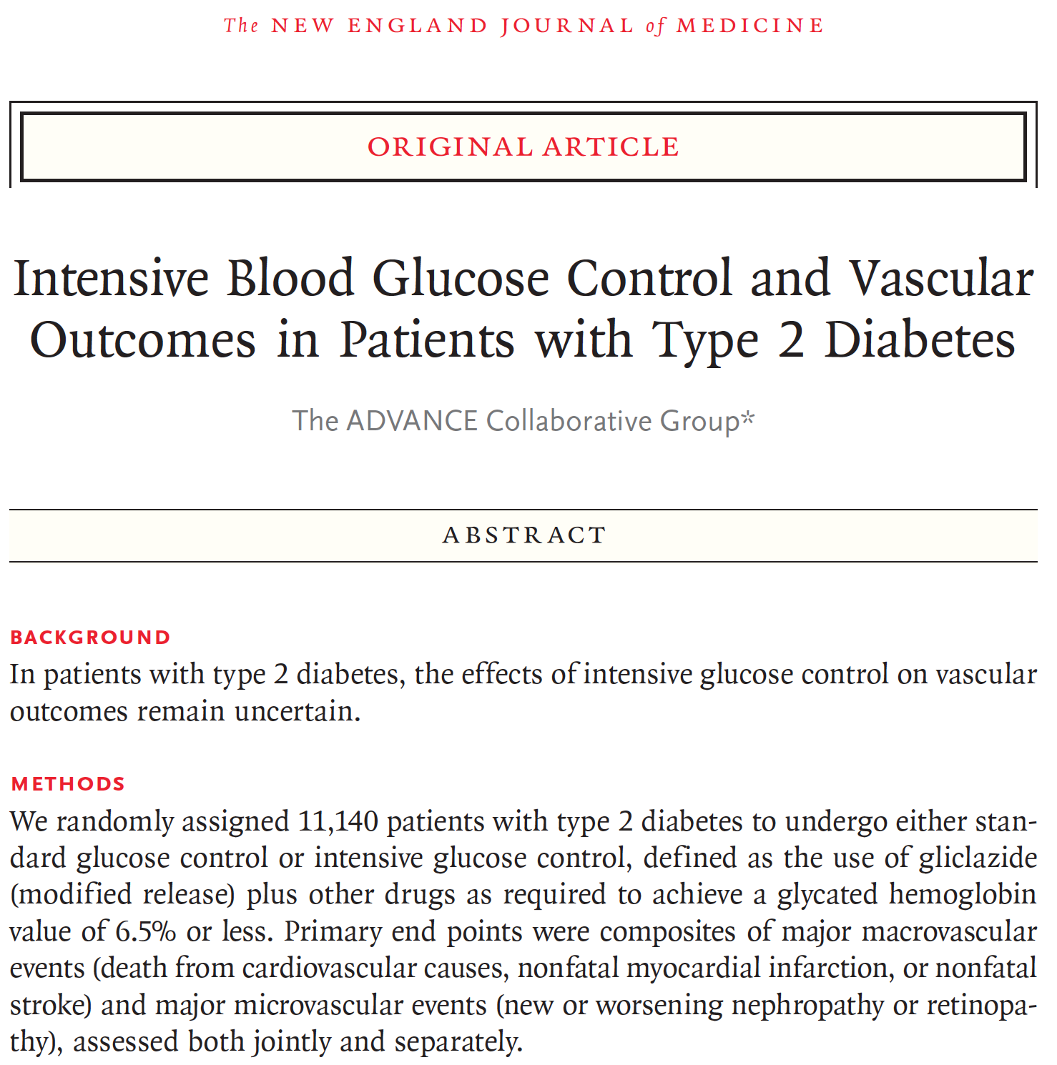
Group report
What kind of study
cohort, case-control, RCT, etc.
Who were the patients (inclusion, exclusion criteria)
What outcomes measured
What were the interventions
What were the findings in relative and absolute terms
Concerns for bias, error, confounding, validity

Slide 10
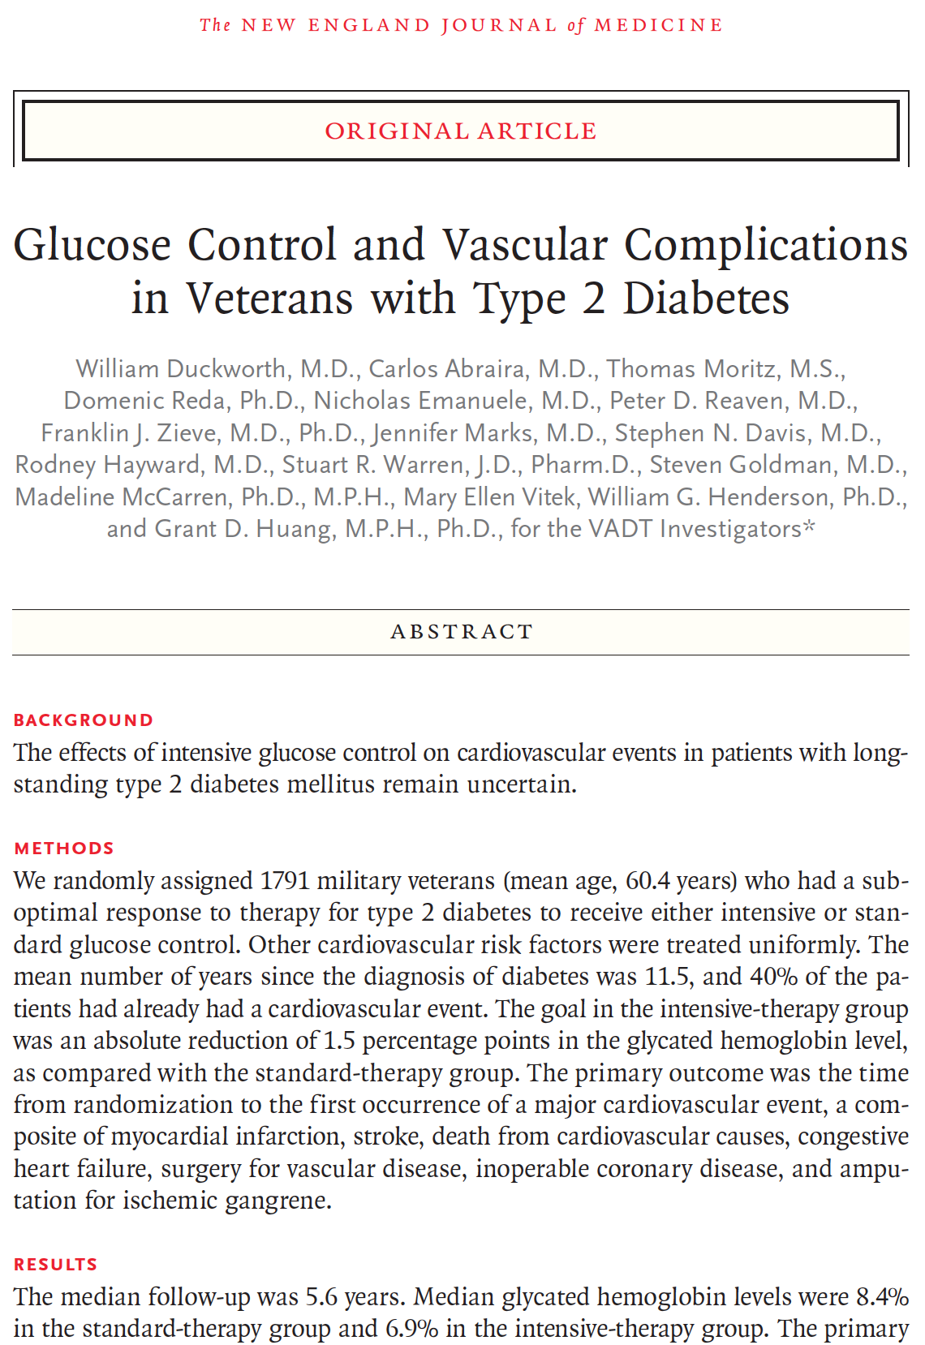
Group report
What kind of study
cohort, case-control, RCT, etc.
Who were the patients (inclusion, exclusion criteria)
What outcomes measured
What were the interventions
What were the findings in relative and absolute terms
Concerns for bias, error, confounding, validity

Slide 11
So how good should A1c be?
usually feasible to get A1c decent, into the 7’s
should we push it towards normal, in the 6’s?
now you know the evidence
what are those criteria for considering pros and cons of interventions?
you know, the patient-oriented ones...
5 criteria...

Slide 12
STEPS for A1c intense control
SAFETY
TOLERABILITY
EFFICACY
PRICE
SIMPLICITY
⇧ hypoglycemia, ⇧ mortality
more meds = ⇧ side effects
no benefit, some harm
more meds = ⇧ cost
more meds = ⇧ complexity

