Slide 1
Artificial Intelligence and Medicine
Nipa R. Shah, MD University of Florida, College of Medicine, Jacksonville
September, 2022

Slide 2
Disclosure
I have no financial relationships with any commercial interest related to the content of this activity.
Notes:
Partnership for Artificial Intelligence, Automation and Robotics in Healthcare (PATH)--. PATH is the only organization, grounded in both medicine and technology, that enables the confluence of these revolutionary tools and how they must be smoothly integrated into healthcare enterprises.

Slide 3
Goals and Objectives
1. Define basic terminology in artificial intelligence (AI)
2. Become aware of how AI is used in a variety of medical applications
3. Comprehend the challenges of AI at this time
4. Prepare learners and clinicians for the upcoming changes due to AI

Slide 4
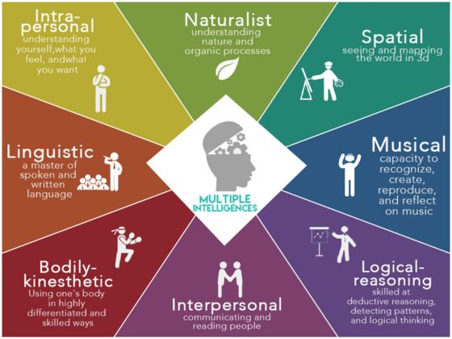

Slide 5
Terminology
Artificial Intelligence--the theory and development of computer systems to perform tasks that normally require human intelligence:
visual perception, speech recognition, decision-making, and translation between languages.
Notes:
https://www.ft.com/content/4367e34e-db72-11e7-9504-59efdb70e12f
https://www.google.com/search?q=artificial+intelligence&rlz=1C1CHBF_enUS742US742&oq=artificial+intelligence&aqs=chrome..69i57j0l5.3691j1j7&sourceid=chrome&ie=UTF-8
What is AI, anyway?—Imitation Game
The term “artificial intelligence” was first coined by the English mathematician Alan Turing to describe “the science and engineering of making intelligent machines, especially intelligent computer programs.” Today, AI may be better described as computer programs, trained on massive data sets, that can accomplish tasks that usually require human intelligence, including, problem-solving, and decision-making, says Pedro Domingos, PhD, a computer scientist at the University of Washington and author of The Master Algorithm: How the Quest for the Ultimate Learning Machine Will Remake Our World.
---https://www.medicaleconomics.com/technology/artificial-intelligence-looking-beyond-hype

Slide 6
AI Market→$34 billion by 2025
Deepening of data analytics capabilities
Automating key healthcare-related tasks.
Forecast includes both sales of hardware and services that will be driven by AI software implementation.
Global software revenue from 22 key healthcare AI use cases will grow from $511.7 million in 2018 to $8.6 billion annually by 2025.
Notes:
https://www.tractica.com/research/artificial-intelligence-for-healthcare-applications/

Slide 7
How?
Deep Learning-type of machine learning that trains a computer to perform human-like tasks by interpreting patterns in data
In deep learning, the algorithm automatically learns what features are useful. Common deep learning techniques include convolutional neural networks (CNNs), recurrent neural networks (such as long short-term memory, or LSTM), and deep Q networks.
Natural Language Processing-- is a branch of artificial intelligence that helps computers understand, interpret and manipulate human language.
Notes:
Machine learning helps AI systems perform tasks: photo recognition, identifying a word that is spoken, and language translation. https://jamanetwork.com/journals/jama/fullarticle/2701666?utm_source=silverchair&utm_medium=email&utm_campaign=article_alert-jama&utm_content=olf&utm_term=083018
https://jamanetwork.com/journals/jama/fullarticle/2701665?utm_source=silverchair&utm_medium=email&utm_campaign=article_alert-jama&utm_content=olf&utm_term=083018
Early AI systems represented human reasoning with symbolic logic. As computer processing and storage became more powerful, researchers developed machine-learning techniques to imitate the way the human brain learns. The first machine learning continued to rely on human experts to label the data the system trained on (eg, the diagnosis) and to identify the significant features (eg, findings). Machine learning weighted the features from the data. With continued advances in computational power and with larger data sets, researchers began to develop deep learning techniques. The first deep learning algorithms were “supervised” in that human experts continued to label the training data, and the deep learning algorithms learned the features and weights directly from the data. The retinopathy screening algorithms are an example of supervised deep learning. Hinton⁴ describes continuing development of new deep learning techniques, including ones that are completely unsupervised. He also points out that it is not feasible to see the features learned by deep learning to explain how the system reaches a conclusion.
https://jamanetwork.com/journals/jama/fullarticle/2701665?utm_source=silverchair&utm_medium=email&utm_campaign=article_alert-jama&utm_content=etoc&utm_term=091818
“While deep learning at present has some unique advantages as an analytic and modeling tool, it also exemplifies a broader trend: the convergence of health and data sciences.“ Dr. Naylor Univ. of Toronto
https://jamanetwork.com/journals/jama/fullarticle/2701667?utm_source=silverchair&utm_medium=email&utm_campaign=article_alert-jama&utm_content=etoc&utm_term=091818
The availability of large amounts of interconnected data across all levels of biomedical research could enable thorough interrogation of relationships among those data, and may ultimately lead to breakthroughs that can improve health care. Dr. Zheng, University of Texas
https://jamanetwork.com/journals/jama/fullarticle/2702879?utm_source=silverchair&utm_medium=email&utm_campaign=article_alert-jama&utm_content=etoc&utm_term=091818
Black box nature of deep neural networks – Explainability −Can you show how the model made its decision? −What are the most important pieces of data in a specific prediction?

Slide 8
Notes:
Bitcoin uses blockchain technology
https://www.mdedge.com/familymedicine/article/193564/business-medicine/breaking-down-blockchain-how-novel-technology-will?utm_source=News_FPN_eNL_020319_F&utm_medium=email&utm_content=Med%20Tech%20Report:%20Breaking%20down%20blockchain
a way to store and communicate information while ensuring its integrity and security
model relies on a chain of connected blocks
Blockchains are very secure yet highly accessible, and will be essential to how data – especially health data – are stored and communicated in the future.
Each block contains some data (which can be financial, medical, legal, or anything else) and bears a unique fingerprint known as a “hash.” Each hash is different and depends entirely on the data stored in the block. In other words, if the contents of the block change, the hash changes, creating an entirely new fingerprint. Each block on the chain also keeps a record of the hash of the previous block. This “links” the chain together, and is the first key to its robust security: If any block is tampered with, its fingerprint will change and it will no longer be linked, thus invalidating all following blocks on the chain.
--https://www.mdedge.com/familymedicine/article/193564/business-medicine/breaking-down-blockchain-how-novel-technology-will?utm_source=News_FPN_eNL_020319_F&utm_medium=email&utm_content=Med%20Tech%20Report:%20Breaking%20down%20blockchain
Nathaniel: The blockchain in the simplest terms is a ledger — a method of record keeping — that was invented for Bitcoin, which is a cryptocurrency. Unlike conventional records kept by one bank or accountant, the blockchain ledger uses a bunch of computers that each add new entries visible to everyone.
The blockchain design that Bitcoin inspired has been adapted for other kinds of records. The underlying principle is there is no central authority controlling a single ledger. Everyone who is part of the system controls a decentralized and shared record. Source: https://www.nytimes.com/2021/01/26/technology/big-tech-power-bitcoin.html?campaign_id=158&emc=edit_ot_20210126&instance_id=26424&nl=on-tech-with-shira-ovide&regi_id=70073566&segment_id=50296&te=1&user_id=a79ece8fc7ae07932ed648336fd3b9b6

Slide 9
Blockchain is secure.
“decentralization.”
blockchains are not stored on any single computer.
Before any change in the blockchain can be made and accepted, it must be validated by a majority of the computers storing the chain.
Notes:
https://www.mdedge.com/familymedicine/article/193564/business-medicine/breaking-down-blockchain-how-novel-technology-will?utm_source=News_FPN_eNL_020319_F&utm_medium=email&utm_content=Med%20Tech%20Report:%20Breaking%20down%20blockchain
On the contrary, duplicate copies of every blockchain exist on thousands of computers around the world, creating redundancy and minimizing the vulnerability that any single chain could be tampered with.

Slide 10
A specific example of Blockchain use:
Walmart
requires lettuce and spinach suppliers to contribute to a blockchain database that can rapidly pinpoint contamination.

Slide 11
Tracking counterfeit drugs with Blockchain: Mediledger Project
Notes:
core function of the MediLedger Network is to validate the authenticity of drug identifiers throughout the supply chain
https://www.reuters.com/article/us-usa-healthcare-blockchain/companies-in-pharmaceutical-supply-chain-develop-system-to-track-counterfeit-drugs-idUSKBN20F29L
Among the 24 participating companies are Amgen Inc (AMGN.O), FedEx Corp (FDX.N), GlaxoSmithKline Plc (GSK.L), Novartis (NOVN.S), AmerisourceBergen Corp (ABC.N), Sanofi (SASY.PA), Walgreens Boots Alliance Inc (WBA.O) and Walmart Inc (WMT.N).
The World Health Organization estimates that counterfeit medicines worth 73 billion euros ($79.26 billion) are traded annually.

Slide 12
Genomic data and AI
“The new genomic diagnostics work by matching the DNA or RNA of microbes in a patient’s bodily fluid against vast databases of all known bacteria, viruses or fungi that can sicken humans.
Many of the tests produce results in hours, a marked contrast to traditional cultures, which can take days or even weeks to get results”
“a supercomputer can go through billions of nucleotides and spit out a result in a few hours”
Notes:
https://www.nytimes.com/2020/02/24/health/genomic-diagnostic-tests.html
Arc Bio in Cambridge, Mass., is developing a diagnostics platform that focuses solely on the 400 viruses that make people sick. Day Zero Diagnostics in Boston is field-testing a sequencing and analysis service that allows hospitals to quickly detect infectious disease outbreaks. And then there is the hand-held gadget made by medical device company BD that allows doctors to rapidly determine whether a patient with a high fever needs an antibiotic for strep throat or simply bed rest for what is most likely a viral respiratory bug.
Another Boston company, Selux Diagnostics, started five years ago in a makeshift lab in the attic of its founder, Dr. Eric Stern, has developed a dishwasher-size machine that can test pathogens against a panel of 60 antibiotics and determine which ones are most likely to work. Unlike standard antibiotic susceptibility tests that take three or more days, Selux’s powerful algorithm can yield results within hours of a pathogen being identified from a patient sample.

Slide 13
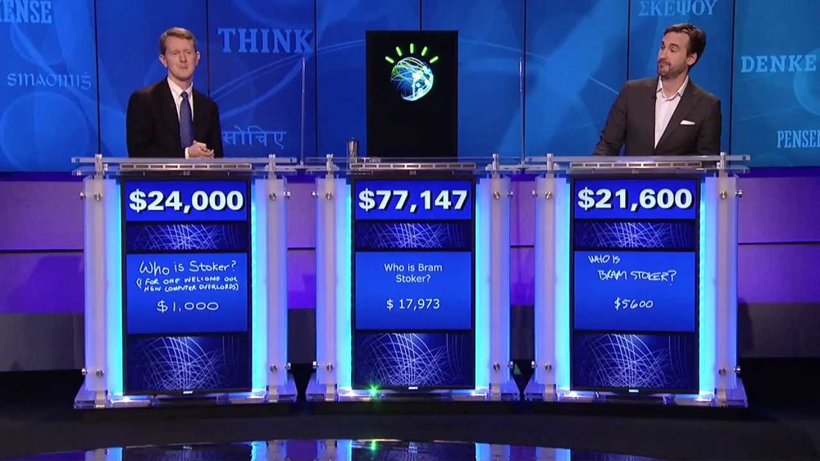
Notes:
2011—Jeopardy contest…IBM Watson won. IBM's Watson had $77,147 at the end of two days.
Jennings had $24,000.
Rutter rounded out the festivities with $21,600. Final Jeopardy bet on the answer “William Wilkinson’s ‘An account of the principalities of Wallachia and Modavia’ inspired this author’s most famous novel.”

Slide 14
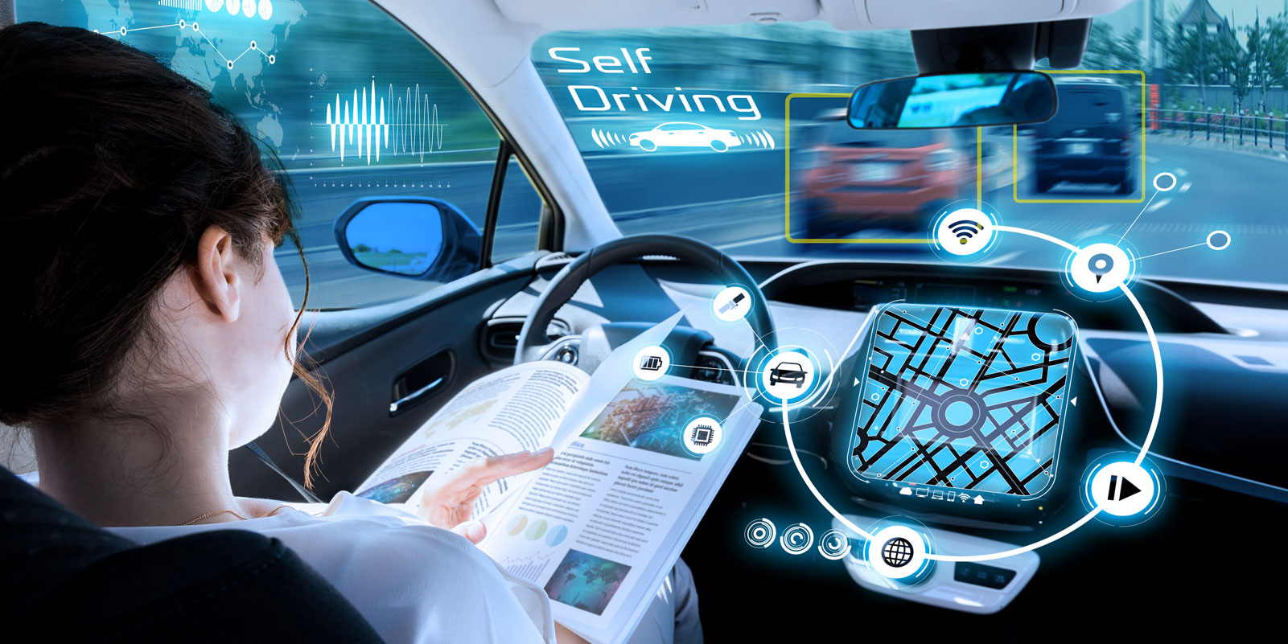
Notes:
AI helps self driving cars recognize and make decisions.

Slide 15
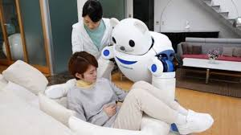
Robotics and AI
Robotics involves building robots physical whereas AI involves programming intelligence

Slide 16
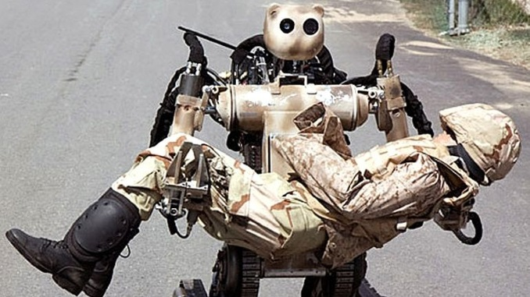
Notes:
Rescue operations

Slide 17
Risky human jobs replaced with robots

Slide 18
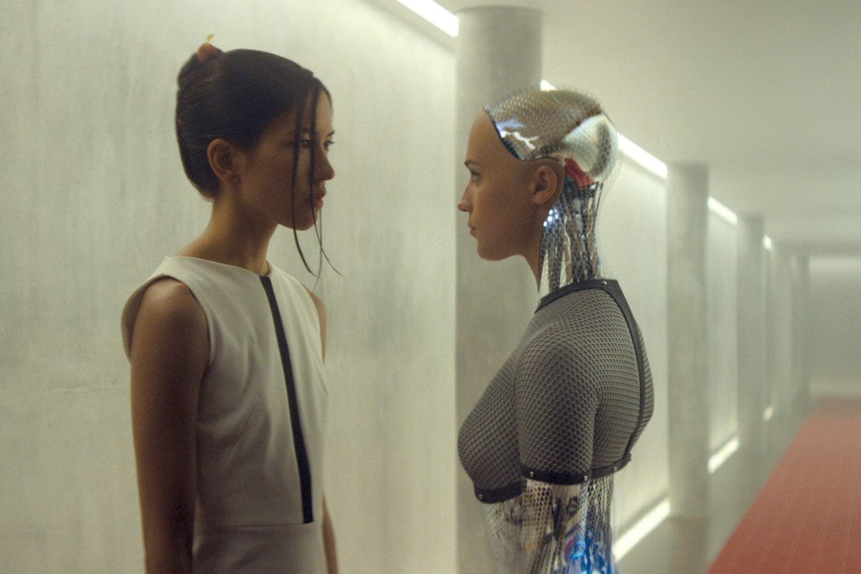
Notes:
Ex Machina
What remains the biggest misconception about A.I.?
People confuse intelligence with consciousness; they expect A.I. to have consciousness, which is a total mistake. Intelligence is the ability to solve problems; consciousness is the ability to feel things — pain, hate, love, pleasure.
Can machines develop consciousness?
Well, there are “experts” in science-fiction films who think you can, but no — there’s no indication that computers are anywhere on the path to developing consciousness.
https://www.nytimes.com/2018/10/18/business/q-and-a-yuval-harari.html?emc=edit_th_181019&nl=todaysheadlines&nlid=700735661019
21 Lessons for the 21st Century Israeli author and historian Yuval Noah Harari

Slide 19
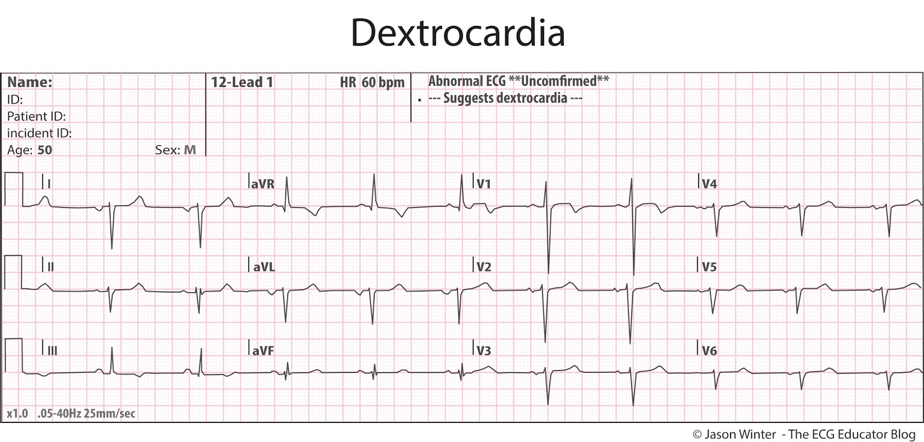

Slide 20
Early Sepsis-information pulled from medical records every five minutes
Early Detection
Data Analytics
Notes:
http://www.pbs.org/wgbh/nova/next/body/ai-sepsis-detection/
http://www.clinical-innovation.com/topics/artificial-intelligence/ai-predicts-early-onset-sepsis
https://www.google.com/search?rlz=1C1CHBF_enUS742US742&biw=1243&bih=733&tbm=isch&sa=1&ei=febPWvv3GcbwsAWN5LjoDA&q=vitals+monitorsepsis&oq=vitals+monitorsepsis&gs_l=psy-ab.3...5458.9154.0.9331.19.15.4.0.0.0.185.1450.6j7.13.0....0...1c.1.64.psy-ab..2.2.138...0i13k1.0.6RiodsZ6I4o#imgrc=k4W5p7Rw-e5mvM:
https://www.sas.com/en_us/insights/articles/analytics/using-analytics-to-prevent-sepsis.html
https://www.beckershospitalreview.com/quality/duke-university-hospital-to-roll-out-ai-system-for-sepsis.html?origin=qualitye&utm_source=qualitye
The Sepsis Watch system can identify cases based on numerous variables, including vital signs, lab test results and medical histories. The AI's training data consists of 50,000 patient records and more than 32 million data points. (at Duke)
https://www.nbcnews.com/mach/science/how-hospitals-are-using-ai-save-their-sickest-patients-curb-ncna1032861

Slide 21
PCORI: Review of AI applications for medical care as of April 2021
Review of 109 AI applications:
only 20 percent of the applications both in the pipeline and in use have FDA clearance
40 percent are already in use without FDA clearance
remaining 40 percent are in development.
Source: https://www.pcori.org/research-results/evidence-synthesis/evidence-maps-and-evidence-visualizations/artificial
Notes:
https://www.pcori.org/sites/default/files/PCORI-RAND-Artificial-Intelligence-Clinical-Care-Narrative-Review-Evidence-Mapping-Report.pdf
https://www.pcori.org/research-results/evidence-synthesis/evidence-maps-and-evidence-visualizations/artificial

Slide 22
Imagen’s OsteoDetect software
FDA Clears Marketing for AI Algorithm to Detect Wrist Fractures (distal radius fractures)
Company submitted the results of a retrospective study including 1000 radiograph images.
The study independently verified the artificial intelligence algorithm’s ability to identify wrist fractures with similar accuracy as human radiologists.
Notes:
https://healthitanalytics.com/news/fda-clears-marketing-for-ai-algorithm-to-detect-wrist-fractures

Slide 23
AI and detection of pneumothorax
Reduces time for diagnosis by 80%
FDA Approved
https://www.zebra-med.com/solutions/triage/pneumothorax/
Also explores intracranial hemorrhage and pleural effusion
Notes:
https://www.reuters.com/article/us-healthcare-zebra-medical-regulator/israels-zebra-medical-gets-fda-ok-for-ai-chest-x-ray-product-idUSKCN1SJ0LI

Slide 24
Lung Cancer Screening
“When prior computed tomography imaging was not available, our model outperformed all six radiologists with absolute reductions of 11% in false positives and 5% in false negatives”
https://www.nature.com/articles/s41591-019-0447-x
Published: 20 May 2019
Notes:
https://www.nature.com/articles/s41591-019-0447-x
https://www.nature.com/articles/d41586-020-03157-9#:~:text=Bagci%20and%20his%20team%20have,rate%20that%20radiologists%20typically%20achieve.

Slide 25
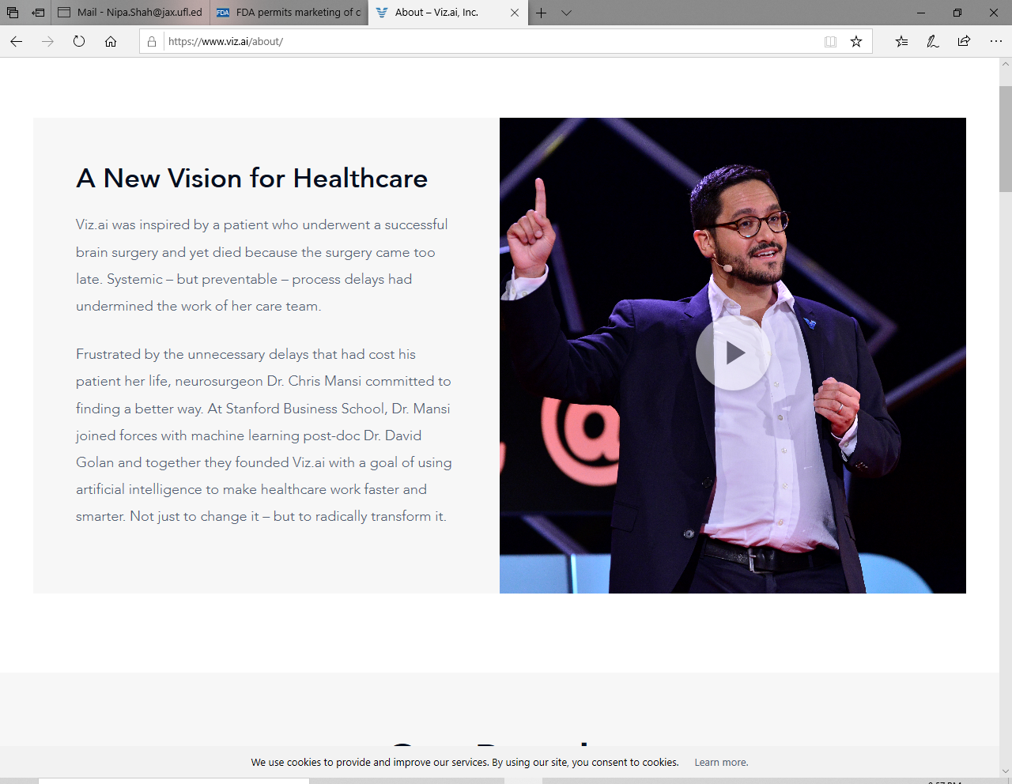
FDA permits marketing of clinical decision support software for alerting providers of a potential stroke in patients https://youtu.be/fgshbtlSEQQ
Notes:
https://youtu.be/fgshbtlSEQQ
https://www.viz.ai/about/
https://www.fda.gov/news-events/press-announcements/fda-permits-marketing-clinical-decision-support-software-alerting-providers-potential-stroke

Slide 26
AI and breast cancer screening
AI system surpassed human experts
Could decrease the burden on radiologists
Can provide immediate, automated feedback
https://www.nature.com/articles/s41586-019-1799-6
Notes:
https://www.medpagetoday.com/hematologyoncology/breastcancer/88337?ocid=uxbndlbing

Slide 27
FastMRI project—NYU and Facebook: changes the way an MRI machine creates an image-increases speed to diagnosis x10
MRI gathers a series of sequential views of a patient, which it translates into a cross-sectional image.
AI can generate high-quality images from limited data.
Researchers train an artificial neural network — which mimics the way a human brain learns and processes information — to recognize the underlying structure of the images it gathers.
Notes:
10,000 clinical cases and 3 million MRI scans of knees, brains and livers collected at NYU School of Medicine
https://www.beckershospitalreview.com/artificial-intelligence/nyu-school-of-medicine-teams-up-with-facebook-to-improve-mris.html
"A few missing or incorrectly modeled pixels could mean the difference between an all-clear scan and one in which radiologists find a torn ligament or a possible tumor," a Facebook blog post announcing the collaboration reads. "Conversely, capturing previously inaccessible information in an image can quite literally save lives."
https://www.wsj.com/articles/researchers-at-facebook-ai-nyu-langone-push-speed-limits-of-mri-11597755600?st=8yqa1kzxu3asu2x&reflink=share_mobilewebshare

Slide 28
Google’s LYNA to detect breast cancer spread
Notes:
https://www.beckershospitalreview.com/artificial-intelligence/google-creates-ai-to-detect-when-breast-cancer-spreads.html?origin=qualitye&utm_source=qualitye

Slide 29
Machine Learning---recognize patterns from labeled photographs Tampa VA Hospital
https://www.mdedge.com/fedprac/article/209325/health-policy/comparing-artificial-intelligence-platforms-histopathologic
Notes:
Two novel ML platforms available for public use are offered through Google (Mountain View, CA) and Apple (Cupertino, CA).^{14,15} They each offer a user-friendly interface with minimal experience required in computer science. Google AutoML uses ML via cloud services to store and retrieve data with ease. No coding knowledge is required. The Apple Create ML Module provides computer-based ML, requiring only a few lines of code.
Machine learning (ML), a subset of AI, was defined in 1959 by Arthur Samuel and is achieved by employing mathematic models to compute sample data sets.³ Originating from statistical linear models, neural networks were conceived to accomplish these tasks.⁴
These models are developed to recognize patterns and achieve complex computational tasks within a matter of minutes, often far exceeding human ability
The AI software was able to differentiate between benign colon tissue (left) and cancerous colon tissue. Beyond that, it was able to determine what kind of colon cancer it was, in the case of the image on the right, adenocarcinoma. COURTESY OF DR. ANDREW BORKOWSKI/JAMES A. HALEY VETERANS' HOSPITAL

Slide 30
AI can help detect colon cancer lesions during endoscopy
GI Genius Intelligent Endocsopy module by Cosmo Pharmaceuticals
FDA approved as of April, 2021
Notes:
https://www.prnewswire.com/news-releases/cosmo-announces-fda-approval-of-gi-genius-intelligent-endoscopy-module-its-revolutionary-artificial-intelligence-device-for-lesion-detection-during-colonoscopy-301266282.html

Slide 31
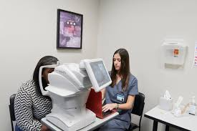
No specialist needed—FDA approves Diabetic Retinopathy Screening Device- IDx-DR. Camera used: Topcon NW400
Notes:
https://www.fda.gov/NewsEvents/Newsroom/PressAnnouncements/ucm604357.htm
https://www.nature.com/articles/s41746-018-0040-6
Remember, this is just Version 1—over time, it will likely get easier/cheaper
FDA reduced the risk of releasing the device by limiting the indication for use to screening adults who do not have visual symptoms for greater than mild retinopathy, to refer them to an eye care specialist.
https://jamanetwork.com/journals/jama/fullarticle/2701665?utm_source=silverchair&utm_medium=email&utm_campaign=article_alert-jama&utm_content=etoc&utm_term=091818

Slide 32
Primary Care
Britain’s NHS GP at Hand app
Babylon-Chatbot answered exam questions on a clinical knowledge and diagnostic test as well as GPs in Britain
https://www.gpathand.nhs.uk/

Slide 33
Help for Rwanda
Notes:
Since 2016, Babylon has been working in partnership with the government of Rwanda.
The country's health care service was decimated after the genocide in 1994, in which more than 800,000 people were killed.
Babylon has two million registered users in Rwanda and has conducted tens of thousands of consultations.
“I was in Brussels for a speaking engagement when I got very ill, with a high temperature. As I got off the stage and made my way to the cab I made an appointment with a doctor. I spoke to the doctor on the way to the airport and when I landed at Heathrow there was someone waiting for me with antibiotics. I did this through the Babylon app. Bill Gates can’t get this done, right? And that is who we are. Not just an AI system, but an end-to-end healthcare service.”
https://www.thedrum.com/news/2018/09/24/doctors-orders-how-ali-parsa-plans-make-digital-health-startup-babylon-the-google

Slide 34
Notes:
https://www.bbc.com/news/technology-44635134
While Babylon's existing GP at Hand service refers users to a human doctor if the app suspects a medical problem, the new chatbot makes a diagnosis itself - offering several possible scenarios along with a percentage-based estimate of each one being correct.

Slide 35
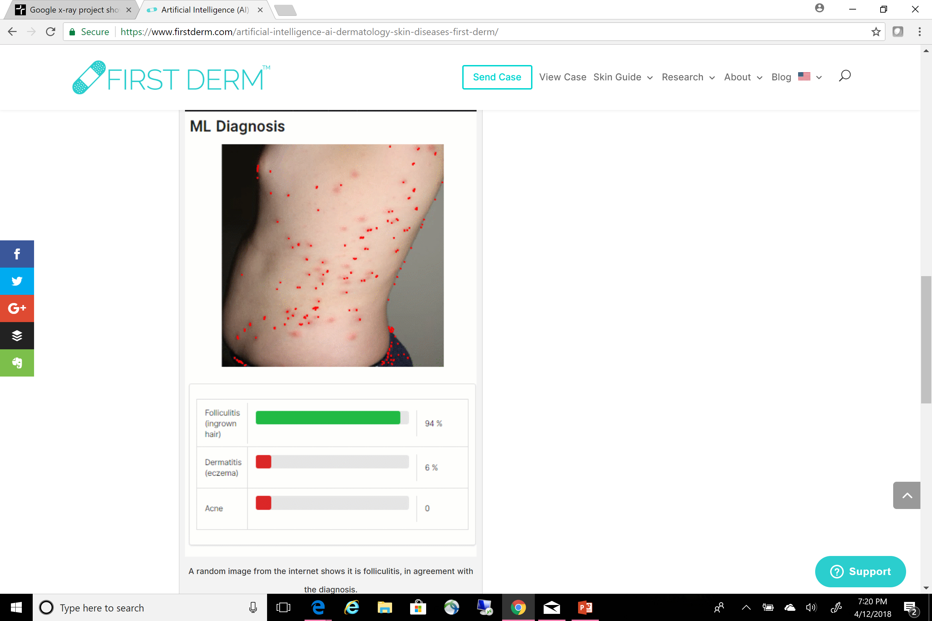
Notes:
Also other apps—just search ‘dermatologist’ in your app store

Slide 36
AEI-- Artificial emotional intelligence
Sentiment Analysis
An increased ability of computers to sense and adapt to human emotion and behavior to better serve, monitor, and treat patients
Notes:
Talk fo
Affectiva, an AEI company based in Boston, focuses on facial-expression analysis and offers several products used across multiple industries. These products include a software development kit (SDK) and cloud-based application programming interface (API) for developers to add AEI to mobile apps and other devices, and an "emotion-as-a-service" offering for analyzing images and videos on demand. Affectiva has partnered with Brain Power, a neurotechnology company, to deliver a smart glass-system that helps individuals with autism interpret the emotions of others and improve their social and cognitive skills, and Catalia Health to incorporate AEI into a companion robot named Mabu. This robot engages with patients to improve care management and medication adherence.
Beyond Verbal, an Israeli company, focuses on voice analysis. It offers two mobile apps and a cloud-based API for developers to add AEI to wearables, robots, or mobile apps to track emotion and wellness. This product includes a dashboard which shows dominant emotions across voice recordings and positive/negative fluctuations against a subject's baseline emotional state. Beyond Verbal has analyzed increased pitch variability and other speech abnormalities in children with autism, studied voice abnormalities in patients with Parkinson's, and collaborated with Mayo Clinic to determine if its algorithms could detect coronary artery disease (CAD) among patients referred for a coronary angiogram. To further this work, the company launched its Beyond mHealth Research Platform, a collaboration between medical centers, commercial organizations, and other health care stakeholders to identify vocal biomarkers that may indicate health-related issues.
r another day

Slide 37
Monitoring the Tone of your voice
Amazon Halo watch
Uses Natural Language Processing
Notes:
https://arstechnica.com/gadgets/2020/08/amazon-halo-will-charge-a-
Amazon has announced Halo, a combination subscription service, app, and fitness wearable that promises to use some of the same technology the company developed for Alexa to add a new dimension to personal health tracking—tone of voice.
The product's announcement copy makes the case that "strong social connections are just as important to long-term health as adequate sleep, being fit, having a good diet, or even not smoking."
Beyond Verbal, an Israeli company, focuses on voice analysis. It offers two mobile apps and a cloud-based API for developers to add AEI to wearables, robots, or mobile apps to track emotion and wellness. This product includes a dashboard which shows dominant emotions across voice recordings and positive/negative fluctuations against a subject's baseline emotional state. Beyond Verbal has analyzed increased pitch variability and other speech abnormalities in children with autism, studied voice abnormalities in patients with Parkinson's, and collaborated with Mayo Clinic to determine if its algorithms could detect coronary artery disease (CAD) among patients referred for a coronary angiogram. To further this work, the company launched its Beyond mHealth Research Platform, a collaboration between medical centers, commercial organizations, and other health care stakeholders to identify vocal biomarkers that may indicate health-related issues.

Slide 38
Mental Health and AI
Notes:
https://www.marketwatch.com/story/how-ai-therapists-could-shrink-the-cost-of-mental-health-2020-02-18?mod=personal-finance&ns=prod/accounts-mw
What if you need an anti-depressant or another psychiatric medication? AI can help a psychiatrist pinpoint the exact drug or drug class that your body will respond to, shortening or even eliminating the trial and error — and its side-effects — that frustrates both patients and doctors. Algorithms also can tell, based on someone’s age, gender, responses to questions and other factors, if that person is about to attempt suicide; Facebook FB, -2.65%, for example, uses an algorithm that flags a post if it contains words that suggest suicidal thoughts or self-harm.
Some large companies including Gap GPS, -2.18% and Amazon’s AMZN, -3.77% Whole Foods use Spring Health’s technology for their employees. After answering questions about personal problems and behaviors, employees are directed to an in-network provider who is given specific treatments that Spring Health determines are most likely to help that patient. Adds Chekroud: “When people did what was predicted [for them], they were twice as likely to recover
Woebot introduces itself as an “emotional assistant” that is “like a wise little person you can consult with during difficult times, and not-so-difficult times.” Its chatty interface is friendly and colloquial, gently probing about feelings and habits. “This allows me to find patterns that are sometimes hard for humans to see,” Woebot explains.

Slide 39
Precision medicine-using AI for treatment with medications for depression
An electroencephalographic signature predicts sertraline response in major depression
https://www.nature.com/articles/s41587-019-0397-3
Published February 10, 2020

Slide 40
“Her”
Notes:
In a near future, a lonely writer develops an unlikely relationship with an operating system designed to meet his every need.
Three of the many questions that may arise are whether Theodore's relationship with Samantha is preventing him from having a more satisfying relationship with a female human, whether a human and a computer operating system truly can be bonded in all critical aspects, and whether Samantha's quick evolution means she will evolve even further to her own form of self-fulfillment.
---https://www.imdb.com/title/tt1798709/plotsummary

Slide 41
Will AI replace clinicians?
Machines can:
scan vast quantities of data
pinpoint subtle signs and symptoms that clinicians might otherwise miss.
By providing this information within the workflow, human capability can be enhanced.
These machines can even learn over time what is most relevant.
Human experts working with smart software to augment decision making will do significantly better than the experts or software alone.
Notes:
https://wire.ama-assn.org/practice-management/don-t-fall-these-3-myths-about-ai-machine-learning?utm_source=BulletinHealthCare&utm_medium=email&utm_term=102018&utm_content=physicians&utm_campaign=article_alert-morning_rounds_weekend
AI may augment jobs that are mundane and monotonous to take away those components of that person’s life.

Slide 42
Human/machine interactions
Patients are still likely to prefer human interaction when they visit a doctor's office or hospital
Will we trust decisions from an algorithm?
Some vendors have started to address these concerns by developing technology that can read emotions and possibly display empathy in the near future.
Notes:
David Luxton, a clinical psychologist and an authority on the ethics of artificial intelligence in behavioral- and mental-health care, is concerned about these questions and more. “Who is controlling the technology?” he says. “I would be reluctant to provide private information about my mental state on a mobile app or the internet. How do you know what the company is going to be doing with that information?”
More chillingly, machine-learning algorithms can be biased. Algorithms look for patterns — that’s how Amazon and other retailers can tell you what to buy, given what you’ve purchased or shown interest in. But algorithmic patterns can be harmful, making systematic errors that, for instance, favor one ethnic or cultural group over another or define your emotional state based on incomplete data and inaccurate assumptions. Before long the pattern becomes self-reinforcing in its confirmation bias, leading to unfair and unfortunate results.
https://www.marketwatch.com/story/how-ai-therapists-could-shrink-the-cost-of-mental-health-2020-02-18?mod=personal-finance&ns=prod/accounts-mw

Slide 43
Repetitive Tasks—No more!

Slide 44
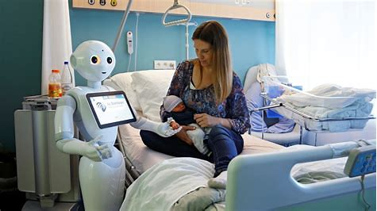
Notes:
https://go.beckershospitalreview.com/virtual-care-solutions-in-action-rise-of-the-virtual-nurse?utm_campaign=Lenovo_Webinar_2.28.2019&utm_source=etextad

Slide 45
Virtual Assistants for your EHR
Nuance Communications released its Dragon Medical Virtual Assistant to help health care providers interact with clinical workflows using AI conversations.
It integrates into EPIC EHR.
Physicians can use the virtual assistant to ask for information from a patient's chart, retrieve labs, medication lists, and visit summaries using Epic Haiku.
Amazon Alexa and Microsoft also are working on similar products
Notes:
https://www.advisory.com/research/health-care-it-advisor/it-forefront/2018/07/virtual-assistants?WT.mc_id=Email|DailyBriefing+Headline|DBABBlog|DBA|DB|2018Aug29|BTestDB2018Aug29||||&elq_cid=1456327&x_id=003C000001JkTyfIAF

Slide 46
Discrete Data Fields no longer a necessity?
Up to 80% of EMR documentation is ‘free script’ or pdf files. Not in discrete data fields.
Natural Language Processing (NLP)—one example from Nuance by Microsoft
https://youtu.be/qm1PSXXEYLw
A device on the wall of the exam room that uses AI and natural language processing
Notes:
Schedule a restaurant reservation or hair appointment: https://ai.googleblog.com/2018/05/duplex-ai-system-for-natural-conversation.html
https://www.youtube.com/watch?v=Q-cGhjzJkpI

Slide 47
Health Administration-’Digital Employee’
CrossChx is using its AI-assisted automation tool called Olive in a partnership with a health system in Georgia.
Olive is called a “digital employee” which automates:
order management
Eligibility
prior authorizations
claims processing
By logging into EHRs and other existing technology, Olive can automate more than 35 administrative processes (billing cycle reduced from 30 days to 3 days)
Notes:
http://www.managedhealthcareexecutive.com/mhe-articles/how-health-systems-are-using-ai-and-future-predictions?rememberme=1&elq_mid=3017&elq_cid=357103

Slide 48
"When the other person speaks, you'll hear the translation right in your ear."
Google is also highlighting that Pixel phone owners will exclusively be able get real-time translation with Pixel Buds and Google Translate. "Your earphones hear you and your Pixel's speaker will play the translation in another language," the press release states.

Slide 49
Challenges--COST
Unclear: average cost of developing, testing, certifying, and implementing, maintaining, upgrading, eliminating
How do we measure ROI?
Notes:
https://www.advisory.com/research/health-care-it-advisor/it-forefront/2018/03/artificial-intelligence-challenges?WT.mc_id=Email|DailyBriefing+Headline|DBABBlog|DBA|DB|2018Mar15|FinalDB2018Mar15||||&elq_cid=1456327&x_id=003C000001JkTyfIAF

Slide 50
Challenges-WORKFLOW
AI needs to be intuitive, not disruptive.
How do we integrate external processes in our EHR?
Notes:
AI assistants may require new concepts in EHR user interface design

Slide 51
Challenges- Competing priorities
"EHR fatigue“
new regulatory mandates
population health management
margin management, etc.
Where will the time and money to focus on AI come from?

Slide 52
Challenges-Staff Resistance
Skepticism that AI technologies can replace human decision-making, even for narrowly targeted tasks.
Fear of irrelevance, job loss, devaluation of their skills

Slide 53
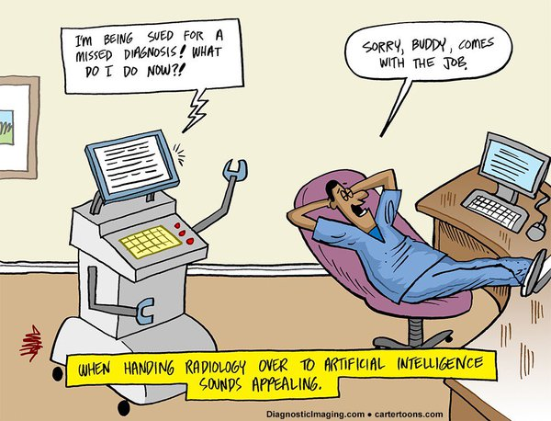

Slide 54
Legal Challenges-Liability
How do we deal with algorithms that produce unethical responses, or worse, lead to patient harm?
Concerns with data privacy
AI will be vulnerable to security threats or hacking

Slide 55
Cautions from experts
We can’t rush in health care. We need thorough testing and regulation. The wrong algorithm could actually kill someone.
Will people and industry wait for it?
Hackers
Deepfakes—video/audio that seems very real, but is fake.
Animated photos and deep fakes
Is this really Tom Cruise?
Notes:
https://www.medscape.com/viewarticle/897350
https://med.stanford.edu/presence/initiatives/hiai-symposium.html
https://www.nytimes.com/2019/03/21/science/health-medicine-artificial-intelligence.html?emc=edit_th_190325&nl=todaysheadlines&nlid=700735660325
https://www.cnn.com/2019/02/18/tech/dangerous-ai-text-generator/index.html
No, Tom Cruise isn't on TikTok. It's a deepfake https://www.cnn.com/videos/business/2021/03/02/tom-cruise-tiktok-deepfake-orig.cnn-business
https://www.cnn.com/videos/business/2021/03/02/myheritage-nostalgia-old-photo-animation-orig.cnn-business

Slide 57
AI will be expected, assumed, and invisible
diagnostic support systems
knowledge discovery systems
advanced analytics
More focus on the relationship between the patient and the physician
Notes:
https://www.beckershospitalreview.com/more-than-a-buzzword-how-ai-can-deliver-real-world-value-and-put-the-human-touch-back-in-healthcare.html?oly_enc_id=9029B2668090F4S

Slide 58
Ways to approach AI
1. Is this a problem that AI can help solve?
2. Do we have ample, good quality data?
3. What are the costs/benefits?
4. What are the risks?
(financial, ethical, legal, patient safety, employee resistance, etc.)
5. Who will decide?
6. What is the timeline?
7. What resources will be needed short term and long term?

Slide 59
Notes:
https://twitter.com/bill_gross/status/955826365516976128
Rate of adaptation
“Everything that will make our lives more efficient, simpler, and is easy to use will be used, and change will happen fast.” Think of how quickly we went from paper maps to GPS, or the transition to smart phones.

Slide 60
SUMMARY
Your day jobs are not at risk
Not yet (? 10 years)
Learn to separate hype from real possibilities
Don’t ignore the potential and disruption of innovations
Educate yourself
Notes:
Artificial intelligence and deep learning are entering the mainstream of clinical medicine. This technology can augment human intelligence to improve decision making and operational processes. Physicians need to actively engage to adapt their practice and to shape the technology.
https://jamanetwork.com/journals/jama/fullarticle/2701665?utm_source=silverchair&utm_medium=email&utm_campaign=article_alert-jama&utm_content=etoc&utm_term=091818
Hotel Workers Fret Over a New Rival: Alexa at the Front Desk https://www.nytimes.com/2018/09/24/business/economy/hotel-workers-ai-technology-alexa.html?emc=edit_th_180925&nl=todaysheadlines&nlid=700735660925

Slide 61
Thank you for your attention!

