Slide 1
Systematic Assessment of Student Performance on Entrustable Professional Activities
Anthony Dambro, MD, FAAFP
Alyssa Anderson, MD
Nora Callinan, MD
Makenna Brezitski, MS IV
Penn State College of Medicine

Slide 2
Disclosures
None

Slide 3
Learning Objectives
On completion of this session the participants should be able to...
Identify gaps in assessment of learners at their home institution
Assess learners using the EPA framework
Draft a framework for systematic assessment at their home institution including a POC tool.

Slide 4
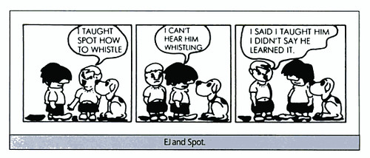
Creative Commons https://www.flickr.com/photos/teachandlearn/3792277913
Traditional Model
Structure/Process
Time
Competency Based Education
OUTCOMES
Patient Safety
Cost

Slide 5
AAMC Entrustable Professional Activities
13 discrete activities/tasks that a graduating medical student should be able to independently perform upon medical school graduation

Slide 6
AAMC EPAs
EPA | Name
EPA 1 | Gather a History and Perform a Physical Exam
EPA 2 | Prioritize a Differential Diagnosis
EPA 3 | Recommend and Interpret Common Diagnostic and Screening Tests
EPA 4 | Enter and Discuss Orders and Prescriptions
EPA 5 | Document a Clinical Encounter in the Patient Record
EPA 6 | Provide an Oral Presentation of a Clinical Encounter
EPA 7 | Form Clinical Questions and Retrieve to Advance Patient Care
EPA 8 | Give or Receive a Patient Handover to Transition Care Responsibly
EPA 9 | Collaborate as a Member of an Interprofessional Team
EPA 10 | Recognize a Patient Requiring Urgent or Emergent Care and Initiate Evaluation and Management
EPA 11 | Obtain Informed Consent for Tests and/or Procedures
EPA 12 | Perform General Procedures of a Physician
EPA 13 | System Failures and Culture of Safety

Slide 7
Assessment of EPAs: Entrustment Scales
2 Entrustment Scales AAMC Recommends: Ottawa & Chen
PSCOM: Used modified Ottawa Entrustment Scale for clerkship students
Entrustment Level​ | Description from Preceptor Perspective​
1​ | "I did it"​
2​ | "I talked them through it"​
3​ | "I directed them from time to time"​
4​ | "I was available just in case"​

Slide 8
Family Medicine Clerkship EPA Assessment
EPA​ | Name ​ | Assessment Method​
EPA 1​ | Gather a History and Perform a Physical Exam​ | Workplace-based assessments (WBA)​
EPA 2​ | Prioritize a Differential Diagnosis​ | WBA, Illness script, SOAP-V note, clinical reasoning cases​
EPA 3​ | Recommend and Interpret Common Diagnostic and Screening Tests​ | WBA​
EPA 4​ | Enter and Discuss Orders and Prescriptions​ | WBA​
EPA 5​ | Document a Clinical Encounter in the Patient Record​ | WBA, SOAP-V note​
EPA 6​ | Provide an Oral Presentation of a Clinical Encounter​ | WBA​
EPA 7​ | Form Clinical Questions and Retrieve to Advance Patient Care​ | EBM exercise (PICO)​
EPA 8​ | Give or Receive a Patient Handover to Transition Care Responsibly​ | Transition of Care assignment (TOC)​
EPA 9​ | Collaborate as a Member of an Interprofessional Team​ | WBA, IPE-TOC​
EPA 10​ | Recognize a Patient Requiring Urgent or Emergent Care and Initiate Evaluation and Management​ | (WBA)​
EPA 11​ | Obtain Informed Consent for Tests and/or Procedures​ | N/A​
EPA 12​ | Perform General Procedures of a Physician​ | N/A​
EPA 13​ | System Failures and Culture of Safety​ | IPE-TOC​

Slide 9
Rubrics for each assignment
Overall clerkship assessment based on preceptor feedback, SOAP note, written illness script, and PICO based question
SOAP note focused on performing and writing an accurate and concise history and physical
Illness script helped us strengthen our knowledge of a condition and associated diagnoses
PICO based question utilized critical thinking skills to investigate a clinical question and provide research based recommendations
Multiple ways of assessing students over different domains giving an all-encompassing review of our skills

Slide 10
Workplace Based Assessment (WBA)
Survey software linked to individual QR code/link
Training provided to faculty, residents and students on how to use the software
The ASK:
Provide feedback to learner each time you work with them.
No less than 2x/week

Slide 11
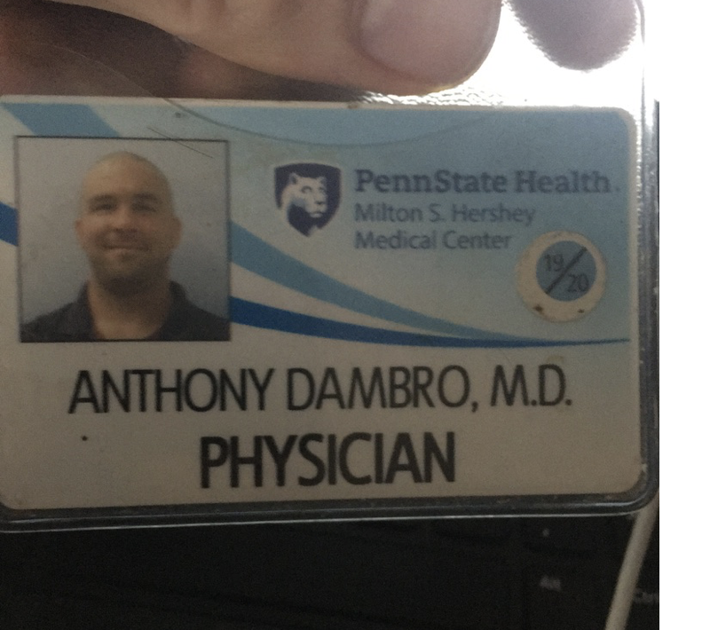
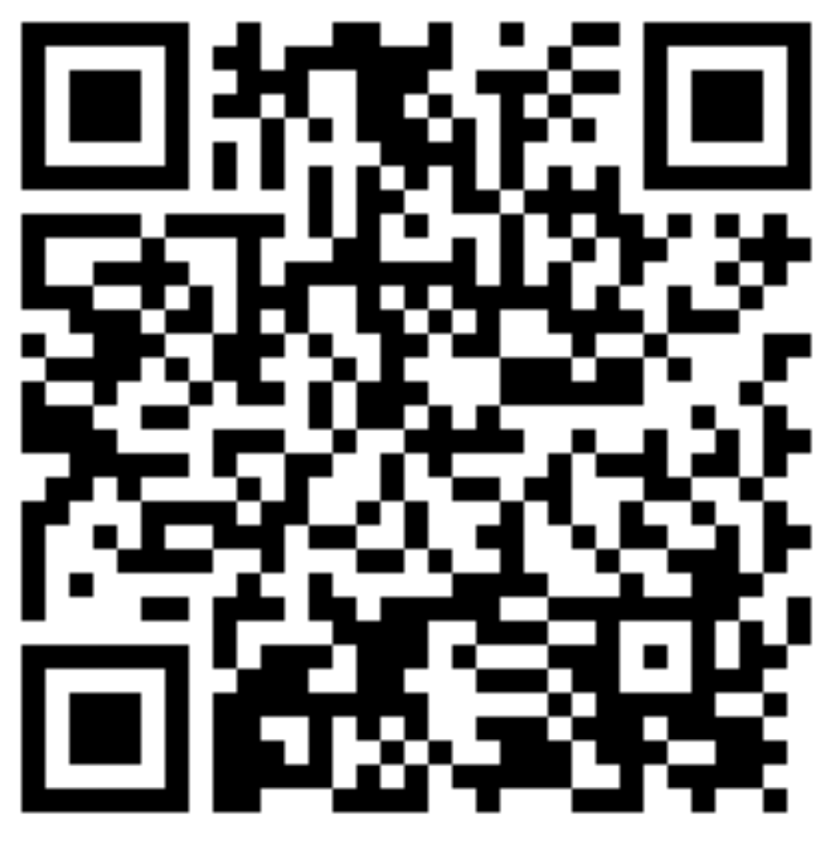

Slide 12
Family Medicine Clerkship WBA Assessment
EPA | Name
EPA 1 | Gather a History and Perform a Physical Exam
EPA 2 | Prioritize a Differential Diagnosis
EPA 3 | Recommend and Interpret Common Diagnostic and Screening Tests
EPA 4 | Enter and Discuss Orders and Prescriptions
EPA 5 | Document a Clinical Encounter in the Patient Record
EPA 6 | Provide an Oral Presentation of a Clinical Encounter
EPA 7 | Form Clinical Questions and Retrieve to Advance Patient Care
EPA 8 | Give or Receive a Patient Handover to Transition Care Responsibly
EPA 9 | Collaborate as a Member of an Interprofessional Team
EPA 10 | Recognize a Patient Requiring Urgent or Emergent Care and Initiate Evaluation and Management
EPA 11 | Obtain Informed Consent for Tests and/or Procedures
EPA 12 | Perform General Procedures of a Physician
EPA 13 | System Failures and Culture of Safety

Slide 13
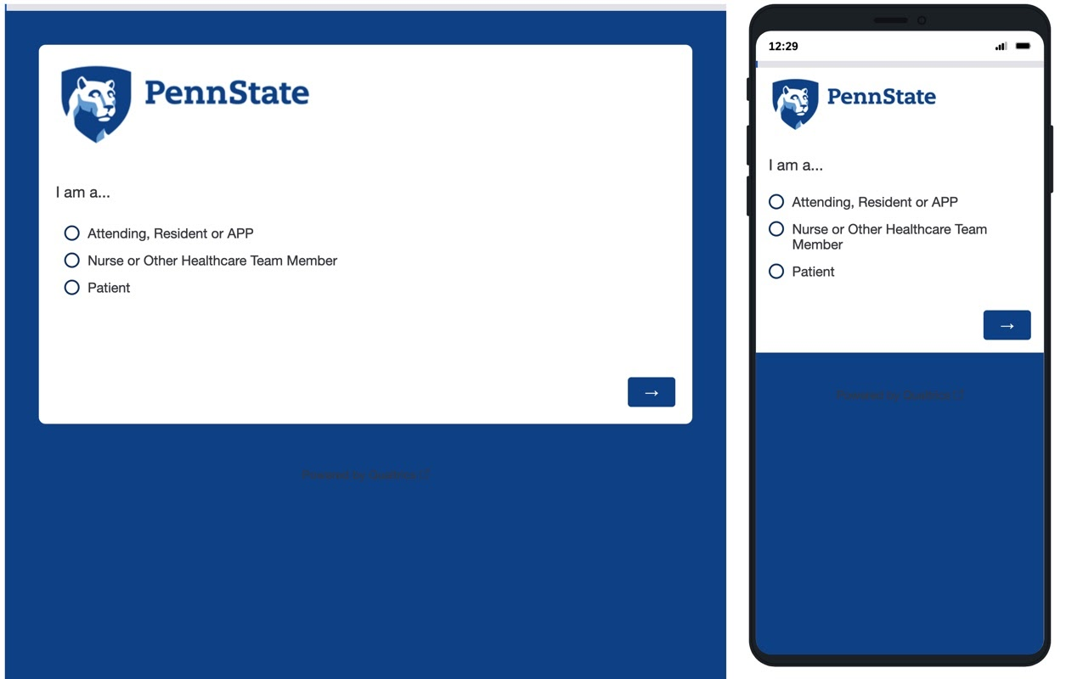

Slide 14
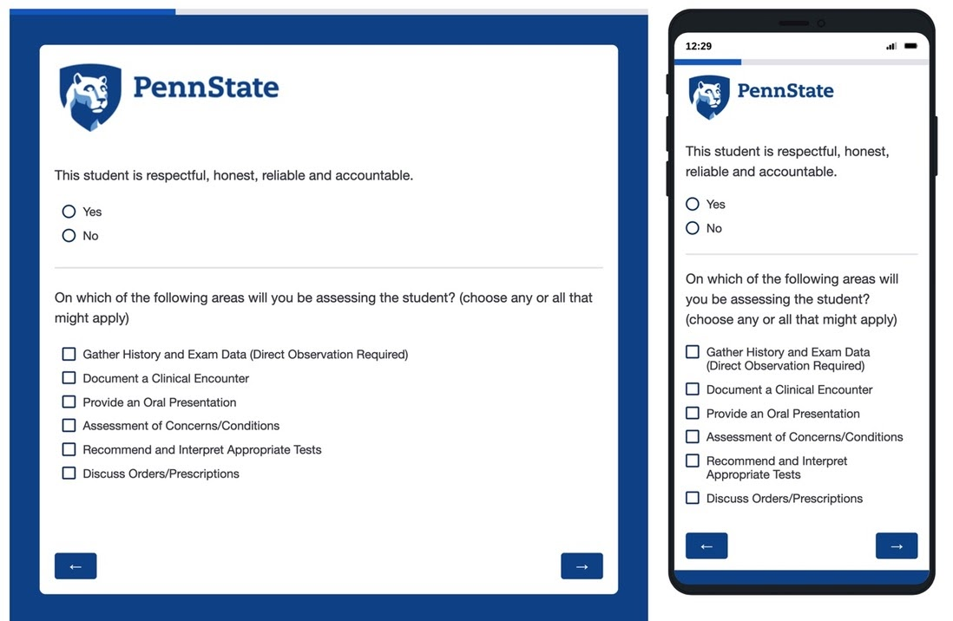

Slide 15
Gather History and Exam Data
Prepared for a patient encounter by reviewing the chart in advance (e.g. PMHX, SurgHx, Meds, etc)
Selects an appropriate strategy for the encounter (complete H&P vs focused/acute)
History is hypothesis driven and relevant to the chief complaint
Uses open ended questions and reflective listening techniques
Exam proceeds in an organized fashion and components are relevant to the chief complaint
Exam techniques are performed correctly
Pays attention to patient comfort and modesty

Slide 16
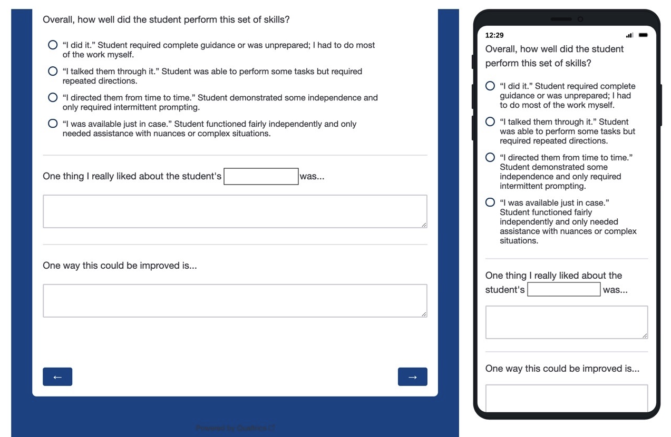

Slide 17
Assessor reaction to WBA
55 respondents
49 Faculty/Residents/APPs
5 patients
1 nursing/ancillary staff
75 % (41/55) perceived spending 6 mins or less
27% (11/41) rated less than 2 min

Slide 18
Assessor reaction to WBA
Ease of use
Strongly agree or agree: 87% (48/55)
Ease of access
96% (53/55)
Able to provide quality feedback
91% (50/55)

Slide 19
"How has this changed your approach to feedback?"
Documentation of feedback: 6/37
Promotes timely/in-moment feedback: 9/37
Improved content of feedback: 6/37
18/55 left no comment whatsoever (n=37)
No change or N/A (11/37)

Slide 20
"How has this changed student behavior?"
Promoted proactive feedback-seeking: 5/37
Students responding to feedback: 4/37
18/55 left no comment whatsoever (n=37)
No change or N/A (26/37)

Slide 21
Site director reaction
Advantages
Limitations
Preceptor/resident hesitancy to be honest about opportunities for improvement (larger issue)
Students may be hesitant or 'feel like a bother' asking for feedback frequently
Clear expectation and venue for timely feedback
Puts some responsibility in student's hand to ask for feedback
Thorough and allows for patients to evaluate students
Site director able to give more specific midway/final feedback, even when limited direct interaction with student
Residency selection​
Wider application of this tool could be useful in the future for evaluating applicants for residency​

Slide 22
Student reaction
Advantages
Real-time feedback allowed changes to be implemented during the rotation
Able to track progress throughout clerkship
Compiled report of feedback --> consensus of strengths/weaknesses
Allows for development of personalized improvement plans based on our assigned entrustment level
60 student responses
63.3% thought the report was easy to use, 71.6% said easy to access
60% of students thought the WBA provided quality feedback

Slide 23
Student reaction
Limitations
Provider dependent
Particularly in relation to timeliness and thoroughness of feedback
Additional "evaluation" task for preceptors to complete
Student engagement with seeking feedback may vary
Report populates as a lengthy PDF that requires scrolling through
Residency selection
May provide indices of performance for residencies to assess potential candidates
May be advantageous given recent USMLE Step 1 moving to P/F

Slide 24
What's next?
Dean's Letter/MSPE summaries
Continued Faculty development on improving narrative feedback
Further engagement of patients/nursing/staff
Improve tool through IT support
Better report functionality
Metadata

Slide 25
Discussion and Questions

Slide 26
Evaluation
Please be sure to complete an evaluation for this presentation.

Slide 27
Systematic Assessment of Student Performance on Entrustable Professional Activities
Anthony Dambro, MD, FAAFP
Alyssa Anderson, MD
Nora Callinan, MD
Makenna Brezitski, MS IV
Penn State College of Medicine

