Slide 1
Osteopathic Manipulative Treatment for the Allopathic Resident Elective: Does it change practice after graduation?
Andrew H. Slattengren, DO, FAAFP
Tanner Nissly, DO
University of Minnesota Medical School
Department of Family Medicine and Community Health
North Memorial Family Medicine Residency Program

Slide 2
Objectives:
At the conclusion of this session, the learner will be able to:
Briefly describe the current evidence regarding Osteopathic Manipulation Treatment (OMT) for the Allopathic Resident elective rotations.
Explain how practicing Family Physicians who completed an OMT for the Allopathic Resident elective rotation during their residency training differ in their management of patients who present to their practice with low back pain.
Consider how they can implement an OMT elective at their program to improve the care of patients presenting with back pain.

Slide 3
Disclosures
Financial support for research on “Osteopathic Manipulation for the MD Resident” has been provided through a University of Minnesota Department of Family Medicine and Community Health Education Support Grant.
The University of Minnesota Institutional Review Board determined that the study met the criteria for exemption from IRB review.

Slide 4
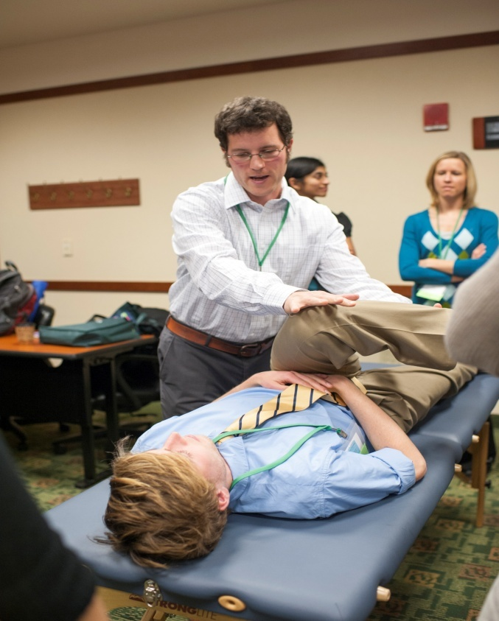
OMT for the Allopathic Resident Elective
Engages the resident in the basic tenets of Osteopathic Medicine with special interaction in OMT
Educational opportunities
Hands-on patient demonstrations
Care of patients in the outpatient setting
Formal didactic teaching
1:1 OMT session with faculty
Structured literature review

Slide 5
Background
OMT is an intervention shown to decrease pain, improve disability scores and increase satisfaction with care in patients who present with back pain (1)
Allopathic Family Medicine residents are interested in OMT training and interest in OMT increases with exposure (2)

Slide 6
Background
Implementing an elective curriculum is a feasible way to improve attitudes and confidence in OMT for MDs in a Family Medicine residency (3)
Allopathic Family Medicine residents can learn OMT in an elective rotation (4)

Slide 7
Unknown
Will MDs continue to incorporate OMT into the care they provide once they graduate from their residency programs?

Slide 8
Methods
North Memorial Family Medicine Graduates 2013-2019
Qualtrics survey link within an email invitation sent in 2020
Comfort with caring for patients with back pain
Physical exam
Creation of treatment plans
OMT use
Referrals for spinal manipulation
The University of Minnesota Institutional Review Board determined that the study med the criteria for exemption from IRB review

Slide 9
Results
62% (42/68) emailed graduates completed the survey
5 DO graduates who responded were removed from the data analysis
27 MDs had completed the OMT for MD Elective
10 MDs did not complete the OMT for MD Elective

Slide 10
Provide OMT care
Completed OMT for MD Elective: 67%
Comfort Score 34.0 (SD 21.0)
Did not Complete OMT for MD Elective: 50%
Comfort Score 22.6 (SD 32.7)

Slide 11
Regularly refer to a DO provider
Completed OMT for MD Elective: 66%
Did not Complete OMT for MD Elective: 40%

Slide 12
Performing Physical Exam on Patients Presenting with Back Pain
Completed OMT for MD Elective
Comfort Score 80.9 (SD 19.3)
Did not Complete OMT for MD Elective
Comfort Score 78.7 (SD 13.1)

Slide 13
Most Common Barrier to OMT Care
Limited number of DOs (62%)

Slide 14
Conclusions
Allopathic Family Medicine Residents who completed an elective rotation in OMT have a slight increase in frequency of referring to DOs after graduating.
They also have a meaningful increase in comfort performing OMT on their patients who present with back pain when compared to peers who did not complete an OMT elective rotation.

Slide 15
Conclusions
With the limited number of DOs being a common barrier to OMT care, more widely implemented training in OMT for allopathic Family Medicine residents may be a reasonable intervention to improve the care of patients presenting with back pain.

Slide 16
References
1. Slattengren AH, Nissly T, Blustin J, Bader A, Westfall E. Best uses of osteopathic manipulation. J Fam Pract. 2017;66(12).
2. Turnbull J, Merck D, MacMillan K. Introducing Osteopathic Curriculum for Family Medicine Physicians in a Community-based Allopathic Residency Program. Spartan Med Res J. 2019;4(1).
3. Dubey J, James S, Zakletskaia L. Osteopathic manipulative treatment (OMT) for MDs: piloting a longitudinal curriculum. J Osteopath Med. 2021;0(0). doi:10.1515/jom-2020-0038
4. James D. Leiber. Allopathic Family Medicine Residents Can Learn Osteopathic Manipulation Techniques in a 1-month Elective. Fam Med. 2005;37(10):693-695. www.nbome.org. Accessed May 20, 2020.

Slide 17
Questions? aslatten@umn.edu @broadwaydo

