Slide 1
Why Is Being Black More Dangerous Than Smoking?
Rethinking How We Teach Social Determinants of Health

Slide 2
Integrating Social Determinants of Health into Biomedical Curricula
Kamal Mohiuddin, MD & Bonzo Reddick, MD
STFM MSE 2020

Slide 3
Race-Based Medical Decision Making
Cardiovascular Disease
Hypertension
GFR
Spirometry

Slide 4
1. Cardiovascular Disease/ASCVD Module

Slide 5
SAMPLE CASES
S: 40-year-old male here for annual physical without any complaints.
O: BP 131/81, P 86, BMI 30.1
Total chol 203, HDL 39, LDL 126
Fasting glucose 101
A/P: CV risk?
ASCVD risk 1.7%
S: 40-year-old male here for annual physical without any complaints.
O: BP 118/80, P 58, BMI 23.29
Total chol 183, HDL 81, LDL 85
Fasting glucose 80
A/P: CV risk?
ASCVD risk 2.3%

Slide 6
SAMPLE CASES
S: 40-year-old male here for annual physical without any complaints.
O: BP 118/80, P 58, BMI 23.29
Total chol 183, HDL 81, LDL 85
Fasting glucose 80
A/P: CV risk?
ASCVD risk 0.4%
S: 40-year-old male here for annual physical without any complaints.
O: BP 118/80, P 58, BMI 23.29
Total chol 183, HDL 81, LDL 85
Fasting glucose 80
A/P: CV risk?
ASCVD risk 2.3%

Slide 7
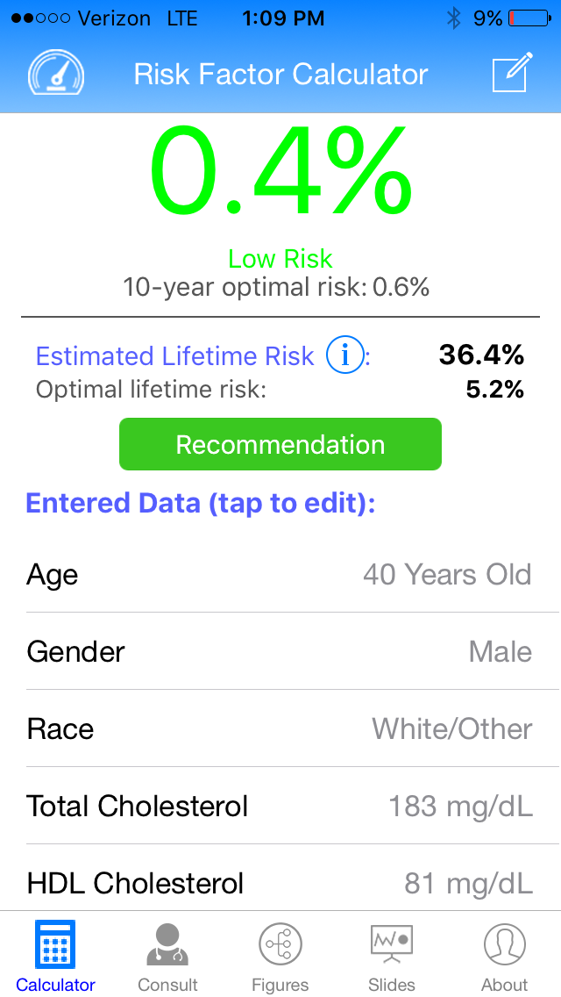

Slide 8
What if White Bonzo started smoking?
White/smoking Bonzo
Black/non-smoking Bonzo

Slide 9
Is being Black more dangerous than smoking?

Slide 10
Why does being Black raise CV risk?

Slide 11
How do you explain racial differences in health outcomes?
Innate biological differences
Mostly social factors
A combination of both

Slide 12
WHAT WE CAN DO
KNOWLEDGE (literature & experiential)
ATTITUDES (cultural sensitivity & awareness)
SKILLS (cross cultural approach, cultural humility)
Notes:
3 conceptual approaches from IOM

Slide 13
2. Hypertension Module

Slide 14
WHAT WE CAN DO
KNOWLEDGE (literature & experiential)
ATTITUDES (cultural sensitivity & awareness)
SKILLS (cross cultural approach, cultural humility)
Notes:
3 conceptual approaches from IOM

Slide 15
Why do black patients have worse HTN?
Not just higher incidence
Earlier onset
Greater related end-organ damage
Common answers given in medical schools: Renin-angiotensin system, salt sensitivity, abnormal diurnal BP variation

Slide 16
American Heart Association (AHA)¹
Poor BP control in hypertensive blacks is linked to non-physiologic factors:
high stress levels
diet (low K+ intake, consume more calories)
lifestyle (less physically active)
medication nonadherence (including lower health literacy & concerns about adverse effects of HTN meds)
Even biological differences between races are caused by social factors (not genetics!).

Slide 17
American Heart Association (AHA)¹
Biological differences in HTN for blacks:
Abnormal diurnal BP variation
Renin-angiotensin system
Salt sensitivity

Slide 18
AHA – Racial Differences in HTN¹
Abnormal Diurnal BP Variation (more “nondipping” of BP at night)
Corrects with increased potassium intake & lower sodium intake
Renin-Angiotensin System
Urban legend that RAS system is less active in blacks than in whites
Variation is much larger within racial/ethnic groups than between them
Black vs. white differences in studies linked to high dietary sodium intake
Notes:
“long held & erroneous conclusion

Slide 19
AHA – Racial Differences in HTN¹ ^{(continued)}
Salt Sensitivity
Reversible phenotype linked to obesity in both blacks & whites
Obstructive Sleep Apnea
Increased apnea-hypopnea index
Obesity is more common in blacks than in whites

Slide 20
3. Kidney Disease Module
Black patients have higher rates of chronic kidney disease
Worse outcomes (more likely to end up on dialysis)
Less likely to receive a kidney transplant

Slide 21
WHAT WE CAN DO
KNOWLEDGE (literature & experiential)
ATTITUDES (cultural sensitivity & awareness)
SKILLS (cross cultural approach, cultural humility)
Notes:
3 conceptual approaches from IOM

Slide 22
CASE #1
S: 45-year-old male with long history of untreated HTN comes in to discuss medication. He was encouraged to take BP meds for the last few years but did not want to. Now he has agreed to pharmacotherapy.
O: BP 155/98, P 79, BMI 38
CVS – S1,S2,RRR, no m/r/g
Labs – creat 1.59, GFR 52 (similar to previous check 7-8 months ago)
A/P: ???

Slide 23
Example #1 – GFR²
Notes:
Creative Commons

Slide 24
CASE #1
S: 45-year-old male with long history of untreated HTN comes in to discuss medication. He was encouraged to take BP meds for the last few years but did not want to. Now he has agreed to pharmacotherapy.
O: BP 155/98, P 79, BMI 38
CVS – S1,S2,RRR, no m/r/g
Labs – GFR 52 (similar to previous check 7-8 months ago)
A/P: ???

Slide 25
JNC 8 Guidelines³
Patient has chronic kidney disease (CKD)
ACE-I or ARB preferred to delay progression to end-stage renal disease (ESRD)
Resident physicians also recommended: 25-OH vit D level, PTH, CBC, Ca++ & Phos levels, renal ultrasound (and some recommended Nephrology referral)

Slide 26
CASE #1 – revised
S: 45-year-old male with long history of untreated HTN comes in to discuss medication. He was encouraged to take BP meds for the last few years but did not want to. Now he has agreed to pharmacotherapy.
O: BP 155/98, P 79, BMI 38
CVS – S1,S2,RRR, no m/r/g
Labs – GFR >60 (similar to previous check 7-8 months ago)
A/P: ???

Slide 27
Back to Our Case (continued)
Creatinine value of 1.59 is “normal” for black male (GFR >60), but consistent with stage 3 CKD for a while male (GFR 52).

Slide 28
“I have more muscle mass than this guy!”
https://framednetwork.com/ill-be-back-from-a-young-weightlifter-to-an-olympic-heavyweight-and-beyond/
Racial differences…⁴⁻⁶
Higher serum creatinine values
Higher appendicular skeletal muscle mass?
Adjustment for “nutritional status” (albumin, transferrin, glucose, predialysis BUN)
Variation between AND within groups
Notes:
5. self-report; all grandparents required to be non-Hispanic (148 women, 136 men) 6. A whopping 79 PEOPLE IN STUDY!!!

Slide 29
GFR⁷
“Current equations used to define CKD may systematically miss a high-risk group of blacks at a time in the disease course when interventions are crucial.”

Slide 30
JAMA (2019)⁸
50-year-old woman with creatinine 2.0
White GFR = 28 (GFR <30, Nephrology referral per KDIGO guidelines)
Black GFR = 33
55-year-old woman with creatinine 2.8
White patient = transplant candidate
Black GFR = keep waiting

Slide 31
4. Obstrutcitve Lung Disease Module (SPIROMETRY)

Slide 32
WHAT WE CAN DO
KNOWLEDGE (literature & experiential)
ATTITUDES (cultural sensitivity & awareness)
SKILLS (cross cultural approach, cultural humility)
Notes:
3 conceptual approaches from IOM

Slide 33
4. Obstrutcitve Lung Disease Module SPIROMETRY^{9,10}
Systematic review of studies on spirometry
Only 17.3% of studies actually defined race and/or ethnicity
94% of articles failed to examine socioeconomic status
23.1% cited explanations of environmental & social factors

Slide 34
Project HOPE (Cincinnati)¹¹
Housing code violations (e.g., presence of mold & cockroaches)
Density of housing units
Explained 22% of asthma-related ER visits

Slide 36
Definitions¹
RACE
White
Black/African American
American Indian/Alaska Native
Asian
Native Hawaiian/Pacific Islander
ETHNICITY
Hispanic/Latino
Not Hispanic or Latino

Slide 37
Definitions (continued)^{1,2}
Members of a racial group “have origins in any of the original peoples” of various countries or locations that the racial groups are traditionally identified with.
This Photo by Unknown Author is licensed under CC BY-NC
Notes:
Creative Commons

Slide 38
RACE: Subjective, Social, & Fluid Over Time³
“I’m White” - 1988
“I’m Black” - 1990
This Photo by Unknown Author is licensed under CC BY-SA
This Photo by Unknown Author is licensed under CC BY-SA
Notes:
National Center for Health Statistics (1988 = age 27…1990 = age 29)

Slide 39
Who are the “original peoples” of Asia?
This Photo by Unknown Author is licensed under CC BY-SA
Notes:
http://cebp.aacrjournals.org/content/25/1/16 (incidence of stomach cancer per 100,000: Japan 66.7, Korea 64.6, China Shanghai 26.6, Hong Kong 12.1)

Slide 40
References
Flack JM, Sica DA, Barkis G, et al. Management of high blood pressure in blacks: An update of the International Society on Hypertension in Blacks consensus statement. Hypertension 2010; 56: 780-800.
James PA, Oparil SO, Carter BL, Cushman WC, Dennison-Himmelfarb C, Handler J, et al. 2014 Evidence-Based Guidelines for the Management of High Blood Pressure in Adults: Report from the Panel Members Appointed to the Eighth Joint National Committee (JNC 8). JAMA 2014; 311(5): 507-20.
Peralta CA, Lin F, Shlipak MG, et al. Race differences in prevalence of chronic kidney disease among young adults using creatinine-based glomerular filtration rate-estimating equations. Nephrol Dial Transplant 2010; 25: 3934-9.
Gallagher D, Visser M, De Meersman RE, et al. Appendicular skeletal muscle mass: effects of age, gender, and ethnicity. J Appl Physiol (1985). 1997;83(1):229-239.
Barondess DA, Nelson DA, Schlaen SE. Whole body bone, fat, and lean mass in black and white men. J Bone Miner Res. 1997;12(6):967-971.
Hsu J, Johansen KL, Hsu CY, Kaysen GA, Chertow GM. Higher serum creatinine concentrations in black patients with chronic kidney disease: beyond nutritional status and body composition. Clin J Am Soc Nephrol. 2008;3(4):992-99.
United States Census Bureau. Available from: https://www.census.gov/topics/population/race/about.html. (last accessed October 4, 2018).
Office of Management and the Budget. Revisions to the standard for the classification of federal data on race and ethnicity. Federal Register 1997; 62: 58781-90.
Hahn RA. The state of federal health statistics on racial and ethnic groups. JAMA 1992; 267(2): 268-71.
Roberts D. The problem with race-based medicine. TEDMED 2015; https://www.ted.com/talks/dorothy_roberts_the_problem_with_race_based_medicine (last accessed June 13, 2019).

