Slide 1
QI Methods Review

Slide 3
QI Tools
Cause and Effect (Fishbone) Diagram (6/29)
Pareto Chart (6/29)
Driver Diagram (7/6)
Run Chart (7/13)
Flow Chart (7/20)

Slide 4
Cause and Effect (Fishbone)
Organizational tool to explore and display the many causes contributing to a certain effect or outcome
Graphically displays relationship of causes to effects and to each other, helping teams identify areas of improvement
Categories: Materials, Methods, Equipment, Environment, People

Slide 5
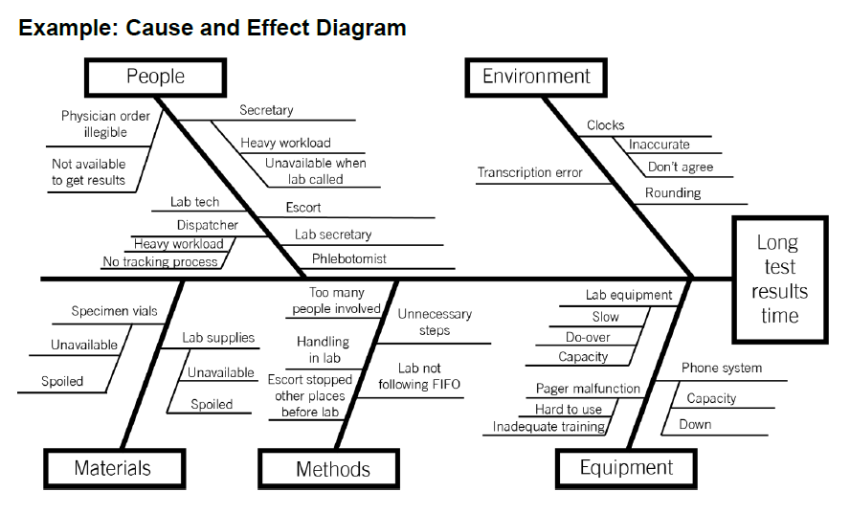
Note: not all categories may apply, choose only the relevant ones

Slide 6
Cause and Effect – take home points
Visualize all the causes contributing to an outcome

Slide 7
CAUSES OF LONG TEST RESULTS TIME
PEOPLE
ENVIRONMENT
Physician
Clocks
Lab tech
Rounding
Secretary
LONG TEST RESULTS TIME
Specimen vials
Lab handling
Slow equipment
Lab supplies
Unnecessary steps
Pager malfunction
Computers
Too many people
Phone system capacity
MATERIALS
METHODS
EQUIPMENT

Slide 8
Pareto Chart
“Pareto principle” – 80/20 rule
Roughly 80% of effect comes from 20% of causes
Arrange all factors that contribute to an effect in order from largest to smallest contribution
“Vital few” (largest contribution) vs “useful many” (important to know about, but relatively small contribution to effect)
Concentrate improvement efforts on factors that have the most impact
Explain rationale for focusing on certain areas and not others
However, "useful many" may have "low hanging fruit" interventions, more feasible and favorable to test, despite small contribution

Slide 9
Pareto Charts _________ The 80:20 Principle
Notes:
Write out the 80:20 rule

Slide 10
Pareto Charts _________ The 80:20 Principle
in any group of factors (x-axis) that contribute to an overall effect (medication error), roughly 80% of the effect comes from 20% of the causes (vital few)
Notes:
Write out the 80:20 rule

Slide 11
Pareto Charts _________ The 80:20 Principle
in any group of factors (x-axis) that contribute to an overall effect (medication error), roughly 80% of the effect comes from 20% of the causes (vital few)

Slide 13
Pareto chart – take home points
80% of the effect comes from 20% of the causes
Helps to identify high impact interventions and predict their effects
Provides rationale for your focus areas
Remember that "trivial many" may have low hanging fruit worth considering

Slide 14
Driver Diagram
Visual display of team’s theory of what ‘drives’ / contributes to the achievement of a project aim.
Used to communicate with stakeholders what the team is testing and working on
Shows relationship between Aim, Key/Primary Drivers, Secondary Drivers (components of primary drivers) and specific change ideas to test for each secondary driver

Slide 15
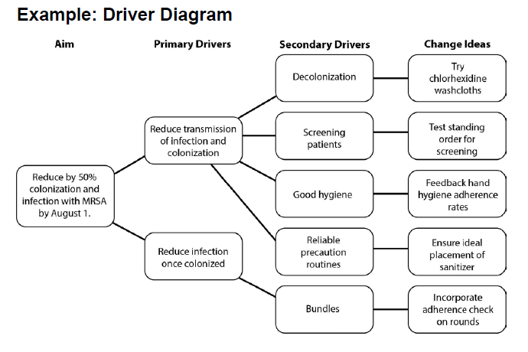

Slide 16
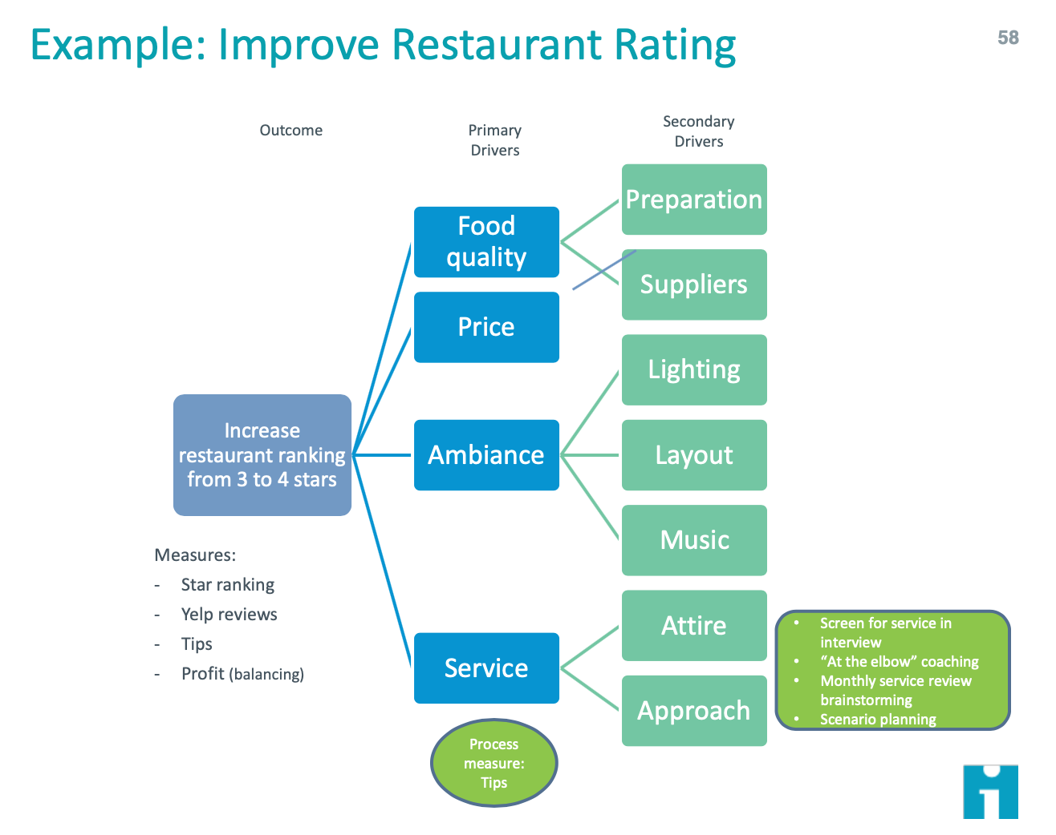

Slide 19
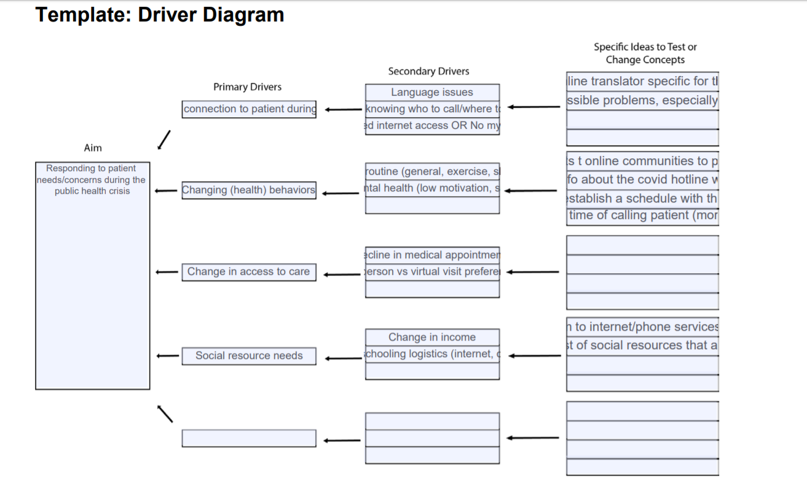

Slide 20
SECONDARY DRIVERS
CHANGE IDEAS
PRIMARY DRIVERS
Text here
Text here
Text here
Text here
Text here
Text here
Text here
AIM
Text here
Text here
Text here
Text here
Text here
Text here
Text here
Text here
Text here
Text here
Text here
Text here
Text here
Text here

Slide 21
Insert Title of CQI Project
Primary Drivers
Secondary Drivers
Strategies & Opportunities
Global Aim:
Specific Aim:
…
…
….
…
Primary Driver 1…
Measures:
….
……
…..
Primary Driver 2…

Slide 22
Driver Diagram – take home points
Visualize and develop tests of change that are related to specific drivers of an aim
Describes your project on "one piece of paper"

Slide 23
Flow Chart
“Process map” – visual representation of sequence of steps in a process
Understanding current process important to identify ways to improve it
Useful in early phases of improvement work
Boxes = steps; diamonds = decision point
Helps identify steps that cause delay, do not add value, unnecessary work, duplication, breakdown in communication

Slide 24
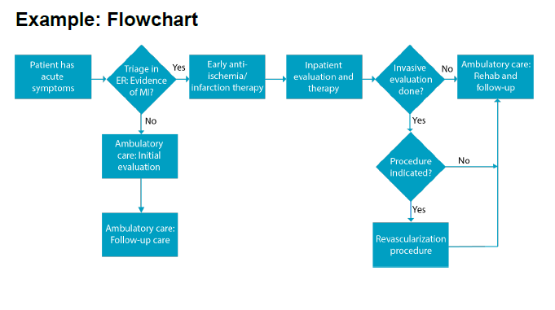

Slide 25
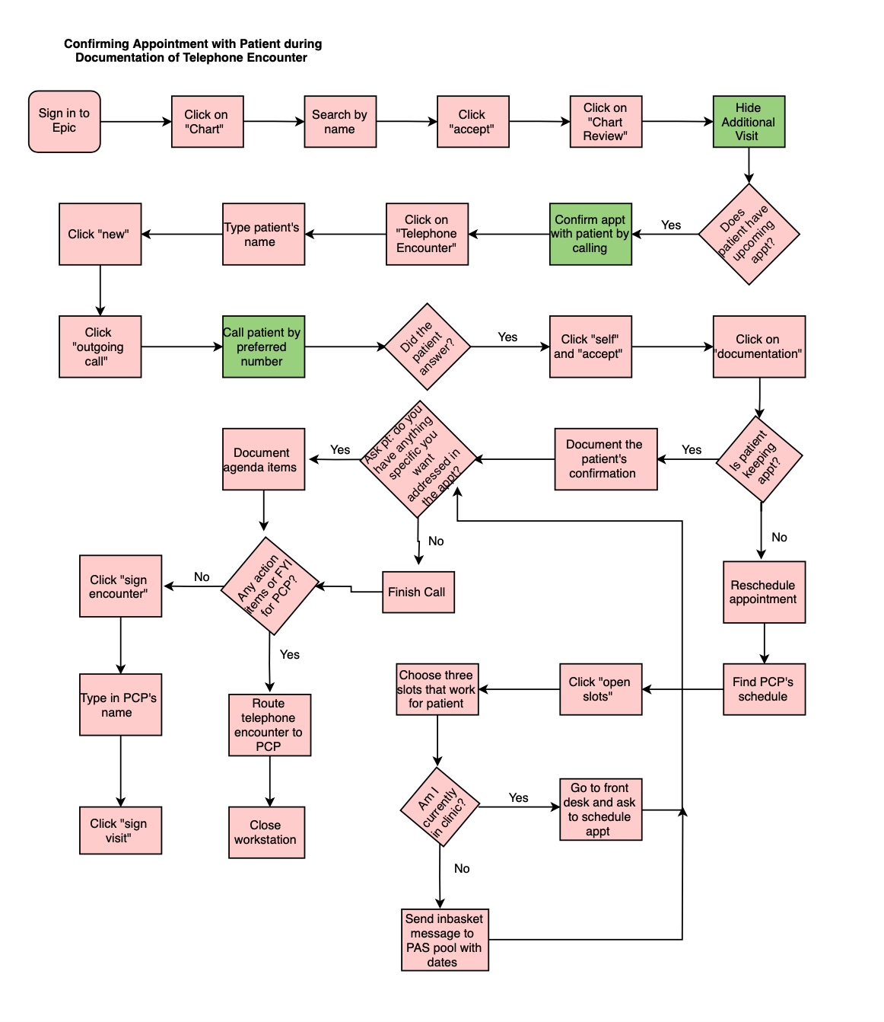

Slide 27
What do Danish Elephants have to do with Diversity and Inclusion?

Slide 28
Flow Chart – take home points
Outlines the steps in the process

Slide 29
Run Chart
Graph of data over time
Helps determine if changes you are making are leading to improvement

Slide 30
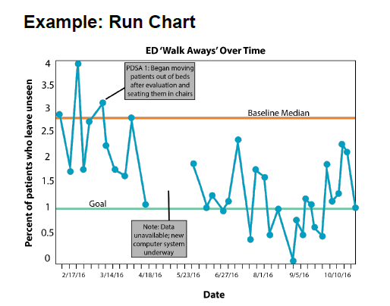

Slide 31
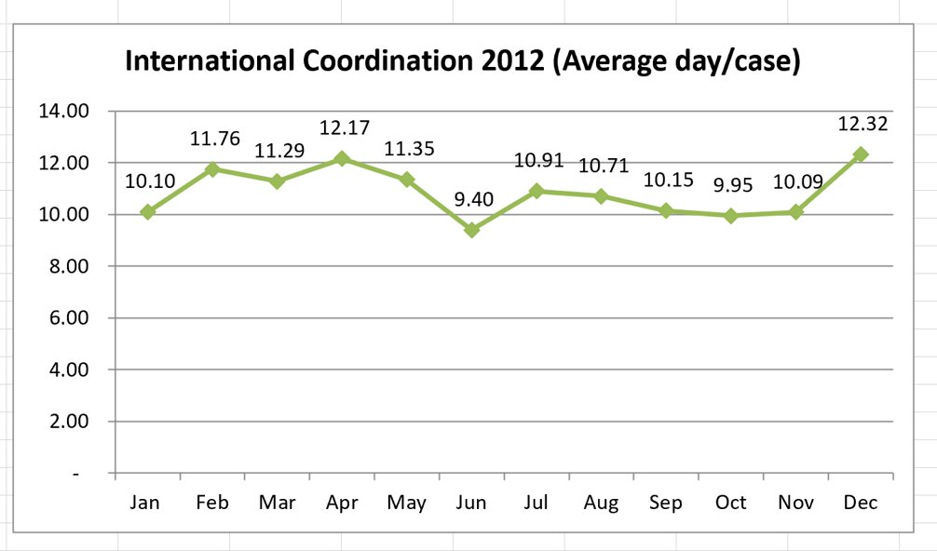
Run chart – data vs. trends
Cycle 1 intervention: response template
Notes: more on run charts later in Studying PDSA cycle.
COVID19 application
Notes:
Linh: raw data tables: 2 things to point out: stratification of data (by account types) + no trends ---> then look at graph.
Look at graph, notice difference in June data point, then again in December data point?
COVID19 application on Google Trends: narrow search to Oregon, mask + social distancing --> notice the difference? What does that tell us about the population of Oregon? What does this mean about social distancing, the hottest topic re: COVID not being the more popular search? What are the possible contributing drivers? (hint to lead into the next discussion).

Slide 32
Notes:
Bar before and after graph = static. Run chart = dynamic, shows how an improvement actually occurred in the presence of the change made between week 7 and 8, then sustained through week 14

Slide 33
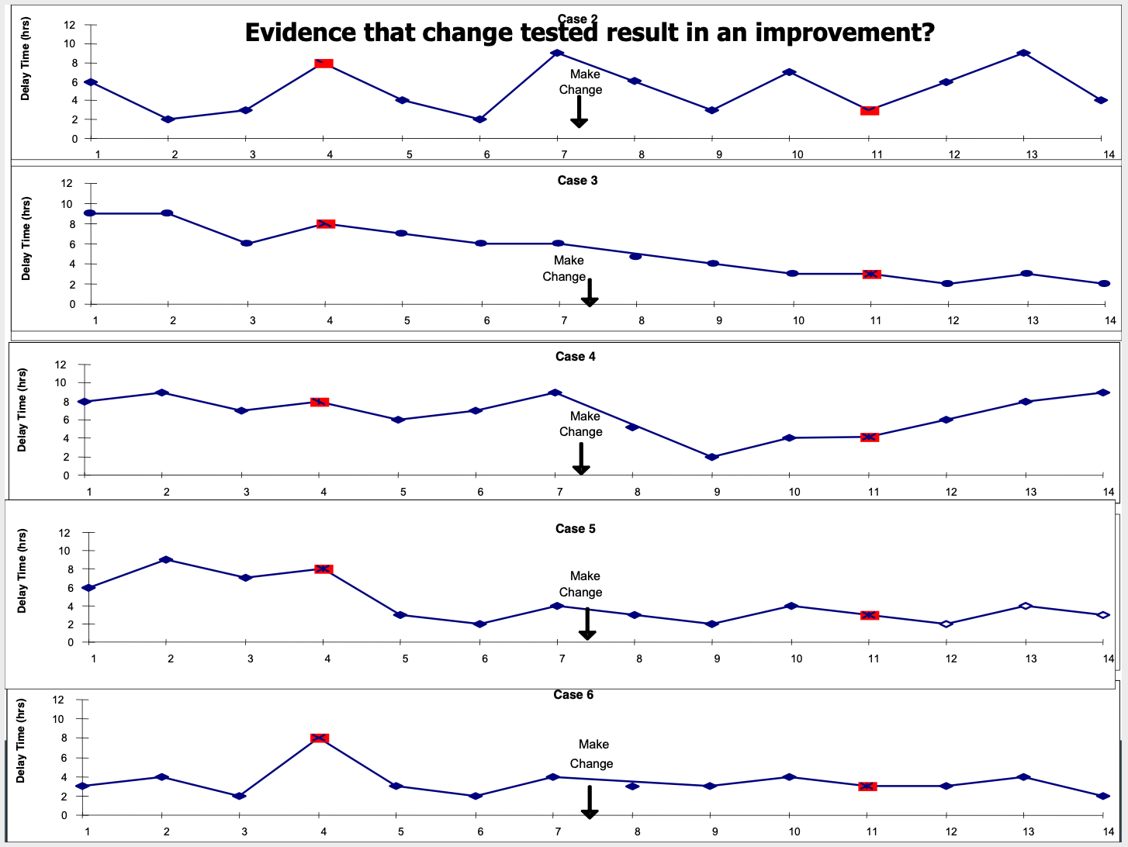
Notes:
5 scenarios – what they all have in common is that week 4 and week 11 are the same (and would have the same bar graph) but what are the different run charts saying about each system and the effect of the change between week 7 and 8?

Slide 34
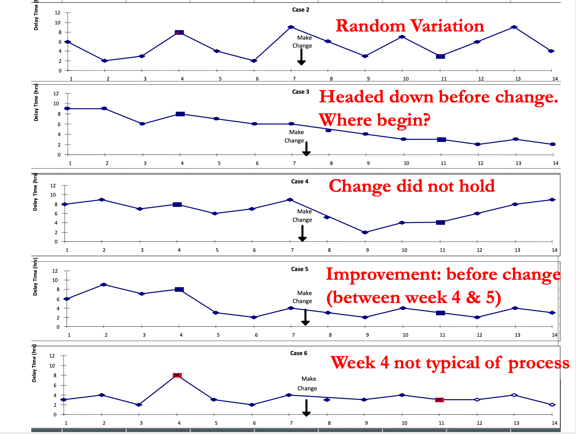
Notes:
Answers

Slide 35
Run chart – take home points
Run chart = tool to show trends
Continuous monitoring of data over time
X-axis = time, y-axis = measure (outcome, process, balancing)

