Slide 1
How can we measure success?
Clinical Outcome Measures for a
Short-term Medical Service Trip
Christine George MD PGY2, Sam Waling DO PGY2, Rameeza Sheriff MD PGY2
Maria Gabriela Castro MD, Associate Professor & Director of Global Health Programs
Sam Matheny MD MPH, Assistant Provost for Global Health Initiatives
University of Kentucky

Slide 2
Disclosure statement
We have no financial interest or affiliation concerning material discussed in this presentation.
Dr. Castro is on the Shoulder to Shoulder Global council and Dr. Matheny is an ex-officio member.

Slide 3
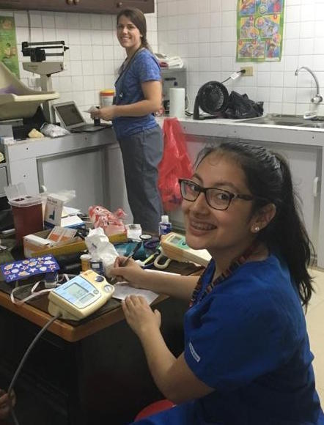
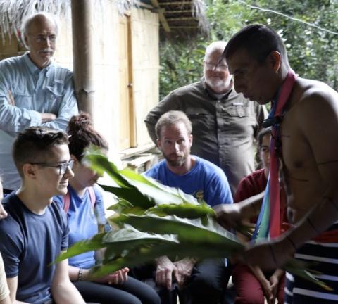
Introduction:
Who benefits from short-term medical service trips to low-resource settings?

Slide 4
Session Objectives
Literature Review
Methods, Analysis, and Clinical Outcomes
Challenges and Limitations
DIY, Develop a plan

Slide 5
Audience Participation

Slide 6
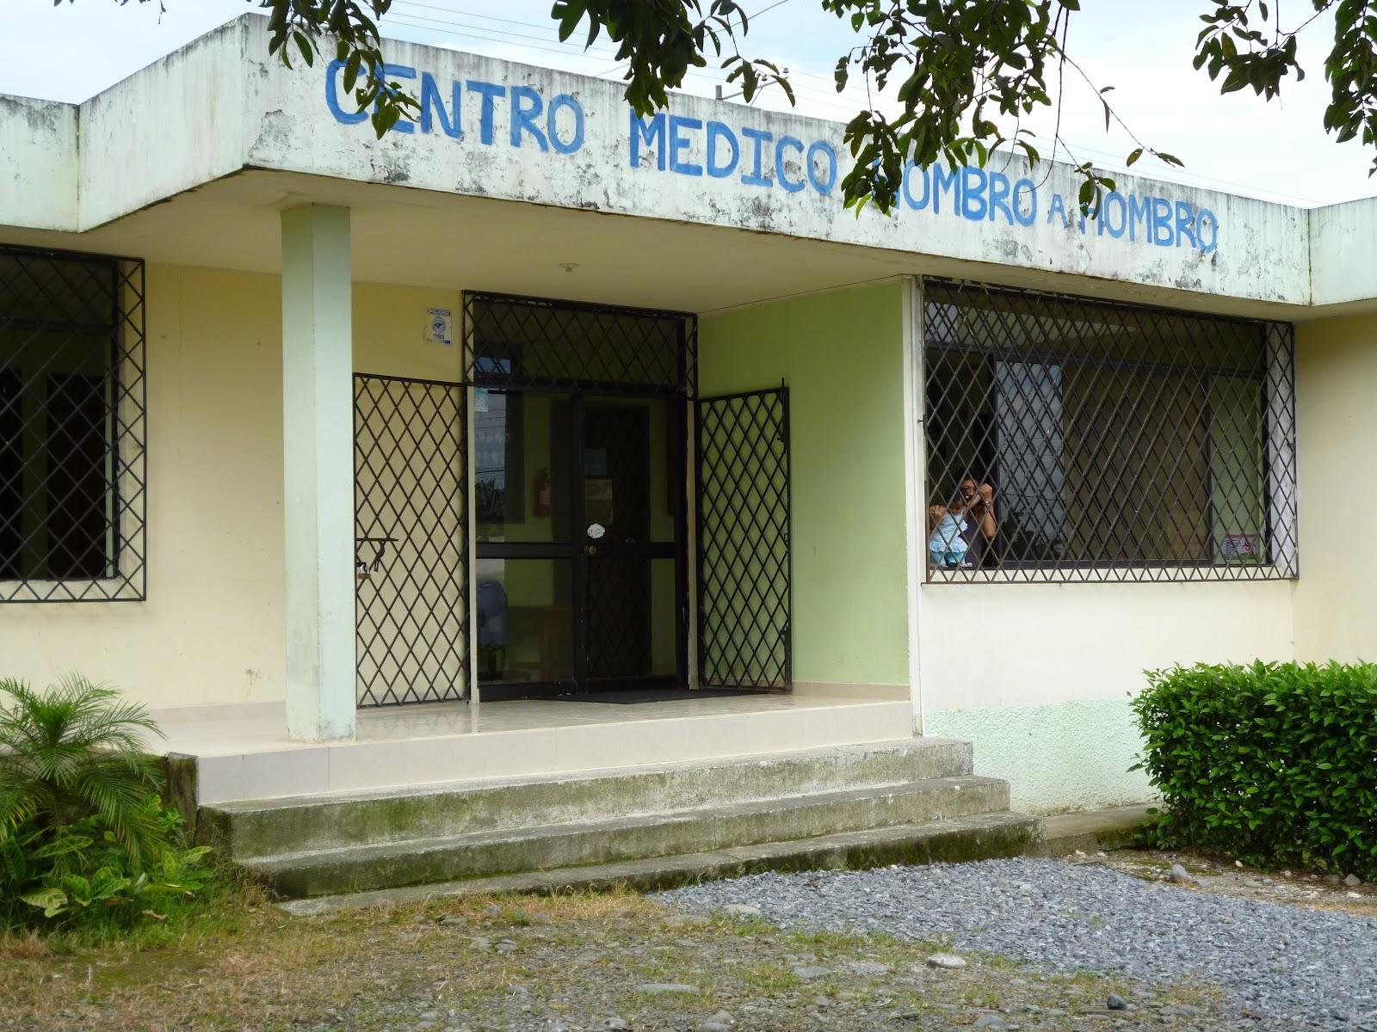
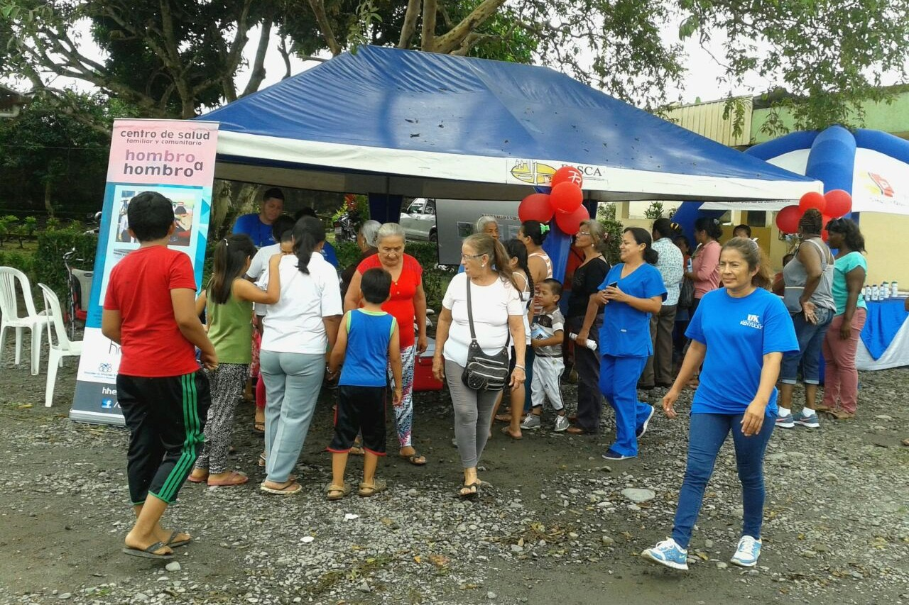
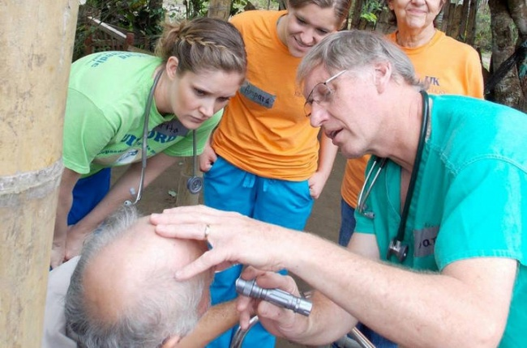
Shoulder to Shoulder Global
Mission - Vision - Values

Slide 7
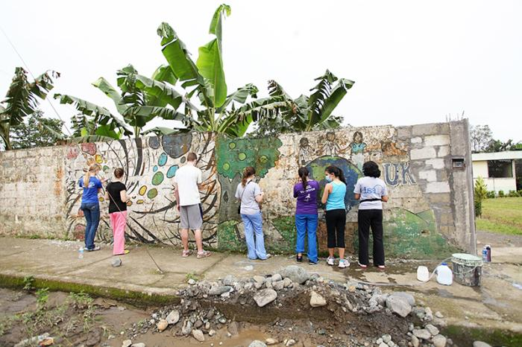
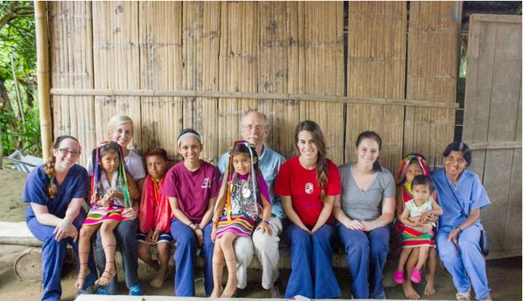
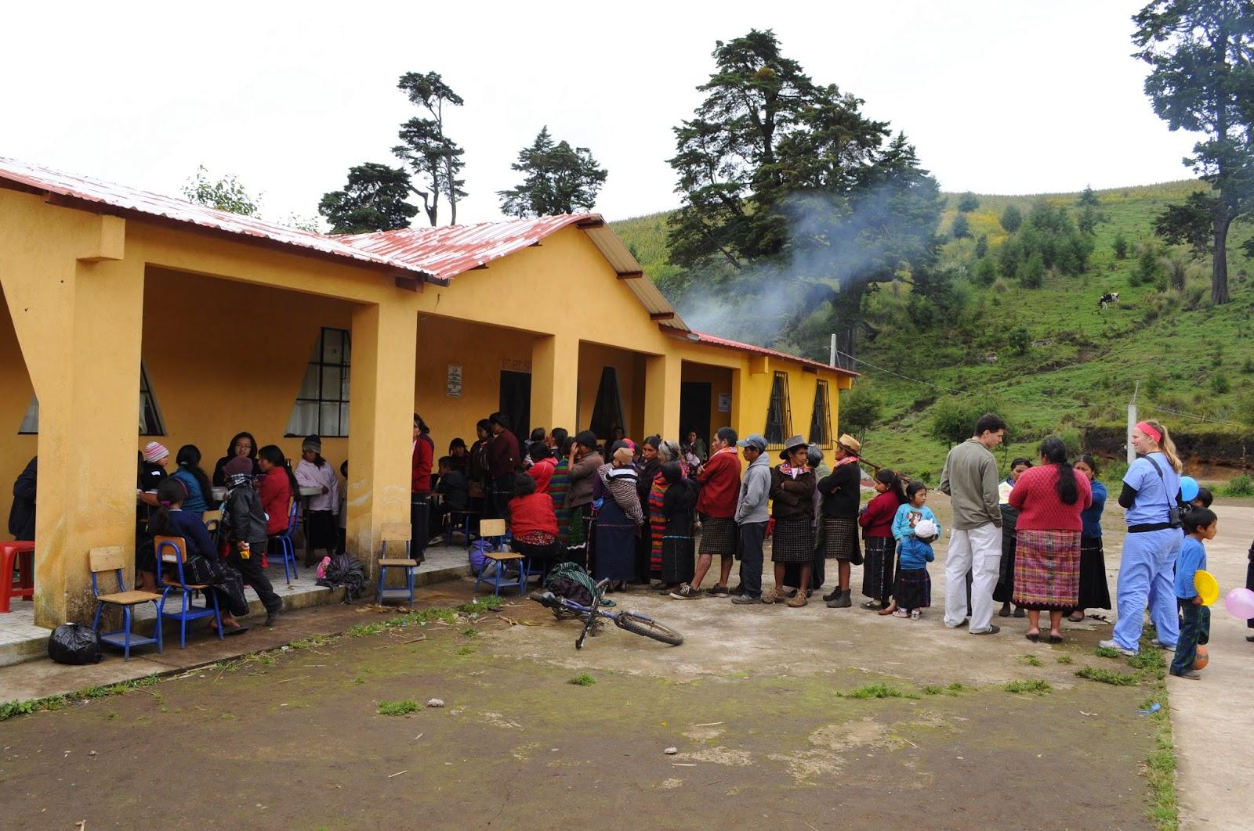
Shoulder to Shoulder Global
goals > strategies > outcomes?

Slide 8
What has been published about clinical outcomes of short-term MSTs?
Literature Review Questions:
What are the clinical outcomes of short-term MSTs?
Are there recommendations for clinical outcome measures?

Slide 9
Review of the literature on MST clinical outcomes
Pertinent publications:
“Short-Term Medical Service Trips: A Systematic Review of the Evidence” -Sykes 2014
“Health impact assessment and short-term medical missions: a methods study to evaluate quality of care” -Maki 2008
Findings:
Nearly 95% of all publications lacked significant data collection.
Outcomes from the interventions that exist are not well understood.
Most publications related to clinical outcomes related to surgical interventions and short-/long-term complications (morbidity/mortality), not chronic diseases.
Keywords:
short-term medical
outcomes
developing country
Ecuador
global
medical mission

Slide 10
So, how can we measure success?
Find a meaningful clinical quality measure to assess outcomes addressed by STSG brigades:
Eg:
What is the relationship between HTN control and prior STSG visits?

Slide 11
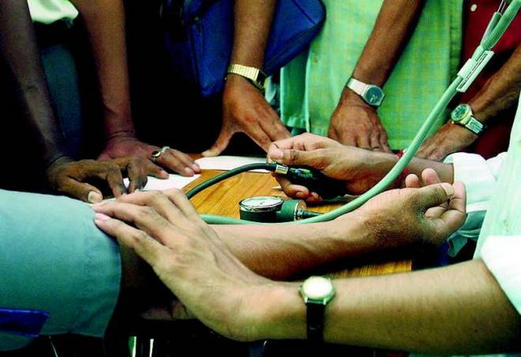
Our Hypotheses
Patients with HTN seen by STSG brigades
will be less likely to have uncontrolled HTN
than those not seen by the STSG brigade.
Patients with HTN with more total visits
will be less likely to have uncontrolled HTN
than those with fewer total visits.

Slide 12
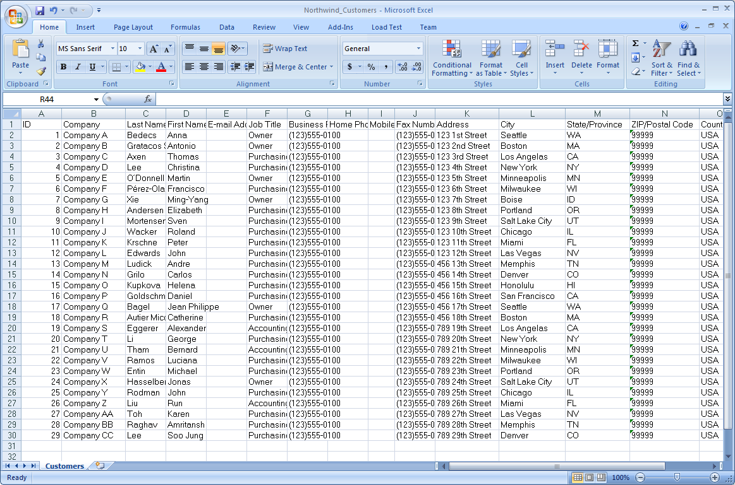
Methods: Getting the data
University of Kentucky IRB - waiver obtained
STSG Council - permission obtained
Fundacion Hombro A Hombro - permission obtained
TimmyCare - Visit data extracted
CSHH clinic - April 14, 2015-May 9, 2017
STSG brigade - March 18, 2014 - March 16, 2017

Slide 13
Methods: Study design
Inclusion criteria:
Diagnosis of hypertension (at any visit)
Age > 18 years
Outcome measure:
Uncontrolled HTN
(AVG sbp > 140 OR AVG dbp > 90)
Variables of interest:
Any STSG brigade visit
Total number of visits (clinic + brigade)
Gender
Age
P: Adult patients with HTN in TimmyCare since implementation
I: STSG brigade visits
C: No STSG brigade visits
O: uncontrolled HTN
(SBP > 140 OR DBP > 90)

Slide 14
Methods: Analysis
Descriptive statistics of the study variables
Multivariate logistic regression to assess association of exposure of prior STSG visit with uncontrolled HTN
Analyses were conducted with SPSS Version 24 statistical software (IBM Corp.)

Slide 15
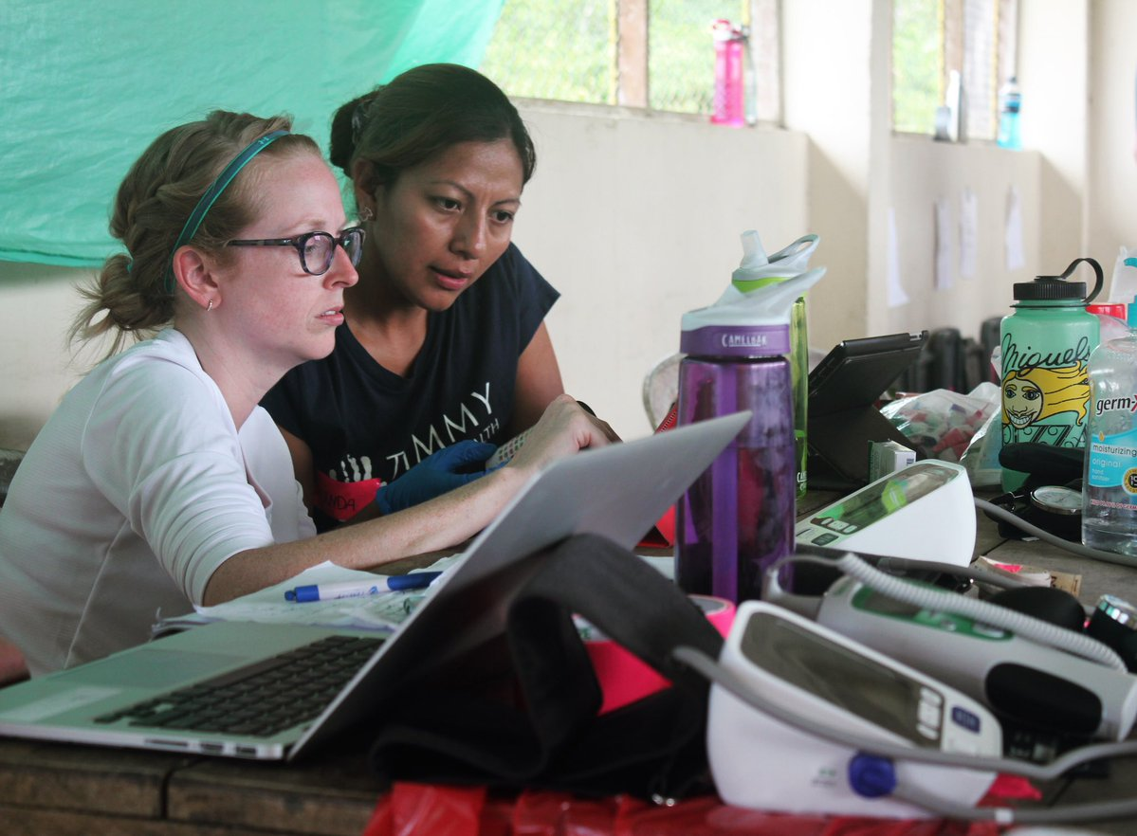
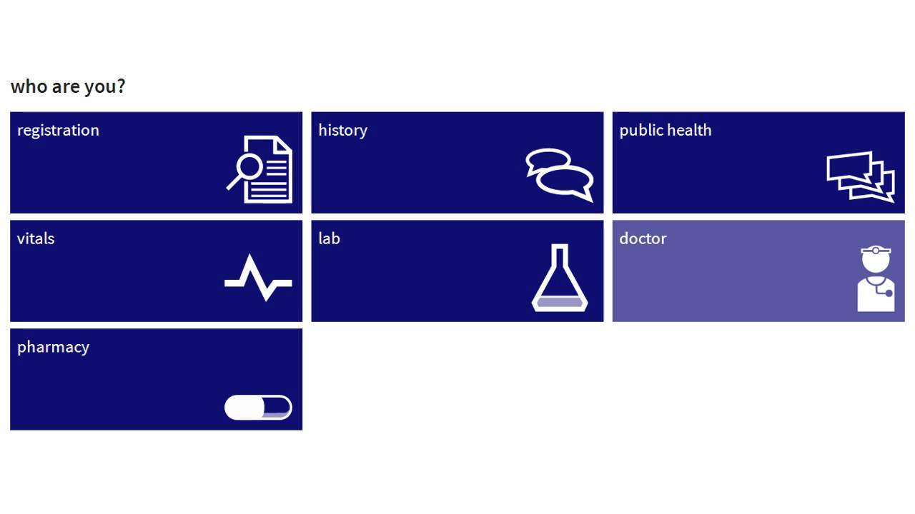
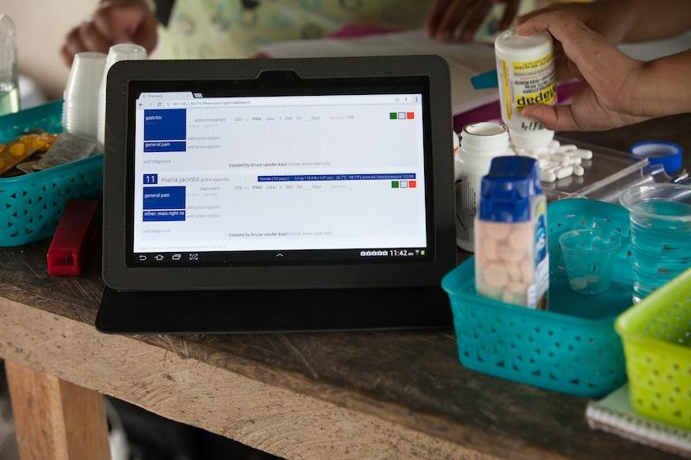
TimmyCare

Slide 16
Results
Characteristics | All | CSHH | STSG
Number of subjects | 326 | 287 | 39
Age, n (%) | — | — | —
18-39 | 16 (4.9%) | 9 (3.1%) | 1 (2.6%)
40-59 | 113 (34.7%) | 81 (28.2%) | 7 (17.9%)
60+ | 197 (60.4%) | 197 (68.6%) | 31 (79.5%)
Age, mean (SD) | 63.6 | 63.0 | 66.9
Gender, n (%) | — | — | —
Female | 226 (69.3%) | 197 (68.6%) | 33 (84.5%)
Male | 100 (30.7%) | 90 (31.3%) | 6 (15.4%)
Characteristics of hypertensive patients seen at CSHH between May 2015 and March 2017

Slide 17
Results
 | All participants | No prior STSG visit | Prior STSG visit
Uncontrolled HTN, n (%) | 211 (64.7%) | 209 (65%) | 33 (84.5%)
CSHH visits | -- | -- | --
1 | 125 (38.3%) | 116 (40.4%) | 9 (7.7%)
2-3 | 101 (31.0%) | 90 (31.3%) | 11 (28.2%)
4+ | 100 (30.7%) | 81 (28.2%) | 19 (48.7%)
Hypertension control and number of visits by patient cohort
for adult CSHH patients with HTN from May 2015-May 2017

Slide 18
Results
Q1) Were patients with a prior STSG brigade visit less likely to have uncontrolled hypertension compared with patients who were only seen at the CSHH clinic?
YES - but not significant. Those exposed to the STSG brigade had an approximate 54% decrease in odds of having uncontrolled HTN, adjusted for age, gender and total number of visits.

Slide 19
Results
Q2) Were patients with a greater number of total visits (STSG+CSHH) less likely to be uncontrolled?
NO - and this was significant. For every additional visit, there is a 9.4% increase in odds of having uncontrolled HTN.

Slide 20
Discussion: What our data suggests
Attendance at STSG is associated with reduced odds of uncontrolled HTN
-- Our Intervention was the brigade, but what component of the brigade contributes to reduced odds of uncontrolled HTN?
-- No previous data to suggest why brigades may have this effect

Slide 21
Discussion: What our data suggests
2. Patients with increased attendance to STSG/CSHH have greater odds of uncontrolled HTN.
-- Are the patients having more clinic visits because their blood pressure is uncontrolled or is their blood pressure uncontrolled because they have more visits?
-- Previous literature does not indicate whether patients with uncontrolled HTN have increased amount of visits
-- Modesti (2015): reiterates the need for proper controls when diagnosing HTN

Slide 22
Discussion:
To whom does this apply:
-- Other providers on MST or who provide intermittent care
-- Providers in low resource settings
-- Primary care physicians abroad
What can people do with this information:
-- Can our results be applied to other MST?
-- Is this information generalizable?
What can we learn from our process:
-- Better control of confounders in order to determine the true factors that contribute to BP control

Slide 23
The Limitations
Retrospective study
Intervention is not discrete element
Less refined outcome measure
Prescribed medications and medication adherence
Poor data quality: missing fields and values
No inclusion of BMI in multivariate analysis
Used AVG BPs instead of pre and post BPs due to lack of number of patients
Small size of brigade cohort

Slide 24
Challenges to reporting outcomes for MST’s
-Difficult access to data; using third party getting information
-Lack of models
-Variable quality of data
-Limited Public health knowledge

Slide 25
What is the clinical impact of STSG?
-- Still difficult to assess as there are few clinical outcomes reported
-- The need for more consistent data collection
-- More objective data to assess interventions abroad
Recommendation for Future Studies
-- Looking at BMI and other factors that influence HTN and cardiovascular disease
-- Prospective study

Slide 26
DIY: Measuring Clinical Outcomes
Your step-by-step worksheet to doing what we did but *better*!
Develop your team
Local clinician, staff, NGO administrators, data managers, learners, IRB
Who needs to give you permission and allow you access to health data?
Elaborate your study question
What chronic conditions do you treat?
What outcome measures and key variables are collected?
Select your study design
Paper or electronic charts?
What is the information transfer process?
How much time do you have?
Develop an analysis plan
Consult a statistician
Confirm data availability
How much time do you have?
With whom will you share this information with?

Slide 27
References:
Maki, Jesse, Munirih Qualls, Benjamin White, Sharon Kleefield, and Robert Crone. "Health impact assessment and short-term medical missions: a methods study to evaluate quality of care." BMC health services research 8, no. 1 (2008): 121.
Modesti, Pietro Amedeo, Eleonora Perruolo, and Gianfranco Parati. "Need for better blood pressure measurement in developing countries to improve prevention of cardiovascular disease." Journal of epidemiology 25, no. 2 (2015): 91-98.
Sykes, Kevin J. "Short-term medical service trips: a systematic review of the evidence." American journal of public health 104, no. 7 (2014): e38-e48.

Slide 28
Acknowledgments
We would like to thank Dr. Roberto Cardarelli for his help with statistical review and guidance in project development

Slide 29
Questions?
Please rate our session!

