Slide 1
2019 STFM Conference on
Practice & Quality Improvement

Slide 2
Setting
This session applies to anyone who cares for Medicare patients.

Slide 3
Payment Update
Top Ten Questions for 2019
Amy Mullins, MD, CPE, FAAFP

Slide 4
Question #1: What is QPP and will it go away?

Slide 5
MACRA vs. Quality Payment Program (QPP)
Merit Based Incentive Payment System (MIPS)
Advanced Alternative Payment Models (AAPMs)

Slide 8
No!
APMs must meet certain criteria to be AAPMs and gain exemption from MIPS
Base payment on quality measures comparable to those in MIPS
Use CEHRT
Bear more than nominal financial risk, or
Be a medical home model expanded under CMMI
Question #2: Are all APMs AAPMs?

Slide 9
Primary Care AAPMs
Shared Savings Program (Tracks 1+, 2, &3)
May finish current MSSP track contract
Program changed to “Pathways to Success” July 2019
Next Generation ACO
Comprehensive Primary Care Plus (CPC+)
Primary Care First

Slide 10
Question #3: How are the weights of the MIPS categories changing?

Slide 11
Quality
2018: 50%
2019: 45%
2020: 45%
Cost will increase until equally weighted with quality at 30% in 2022
Cost and quality percentages were proposed to change in 2020, but they will remain the same
Improvement Activities (15%) and Promoting Interoperability (25%) remain the same
Cost
2020: 15%
2019: 15%
2018: 10%

Slide 12
Question #4: How is the performance threshold changing?

Slide 13
Exceptional Performance 2020: 80
Exceptional Performance 2019: 75
Performance Threshold 2020: 45
Performance Threshold 2019: 30
Performance Threshold 2018: 15
Performance Threshold 2017: 3
Forecast: 2021 Threshold 60, EP 85; 2022 Mean or Median of previous year scores

Slide 14
Question #5: Why is my payment adjustment so small in 2019?

Slide 15
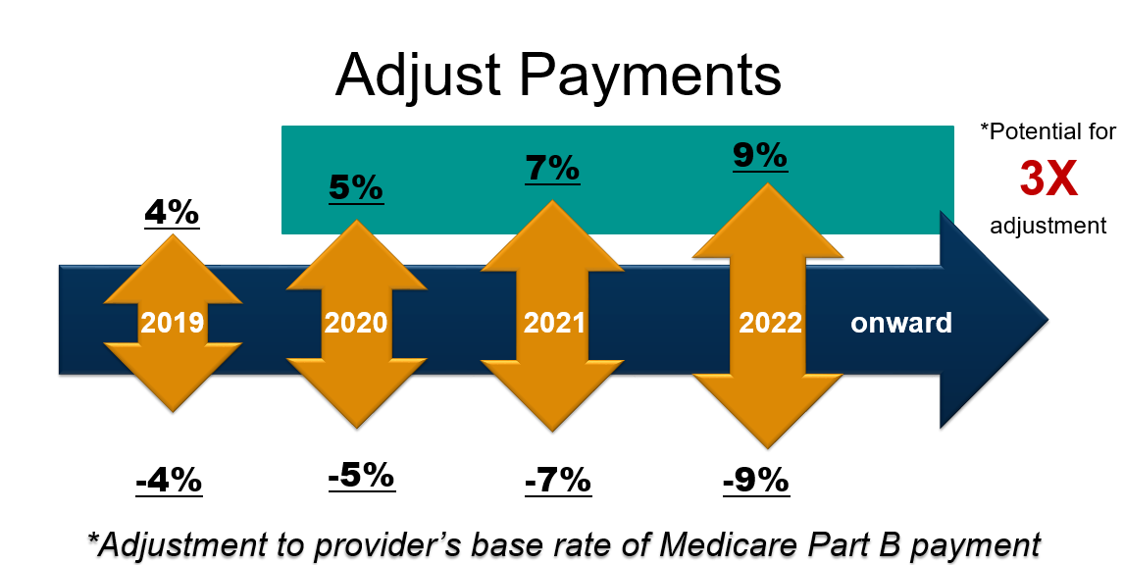

Slide 16
Question #6: I am an employed physician or resident, does this apply to me?

Slide 17
MIPS Exemptions
First year of Medicare participation
AAPM Participant eligible for bonus
Below the Low Volume Threshold
Cares for less than 200 Medicare Part B beneficiaries, or
Received $90K or less in Medicare Part B payments, or
Provide less than or equal to 200 covered professional services

Slide 18
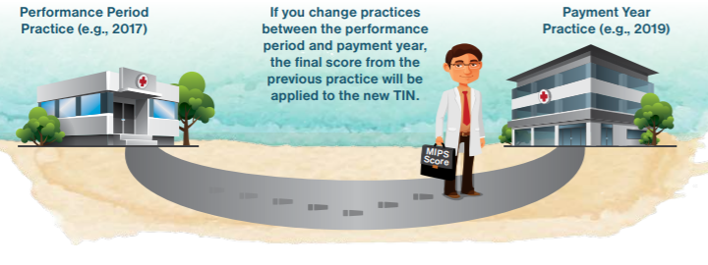
MIPS scores follow you
MIPS scores are publicly available
Consider a practices’ MIPS score as you evaluate employment contracts
*More information in the FPM Employed Physician Supplement

Slide 19
Question #7: What is CMS Primary Cares?

Slide 20
CMS Primary Cares
Primary Care First (PCF)
A progression from CPC+
Includes a model for high need, seriously ill beneficiaries who lack PCP/coordinated care
Will start in 2021
Direct Contracting
Built off Next Generation ACO
Not designed for small practices

Slide 21
Primary Care First Regions

Slide 22
Questions #8/9: What is happening with E&M codes?

Slide 23
In 2021, level of service for office visits will be chosen based on either
Medical decision making; or
Physician times spent on the date of service
There will not be a code collapse as proposed
There will be only four levels of service for new patients (99202-99205)
CMS has a new “add on” code for primary care
Could be added to each visit
Brief Coding Update

Slide 24
Private Payers have not committed to adopt the changes
Does not take effect until 2021
Unknowns

Slide 25
Question #10: What resources are available?

Slide 26
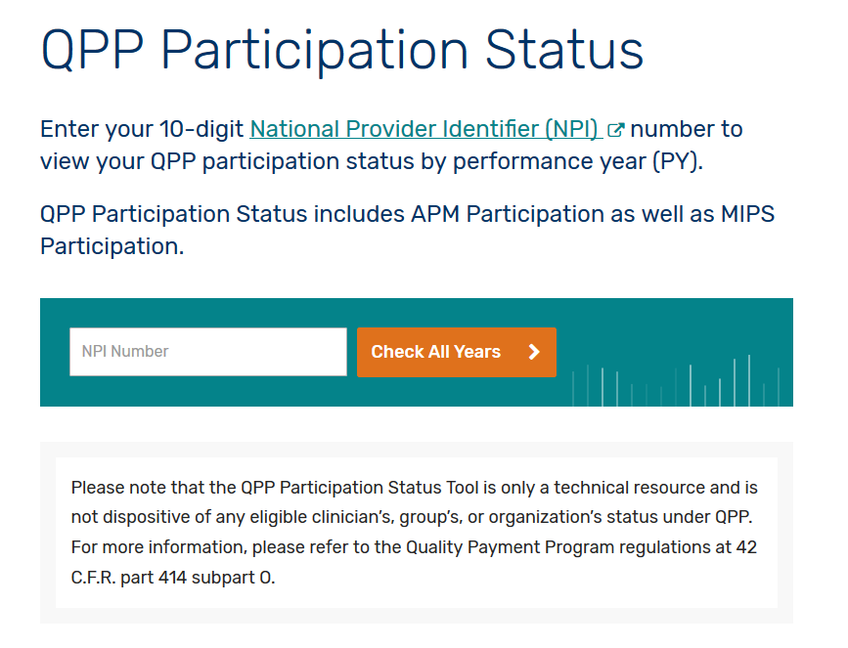
Check Your Status
The Centers for Medicare and Medicaid Services (CMS) has published a CMS Look-Up Tool for clinicians to verify their MIPS-eligibility status by entering their National Provider Identifier (NPI) number
qpp.cms.gov

Slide 27
Guide to help
Understand MIPS reporting requirements
Provides checklists and actionable steps
Prepare for successful performance in the QPP
Free for AAFP Members!!
Available at www.aafp.org/MACRAReady

Slide 28
Evaluate
Please evaluate this presentation using the conference mobile app! Simply click on the "clipboard" icon on the presentation page.

Slide 29
Thank you

