Slide 1
Feedback on Feedback
Effective feedback is essential for helping our learners grow
Practice both giving and receiving feedback
The recipient may not process the feedback immediately, or ever, and that’s ok.
People generally want feedback (consider barriers)
Effective feedback requires preparation and framework
Notes:
The ability to receive feedback gracefully is a large component of success as a resident

Slide 2
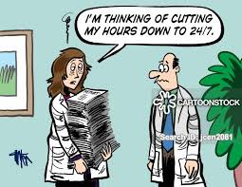
Case 1: The Overcommitted Intern
One of your interns you’ve noted has great rapport with her patients, and patients often rave about their experience with this physician. However, in the resident work-room, this resident has difficulty prioritizing tasks and completing notes on time, which limits her from being a team player.
For example, for one week, your intern has been staying 2 hours past sign out just to talk to patients, yet you have had to write all of this intern’s discharge summaries. She is so burned out at the end of the week, she calls out sick.
It is now time for your weekly feedback group session.
What feedback would you give this resident, and how
would you say it?
(HINT: use SOME TLC)

Slide 3
Case 2: The Over Critical Senior
One of your co-senior residents, who is also your friend, is often criticizing his interns for not completing notes on time, being unprepared for rounds, and not completing tasks in a timely matter.
One day, you find one of the interns crying because your co-senior was overly harsh during rounds about their knowledge of sick and complicated patient.
How do you give feedback to this peer and co-resident to better improve the learning environment for your team?
(Hint: Use SOME TLC)
Hi

Slide 4
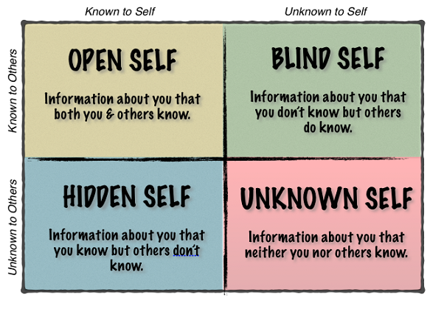
Potential Barriers to Effective Feedback
Developed metacognitive capacities
Where is the feedback coming from?
Where is the receivers’ emotional capacity, self awareness, and self assessment?
Lack of time / timing
Personal biases and cultural differences
Institutional culture surrounding feedback
Harvard Business School Case Review: The Whys and Hows of Feedback

Slide 5
Options for Breakout Rooms!
You will have 15 minutes in each room
Frist Time Slot:
Orientation
Problem Faculty
Second Time slot:
Wellness and Residents in Distress
Scheduling Conflicts
Third Time Slot:
Problem Residents

Slide 6
Options for Breakout Rooms!
You will have 15 minutes in each room
Frist Time Slot: Problem Faculty
Second Time slot: Wellness and Residents in Distress
Third Time Slot: Problem Residents and Scheduling Conflicts

