Slide 1
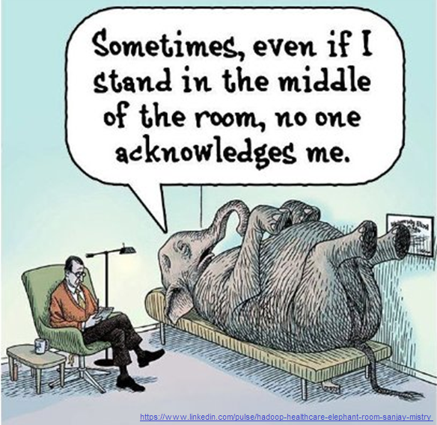
Notes:
Thank you and good morning.
My name is Tammy Chang and I am the STFM Research Committee Chair. I am a practicing family physician, family medicine educator, and health services researcher at the University of Michigan.
Today we want to bring to light an issue that many of us recognize, but is rarely discussed. The scenario where you nod when your chair says do research or scholarly work, but in your heart, you I feel like dying.
The contradiction between the requirements to do “research” or scholarly work by ACGME, our department chairs, and our institutions, and the pure dread that many family physicians and educators feel when the word research is brought up- is a feeling that may be keeping family medicine as a specialty from fully realizing the potential of research.
I recently was talking with some of my colleagues from an amazing community family medicine program and they were telling me that there is no easier way to strike fear into the heart of a community family doc (even one that trains students and residents) than to say they are expected to do research. And I am reminded that most family medicine programs ARE community programs. So where does this leave us? With this elephant in the room.
And rather than continue to not acknowledge this significant disconnect between what many think needs to be done to further our field and what the docs and educators are feeling on the ground, in the clinics, precepting rooms- we wanted to allow two of our most esteemed colleagues to let loose and duke it out in STFM’s first point counterpoint debate.

Slide 2
Should Family Medicine Educators Be Expected to Do Research?
A Point-Counterpoint Debate
Notes:
The objective of this debate is provide an opportunity for both sides of the debate to present their case and to ignite lively and honest discussion over this challenge.
The object is not to argue over the minutae and details, rather to be open about the BIG picture issues that exist on both sides of this debate.
And maybe you are already on board- but there are others in your department that are not quite there. We hope that this debate opens the eyes of both sides to see where people might be coming from, and that the struggle is REAL and the solutions are not easy. But we believe it begins with having an open conversation.

Slide 3
Opening Statements
POSE A QUESTION
Rebuttal
10 minute- Discussion
10 minute- Questions
Closing Statements
Notes:
The format of the debate will look like this:
Without further adieu, I am pleased to briefly introduce Dr. Jeff Borkan and Dr. Dave Schneider.
Dr. Dave Schneider is the Perry E. Gross, MD Distinguished Chair in Family Medicine at UT Southwestern Medical Center.
Dr. Jeff Borkan is Assistant Dean for Primary Care-Population Health, Professor of Family Medicine, Professor of Medical Science, Chair of Family Medicine at Brown University.
Dave will be taking the PRO side.
Jeff will be taking the CON side.

Slide 4
Should Family Medicine Educators Be Expected to Do Research?
Notes:
Short answer: NO!!!

Slide 5
Notes:
Just say the word “research” and a frosty chill comes over the room – our eyes begin to glaze over, and our brainwaves begin to slow!
This reaction is shared across the discipline and probably by you! –it pervades family medicine – sometimes even our leadership. Once at a small FM meeting of the presidents of FM organizations, a former president of AAFP let it slip, “When I hear the word research, my ears close up!” – how many of you react the same way?

Slide 6
“All I am surrounded by is Fear”
Notes:
Not just the word “reeesearch” is scary – the concept of actually doing research strikes fear into the heart of family medicine trainees and faculty alike -- we are not trained for it, we have the questions but generally lack the necessary knowledge and skills.
Even the jargon is terrible (I am in anthropology and we may win the prize for incomprehensible terminology (like the “phonology of affinal bilineal lorenz curves” but statistics is almost as bad – cumulative probablity distribution function of a benoulli’s inequality). Arrgh!
Even when we finally finish a research project and painstakingly write it up for publication, the paper is inevitably rejected, Rejected, REJECTED!
We are just not made to do research in Family Medicine …

Slide 7
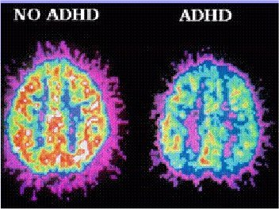
Notes:
We in Family Medicine are the ADD of specialties – collective Attentional Deficit Disorder -- we can only maintain an interest in topic in units of 15 minutes or less (even that is a stretch for many of us) and most of our researchers, as well as clinicians, bounce around from topic to topic. At heart, we are wandering, migratory, shifting, and even nomadic in our interests. The research cycle from start to publication is often 7 years or more….we just aren’t built for it!

Slide 8
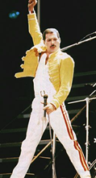
…clinicians and teachers….let someone else be the researchers
Notes:
Let be honest –– we are experts at patient care, we are awesome at education – why not focus on what we do best?
– all the studies show it and we see it in every medical school and residency – We are AMAZING when we see patients and teach the next generation.
Face it! We should just focus on being good at these things and leave research to other disciplines -- the folks in Internal Medicine, Peds, and OB always say they are smarter than us– let them knock themselves out doing research rather than us! In the meantime we can generate more wRVUs, lead a group visit, mentor a student, and maybe see our families and kids once and a while.
Queen and Freddie Mercury knew, let’s sing together -- “we are the champions, we are champions, clinicians and teachers, let someone else be the researchers, of the world”

Slide 9
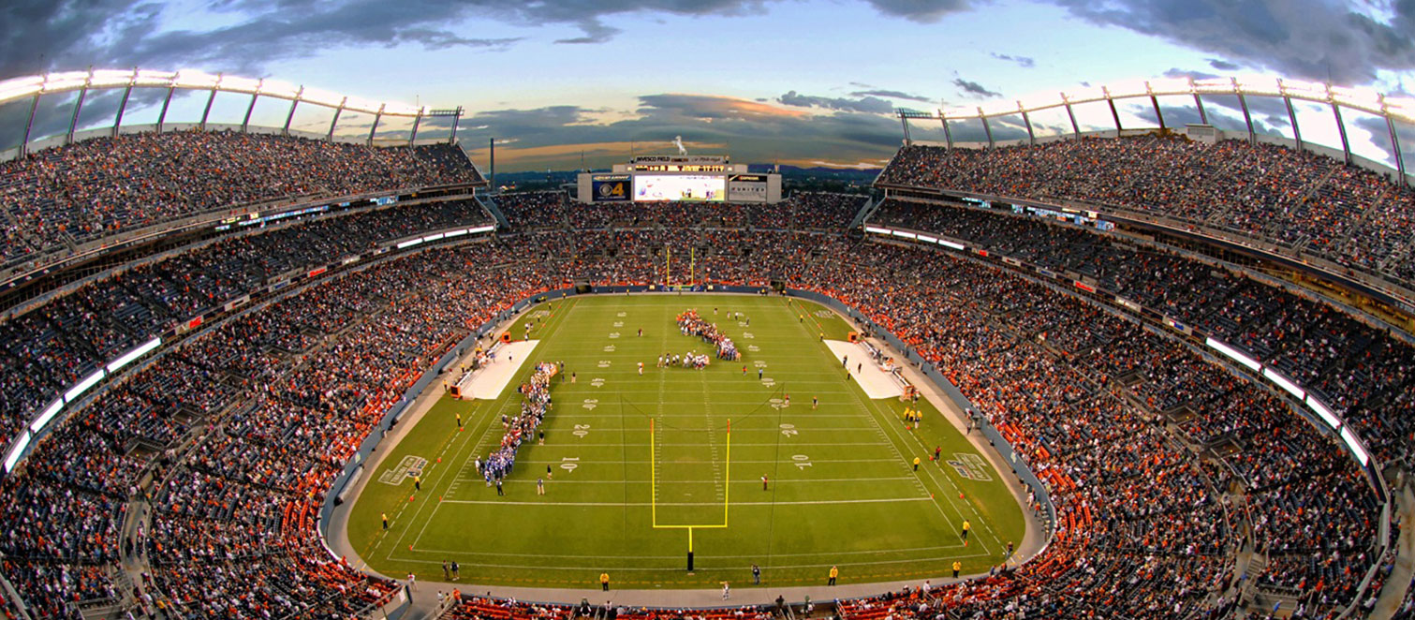
REAL RESEARCHERS
Notes:
We are amateurs in a world of highly trained, exquisitely prepared professional research players, teams, and franchises. There is a false sense in family medicine that “everyone can be a researcher” – even without training.
Raise your hand if you ever had more than a 1 year of research training?
Many of our most accomplished researchers met at the University of Wisconsin about a decade ago to determine how long it takes to transform a neophyte FM investigator into an independent, funded researcher – guess what – they came up with 10 years as the “incubation time”. We send out our sweet, naïve, researchers into the field with at most 1-2 years of faculty development and what happens to them?

Slide 10
Death of the Jedi younglings….Star Wars: The Last Jedi….and also true for new researchers in Family Medicine 1980-present
Notes:
They get killed off. Actually it is often We who kill off our young researchers – sending them out without what they need to survive or thrive. The original model for departments of family medicine and even many residencies was to send out a single, generally eager but under-prepared family physician researcher to be responsible for all scholarly work – without adequate research infrastructure, colleagues, or teams – and they were slaughtered! We squandered a generation – we can’t do that again but often we do because we don’t have critical masses of researchers except in a few places in the US.

Slide 11
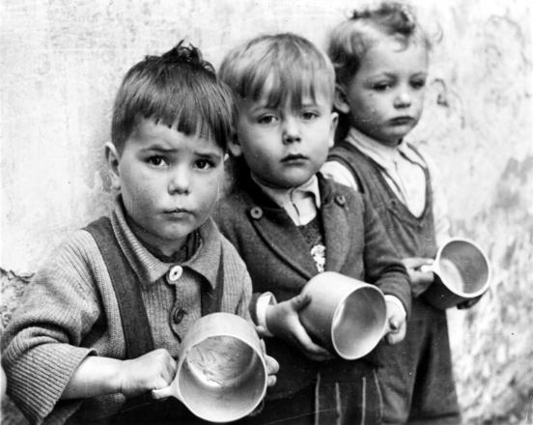
Notes:
Also -- Brothers and sisters in the audience – can you spare a dime for our discipline?
From that dime, after you take care of your major responsibilities – your REAL Responsibilities, what is left over for research? Funding researchers, even funded researcher, costs 10-30% more than what they get in grants. The folks in the picture on the right are the Presidents of STFM, Napcrg, and ADFM on ….trying to raise money for the discipline (and their cups are EMPTY!). We don’t have sufficient resources for clinical service and education; now you want to spend money that we don’t have on research?!?!
Not only does research take away resources from our what should be our main priorities, but funders give us short shrift! The NIH has steadfastly denied requests for an NIH Center for Primary Care and nationally research budgets are being slashed at many med schools, universities, states and the Feds –forcing us to fight over the scraps – our precious few resources cannot be squandered on superfluous research while we fight over the crumbs!

Slide 12
Notes:
And finally ….Research may not smiles to our faces or joy to our lives. Research is where FUN GOES TO DIE! How much fun is it to do research, compared to diagnosing a complex illness, delivering a baby, or fixing a fracture. Let’s go running, swimming riding a bike or baking a cake rather than sitting hour after hour staring at stats or collecting and analyzing data. Research is not in the fun zone -

Slide 13
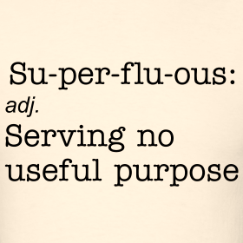
Why Not Research in FM? …a superfluous question!!
We don’t have a focused discipline that can be studied
We lack the resources
Our identity is as clinicians and teachers
We are amateurs at research
We kill off researchers
Research kills off joy
Notes:
Why not research in Family Medicine – is that even a question? The questions of research like Research is superfluous to us – serving no useful purpose
Dr. Sneider, I challenge you to tell us differently …..but I should let you know…you are already wrong!

Slide 14
Should Family Medicine Educators Be Expected to Do Research?
Notes:
Thank you, Jeff; but you’re wrong
Research can be fun, and you don’t need to be an expert to participate in research
There are many ways to do research - Boyer’s model of scholarship presents a spectrum from original basic research to a synthesis or review article

Slide 15
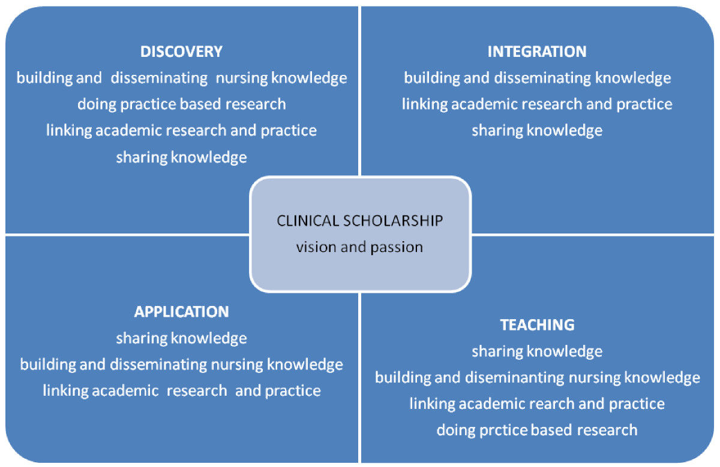
Notes:
This model of research gives spans a spectrum from new basic discoveries to synthesizing the literature and its application to the patients in front of us. And then how we teach this to our learners. Something you even said is out strength in family medicine. But how do we know we’re even effective at teaching it if we’re not critically analyzing how we do this.

Slide 16
Notes:
Why is research in FM different?
Most research is done on this little green box here at the bottom – does it really apply to our patients? Our patients are this 217 that visit our offices, and the other 783 patients we don’t necessarily see in our offices. So does the subspecialist-driven research even apply to our patients? No, it doesn’t.
If we’re not doing our own research on our own patients, how do we know how to practice medicine well? Drive the best outcomes for our patients?

Slide 17
Notes:
We’re family doctors – we’re different.
This doctor does research – he collects information about his patients. And he constantly asks, “Am I doing the best thing for my patient?”

Slide 18
Notes:
Tell the story of my patients with chronic pain and how this research changed the way I speak to them

Slide 19
Notes:
To me, research is play – for me it’s the fun part of my job. And it does make me feel like I’ve accomplished something – changed (in even the smallest way) the way I and we practice medicine

Slide 20
Notes:
It’s also fun to see my name on a published paper – it’s a bit infectious too. It even justifies my going to places to present the research – places that are fun… Like Montreal and Cancun for NAPCRG

Slide 22
CONCLUSION
There is room for discovery in everything we do.

Slide 23
Notes:
As you think about what we do, think about how we can do it better

Slide 24
Why Research in FM…NOT a superfluous question
How do we need to know if what we do is effective?
Most research is done by subspecialists on sicker patients
We need our own body of knowledge
Credibility as teachers
It makes us better doctors and teachers
Research is fun
Notes:
My questions to you, Jeff are:
If we’re not doing research, are we relevant?
Where does the knowledge come from for teaching and practice?
REBUTAL MATERIAL:
How much of what we learned in med school is still true today?
Questioning what we do => research
Do we have to be the research experts?
How are we excellent clinicians if we’re not doing research? Finding new knowledge? Continually questioning how we practice? There are lots of ways to do research. Research is part of our fabric. How often do you look up something while you’re seeing patients – that’s research…
Better doctors
Improved patient outcomes
Better teachers
Paying for research: Be creative – it’s up to us, the program directors and department chairs to garner the resources
We need to look to our hospital systems and partner medical schools to find people to work with
Medical schools have these methodologists who know HOW to do the research, get them to work with us – what are we good at, developing relationships – engage folks, develop research teams. We (the clinicians) are there to keep the research relevant to our patients.

Slide 25
Opening Statements
POSE A QUESTION
Rebuttal
10 minute- Discussion
10 minute- Questions
Closing Statements
Notes:
David to Jeff –
My questions to you –
If we really don’t do research, are we even relevant?
What will inform the clinical work and teaching you so admire?
Jeff’s Responses:
We are relevant by doing what we do best – being clinicians and researchers …. Not by trying to be relevant as mediocre researchers!
Others see that -- We have mostly been pigeonholed in academic health centers mostly in the clinical and teaching roles because we are good at it!
Maybe rather than fighting to do research, we should glory in being awesome clinicians and teachers – should be proud of that – and in the current climate of constrained resources – more important than ever.
We will stand out and be relevant by being excellent at what we cherish.
Our relevance is also internal -- value to the discipline, to our patients and communities and to ourselves – we long ago learned that our value must be determined by what we do and how we feel about ourselves – not by our often arrogant “partialist” specialty colleagues.
What will inform our clinical and education in family medicine? ….hmmm– tough question – could depend on all the disciplines that are willing to do the research for us – and when in doubt, we can fall back on a well-worn phrase - “in my experience” – but often our experience is limited and our conclusions are often wrong – this is a tough one -- will be in trouble in 10-20 years
We might want to leave room for scholarship in family medicine, especially if it related to what we do and makes us even more awesome clinicians and teachers – but a small room – maybe more like a broom closet in a large house
Jeff to David
My questions to you:
How will research help us with our main tasks – clinical service and training the next generation?
How do we pay for the time for research –– show me the money!

Slide 26
Discussion & Questions

Slide 27
Notes:
We may need to all embrace research – but think of it in broader terms
The scholarship of discovery that includes original research that advances knowledge;
The scholarship of integration that involves synthesis of information across disciplines, across topics within a discipline, or across time;
The scholarship of application (also later called the scholarship of engagement) that goes beyond the service duties of a faculty member to those within or outside the University and involves the rigor and application of disciplinary expertise with results that can be shared with and/or evaluated by peers; and
The scholarship of teaching and learning that the systematic study of teaching and learning processes. It differs from scholarly teaching in that it requires a format that will allow public sharing and the opportunity for application and evaluation by others.
Final: You know David, I still think you are mostly wrong but I can accept that if you frame it as scholarship linked to what we do – teaching, application, integration and a bit of discovery – we may find our way into the future – and in peace
Let us put down our light sabres and join together in scholarship – and all hail the empress!

Slide 28
Notes:
What we hope to do is make all family medicine educators feel comfortable about how they really feel about research. To be open to talking to others about how and what can be done.
We have heard about how it can help educators and docs be better at their jobs, that it is our professional responsibilities.
One of the reason we even come to meetings like this is to be around others who want to do and be better for the betterment of our patients and communities. How can research be a part of that strategy?
I would be remiss if I did not mention the plethora of resources that STFM and our sister organizations have created and organized to promote scholarly work at all levels.
We have put these resources at each table and near the doors for your reference and welcome you to contact STFM and specifically the research committee and our presenters today with your comments concerns and challenges. STFM is here for you. Let there be peace and prosperity in all of our lives and may research enrich your live and that of your patients- however, you engage with it.
Keep the conversations going- say how you really feel so we can start to honest about where we are as a specialty and field. We want this to just be the beginning.
This effort today was brought to you by our amazing research committee who has been on a quest to blanket the entire meeting with hearts in our I heart research campaign. Our goal is to demonstrate the joy and accessibility of research and we hope that we can reach out to you about research and be a service to you as you work towards your mission to improve health in your communities as an educator or clinician.
Panel- Tuesday at 11:15 eastern in Lincoln 5.
Thank you to our wonderful debaters, Dave Schneider and Jeff Borkan and thank you to you for your participation today.

