Slide 1
Socially Determined: How to build a workshop exploring anti-racism and privilege for family medicine residents
May 5, 2021
STFM Annual Spring Conference
Submission #5470
D#25 Breakout Room

Slide 2
Workshop Facilitators
Hannah Christiansen, MD
Susan Evans, MD
Andrea Jones, MD
Melanie Menning, MD
Jennifer Liu, MD
Jessica Koran-Scholl, PhD
Alberto Marcelin, MD
Alex Dworak, MD
Neil Kalsi, MD

Slide 3
Workshop goals
1. Bring awareness to racism as a structural determinant of health.
2. Examine the historical and structural roots of racism.
3. Develop skills to promote health equity in clinical decision making.
4. Develop concrete plans to promote health equity.
5. Build a culture of anti-racism in our department, institution and community.
Notes:
2. extra into: including the living and working conditions of our own Black, Indigenous, and People of Color (BIPOC) communities in Omaha.

Slide 4
Timelines and Workshop settings
Interns - completed during orientation
4-hour workshop
6 residents per small group
2 facilitators per small group
In person and via Zoom
2nd/3rd year residents – completed during protected monthly teaching time
3-hour workshop
8 residents per small group
2 facilitators per small group
Zoom

Slide 5
The workshop consisted of:
Lectures
Video segments
Reflection
Racial wealth gap simulation that highlighted federal policies that have led to structural harm.
Some activities were completed in small groups while lectures were presented via zoom to all groups simultaneously.

Slide 7
Start | Duration (minutes) | Title
1:00 | 10 | Pre-Session Eval
1:10 | 15 | 7 Questions from AAFP EveryONE project
1:25 | 25 | Videos: Intro + watch · Systemic racism (4:23 min) https://www.youtube.com/watch?v=YrHIQIO_bdQ · Roots of racism (19:37 min) https://www.youtube.com/watch?v=-aCn72iXO9s&feature=youtu.be
1:50 | 50 | Health equity & Omaha’s race history · Dr. Jones (30 min): focus on North Omaha, redlining, health desert in North Omaha, white privilege, family medicine creed · Dr. Menning (20 min): focus on South Omaha, immigrants & refugees · Q&A
2:40 | 15 | BREAK
2:55 | 25 | Social Perspective for Medical Students & Residents; Begin with appendix B as group (medical students and residents), can also discuss appendix A (health care professionals) as time/interest permits
3:20 | 20 | Video segments: White fragility https://www.youtube.com/watch?v=KCxNjdewAAA&feature=youtu.be
3:40 | 60 | Racial wealth gap learning simulation + debrief · 6 participants (one faculty as facilitator, one faculty + 5 residents as participants) · 10 minutes: intro via powerpoint · 25-30 minutes: simulation · 20-30 minutes: group discussion via powerpoint
4:40 | 25 | Conclusion in small groups Debrief Written commitment to actionable next steps on back of icebreaker paper, "How will people of color know you are actively working to become anti-racist?”, then share with group Post-Participation Eval: on paper
Workshop Schedule
Interns
Notes:
7 Questions from AAFP EveryONE project
· First individually on paper
· Then share within small group as comfortable
· Have individuals keep their paper for later
Video segments: White fragilitys https://www.youtube.com/watch?v=KCxNjdewAAA&feature=youtu.be
Entire video is 30:27 min, watching from 8:23 to 17:30 shortens to 14:27, and 21:31 to 26:40 for 18:04 min.
Have participants substitute concept of patient-physician relationship for student-teacher relationship.

Slide 8
Start | Duration (minutes) | Title
8:00 | 10 | Introduction of faculty Review objectives Pre-session Eval: via MIcrosoft Forms
8:10 | 20 | Videos: Watch and then Introduction/Objectives Systemic racism (4:23) https://www.youtube.com/watch?v=YrHIQIO_bdQ [youtube.com] Dorothy Roberts TED talk: The problem with race- based medicine https://www.ted.com/talks/dorothy_roberts_the_problem_with_race_based_medicine (14:28)
8:30 | 10 | Race Construct Intro/ 7 Questions from AAFP EveryONE project First answer individually (will send out in advance) Then share within small group as comfortable
8: 40 | 45 | Racial Wealth Gap Learning Simulation + Debrief 5 minutes: intro via powerpoint 20 minutes: simulation 20 minutes: group discussion via powerpoint
9:25 | 10 | Social Perspective for Medical Students & Residents Handout is double sided, focus on appendix B as group (medical students and residents), can also discuss appendix A (health care professionals) as time/interest permits
9:35 | 10 | Break!
9:45 | 15 | Video segment: White fragility https://www.youtube.com/watch?v=KCxNjdewAAA&feature=youtu.be[youtube.com]
10:00 | 40 | Health equity & Omaha’s race history Dr. Jones (20 min): focus on North Omaha, redlining, health desert in North Omaha, bias, white privilege, SDOH Dr. Menning (20 min): focus on South Omaha, immigrants & refugees
10:40 | 10 | Conclusion in small groups Debrief Written commitment to actionable next steps: "How will people of color know you are actively working to become anti-racist?”, Post-Participation Eval via Microsoft Forms
Workshop Schedule​
2nd/3rd Year Residents
Notes:
Kept most content – shortened Racial wealth gap simulation from 60 to 45 minutes
Shortened lectures from 50 to 40 minues, shortened break from 15 to 10 minutes, shortened conclusion and debrief from 25 to 10 minutes
Swapped out one video to cut 5 minutes (net 55 minutes difference)
Video segment: White fragility
https://www.youtube.com/watch?v=KCxNjdewAAA&feature=youtu.be[youtube.com]
Entire video is 30:27 min, watching from 8:23 to 17:30 shortens to 14:27

Slide 9
Resources
7 Questions from AAFP EveryONE project
Appendix B. Social Perspective-Taking Survey for Medical Students and Residents
Appendix A. Social Perspective-Taking Survey for Health Care Professionals
Racial wealth gap learning simultion
Notes:
Pooled from AAFP and other sources

Slide 10
7 Questions from AAFP EveryONE project
1. The part of my identity that I am most aware of on a daily basis is _____________ .
2. The part of my identity that I am the least aware of on a daily basis is ___________ .
3. The part of my identity that I wish I knew more about is _____________________ .
4. The part of my identity that provides me the most privilege is _______________ .
5. The part of my identity that I believe is the most misunderstood by others is_____ .
6. The part of my identity that I feel is difficult to discuss with others who identify differently is ________________ .
7. The part of my identity that makes me feel discriminated against is ____________ .

Slide 11
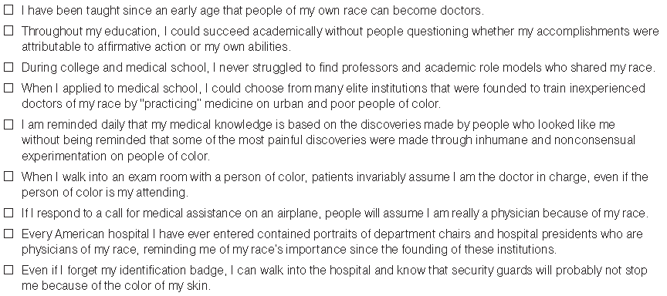

Slide 12
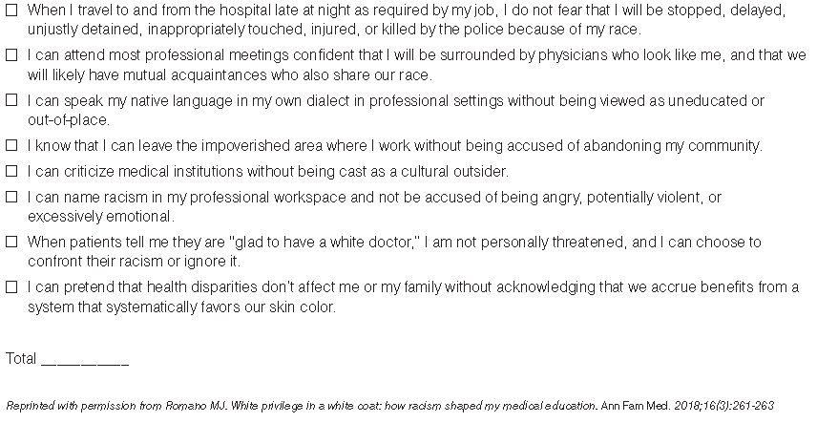

Slide 13
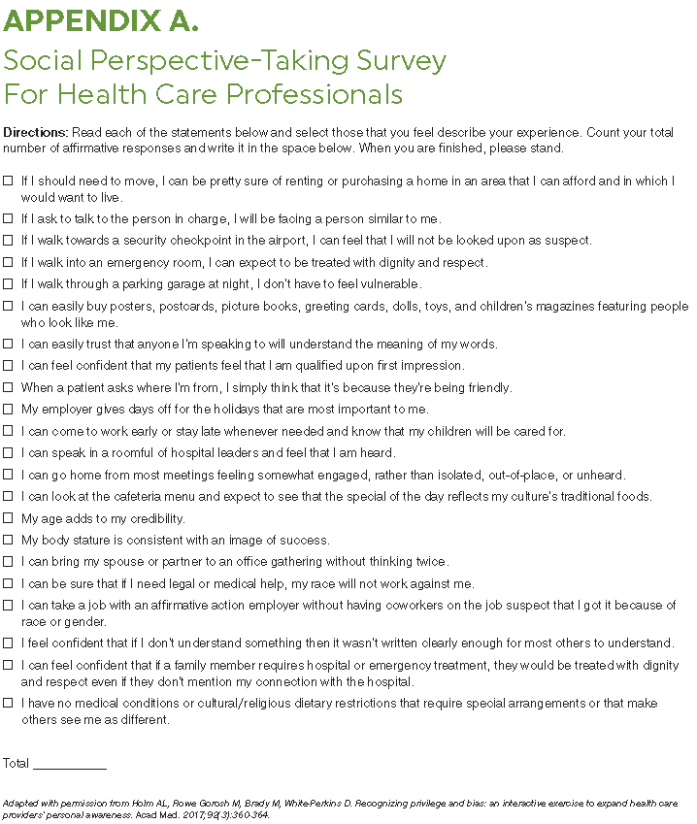

Slide 15
Instructions
Each person is randomly assigned “white participant” or “black participant”
There are three action cards (“money,” “land,” and “lost opportunity”) and 13 policy cards.
Starting with a participant with a “white” race card, each participant will take turns reading policy and then reading the action(s) on the card for participants to carry out.
Participants will gain or lose cards in each round. At the end, count how many cards you have!

Slide 16
Example – Policy #7: The G.I. Bill of 1944
This was enacted to help World War II veterans adjust to civilian life by providing low-cost home mortgages, low-interest business loans, tuition assistance, and unemployment insurance.
Unfortunately, black veterans were excluded from many of these benefits.

Slide 17
Example: Action #7: The G.I. Bill of 1944
White participants:
Pick up two money cards and one land card for the opportunities you received, such as government-guaranteed housing loans, which helped to build the American “middle class.”
Black participants:
Only ONE black participant picks up a money card, representing the few African Americans who had access to some benefits of the GI Bill. All black participants pick up one lost opportunity card for not being able to benefit from the GI Bill even though they too had fought for the United States in World War II.
PAUSE to allow participants to complete their respective action(s).

Slide 18
Lecture Presentations
Health Equity and Omaha's Race History
Dr. Andrea Jones – Focus on North Omaha, redlining, health desert in North Omaha, white privilege, family medicine creed
Dr. Melanie Menning – Focus on South Omaha, immigrants & refugees

Slide 19
Pre and Post Workshop Survey
Surveys were matched pre/post for all residents
Interns completed surveys via paper (front/back)
2nd/3rd years completed surveys via Microsoft Forms (created a unique code to match responses)
8 Survey questions were provided to all participants to assess resident training and education in:
Recognizing
Addressing
Understanding
Reducing
systemic Racism and Health Inequity

Slide 20
Survey Results

Slide 21
Survey Results
Seventeen interns attended the workshop and all completed the pre and post surveys.
Twenty-one second- and third-year residents attended the workshop. All completed the pre survey and 19 completed the post survey.
Respondents demonstrated statistically significant improvements in all 8 questions concerning their education in and understanding of bias and racism.
Comments ranged from positive to critical. Critical comments regarding the session included the following themes:
Denial about the existence of systemic racism
Factual misrepresentation
White shaming
Political agenda
Race baiting

Slide 22
Questions to ponder and Open Discussion
What is working well in your department/institution to combat structural racism and to build a culture of equity?
What is your institution's biggest challenges at this time?
How are you incorporating social determinants of health education into the residency curriculum?
What feedback have you received from faculty/residents/staff about your efforts?
What are your next steps?

Slide 25
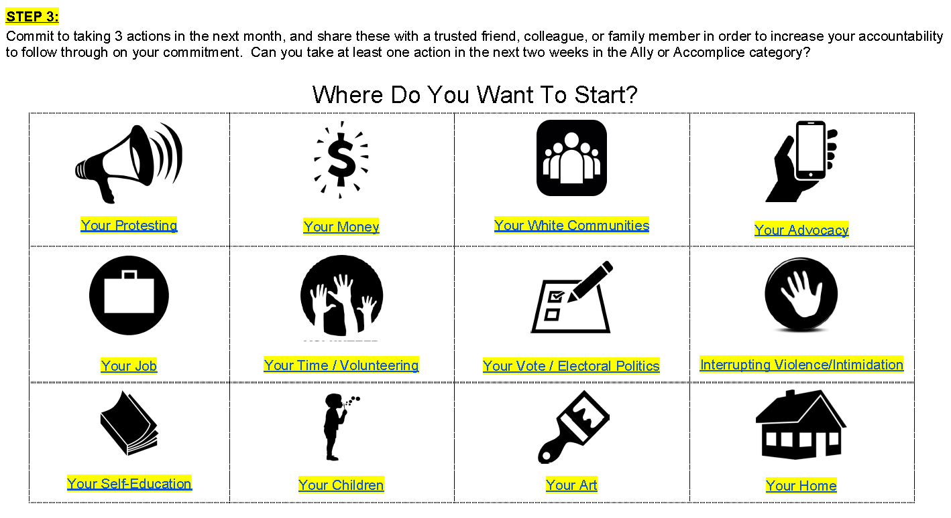

Slide 26
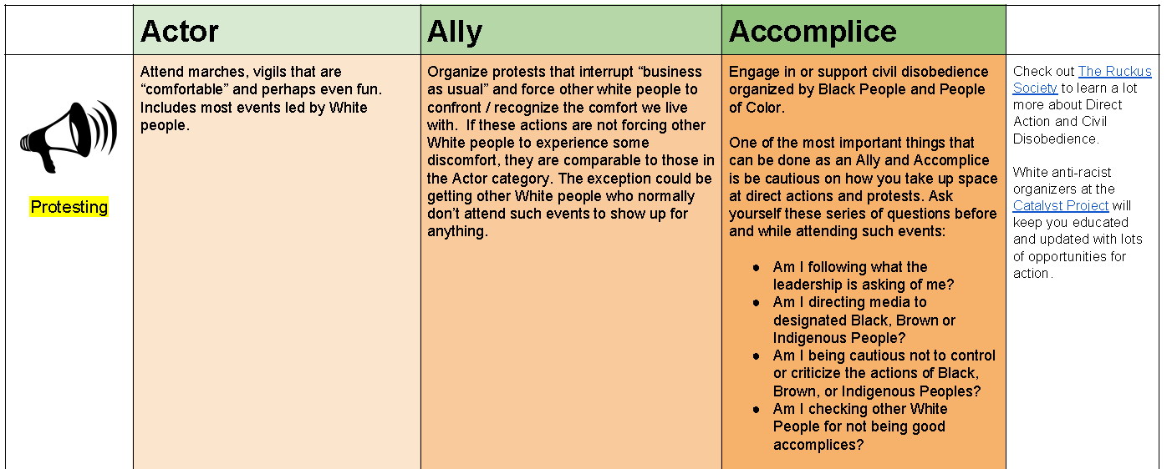

Slide 27
Future Collaboration
Please reach out to any of us if you are interested in possible collaborations.
Neil.kalsi@unmc.edu
Hannah.christiansen@unmc.edu
Susan.evans@unmc.edu
Andrea.jones@unmc.edu
Melanie.menning@unmc.edu
Jlliu@unmc.edu
Jessica.koran@unmc.edu
Alberto.marcelin@unmc.edu
Adworak@oneworldomaha.org

Slide 28
Thank you!
References
https://www.aafp.org/family-physician/patient-care/the-everyone-project/toolkit.html
https://www.bread.org/library/racial-wealth-gap-learning-simulation

