Slide 1
Defining your Why and your what: Using mission statements as a career compass
Society for teachers of Family Medicine, spring conference 2021
Isabel Lee, MD and Grace Shih, MD MAS
Thanks to Jessica Muller, PhD, co-founder UCSF Family Medicine Faculty Development Fellowship

Slide 2
Creative Commons License Attribution-NonCommercial-Share Alike 3.0 Unported

Slide 3
Learning objectives
Describe the components of a personal and professional mission statement (PPMS)
Write a draft of your own PPMS
Identify one place where it would be meaningful to implement PPMS in your home program

Slide 4
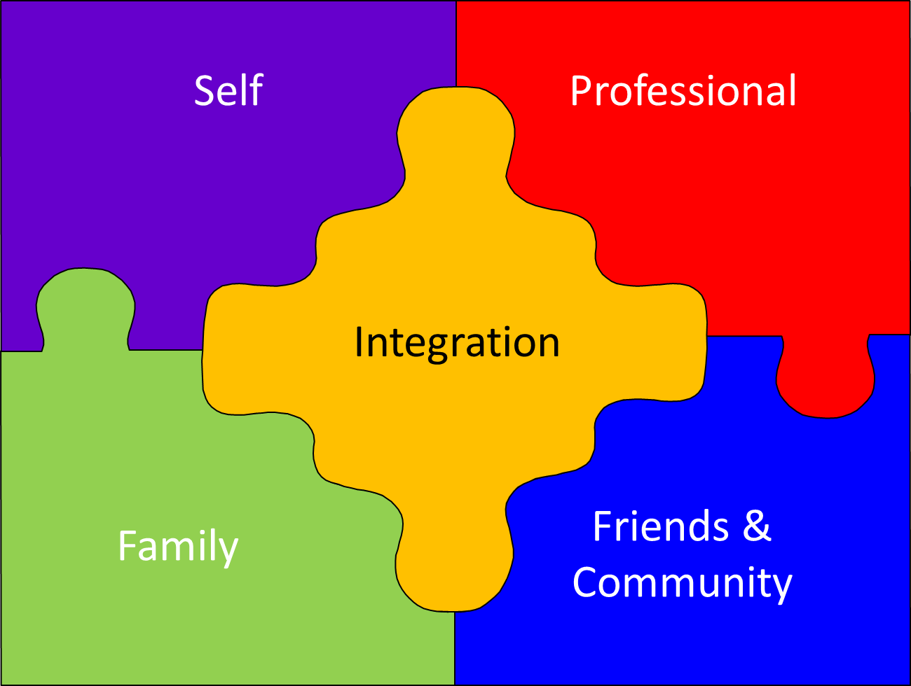
https://hygger.io/blog/what-is-work-life-balance/
Notes:
The

Slide 5
What makes something a mission statement?
Incorporates: what you want to focus on, what you are passionate about, and who you want to become
Identifies: core values, priorities, and principles
Describes: what, for whom, how
General or specific
Guides every day actions, e.g. yes vs no
Simple, brief, & positive
https://www.inc.com/steve-cody/how-to-create-the-right-purpose-for-your-business.html
Notes:
A way to focus your energy, actions, behaviors and decisions toward what’s most important to you
Includes actions, behaviors, values and traits important to you
1-5 sentences that convey your vision and path toward achieving it
Take a birds eye view of what you’ve just written → what are themes, recurrent words/core values/clinical areas, who is present/who is not

Slide 6
Why are mission statements useful?
Business & Non-Profit Health Care Sector:
enhance organizational performance
Individual:
clarify purpose & direction
more personal & more dynamic
https://live.staticflickr.com/7213/7163227255_dafb74ab94_b.jpg
Notes:
Business: gained popularity in the 1960s; means for an organization to express its vision, define its domain, highlight strengths & identify core values; means to communicate its motivating vision to internal and external stakeholders
Non-profit health care: starting in 1990s, used to help develop business plans and organizational goals; helpful to define purpose and direction
Individual: more commonly promoted in 2000s as means for individuals to define/focus on their purpose and direction
Personal experience

Slide 7
Sustainable, Satisfying Careers require clarity
Clarity: about guiding principles for our professional and personal lives
https://iliteam.org/coreleadership/thepowerofclarity
Notes:
Require many elements but most of all, they don’t just happen;

Slide 8
Finding clarity & vision
Outline current roles/responsibilities
Define key current personal/professional issues
Identify passions & priorities
Note what activities rejuvenate vs drain
Notes:
Roles/responsibilities: both at home and at work (and anywhere else: eg kids school, church, community): what percent of your time do you currently spend doing the activity
Key issues: speaks to the moment- may reflect transitions on the horizon or ongoing at home/work, specific pressures or needs; eg Defining what a meaningful career in medicine means to you, Developing credibility as a clinician/ faculty member, Finding where & how you fit in your organization, Meeting competing demands from family, community, and profession, Balancing your different role sat work and at home., Prioritizing what is truly important to you
Passions & priorities for you at home/work/community
Stephen Covey’s sharpening the saw: there are parts of are home, family and leisure time that bring us joy & rejuvenate us and others that mostly leave us dulled or drained (may be particular domain of job, collaborations with certain colleagues/learners, time on social media, obligation outside of work)

Slide 9
For example
Current Roles (Work):
30% direct fellowship
15% clinic attending
20% direct patient care
15% resident professional development
Current Key Issues:
Negotiating mentoring program for junior faculty
Explore expansion of MAB services to county clinics
House renovation
Kindergarten/middle school starts on horizon
Passions/Priorities
Advocating for MAB services in primary care
Expanding URM mentorship for residents and faculty
Maintaining clinical skills
Spending time with kids/family
Making time for exercise, outdoors and friends
Rejuvenating/Draining
R: 1:1 mentoring with residents and faculty; teaching fellowship; 1:1 time with friends, wife; outdoors with kids
D: zoom, driving in traffic, the internet

Slide 10
Exercise #1: taking stock
Using the worksheet provided, take 15 minutes to fill out the first side: outlining current roles, identifying key issues, & listing passions & priorities. If you have time, also start to answer what activities rejuvenate vs drain you.
Notes:
Photo credit: https://www.onegreenplanet.org/natural-health/how-a-vegan-macrobiotic-chef-stocks-her-pantry-and-kitchen-for-success/

Slide 11
Reflection: Preparing for mission Statement writing
Is your FTE distribution where you want it to be? Does it reflect emphasis on your passions and priorities?
Do your key issues at work align with your priorities? Are you giving the attention you want to key issues outside of work?
What is your mix of rejuvenating vs draining activities?
https://pixabay.com/photos/sea-boat-reflection-water-ocean-4276326/
Notes:
Photo credit: https://pixabay.com/photos/sea-boat-reflection-water-ocean-4276326/

Slide 12
​Mission statement templates
“To …. (do/become/etc) so that I will do …. by…”​
“I value … because… Accordingly, I will …”​
“To appreciate and enjoy…”​
“To be someone who is …”​
“To treasure above all else …”​
“To develop & cultivate the qualities of …”​
“To live each day with … so that …”​

Slide 13
Examples
“Not merely to survive, but to thrive; and to do so with some passion, some compassion, some humor, and some style.” –Maya Angelou Poet/novelist
Notes:
Example of general guiding principle for life

Slide 14
Examples
“My purpose is to make the world a better place for everyone including my patients, myself and those I love. My goal is to become as emotionally strong as I am clinically strong so my patients have someone to lean on and are healthy to be there for those they love.”
WWAMI Chief Resident, 2019

Slide 15
Examples
“To be a present & caring member of my community—prioritizing family over work. To lead with fairness, inclusion, and trustworthiness. To partner with my patients to help them thrive. To advocate for policies that address the root causes of disparities in health and healthcare. To protect and appreciate nature and the environment.”
Rossan Chen, MD Faculty, Kaiser Vallejo Family Medicine Residency Program

Slide 16
Examples
“To guide learners to fulfillment and training programs to excellence, by attending to humanistic principles.”
Mary Westergaard, MD Vice Chair of Education Emergency Medicine Residency PD University of Wisconsin
Notes:
Educational leadership-focused mission

Slide 17
Exercise #2: drafting a mission statement
The time has come! On page 2 of your worksheet, follow the prompt and take 15 minutes to craft a 3-5 line mission statement. It can incorporate both professional and personal elements or focus on just one of those domains, if one feels more in need of intention-setting.

Slide 18
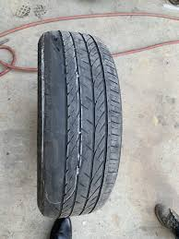
Checking alignment
Looking back at first exercise, do your current roles, responsibilities and priorities align with your mission statement?
Take 5 minutes to identify three SMART goals to promote alignment

Slide 19
University of Washington FMRP
Structure:
UW Chief Resident Conference
2-day in-person conference (pre-COVID); Day 1 “5-minute mission statement”; talk on self-determination theory, exercise of 7 Whys?; Day 2: Revisit mission statement and share with partner
UW R1 Retreat
Brief (45 min) as part of larger reflective half-day, during winter slump, start with identifying core values, then independent writing time followed by optional sharing with large group.
Notes:
Self-Determination Theory – provide a framework/theory on how to think about it for self and others
Autonomy
Competence
Deep connection
7 Why’s or until you cannot go any deeper → What made you choose being a family physician? Then…5xs “Why is that important to you?” ~5 min for each person (in pair) plus 15 min big group discussion = 30 min total

Slide 20
UW Chief’s conference feedback
Evaluations (n=32)
Overall exercise, 91% rated as at least 4 out of 5 (outstanding); 86% at least 4/5, sharing reflections with partner supported growth
Comments:
“Forces you to clarify the exact value, meaning, and purpose of what you're hoping to do with your life/career...and how you're going to get there.”
“Gave me time to clarify my personal goals and synthesize the direction I want to take this year.”
“Direction in times of angst.” “Revisit it during transitions in life.”

Slide 21
UCSF FM Faculty Development Fellowship
Structure
Half day
Workbook guides reflection steps, mission statement, goal-writing
Paired with partner
Gallery walk

Slide 22
FEEDBACK from the Fellows: isabel
Evaluations (n=49)
>75% agreed or strongly agreed: the workbook self-inventory exercise helped clarify their roles and identify personal and professional values and priorities
100% agreed or strongly agreed: developing a mission statement helped them identify short and long term goals for life and career.
Comments
“Although uncomfortable, I found that actually thinking about my values and putting (them) together as (a) Mission Statement and setting goals was extremely helpful and rejuvenating.”.
“I have spent a lot of time doing this already, so I was skeptical I would get a lot out of it. But I was wrong as it was very helpful as the guidance helped tremendously. Previously I had only done it on my own.”

Slide 23
In sum… Mission statement writing: part of professional development
Applicable to residents, chief residents, junior faculty, leaders
Writing (and updating) an effective MS requires clarifying our current roles, pressing issues, priorities, and goals
Encourages reflection on components of meaningful work
Can provide a compass to support a sustainable, integrated career
Notes:
Finding meaning and joy in work reduce burnout; integrating this exercise pushes people to take stock of where they are, identify what’s most important to them and articulate those in a mission statement. Where those don’t align, important to identify SMART goals toward alignment

