Slide 1
Bipolar Disorder
David M. Newman, MD

Slide 2
Disclosures
None

Slide 3
Outline
Epidemiology
Description
Diagnosis
Treatment

Slide 4
Epidemiology
Notes:
Dx is hard. Over and Under dx.
Multiple criteria, fluctuate over time
Even the experts don’t get it right.

Slide 5
Prevalence
1.5% of US population
(~ 50:50 Type I and II)
Heritability
Identical twin: 70%
Both parents: 50-75%
Sibling: 15-25%
One parent: 15-30%
Notes:
At least 13 associated genes

Slide 6
Course
Onset 15 – 25
The younger the worse
Mean Bipolar I = 18
Mean Bipolar II = 22 (or delay in Dx)

Slide 7
Description

Slide 8
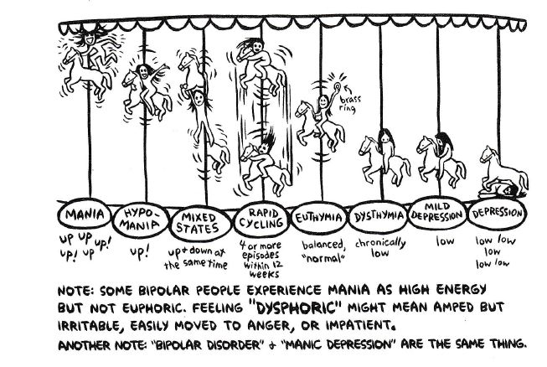
Mood Definitions
Notes:
Not “mood swings.”
This says 4 or more in 12 weeks, The standard is 12 months

Slide 9
Define mania:
–

Slide 10
Mania DSM 5
Distinct period of elevated, expansive, or irritable mood, lasting at least 1 week.
Accompanied by 3 or more* of following:
Inflated self-esteem or grandiosity
Decreased need for sleep (3 hours or less) and not missing it
More talkative or pressure to talk
Flight of ideas or thoughts racing
Distractibility
Increase in goal-directed activity
Excessive involvement in pleasurable activities that have a high potential for painful consequences
* 4 or more needed if mood is only irritable

Slide 11
Mania DSM 5
Distinct period of elevated, expansive, or irritable mood, lasting at least 1 week.
Accompanied by 3 or more* of following:
Inflated self-esteem or grandiosity
Decreased need for sleep (3 hours or less) and not missing it
More talkative or pressure to talk
Flight of ideas or thoughts racing
Distractibility
Increase in goal-directed activity
Excessive involvement in pleasurable activities that have a high potential for painful consequences
* 4 or more needed if mood is only irritable
Notes:
Not all

Slide 12
Mania DSM 5
Distinct period of elevated, expansive, or irritable mood, lasting at least 1 week.
Accompanied by 3 or more* of following:
Inflated self-esteem or grandiosity
Decreased need for sleep (3 hours or less) and not missing it
More talkative or pressure to talk
Flight of ideas or thoughts racing
Distractibility
Increase in goal-directed activity
Excessive involvement in pleasurable activities that have a high potential for painful consequences
* 4 or more needed if mood is only irritable

Slide 13
Mania DSM 5
Sufficient to cause significant disruption in personal or vocational functioning.

Slide 14
Mania - Details
Flight of ideas = abrupt changes from one topic to another that are based upon understandable associations
Manic speech is generally loud, pressured or fast, difficult to interrupt, and may have joking, singing, clanging (choosing words based upon sounds rather than meaning), and dramatic gestures.
Irritable patients often make hostile comments, swear more than usual, or go off on angry tirades
Notes:
Disinhibition
Disregard for social boundaries
Relentless pursuit of stimulation and social activities (eg, acting flirtatious, renewing old friendships, or lengthy telephone calls with strangers or at unusual times)
Taking on new and foolish business ventures, unaffordable spending sprees, sexual infidelity or sexual encounters with strangers, and driving recklessly.
Often unable to complete the many tasks or projects that are started.

Slide 15
Mania with Psychotic Features
Severe mania can be accompanied by psychosis:
Hallucinations – hearing or seeing things
Delusions – false fixed beliefs not linked to reason
Notes:
Grandiosity.
Personal relation to God or celebrities
Special talents

Slide 16
Hypomania
Distinct period of elevated, expansive, or irritable mood, lasting at least 4 days.
Unlike mania, this is not severe enough to cause marked impairment in social or occupational functioning.
Unlike mania, there is no potential need for hospitalization.
Unlike mania, there are no psychotic features.

Slide 17
Major Depression
2 wks of depressed mood / anhedonia + 5:
Weight change AND
Sleep change Not from grief
Agitation or slowing Marked Impairment
Fatigue
Worthlessness or guilt Single or recurrent
Poor concentration
Thoughts of death
Notes:
Recurrent depression very hard to tell from bipolar II

Slide 18
Mixed
Manic features with dysphoric mood, anxiety, agitation or irritability
Increased risk for suicide and drug abuse

Slide 19
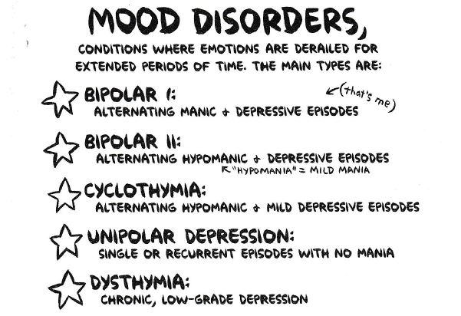
Definitions
Notes:
ICD 10 does not distinguish Bipolar I from II
19

Slide 20
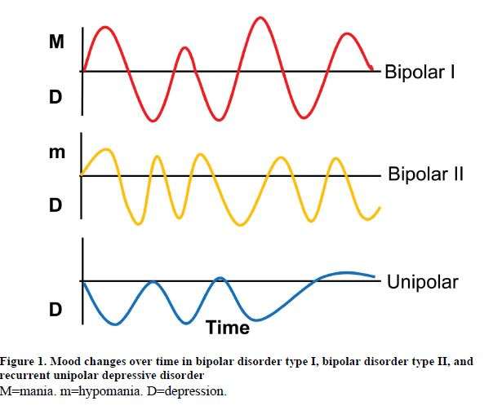
Graphs
Notes:
Some believe in unipolar mania.
Difference between unipolar depression and depression w/ multiple episodes?

Slide 21
Duration
Bipolar I:
Average duration of depression is 12 - 16 weeks
25% resolve in 4 wks
10% of the time they are either manic or hypomanic
Bipolar II
1% of the time is hypomanic

Slide 22
Rapid Cycling
More than 4 swings in a year
0 – 20% of bipolar; 0.7% of population
80% convert to non-rapid in 1 – 2 years but can last up to 8 years.
Changes not in reaction to life stress (unlike Borderline)
DSM: Mania must last at least 1 wk;

Slide 23
Diagnosis
Notes:
Dx is hard. Over and Under dx.
Multiple criteria, fluctuate over time
Even the experts don’t get it right.

Slide 24
Bipolar Screen
current episode of major depression
☐ 1 or more prior episodes of depression
☐ Parent, sibling, or child with major depression or bipolar
☐ Delusions of any type during this episode. Persecutory, somatic, grandiose, religious, Thought insertion or withdrawal
2 (+) = 80% chance of Bipolar I and 60% of bipolar II.

Slide 25
MDQ
Has there ever been a period of time when you were not your usual self and:
Y N You felt so good or so “hyper” that other people thought you were not your normal self, or you were so “hyper” that you got into trouble?
Y N You were so irritable that you shouted at people or started fights?
Y N You felt much more self-confident than usual?
Y N You got much less sleep than usual and found you did not miss it?
Y N You were much more talkative and spoke faster than usual?
Y N Thoughts raced through your head or you could not slow your mind down?
Y N You were so easily distracted by things around you that you had trouble concentrating or staying on track?
Y N You had much more energy than usual?
Y N You were much more active or did many more things than usual?
Sensitivity 58%, Specificity 90+%
Notes:
This is a partial version

Slide 26
Differential Dx
-

Slide 27
Differential Dx
Anxiety
ADHD
PTSD
Abuse
Schizophrenia / Schizoaffective
Substance Use
Borderline
Meds
Levodopa
Stimulants
Steroids
Cortico & Anabolic
SLE
Hyperthyroid
Wilson’s Dz
Notes:
Cushings – steroids
Tumor
Stroke

Slide 28
Comorbidity
●Anxiety disorders – 65 – 75%
●Substance use disorders – 50 – 60%
●ADHD 20 – 30%
●Eating disorders – 10 – 15%
●Intermittent explosive disorder – 25 – 30%
●Personality disorders – 50% (half borderline)
●Post-traumatic stress disorder
Notes:
Making dx even more difficult
Note overlap with DDx.

Slide 29
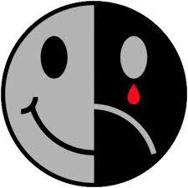
Questions?

Slide 30
Treatment

Slide 31
Non-Pharmacologic

Slide 32
Talk Therapy
Active Skills Training
Cognitive Behavioral Therapy (CBT)
Family Therapy
Psychoeducational
Group / family better than individual
Meds + Talk better than either alone
Notes:
Supportive did not work well.

Slide 33
Non-pharmacologic
Skills:
Education about bipolar disorder
Mood Charting
Improvement of treatment adherence
Discussing consequences of impulsive behavior
Sleep hygiene
Dealing with triggers
Train an observer!

Slide 34
Light Therapy
Not great data, but...
Light therapy can help depression, esp SAD but can trigger mania.
“Women with bipolar illness are highly sensitive to morning bright light treatment; the induction of mixed states is a substantial risk. Initiating treatment with a brief duration (15 min) of midday light for bipolar depression is advisable.”
A small study indicated that blue-blocking glasses may help mania.

Slide 35
Meds – Acute Mania
IM
Haldol, Lorazepam, Atypical
Oral
Lithium
Valproate
Haldol
Atypical
Notes:
Not all are approved by FDA
½ respond to mono therapy within 4 weeks
Stop stimulants!

Slide 36
Meds – Bipolar Depression
1^{st s}Line
Quetiapine, Lurasidone (Latuda ®)
2nd Line
Olanzapine + Fluoxetine
Valproate
Lithium
Lamotrigine
Notes:
Combos
SSRI less like to cause mania than SNRI or tricyclic
Li reduces risk of suicide
Avoid Trazodone
If all else fails – ECT
Evidence for melatonin scant and mixed

Slide 37
Preventing Relapse
Acknowledge the illness
Understand it
Spot a relapse (appoint a spotter)
Emergency plan
Mend relationships
Know the triggers

Slide 38
Triggers
Time change
Shift Work, Jet Lag
Daylight savings time, Seasons
Hormone changes
Pregnancy
Puberty, Menopause
Menses
Psychosocial Stress

Slide 39
Alternative Meds
Omega-3
Co-Q 10 - 200 mg daily
Notes:
1 study each

Slide 40
Apps
True Colours
Emoods
MoodLog (android)
Up! (android)
iMoodJournal - $

Slide 41
Questions?

Slide 42
References
Marzani G, Neff AP. Bipolar Disorders: Evaluation and Treatment. Am Fam Physician. 2021:103(4):227-239.
Plante DT. The Importance of Sleep Phenotypes in Bipolar Disorders. JAMA Psychiatry. 2020;77(3):235–236. doi:10.1001/jamapsychiatry.2019.3747
Kendler KS, Ohlsson H, Sundquist J, Sundquist K. An Extended Swedish National Adoption Study of Bipolar Disorder Illness and Cross-Generational Familial Association With Schizophrenia and Major Depression. JAMA Psychiatry. 2020;77(8):814–822. doi:10.1001/jamapsychiatry.2020.0223
Miklowitz DJ, Efthimiou O, Furukawa TA, et al. Adjunctive Psychotherapy for Bipolar Disorder: A Systematic Review and Component Network Meta-analysis. JAMA Psychiatry. 2021;78(2):141–150. doi:10.1001/jamapsychiatry.2020.299
Solé B, Jiménez E, Torrent C, Reinares M, Bonnin CDM, Torres I, Varo C, Grande I, Valls E, Salagre E, Sanchez-Moreno J, Martinez-Aran A, Carvalho AF, Vieta E. Cognitive Impairment in Bipolar Disorder: Treatment and Prevention Strategies. Int J Neuropsychopharmacol. 2017 Aug 1;20(8):670-680. doi: 10.1093/ijnp/pyx032. PMID: 28498954; PMCID: PMC5570032.
Harrison PJ, Geddes JR, Tunbridge EM. The Emerging Neurobiology of Bipolar Disorder. Trends Neurosci. 2018 Jan;41(1):18-30. doi: 10.1016/j.tins.2017.10.006. Epub 2017 Nov 20. PMID: 29169634; PMCID: PMC5755726.

Slide 43
References
Tondo L, Vázquez GH, Baldessarini RJ. Depression and Mania in Bipolar Disorder. Curr Neuropharmacol. 2017;15(3):353-358. doi:10.2174/1570159X14666160606210811
Phillips ML, Kupfer DJ. Bipolar disorder diagnosis: challenges and future directions. Lancet. 2013;381(9878):1663-1671. doi:10.1016/S0140-6736(13)60989-7
Zimmerman M, Morgan TA. The relationship between borderline personality disorder and bipolar disorder. Dialogues Clin Neurosci. 2013 Jun;15(2):155-69. doi: 10.31887/DCNS.2013.15.2/mzimmerman. PMID: 24174890; PMCID: PMC3811087.
UpToDate
Marbles & Rock Steady by Ellen Forney
Johnson WM, Fields SA, Bluett E; Bipolar Disorder: Managing the Peaks and Valleys, PowerPoint Presentation from STFM Library.
Solomon DA, Leon AC, Maser JD, Truman CJ, Coryell W, Endicott J, Teres JJ, Keller MB. Distinguishing bipolar major depression from unipolar major depression with the screening assessment of depression-polarity (SAD-P). J Clin Psychiatry. 2006 Mar;67(3):434-42. doi: 10.4088/jcp.v67n0315. PMID: 16649831.

Slide 44
References
Sit D, Wisner KL, Hanusa BH, Stull S, Terman M. Light therapy for bipolar disorder: a case series in women. Bipolar Disord. 2007 Dec;9(8):918-27. doi: 10.1111/j.1399-5618.2007.00451.x. PMID: 18076544.
van Hout, L.J.E., Rops, L.E.P. & Simons, C.J.P. Treating winter depressive episodes in bipolar disorder: an open trial of light therapy. Int J Bipolar Disord 8, 17 (2020). https://doi.org/10.1186/s40345-020-00182-5
Gottlieb JF, Benedetti F, Geoffroy PA,et al. The chronotherapeutic treatment of bipolar disorders: A systematic review and practice recommendations from the ISBD task force on chronotherapy and chronobiology. Bipolar Disord. 2019 Dec;21(8):741-773. doi: 10.1111/bdi.12847. Epub 2019 Nov 22. PMID: 31609530.
Pharmacotherapy of Bipolar Disorder in Adults. Pharmacist’s Letter/Prescriber’s Letter. July 2018.

