Slide 1
Implementing Narrative Evaluations in a New Family Medicine Clerkship: Strategies to Reduce Bias and Improve Quality
Elizabeth Brown, MD​, MPH
Nina Piazza, MD​
Amy Blatt, MD​
University of Rochester School of Medicine and Dentistry​

Slide 2
Disclosures
None

Slide 3
Learning Objectives​
On completion of this session the participants should be able to...​
Apply a narrative framework to generate a useful written evaluation for the next learner with whom they work.​
Incorporate narrative feedback into the evaluations and grading of their medical student rotations.​
Choose words to incorporate into evaluations that minimize bias in grading.​

Slide 4
We'd like to learn more about you! ​
Please put in the chat...​
At what institution do you work?​
What is your role at your medical school?
Does your current evaluation system rely more heavily on narrative or numeric evaluation?

Slide 5
Bias in Medical Student Evaluations​
Internal reviews of medical school grading show that grading disparities favor white students, on final clerkship grades and MSPE summary words​
Evaluations of women and URM students are more likely to contain words related to personal attributes, rather than competency

Slide 6
Narrative Feedback​
The best narrative comments are…​
Descriptive ​
Behavior focused​
Specific​
Non-judgmental​
Relate to the learning objectives​
Offer suggestions for improvement

Slide 7
Performance Domains​
Knowledge base​ | Demonstrates understanding of common medical conditions, diagnostic tests, and treatments ​ Relates common symptoms and diseases to underlying pathophysiology​ Displays intellectual curiosity and self-directed learning​
History taking and data gathering​ | Clinical history is complete, accurate, and relevant​ Information is obtained from chart review and collateral sources when necessary​
Physical exam skills​ | Performs thorough exam, as appropriate for visit focus​ Accurately identifies and describes abnormal findings​
Oral presentations​ | Organized and clear ​ Able to presently clearly in front of patient using patient-centered language​
Written notes​ | Structured format​ Updated to reflect final assessment and plan for the visit​ Reflects clinical decision making​ Completed in a timely manner ​
Clinical reasoning​ | Synthesizes key clinical information to summarize cases​ Develops and reasons through differential diagnosis for common symptoms/presentations​
Relationships with patients​ | Forms constructive relationships​ Sensitive and attentive to individual patient’s concerns/needs​
Team work​ | Respects role of all team members​ Willingly participates in patient care tasks​ Communicates and collaborates effectively ​

Slide 8
PRIME+ Framework​
RIME​
Professionalism​
Reporter​
Interpreter​
Manager​
Educator​
+ (Areas for Improvement)​
Helps provide an overall summary of performance​

Slide 9
Jane was always on time, reliable, and dependable such that I always knew the information she provided was accurate. She was able to report data succinctly and gather complete histories while simultaneously maintaining excellent rapport with families. She performed good differential diagnoses, was able to interpret lab data, PFTs, etc, and to independently find resources to help her when she came across data she had not encountered previously. Jane could synthesize good plans, and managed patients well, always spending additional time to ensure family understanding of instructions. She responded well to feedback with appreciation and an upbeat attitude, worked diligently on fund of knowledge, and was able to educate families and patients well on various illnesses; always the professional, spending more time and effort whenever it was required by the situation.​

Slide 10
SMART Framework​
SMART ​
Specific​
Measurable​
Achievable​
Relevant​
Time-bound​
Helps provide actionable advice regarding areas for improvement. ​
Great option for mid-clerkship or daily feedback (formative).

Slide 11
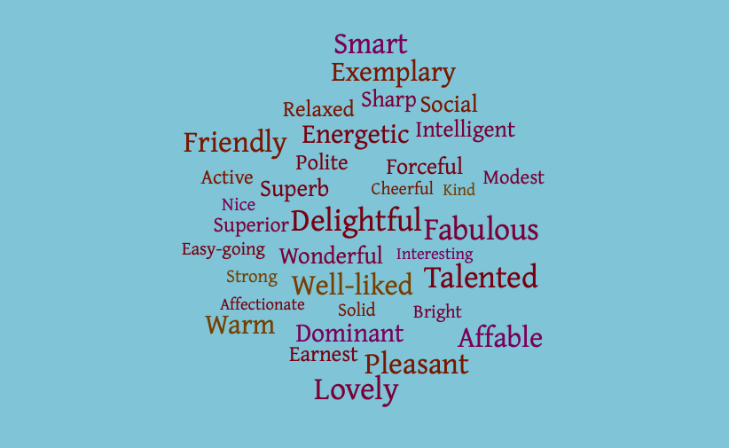
Words that lead to bias in evaluations​

Slide 12
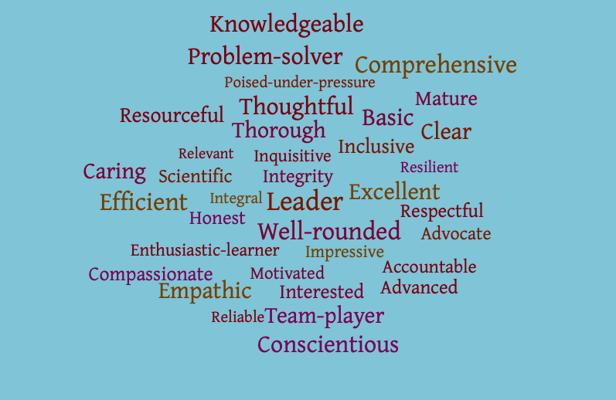
Consider using these words instead

Slide 13
What do you think of this evaluation?
"[Student] did a superb job on their rotation. They were well-liked by all clinic staff and had a warm bedside manner. Their knowledge base is solid and they are strong in oral presentations and written notes."
Notes:
Words that cause bias, and other options to use instead?
-Guess the gender

Slide 14
Our process of transitioning to narrative evaluations
Faculty development session about high quality narrative evaluations and eliminating bias
Review of current evaluations, changing to narrative comments focusing on appropriate performance domains for 3rd/4th year FM Clerkship, with input from other clerkships at our institution
Next steps: Comprehensive review of quality of narrative evaluations and individualized feedback

Slide 15
Our initial outpatient evaluation​
Numeric (0-9) scores in the following domains​
Knowledge base description​
Knowledge base improvement​
History gathering skills​
Physical exam skills​
Oral presentations​
Written notes and Differential Diagnoses​
Professionalism​
Motivation and Attitude​
Relationships with patients​
Teamwork
Short answer questions related to:​
​
Clinical Performance​
Personal and Professional Qualities​
Summary comments​
Areas for Improvement

Slide 16
Current Clerkship Evaluation​
Prompt at the beginning to discourage use of words that can lead to bias​
Short answer questions in the following 3 domains, with descriptions of expected skills at their level of training​
Clinical Skills and Communication​
Knowledge Base and Clinical Reasoning​
Professional Qualities​
One numeric question, rating overall performance on scale of 1-5, with reminder that 90% of students will fall in 2-4 category

Slide 17
NEQI Scoring​
Tool to evaluate quality of narrative evaluations, based on the following three domains​
Performance Domains​ (4 points)
Specificity of comments​ (4 points)
Usefulness to trainee (4 points)
Total possible: 12 points

Slide 18
Evaluation pre-faculty development and evaluation change​
"[Student] met every aspect of the ICARE model. She was inquisitive, empathetic, a great team member, and very self-aware. [Student] was a pleasure to work with. From multiple evaluators, they commented on her inquisitive nature, engagement, and rapport with patients. She is also very efficient, and does well with oral and written presentations of her patients. Continue seeking out interested physical exam findings, forming your own assessments and plans, reading up on patients that you see in clinic or on the wards."​
NEQI score: 6

Slide 19
Evaluation post-faculty development and evaluation change
“[Student] was effective in gather[ing] a history from patients and reliably completing pertinent aspects of a physical exam when clinically indicated. His oral presentations were succinct and well organized with pertinent history, ROS, and exam findings included. He always challenged himself with formulating his own assessment and plan. His written notes were brief and concise, I would encourage him to describe more of this differential and thought process. Notes sometimes needed to be edited to add additional information prior to completion. He demonstrated an appropriate understanding of common conditions, work-up, and broad differential that is seen in the primary care setting. I would encourage [student] to continue to work on a broad but prioritized differential (with evidence to back up each item on the differential) to further fine-tune his diagnostic reasoning skills. [Student] was professional, engaged, motivated in working with patients. He read up ahead on patients and reviewed their history. He was enthusiastic to see patients, even staying late to complete encounters, notes, or see patients. He appeared to develop good rapport with patients."​
NEQI score: 10

Slide 20
What do you think of this evaluation? ​
“Patient connection is a real strength for her. Anticipates needs/barriers, connects quickly and deeply with even reserved patients. Actively sought feedback and looked to grow based on this. Exceptional student; quiet but efficient and effective in her work. Driven to work with underserved, will be an excellent family physician.”​
Notes:
-Any evidence of bias? (quiet)
-Apply framework/performance domains?

Slide 21
And this one?​
“Checks all the boxes in this skill set for what would be expected of her level of training. No major elements missed in history taking. Has room to grow in terms of time and efficiency. Performs clinically relevant exam, presentations were clear and notes needed only minor edits. Has a solid base of knowledge. Formulates a good differential and appropriate diagnostic plan. Easily developed rapport with patients. Reliable and poised.”
Notes:
Frameworks to apply?
Ways to avoid bias?

Slide 22
References​
Rojek AE, Khanna R, Yim JWL, Gardner R, Lisker S, Hauer KE, Lucey C, Sarkar U. Differences in Narrative Language in Evaluations of Medical Students by Gender and Under-represented Minority Status. J Gen Intern Med. 2019 May;34(5):684-691. doi: 10.1007/s11606-019-04889-9. PMID: 30993609; PMCID: PMC6502922.​
Low D, Pollack SW, Liao ZC, Maestas R, Kirven LE, Eacker AM, Morales LS. Racial/Ethnic Disparities in Clinical Grading in Medical School. Teach Learn Med. 2019 Oct-Dec;31(5):487-496. doi: 10.1080/10401334.2019.1597724. Epub 2019 Apr 29. PMID: 31032666.​
Ross DA, Boatright D, Nunez-Smith M, Jordan A, Chekroud A, Moore EZ. Differences in words used to describe racial and gender groups in Medical Student Performance Evaluations. PLoS One. 2017 Aug 9;12(8):e0181659. doi: 10.1371/journal.pone.0181659. PMID: 28792940; PMCID: PMC5549898.
Holmes AV, Peltier CB, et al. Writing Medical Student and Resident Performance Evaluations: Beyond “Performed as Expected. Pediatrics. May 2014, 133 (5) 766-768; https://doi.org/10.1542/peds.2014-0418.
Hewson MG, Little ML. Giving feedback in medical education: verification of recommended techniques. J Gen Intern Med. 1998;13(2):111-116. doi:10.1046/j.1525-1497.1998.00027.
“Evaluation.” TeachingPhysician.org, STFM.

Slide 23
We'd love to hear from you!
Any questions?
Best practices and strategies you're using at your institution?

Slide 24
Evaluation
Please be sure to complete an evaluation for this presentation.

