Slide 1
Making Adult Learning Theory Come Alive!
COL Douglas Maurer, DO, MPH, FAAFP
MAJ Mike Arnold, DO
Madigan Faculty Development Fellowship, WA
CPT Katie Westerfield, DO
Family Medicine Residency
Martin Army Community Hospital, GA
Notes:
Now I stand before you a convinced woman. Convinced of the value of having a system to plan learning events. I love this session because this is where we get practical and put it all together. I promise you that, by the end of this session, you will be as excited as I am about planning your next learning event and convinced to use this system! I am Amanda Cuda, a second year faculty development fellow.

Slide 2
Consider the best teaching or learning event you can remember participating in…What made this such a great session? What is an upcoming event you are supposed to teach?
Activity #1
Share your thoughts with a partner
We will hear a sample
2 Minutes
Notes:
CHECK THESE

Slide 3
Making Adult Learning Theory Come Alive!
COL Douglas Maurer, DO, MPH, FAAFP
MAJ Mike Arnold, DO
Madigan Faculty Development Fellowship, WA
MAJ Katie Westerfield, DO
Family Medicine Residency
Martin Army Community Hospital, GA
Notes:
Now I stand before you a convinced woman. Convinced of the value of having a system to plan learning events. I love this session because this is where we get practical and put it all together. I promise you that, by the end of this session, you will be as excited as I am about planning your next learning event and convinced to use this system! I am Amanda Cuda, a second year faculty development fellow.

Slide 4
Disclosures
The views expressed are those of the author(s) and do not reflect the official policy of the Department of the Army, the Department of Defense or the U.S. Government.

Slide 5
Objectives
Reviewed classic and modern adult learning theories
Introduced the AIM to ACT Toolbox
Discussed the Vela model for designing learning events
Designed learning tasks for your event using the Toolbox
Take Away
Promotion of understanding and retention of didactic material
Notes:
Define educational concepts and name key components of promotion of understanding and retention through lecture
Recognize behaviors to promote understanding of the learner through video reviews, discussion and personal reflection of current methods used.

Slide 6
Who Is the Adult Learner?
Experience
Focus
Pattern of learning
Need for immediacy
Reduced attention span
Dialogue
Relationships
Notes:
All of us in this room, just by the fact that we are here, are adult learners and are involved in the education of adult learners. In a few minutes we will be talking about one of the many sets of principles that are associated with adult learning, but first, we really should talk about the concept of the adult learner. Who is the adult learner? How is the adult learner different than “other learners”? Why do we spend so much time and energy trying to discuss “adult learning theory”, rather than just “learning theory”?
Well, to start with, people that are engaged in adult learning are different than people that are engaged in elementary and secondary education. Most obviously is that there is an age difference between adult learners and those in elementary and secondary education, but there is more than that.
Because we are all adult learners and because engagement is one of the major principles of adult learning, I am going to try to involve you, the learners, in my presentation.
So, what do you think are some characteristics of the adult learner.
Adult learners:
Have a variety of experiences that they can offer to the learning environment
Have some idea about what they want to learn.
Have an established pattern about learning.
Have a comparatively short attention span.
Want to have some immediacy to their learning. They want information that will get them a better job, promotion, more money or improve their situation in some way.

Slide 7
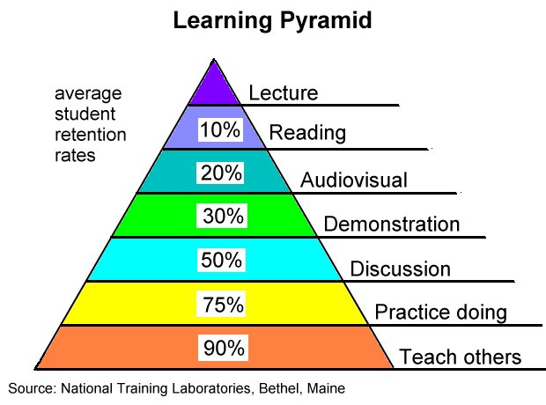
Notes:
Edgar Dale 1960: Cone of Learning

Slide 8
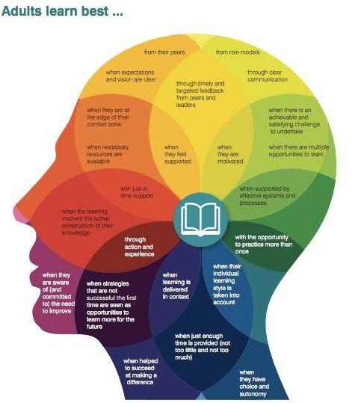
Part I: Adult Learning Theories

Slide 9
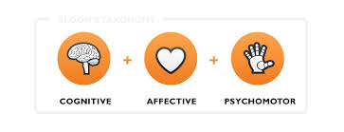
Bloom’s Learning Domains
Cognitive
Knowledge
Affective
Attitudes
Psychomotor
Skills
Behavior
Notes:
The Three Domains of Learning
The committee identified three domains of educational activities or learning (Bloom, et al. 1956):
Cognitive: mental skills (knowledge)
Affective: growth in feelings or emotional areas (attitude or self)
Psychomotor: manual or physical skills (skills)

Slide 10
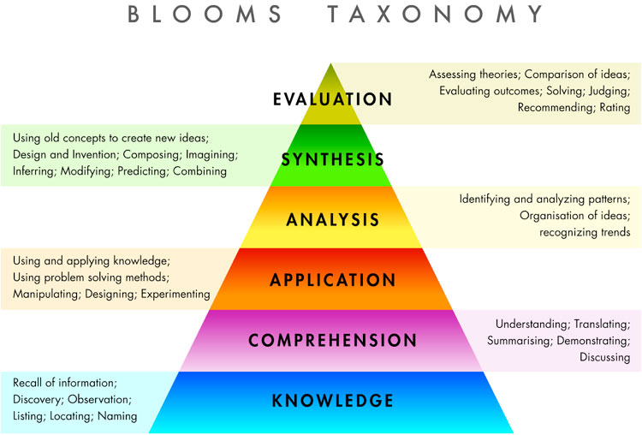

Slide 11
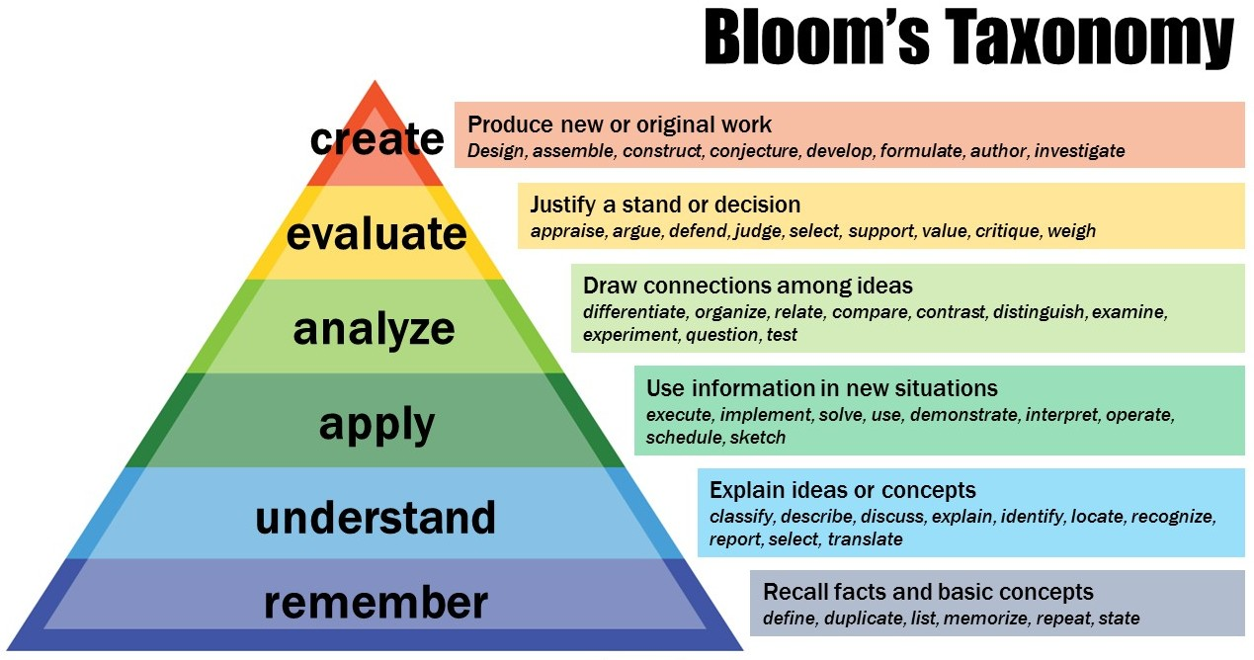
Notes:
Krathwohl, 2001
Factual knowledge
Terminology, dates, elements
Conceptual knowledge
Classifications, categories, principles, generalizations, theories, models, structures
Procedural knowledge
Subject specific skills, algorithms, techniques, methods, criteria for use of specific techniques
Metacognitive knowledge
Strategic, contextual and conditional knowledge, self-knowledge
We must remember a concept before we can understand it. We must understand a concept before we can apply it. We must be able to apply a concept before we analyze it. We must have analyzed a concept before we can evaluate it. We must have remembered, understood, applied, analyzed, and evaluated a concept before we can create.

Slide 12
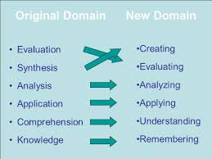

Slide 14
Notes:
Published in 1984

Slide 15
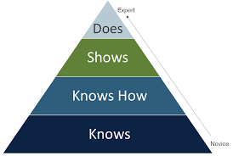
Miller’s Pyramid
Framework for assessing competence
Learners journey from novice to expert
Objectives should define methods
Objectives connected to assessments used
How to assess competence at each level?
Miller GE. The assessment of clinical skills/competence/performance. Academic Medicine. 1990.65(9)Supplement. S63-S67
Notes:
Published in 1990
Define clear learning outcomes
Match instructional methods with those outcomes
Support learning
Valid and reliable assessments

Slide 16
Miller’s Pyramid
Does
Knows how
Knowledge
Shows how
Basis for Performance of Skills

Slide 17
Miller’s Pyramid
Does
Knows how
Knowledge
Shows how
Learning Related Skill
How Knowledge Is Employed

Slide 18
Miller’s Pyramid
Does
Knows how
Knowledge
Shows how
Demonstrates the Skill
Performance Objective
Competence

Slide 19
Miller’s Pyramid
Does
Knows how
Knowledge
Shows how
Performs in Independent, Clinical Practice

Slide 20
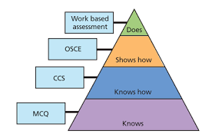
Miller’s Methods of Teaching
Multiple choice questions
Modified essay questions
Patient management problems
Objective Structured Clinical Examinations (OSCEs)
Simulations
Standardized patients
Assessments
Notes:
CCS: computer case-based simulations

Slide 21
Dreyfus Model of Skill Acquisition
Develop skills via instruction and experience
5 defined stages
From dependence on abstract principles to concrete experience
Shift from controlled processing
Requires attention, not as proficient or skilled
Towards automatic processing
Requires less attention, easily completes task
Notes:
Stuart and Hubert U of Calif. Berkeley, USAF contract (Dept. of Industrial Engineering and Operations Research and Dept. of Philosophy)
Original document listed in syllabus
The designer of training aids and courses must at all times be aware of the developmental stage of the student, so as to facilitate the trainee's advancement to the next stage, and to avoid the temptation to introduce intricate and sophisticated aids which, although they might improve performance at a particular level, would impede advancement to a higher stage, or even encourage regression to a lower one.”
From consciously competent (thinking about what you are doing) to unconsciously competent (autopilot---you can do it in your sleep/with your eyes closed)…not even thinking about what/how you are doing (to a point).

Slide 23
Mental models for skill acquisition
Stage 1 | Stage 2 | Stage 3 | Stage 4 | Stage 5
NOVICE | COMPETENCE | PROFICIENCY | EXPERTISE | MASTERY
Task has context free features Non-situational General rules or principles Requires monitoring | Situational components Aspect recognition (recurrent patterns) Guidelines for action | Exposed to whole “Maxims” or memorized principles Judges importance of salient aspects | Intuitive appropriate actions Uses rules, guidelines, maxims Appropriate responses to context | Automaticity Intuitive response Minimal mental effort required “In the zone”
Dreyfus and Dreyfus, 1980.

Slide 24
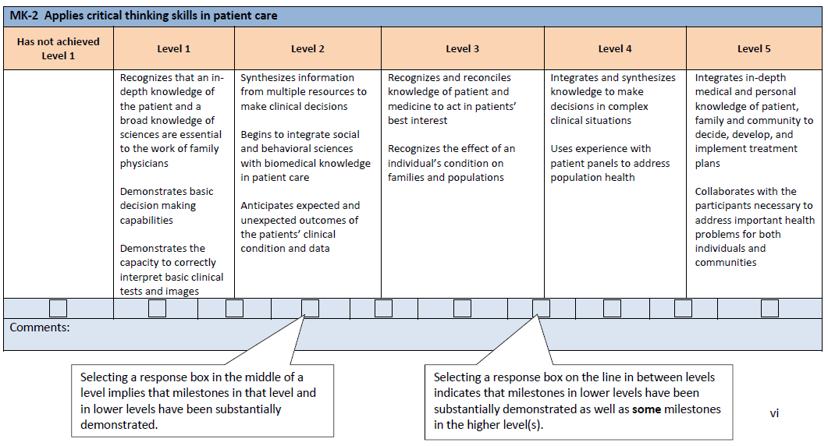

Slide 25
Part II: AIM to ACT Active Classroom Toolbox
UNC Family Medicine Teaching Fellowship 2015-2016 Educational Collaborative

Slide 26
Purpose of the Toolbox
Created by the Education Collaborative at the Faculty Development Fellowship at UNC Chapel Hill
Provides simple, brief explanations of multiple active learning techniques
Enables educators to overcome the status quo inertia that inhibits utilization of active learning methods
Common barriers included: too much time to prepare, inability to cover content, status quo inertia
Notes:
AIM to ACT (Assessing and Improving Medical education through an Active Classroom Toolbox)

Slide 27
AIM to ACT Index
1
Moving from Passive Lectures to Active Learning
2
Toolbox of Teaching Techniques
3
Faculty Development Sessions

Slide 28
https://www.dropbox.com/s/n8fi1podmcwr7sy/0%20AIM%20to%20ACT%20Toolbox.pptx?dl=0

Slide 29
Large Group Techniques
Small Group Techniques
1
1
Audience Response Systems
Jigsaw
2
Find the Flaw
2
3-2-1 Process
3
Jeopardy!
3
Small Group Questions
4
Walking Gallery
4
Small Working Groups
5
Guided Note Taking
5
Think-Pair-Share
6
Team Recall
6
Poll Everywhere Instant Feedback

Slide 30
Audience Response Systems
Dr Lisa Johnson

Slide 31
Large group – Audience response systems
Audience Response Systems (ARS)have been used to improve student interaction, engagement, attention and increase attendance
Stimulate peer and class discussion
Provide feedback for both students and instructors in order to improve instruction
Improve learning performance
Dr Lisa Johnson

Slide 32
Large group – Audience response systems
An ARS allows an entire class to respond to multiple choice questions displayed on a screen.
This can be incorporated within a power point presentation or traditional lecture.
After students click in their responses using remote devices, the results are instantly collected, summarized and presented to the class in visual format, usually a histogram.
Remote devices can include texting the responses from smart phones or responding through a webpage.
Dr Lisa Johnson

Slide 33
Large group – Audience response systems
Responses are always anonymous to peers, but the teacher can associate ARS devices with individual students for testing purposes
With feedback from the class, an instructor is provided with an opportunity to orchestrate peer or classroom discussion about concepts being covered.
Dr Lisa Johnson

Slide 34
References - Audience response systems
Kay, R. H., & LeSage, A. (2009). Examining the benefits and challenges of using audience response systems: A review of the literature. Computers & Education, 53(3), 819-827.
Dr Lisa Johnson

Slide 35
Find the Flaw
Dr Christina Raguckas

Slide 36
Large Group: Find the Flaw
Deliberately insert misinformation in the course material
Learners are asked to identify the flaw
Can play a game of which learner can find the flaw first
May choose to reward the winner
Or ask all learners to identify what they think the flaw is by writing it down
Must clarify what the flaw is before ending the learning session
Make sure all learners are clear on the flaw
Dr Christina Raguckas

Slide 37
Large Group: Find the Flaw
Benefits:
Enhances critical listening and thinking skills as learners actively look for misinformation
Keeps those who feel knowledgeable about the topic engaged
Teaches learners to look for confirming and disconfirming evidence when learning about a new concept (Closer to information processing when learners are working on their own)
Stresses importance of analyzing everything learners read/hear
Not just passive reception of new information
Dr Christina Raguckas

Slide 38
Large Group: Find the Flaw
Preparation:
Insert misinformation in the materials
Inform learners there is misinformation present
Implementation:
Can ask learners to raise their hand if they spot misinformation
May reward with a small prize
May ask learners to write misinformation on a notecard and collect
Address the misinformation quickly and give the correct information or may identify the misinformation and ask learners to look up the correct answer
Dr Christina Raguckas

Slide 39
Large Group: Find the Flaw
Challenges:
Learners are ingrained to think the instructor is right and may be hesitant to point out flaws
If learners are entry-level it may be necessary to help facilitate finding the flaw (i.e. telling them what slide it is on)
Learner misunderstanding could occur if learners do not recognize the misinformation or have a clear understanding of the flaw by the end of the lesson.
Dr Christina Raguckas

Slide 40
References: Find the Flaw
Major, Claire Howell; Harris, Michael S.; Zakrajsek, Todd: Teaching for Learning: 101 Intentionally Designed Educational Activities to Put Students on the Path to Success, Taylor & Francis, 2016.
Dr Christina Raguckas

Slide 41
Jeopardy!
Dr Christina Zarza

Slide 42
Useful for more fact based knowledge
Examples:
Immunizations schedules/Indications for immunizations
Diabetes diagnostic criteria
Pediatric milestones
More difficult to apply to critical thinking processes or emotionally charged topics such as end of life decision making
Dr Christina Zarza

Slide 43
Large group: Jeopardy!
Instructor creates a Jeopardy! game board with questions related to the teaching topic
Classroom is divided into 4-5 small groups
Each group is given a buzzer or signaling device to press when they have the answer
Scoreboard is kept by the instructor or a student in class, or can be managed within the program
Can use Jeopardy! board alone or can provide instruction before or after the Jeopardy! board to solidify teaching points
Dr Christina Zarza

Slide 44
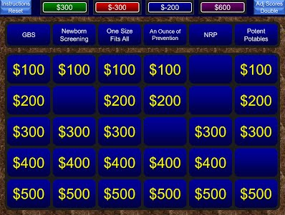
Example: OB and Newborn Care
Dr Christina Zarza

Slide 45
Jeopardy! Online Tutorial
https://youtu.be/M0RRaK1Ir-8
Dr Christina Zarza

Slide 46
Large group: Jeopardy!
Benefits
Challenges
Engaging and fun
Creates competitive atmosphere which further engages students
Who doesn’t want to be Alex Trebek?
Is a Socratic type teaching format that will get all students to think
Increased preparation time
Competition can get unfriendly/out of hand
Useful for more fact based knowledge and less applicable to critical thinking type learning
Dr Christina Zarza

Slide 47
Walking Gallery
Dr Katie Westerfield

Slide 48
Walking Gallery
This is helpful to teach or discuss abstract ideas like leadership and professionalism qualities.
Materials Needed: writing boards, markers, colored dots
Divide larger group into small groups of 3-4.
This can also be done with a small group divided into individuals.
Have individuals or groups write their ideas/answers on the writing boards
Dr Katie Westerfield

Slide 49
Walking Gallery
Then give colored dots to individuals to vote
Allow individuals walk around to view each writing board and place a dot sticker to vote
Can color code to get feedback
Green dots = Agree
Red dots = Disagree
Can limit the number of dots each person gets so that they have to decide where to place them
Dr Katie Westerfield

Slide 50
Walking Gallery
After 5-10mins of voting, collect the writing boards and review the ideas/answers that had the most votes
Have each group talk about their boards and which ideas had the most votes
Dr Katie Westerfield

Slide 51
Walking Gallery References
http://serc.carleton.edu/introgeo/gallerywalk/references.html
http://serc.carleton.edu/introgeo/gallerywalk/what.html
Dr Katie Westerfield

Slide 52
Guided Note Taking
Dr Lisa Harris

Slide 53
ACTIVE/ENGAGED LEARNING TECHNIQUE GUIDED NOTE taking
Large or Small Group
Increase the likelihood that learners will actively engage and respond to a lesson
Helps to distinguish between more important and less important material
Dr Lisa Harris

Slide 54
Guided Note Taking
Prioritize
Decide what is most important for learners to learn from instructional block
Create
Prepare a set o notes with essential information, highlight key concepts, and create blanks in chart/algorithm/notes the learners are responsible to complete
Explain
Ensure student understand their responsibility to complete the blanks which helps learners understand what their seeing, hearing, or reading
Plan
Discuss the correct answers throughout the presentation or after
Dr Lisa Harris

Slide 55
Guided Note Taking Example Templates
Bonus Points
Combine Guided Note Taking with Clinical Based Scenarios
Anovulatory Abnormal Bleeding
H&P: _____________________________________________________
Risk Factor: _________________________________________________
Group 1
Group 2
Group 3
Evaluation and Treatment Algo
Evaluation and Treatment Algo
Evaluation and Treatment Algo
Five Clinical Microskills
________________________
2. ________________________
________________________
________________________
5. ________________________
Dr Lisa Harris
Notes:
THESE ARE EXAMPLES OF GUIDED NOTE TEMPLATES

Slide 56
Guided Note Taking Additional Tips
Cues
Symbols or sound affects within presentation/PowerPoint to alert learners about where, when, and how many concepts to record
Balance
Diversify the types of guided notes
Simple: fill-in-the-blank
Complex: open-ended
Dr Lisa Harris

Slide 57
References
Guided Note Taking
Konrad M, Joseph LM, Eveleigh E. A Meta-Analytic Review of Guided Notes. Education and Treatment of Children. 2009. 32(3):421–444.
Morrow J. Do Guided Notes Improve Student Performance?
Austin JL, Gilbert M, et. al. The effects of guided notes on student responding and recall of information in a university classroom. Journal of Behavioral Education. Dec 2002. 11:4 243–254.
http://www.theteachertoolkit.com/index.php/tool/guided-notes
Dr Lisa Harris

Slide 58
Team Recall
Dr Jesse Clark

Slide 59
Team Recall: Overview
Helps learners recall basic information they should either already know or have reviewed before session
OB Prenatal Labs
Preventative Health Guidelines
Excellent if you have a competitive group of students
Minimal preparation for instructor
Dr Jesse Clark

Slide 60
Team Recall: Set-up
Prepare a set of questions for your learners to answer
Name at least 3 labs you would order at a 28 week prenatal visit
What are 3 Grade A USPSTF Recommendations for a 45 year old male who smokes?
Divide your learners into teams of 3-5
Dr Jesse Clark

Slide 61
Team Recall: Student Instructions
After each question is displayed, you can discuss your answer within your teams
No books, phones, laptops, etc.
When you have your answer, have a representative stand up
The first team to have someone stand must fully answer the question WITHOUT talking with their team
If they’re correct, the team scores 10 points
If incorrect, the team loses 10 points and the next team to have someone stand gets their chance to answer
(Can also impose a time limit if necessary)
Dr Jesse Clark

Slide 62
Team Recall
Advantages
Disadvantages
Quick to prepare
Engages competitive students
Great for basic quick recall
Difficult to teach new or complex topics
Can upset extremely competitive students
Needs to be somewhat challenging recall to keep learners engaged
Dr Jesse Clark

Slide 63
Jigsaw Technique
Dr Lisa Johnson

Slide 64
Small group - Jigsaw Technique
Collaborative learning concept
Increases academic success ,the social and intellectual abilities of students
Is effective :
in the learning process of theoretical courses
development of critical thinking
improvement of the learner’s communication skills
Dr Lisa Johnson

Slide 65
Small group - Jigsaw Technique
Students are assigned to small heterogeneous teams
Academic material is broken into as many sections as there are team members.
The students study their sections with members of their team and teach the material to each other.
They become the “ team expert “ on that section of the material.
Dr Lisa Johnson

Slide 66
Small group - Jigsaw Technique
The students are all asked to change to another team, each team should now include a “team expert“ for a particular section of that material and teaches the material to the new group.
The team members then take a quiz, and the quiz scores are used to form team scores.
Dr Lisa Johnson

Slide 67
Small group - Jigsaw Technique
https://youtu.be/RfSKkCVFXfM
Dr Lisa Johnson

Slide 68
References - Jigsaw Technique
Kilic, D. (2008). The effect of the jigsaw technique on learning the concepts of the principles and methods of teaching. World applied sciences journal, 4(1), 109-114.
Slavin, R. E. (1980). Cooperative learning. Review of educational research, 50(2), 315-342.
Dr Lisa Johnson

Slide 69
3 – 2 - 1 Process
Dr Christina Raguckas

Slide 70
Small Group: 3 – 2 - 1 Process
Helps learners analyze text and coarse materials
Learners identify 3 central issues from class material/readings
Learners identify 2 questions from the materials
Learners pose 1 question of the instructor
Dr Christina Raguckas

Slide 71
Small Group: 3-2-1 Process
Preparation
Relatively little advanced preparation
May only need to identify what course material being used
May provide handout of format ahead of time
Implementation
Describe the 3-2-1 process
Have learners write out answers individually or in small groups
Facilitate discussion as a group, making note of areas that learners did not understand or questions asked to potentially cover in subsequent lessons
Dr Christina Raguckas

Slide 72
Small Group: 3-2-1 Process
Benefits:
Helps learners engage materials using a systematic format
Learners are better prepared to discuss course materials
Improved comprehension/understanding as learners interact with materials
Encourages learner focused classroom
Dr Christina Raguckas

Slide 73
Small Group: 3-2-1 Process
May use tailor the questions to the material
May form small groups to discuss/answer the questions that learners posed regarding the material
Learners may come with the 3-2-1 process completed or complete during the lesson
Dr Christina Raguckas

Slide 74
References: 3-2-1 Process
Major, Claire Howell; Harris, Michael S.; Zakrajsek, Todd: Teaching for Learning: 101 Intentionally Designed Educational Activities to Put Students on the Path to Success, Taylor & Francis, 2016.
Dr Christina Raguckas

Slide 75
Small Group Questions
Dr Stephen Brawley

Slide 76
Small Group Questions: HOW TO ASK QUESTIONS
Be prepared - identify key questions in advance
Pause after the question and select students individually
Act as through you are seeking knowledge
Keep a journal of responders
Dr Stephen Brawley

Slide 77
Small Group Questions: BALANCE THE KIND OF QUESTIONS
Exploratory Questions – probe facts and knowledge base of learners: What research supports your plan?
Challenge Questions - examine assumptions and conclusions: How else could you manage this?
Relational Questions – ask for comparisons of themes: How will this effect the patient’s other medical conditions?
Diagnostics Questions – probe for causes: What led to this condition?
Action Questions – call for conclusion or action: What is the plan for this patient?
Dr Stephen Brawley

Slide 78
Small Group Questions: Other Kinds of Questions
Extension Questions: expand the discussion
Hypothetical Question: changes situation and emphasizes another learning point
Priority Questions: seeks to identify the most important issues
Summary Questions: elicits syntheses of important lessons learned
Dr Stephen Brawley

Slide 79
Small Group Questions: TACTICS FOR EFFECTIVE QUESTIONING
Ask one question at a time
Avoid yes and no questions
Ask focused questions
Avoid leading questions
Be patient waiting for answers
Ask others if the response was correct
Draw out reserved learners to participate
Use probing strategies to increase the complexities of the questions
Dr Stephen Brawley

Slide 80
Small Group Questions: HANDLING STUDENT RESPONSES
Listen to the response
Use nonverbal gestures to indicate your attention: eye contact, nod head, facial expressions and hand gestures
Vary your reactions to responses: repeat answer, ask for clarification or elaboration, expand on the response
Acknowledge originality: say that you did not think of that answer
Praise correct answers and tactfully correct wrong answers
Dr Stephen Brawley

Slide 81
References: Small Group Questions
TOOLS FOR TEACHING, Chapter 10, Davis, BG, 2nd Edition
Dr Stephen Brawley

Slide 82
Small Working Groups
Dr Katie Westerfield

Slide 83
Small Working Groups
Works well to evaluate statistics in journal club, create PICO questions, research answers to PICO questions
Can be used to present epidemiology, diagnosis, treatment, prognosis of disease states
Dr Katie Westerfield

Slide 84
Small Working Groups
Evaluate the different components of the topic and divide the topic into the number of small working groups you are going to have
Ideally each working group will have no more than 4-6 persons
Assign the working group a portion of the topic or a question to answer
Have the working group report the answer to the larger group
Dr Katie Westerfield

Slide 85
Think – Pair - Share
Dr Christina Zarza

Slide 86
Small Group: Think –pair –share
Students pair up to discuss a problem or question posed by the instructor
Allows for active learning by necessitating that each student come up with ideas during paired discussions
Less intimidating form of discussion for introverts
Dr Christina Zarza

Slide 87
Small Group: Think –pair –share: Technique
Instructor presents an issue for discussion in the form of a problem or question
“Think”: Students are provided 30-45 sec to think about question independently
“Pair”: Then students pair to discuss
May need 1-3 minutes to discuss
“Share”: Regroup and elicit responses
Dr Christina Zarza

Slide 88
Small Group: Think –pair –share: Modifications
Can have students pair with row behind them instead of neighbor to mix up social groups
Can do Think-Pair-Square-Share, where pairs join one other pair to discuss ideas prior to returning to large group
Dr Christina Zarza

Slide 89
Small Group: Think –pair –share
Benefits
Challenges
Very easy to use
Can be applied to any class size (3-100+)
Can use at all levels of education
Allows introverts to contribute
Minimizes domination of discussion by one person/group
Requires some active surveillance to ensure all students talking/discussing
Sometimes difficult to estimate how much time to allot for paired discussion
Dr Christina Zarza

Slide 90
Small Group: Think –pair –share
https://youtu.be/vxMOl2Vnw54
https://youtu.be/vxMOl2Vnw54
Dr Christina Zarza

Slide 91
References
“Think-Pair-Share.” Brown University website: https://www.brown.edu/about/administration/sheridan-center/teaching-learning/effective-classroom-practices/think-pair-share
Dr Christina Zarza

Slide 92
Poll Everywhere Instant Feedback
Dr Jesse Clark

Slide 93
Small Group: Poll Everywhere Instant Feedback
Text or Web-based audience-response system that can be used to quickly gage comprehension in a small group presentation
Ask an open-ended question for learners to send in their examples of material just covered
Displayed real-time on the screen
Teacher is able to quickly assess if learners have grasped concept or not
If majority have comprehended material, can then move on to next topic
If some have comprehended, can ask learners who did to explain their answers and how they got there
If majority have not comprehended, can spend additional time covering the topic
Dr Jesse Clark

Slide 94
Small Group: Poll Everywhere Instant Feedback
Example:
Poll-Everywhere slide from Intro to PICO question lecture
Dr Jesse Clark

Slide 95
Small Group: Poll Everywhere Instant Feedback
Advantages
Disadvantages
Immediate feedback helps to pace lecture and gage comprehension
Anonymous responses help your quieter or less confident learners respond
Learners enjoy using new technology in the classroom
Works particularly well with small group of learners so not overwhelmed with reading responses
Need to set up Poll Everywhere polls and embed them into PowerPoint Presentation
Learners are able to send inappropriate responses to questions (opportunity to teach professionalism!)
Dr Jesse Clark

Slide 96
Poll Everywhere Tutorial Videos
How to create an open-ended poll in Poll Everywhere:
https://www.polleverywhere.com/videos?v=creating_polls
How to embed poll into a PowerPoint presentation on a PC:
https://www.polleverywhere.com/videos?v=presenting_from_powerpoint_pc
How to embed poll into a PowerPoint presentation on a Mac:
https://www.polleverywhere.com/videos?v=presenting_from_powerpoint_mac
Dr Jesse Clark

Slide 97
Faculty Development Sessions
1
Guided Note Taking
2
Jigsaw
For these sessions, please see the Notes in the PowerPoint presentation for instructions to lead a Faculty Development Session

Slide 98
Faculty Development Session: Guided Note Taking
Dr Lisa Harris

Slide 99
Faculty Development Session Guided Note taking
Small Group Activity
Faculty Development Session
Faculty prepare and bring 1-2 “canned lectures”
Divide in pairs – two rotations (2 lectures reviewed or one lecture review by two different colleagues)
Utilize tools to develop Guided Notes
Provide feedback to lecture author with recommendation for Guided Notes
Dr Lisa Harris
Notes:
GUIDED NOTES CAN INCREASE THE LIKELHOOD THAT LEARNERS WILL ACTIVELY ENGAGE AND RESPOND TO LESSON
- HELPS TO DISTINGUISH BETWEEN MORE IMPORTANT AND LESS IMPORTANT MATERIAL

Slide 100
Guided Note Taking
Prioritize
Create
Explain
Plan
Dr Lisa Harris
Notes:
DISCUSS OVERALL PRINCIPLES REGARDING SELECTING AND DEVELOPING LESSON PLAN
- MAY USE EXAMPLES
Prioritize: Decide what is most important
Create: Prepare a set of notes with essential information, highlight key concepts, and create blanks in chart/algorithm/notes the students are responsible to complete
Explain: ensure students understand their responsibility to complete the blanks this enables them to understand what they will be seeing, hearing, or reading
Review: discuss the correct answers throughout the presentation or after

Slide 101
Bonus Points
Combine Guided Note Taking with Clinical Based Scenarios
Five Clinical Microskills
________________________
2. ________________________
________________________
________________________
5. ________________________
Anovulatory Abnormal Bleeding
H&P: _____________________________________________________
Risk Factor: _________________________________________________
Group 1
Group 2
Group 3
Evaluation and Treatment Algo
Evaluation and Treatment Algo
Evaluation and Treatment Algo
Dr Lisa Harris
Notes:
THESE ARE EXAMPLES OF GUIDED NOTE TEMPLATES
MAY PROBE THE GROUP OF LEARNERS REGARDING ADDITIONAL STRATEGIES

Slide 102
Small Group Activity
Divide in pairs
Review a “canned lecture” (20 minutes)
Design/Outline Guided Notes
Individual Feedback (10 minutes)
Group Feedback (15 minutes)
- BREAK -
Optional: Rotate for Round 2 – either second lecture or second review (45 minutes)
Dr Lisa Harris

Slide 103
Guided Note Taking
Cues
Balance
Advantages
Disadvantages
Dr Lisa Harris
Notes:
LEAD A DISCUSSION REGARDING THE ADVANTAGES AND DISADVANTAGES OF TECHNIQUES.
- MAY FOCUS ON PARTICALUR CHALLENGES AT LOCAL PROGRAM
- OPTIMAL GROUP SIZES
- TIMELINES
- CUES: WITHIN THE POWERPOINT/PRESENTATION TO ALERT LEARNERS ABOUT WHERE, WHEN, AND HOW MANY CONCEPTS TO RECORD
(I.E. A PARTICULAR SYMBOL, SOUND AFFECT, OR PHRASE)
- BALANCE: DIVERSIFY THE TYPES OF GUIDED NOTES TO INCLUDE SIMPLIFIED FILL-IN-THE-BLANK TO OPEN-ENDED
(I.E. REFERENCE EXAMPLE SLIDE TO INCLUDE TABLES, ALGORITHMS, ETC.)

Slide 104
References
Guided Note Taking
Konrad M, Joseph LM, Eveleigh E. A Meta-Analytic Review of Guided Notes. Education and Treatment of Children. 2009. 32(3):421–444.
Morrow J. Do Guided Notes Improve Student Performance?
Austin JL, Gilbert M, et. al. The effects of guided notes on student responding and recall of information in a university classroom. Journal of Behavioral Education. Dec 2002. 11:4 243–254.
http://www.theteachertoolkit.com/index.php/tool/guided-notes
Dr Lisa Harris

Slide 105
Faculty Development Session: Jigsaw
Dr Lisa Harris

Slide 106
Faculty Development Session Jigsaw collaborative
Large Group Activity
Faculty Development Session
Faculty divided and assigned reading material in preparation for session.
OR
Faculty bring “canned lecture”
JIGSAW framework – background information
JIGSAW exercise (if large group otherwise lecture)
Discussion regarding advantages and disadvantages
Dr Lisa Harris

Slide 107
JIGSAW Collaborative
research-based cooperative learning technique
invented and developed 1971
Elliot Aronson
University of Texas students
University of California students
Dr Lisa Harris

Slide 108
JIGSAW Collaborative 10 Steps
Divide learners into jigsaw groups
Appoint one learner from each group as the leader
Divide the lesson into segments
Assign each learner to learn one segment
Give learner time to read over their segment at least twice and become familiar with it
Form temporary “expert groups by having one learner from each jigsaw group join together learners assigned to the same segment
Learners rejoin their jigsaw groups
Ask each learner to present his/her segment to the group
Float from group to group, observing the process
At the end of session, give a quiz on material
Bonus Points
Combine JIGSAW with Clinical Based Scenarios
Dr Lisa Harris
Notes:
REVIEW THE STEPS OF THE JIGSAW

Slide 109
Large Group Activity A (optional)
Pre session
Select example lesson topic
Divide learners into jigsaw groups
Appoint one learner from each group as the leader
Divide the lesson into segments
Assign each learner to learn one segment
Give learner time to read over their segment at least twice and become familiar with it
Session: Review basics of JIGSAW (50 minutes)
Temporary Expert Groups (20 minutes)
Learners rejoins JIGSAW group and presents their segment to the group (30 min)
Group Feedback (10 minutes)
Dr Lisa Harris
Notes:
THIS ACTIVITY ALLOWS FOR THE FACULTY TO PARTICIPATE IN A JIGSAW LEARNING TECHNIQUE

Slide 110
Large Group Activity B (optional)
Divide in groups of 2-3
Review a “canned lecture”– JIGSAW (45 minutes)
Discuss techniques in dividing group based on learner type
Who should/could be the group leader
Divide the lesson into segments and assign each learner to segment
How far in advance do learners need assignment? Can this be done within the time frame of a single lecture (“mini-JIGSAW”)?
Expert groups: What is the goal of this group? Are they answering a question or presenting material to the group in a particular way?
What is the goal when learners rejoin their jigsaw groups?
What is the overall timeline?
Individual/Group Feedback (15 minutes)
Dr Lisa Harris
Notes:
THIS ACTIVITY ALLOWS FOR THE FACULTY TO DEVELOP A JIGSAW LEARNING PLAN BASED FROM A CANNED LECTURE

Slide 111
JIGSAW Collaborative
Dominant Learner
Challenged Learner
Gifted Learner
Competitive Learner
Advantages
Disadvantages
Dr Lisa Harris
Notes:
LEAD A DISCUSSION REGARDING THE CHALLENGES ASSOCIATED WITH SPECIFIC TYPES OF LEARNERS ALSO DISCUSS THE ADVANTAGES AND DISADVANTAGES OF TECHNIQUES.
- MAY FOCUS ON PARTICALUR CHALLENGES AT LOCAL PROGRAM
- OPTIMAL GROUP SIZES
- TIMELINES
Dominant Learner: Many jigsaw teachers find it useful to appoint one of the students to be the discussion leader for each session, on a rotating basis. It is the leader's job to call on students in a fair manner and try to spread participation evenly. In addition, students quickly realize that the group runs more effectively if each student is allowed to present her or his material before question and comments are taken. Thus, the self interest of the group eventually reduces the problem of dominance.
Challenged Learner: Teachers must make sure that students with poor study skills do not present an inferior report to the jigsaw group. If this were to happen, the jigsaw experience might backfire (the situation would be akin to the untalented baseball player dropping a routine fly ball with the bases loaded, earning the wrath of teammates). To deal with this problem, the jigsaw technique relies on “expert” groups. Before presenting a report to their jigsaw groups, each student enters an expert group consisting of other students who have prepared a report on the same topic. In the expert group, students have a chance to discuss their report and modify it based on the suggestions of other members of their expert group. This system works very well. In the early stages, teachers may want to monitor the expert groups carefully, just to make sure that each student ends with an accurate report to bring to her or his jigsaw group. Most teachers find that once the expert groups get the hang of it, close monitoring becomes unnecessary.
Gifted Learner: Boredom can be a problem in any classroom, regardless of the learning technique being used. Research suggests, however, that there is less boredom in jigsaw classrooms than in traditional classrooms. Youngsters in jigsaw classes report liking school better, and this is true for the bright students as well as the slower students. After all, being in the position of a teacher can be an exciting change of pace for all students. If bright students are encouraged to develop the mind set of “teacher,” the learning experience can be transformed from a boring task into an exciting challenge. Not only does such a challenge produce psychological benefits, but the learning is frequently more thorough.
Competitive Learner: Research suggests that jigsaw has its strongest effect if introduced in elementary school. When children have been exposed to jigsaw in their early years, little more than a “booster shot” (one hour per day) of jigsaw in middle school and high school is required to maintain the benefits of cooperative learning. But what if jigsaw has not been used in elementary school? Admittedly, it is an uphill battle to introduce cooperative learning to 16-year olds who have never before experienced it. Old habits are not easy to break. But they can be broken, and it is never too late to begin. Experience has shown that although it generally takes a bit longer, most high school students participating in jigsaw for the first time display a remarkable ability to benefit from the cooperative structure.

Slide 112
Small group - Jigsaw Technique
https://youtu.be/RfSKkCVFXfM
Dr Lisa Harris

Slide 113
References
Jigsaw Collaborative
Phillips J and Fusco J. Using the Jigsaw Technique to Teach Clinical Controversy in a Clinical Skills Course. American Journal of Pharmaceutical Education. 2015. 79 (6): 90.
Buhr GT, Heflin MT, et al. Using the jigsaw cooperative learning method to teach medical students about long- term and post-acute care. J Am Med Dir Assoc. 2014;15(6):429-434.
https://www.jigsaw.org
Dr Lisa Harris

Slide 114
AIM to ACT Demo! Which Active Learning Techniques Do You Want to Explore? We Will Demo Three for You!

Slide 115
Large Group Techniques
Small Group Techniques
1
1
Audience Response Systems
Jigsaw
2
Find the Flaw
2
3-2-1 Process
3
Jeopardy!
3
Small Group Questions
4
Walking Gallery
4
Small Working Groups
5
Guided Note Taking
5
Think-Pair-Share
6
Team Recall
6
Poll Everywhere Instant Feedback

Slide 116
Activity #2: Explore the Toolbox
Work in small groups
Pick a topic your are scheduled to teach
Select 1-2 techniques from the AIM to ACT Toolbox
Incorporate them into your didactic plan
Be prepared to share your plan
5 Minutes
Notes:
How would you change your approach??

Slide 117
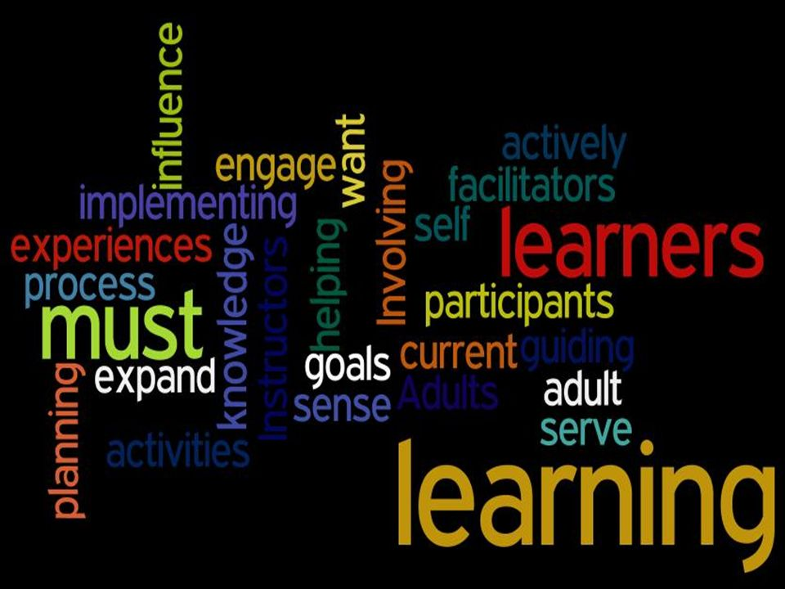
Jane Vella’s 6 Core Principles of Dialogue Education
Respect
Immediacy
Relevance
Safety
Engagement
Inclusion

Slide 118
Respect
Acknowledge/validate learners’ experiences
Use learner’s experiences in learning event
Allow learners to add their examples/input
Avoid “cold calling” people; don’t embarrass
“Do not tell what you can ask”
Notes:
Invite sharing, expectations, needs.

Slide 119
Immediacy
Show the usefulness of the material
Motivated to learn if can be used right away
“Tell me what I need to know now”
Build in opportunities to use material
Ask learners to create action plans
Notes:
Medical education is a busy time and learners will quickly tune out information that is not perceived as needed in the near future. It is the instructor’s job to identify the “why” of the information being presented and attempt to tie it to the learners’ circumstances in a timely manner.
ACLS instruction vs the work-up of pheochromocytoma—this is what the teacher can bring to the table.
What comes to mind when you think of teaching in accordance with the immediacy principle? Can anyone share how you apply it in your daily life?
?surgery instruction more immediate than non-surgical

Slide 120
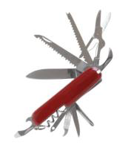
Relevance
Must see a reason for the learning
Connect content to daily life/needs
Invite learners input
Use stories and examples
Ask learners to personalize content
Ensure content relevant to the many not the few

Slide 121
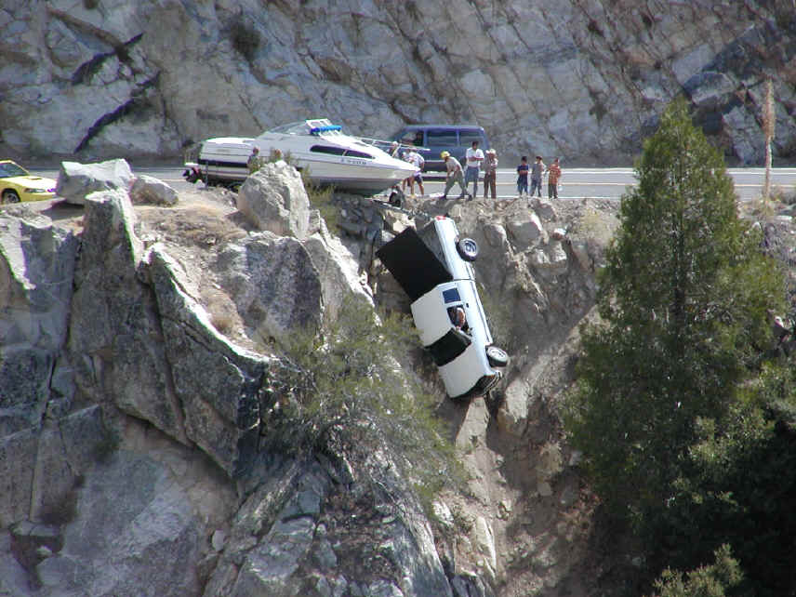
Safety
Cannot learn in threatening environment
Create safe environment to permit risk taking
Affirm learner’s ideas, questions, resistance
Be transparent
Ice breakers or warm-ups
Be aware of power dynamics
Notes:
Should learning be designed to be challenging or safe? The answer is Yes.
How do we create a safe learning environment?
By insuring the above. Identify your credentials/describe how the objectives were derived/seek small group approach to facilitate input/sequence activities to insure progression/maintain affirmative posture
Avoid fatal plops

Slide 122
Engagement
Adults learn best when fully engaged
“Noisy” process of intellect, feelings, actions
Avoid passive transmission of knowledge
Opportunity to “do something” with content
Individual, pair, small group activities
Keep material short, “chunked”
Notes:
Design learning that is active, where people have to get involved. Provide variety for the visual, auditory, and hands on (kinesthetic) learners, provide energy through games, exercises, relate the information you are teaching to the students’ lives, or even better, help them relate the information to their lives.
“Efforts to “cover” a set curriculum often lead to neglect of this principle. We need to design methods that engage adults in effective and significant learning.” (Vella)

Slide 123
Inclusion
Adults part of the learning process
Ensure their perspective heard
Account for gender, ethnicity, age, etc.
Establish clear ground rules
Ensure no one dominant voice
Small group work

Slide 124
Activity #3
Work in small groups
Discuss three principles by Vella that apply to your trainees
How will you change your teaching approach?
5 Minutes
Notes:
How would you change your approach??

Slide 125
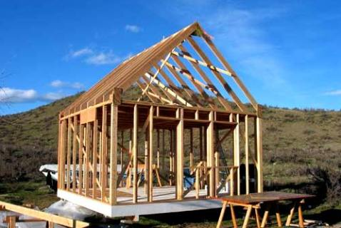
Three Frameworks for Designing Active Learning Events

Slide 126
Susan Ambrose, et. al.

Slide 127
Notes:
Must activate prior learner knowledge
Give explicit structure to your material
Connect material to student interests
Break material into fundamentals
Repeat until mastery attained
Give specific feedback
Environment of inclusion
Ensure time for reflection

Slide 128
John Medina
Notes:
By the end of today’s session we will have: (cover objectives)

Slide 129
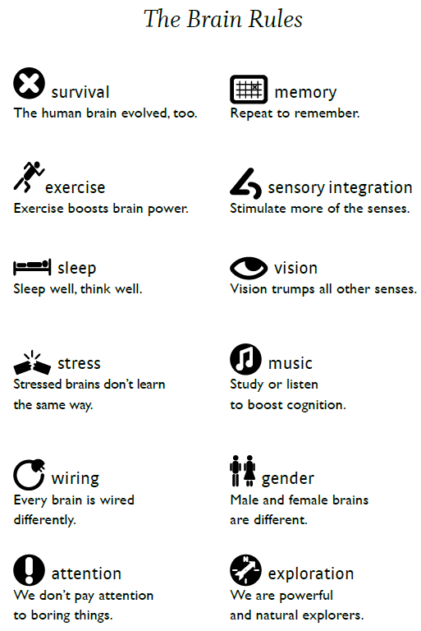

Slide 130
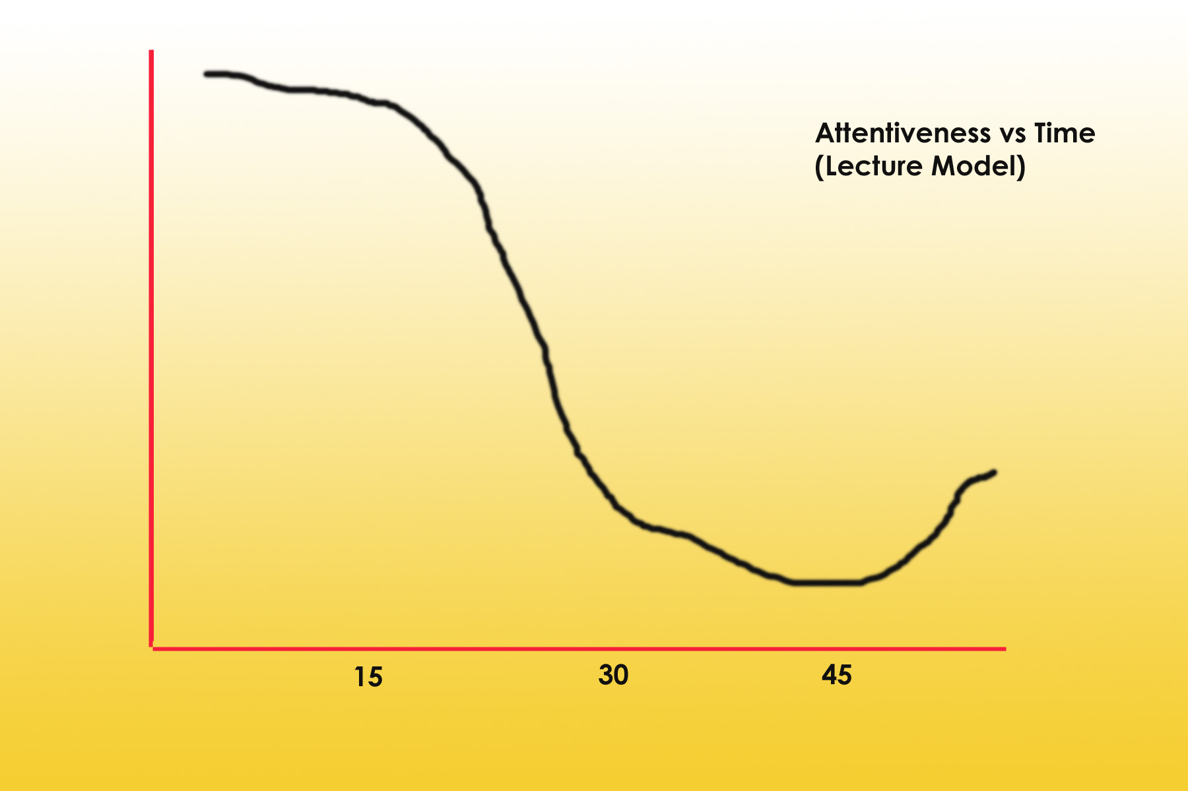
Adult Attention Span
10-15 minutes !

Slide 131
Incorporate “The Brain Rules”
MUST repeat material within 30 seconds
MUST repeat again at 60-90 minutes
Overnight activities (sleep cycle)
Morning review (boosts another 10%)
Move from “lecturer” to “facilitator”
Expect learners to come prepared
Engage them with each other and the material
Highlight key points via group discussion
Notes:
You can move from 10% up to 60% retention!!
Avoid These Temptations…
Give the learners all of the information you think they need
Too much focus on factual content vs. meaning/understanding of key concepts
Death by PowerPoint

Slide 132
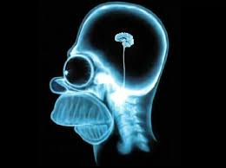
What Does this Look Like?
Fewer slides, less text, more images/video
More case-based questions
More thought into WHAT the key learning points are (not just facts)
Summarize key learning points

Slide 133
Brain Rules Recap
Must actively engage learners
Use visual tools to activate brain
Teach concepts more than facts
Use memory timing rules to improve retention
Use cases
Summarize at end of presentation

Slide 134
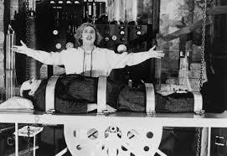
Part III: Planning a Learning Event:
The 8 Steps and 4 A’s
Notes:
Now I stand before you a convinced woman. Convinced of the value of having a system to plan learning events. I love this session because this is where we get practical and put it all together. I promise you that, by the end of this session, you will be as excited as I am about planning your next learning event and convinced to use this system! I am Amanda Cuda, a second year faculty development fellow.

Slide 135
Vella’s Dialogue Education
8 Steps and 4 A’s by Jane Vella
“On Teaching and Learning”
“Learning to Listen, Learning to Teach”
Notes:
We use systems to help us accomplish much in medicine. Think of systems that you use regularly. Can anyone name one? Example: reading an EKG or reading a chest xray. How about our SOAP notes? They are all systems to ensure we don’t forget something important. I’d like to introduce an example of a planning system from the adult education literature, the eight steps of planning, which includes the 4 I’s. These concepts come from a well known author of adult learning, Jane Vella. Her Teaching Philosophy initially documented in Taking Learning to Task (2001), further developed in Learning to Listen, Learning to Teach, and further elaborated in On Teaching and Learning (2008). Many other systems exist that are similar in scope. This is just one example. The important thing is that you use something to plan your learning events.

Slide 136
Activity 3: Review Our 8 Steps
1. Who?
2. Why?
3. So that?
4. When?
5. Where?
6. What?
7. What for?
8. How?
1 Minutes
Notes:
We’re all familiar with these questions. They are simple, helpful, but often forgotten. They become powerful when you invest some time to answer these questions in the process of planning your learning event. We will work through the 8 steps together with particular focus on step 7, which includes the 4 I’s. Take a look at the first page of your worksheet. I’ve provided you with my 8 steps for this session. I’m going to quickly run through the 8 steps. Follow along with my 8 steps as I elaborate on them.

Slide 137
The 8 Steps
1. Who?
2. Why?
3. So that?
4. When?
5. Where?
6. What?
7. What for?
8. How?
Notes:
We’re all familiar with these questions. They are simple, helpful, but often forgotten. They become powerful when you invest some time to answer these questions in the process of planning your learning event. We will work through the 8 steps together with particular focus on step 7, which includes the 4 I’s. Take a look at the first page of your worksheet. I’ve provided you with my 8 steps for this session. I’m going to quickly run through the 8 steps. Follow along with my 8 steps as I elaborate on them.

Slide 138
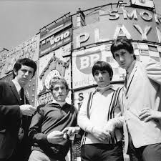
Step 1: Who?
Number of attendees
Who are your learners? Teachers?
What do they know? LNA ideal!
How do they learn best?
Notes:
Asking this question invites a profile of the participants and the # expected.
The # of participants is a major factor, as it affects decisions made about future steps, e.g. space requirements, practicality of learning tasks, etc.
Profile of Participants: Info garnered from the LNA about their experiences, knowledge base, interests, and needs are valuable in future steps as you will see.
When we have completed this first design step, we are clear about exactly who will be the learners and how many of them we can expect.

Slide 139
Step 2: Why?
What situation calls for this course?
Why is this course important?
Why are you here? Why NOW?
Identify need vs. requirement
Notes:
Answering this question reveals the situation that demands such training.
“Why does the present situation call for this course?”
“Why are the named outcomes necessary?” “Why is this course important?”
“What do participants need to do as a result of this course?”
When we give a lecture is it because we want to impart knowledge, or fulfill a requirement?

Slide 140
Step 3: So That?
Learning: what occurs in the event?
Transfer: take it to a new place?
Impact: change in organization?
Notes:
Learning: what occurs within the event_____________________________________ ?
Transfer: taking learning to new place _____________________________________ ?
Impact: change in organization/system _____________________________________?This question is so key. If I throw a bunch of information at you, a really nice system, but you don’t learn it or use it and it doesn’t make a difference, then I’ve just wasted 1 hour of your life. I wouldn’t be respectful of your time. The wonderfully inspiring piece of being medical educators is that we have the opportunity to make a difference: improving and saving lives through our learners.

Slide 141
Step 4: When?
Time of day, time frame
How much can be taught?
Respect for learner’s time
How much time to prepare?
Notes:
Answering this questions establishes the time frame. Sometimes, when you are a single speaker at a conference, or you are invited to speak during at a CME activity, your time slot is usually pre-determined. On the other hand, you may be the one setting up a learning activity and must make a determination about the day, time, and length of the events. It is critical to understand that “participants have a deliberate voice”: their needs inform the decision of the timing and length of the learning activity. The time available to be committed by busy professionals is limited, and there are optimal times that must be ascertained to maximize attendance. A great learning event that is inconvenient for the participants will be of little value.
It invites serious consideration of just how much can be taught in the available time.

Slide 142
Step 5: Where?
Classroom, lecture hall, large or small
Small-group facilitation
AV support as needed
Lighting and sound
Notes:
Answering this question determines the site where the course will be given.
The ideal setting would be a comfortable room with tables for small groups, and audiovisual equipment.
The site is a dramatically important factor in the success of a training program.
“We need an environment that feels safe for all.”
“…has room for small-group work at tables.”

Slide 143
Step 6: What?
Content of the course
Informed by the LNA
Knowledge (cognitive)
Skills (psychomotor)
Attitudes (affective)
Notes:
Answering this question determines the content of the course. It is the WHAT will be learned.
It addresses the skills, knowledge, and attitudes (SKA’s) to be taught.
“In dialogue education, the adults’ needs, discovered during the learning needs and resources assessment, inform the what.” (Vella, 2002, p. 40)
Shape the plan so that members will do what they are learning.
Content relates directly to the achievement based objections.
Another way to ask this of yourself as you prepare your presentations is, “What are the core needs that will be addressed by by this event and how will I address each of these needs, specifically?”

Slide 144
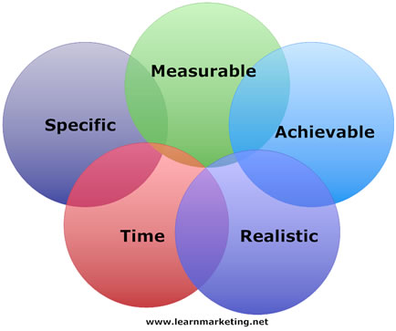
Step 7: What for?
Learning objectives of the course
Achievement based
Specific, measurable, “doable”
Expressed by verbs
Include cognitive, psychomotor, affective
Notes:
Answering this question identifies the achievement based objectives.
For example, by then end of this discussion, participants will be able to:
“Each objective is directly related to a content piece (what) and to one or more learning tasks (how) that will involve cognitive, affective, and psychomotor activities.”

Slide 145
Step 8: How?
Timeline
4 A’s = learning tasks
Takes planning & materials
Teacher as facilitator
Notes:
Addressing this question leads to the structure of the educational activity, the learning tasks (or activities) and materials to be used. I start with a timeline. How much time do I want to spend in each activity to achieve each of my objectives? We are going to come back to the details of the 4 I’s, which give us even more structure to how this is done. It takes the most planning to facilitate these tasks and activities. That is why I am dedicating the majority of the session to these.
The structure is “a set of sequenced learning tasks through which the participants will, in teams, use the concepts they are learning to design and practice.”
It is the process through which learners interact with the What to meet the objectives (What For)
“Learning tasks are open questions put to a group for response with all the resources they need.” (e.g. worksheet)
As small groups complete the tasks, response are shared.
Role of the teacher during a learning tasks: resource for the process and for the content. Once the task starts, we get out of the way but stay available for questions on process or content.
Your “How” will be informed by the a learning needs assessment…finding out from the participants what they are interested in learning.
The purpose of Dialogue Education is to invite men and women of all ages to celebrate their own power as they contemplate, examine, struggle with and manage for their own context new learning, new content. Our assumption is that the learners bring their own “points of power” as they name their unique and idiosyncratic context ( inductive work), examine new research and content (input), do something meaningful with that content (implementation) and bring that content home to renew their context (integration). These are the four general steps in a Dialogue Education learning task.

Slide 146
Activity 4: Your Learning Event
On the worksheet, complete the 8 Steps for YOUR learning event
Don’t work on the 4 A’s yet!
Share your ideas with your neighbors
10 Minutes
Notes:
Your salmon worksheet is in your folder, please grab it and complete activity 2 to start thinking about an upcoming learning event that you are responsible to plan. It might be academic or it might be a clinic meeting. Learning events can look very different, which is why the 8 steps are so important. Take 10 minutes. If you have time, share with your neighbor.

Slide 147
Activity 5: Review Our 4 A’s
Page 3 lists the 4 A’s for this session
No specific order or blend of activities
Mix of activities is KEY
Follow along and think about YOUR event
1 Minutes
Notes:
Continue to follow onto page 3 of your worksheet. I’ve provided you with my 4 I’s for this session. Let’s look at them together. Follow along with my 4 I’s as I elaborate on them. Note that the blend and order of the activities does not have to be always prescribed. A mix of activities is better and should be based on your objectives. If you want a group of learners to achieve proficiency in a skill like putting in an IV, then you don’t want to spend too much time on an activity teaching about knowledge about IV fluids (unless that is also one of your objectives). Think of activities that might cross over the types, as well. Some activities will be input and implementation, depending on what your learners already know. Here’s an example of that.

Slide 148
8. How = 4 A’s
Anchor: connect with what they know
Add: learn something new
Apply: practice what they learned
Away: take it home and use it
Notes:
Anchor – access own prior knowledge; Add – new piece of content; Apply – do something with new content; Away – connects new learning back to learner and future use
Back to the 7th of the 8 steps. “How” is the meat of your presentation. The How of an educational event should incorporate at least one task each of the 4 I’s: Induction, Input, Implementation, and Integration. The activities may overlap in application of the 4 I’s. Observe the activities for this session on page 3 of your worksheet. I’ve written down how each of the segments of the session fit into one of the four I’s. I’ve also labeled each activity section of the worksheet with the “I” that I’m trying to accomplish with that activity. You’ll see under “Activity 3 on the worksheet that this is Input. I’m teaching you something new.
They all have overlapping application of the How. This part of the planning of the educational event is where a little time invested can reap great results for your learners as you apply some active learning techniques. It is also likely the most intimidating of the 8 steps to plan. I can imagine what many of you are thinking: I’m not creative enough, I don’t have enough time, I don’t want to veer from the status quo. Just try one of the techniques that Sara mentioned in her session as a task/activity. I hope to prove to you through the following activities that more active learning leads to fewer slides (I have only 23 slides if you noticed), greater depth of understanding of a few concepts, and more fun for you. Let’s start with an easy, every day example.

Slide 149
Large Group Techniques
Small Group Techniques
1
1
Audience Response Systems
Jigsaw
2
Find the Flaw
2
3-2-1 Process
3
Jeopardy!
3
Small Group Questions
4
Walking Gallery
4
Small Working Groups
5
Guided Note Taking
5
Think-Pair-Share
6
Team Recall
6
Poll Everywhere Instant Feedback

Slide 150
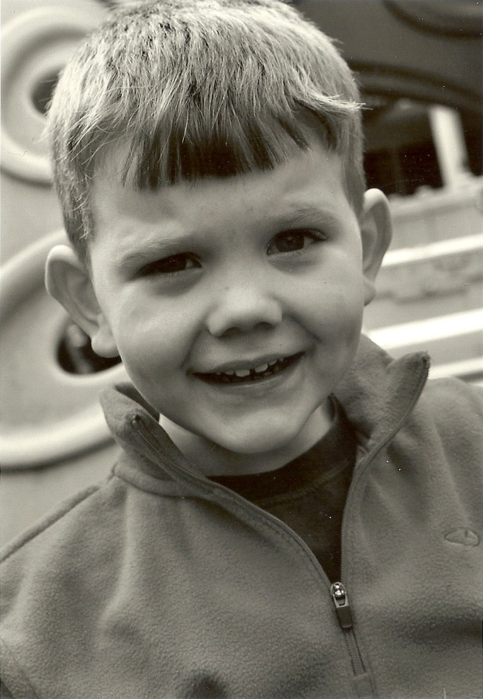
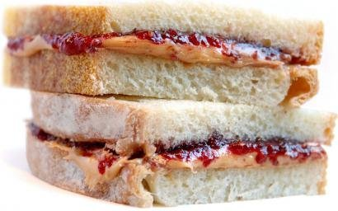
Activity 6: How to Make a PB&J
Form pairs or groups of three
Write 4 tasks for a 4 year old using the 4 A’s
Use tools from the AIM to ACT Toolbox
5 Minutes
Notes:
Depending on which internet source you read, PB&J may have its roots in WWII. The PB received in the Servicemember’s rations was unpalatable, therefore, they added jelly to make it taste better. Regardless of its origins, it is a staple of many a 4 year old’s diet. I have a four year old son named Jake. When the increase in the numbers of kids in the Cuda household occurred last winter, I had to teach him how to do more by himself. Your task is to teach Jake how to make a PB&J using a task from each of the 4 I’s. When the video plays, please return to large group to see if you and I came up with the same 4 I’s for Jake.
http://youtu.be/IwZX0wDPXb8

Slide 151
Activity 7: Design Your Event with Vella
Review the 8 Steps and 4 A’s handout
Plan the 4 A’s for your learning event
Use tools from the AIM to ACT Toolbox
Be prepared to share with the group
10 Minutes
Notes:
Your salmon worksheet is in your folder, please grab it and complete activity 2 to start thinking about an upcoming learning event that you are responsible to plan. It might be academic or it might be a clinic meeting. Learning events can look very different, which is why the 8 steps are so important. Take 10 minutes. If you have time, share with your neighbor.

Slide 152
Large Group Techniques
Small Group Techniques
1
1
Audience Response Systems
Jigsaw
2
Find the Flaw
2
3-2-1 Process
3
Jeopardy!
3
Small Group Questions
4
Walking Gallery
4
Small Working Groups
5
Guided Note Taking
5
Think-Pair-Share
6
Team Recall
6
Poll Everywhere Instant Feedback

Slide 153
Activity 8: Give Your Event
Share details
Write down details
Give your event, get feedback
Attend event, give feedback
TBD
Notes:
I hope you shared or plan to share your planned educational event and learning tasks with one individual, preferably a colleague, with whom you can collaborate, and to whom you can be accountable to execute the educational event.

Slide 154
Objectives
Reviewed classic and modern adult learning theories
Introduced the AIM to ACT Toolbox
Discussed the Vela model for designing learning events
Designed learning tasks for your event using the Toolbox
Take Away
Promotion of understanding and retention of didactic material
Notes:
Define educational concepts and name key components of promotion of understanding and retention through lecture
Recognize behaviors to promote understanding of the learner through video reviews, discussion and personal reflection of current methods used.

Slide 155
?

Slide 156
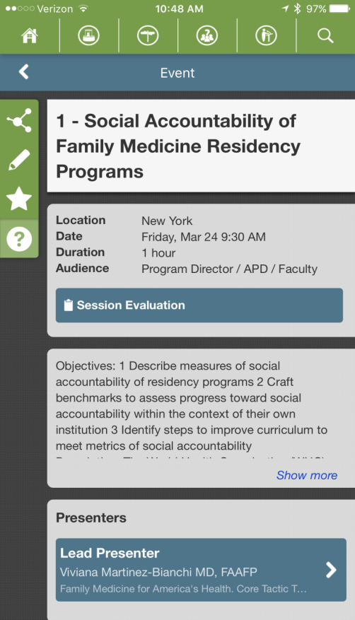
Please…
Complete the
session evaluation.
Thank you.

