Slide 1
Teaching 1° Prevention of CVD that is Evidence-based, Patient-oriented, and FM-aligned
Bill Cayley
Jake Prunuske
Kate Rowland
Josh Steinberg
Stephen Wilson
University of Wisconsin
Medical College of Wisconsin
Rush Medical College
UHS Wilson FMR & SUNY Upstate
Boston University Chobanian & Avedisian School of Medicine
from the STFM Evidence-Based Medicine Collaborative

Slide 2
Using EBM to teach hyperlipidemia and Hyperlipidemia to teach EBM
another way to think of it...

Slide 3
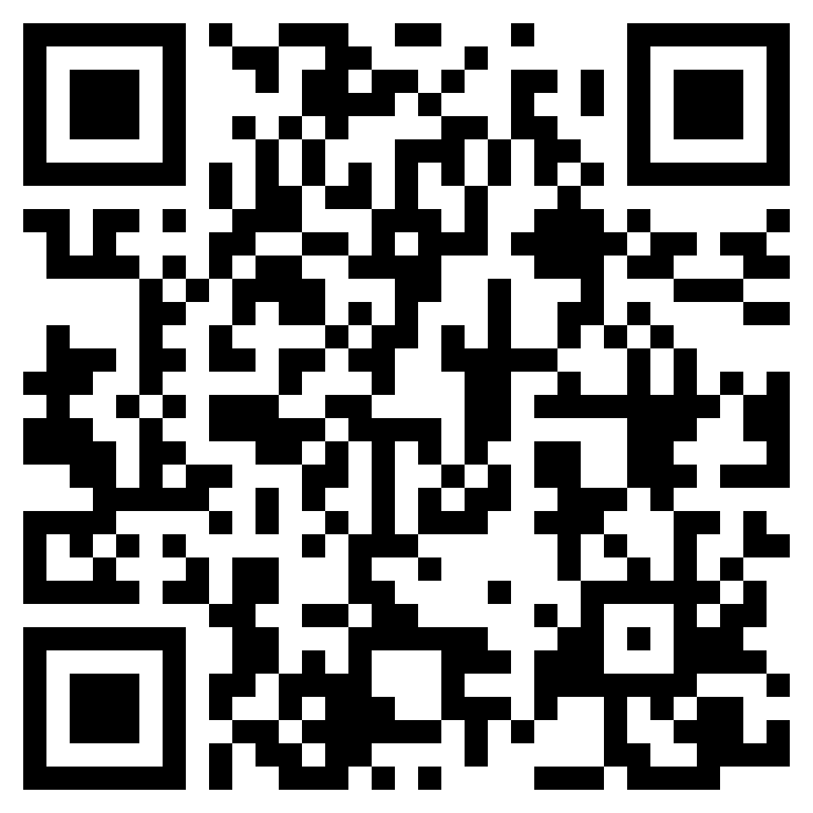
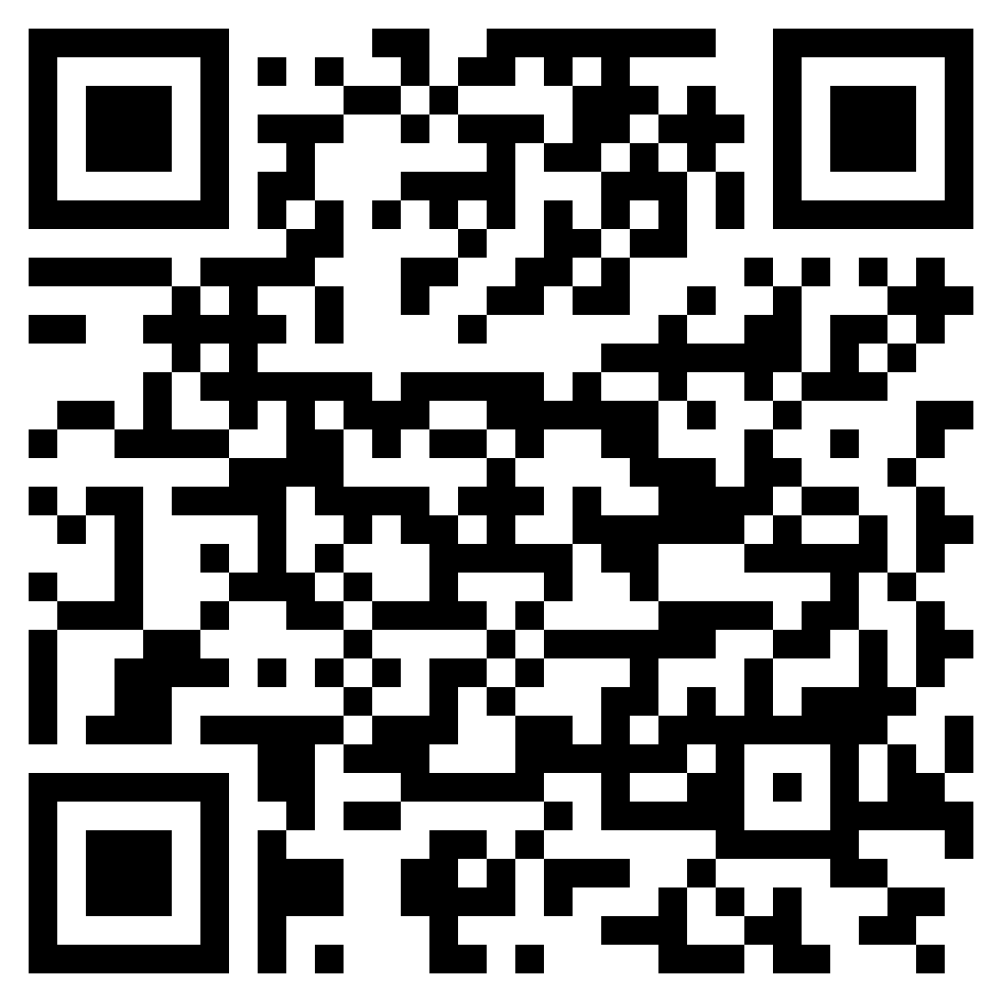
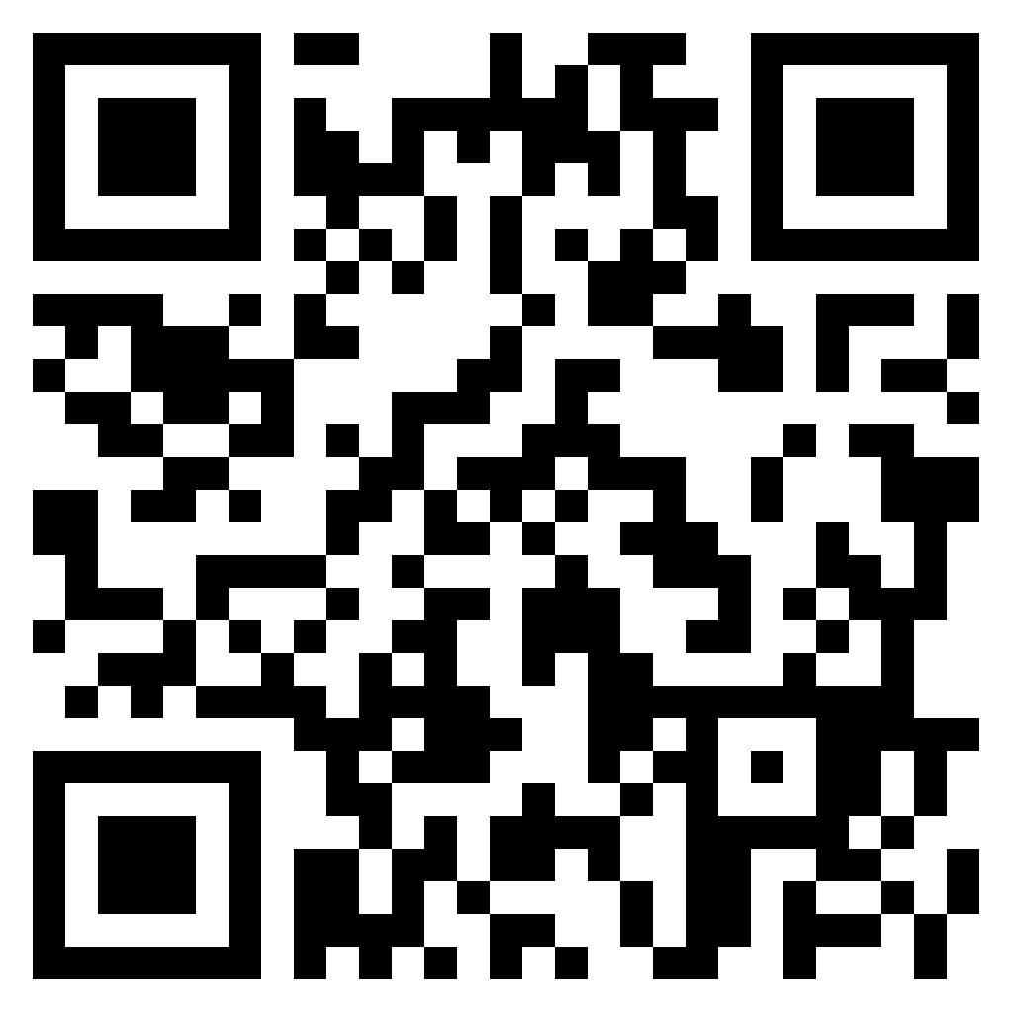
Useful resources to get
ASCVD risk app
(free)
iPhone
ASCVD risk app
(free)
Android
Dr. Steinberg’s
CV Risk Estimation app
(free)
iPhone only
Dr. McCormack’s
CV risk site
(free)
website

Slide 4
Disclosures
When industry heard that we very important people were to give
a major presentation
at a national conference
on cholesterol management
the influence machine of big business whirred into action
So we want you to know where we stand

Slide 5
Introductions and Disclosures
Jacob Prunuske
Medical College of Wisconsin in Wausau
not on the take from
Big Dairy
tho’ they tried to butter me up
Notes:
alternate version

Slide 6
Introductions and Disclosures
Bill Cayley
Univ. Wisconsin and Prevea Health in Eau Claire
not on the take from
The Fishing Hall of Fame
would not take their bait

Slide 7
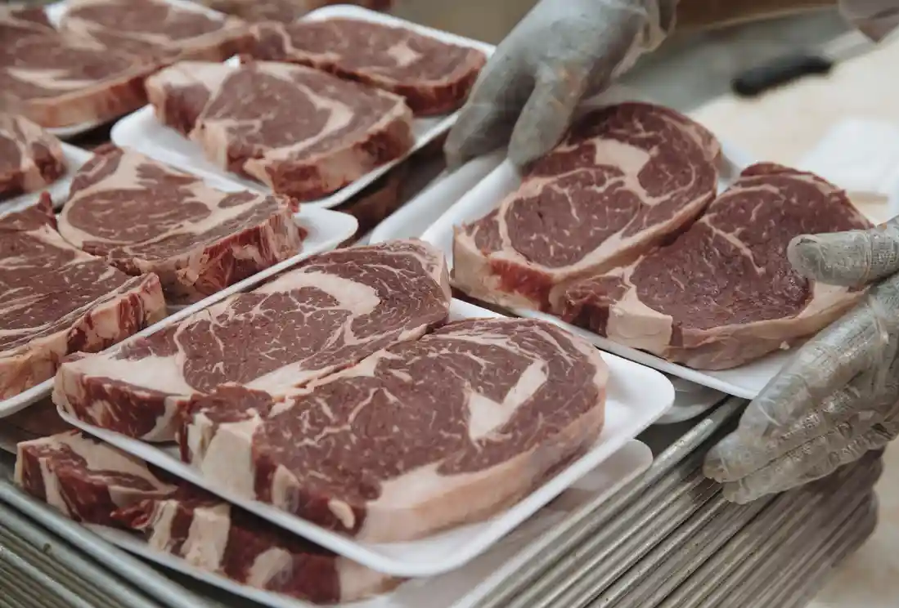
Introductions and Disclosures
Kate Rowland
Rush Medical College in Chicago
not on the take from
Big Meat
the steaks are too hi
I’ll have mutton to do with them

Slide 8
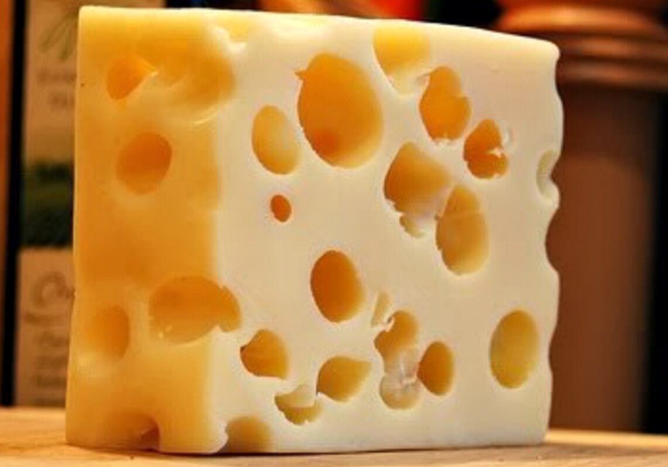
Introductions and Disclosures
Stephen Wilson
Chobanian & Avedisian School of Medicine
As a dept chair,
I am not beholden to
Big Cheese
I am the big cheese

Slide 9
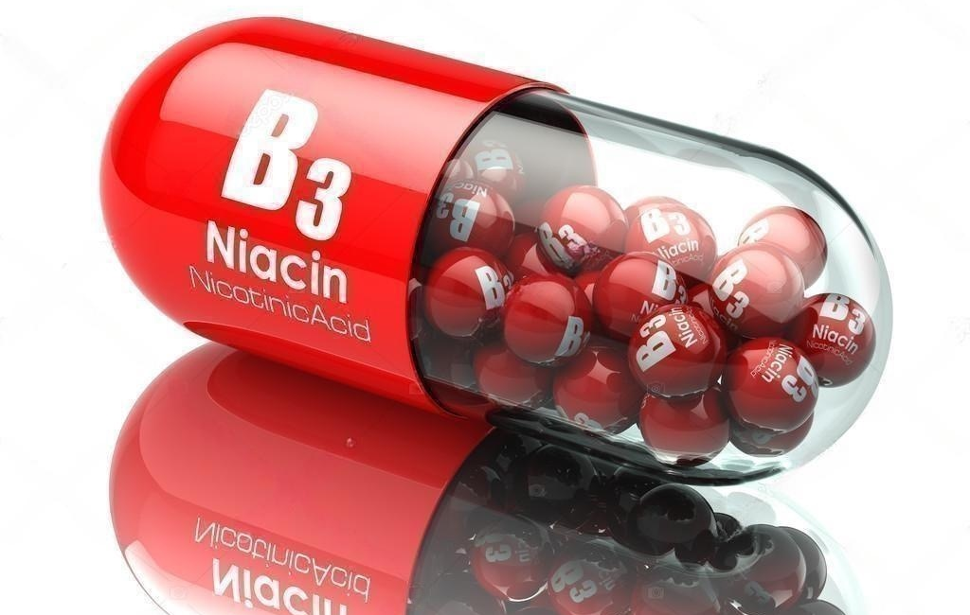
Introductions and Disclosures
Joshua Steinberg
UHS Wilson FMR & SUNY Upstate
not on the take from
Big B-vitamins
tho’ the Niacin folks were flushed with cash
We have no other conflicts of interest either

Slide 10
bjectives
Active participants will
have used old and new point-of-care CV risk calculators, and be able to teach the strengths, weaknesses, and value of each
have practiced through role plays and small group work how to address several common (and irksome!) misconceptions and misapplications disease-oriented expert opinion recommendations
be able to champion patient-oriented, evidence-based prevention of CVD with learners and colleagues back home in practice

Slide 11
Agenda, Approach, and Goal
We will accomplish more by sharing our knowledge and strategies than by lecturing
Case-based with brief small group work
Discussions in and arising from small groups
We will add and highlight points on family medicine’s strengths of being patient-oriented and evidence-based
Everyone leaves with evidence, tools, and strategies for their teaching back home

Slide 12
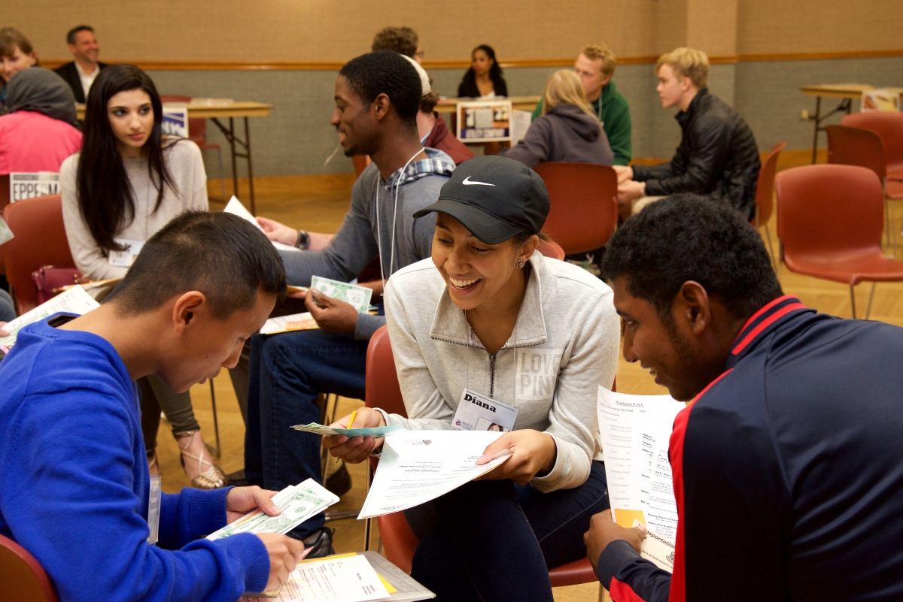
Audience
Lots of teaching talent and experience in the room
How many years have you been faculty?
0-5
5-10
10-20
>20
Why did you choose this seminar?
[I’m worried this question might take up time we don’t have. –JS]

Slide 13
Audience
Lots of teaching talent and experience in the room
Primary educational role?
med school educator
residency educator
How many years have you been faculty?
0-5 years
5-10
10-20
>20

Slide 14
Small group activity
Everyone gets vignettes of teaching cases and situations
Work on your case for 5 minutes
Then groups will report to the whole audience
Present your case
Present the issues you noted and how you would teach them
Discuss amongst group
Facilitators focus on being patient-orientated and evidence-based
Move on to next case

Slide 15
Small Group Time
Review the case
What are the issues that the learner needs to get?
How would you teach your learner?
Ready, set, go!

Slide 16
Case 1
1a) Student: I just saw our next pt, a 46 y.o. cauc. woman for screening lab f/up. Her chol came back 253, HDL 57, LDL 160. There are big red asterisks next to the numbers in the lab results which the patient saw, too, in MyChart. I guess we gotta put her on a statin. I was thinking Atorvastatin 20 mg qDay. (student doesn’t know to mention: no HTN, no DM, no smoking, SBP 120; ASCVD risk 1.1%)
1b) Student: I just saw our next pt, a 56 y.o. cauc. woman for screening lab f/up. Her chol came back 153, HDL 35, LDL 101. No way she needs a statin, right? (student doesn’t know to mention: HTN on meds, no DM, does smokes, SBP 150; ASCVD risk 10.7%)
What are the issues that the learner needs to get?
How would you teach your learner?
any broader group discussion

Slide 17
Case 1 points
This is the quintessential case
Students come out of biochem-obsessed preclinical sciences all too eager to think that improving cholesterol = improving patient health
Patient with lousy lipids and good risk factors has 1.1% CV 10-yr risk
Patient with good lipids and lousy risk factors has 10.7% CV 10-yr risk
Shifting our learners from focus on disease-oriented molecules and risk factors to patient-oriented outcomes is the first step to enlightenment!
More on this to come.
EBM is not about P values and relative risk, it’s first and foremost about values. POEMs > DOEs

Slide 18
Case 2
Resident: I just saw a 58 year old woman for follow-up of her screening labs. Her A1c is fine, but her lipids and other risk factors give an ASCVD 10-year risk of 8%. I told her she’s above 7.5% and she needs to be on a statin. But she really doesn’t want to take another medication, and asked “where’d that 7.5% number come from anyway?” It’s a good point. Do we have to treat above 7.5%?
What are the issues that the learner needs to get?
How would you teach your learner?
Any broader group discussion

Slide 19
Case 2 - "7.5%" risk threshold for considering statin?
2013 cholesterol recommendations - 7.3.2.4. ≥7.5% 10-Year ASCVD Risk. A 10-year ASCVD risk was estimated based on the majority of the participants in AFCAPS/TEXCAPS (average 10-year ASCVD risk approximately 7%) and about one-half the participants in JUPITER (average 10-year ASCVD risk 7.6%).
JUPITER- 17802 M&W randomized to rosuvastatin or placebo and followed 5 years for MI, stroke, CV death.
AFCAPS/TEXCAPS - 6605 M&W randomized to lovastatin or placebo and followed 5 years for fatal or nonfatal MI, coronary events, CVD events.
Thresholds vary by organization
USPSTF: For adults aged 40 - 75 years without a history of CVD but with 1 or more CVD risk factors USPSTF recommends use of a moderate-dose statin for prevention of CVD events and mortality if calculated 10-year risk of a cardiovascular event of 10% or greater (Grade B )
ACC/AHA: "Borderline" risk = 5-7.5%, if "risk enhancers" present then discuss moderate-intensity statin therapy.
"7.5%" is a threshold based on rates in "placebo" patients in cholesterol trials, determining the "right" threshold for considering treatment is a matter for patient-centered shared decision.
2013 Report on the Treatment of Blood Cholesterol to Reduce Atherosclerotic Cardiovascular Disease in Adults: Full Panel Report Supplement. https://www.ahajournals.org/doi/suppl/10.1161/01.cir.0000437738.63853.7a
https://uspreventiveservicestaskforce.org/
2018 AHA/ACC Guideline on the Management of Blood Cholesterol. https://www.jacc.org/doi/10.1016/j.jacc.2018.11.002

Slide 20
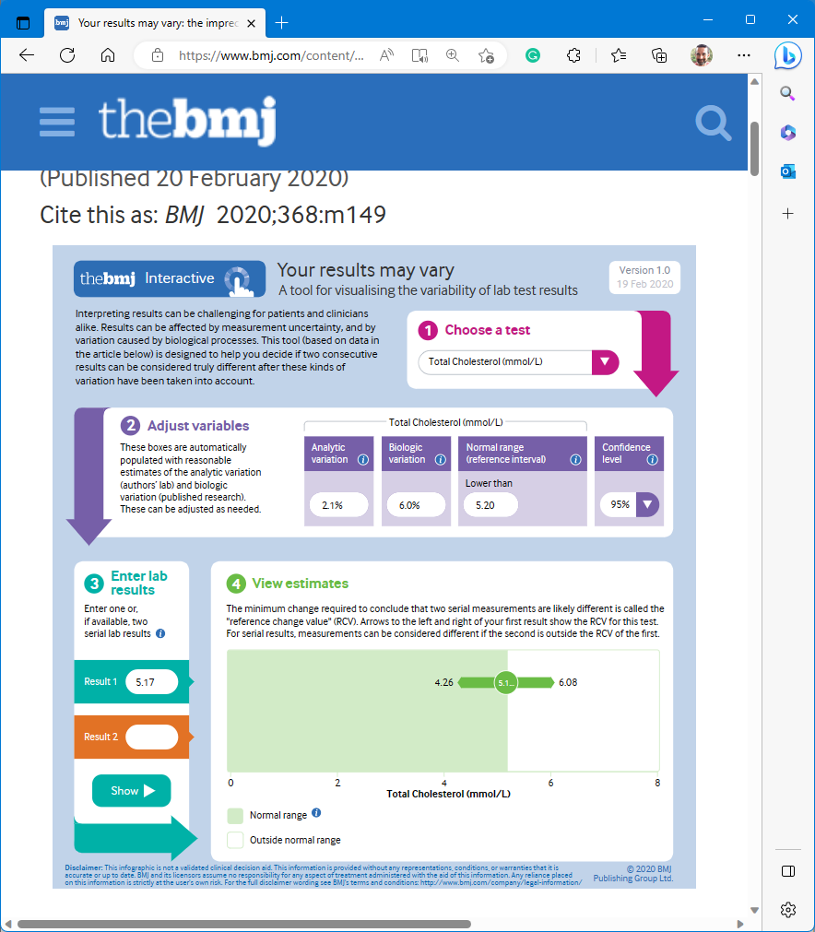
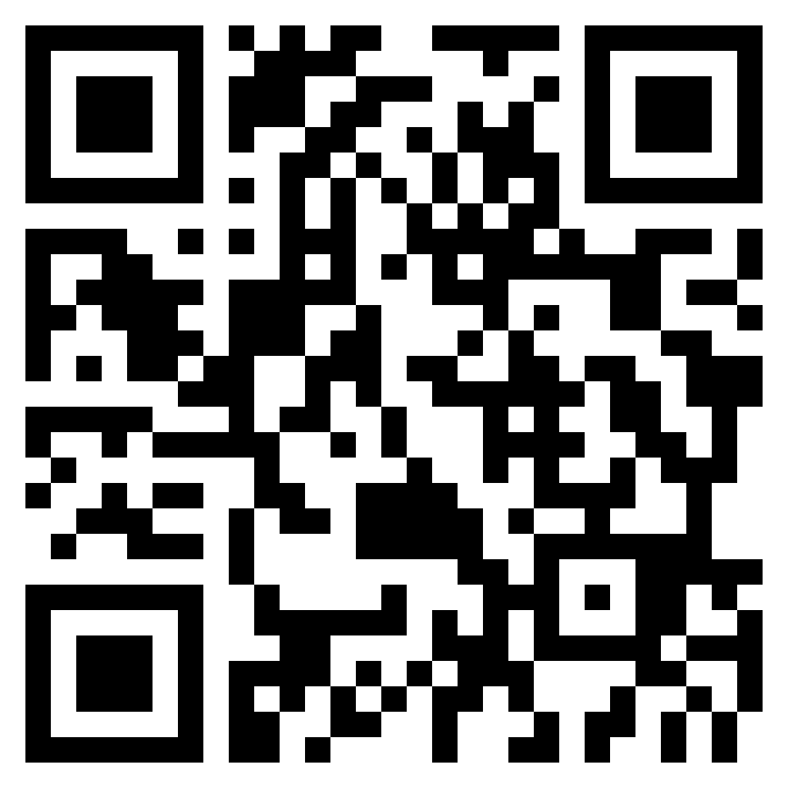
Case 2 – how certain are you of the numbers?
In a study of 9,000 pts with CAD given statin or placebo for 5 yrs, the background variability of cholesterol levels was ~ 7%. (Ann Intern Med.148:656)
"Your results may vary..."
Measured TChol of 200 (5.17) may represent a "true" value from 165 to 242 (4.26-6.28)
BMJ. Your results may vary. (BMJ 2020;368:m149)
BMJ results
variation site

Slide 21
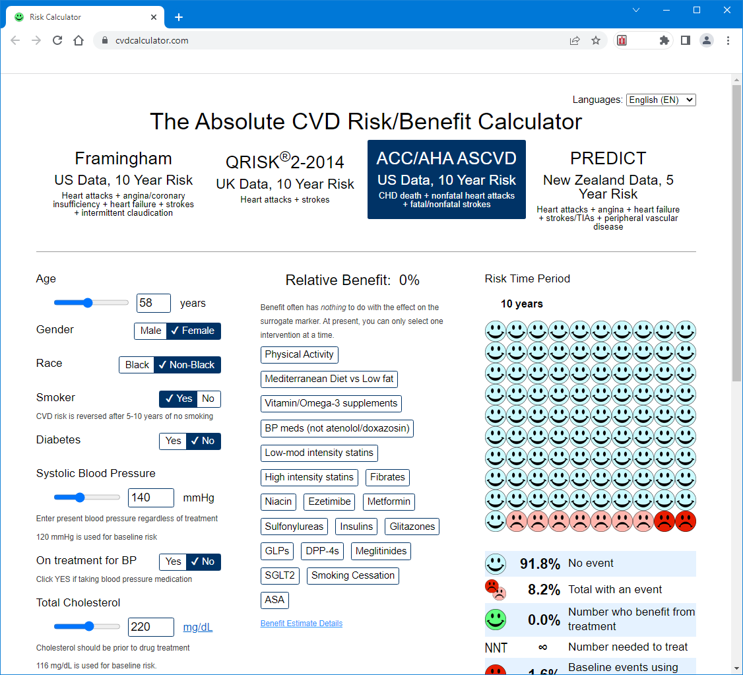
Case 2 – there is more to risk than cholesterol!
58 y/o woman, non-black, smoking, Chol 220, HDL 50, SBP 140 (no meds)
10 yr ASCVD risk ~8.2%
10 year ASCVD risk with -
Smoking cessation ~ 3.7%
Physical activity ~ 6.1%
"Mediterranean" diet ~ 5.7%
Statin ~ 5.3 - 6.1%
https://cvdcalculator.com/

Slide 22
Case 3
Resident:
I just saw a 49 y.o. Black male to review his screening cholesterol panel – TC 220, LDL 130, HDL 40. Other risks: SBP ~135 on his two HTN meds; DM2; he doesn’t smoke.
His 10-year ASCVD risk is 18.4%.
But we’ve been discussing so much that race is a social construct and not biological. Should I click the black race button on the calculator? If I un-click the button and say White, his risk is 11.0%.
And which race button do I click if the patient is Hispanic, or one parent white and one parent black?
What are the issues that the learner needs to get?
How would you teach your learner?
Any broader group discussion
SW

Slide 23
Case 3
Black and Hispanic are people being undertreated with statins
Is this a DOE or POEM?
Figure 3. Temporal Trends in Prevalence of Statin Use Among Participants in the 2013-March 2020 National Health and Nutrition Examination Surveys (NHANES) Meeting Criteria for Primary Prevention
Prevalence of Statin Use for Primary Prevention of Atherosclerotic Cardiovascular Disease by Race, Ethnicity, and 10-Year Disease Risk in the US: National Health and Nutrition Examination Surveys, 2013 to March 2020 | Cardiology | JAMA Cardiology | JAMA Network
SW

Slide 24
Case 3
Race data without educational, income, and other data has limited utility
BMI 30 or greater (vs less than 30) was also significantly associated with greater use of statins among Asian (PR, 1.11; 95% CI, 1.00-1.23), Black (PR, 1.09; 95% CI, 1.03-1.15), and White participants (PR, 1.07; 95% CI, 1.01-1.13), but not among Hispanic participants (PR, 0.94; 95% CI, 0.96-1.12)
Among SDOH factors, access to routine health care and health insurance were both significantly associated with greater statin use among Black, Hispanic, and White participants in the fully adjusted model
Marital status and food insecurity were not associated with statin use
Having a routine location for health care was associated with greater statin use for Asian participants (PR, 1.22; 95% CI, 1.11-1.34), but health insurance was not (PR, 0.99; 95% CI, 0.84-1.17)
Taking at least 1 antihypertensive was the sole component associated with increased statin use across all race and ethnicity groups
SW
Notes:
3417 participants representing 39.4 million US adults
PR = Prevalence ratio

Slide 25
Case 3
Race is not well defined and is a potential proxy for
Ancestry
SES
Access to care
Effects of racism
For now, go with the calculators
Best approximation we have of risk
Remember, calculators → a number that is inserted into a guideline that should start a conversation
For mixed-race people
Risk is probably somewhere between X and Y
Could average
Could choose the higher
SW

Slide 26
Case 4
Resident: Just saw a family: three kids, 9, 12, and 15 for wellness checks. Everyone is doing well. AAP recommends screening lipids for all kids at ages 9-11 so I ordered it. Also ordered it for the older kids because both have BMI >95 %ile. But I’m not sure what to do for their mom, who is 35, because the American College of Cardiology recommends screening at age 20 but the USPSTF says not until 40. Her BMI is 19.
Attending: There’s a lot to unpack here.

Slide 27
Children: What are we screening for?
Familial hyperlipidemia
No indication for screening of asymptomatic people
Indication for statin therapy
LDL > 160 in children
LDL > 190 in adults
BMI is often wnl
Typically strong FHx of HLD and early CAD

Slide 28
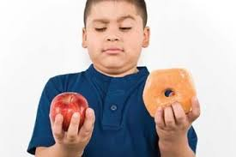
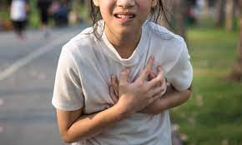
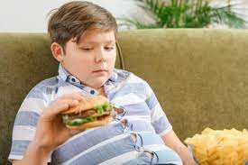
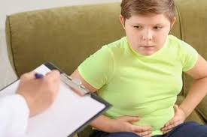
Children: What are we screening for?
Acquired hyperlipidemia
May be associated with higher body weight
No indication that screening leads to improved outcomes
Screening->disease detection-> intervention -> outcome reduction
AAP/NCLBI recommend screening to encourage lifestyle modification

Slide 29
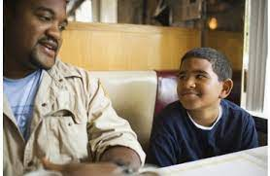
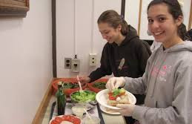
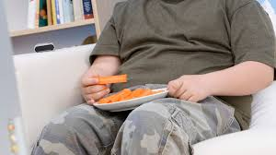
Children: What are we screening for?
Acquired hyperlipidemia
May be associated with higher body weight
No indication that screening leads to improved outcomes
Screening->disease detection-> intervention -> outcome reduction
AAP/NCLBI recommend screening to encourage lifestyle modification

Slide 30
Primary care vs specialty focus: lipid screening
 | Recommendation | Notes
USPSTF-child | Insufficient evidence | No POEMs
NHLBI/AAP | All children at age 9-11 & 17-21 | Tx: TLC (therap. lifestyle changes) Statin for LDL>250/resistant
USPSTF-adult | Start at age 40-75 | For purposes of calculating ASCVD
ACC/AHA | Start at age 20 | 20-39: TLC unless FHx, premature ASCVD, + LDL >160
Notes:
https://uspreventiveservicestaskforce.org/uspstf/recommendation/lipid-disorders-in-children-screening
https://www.aappublications.org/content/33/2/1.3
https://uspreventiveservicestaskforce.org/uspstf/recommendation/statin-use-in-adults-preventive-medication

Slide 31
Case 5
Resident: A 59-year-old man comes to the clinic for a preventive care visit. He hasn’t been to the doctor since he was 50, and before that his last visit was at age 40. He never smoked, doesn’t drink, has a blood pressure of 120/85, and has a BMI of 31. His father died of a heart attack in his early 60s. He said he’d be willing to take a cholesterol pill - if it would make him less likely to die like his dad did. I’m recommending he come back for a fasting lipid panel and blood glucose to better assess his ASCVD risk.
What are the issues that the learner needs to get?
How would you teach your learner?
Discussion

Slide 32
Case 5 Evidence Points
NNT for Statins for 5 Years
10-Year Risk of CVD Events | 5-Year NNT for CVD Events | 5-Year NNT for Myocardial Infarction | 5-Year NNT for Stroke | 5-Year NNT for Mortality
5% | 160 | 278 | 910 | *
7.5% | 108 | 186 | 606 | *
10% | 80 | 140 | 456 | 500
15% | 54 | 94 | 304 | 334
20% | 40 | 70 | 228 | 250
Abbreviation: CVD, cardiovascular disease; NNT, number needed to treat. * No apparent mortality reduction in lowest-risk patients. Reference - BMJ 2013 Oct 22;347:f6123.

Slide 33
PCE vs Individual Risk
PCE estimates of 10-year CVD risk rely heavily on age, sex, and race - skewing the population recommendations for statins.
PCE: < 1% of non-Black women aged 40 to 55 years have a 10-year ASCVD risk > 7.5%, and almost none have a 10-year risk greater than 10%. USPSTF recommendations nearly eliminate statin eligibility for non-Black women younger than 55 years.
Individual: A 45-year-old woman with well-controlled hypertension and an LDL of 175 mg/dL, but a 10-year risk less than 2%, would not be recommended for statin therapy despite having a 50% lifetime risk of heart disease and a highly treatable risk factor (High LDL)
Notes:
PCE estimates of 10-year CVD risk rely so heavily on age, sex, and race, use of these estimates to identify candidates for statins results in significant skewing of the population recommended for statins.
Less than 1% of non-Black women aged 40 to 55 years have a 10-year risk of 7.5% or greater, and almost none have a 10-year risk greater than 10%. Thus, the USPSTF recommendations nearly eliminate statin eligibility for non-Black women younger than 55 years.
More than 90% of Black men age 60 or beyond have an estimated 10-year risk of 7.5% or greater, and 70% have a 10-year risk of 10% or greater.
A 65-year-old man with well-controlled hypertension, an LDL-C level of 55 mg/dL (1.42 mmol/L), and an estimated 10-year risk of 11% would be recommended for statin therapy by the USPSTF, even though there is almost no RCT evidence that further reductions in LDL-C level for this patient would improve his outcomes.
a 45-year-old woman with similarly controlled hypertension and an LDL-C level of 175 mg/dL (4.53 mmol/L), but a 10-year risk less than 2%, would not be recommended for statin therapy despite having a 50% lifetime risk of heart disease and a highly treatable risk factor (ie, elevated LDL-C level)

Slide 34
PCE vs Individual Risk
PCE: More than 90% of Black men age > 60 have an estimated 10-year risk of > 7.5%, and 70% have a 10-year risk of > 10%.
Individual: A 65-year-old man with well-controlled hypertension, an LDL of 55 mg/dL, and an estimated 10-year risk of 11% would be recommended for statin therapy by the USPSTF, despite limited RCT evidence that further reductions in LDL would improve his outcomes.

Slide 35
Case 5 Evidence Points
Conventional testing is fasting (9-12 hours) lipid profile
LDL cholesterol may be directly measured or calculated (more common)
Fasting state does not meaningfully impact assessment of cardiovascular risk
Meta-analysis of 68 prospective studies with 302,430 people without initial vascular disease found no significant change in association between lipid levels and cardiovascular risk after adjusting for fasting state JAMA 2009 Nov 11;302(18):1993

Slide 36
Case 6
Student: I’m confused.
On my general internal medicine outpatient rotation, I worked with an old-timer who estimated CV risk for patients with Framingham.
Then on cardiology, they always used the ACC’s ASCVD calculator.
Now there’s this new revised pooled cohorts equation.
Which one should I use? Does it really matter?
What are the issues that the learner needs to get?
How would you teach your learner?
any broader group discussion

Slide 37
Case 6 points
Framingham – LOVE Framingham!
Not for accuracy, but for history
The Framingham risk estimation got medicine moving off disease-oriented lipids to patient-oriented cardiovascular outcomes.
Quantified
risk from cholesterol as modest
risks from BP, DM, smoking as major
Overestimates risk for modern cohorts

Slide 38
Case 6 points
ACC’s ASCVD risk calculator 2013
Not just the Framingham Heart Study cohort, but 5 US cohorts
ARIC, CHS, CARDIA, Framingham original, Framingham offspring
Racially & geographically diverse
12+ years f/up
Pooled cohorts equation 10 yr risk
Initially hailed as big improvement over Framingham for accuracy
Soon new accuracy concerns arose

Slide 39
Case 6 points
Revised Pooled Cohorts Equation of 2018, Annals Int Med
Two major changes
improved cohorts
improved statistical approach

Slide 40
Improvement 1: Cohorts
Dropped Framingham Heart Study original cohort
participants were 30-62 year old in 1948 (!)
Kept more modern Framingham Offspring, ARIC, CHS, CARDIA cohorts
Added 2 more modern multi-ethnic cohorts
MESA (multi-ethnic study atherosclerosis) study
Jackson (Mississippi) Heart study

Slide 41
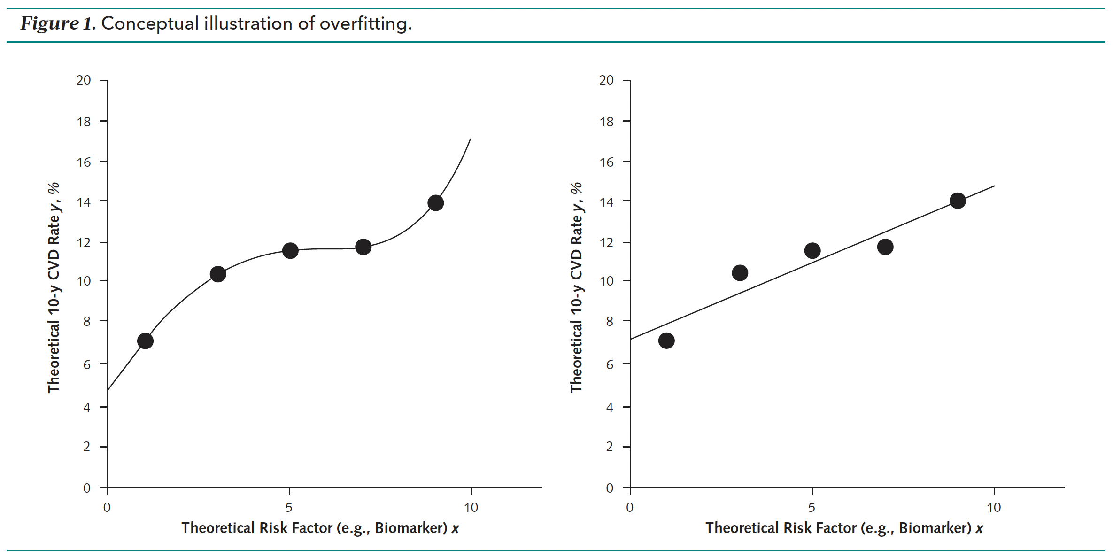
Improvement 2: Math stuff
Tried to avoid “overfitting” via elastic net regularization
Fix underestimation of risk in lower risk Black patients
Fix vast overestimation of risk in higher risk Black patients
Validated 2 different ways (80% random sampling; 20% holdout cohort)

Slide 42
Case 6 points
Revised Pooled Cohort Equations
More accurate than ASCVD 2013
Found ASCVD overestimated by appx. 20% in general
Improved accuracy in Black patients, particularly risk overestimation
Better as well at classifying patients around treatment thresholds of 7.5%, 10% (and even 5%) than ASCVD

Slide 43
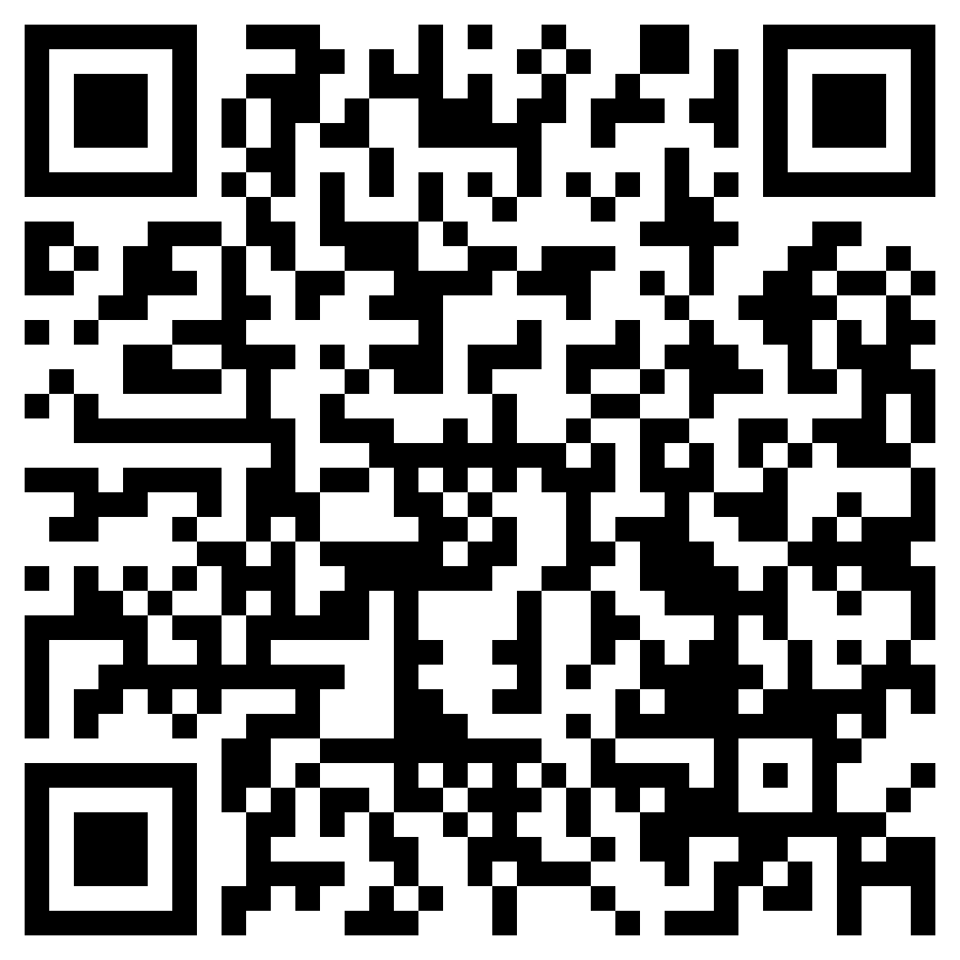
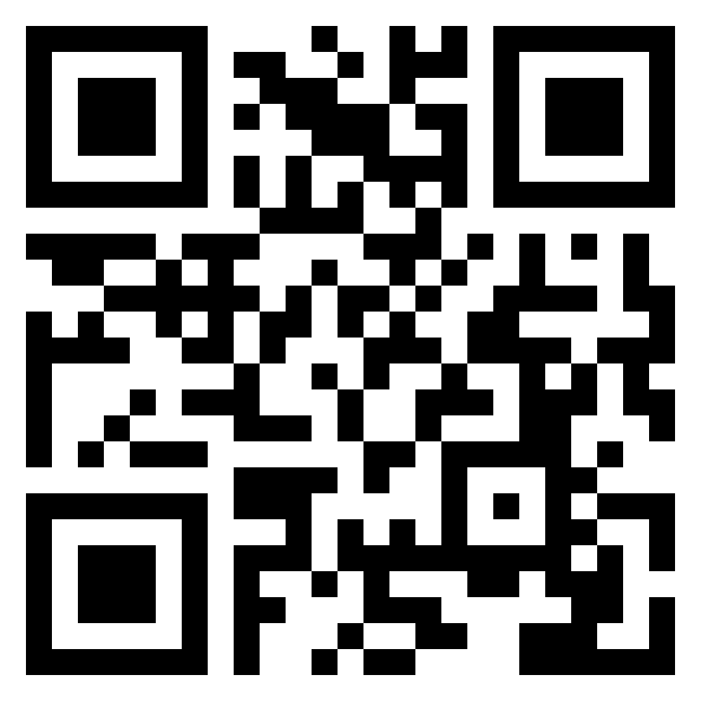
Where can you get the Revised PCE calculator?
Merck Manual online, choose Cardiovascular Risk Assmt 10-yr revised: https://www.merckmanuals.com/professional/pages-with-widgets/clinical-calculators?mode=list
Sanjay Baju MD (one of the authors): https://sanjaybasu.shinyapps.io/ascvd/
Dr. Steinberg’s CV Risk Estimation free iPhone app: https://apps.apple.com/app/id1630193162

Slide 44
Closing pearls
The resident cares for the patient, the faculty cares for the resident Anonymous
Compassion.... that's the one thing no machine (or algorithm) ever had... maybe it's the one thing that keeps us ahead of them..." paraphrased, Leonard McCoy, MD; Starship Enterprise

Slide 45
Discussion
Discussion
Feedback
Thanks for your attention!
Happy to hear from you...
jprunuske@mcw.edu (Prunuske)
bcayley@yahoo.com (Cayley)
kathleen_rowland@rush.edu (Rowland)
stephen.wilson@bmc.org (Wilson)
jds91md@gmail.com (Steinberg)

