Slide 1
2019 STFM Conference on
Practice & Quality Improvement

Slide 2
Setting
Michigan Medicine Primary Care
Dexter Health Center

Slide 3
Behavioral Health Collaborative Care: The Michigan Medicine Model for Integration
Kathryn M Harmes, MD, MHSA
Manasi Ramakrishnan, MBBS
University of Michigan
Department of Family Medicine

Slide 4
Objectives
Upon completion of this session, participants should be able to:
Identify the value of integrated care in patients with mild to moderate depression and anxiety
Describe the benefit of panel and case management in patients who require additional support for disease management
Describe the steps required to implement integrated care in their own practice environment

Slide 5
2015
University of Michigan Health System
Recognized need for integrated behavioral health program
“Multiple failed attempts”
TAAMS
M-DOCC
Washington Model

Slide 6
Core Components:
Patient identification and diagnosis – Depression and Anxiety only
Care management
Engagement in integrated care program and education
Close and pro-active systematic follow-up, treatment adherence, effectiveness and adjustment, treatment side effects, and relapse prevention
Collaboration: Communication between the PCP, psychiatric consultant, and care coordination of the patient

Slide 7
Core Components
Brief counseling using established and evidence-based techniques (such as motivational interviewing, behavioral activation, problem-solving treatment, etc.)
Systematic (weekly) psychiatric case review and consultation
Referrals to and coordination with outside mental health specialty care, substance abuse services, and social services.
Population management - ongoing clinical outcome monitoring
Program Oversight and Quality Improvement

Slide 8
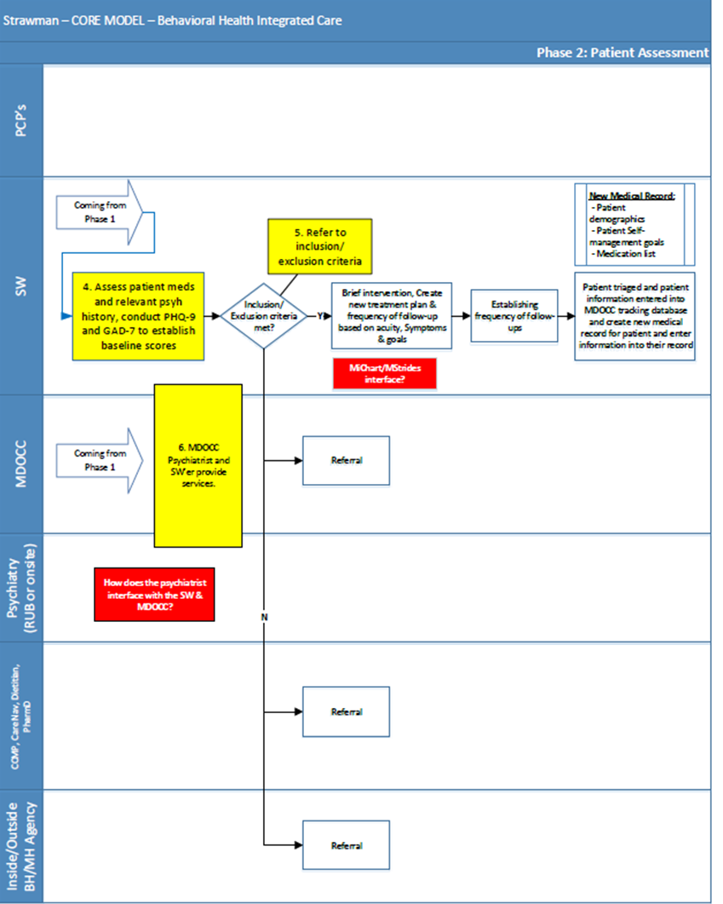

Slide 10
Current State 2019
10/14 (71%) of adult primary care sites
Challenges
Hiring Psychiatrists
Cyclical – FTE increased only in July/August
Hiring Social Workers
New position with different expectations
Site Buy-in
Clinics had to support additional staff

Slide 13
Dexter Health Center
Initiated BHCC in January 2019
Initially two providers enrolled as a pilot
Currently expanded to all providers (12 MD, 2 APP)

Slide 14
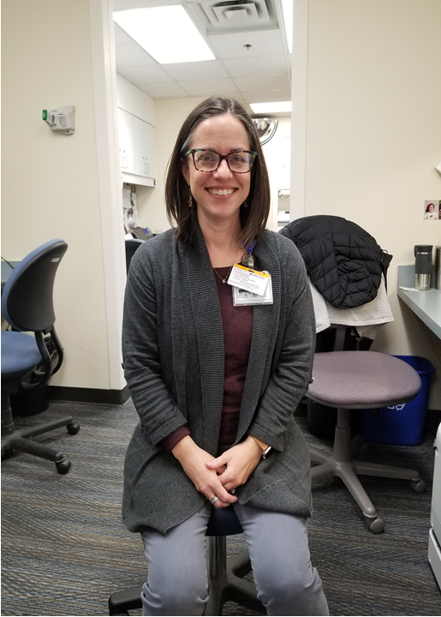
Leslie Pertz, MSW

Slide 15
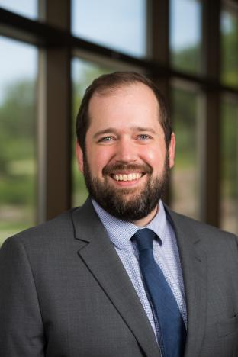
Steven Bartek, M.D.
Clinical Instructor
Ambulatory Site Director for Resident Education, Department of Psychiatry

Slide 17
Provider Survey
12/13 (92%) Response Rate

Slide 18
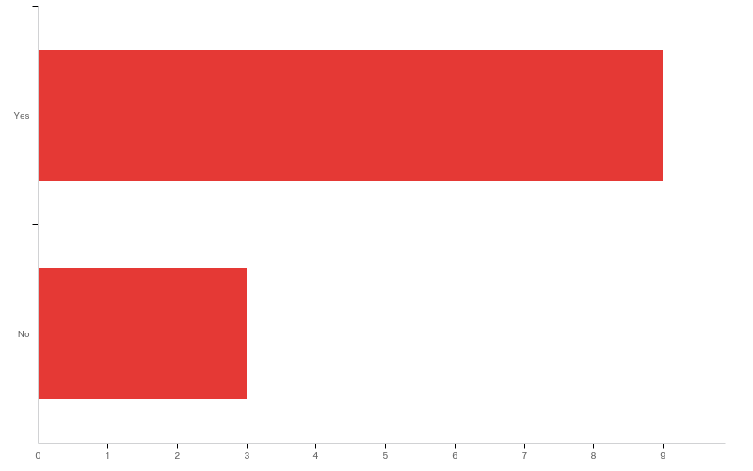
Q3 - Have you referred patients with complicated Depression or Anxiety to the BHCC program?

Slide 19
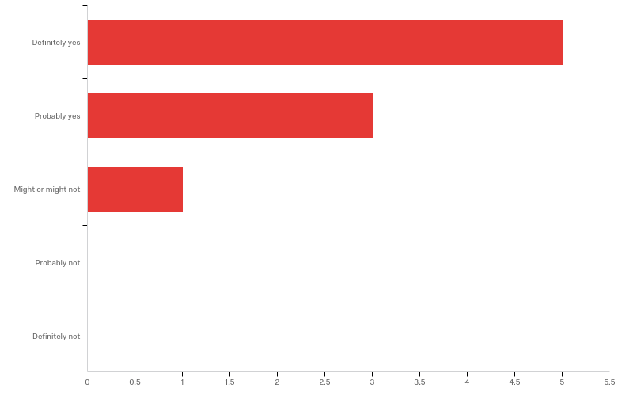
Q4 - Have you found BHCC helpful for patients you have referred?

Slide 20
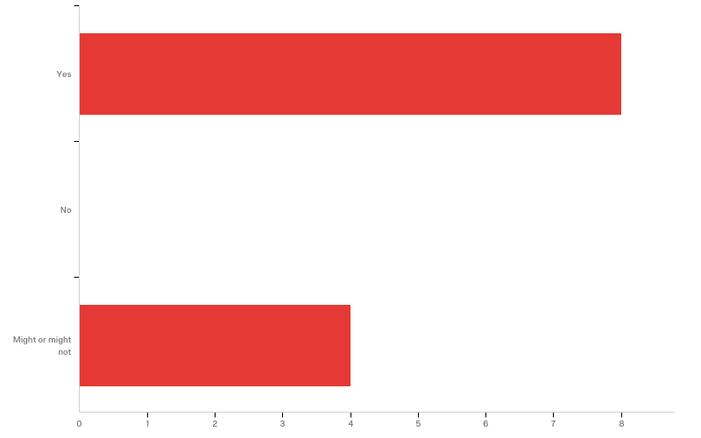
Q1 - Do you routinely consider BHCC referral as an option for patients with complicated Depression or Anxiety?

Slide 21
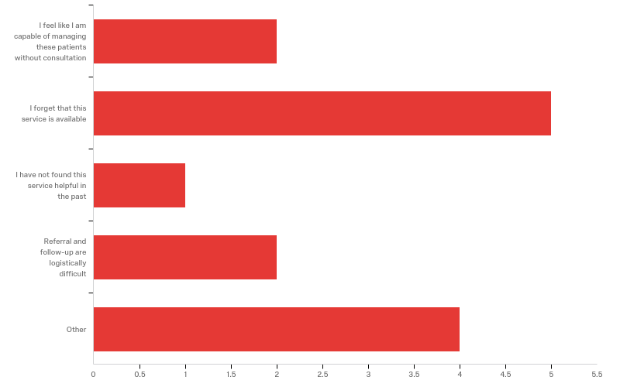
Q2 - What are the barriers to using BHCC for patients with complicated Depression or Anxiety? Please mark all answers that apply.

Slide 22
Q2 - What are the barriers to using BHCC for patients with complicated Depression or Anxiety? Please mark all answers that apply.
Q2_5_TEXT - Other
Other - Text
I am realizing now that the cost to some patients for the phone consultations is a barrier. I know that the social worker and psychiatrists time and expertise are valuable but I need better clarity on how much it will cost each patient depending on their insurance so that they can know up front and make an educated decision regarding participation.
Some patients I feel I can manage and they're "shunted" to psychiatry
Insurance coverage issues
I don't really have time allotted to manage more work in my inbasket, I only use if not able to find a psychiatrist for a face to face visit.

Slide 23
Social Work Feedback
Feels like she is helping people
Competing priorities with other SW responsibilities
Regular scheduled follow-up is good for patients
Psychiatric access is difficult at UM
It helps to have a good partner in Dr. Bartek

Slide 24
Do we have a MJ problem in Ann Arbor?
Many patient referred have high marijuana use
PCP has no idea

Slide 25
Disclosures
None

Slide 26
Evaluate
Please evaluate this presentation using the conference mobile app! Simply click on the "clipboard" icon on the presentation page.

Slide 27
Thank you

